Slide 1
Effects of HRTF on video games performance

Slide 2
Sound spatialization
Sound sources have 3 different DoF:
Azimuth
Elevation
Distance

Slide 3
Azimuth
Azimuth perception is based on mostly 2 things:
Interaural Time Difference
Interaural Level Difference
ILD alone gives good enough perception

Slide 4
Elevation
Elevation perception is a more complex phenome
Based on notches in the spectrum caused by different angles of incidence on the subject pinna
Harder to simulate: HRTF

Slide 5
Distance
Distance perception is based on subject knowledge and loudness
Was not an object of this experiment

Slide 6
The experiment
Subject asked to shoot asteroid in a 3D enviroment
Asteroid emitted sound to aid their localization

Slide 7
Asteroid position
Only one present at a time
Fixed distance
Randomized azimuth and elevation

Slide 8
Player movement
No locomotion
Free camera movement
Mouse aiming
Customizable sensibility

Slide 9
Audio clues
3 types of spatialization (latin square):
Mono, stereo and HRTF based spatializations
3 types of sound (random shuffle):
White noise, steps sound and gunshots sound

Slide 10
Data recorded
21 subjects, 30 asteroids per sound type for each spatialization method
270 asteroids per subject
Different metrics: time and angular distance (both horizontal and vertical)

Slide 11
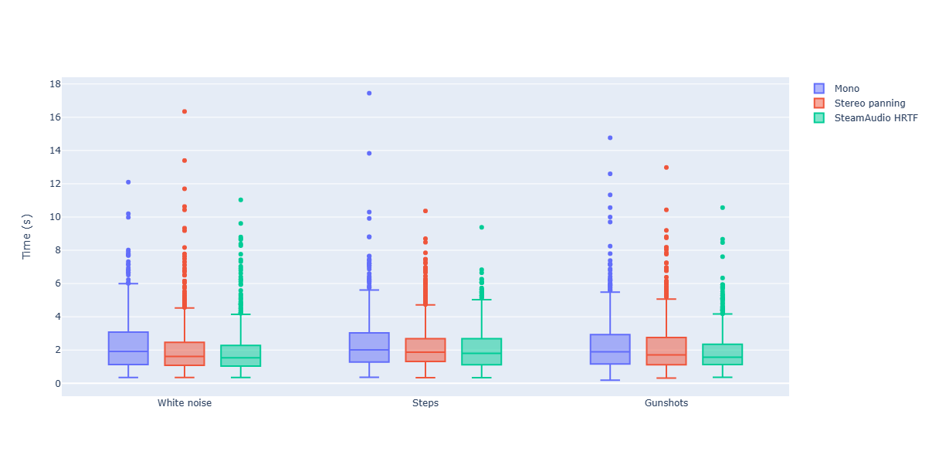
Box plot - time

Slide 12
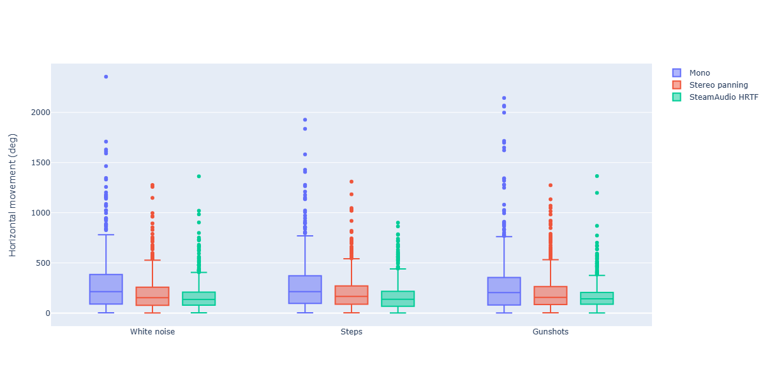
Box plot – horizontal movement

Slide 13
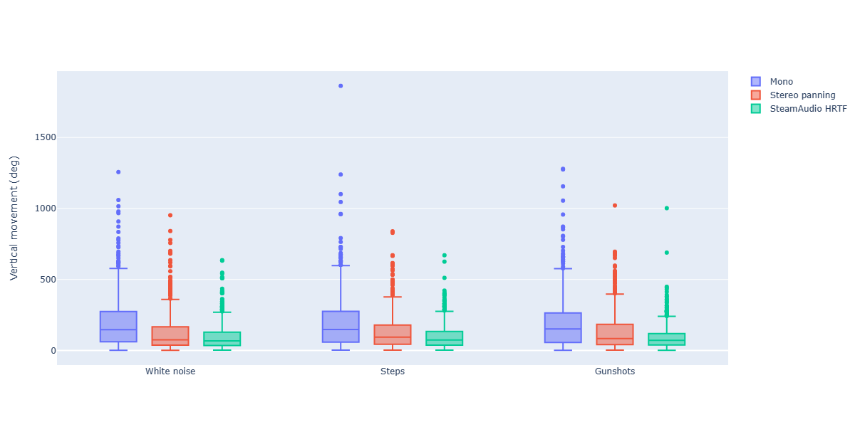
Box plot – vertical movement

Slide 14
Kolmogorov Smirnov test
Check for statistically significant difference
Differences between spatialization techniques
Time being less consistent
No evidence on different sound types

Slide 15
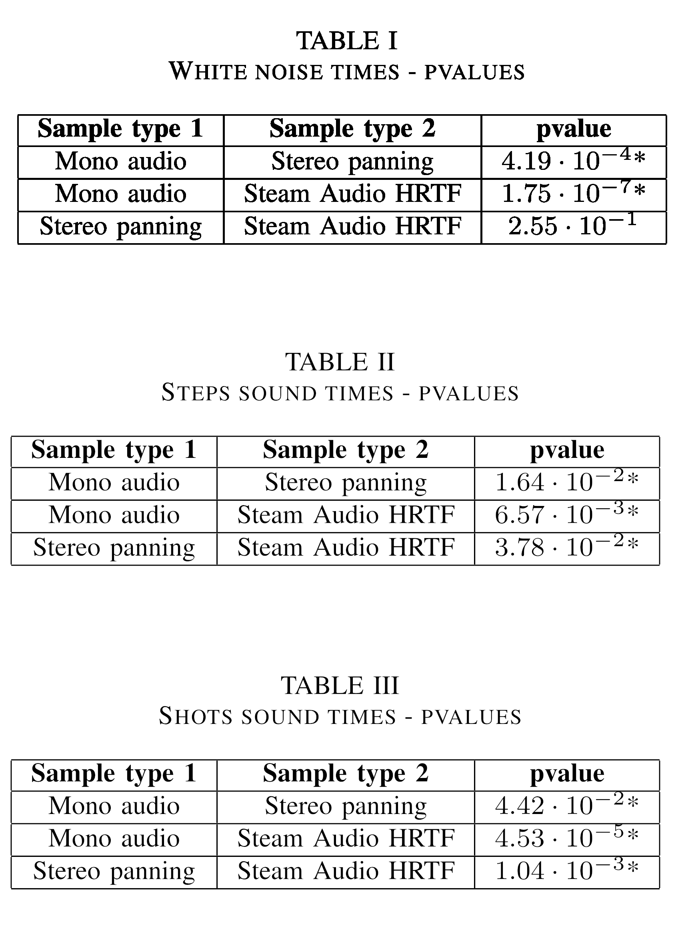
Kolmogorov Smirnov test

Slide 16
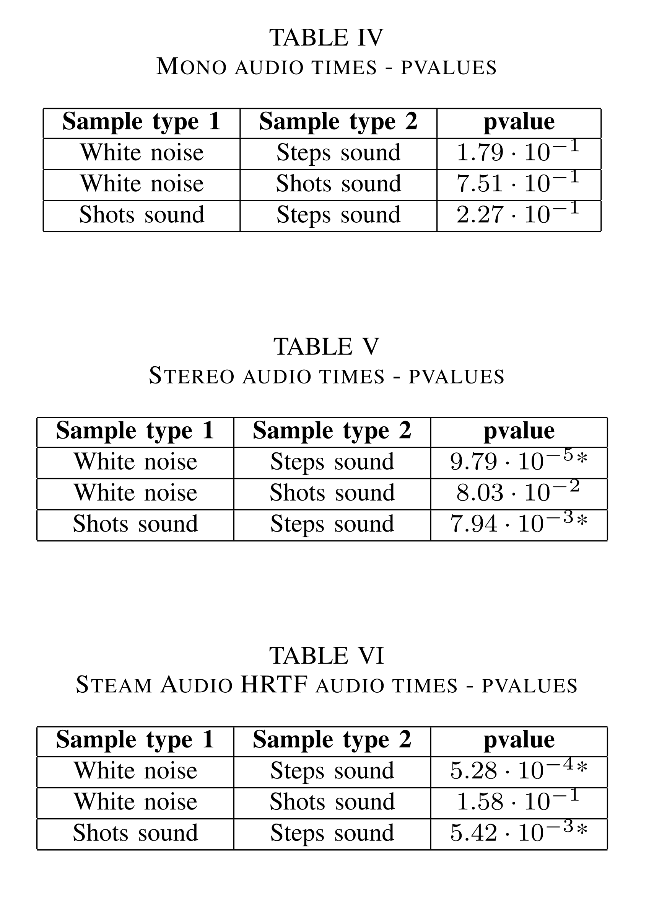
Kolmogorov Smirnov test

Slide 17
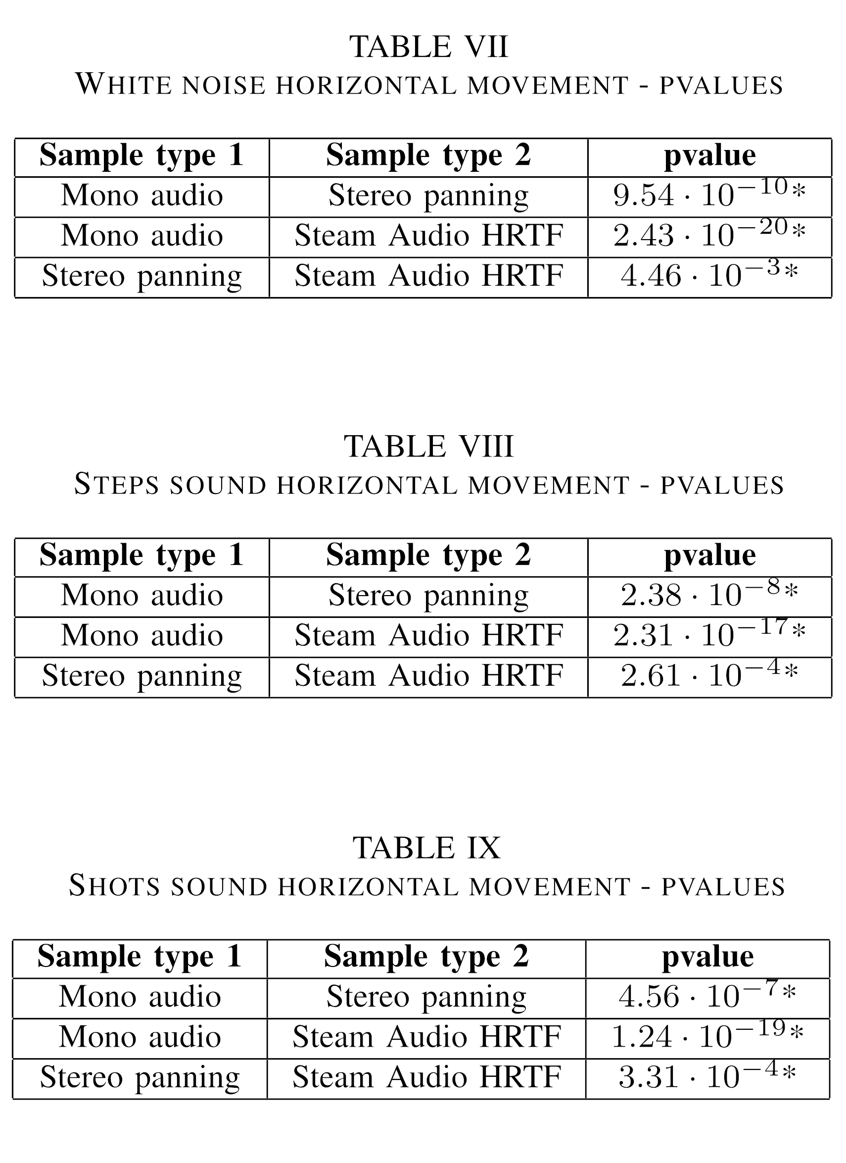
Kolmogorov Smirnov test

Slide 18
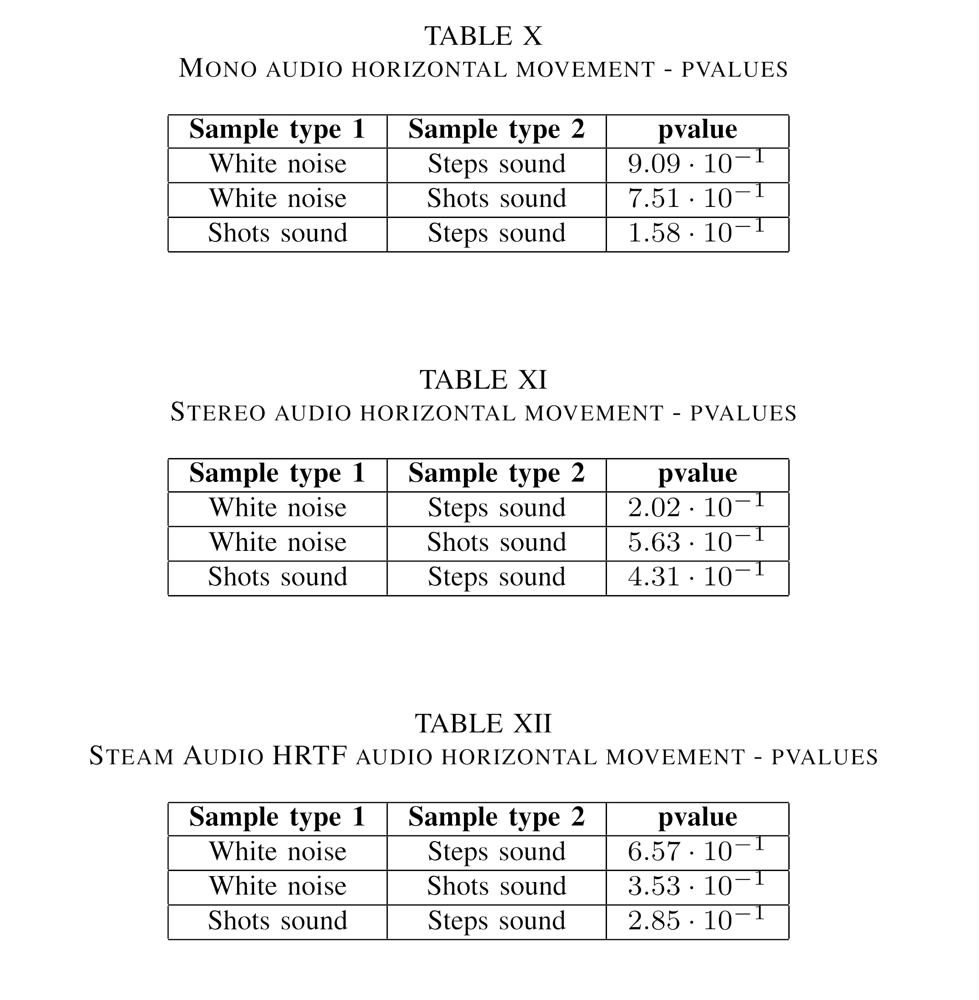
Kolmogorov Smirnov test

Slide 19
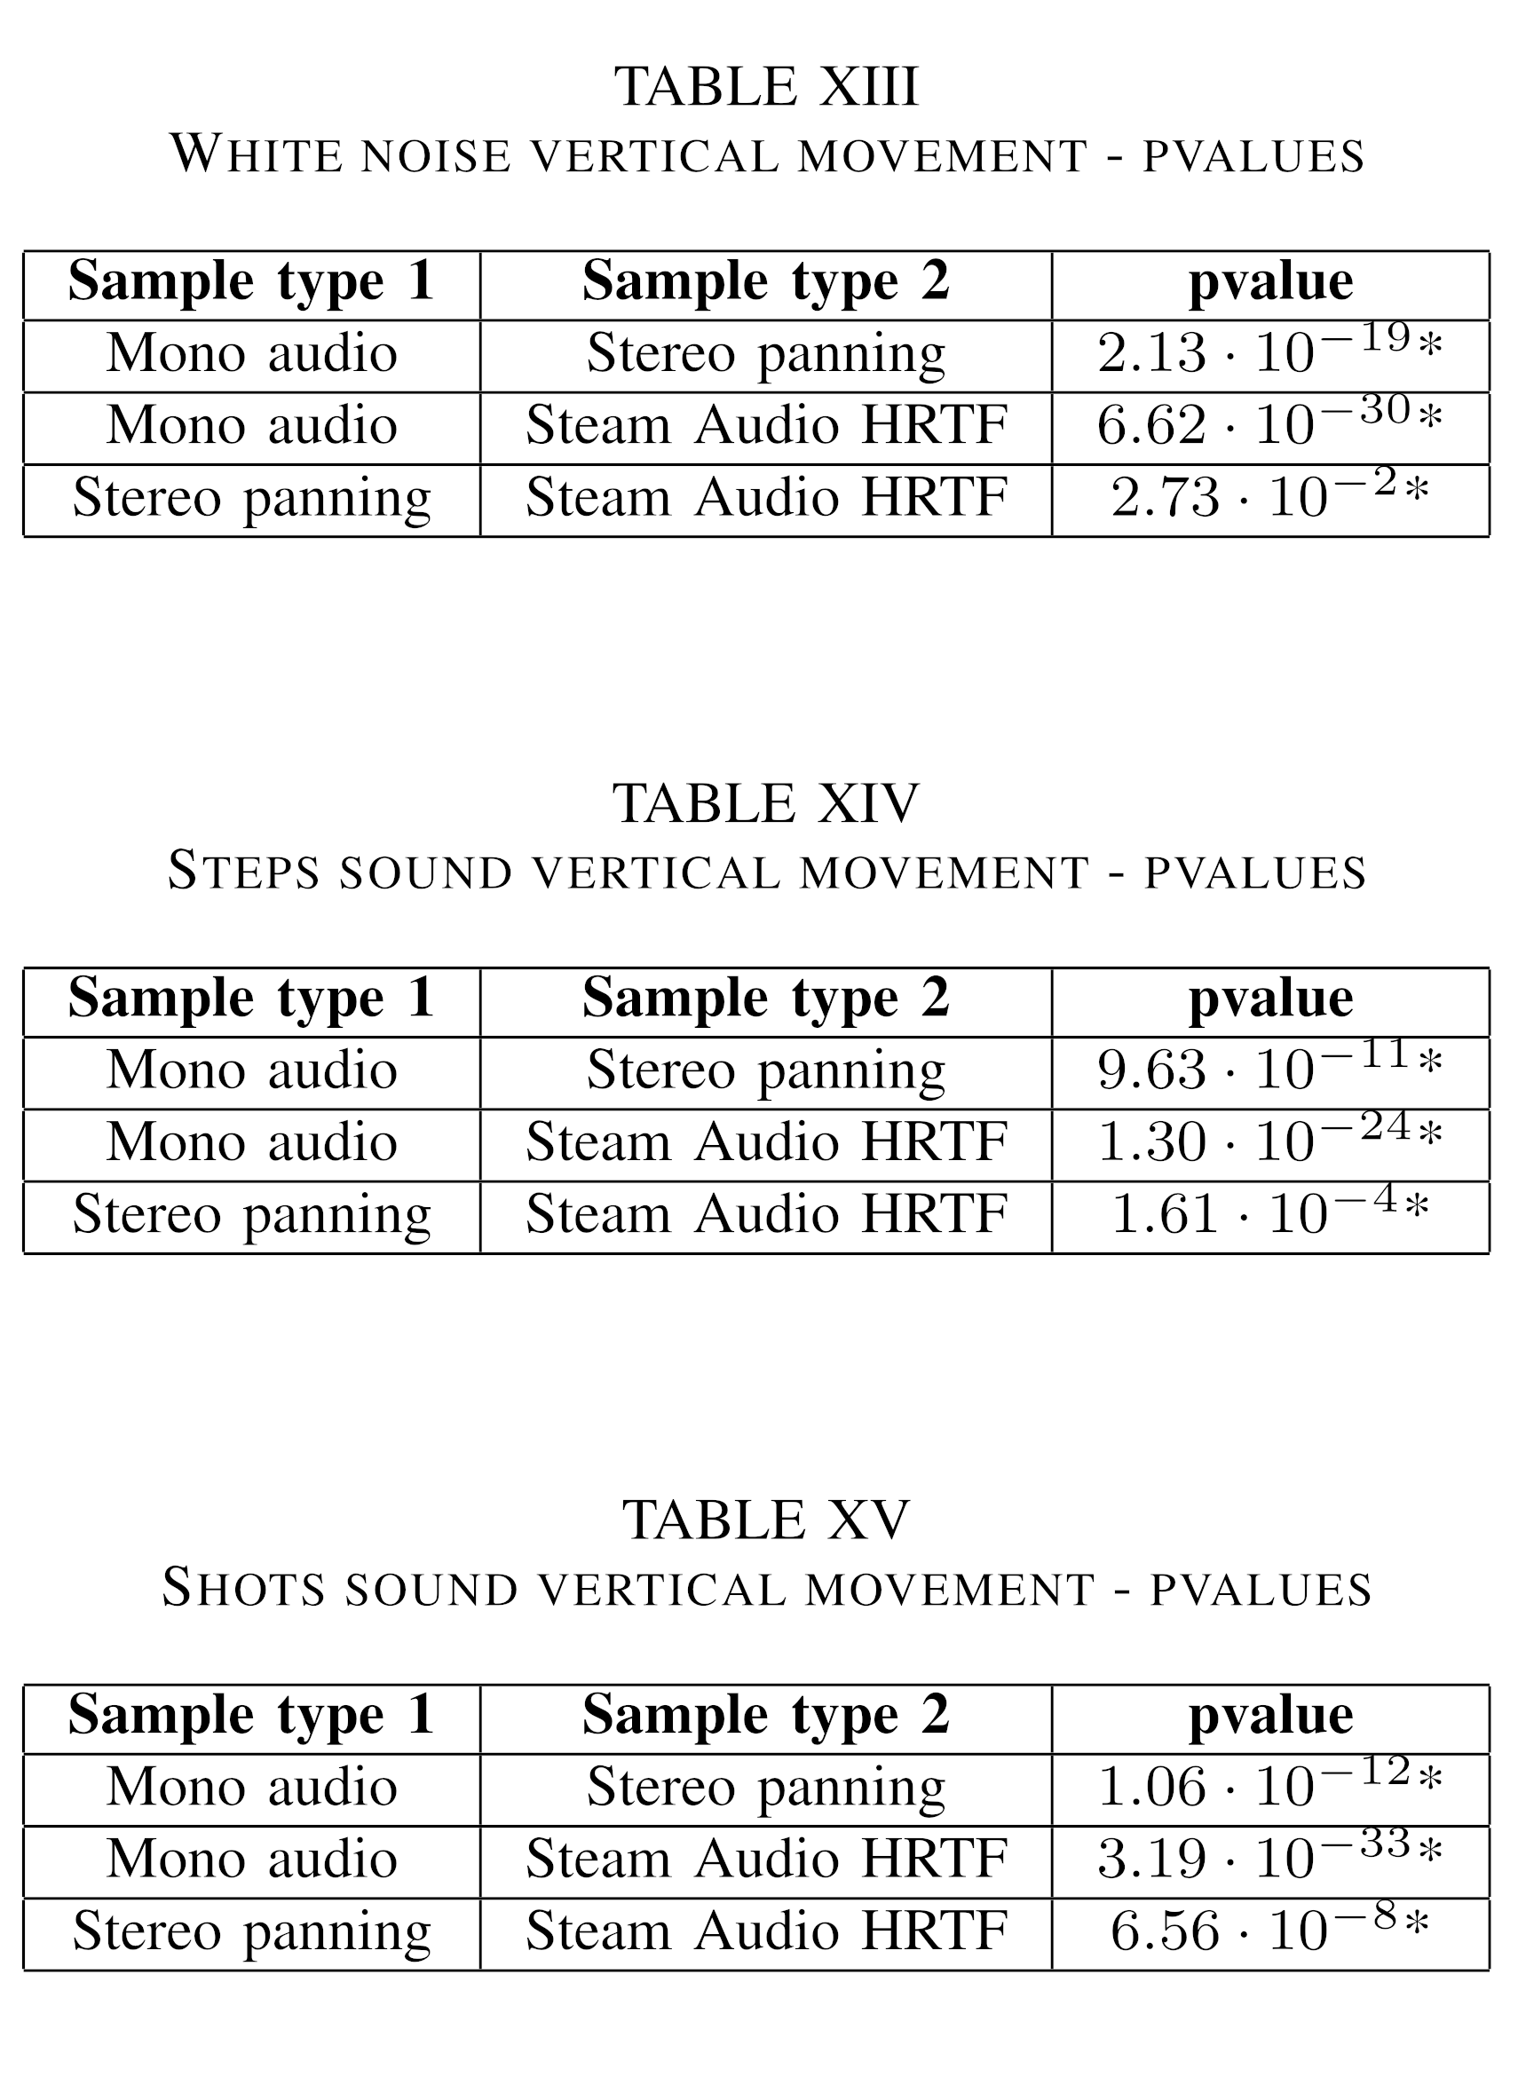
Kolmogorov Smirnov test

Slide 20
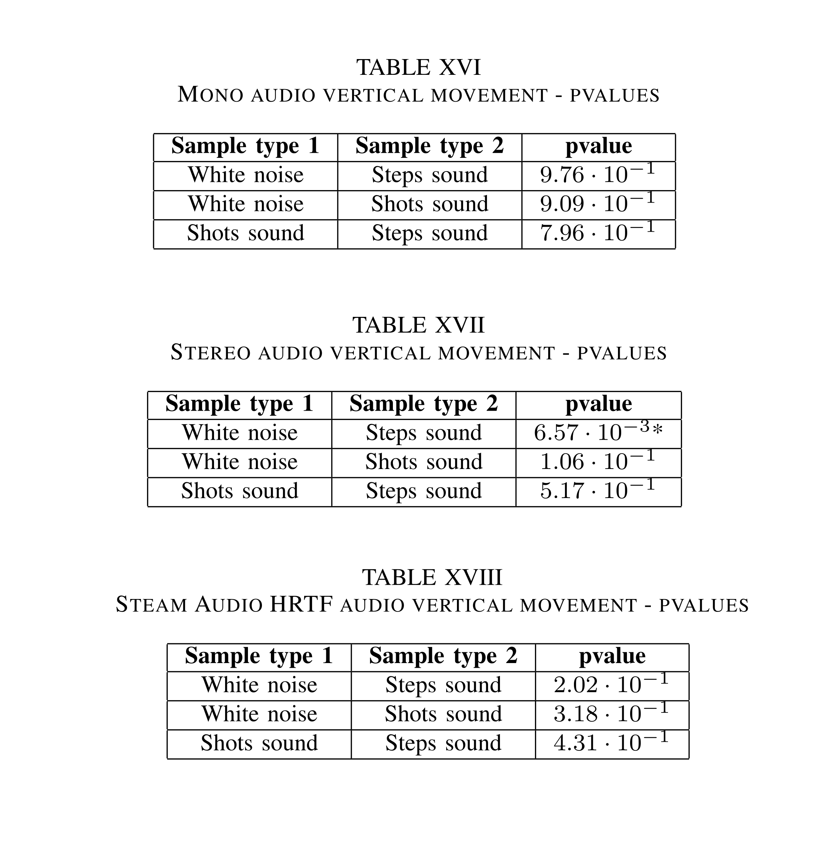
Kolmogorov Smirnov test

Slide 21
Conclusions
Spatialization methods matter
Sound type is inconclusive
Time is less sensible making angular distance
more useful in some situation

