Slide 1
Physical Presence-Based Authentication and Authorization for Cyber-Physical Systems and IoT using LiFi
M.S. Thesis Defense
Jose Felix
with Dongha Kim, Hokeun Kim, Michel Kinsy, Gail-Joon Ahn — KIM Labs, Arizona State University
github.com/asu-kim/lifi-auth
Notes:
Title slide. State the title once clearly, introduce yourself, thank the committee for their time, and give a one-sentence roadmap: what the system is, and that you'll cover motivation, architecture, threat model, and then spend the middle of the talk on measured evaluation results before discussing limitations and future work.

Slide 2
Motivation
RF security is an architecture problem. Optical confinement is a physics problem.
● RF wireless (WiFi, Bluetooth, Zigbee) propagates through walls, floors, and physical barriers by design
● An attacker need not be physically present to intercept, relay, or replay an RF authorization credential
● Enforcing a physical boundary on RF requires costly countermeasures — shielding, Faraday enclosures, attenuation infrastructure
● LEDs have quietly become the dominant lighting technology in nearly every indoor environment — hospitals, schools, warehouses, offices
● That installed, already-powered, already-trusted infrastructure can modulate data imperceptibly to the human eye
● Light does not pass through opaque walls or travel around corners without deliberate redirection — confinement by construction, not by policy
Notes:
Open with the RF problem in one sentence: propagation is the enemy of physical-boundary security. Then pivot to LEDs — they're everywhere already, and the communicative potential is untapped. Land on the physics point: light is confined by construction. That's the one sentence you want the committee to remember from this slide.

Slide 3
The Gap This Thesis Addresses
“Authorized because you are here, now, in the light.”
● No existing work binds authorization to continuous, time-bounded optical reception with automatic revocation
● This thesis reframes the optical signal as an active security primitive — not just a higher-bandwidth data channel
● The optical signal is continuously asserted, continuously verified, and automatically revoked the instant the optical path breaks
● Formalized as four concrete security goals:
‒ G1 — Freshness & Expiration
‒ G2 — Replay Resistance
‒ G3 — Relay-Bounded Authorization
‒ G4 — Revocation on Interruption
Notes:
This is the thesis statement slide. Say directly: the literature has information-theoretic secrecy, physical-layer key generation, encrypted VLC pipes, and commercial one-time-auth products — but nothing that continuously binds authorization to ongoing optical presence with automatic revocation. Then introduce G1 through G4 as the four goals the rest of the talk is structured around — you'll come back to this exact list on the security-goals table slide.

Slide 4
Related Work — Where the Literature Stops Short
Category | What it does | What it doesn't do
Info-theoretic PLS | Statistical eavesdropper disadvantage (Wyner wiretap model) | No real-time authorization decision
Physical-layer key generation | Bootstraps a shared secret from channel measurements | Key persists after the optical link ends
Encrypted VLC implementations | Protects data in transit (RSA/chaos-synchronized links) | Optical channel not used for access control
Commercial LiFi (Signify, Oledcomm) | Markets spatial confinement as a security feature | One-time authentication, not continuous
Gap: no work formalizes, implements, and evaluates continuous optical-presence authorization with automatic revocation on signal loss.
Notes:
Walk the four rows quickly — the point isn't to teach the literature, it's to show you've placed this work precisely. Each row has one thing it does and one thing it stops short of. Land on the caption: nobody formalizes and evaluates continuous optical-presence authorization with automatic revocation. That's the gap.

Slide 5
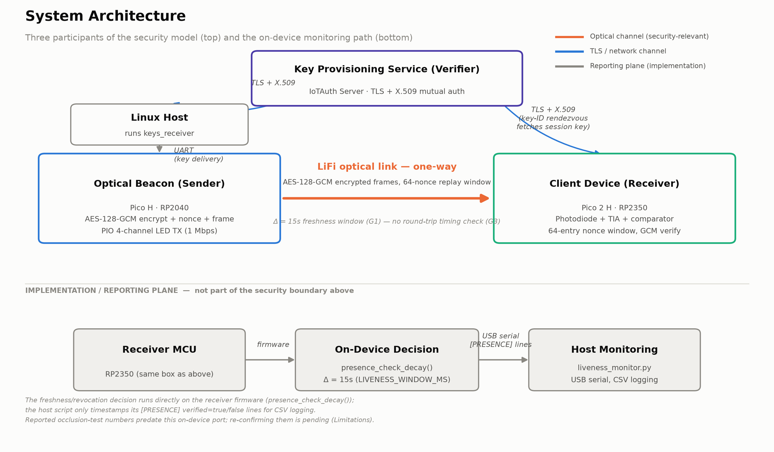
System Architecture
Notes:
This is the system architecture. Three participants: the optical beacon (Sender, RP2040) encrypting every message with AES-128-GCM and driving four LED channels in parallel; the client device (Receiver, RP2350) with a photodiode front-end checking each frame against a 64-entry nonce window before decryption; and the key provisioning service (IoTAuth), which both sides authenticate to independently over TLS with X.509 certs — the IoTAuth host is used only at provisioning time, not in the runtime data path. The orange arrow is the one that matters: the optical channel, one-way, is the whole security argument. Below the divider is the on-device monitoring path — the receiver makes its own revocation decision in firmware and reports it over USB serial — drawn separately and grayed out on purpose, because it is implementation, not part of the security model above it. Flag here that the reported occlusion-test numbers predate this on-device decision logic — you'll return to why on the methodology slide.

Slide 6
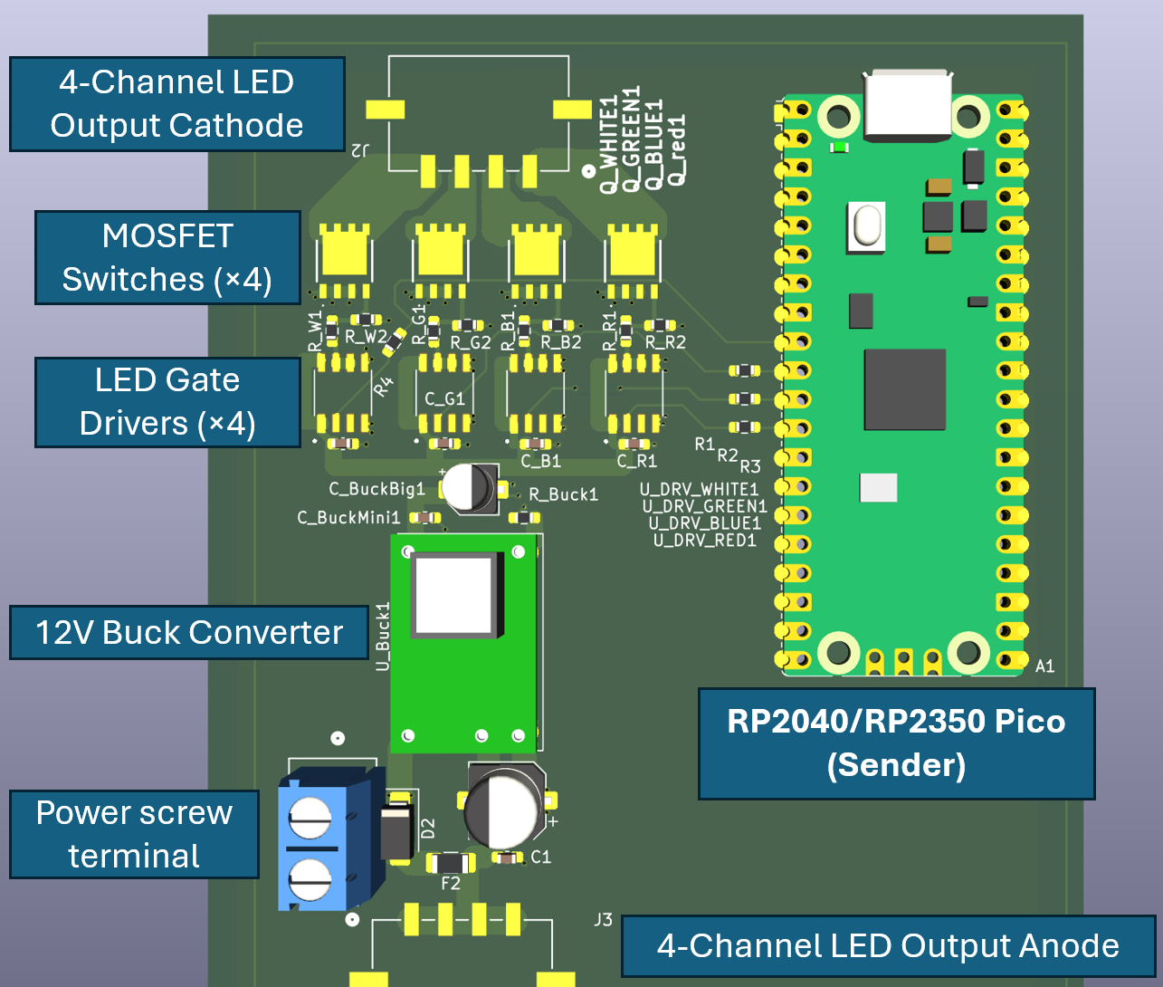
Optical Beacon (Sender)
Pico H · RP2040
● AES-128-GCM encrypt → nonce construction → frame → modulate
● Nonce = 8-byte random boot salt (CTR_DRBG) + 4-byte monotonic counter
● PIO state machine drives 4 LED channels in lockstep, 1 Mbps, zero CPU overhead during TX
● Frame: preamble · type · length · nonce · ciphertext · 16B GCM tag · CRC16
● Dual-slot A/B flash key storage, SHA-256 integrity hash, secure_zero() RAM clearing
Notes:
Sender hardware. Emphasize the crypto pipeline order — encrypt, construct nonce, frame, modulate — and that the PIO transmitter needs zero CPU cycles once armed, which is what makes the 1 Mbps figure achievable on a microcontroller with no dedicated radio hardware. If asked about nonce reuse: counter exhaustion at 2^32 messages triggers an immediate reboot to regenerate the salt.

Slide 7
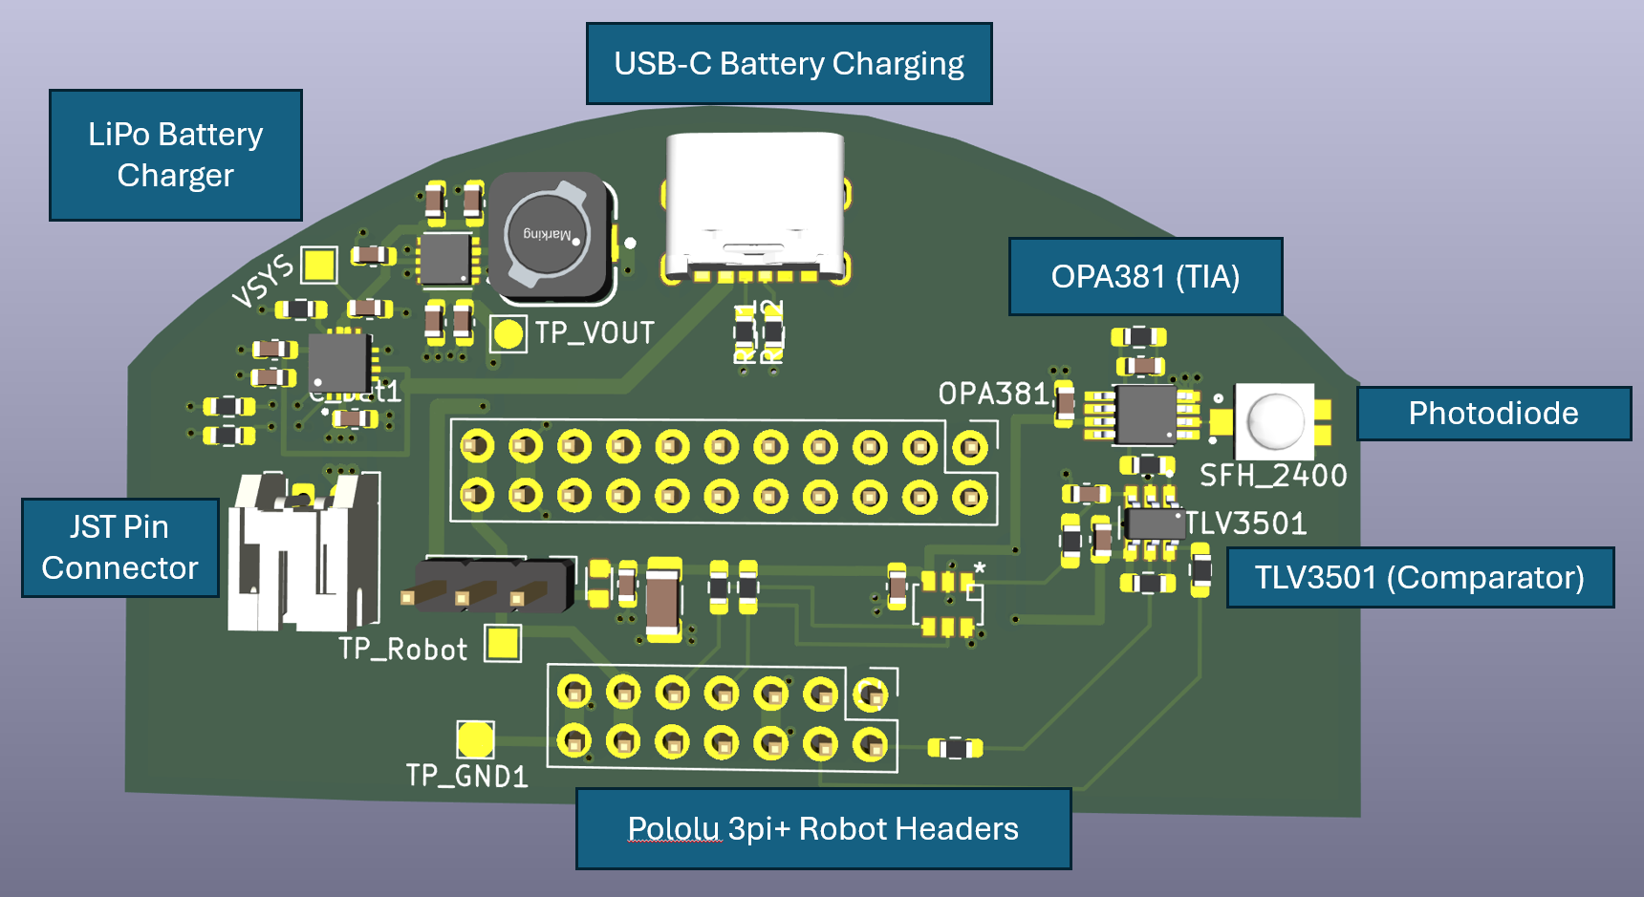
Client Device (Receiver)
Pico 2 H · RP2350
● Photodiode (SFH 2400) → OPA381 TIA → TLV3501 comparator → PIO UART RX
● Programmable threshold via MCP4725 12-bit DAC, tuned each boot (~0.8V)
● 64-entry nonce window checked before decryption is ever attempted
● Robotic integration: Pololu 3pi+ headers, LiPo + buck-boost, USB-C charging
● Same board can operate untethered aboard a mobile CPS platform
Notes:
Receiver hardware and analog front-end. Walk the signal chain left to right: photodiode current, transimpedance amplification, comparator digitization, then a custom PIO UART receiver on the RP2350. Mention the replay window is checked before decryption is attempted at all — a duplicate nonce never reaches the GCM primitive. The robot header is a real, populated connector, not a conceptual placeholder — flag that this feeds the robotic-platform future-work item later.

Slide 8
SST / IoTAuth — the Security Foundation
Not a homebrew crypto stack — a published, decade-long IoT authorization research line
● SST (Secure Swarm Toolkit): open-source authentication & authorization framework for distributed IoT systems
● Auth = the local, automated point of authorization — two roles:
‒ Authenticates/authorizes its own locally registered entities
‒ Bridges authorization between local entities and the wider network
● Architectural concept: “locally centralized, globally distributed” authentication and authorization
● Published research lineage spanning a decade: IoTDI '17, FiCloud '16, IT Professional '17, ACM TIOT '20, SoftwareX '23
● Built and maintained at ASU KIM Labs — this thesis's own lab:
‒ Hokeun Kim (co-author) leads the project; Dongha Kim (co-author) is a core contributor
‒ Jose Felix — this thesis's author — is a listed active contributor to the SST/IoTAuth repo itself
● This work integrates via the sst-c-api C library, rather than reimplementing key distribution from scratch
Notes:
This slide exists to head off a specific committee assumption: that the authentication layer is a student-written crypto stack. It isn't. SST/IoTAuth is a published research architecture with almost a decade of venues behind it — IoTDI, FiCloud, an ACM journal on DoS recovery, a SoftwareX paper for the C API this project actually links against. Say plainly that Hokeun Kim, one of your co-authors, leads the project, and that you yourself are a listed contributor to the SST/IoTAuth repository — not just a consumer of the library. That's a credibility point worth stating out loud, not just leaving in a footnote. Land on the last bullet: this thesis's contribution is applying that existing, trusted key-distribution machinery to a domain — continuous optical presence — it wasn't originally built for.

Slide 9
Sender Provisioning & Key Rotation
Corrected against source — pico_provisioner.c and lifi_session_sender.c, not the earlier diagram
● IoTAuth Server (Java, TLS-protected) → pico_provisioner (Linux host) via the SST C API
‒ init_SST() → get_session_key() → session_key_t { key ID, cipher key, MAC key, mode, validity }
● Session key pushed to the Pico sender over its USB serial port (CDC-ACM, /dev/ttyACM0, 1 Mbps) — the same USB connection used for power and the console, not a separate dedicated UART wire
● Delivery is best-effort, not confirmed: pico_provisioner writes the MSG_TYPE_KEY frame and reports success as soon as write() returns — nothing reads back an acknowledgment from the Pico
‒ If the write itself fails (Pico not connected), the key is saved to session_key.json for manual retry — but a successful write is never verified end-to-end. The 4-state HMAC handshake once shown here (IDLE→WAITING_FOR_YES→WAITING_FOR_ACK→WAITING_FOR_HMAC_RESP) is real code, but it lives in the retired Pi4-side receiver binaries (flash_receiver.c/dash_receiver.c), explicitly marked legacy — it never confirmed sender key delivery.
● Keys persist in dual-slot (A/B) flash, SHA-256 integrity-checked
‒ Operator-driven rotation ('CMD: new key' at the sender console) writes the inactive slot first and refuses to overwrite an occupied slot without -f — genuine rollback safety
‒ The automated provisioning push above writes directly to whichever slot is currently active — it does not use the inactive-slot-first pattern
Notes:
This slide was corrected during defense prep after cross-checking it against pico_provisioner.c and lifi_session_sender.c directly — two claims didn't hold up. First: the host tool is pico_provisioner, not 'keys_receiver' — that name doesn't correspond to any binary in the codebase, only to a stale diagram label. Second, and more substantive: there is no delivery confirmation handshake for the sender at all. The 4-state HMAC handshake is real, implemented code — but it belongs to the retired Pi4-side receiver stack (flash_receiver.c), where the header literally comments it 'Legacy HMAC challenge.' It was never wired to the sender path. The honest story is a best-effort push: pico_provisioner writes over the Pico's USB serial port and considers it done once the write() call returns, with no read-back proving the Pico actually applied the key. If asked how you'd know a push silently failed: you wouldn't, from the host side — you'd have to check the Pico's own console output. The dual-slot/SHA-256 storage claim held up, with one nuance worth having ready: the rollback-safe inactive-slot-first behavior is real, but only for the manual 'CMD: new key' console path, not the automated push this slide's diagram is actually depicting.

Slide 10
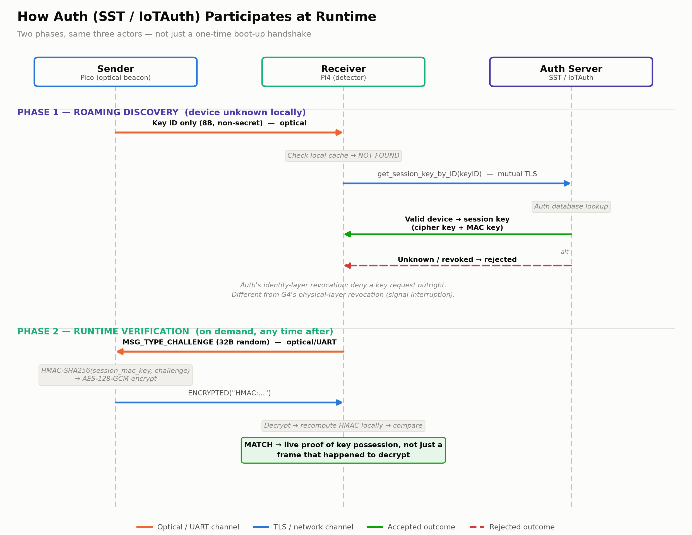
Auth's Role Doesn't Stop After Provisioning
Notes:
Two things happen with Auth in the loop that are easy to miss if you only think of provisioning as a one-time boot-up handshake. Phase one: a device entering a room broadcasts only its non-secret 8-byte key ID over light — never the session key itself. If the receiver doesn't already recognize that ID locally, it performs what the code literally calls a roaming lookup — get_session_key_by_ID over mutual TLS to the Auth server. Auth can return the session key for a valid, registered device, or reject the request outright for an unknown or revoked one. That rejection path is a second, distinct revocation mechanism from G4: G4 revokes because the physical light signal stopped; this revokes because Auth, administratively, said no — identity-layer revocation versus physical-layer revocation, and they're complementary, not redundant. Phase two: at any point after that, the receiver can issue a live HMAC challenge to the sender over the same optical or UART link — a fresh random challenge, HMAC-SHA256 under the session MAC key, AES-GCM-encrypted response, compared locally. That's a stronger, on-demand proof of live key possession, layered on top of the passive 'this frame decrypted successfully' freshness check the whole G1/G4 evaluation is built on. If asked why both mechanisms exist: the passive heartbeat check is what's continuously measured in the evaluation section; the active challenge is available whenever a stronger, interactive proof is warranted, without adding new hardware or a new channel.

Slide 11
Adversary Model
● Network control — standard Dolev-Yao adversary on RF/network links (eavesdrop, replay, delay, drop, inject)
● Optical observation — passive sensors capture ciphertext, tags, nonces — never plaintext or key material
● Relay — capture the optical signal, transport it, re-emit remotely; introduces latency δᵣₑₗₐᵧ
● Optical injection — a rogue light source without the session key fails AES-128-GCM tag verification
● Denial of service — physical obstruction, ambient-light saturation, RF jamming of the network link
‒ The system fails closed by design: denial of signal → revocation, never false authorization
Notes:
Five capabilities, five sentences. The one to slow down on is relay, since it sets up the G3 discussion later — plant the term delta-relay here so it isn't new vocabulary when it resurfaces. On denial of service, be explicit that this is a conscious design tradeoff: availability is sacrificed for safety, and that's stated as a non-goal in the paper, not discovered as a side effect.

Slide 12
Security Goals G1–G4
Goal | Property | Mechanism | Status
G1 | Freshness / Expiration | Token window Δ | Achieved
G2 | Replay Resistance | 64-entry nonce sliding window | Achieved
G3 | Relay-Bounded Authorization | No timing check on data path | Not achieved
G4 | Revocation on Interruption | Absence of signal = revocation | Achieved
This table is the scorecard for the rest of the talk — every evaluation result maps back to one row.
Notes:
Present this table early and deliberately so the committee has the full scorecard before any evidence. Read the four goals aloud, including the G3 status column exactly as written — do not soften 'not achieved.' Tell them directly: you will spend the evaluation section proving the three green rows with measured data, and you will spend the discussion section explaining precisely why the red row is red, on purpose, as a named limitation rather than a discovered gap.

Slide 13
Experimental Setup & Methodology
● Testbed: Pico H sender + Pico 2 H receiver, ~15cm separation, indoor ambient light, no shielding
● IoTAuth provisioning server runs on a Raspberry Pi 4 under Linux, used only at session-key setup — not part of the runtime data path
● Frame-level protocol logic (CRC, replay, decrypt) runs on the deployed receiver firmware (receiver_pico/src/main.c)
‒ The Δ-based revocation decision itself was computed by an external monitoring script at measurement time
‒ That decision logic has since been ported directly into the receiver firmware as well (presence_check_decay())
● Re-confirming the reported numbers against this on-device decision is named explicitly as pending work, not silently assumed
Notes:
State the measurement-provenance caveat proactively and plainly, in the same tone as every other sentence on this slide — don't let your delivery shift when you get to it. The frame-level parsing and crypto were always on-device; only the revocation *decision* (the Δ timer) was external at measurement time, mirroring the same logic that's now been moved on-device. If pressed: this was a deliberate sequencing choice — get clean, directly-instrumented protocol events first, then move the decision itself on-device once the wire-level logic was validated.

Slide 14
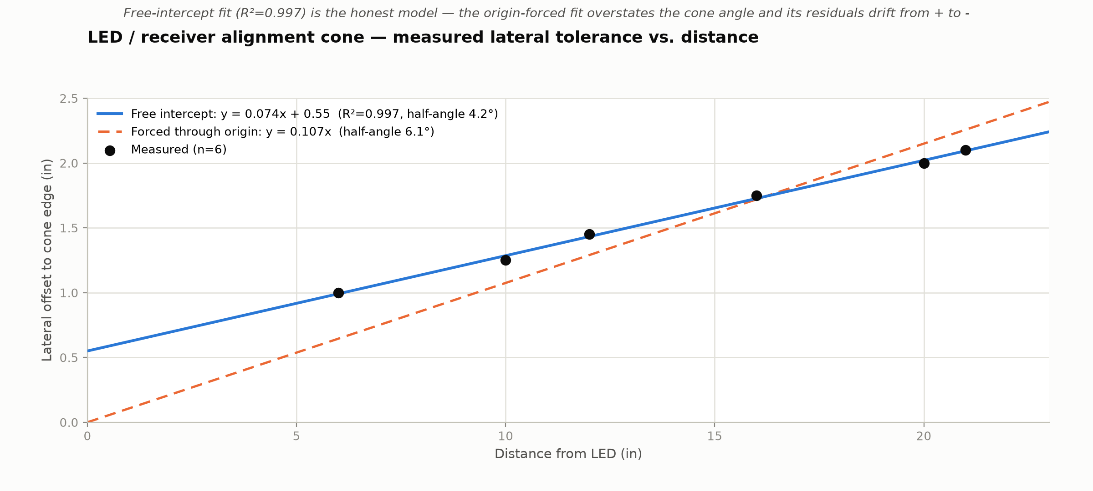
Link Geometry — Alignment Tolerance
How much lateral misalignment the testbed's ~15cm separation actually tolerates
Free-intercept fit: half-angle ≈ 4.2° (R²=0.997) — the naive origin-forced fit overstates the cone at ≈6.1° and its residuals drift systematically.
Notes:
Six manually measured (distance, lateral-offset) pairs bounding the LED emission / photodiode acceptance cone, from 6 to 21 inches. Two fits are shown deliberately: a free-intercept line, which is the honest model, and a forced-through-origin line, which is the naive 'point source' assumption. The origin-forced fit looks fine in isolation (R²=0.986) but its residuals are systematically positive at short range and negative at long range — that's not noise, it's curvature the model can't capture, because the emitter/receiver aperture has real physical size even at zero distance. The free-intercept fit's ~0.55in intercept is that aperture term. Land on the practical point: at the ~15cm (~5.9in) separation used throughout the evaluation testbed, the measured tolerance is about 1 inch of lateral slop — comfortably wide for a fixed benchtop rig, but this is exactly the number that would need to shrink and be re-characterized for the mobile robotic-platform future-work item, where the LED and receiver are no longer rigidly fixtured.

Slide 15
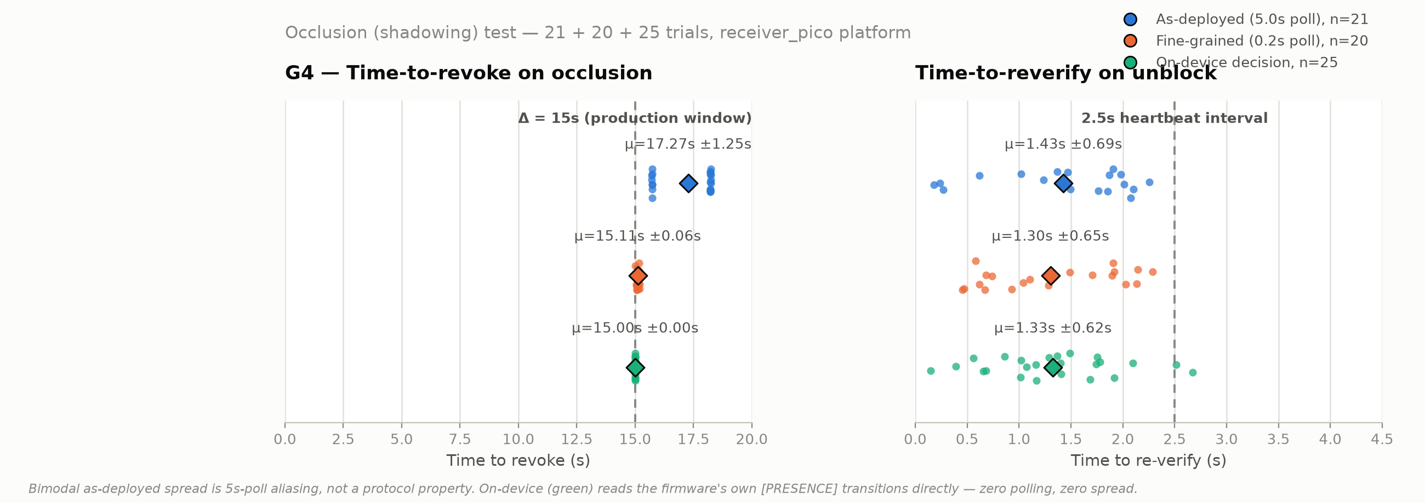
G4 — Revocation Latency on Occlusion
Intrinsic time-to-revoke: 15.11s ± 0.06s — essentially exactly Δ (15s) plus fixed overhead.
Notes:
Two strip plots: time-to-revoke on the left, time-to-reverify on the right, two trial batches each. Blue is the as-deployed condition, 5-second external-monitor polling — 21 trials. Orange is fine-grained 0.2-second polling — 20 trials, run to separate the mechanism's real latency from polling artifacts. The blue row is bimodal, clustering near 15.7 and 18.2 seconds — that's aliasing against the 5-second poll interval, not the protocol misbehaving. The orange row proves it: once polling is fine-grained, time-to-revoke collapses to a tight cluster at 15.11 seconds, standard deviation six hundredths of a second — essentially exactly the 15-second freshness window plus about a tenth of a second of fixed processing overhead. That's the G4 evidence: revocation on interruption, enforced precisely. On the right, re-verification after unblocking is consistently under 1.5 seconds in both batches, bounded above by the 2.5-second heartbeat interval as expected.

Slide 16
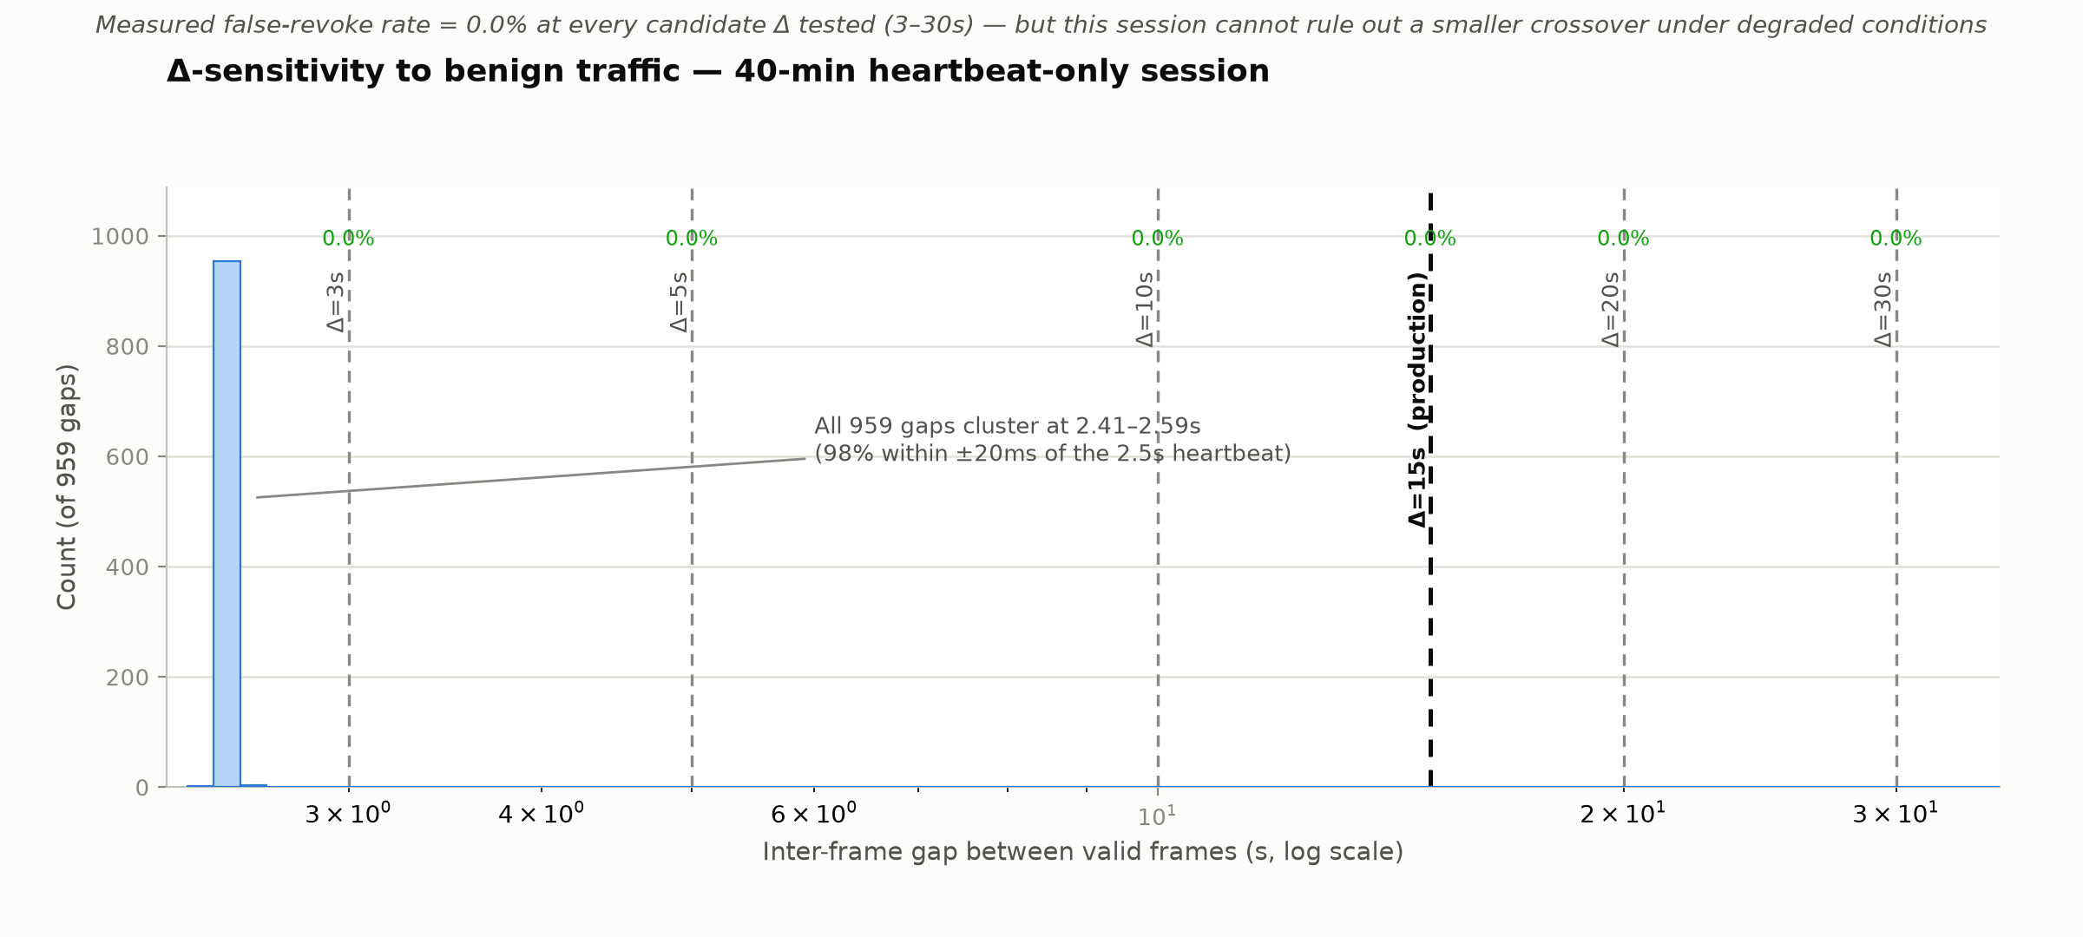
Δ-Sensitivity to Benign Traffic
0.0% false-revoke rate at every candidate Δ tested — but this session can't rule out a smaller crossover under degraded conditions.
Notes:
This experiment asks whether Delta equals 15 seconds is actually justified, or just a number someone picked. 959 gaps between valid frames over a 40-minute benign session, checked against six candidate Delta values from 3 to 30 seconds. The honest result: every gap clustered within about 20 milliseconds of the 2.5-second heartbeat — that spike on the left — so every candidate Delta, including the most aggressive at 3 seconds, comes back at zero percent false-revoke. Say directly why this isn't as strong as it looks: one traffic pattern, a mechanically regular heartbeat, doesn't contain the irregular gaps a real degraded environment would produce, so there's no crossover to find in this data. What it does establish is a floor — Delta=15s costs nothing measured against this traffic. Full parametric justification under degraded conditions is future work, stated as such in the paper rather than let the clean number imply more than it shows.

Slide 17
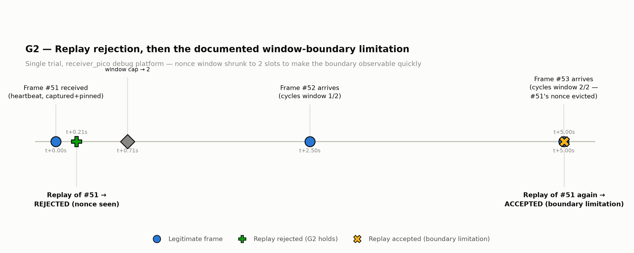
G2 — Replay Rejection & the Window-Boundary Limitation
Immediate replay rejected; the same frame is re-accepted only after being deliberately evicted from a shrunk 2-slot window.
Notes:
Two results in one timeline. At t plus zero, a legitimate heartbeat frame arrives and gets captured and pinned. At t plus 0.21 seconds, replaying that exact frame is rejected — the green marker — because its nonce is already in the replay window. That's G2 working as designed. Then the nonce window is deliberately shrunk from its production size of 64 down to 2 slots, to make a boundary condition observable in a short test instead of needing thousands of frames. Two more legitimate frames cycle through, evicting the original nonce, and at t plus 5 seconds the same frame is replayed a third time — the amber X — and this time it's accepted and decrypted. That's not a bug found by accident, it's a documented, real boundary: replay protection is bounded by window capacity, not permanent. In production at 64 slots, an attacker needs 64 fresh legitimate frames to cycle through before a captured frame becomes replayable again, which bounds how long it stays a live threat — but the limitation is real, and it's on the same slide as the positive result, not buried in a footnote. If asked why a 2-slot window: say plainly it's artificially small only to make the boundary observable quickly — the mechanism and the limitation are identical at any window size, just slower to trigger at 64.

Slide 18
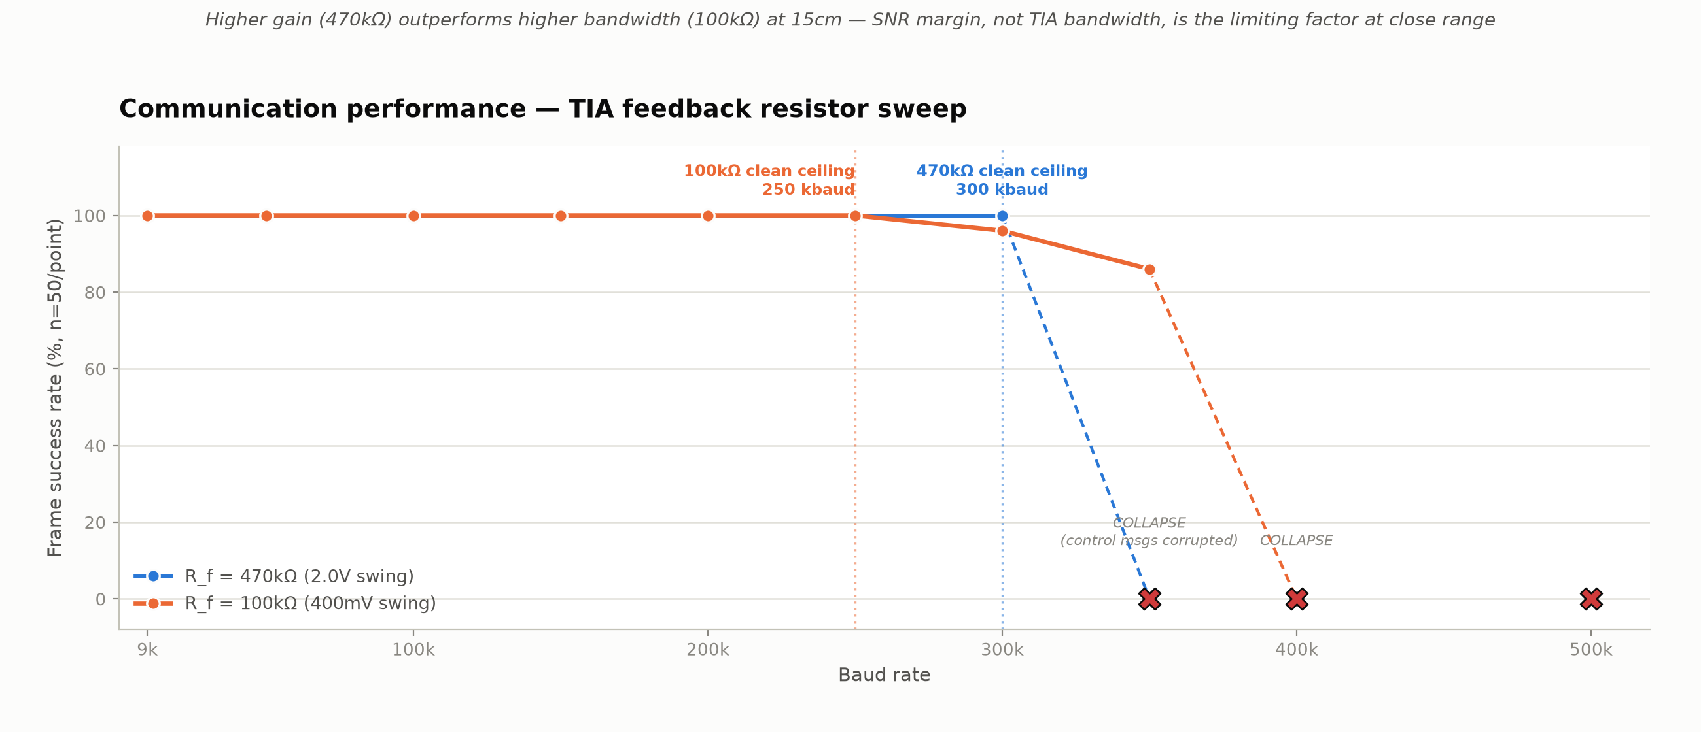
Communication Performance
Higher gain (470kΩ) beats higher bandwidth (100kΩ) at 15cm — SNR margin, not TIA bandwidth, limits close range.
Notes:
The baud-rate sweep behind the bandwidth-range tradeoff in the paper. Blue is 470 kilohms — higher gain, lower bandwidth, 2-volt output swing. Orange is 100 kilohms — lower gain, higher bandwidth, 400-millivolt swing. Both hold 100% frame success up to their ceiling — 300 kilobaud for 470k, 250 kilobaud for 100k — then the orange line shows measurable degradation, 96% and 86%, before both configurations hit a hard collapse where control messages themselves get corrupted. The counterintuitive result: at this close range, the higher-gain 470k configuration outperforms the higher-bandwidth 100k configuration. SNR margin from the larger voltage swing is the limiting factor at short range, not the TIA's raw bandwidth. The classic bandwidth-range tradeoff should favor the higher-bandwidth config once you're far enough that photocurrent drops and the 400-millivolt swing stops clearing the comparator's noise floor — that crossover distance hasn't been measured yet, which is why it's future work rather than a claim in this thesis.

Slide 19
Security Validation — Recap
Goal | Property | Status | Evidence
G1 | Freshness / Expiration | Achieved | 15.11s ± 0.06s intrinsic ≈ Δ + 0.11s
G2 | Replay Resistance | Achieved | Immediate rejection confirmed; window-bounded (documented)
G3 | Relay-Bounded Auth | Not achieved | Named limitation — no timing check on data path
G4 | Revocation on Interruption | Achieved | Follows directly from G1's measured latency
Notes:
This closes the loop back to slide 10's scorecard, now with evidence in the last column instead of just mechanism. Read it goal by goal, evidence-first: this is the moment to sound confident, because everything in the 'evidence' column is a number you already showed them on the previous four slides — you're not introducing anything new here, just tying it together.

Slide 20
G3 — A Named Limitation, Not a Discovered Gap
● G1 bounds how long a captured, later-resent frame stays useful. G2 rejects a byte-identical resend outright.
● Neither mechanism examines WHEN a frame arrived — only whether its nonce is fresh and previously unseen
● A live relay forwarding genuinely fresh frames in real time passes every check the receiver performs:
‒ Nonce never seen before → G2 passes
‒ GCM tag valid, ciphertext untouched → confidentiality/integrity passes
‒ t_last continuously refreshed by relayed-but-fresh frames → G1 passes
● Verified directly in the receiver implementation: the LiFi data-frame path checks only CRC and byte-exact nonce identity — no timestamp, no round-trip bound
● What closing this gap requires: a Brands–Chaum-style distance-bounding challenge-response, binding authorization to measured round-trip time
Notes:
This is the slide to deliver in exactly the same tone as every positive result before it — that consistency is what reads as rigor instead of a hedge. The core distinction, if asked to restate it: G1's window bounds a captured, no-longer-live frame; it does not bound relay latency, because a continuously operating relay keeps t_last refreshed indefinitely with genuinely fresh, just-late frames. That confusion — mistaking G1's expiration window for a relay bound — is the single most likely follow-up question; have this paragraph ready verbatim.

Slide 21
Limitations
● Line-of-sight requirement — dust, fog, or vibration can trigger unnecessary revocation if Δ is set aggressively
● No relay resistance (G3) — a live relay of genuinely fresh frames passes every current check
● Single-channel reception — four LED channels transmit, but only one photodiode receives
● Ambient light sensitivity — partial mitigation via programmable DAC threshold, no full adaptive control yet
● No hardware key protection — RP2040/RP2350 lack a TPM or secure element; keys are extractable with physical access + debugger
● Revocation-latency measurements are pending re-confirmation against the on-device presence decision, ported after these numbers were collected
Notes:
Six limitations, read at the same pace and volume as everything else in the talk — don't rush through this slide to get past it. The last bullet is the one to make sure lands clearly: it's not a generic hedge, it's a specific, checkable pending item with a known reason to be cautious. During eval prep, debugging surfaced two real, previously-invisible protocol bugs on the receiver — a framing bug that broke on binary ciphertext containing 0x0A/0x0D bytes, and a key-push tool silently writing to the wrong UART, so key rotation no-op'd for an unknown stretch of time despite reporting success. Both are fixed. The reported occlusion-test numbers were collected before the revocation decision itself was moved on-device (presence_check_decay()) — the frame-level logic was already on-device throughout, so this is a precision re-check, not a rebuild. See the backup slide on the two bugs found during eval prep if asked how you know your measurements are trustworthy.

Slide 22
Future Work
Ordered by priority — not a wish list
CLOSES A GAP NAMED IN THIS TALK
EXTENDS THE SYSTEM
● Distance-bounding challenge-response for G3 — measured 3–6ms processing latency suggests ample timing margin
● Confirm revocation-latency measurements against the on-device presence decision (receiver_pico/src/main.c), not just the external monitor
● Formal protocol verification (Tamarin / ProVerif) of G1–G4 — not yet attempted, explicitly scoped out
● Time-bounded key validity enforcement — abs_validity/rel_validity fields exist but are not yet enforced
● Higher data rates — 47kΩ/1pF feedback network targeting 2–4 Mbps
● Optical concentration — collimating lenses (TX), CPC/Fresnel concentrators (RX) to extend range
● Hardware key protection — TPM or secure element (e.g., ATECC608)
● Robotic platform demonstration — 3pi+ integration already designed into the receiver PCB
Notes:
Two columns, and the grouping itself is the point: the left column closes gaps you already admitted to earlier in the talk — G3's distance-bounding, the on-device confirmation, formal verification — while the right column extends capability the system already has. Say the grouping out loud rather than just reading bullets: it signals you know what matters most next, rather than reciting a flat wish list.

Slide 23
Contributions
● First system to formalize and evaluate continuous, time-bounded optical-presence authorization with automatic revocation
● Working physical prototype: AES-128-GCM authenticated encryption at 1 Mbps over free-space optical, custom analog front-end
● ~$82 total hardware cost — two orders of magnitude below commercial LiFi access-point pricing
● G1 (freshness), G2 (replay resistance), and G4 (revocation on interruption) empirically demonstrated with real measured data
● G3 (relay-bounded auth) reported as an explicit, named limitation — verified directly against the implementation, not inferred
● Symbolic verification explicitly scoped as future work — stated openly, not left for a reviewer to find
Notes:
Closing content slide before thank-you. Keep this tight and confident — every bullet here is something you already showed evidence for earlier in the talk, so this should feel like a summary, not a new argument. The last two bullets are there on purpose: naming exactly what wasn't done, right next to what was, is itself part of the contribution.

Slide 24
Thank you — Questions
Jose Felix · KIM Labs, Arizona State University
github.com/asu-kim/lifi-auth
Notes:
Thank the committee again. Before opening the floor, briefly restate the scorecard from memory in one breath: freshness, replay resistance, and revocation on interruption were measured and hold; relay-bounding does not, and that's named on purpose. Then stop talking and take questions — the backup slides after this cover BOM/cost, the frame format, the TIA tuning table, and a one-slide answer to the G1-vs-G3 question specifically, pull them up if asked.

Slide 25
Backup
Reference material — pull up on demand during Q&A

Slide 26
Backup — Bill of Materials
Verified DigiKey invoices #120241715, #121892487 — total ≈ $82
Component | Part Number | Cost
Sender MCU | Pico H, RP2040 | $5.00
Gate Driver ×4 | TC4420COA | $1.80 ea.
MOSFET ×4 | SIR800DP-T1-GE3 | $0.88 ea.
DC-DC Module | PTN78000WAH (12V→5V) | $24.58
LED Array | SFH 4715A-CBDB | $2.50
Receiver MCU | Pico 2 H, RP2350 | $6.00
TIA | OPA381AIDGKT | $2.93
Photodiode | SFH 2400-Z | $0.79
Comparator | TLV3501AIDBVR | $2.64
DAC | MCP4725A1T-E/CH | $1.27
LiPo Charger | BQ24074RGTR | $2.50
Buck-Boost Reg. | TPS63031DSKR | $2.14
Passives, PCBs (×2) | R/C/fuses/JST + fab | ≈ $25
Notes:
Pull up only if asked about cost or component selection. The single largest line item is the PTN78000WAH DC-DC module at $24.58, chosen for research-prototype convenience — a production design substituting a discrete buck regulator would bring total cost under $60.

Slide 27
Backup — Wire Frame Format
Field | Size | Notes
Preamble | 4 B | 0xAB 0xCD 0xEF 0x12 — synchronization marker
Type | 1 B | Message type identifier
Length | 2 B | Ciphertext length N
Nonce | 12 B | 8B random boot salt + 4B monotonic counter
Ciphertext | N B | AES-128-GCM output, equal length to plaintext
GCM Tag | 16 B | Authentication tag — verified before any plaintext release
CRC16 | 2 B | CRC16-CCITT, poly 0x1021, init 0xFFFF
64-entry nonce sliding window checked against every incoming nonce BEFORE decryption is attempted.
Notes:
Reference for the wire format question. The key point if asked: replay checking happens before the GCM primitive is ever invoked — a duplicate nonce is rejected without spending the decryption cost, let alone releasing plaintext.

Slide 28
Backup — Why No Symbolic Verification Yet
● G1–G4 are amenable to formal verification with Tamarin or ProVerif — identified explicitly as future work
● A full model covers SST HS1–HS3 mutual auth + the AES-GCM data channel + two independent replay windows
● That's substantial, specialized modeling work — not something to fit alongside the empirical evaluation chapter
● An incomplete or buggy formal model would read worse to a committee than no formal model plus an honest claim
● Findings in this thesis are stated as empirically demonstrated, not formally proven — stated as such throughout, not implied
Notes:
Only pull this up if asked directly why there's no Tamarin/ProVerif model. The core answer: this was a deliberate scoping decision, not an oversight — a rushed or incomplete formal model would be worse evidence than an honest 'empirically demonstrated, not formally proven' claim, which is exactly the language used throughout the paper.

Slide 29
Backup — TIA Feedback Component Tuning
R_f | C_f | BW (kHz) | Max Baud (measured) | Output Swing
470kΩ | 5pF | 68 | 300,000 | ≈2.0V
100kΩ | 5pF | 318 | 250,000 | ≈400mV
100kΩ | 1pF | 1,590 | TBD (future work) | ≈400mV
47kΩ | 1pF | 3,386 | TBD (future work) | ≈200mV
Only the first two rows are experimentally validated; the lower-resistance rows target >1Mbps and are future work.
Notes:
Reference table if pressed on the bandwidth-range tradeoff numbers or asked what's next for higher data rates. Be clear that only the first two rows have measured data — the 100k/1pF and 47k/1pF rows are calculated bandwidths, not measured baud ceilings.

Slide 30
Backup — “Isn't Δ Basically a Relay Bound?”
The single most likely question — answer verbatim
● No. G1's window Δ bounds how long a CAPTURED, NO-LONGER-LIVE frame remains useful.
● A live relay never captures-and-resends stale bytes — it forwards each frame through in real time, added latency and all.
● Every relayed frame is genuinely fresh from the receiver's point of view: new nonce, valid tag, arrives within Δ.
● A continuously operating relay keeps t_last refreshed indefinitely — Δ never expires against it.
● G1 and G2 answer “is this frame new and unseen?” — G3 would require answering “how long did this frame take to arrive?”, which nothing in the current implementation checks.
Notes:
Memorize this slide's content, don't read it verbatim in the room — but have it exact in your head. The tightest one-sentence version if you need to compress under time pressure: freshness answers 'is this new,' relay-bounding answers 'how long did this take to get here,' and this system only answers the first question.

Slide 31
Backup — Three Receiver Variants, Three Auth Interaction Models
Binary | Role | Auth interaction
keys_receiver | “The Manager” | Fetches a session key from Auth at startup, pushes it to the sender
flash_receiver | Combined session app | Chat + file transfer + HMAC verification + key management, combined
ask_receiver | “The Detective” | No keys at start — listens for an optical key-ID broadcast, then queries Auth
ask_receiver implements the roaming/discovery model shown on the Auth-runtime slide — it is the concrete code behind that diagram, not a conceptual simplification.
● Message types relevant to Auth interaction: MSG_TYPE_KEY_ID_ONLY (discovery), MSG_TYPE_CHALLENGE / RESPONSE (runtime HMAC), MSG_TYPE_KEY (provisioning push)
● All three variants share the same SST C API calls underneath: init_SST(), get_session_key(), get_session_key_by_ID()
Notes:
Only needed if asked to justify why three separate receiver binaries exist rather than one. The honest answer: they correspond to three different Auth interaction models that were useful to isolate during development and evaluation — a proactive key-manager, a full combined session app, and a pure discovery/roaming client — not three independent implementations of the security logic, which is shared underneath via the same SST C API and the same replay/freshness code paths.

Slide 32
Backup — SST/IoTAuth Publication Lineage & Team
● IoTDI '17 and FiCloud '16 — secure network architecture with Auth-mediated key distribution for IoT
● IT Professional '17 — the “locally centralized, globally distributed” authentication/authorization architecture
● ACM TIOT '20 — secure migration as a recovery mechanism from denial-of-service attacks or failures
● SoftwareX '23 — the C API this project links against (sst-c-api)
● SIGMOD '25 / Mid4CC '23 — SST applied to large-scale key-value storage and decentralized file-system access control
● Most in-depth technical reference: a 2017 UC Berkeley Ph.D. dissertation on the underlying architecture
● Active contributors (per the project's own repository): Hokeun Kim, Dongha Kim, Carlos Beltran Quinonez, Sunyoung Kim, Jose Felix — all ASU
Notes:
Pull this up only if a committee member asks 'what is SST, really' in more depth than the main slide covers. The point of reading a few venue names aloud is not to name-drop — it's to establish that this is externally reviewed, multi-year infrastructure, not something assembled for this thesis. The last bullet is worth reading slowly: you are named, by GitHub handle, as an active contributor to the repository this project depends on.

Slide 33
Backup — Two Real Bugs Found During Eval Prep
Why the debug-receiver measurements should be trusted, not just assumed correct
Bug | What was wrong | Impact / fix
Framing bug | Newline-terminated framing broke on any real encrypted frame — binary ciphertext routinely contains 0x0A/0x0D bytes | Replaced with proper length-prefixed binary parsing matching the actual wire format
Silent key-rotation no-op | Key-push tool targeted the Pico's USB console instead of the hardware UART the firmware's key handler actually reads from | Reported “success,” changed nothing — for an unknown, possibly long stretch of the project's history
Both found and fixed on the debug receiver during 2026-07-25 eval prep, before any of the reported measurements were taken.
● The receiver firmware's on-device revocation decision (presence_check_decay()) was added after these numbers were measured
● Re-running the occlusion test against it, to confirm the reported latency carries over unchanged, is a specific, named check — not a generic caveat
Notes:
Pull this up if asked how you know the eval numbers are trustworthy, or why the on-device confirmation gap in Limitations is called out so specifically rather than as generic future work. The honest framing: these bugs are evidence the instrumentation was rigorous enough to catch real, previously-invisible problems — including one, the silent key-rotation no-op, that had been reporting false success for an unknown stretch of time before anyone noticed. The revocation-latency numbers were collected while that same decision logic lived in an external monitoring script; it's since been ported onto the receiver itself, and re-measuring against it is flagged by name rather than left as a vague 'pending' bullet.

