Slide 1
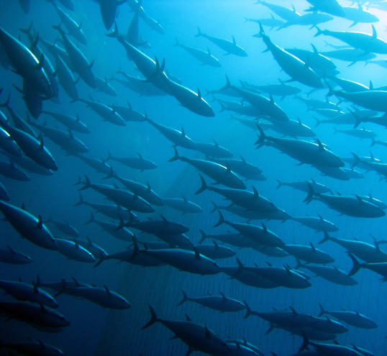

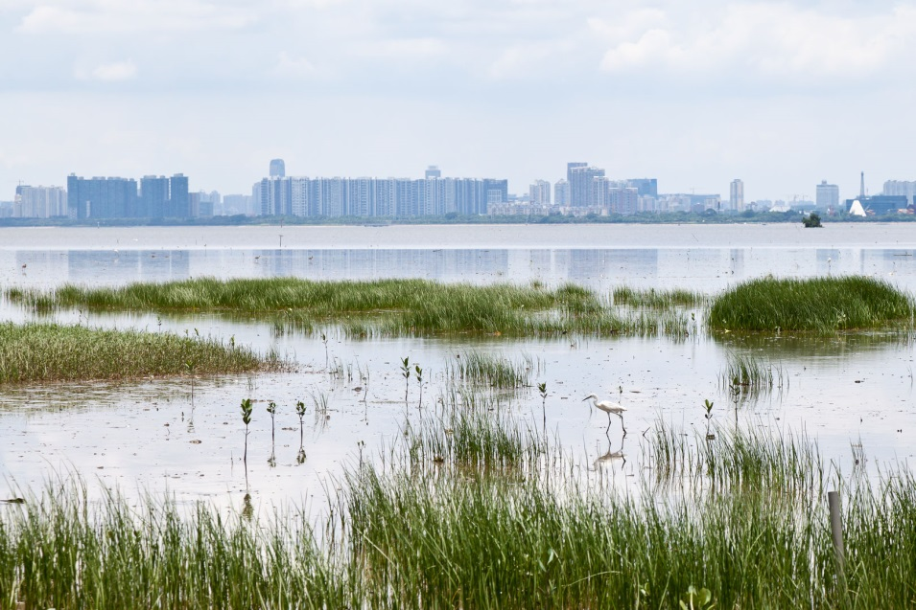
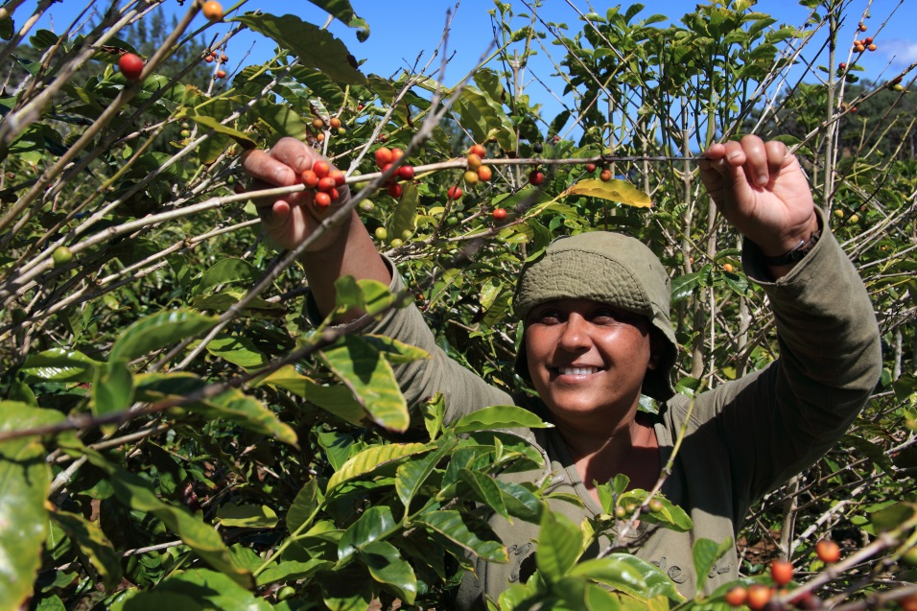


Update of the Indian Ocean Albacore Operating Model & MSE
IOTC WPM12, 18-20 October 2021
Iago MOSQUEIRA – Wageningen Marine Research
Funded by:

Slide 2
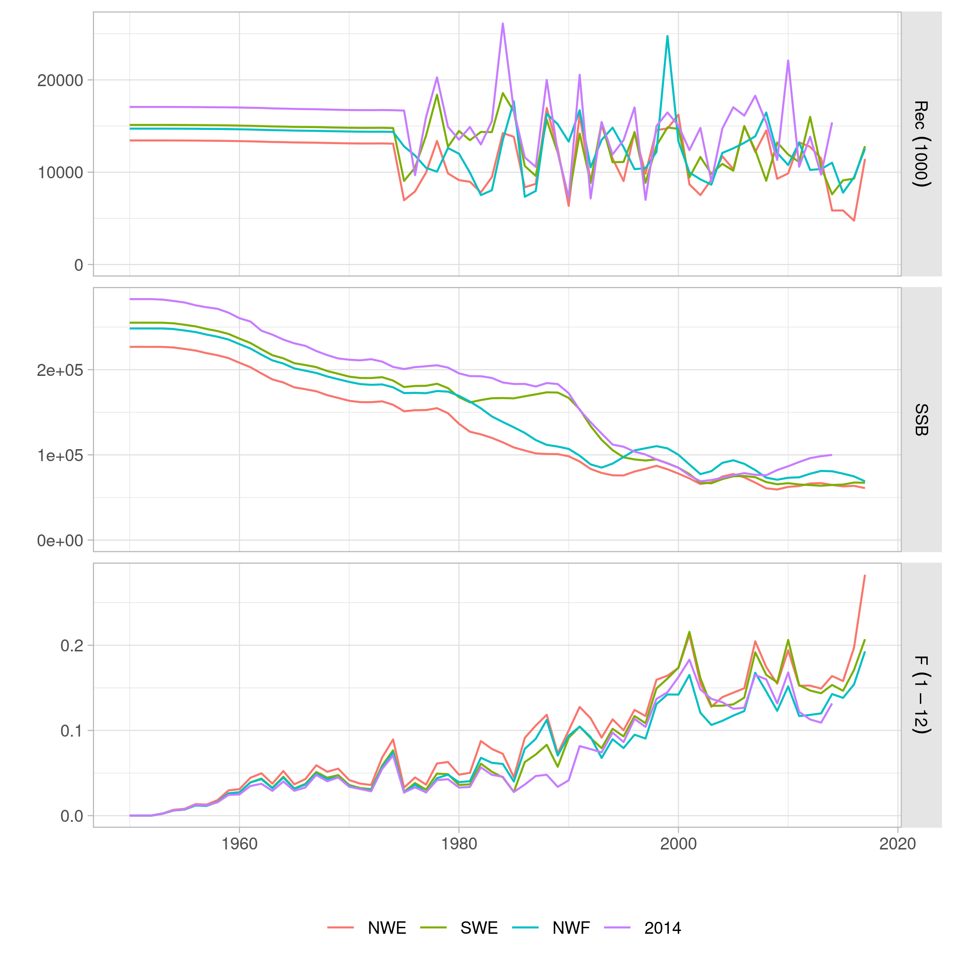
Albacore Stock Assessment 2019
2 sex, 1 area
4 LL fleets, PS (NW), DN (1982-92).
NW CPUE + LF, SW CPUE + LF, NW CPUE down LF.
Lower K, lower SB, higher F than 2014 model.

Slide 3
Albacore Operating Model in brief
WPTmT 2019, data 1950-2017
Uncertainty in
  M
  Steepness
  recruitment variability
  Weight CPUE / length data
  Yearly increase catchability LL
  CPUE (NW, SW)
Runs selected on CPUE MASE, B0 limit 4e5 t
Resampled with weights based on CPUE prediction skill

Slide 4
SS3 model grid
Natural mortality (M): 0.3, 0.325, 0.35, 0.375 or 0.4, for all ages.
Standard deviation in recruitment deviates (sigmaR): 0.4, 0.6, or 0.8.
Stock-recruitment relationship steepness: 0.7, 0.8 or 0.9.
LL CPUE series (cpues): Northwest (12) or Southwest (14).
Length-frequency data likelihood weighting (lfreq): 0.001, 0.01, 0.1 or 1.
Catchability increase of the LL CPUE series (llq): 0% or 1% per year.
432 model runs.

Slide 5
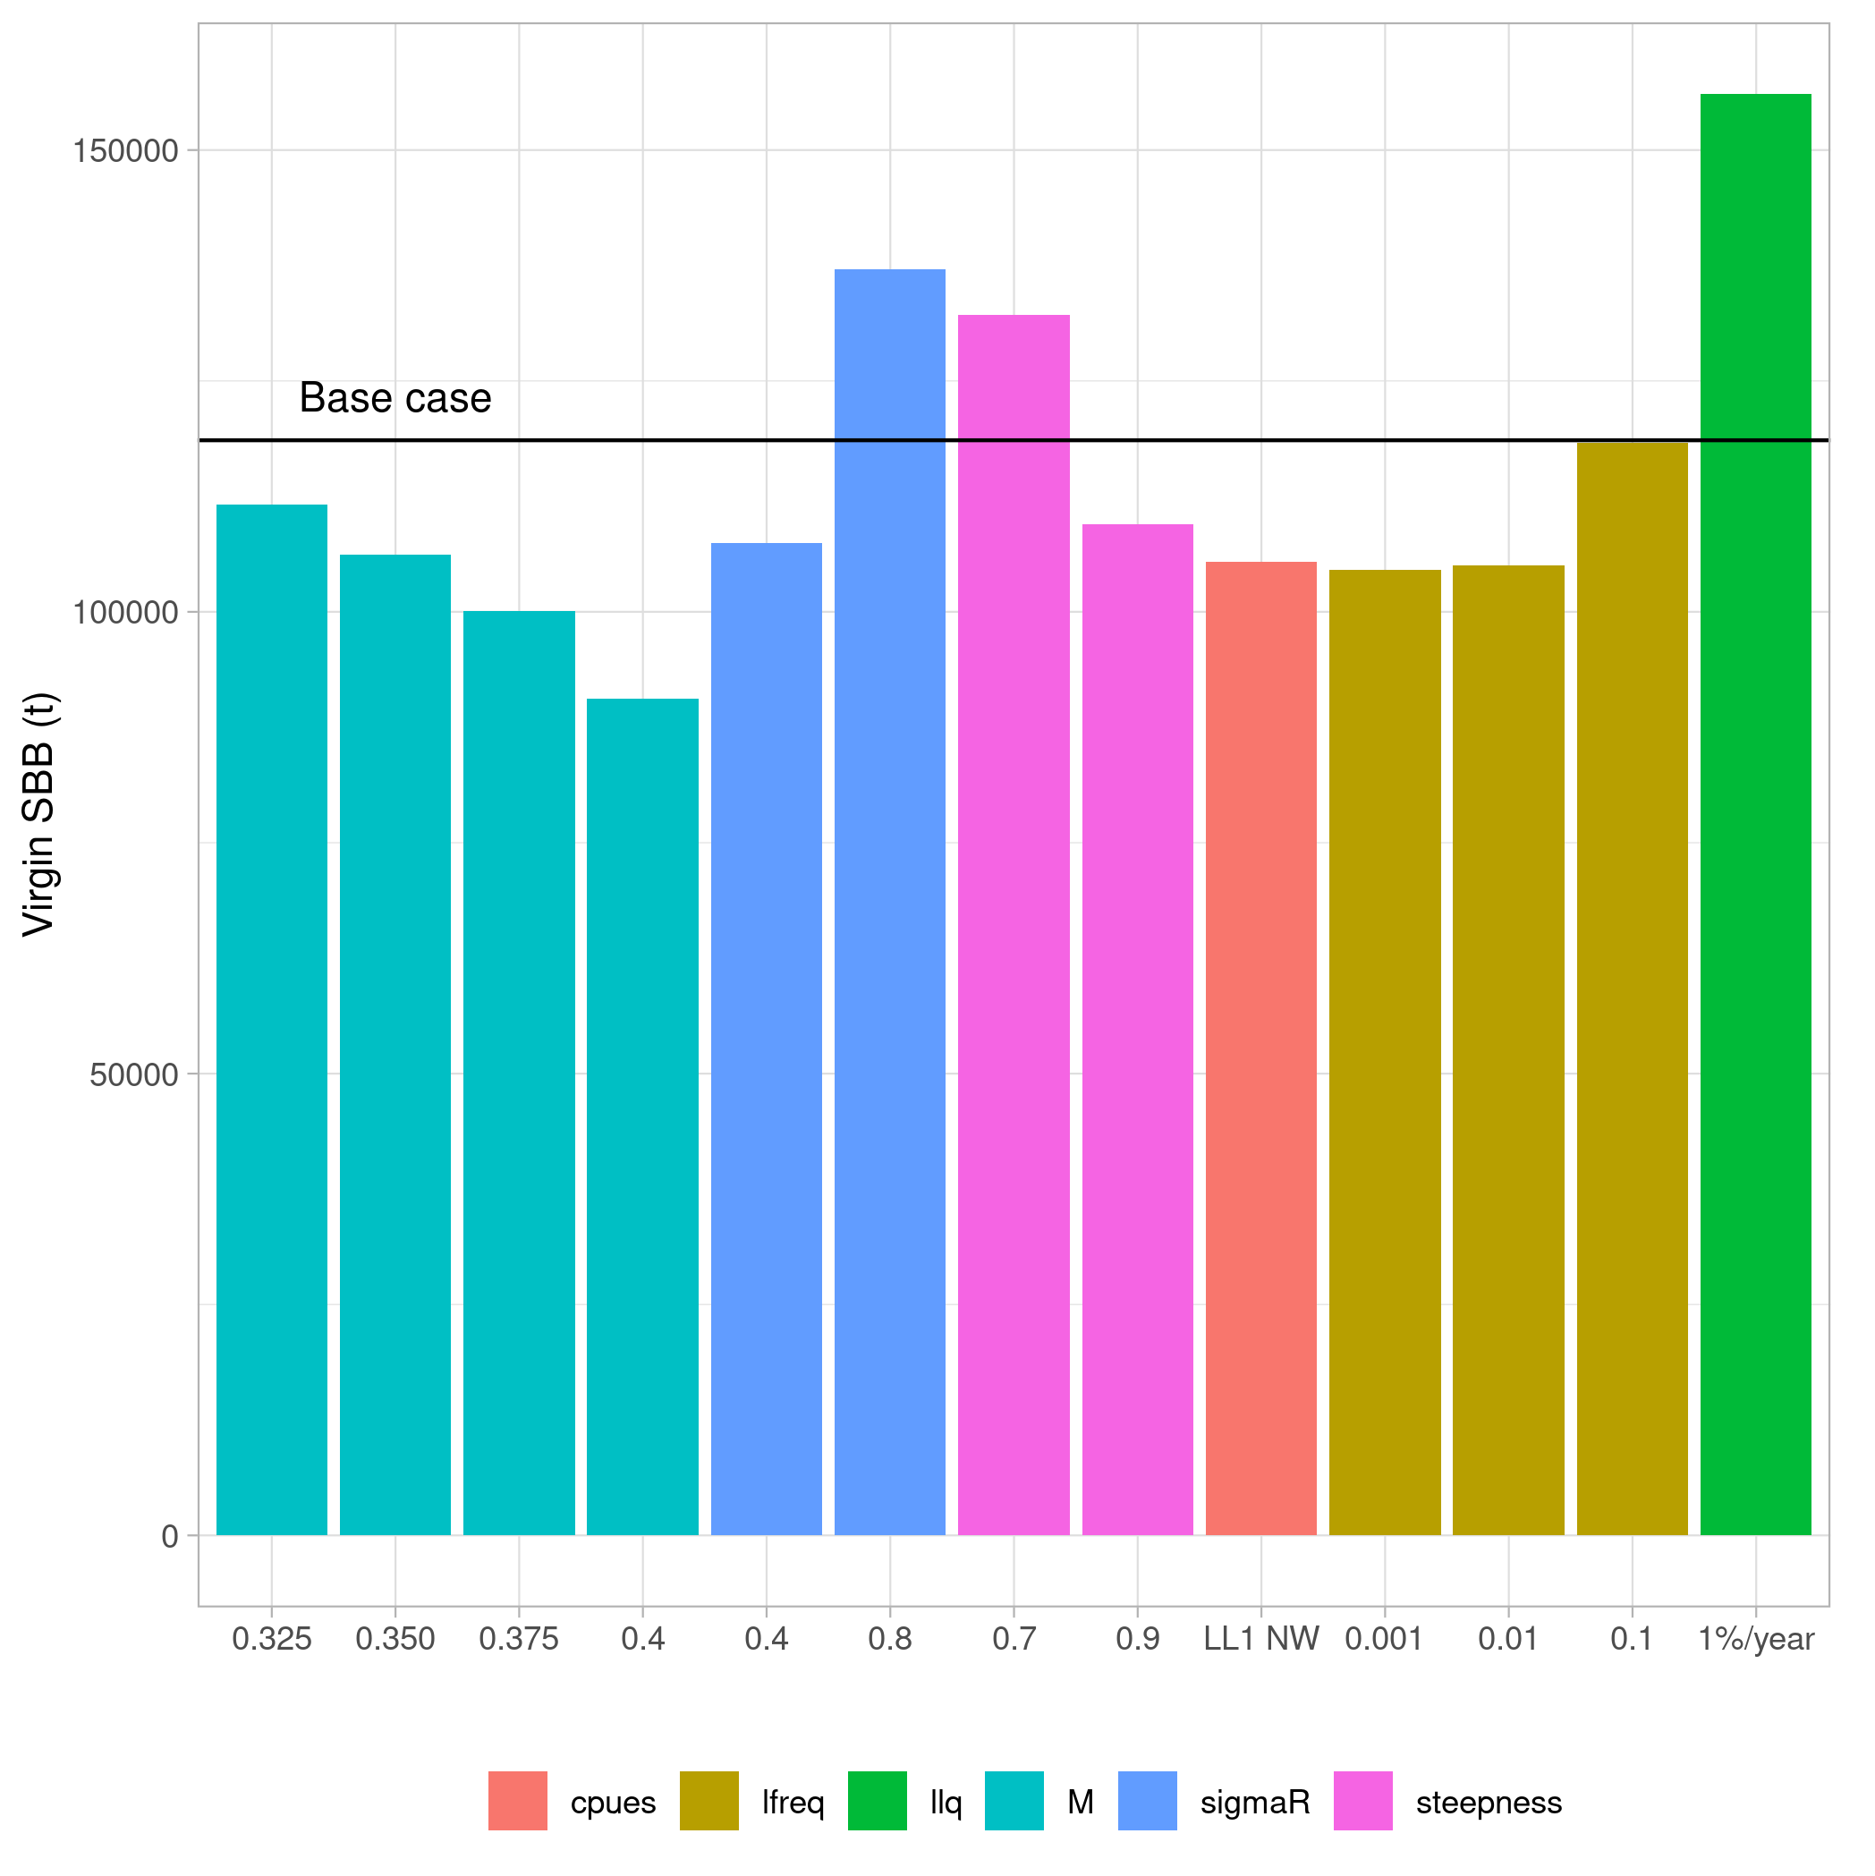
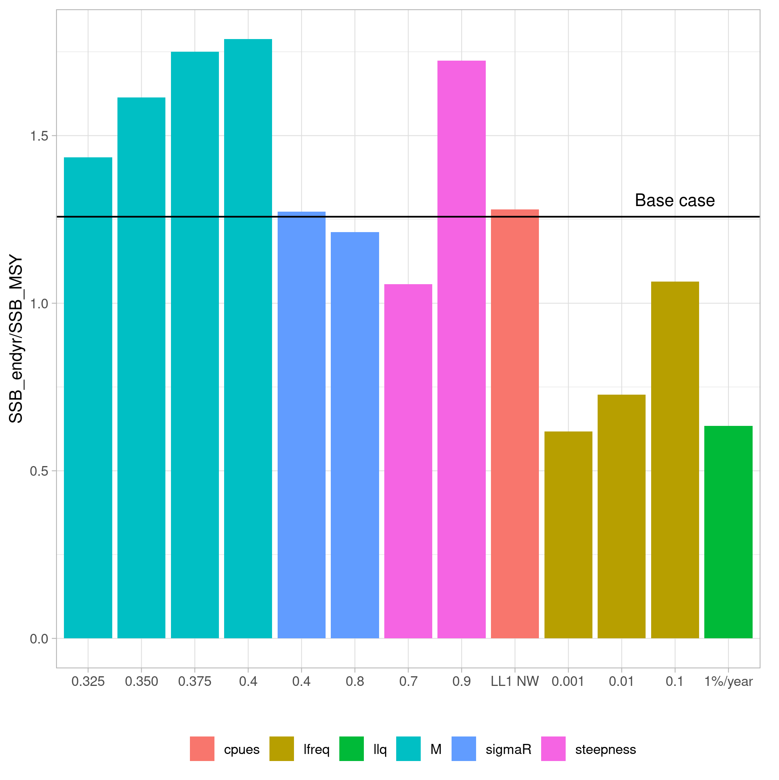
Main effects

Slide 6
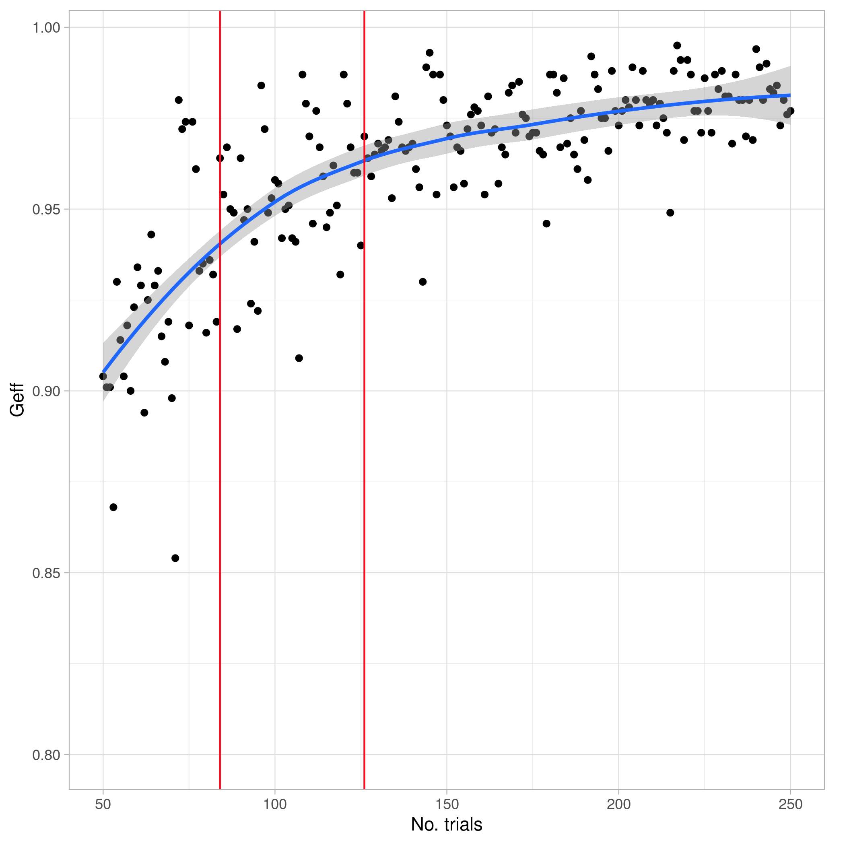
Partial factorial design
84 / 125 model runs
40% rejection rate: 52 runs
Full grid would lead to 260 runs

Slide 7
Full factorial grid
432 models
Model selection criteria
  If SB0 > 1e7 or SB 2017 / SBMSY > 3 (10)
  Convergence, if final gradient > 1e-4 (26)
  MASE of LLCPUE1 NW and LLCPUE3, SW (Q1 & 4) > 1 (120)
  Explain catch 2018-19 (41,615, 39,246 t), with F limited to 200% 2017 (132)
  263 / 432 models selected

Slide 8
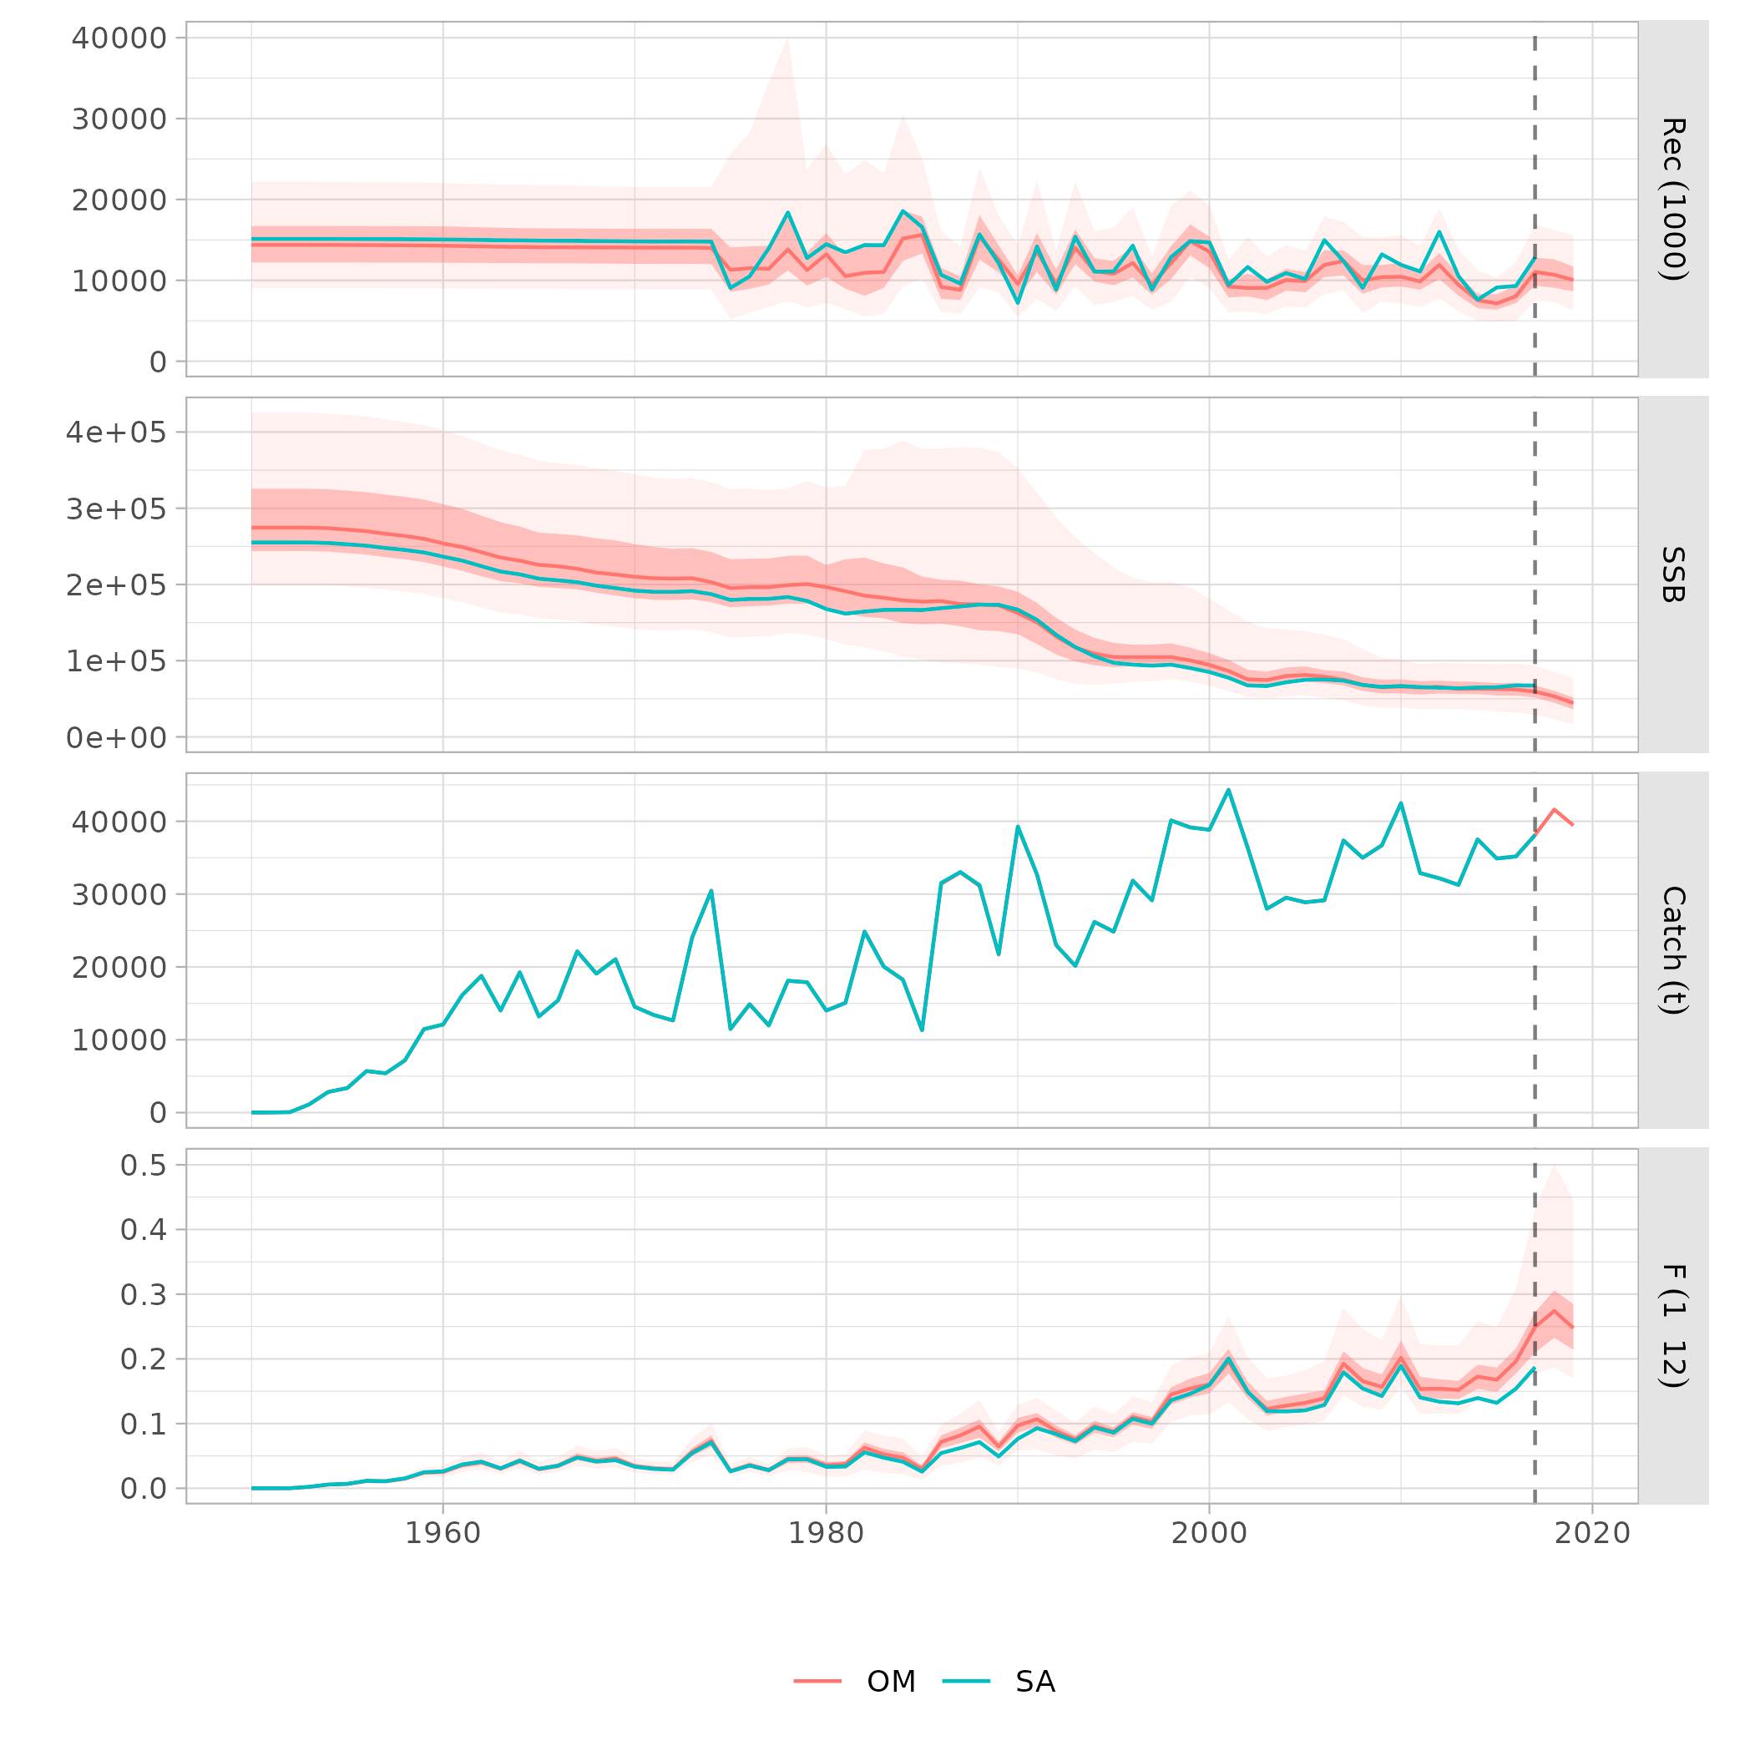
Full factorial OM

Slide 9
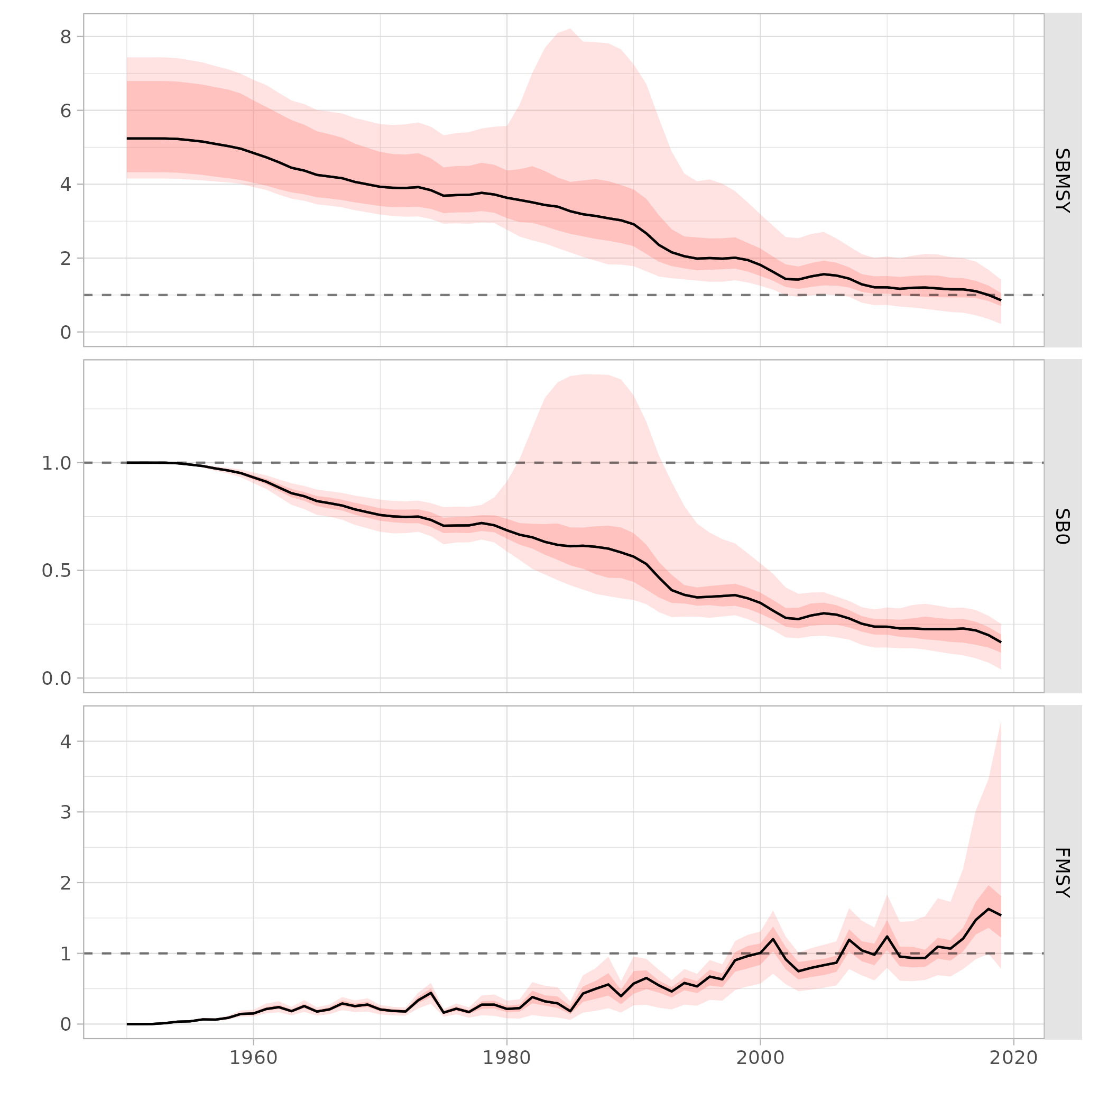
Full factorial OM

Slide 10
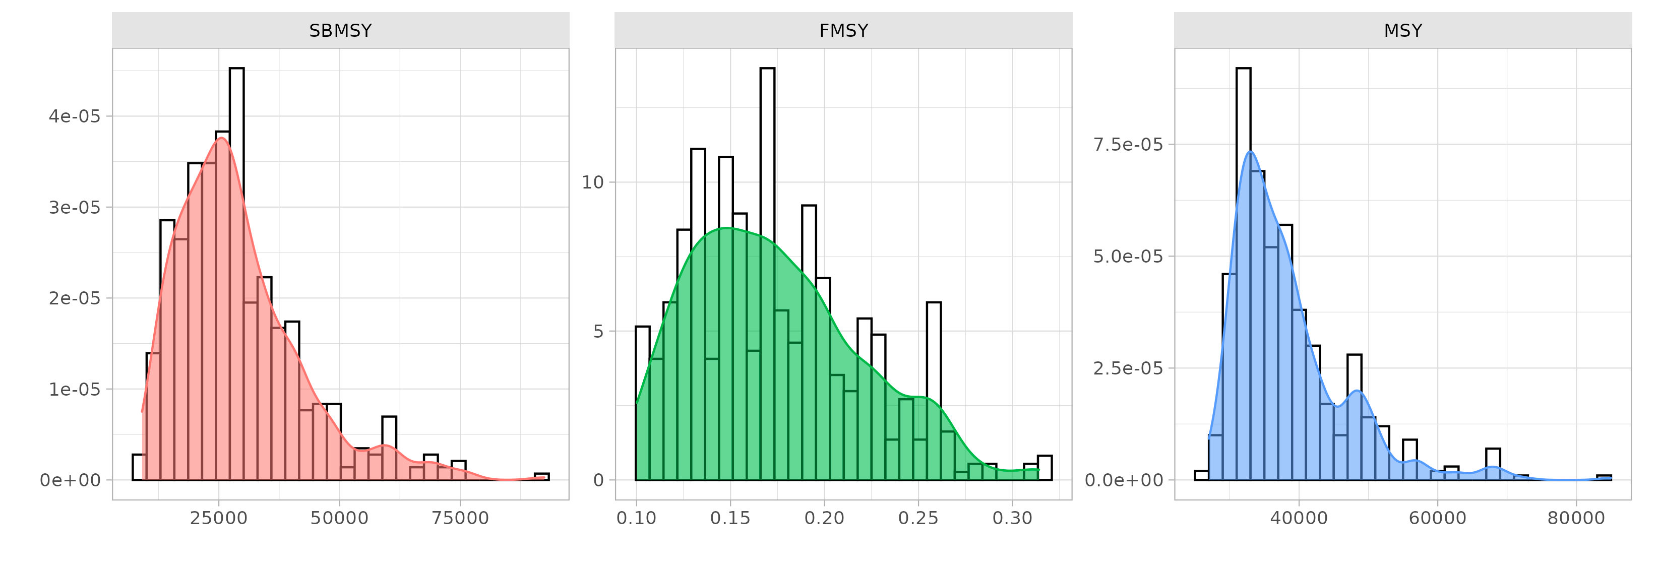
Full factorial OM

Slide 11
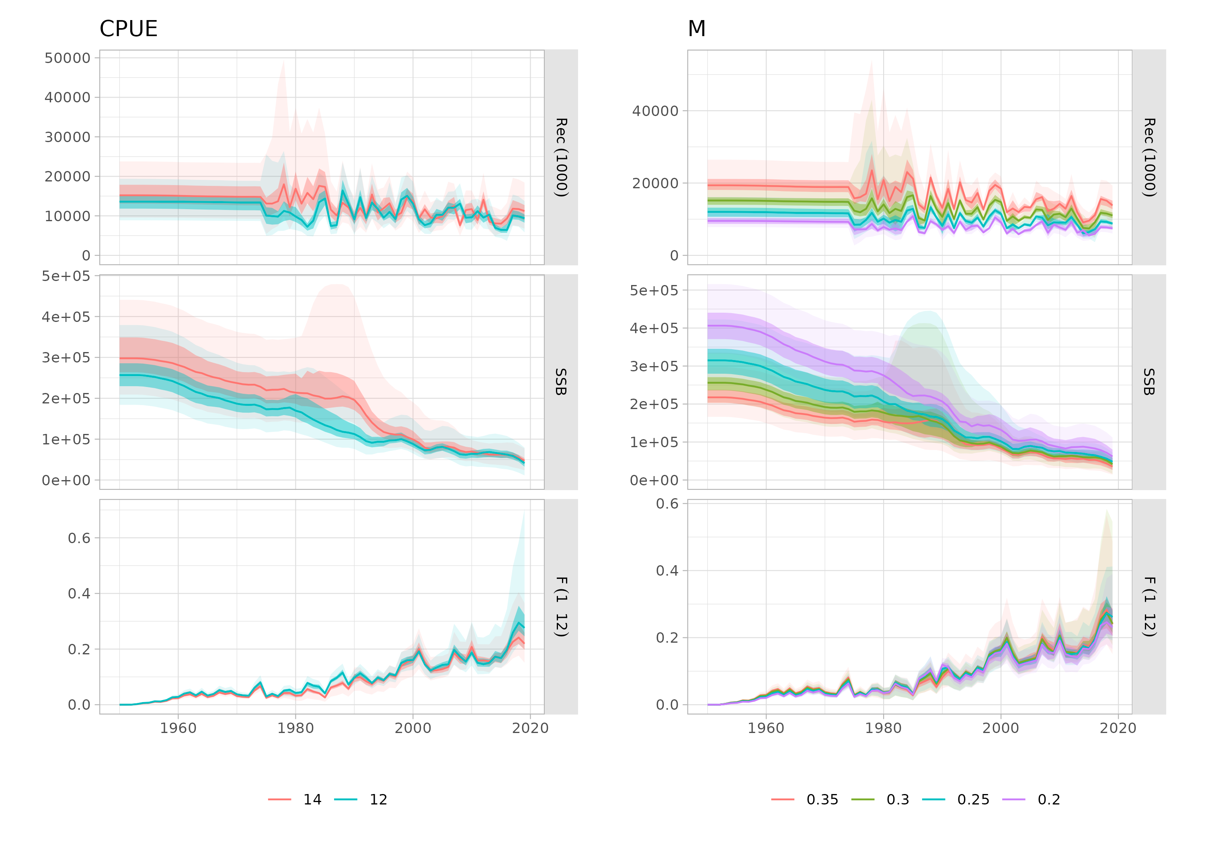
Factors in OM

Slide 12
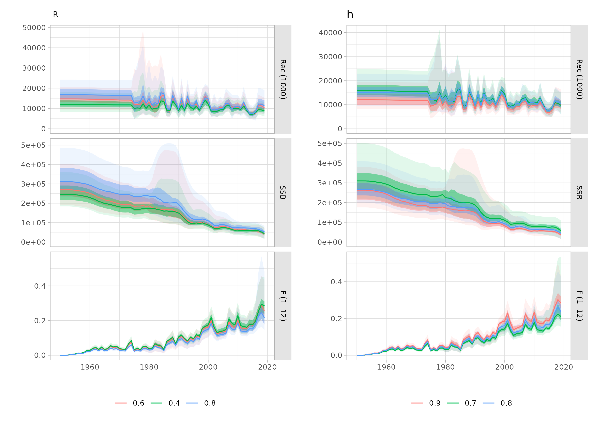
Factors in OM

Slide 13
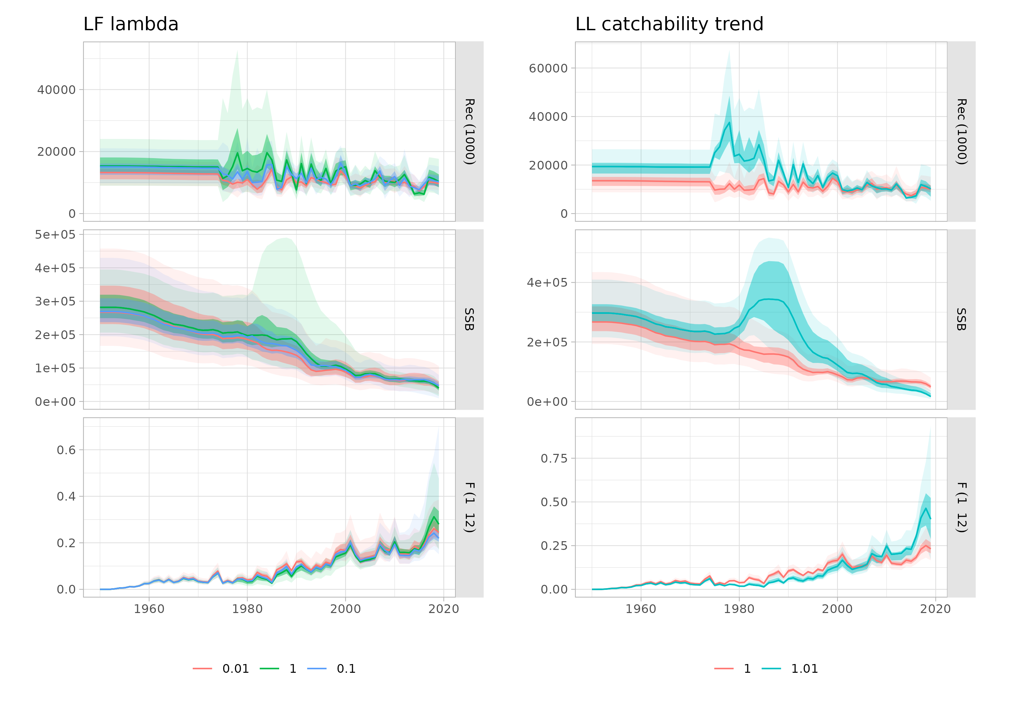
Factors in OM

Slide 14
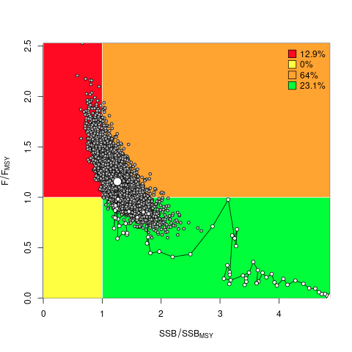
Tuning Objectives
TA2: P(Kobe = green) = 50%
TA3: P(Kobe = green) = 60%
TA4: P(Kobe = green) = 70%
Computed over the 2030-2034 period
Constraints:
3-year TAC setting
15% TAC constraint
Two year data lag, effect of one year.
2017

Slide 15
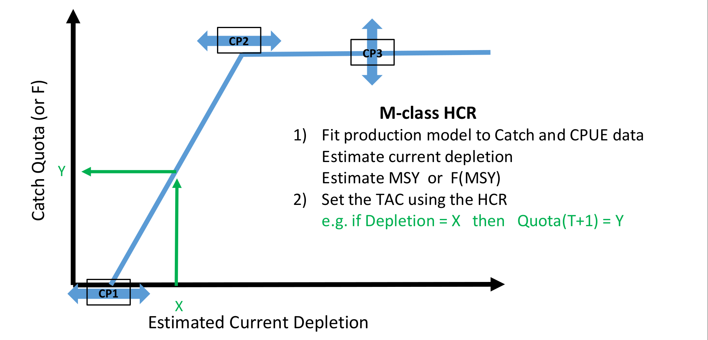
Candidate Management Procedures
M class (model-based) MPs

Slide 16
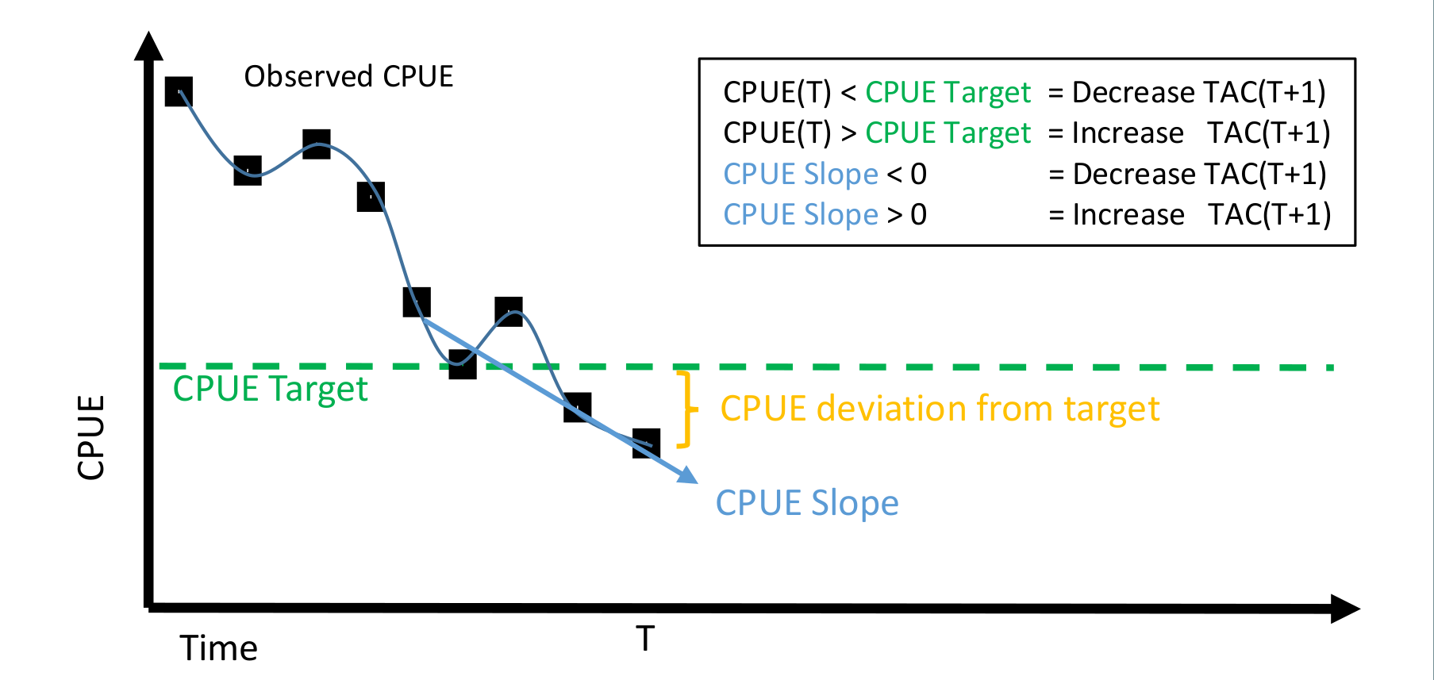
Candidate Management Procedures
D class (data-based) MPs

Slide 17
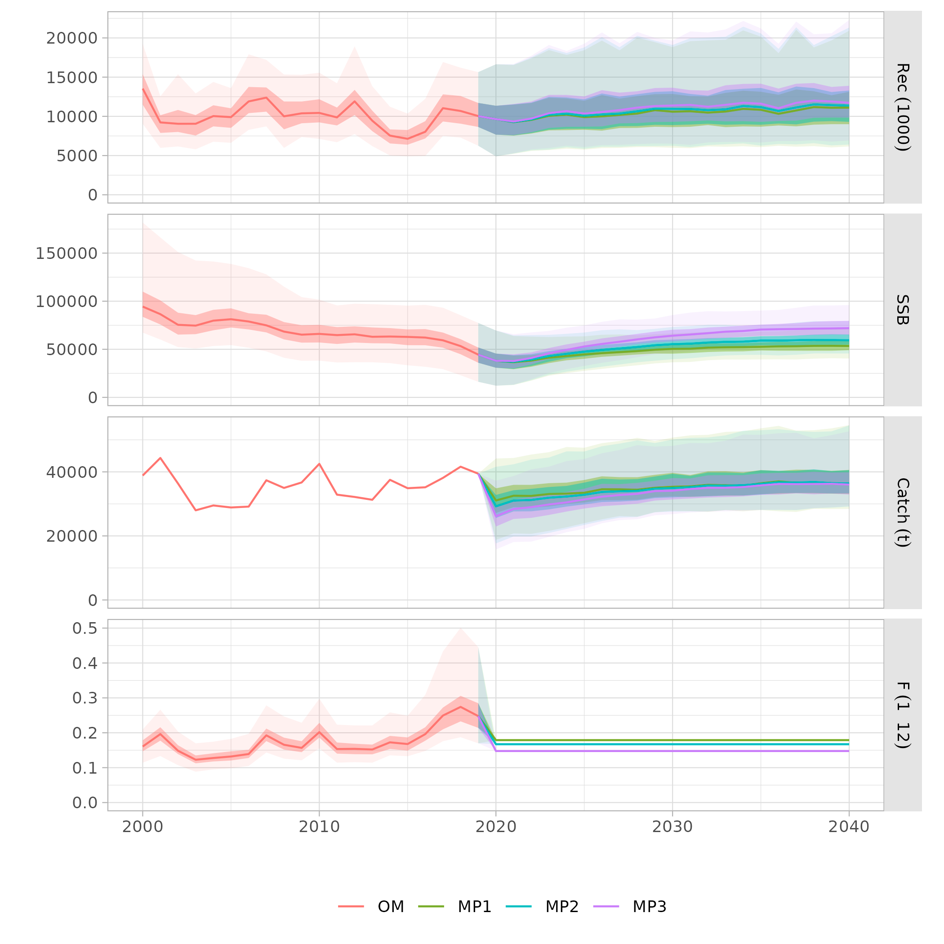
Tests with perfect assessment: fixed F

Slide 18
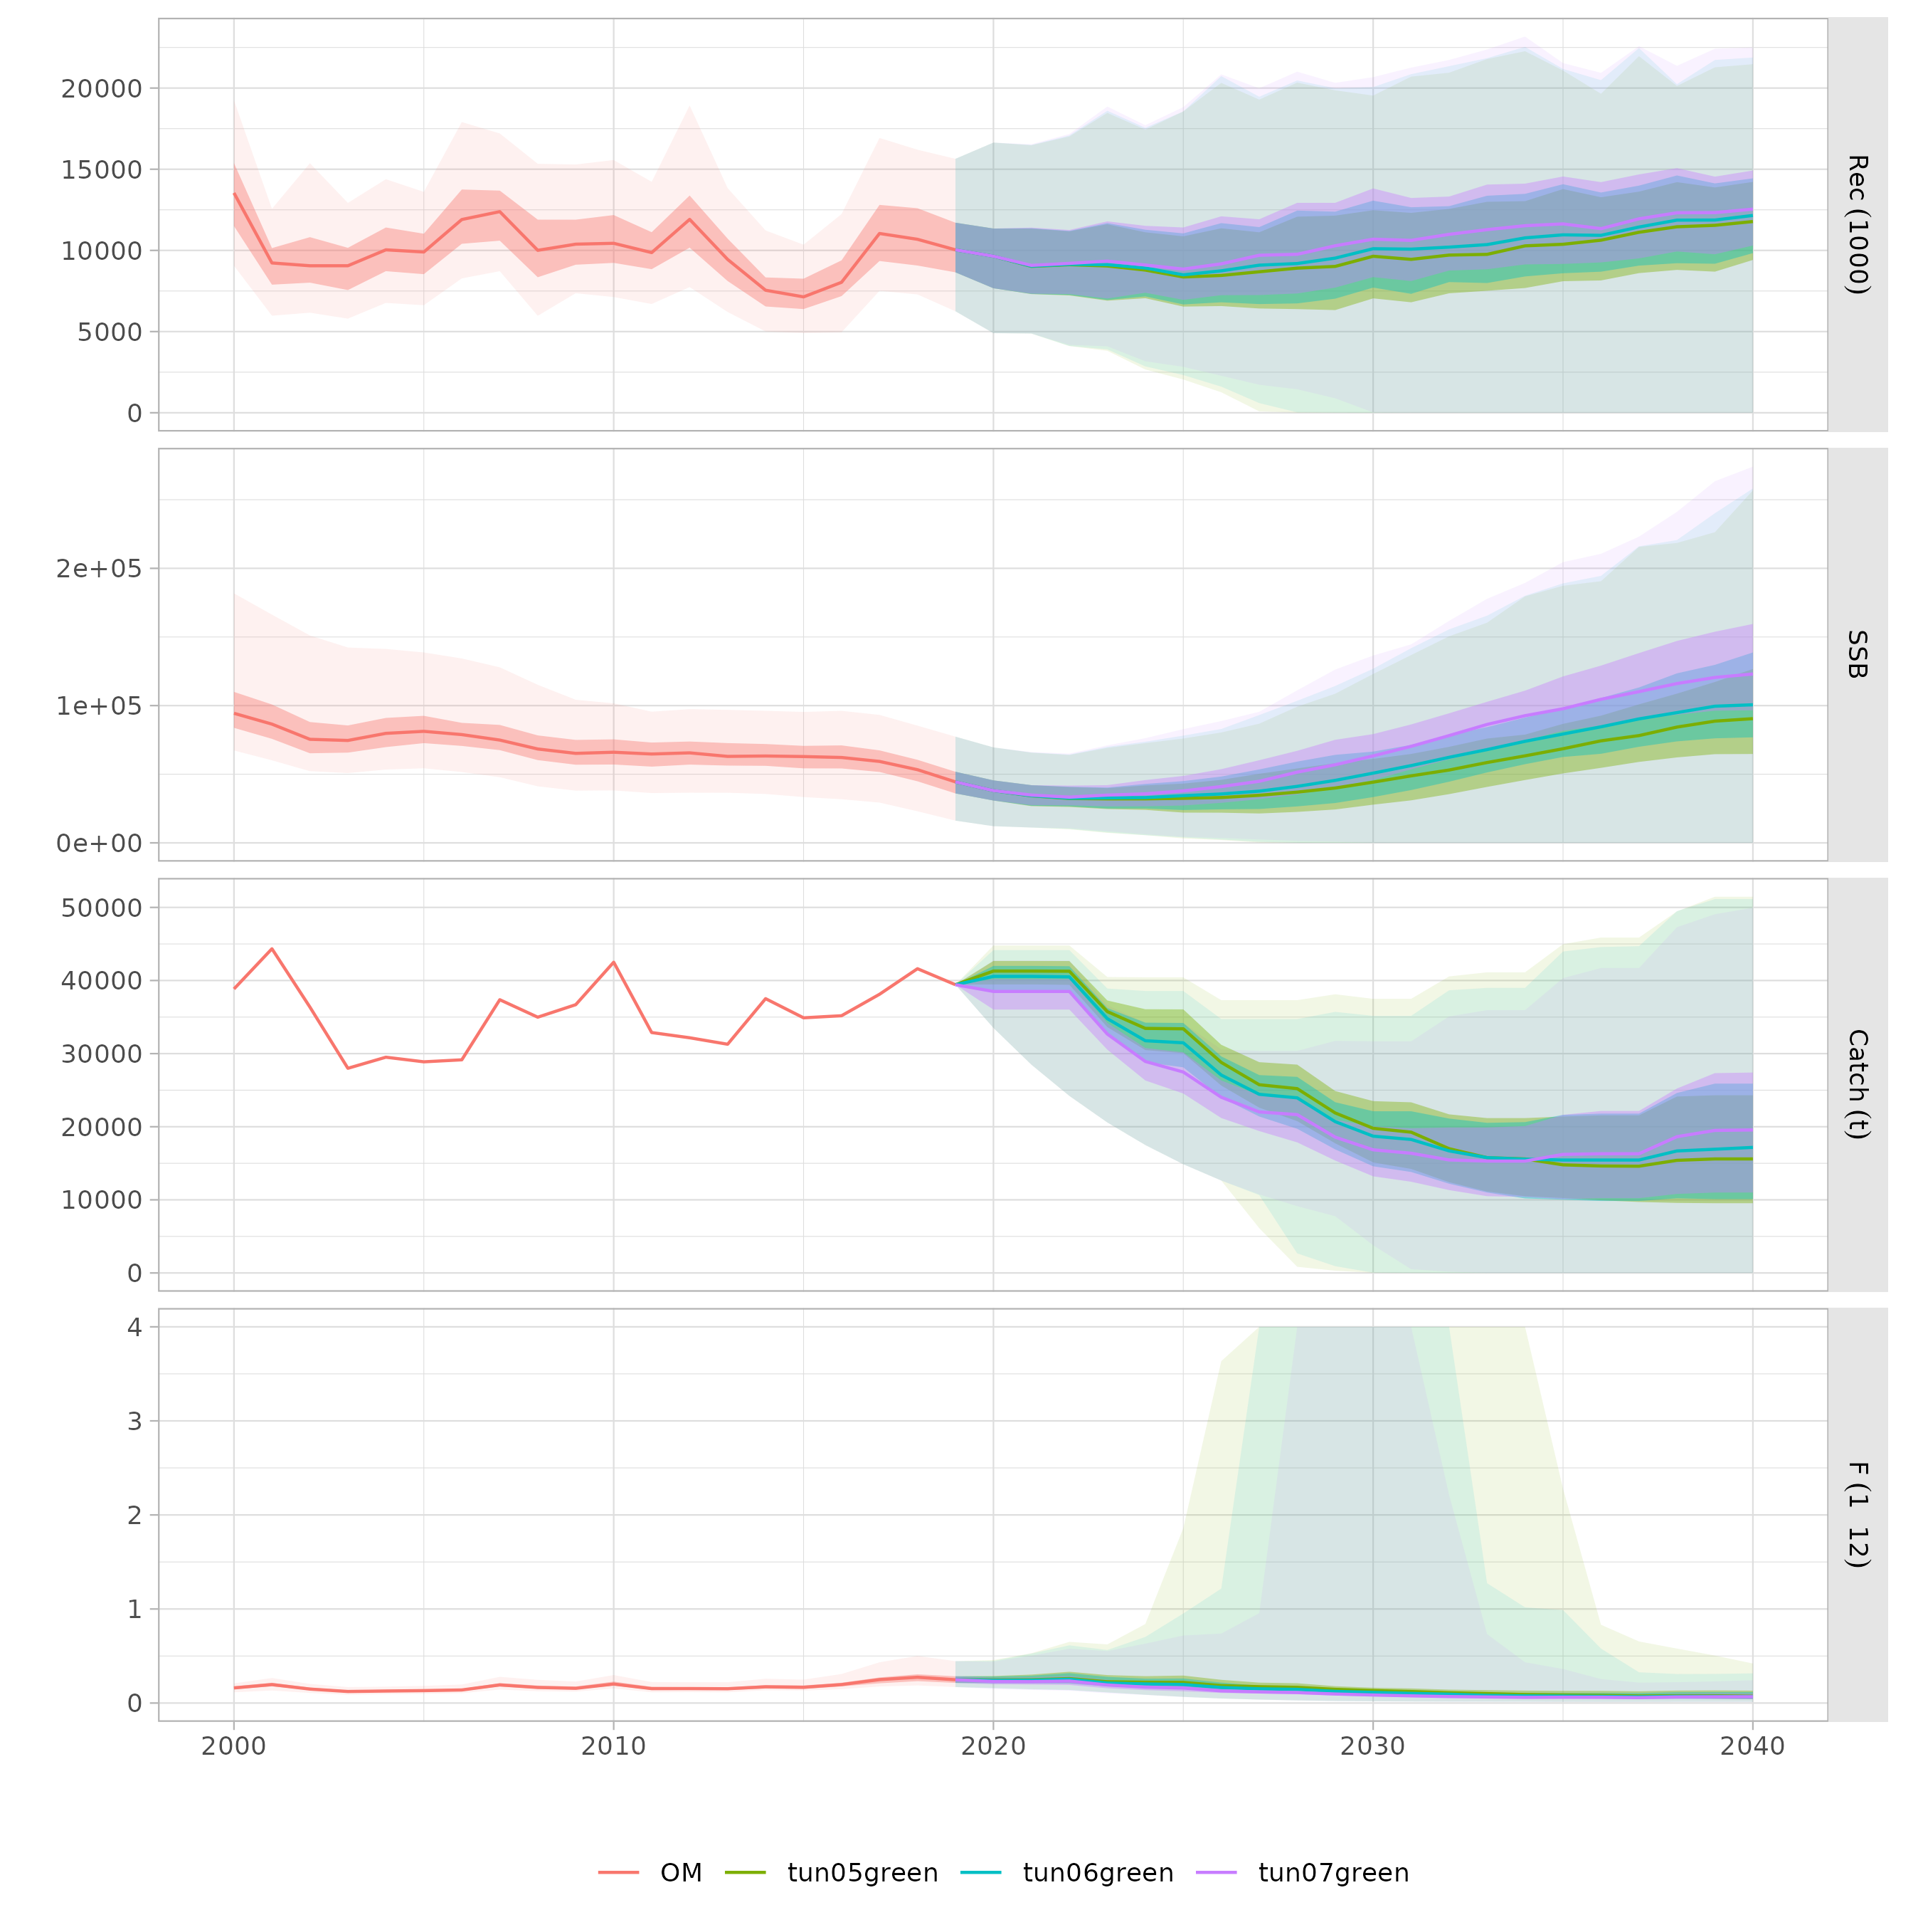
Tuning CPUE MP

Slide 19
Tests with perfect assessment: fixed F

Slide 20
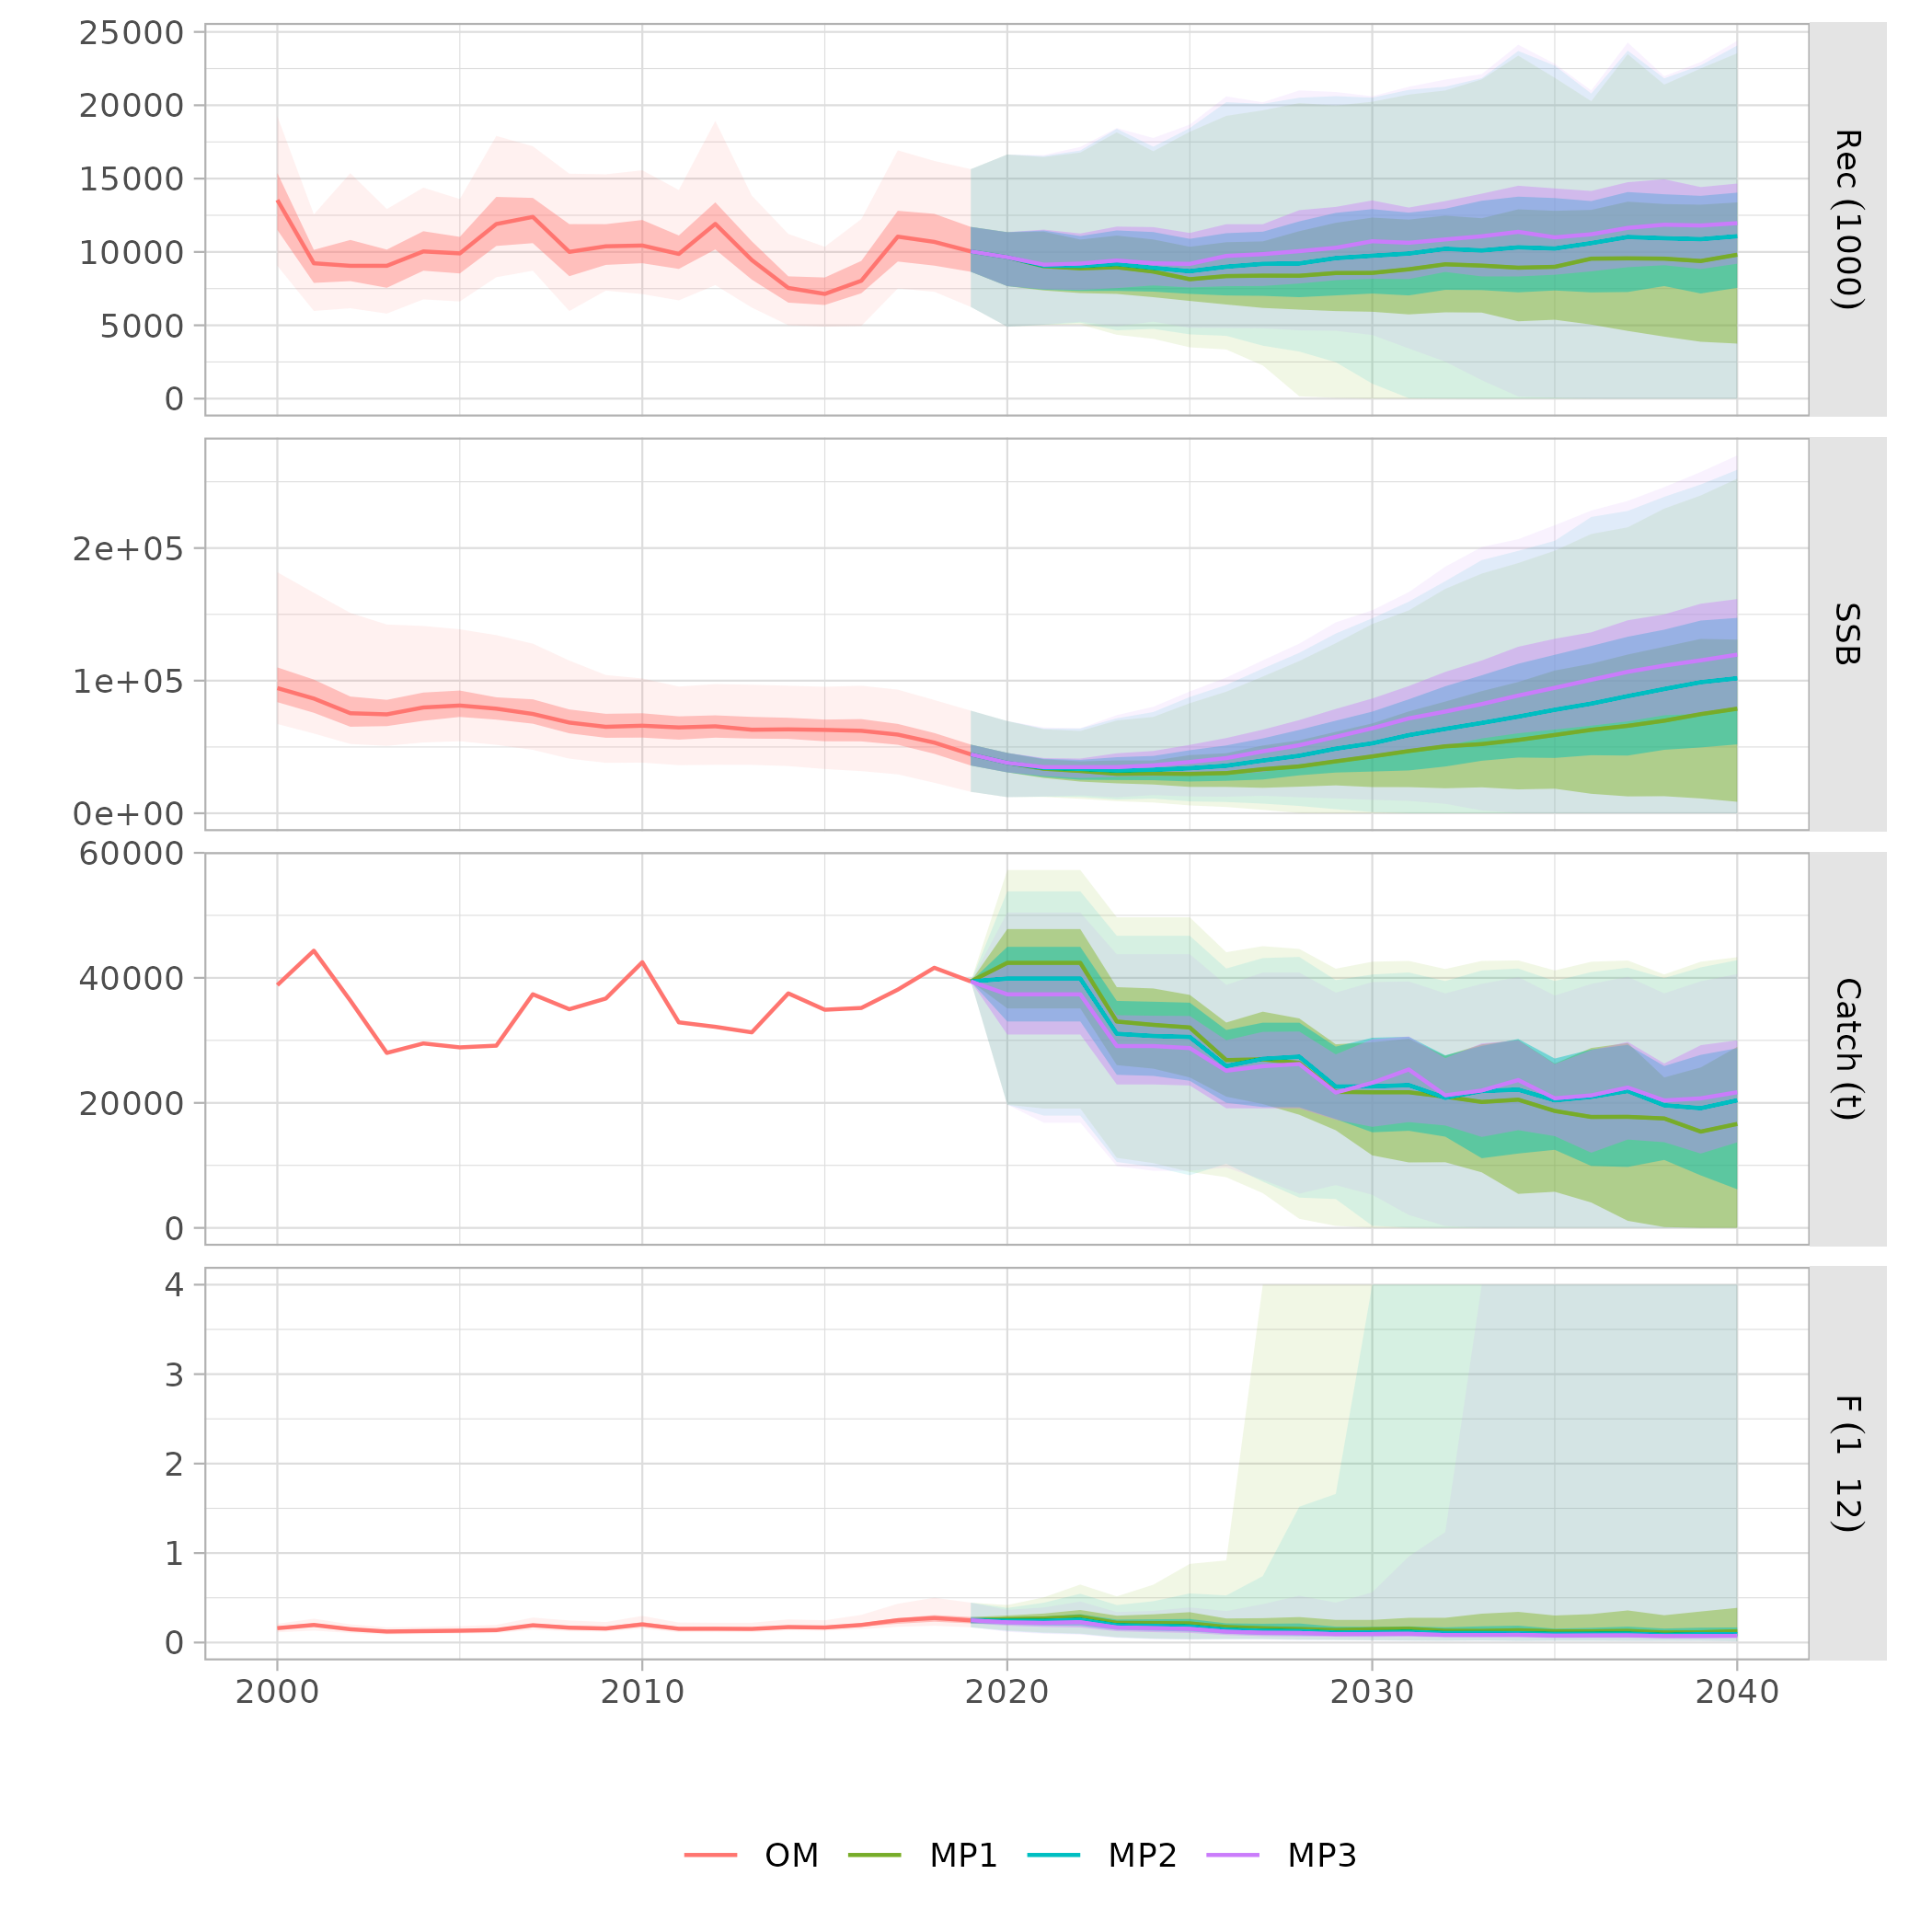
Tests with perfect assessment: catchSSB

Slide 21
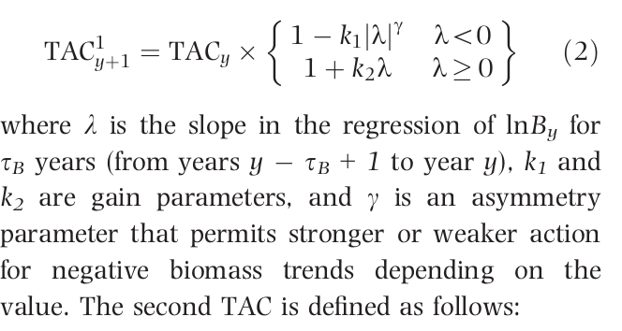
Trend HCR (CCSBT)

Slide 22
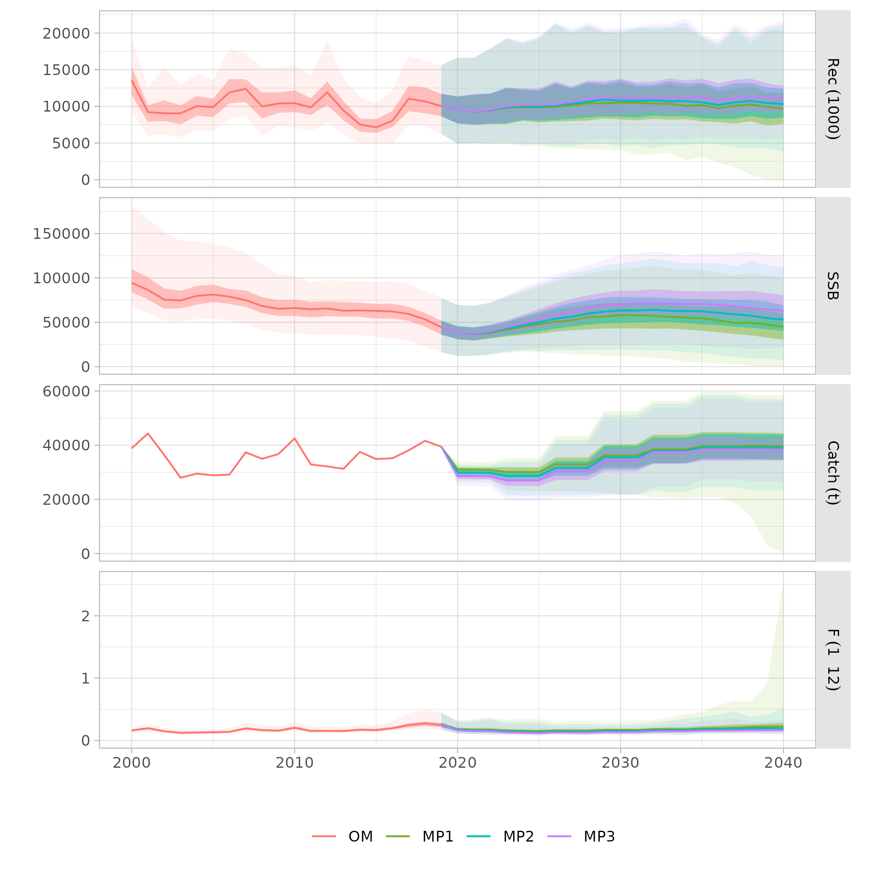
Tests with perfect assessment: trend

Slide 23
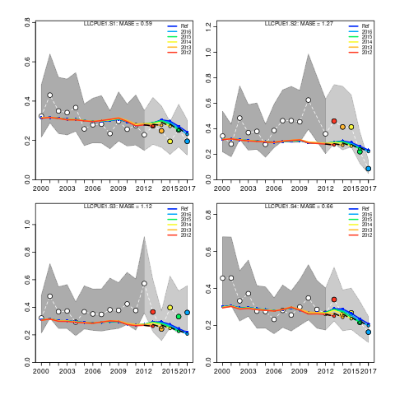
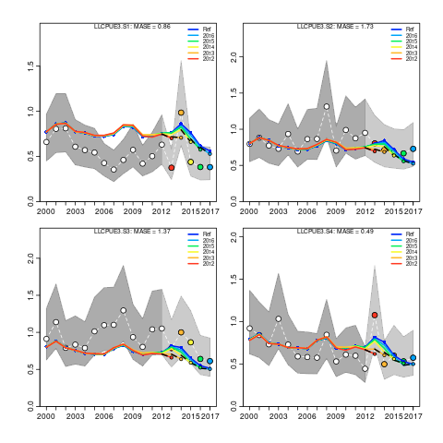
Surplus production MP: CPUEs

Slide 24
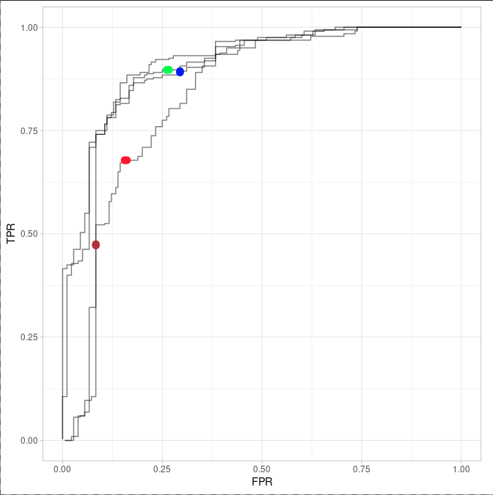
Surplus production MP: CPUEs

Slide 25
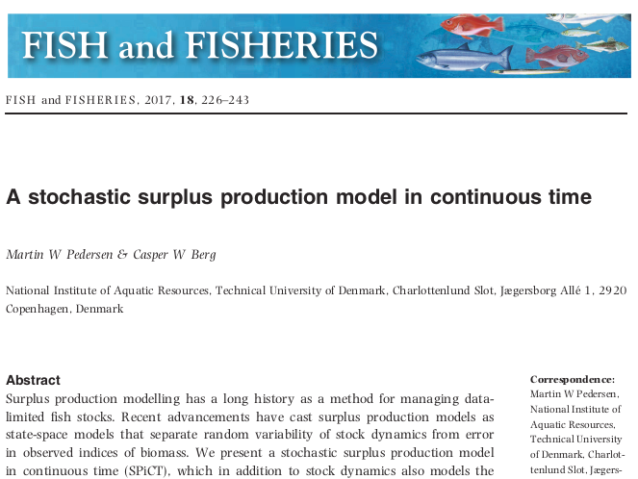
Surplus production MP: spict

Slide 26
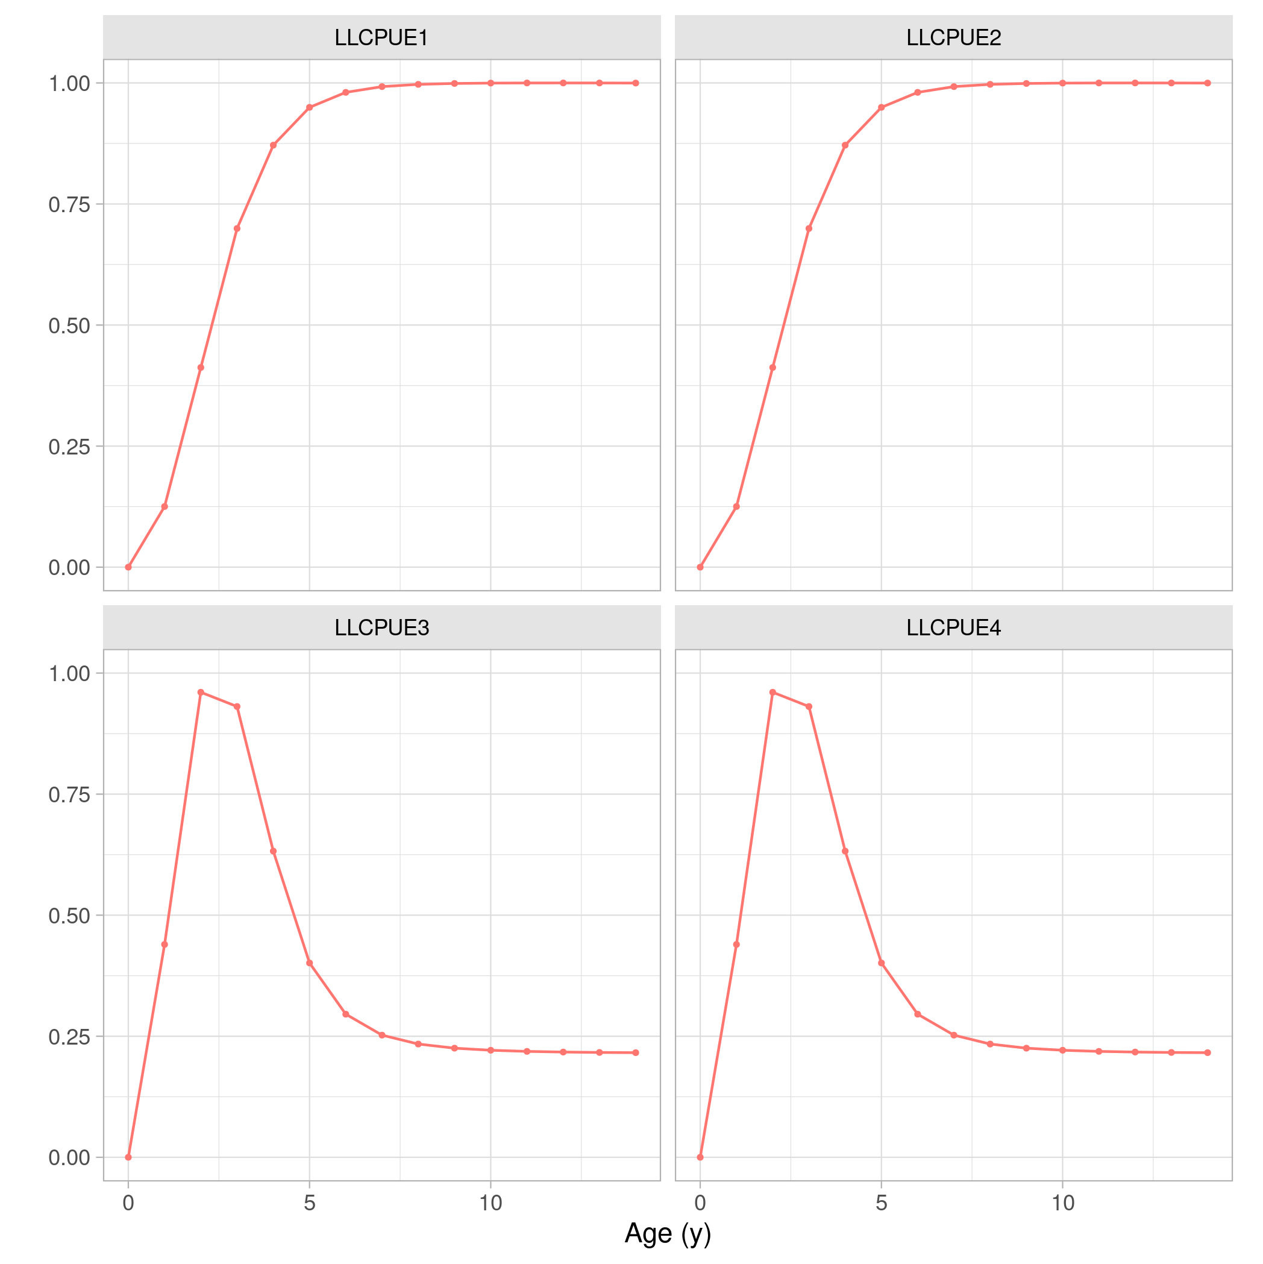
Surplus production MP: CPUEs

Slide 27
Summary
- OM based on 263 runs, large uncertainty.
- MPs based on LLCPUE 1 and LLCPUE3
- Initial runs of MPs indicate need of recovery phase.
- TCMP requests
- OM review, BUT WPTmT 2022
- data lag, not run yet but already doable.
- 15% TAC constraint
- Work delayed due to technical & staff issues.

Slide 28
Questions
- Single OM from such diverse views?
- WPTmT 2022 SA and OM reconditioning.
- Develop alternative OM (ABC), but not by TCMP 2022.
- Expected changes to ALB CPUEs and SA.
- Agreement on tunable HCR arguments.

Slide 29
Next steps
- Run all simulations for
- spict + catchSSB
- spict + trend
- spict + (catchSSB + trend)
- Alternative TAC limits, unequal up and down.
- Submit proposal for 2022-23 contract, ALB & SWO (October 2021)
- Delivery of simulations and platform (December 2021)
- End of contract (December 2021)

Slide 30
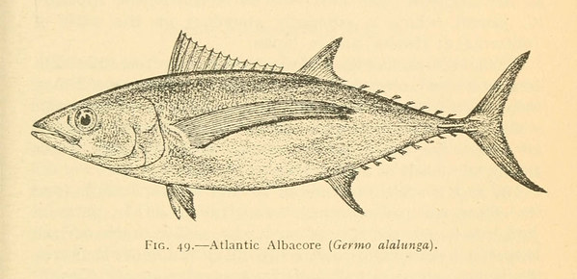
To explore
the potential
of nature to
improve the
quality of life

