Slide 1
Update on the conditioning of an operating model and initial MP testing for
Indian Ocean swordfish
Daniela Rosa†, Iago Mosqueira*, Dan Fu‡, Rui Coelho†
MSE task force
19-22 March 2019 Ispra, Italy
†Instituto Português do Mar e da Atmosfera (IPMA), Av. 5 de Outubro, 8700-305 Olhão, Portugal.
*European Commission, DG Joint Research Centre (JRC), Directorate D - Sustainable Resources, Unit D.02 Water and Marine Resources, Via E. Fermi 2749, 21027 Ispra VA, Italy. iago.mosqueira@ec.europa.eu
‡Indian Ocean Tuna Commission Secretariat, Le Chantier Mall (2nd floor), PO Box 1011, Victoria Mahé, Seychelles

Slide 2
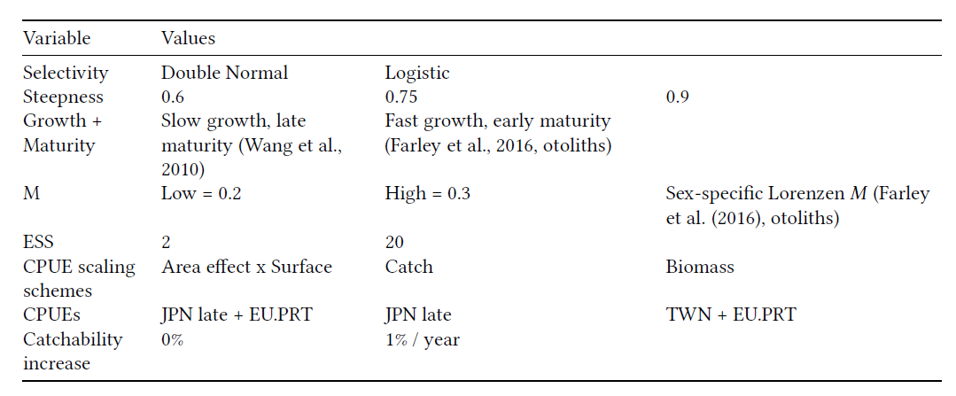
Operating Model Conditioning
An initial grid of model runs was constructed for the Indian Ocean Swordfish based on the initial set of options suggested by the WPM in 2017;
This resulted in a total of 2,592 model runs.

Slide 3
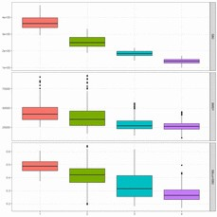
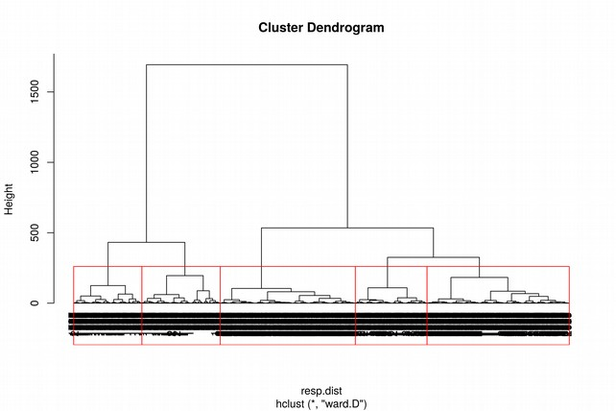
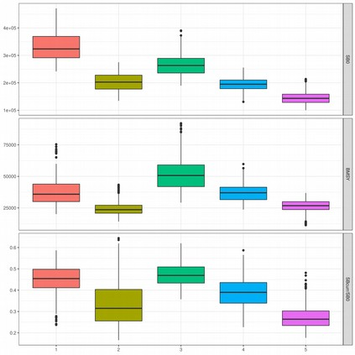
Model Inspection and Clustering
Of the 2592 models, 256 models did not converge – jittering resulted in all models converging.
2592 too demaning!!!!
To reduce the number of runs we did a cluster with SB0, SBMSY, SB2015 and BMSY as response variables.
Scaling all variables, using Eucledian distance and Ward method for clustering (any ideas?)

Slide 4
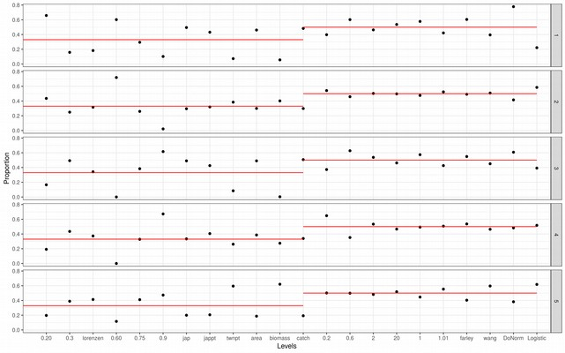
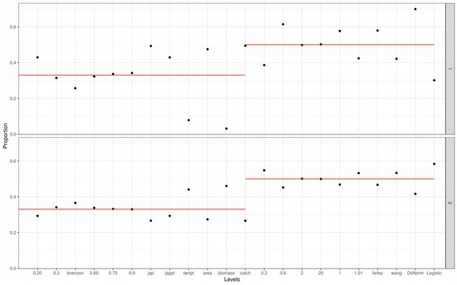
Model Inspection and Clustering
Which uncertanties are behid the clusters?
First 2 clusters are separating mostly runs with high vs low biomass – driven by cpue, scaling and selectivity curve choice
Then it is a combination of the previous factors and mortality and steepness

Slide 5
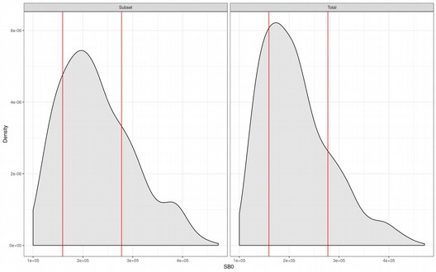
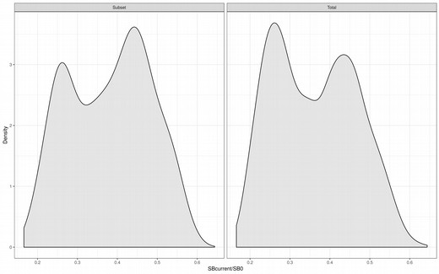
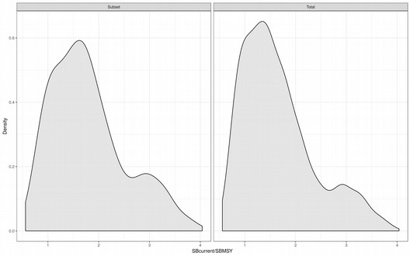
Model Inspection (all vs subset)
Based on the proposed 5 clusters, 100 models were subsetted from each cluster.
Take a look at outputs from the all the runs vs subset
SB0
SBcurr/SB0
SBcurr/SBMSY

Slide 6
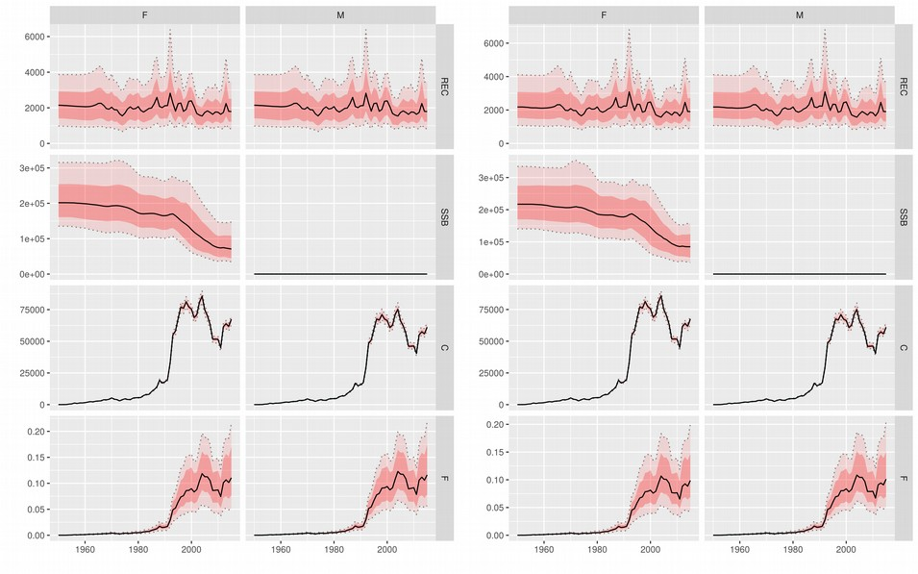
Population trajectories (all vs subset)

Slide 7
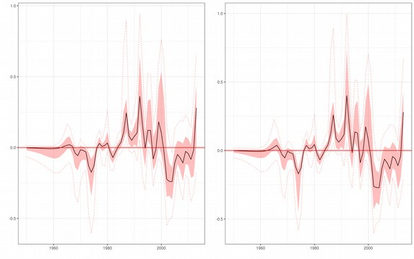
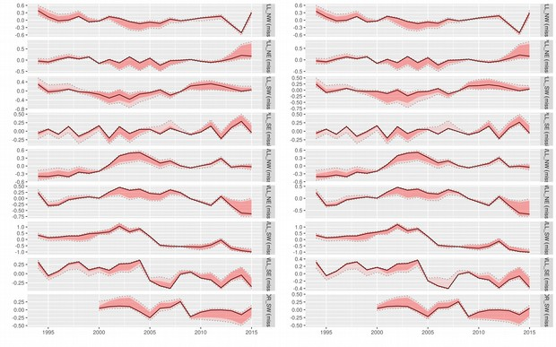
Model Inspection
Residual analysis
CPUE residuals
S-R residuals

Slide 8
Setting up projections
Initial exploratory runs were performed for 50 runs of the subsetted OM
Deviances in future SR relationship were sampled from a lognormal distribution taking into account autocorrelation in the SR residuals
Future CPUE
  Assessment model has 4 areas with different CPUEs
  For projections only one can be used…
  Tentatively, the series from the NE was rescaled for the whole Indian Ocean

Slide 9
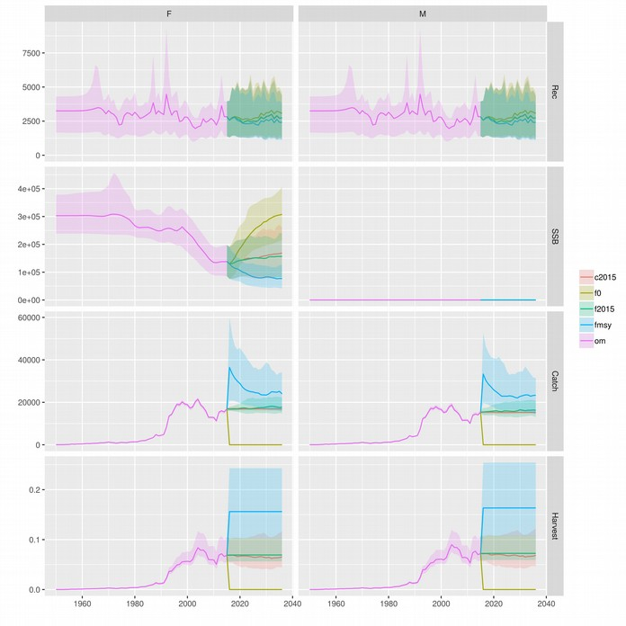
Initial projections
20 yrs projection
Projections for:
  F=0
  F=F2015
  F=FMSY
  Catch=Catch 2015

Slide 10
Initial projections – Management procedures
CPUE trend-based indicator to inform HCR
  target =1 (the response multiplier controlling how fast or slow is the rule to respond to changes in CPUE trend)
  Ny = 3 (number of years from last to use to fit the linear trend)
  dtaclow= 0.85 (lower limit to changes in TAC)
  dtacupp= 1.15 (upper limit to changes in TAC)
Biomass dynamic assessment to inform HCR with “perfect assessment”
  Dlimit =0.2 (the depletion level at which the fishery is closed)
  Dtarget=0.4 (the target depletion level)
  Lambda=1 (Default, multiplier for Dtarget)
  dtaclow= 0.85
  dtacupp= 1.15
  ssb_lag =1 (lag in data collection, number of years between last year of data and current)

Slide 11
Initial projections – Performance Metrics
Status
  S1: Mean spawner biomass relative to unfished, SB/SB[0]
  S2: Minimum spawner biomass relative to unfished, min(SB/SB[0]
  S3: Mean spawnwer biomass relative to SBMSY, SB/SB[MSY]
  S4: Mean fishing mortality relative to target, F/F[target]
  S5: Mean fishing mortality relative to FMSY, F/F[MSY]
  S6: Probability of being in Kobe green quadrant, P(Green)
  S7: Probability of being in Kobe red quadrant, P(Red)
  S8: Probability of SB greater/equal than SBMSY, P(SB >= SB[MSY])
Fishing mortality
  F1: Probability of spawner biomass being above 20 SB[0], P(SB > 0.20 %% SB[0])*
  F2: Probability of spawner biomass being above SBlim, P(SB > SB[lim])

Slide 12
Initial projections – Performance Metrics
Yield
  Y1: Mean catch over years (1000 t), hat(C), 1000 t
  Y3: Mean proportion of MSY, C/MSY
Abundance
  T1: Mean absolute proportional change in catch, var(C)
Stability
  T2: Catch variability, CV(C)
  T3: Variance in fishing mortality, var(F)
  T4: Probability of fishery shutdown, P(catch < 0.1 %% MSY)

Slide 13
Initial projections – Tunning
Tunning objectives
    TA1: Pr(mean(SB)>=SB(MSY)) = 0.5.
    TA2: Pr(Kobe green zone) = 0.5.
    TA3: Pr(Kobe green zone) = 0.6.
    TA4: Pr(Kobe green zone) = 0.7.
Performance computation period
    Over the entire projection period
    Over the last 10 years of the projection period

Slide 14
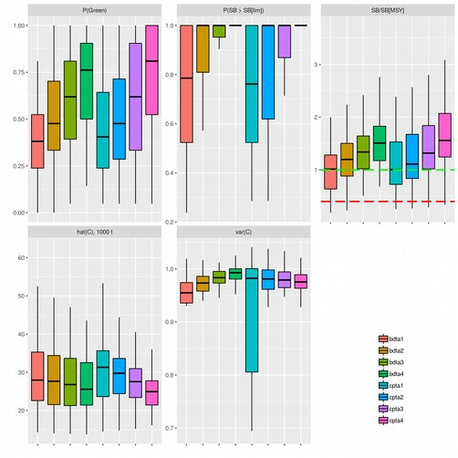
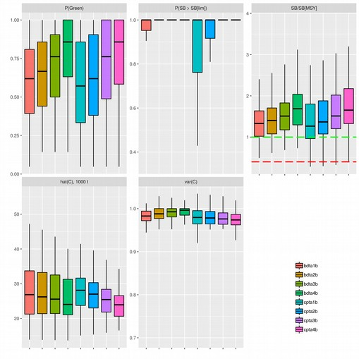
Initial projections – Boxplots
Computation period - 20 years
Computation period - 10 years

Slide 15
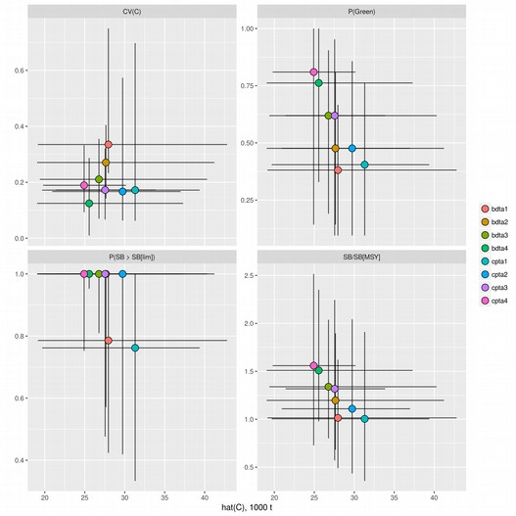
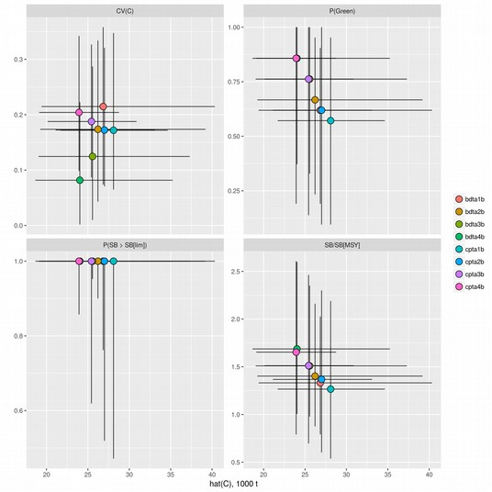
Initial projections – Trade-offs
Computation period - 20 years
Computation period - 10 years

Slide 16
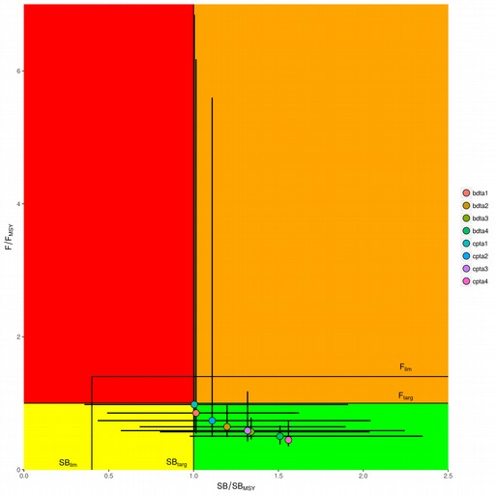
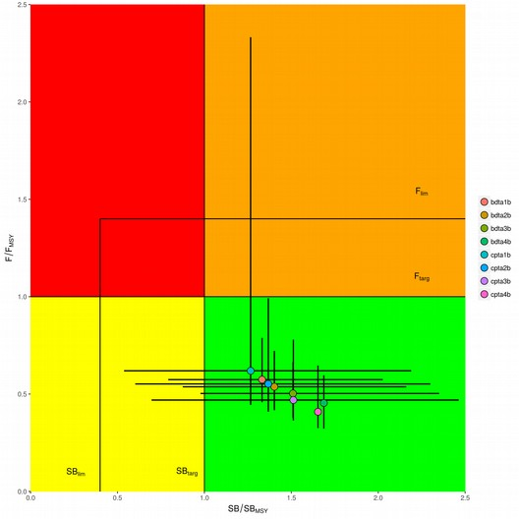
Initial projections – Kobe plot
Computation period - 20 years
Computation period - 10 years

Slide 17
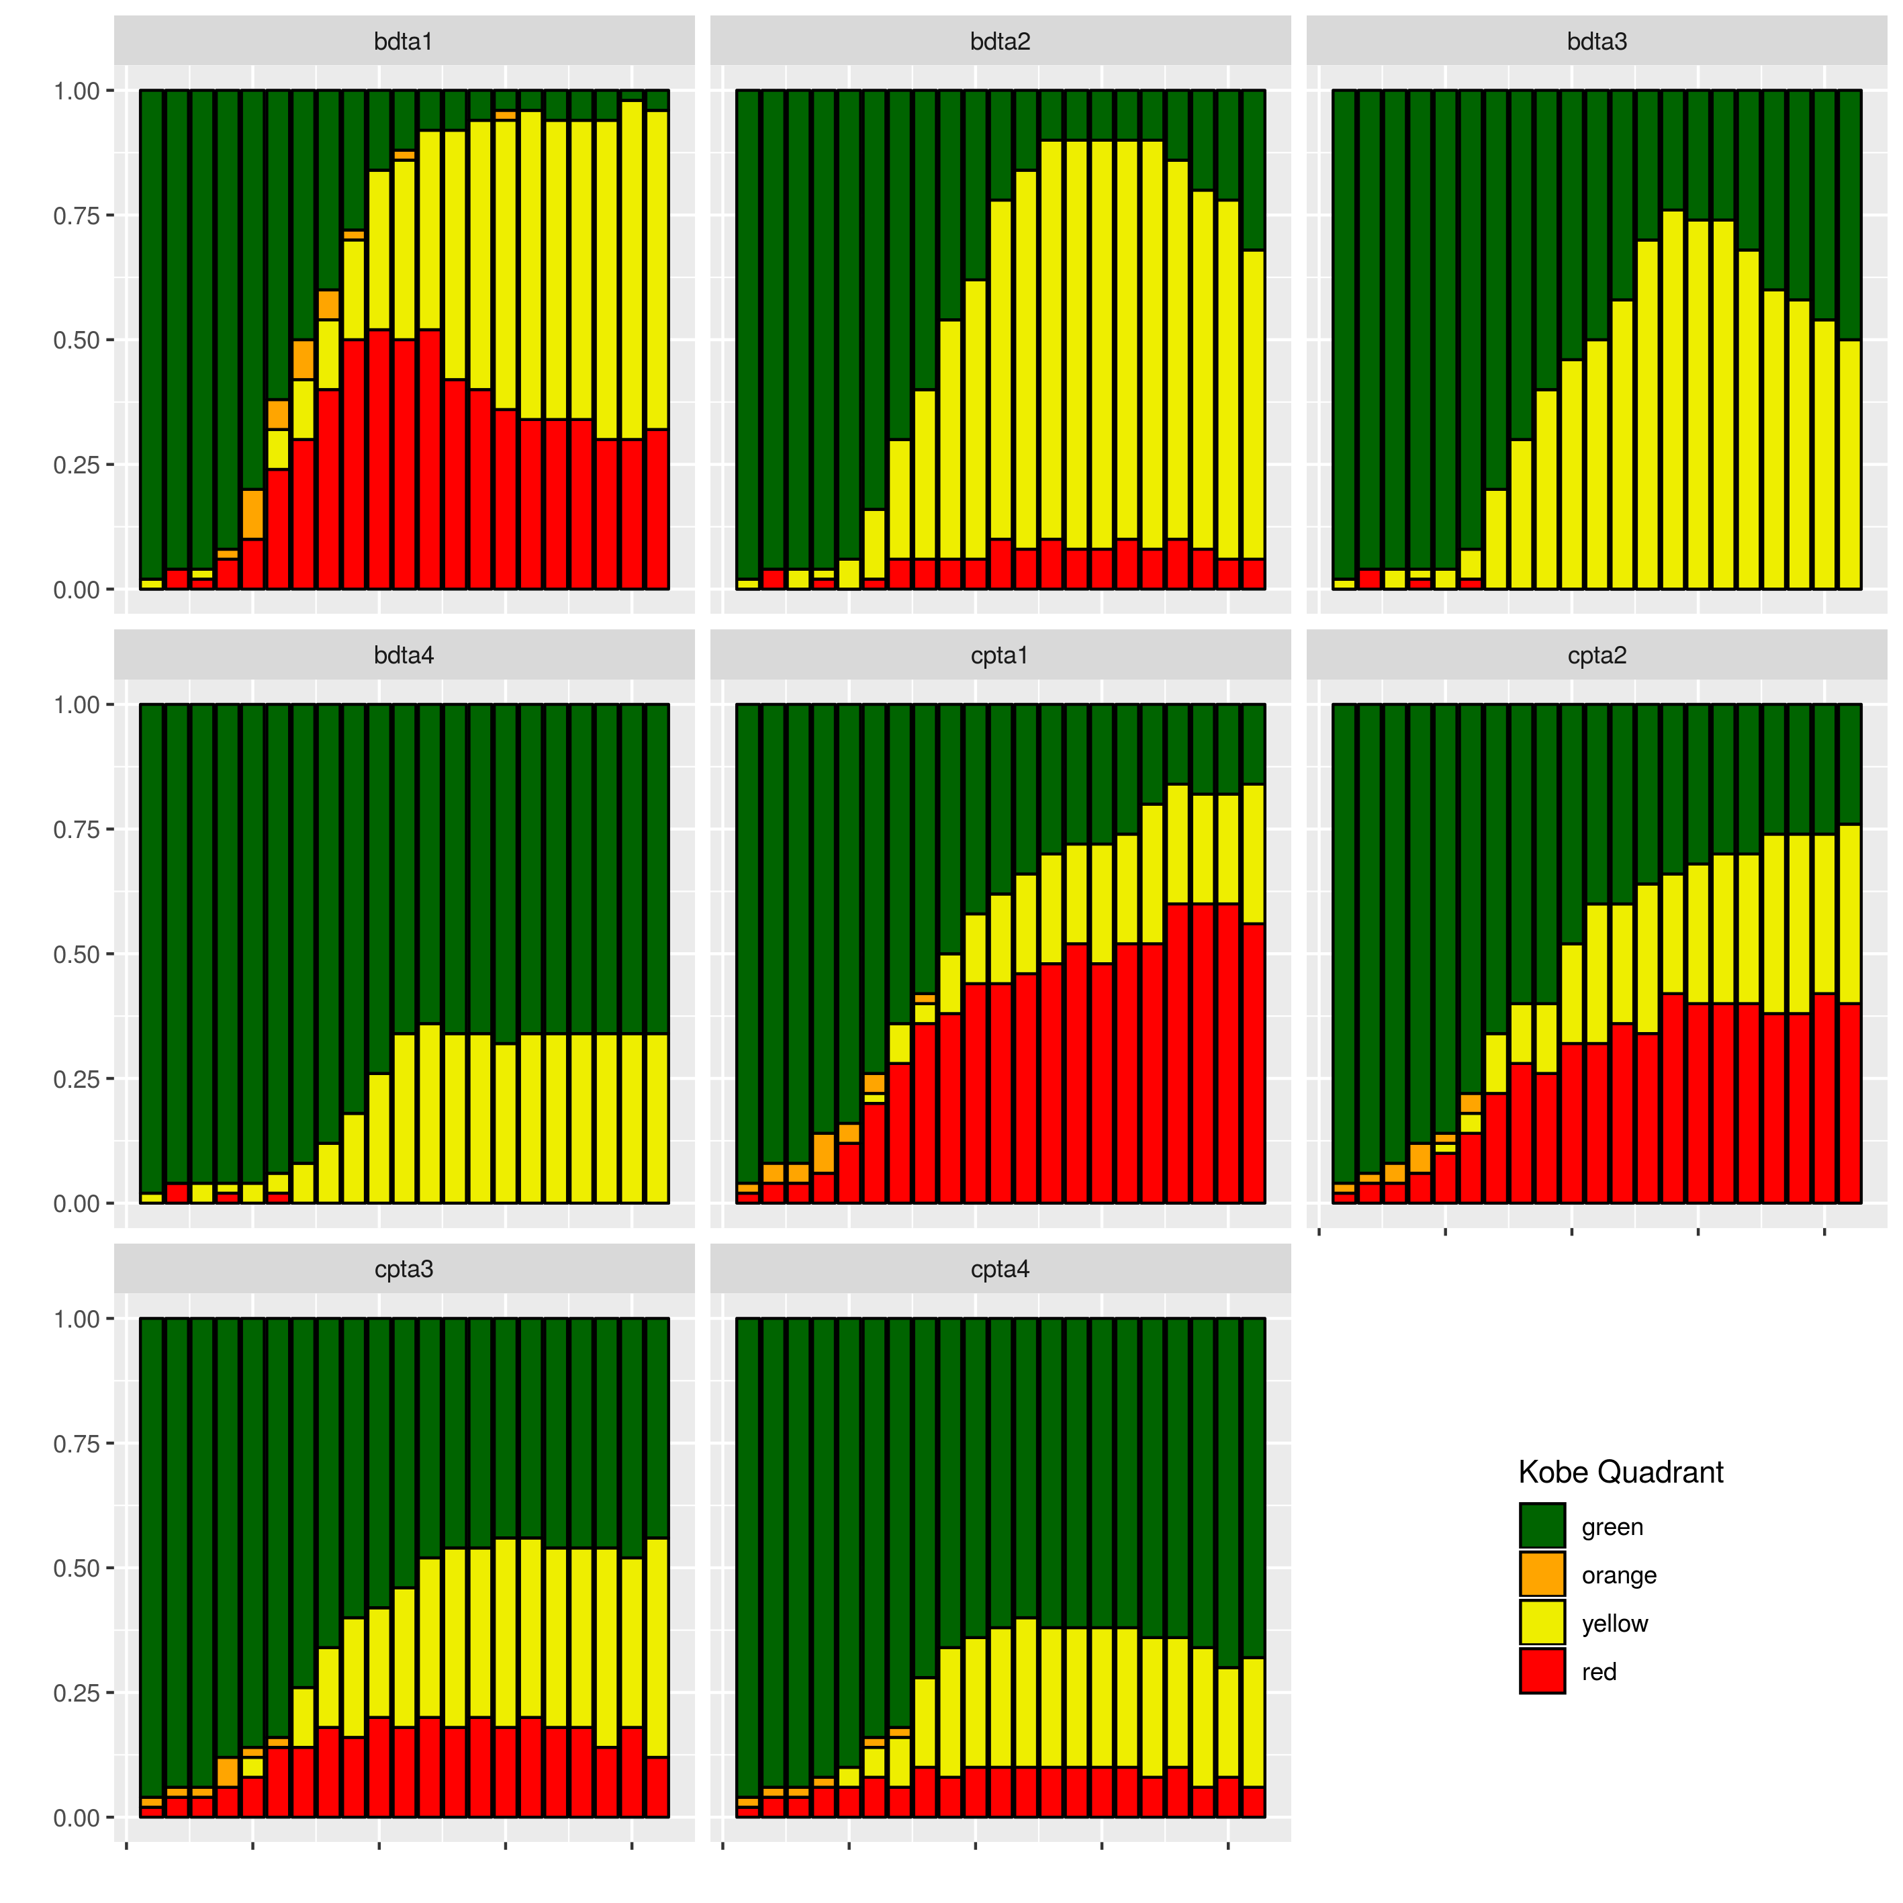
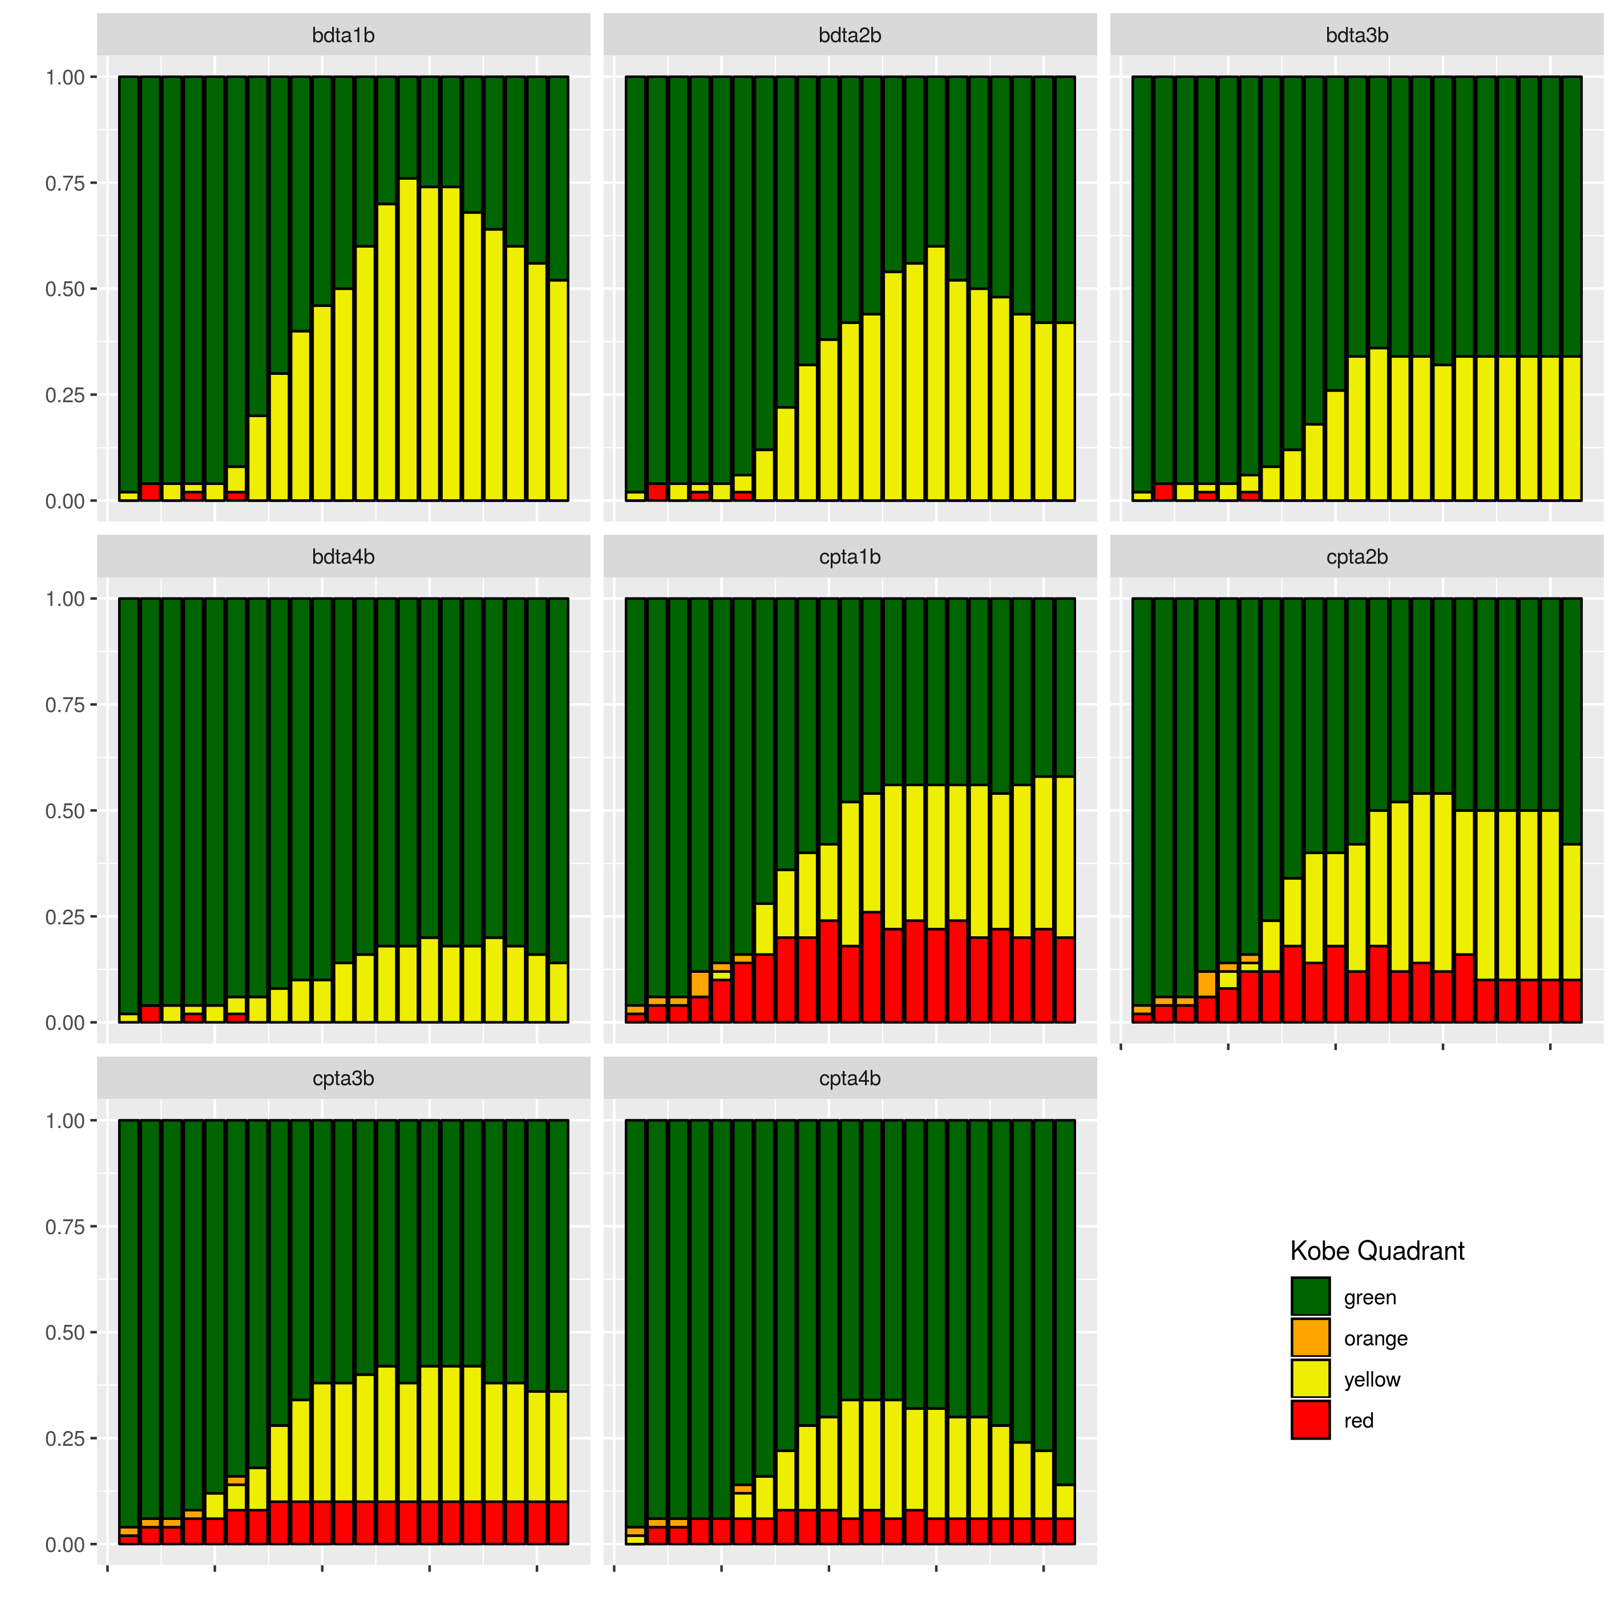
Initial projections – Kobe time series
Computation period - 20 years
Computation period - 10 years

Slide 18
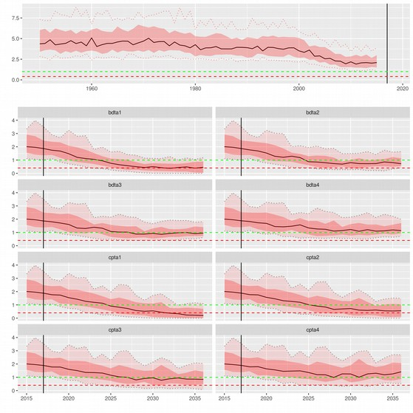
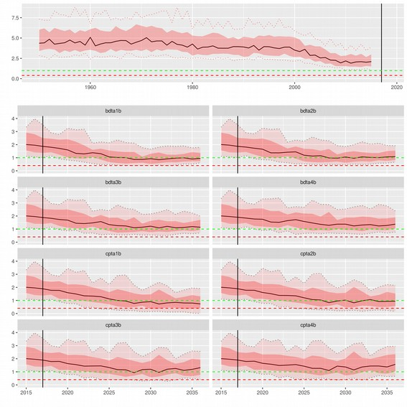
Initial projections – SB/SBMSY trajectories
Computation period - 20 years
Computation period - 10 years

Slide 19
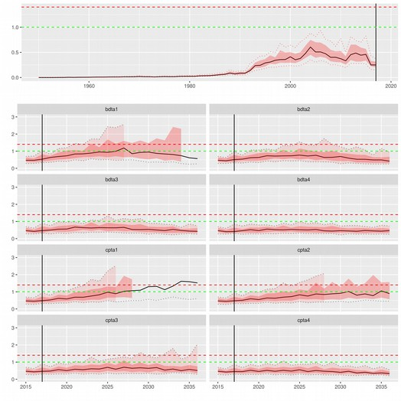
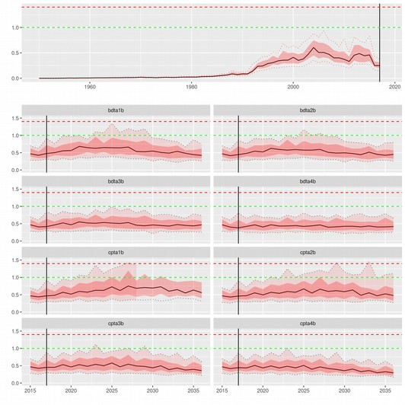
Initial projections – F/FMSY trajectories
Computation period - 20 years
Computation period - 10 years

Slide 20
Next steps and discussion points
Cluster analysis
CPUE spatial structure
SR deviances
Robustness tests

Slide 21
Acknowledgements
Thank you to IOTC for funding my last two weeks working here in JRC with Iago.
Thank you to ISSF for funding me and Rui to participate in this meeting.

