Slide 1
Update of the operating model for
Indian Ocean swordfish
Daniela Rosa†, Dan Fu‡, Rui Coelho†, Iago Mosqueira*
MSE task force of the WPM
1-5 March 2021, online
†Instituto Português do Mar e da Atmosfera (IPMA), Av. 5 de Outubro, 8700-305 Olhão, Portugal
*Wageningen Marine Research. Haringkade 1, Postbus 68, 1976CP, IJmuiden, The Netherlands
‡Indian Ocean Tuna Commission Secretariat, Le Chantier Mall (2nd floor), PO Box 1011, Victoria Mahé, Seychelles

Slide 2
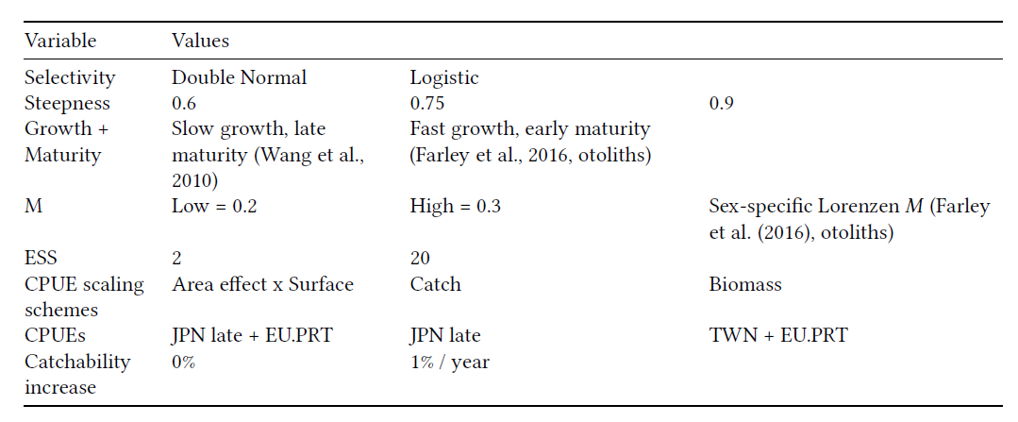
Current Operating Model
An initial grid of model runs was constructed for the Indian Ocean Swordfish based on the 2017 initial set of options suggested by the WPM in 2017;
This resulted in a total of 2,592 model runs.

Slide 3
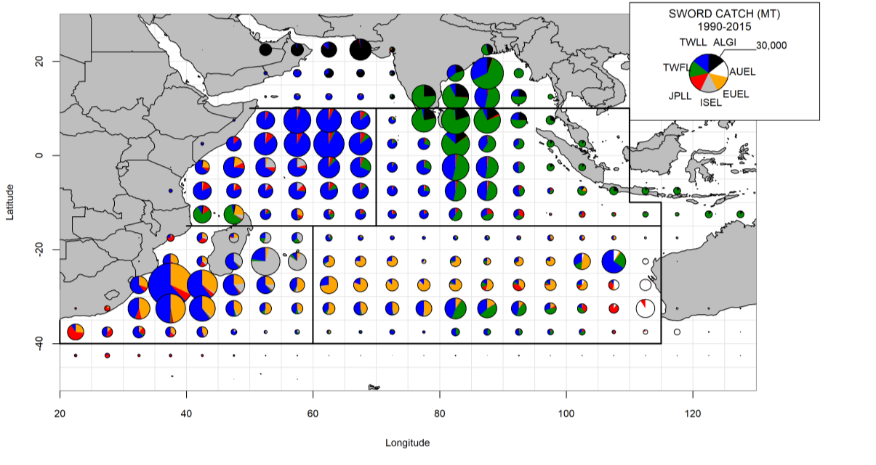
2020 Stock Assessment
Update and revison of the 2017 Stock Synthesis model;
Age-based (with ages 0-30), sex explicit, partitioned into four areas
Period of 1950-2018
Information on 15 fisheries, defined by fleet and region
  Final model uses 3 CPUEs (Japan 4 areas,
  SW - Portugal and South Africa)
  Length compositions data
  are available for 14 fisheries
Fu, 2020 - IOTC-2020-WPB18-16
IOTC, 2020 - IOTC-2020-WPB18-RE

Slide 4
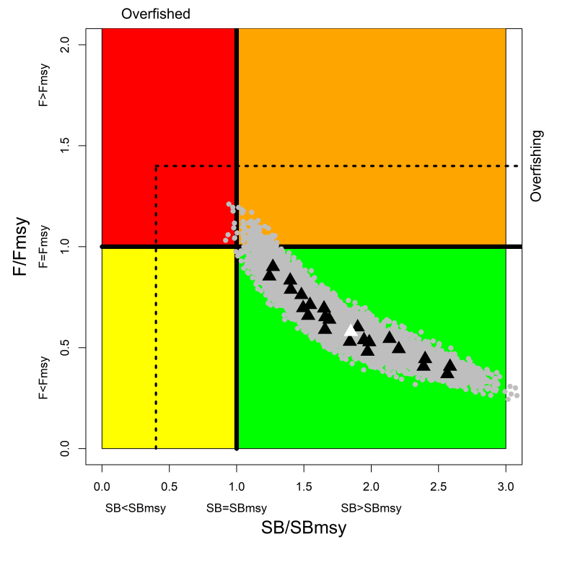
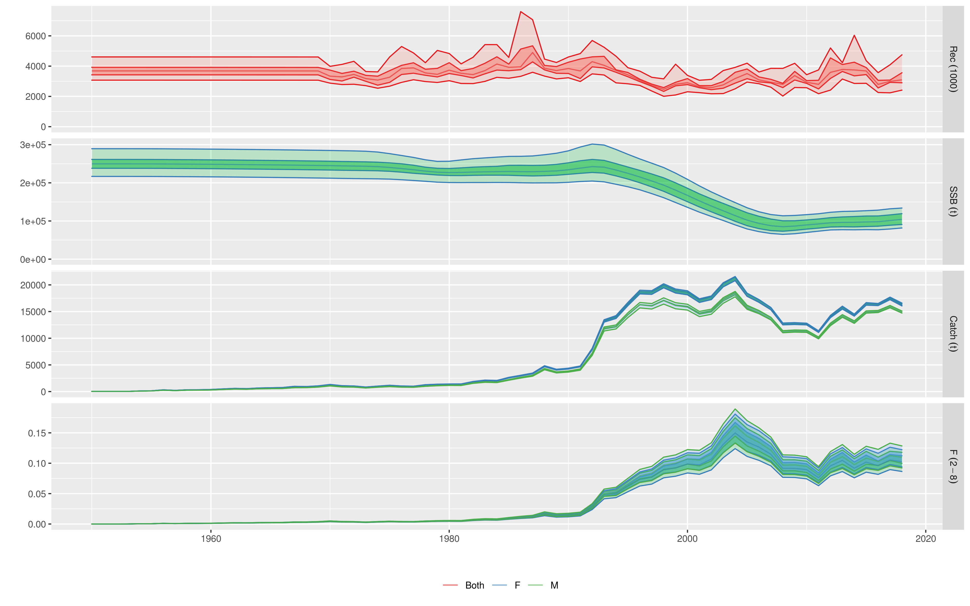
2020 Stock Assessment
Final assessment models based on an ensemble of 24 models:
  Steepness: 0.7/0.8/.09
  Growth: Farley et al., 2016/Wang et al., 2010
  SigmaR: 0.2/0.4
  ESS: 5/20
Fu, 2020 - IOTC-2020-WPB18-16
IOTC, 2020 - IOTC-2020-WPB18-RE

Slide 5
Base Case
M=0.25;
h=0.8;
SigmaR= 0.2;
Growth&Mat: Farley et al., 2016,
ESS=5;
CPUE= JPNlate+PRT;
Scaling= biomass,
Selectivity= Double normal for longlines
Turned-off: South Africa CPUE
First iteration – did not converge; jittered → convergence

Slide 6
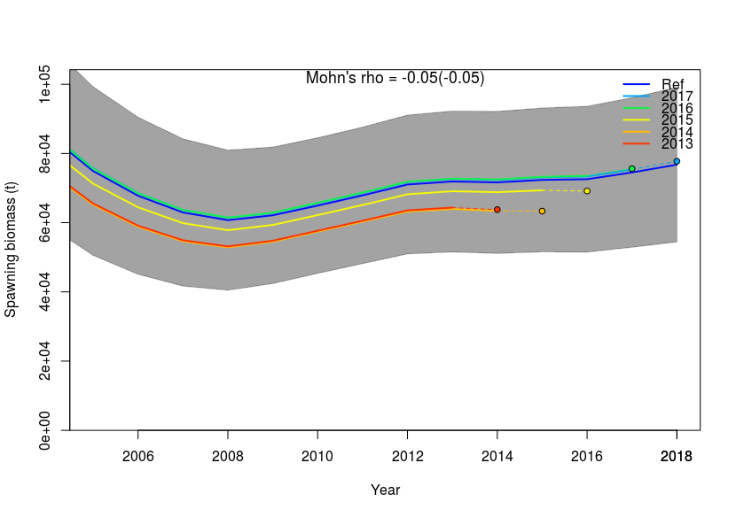
Model diagnostics: Retrospective analysis

Slide 7
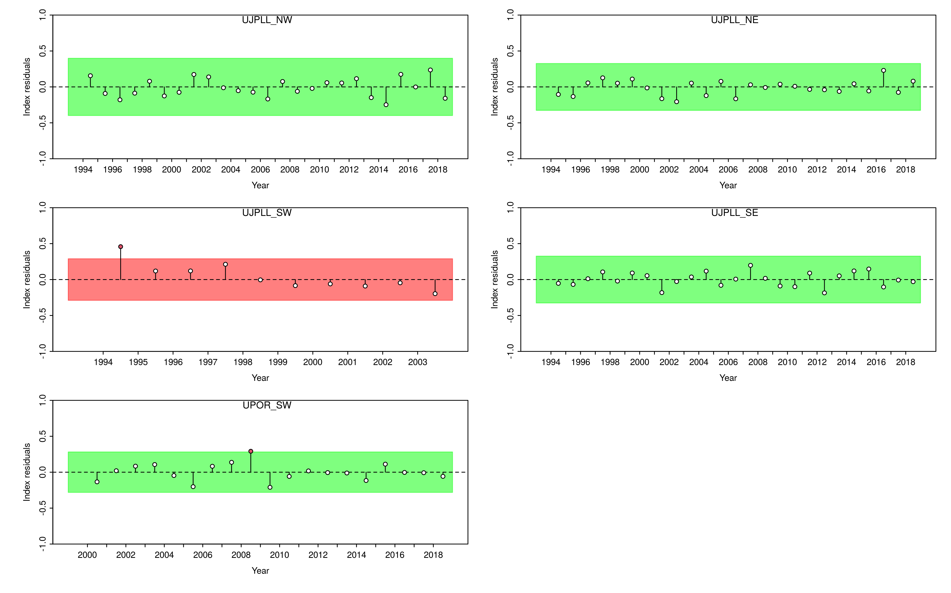
Model diagnostics: CPUE runs test

Slide 8
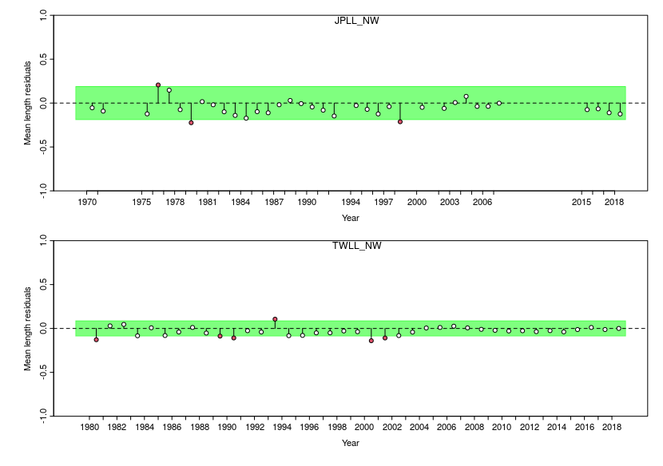
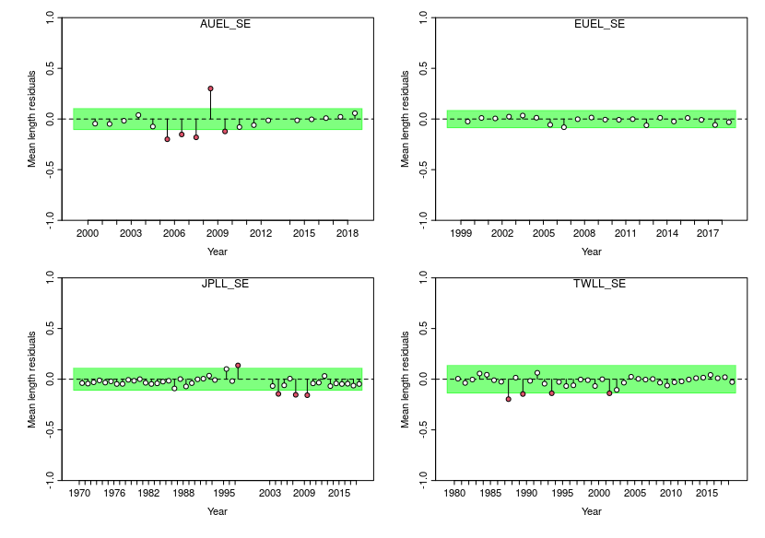
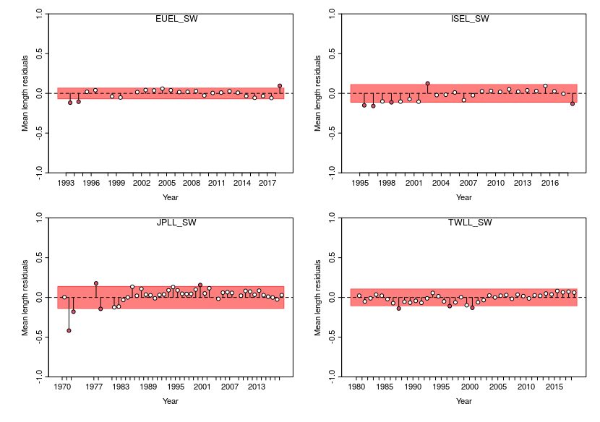
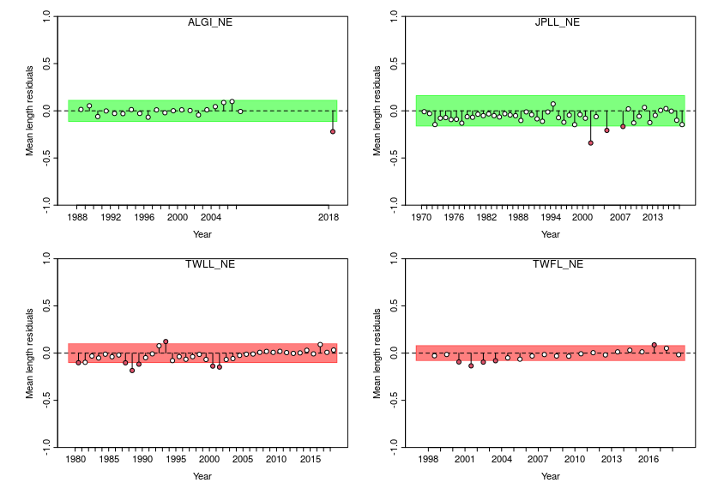
Model diagnostics: Length frequency runs test

Slide 9
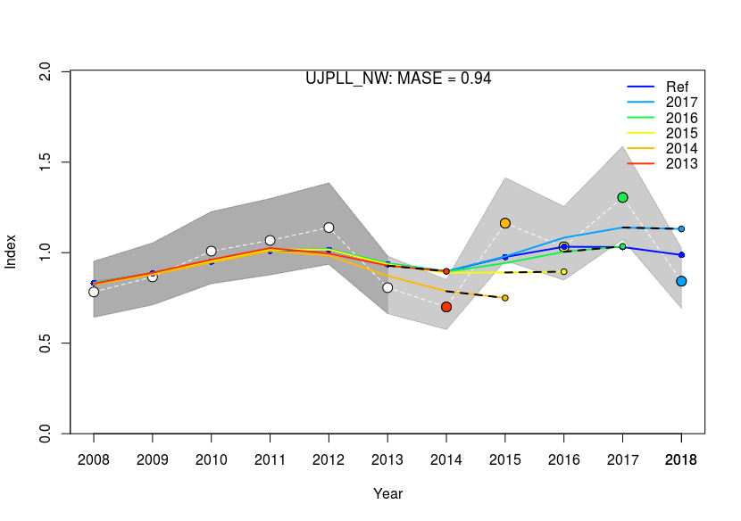
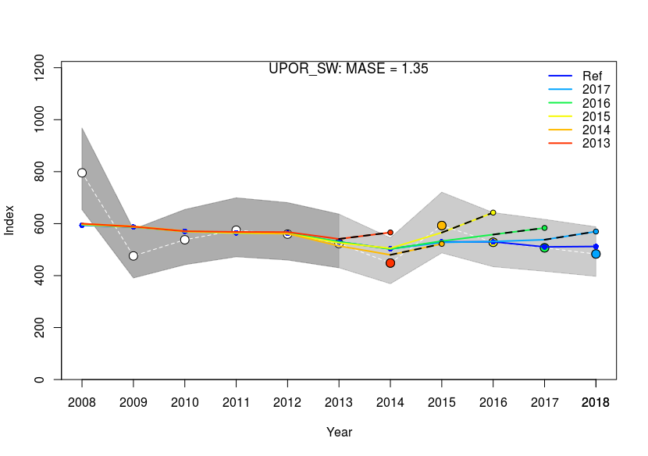
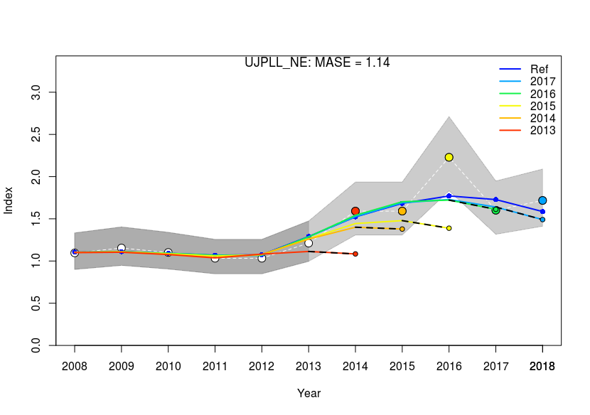
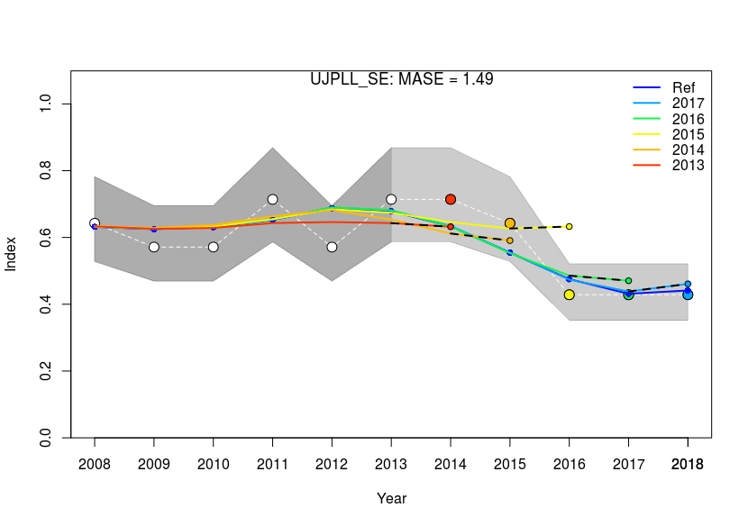
Model diagnostics: Hindcast cross validation

Slide 10
Main effects
M=0.2, 0.3, Lorenzen
h=0.6, 0.75, 0.9
SigmaR= 0.2, 0.6
Growth&Mat= Farley et al., 2016, Wang et al., 2010
ESS=2,20
CPUE= JPNlate+PRT, JPNlate, TWNlate+PRT
Scaling= biomass, catch (region?), area
Selectivity= Double normal, Logistic
One by one change to the “base model” model with current grid (16 models)
  Non convergence in several models – had to be jittered

Slide 11
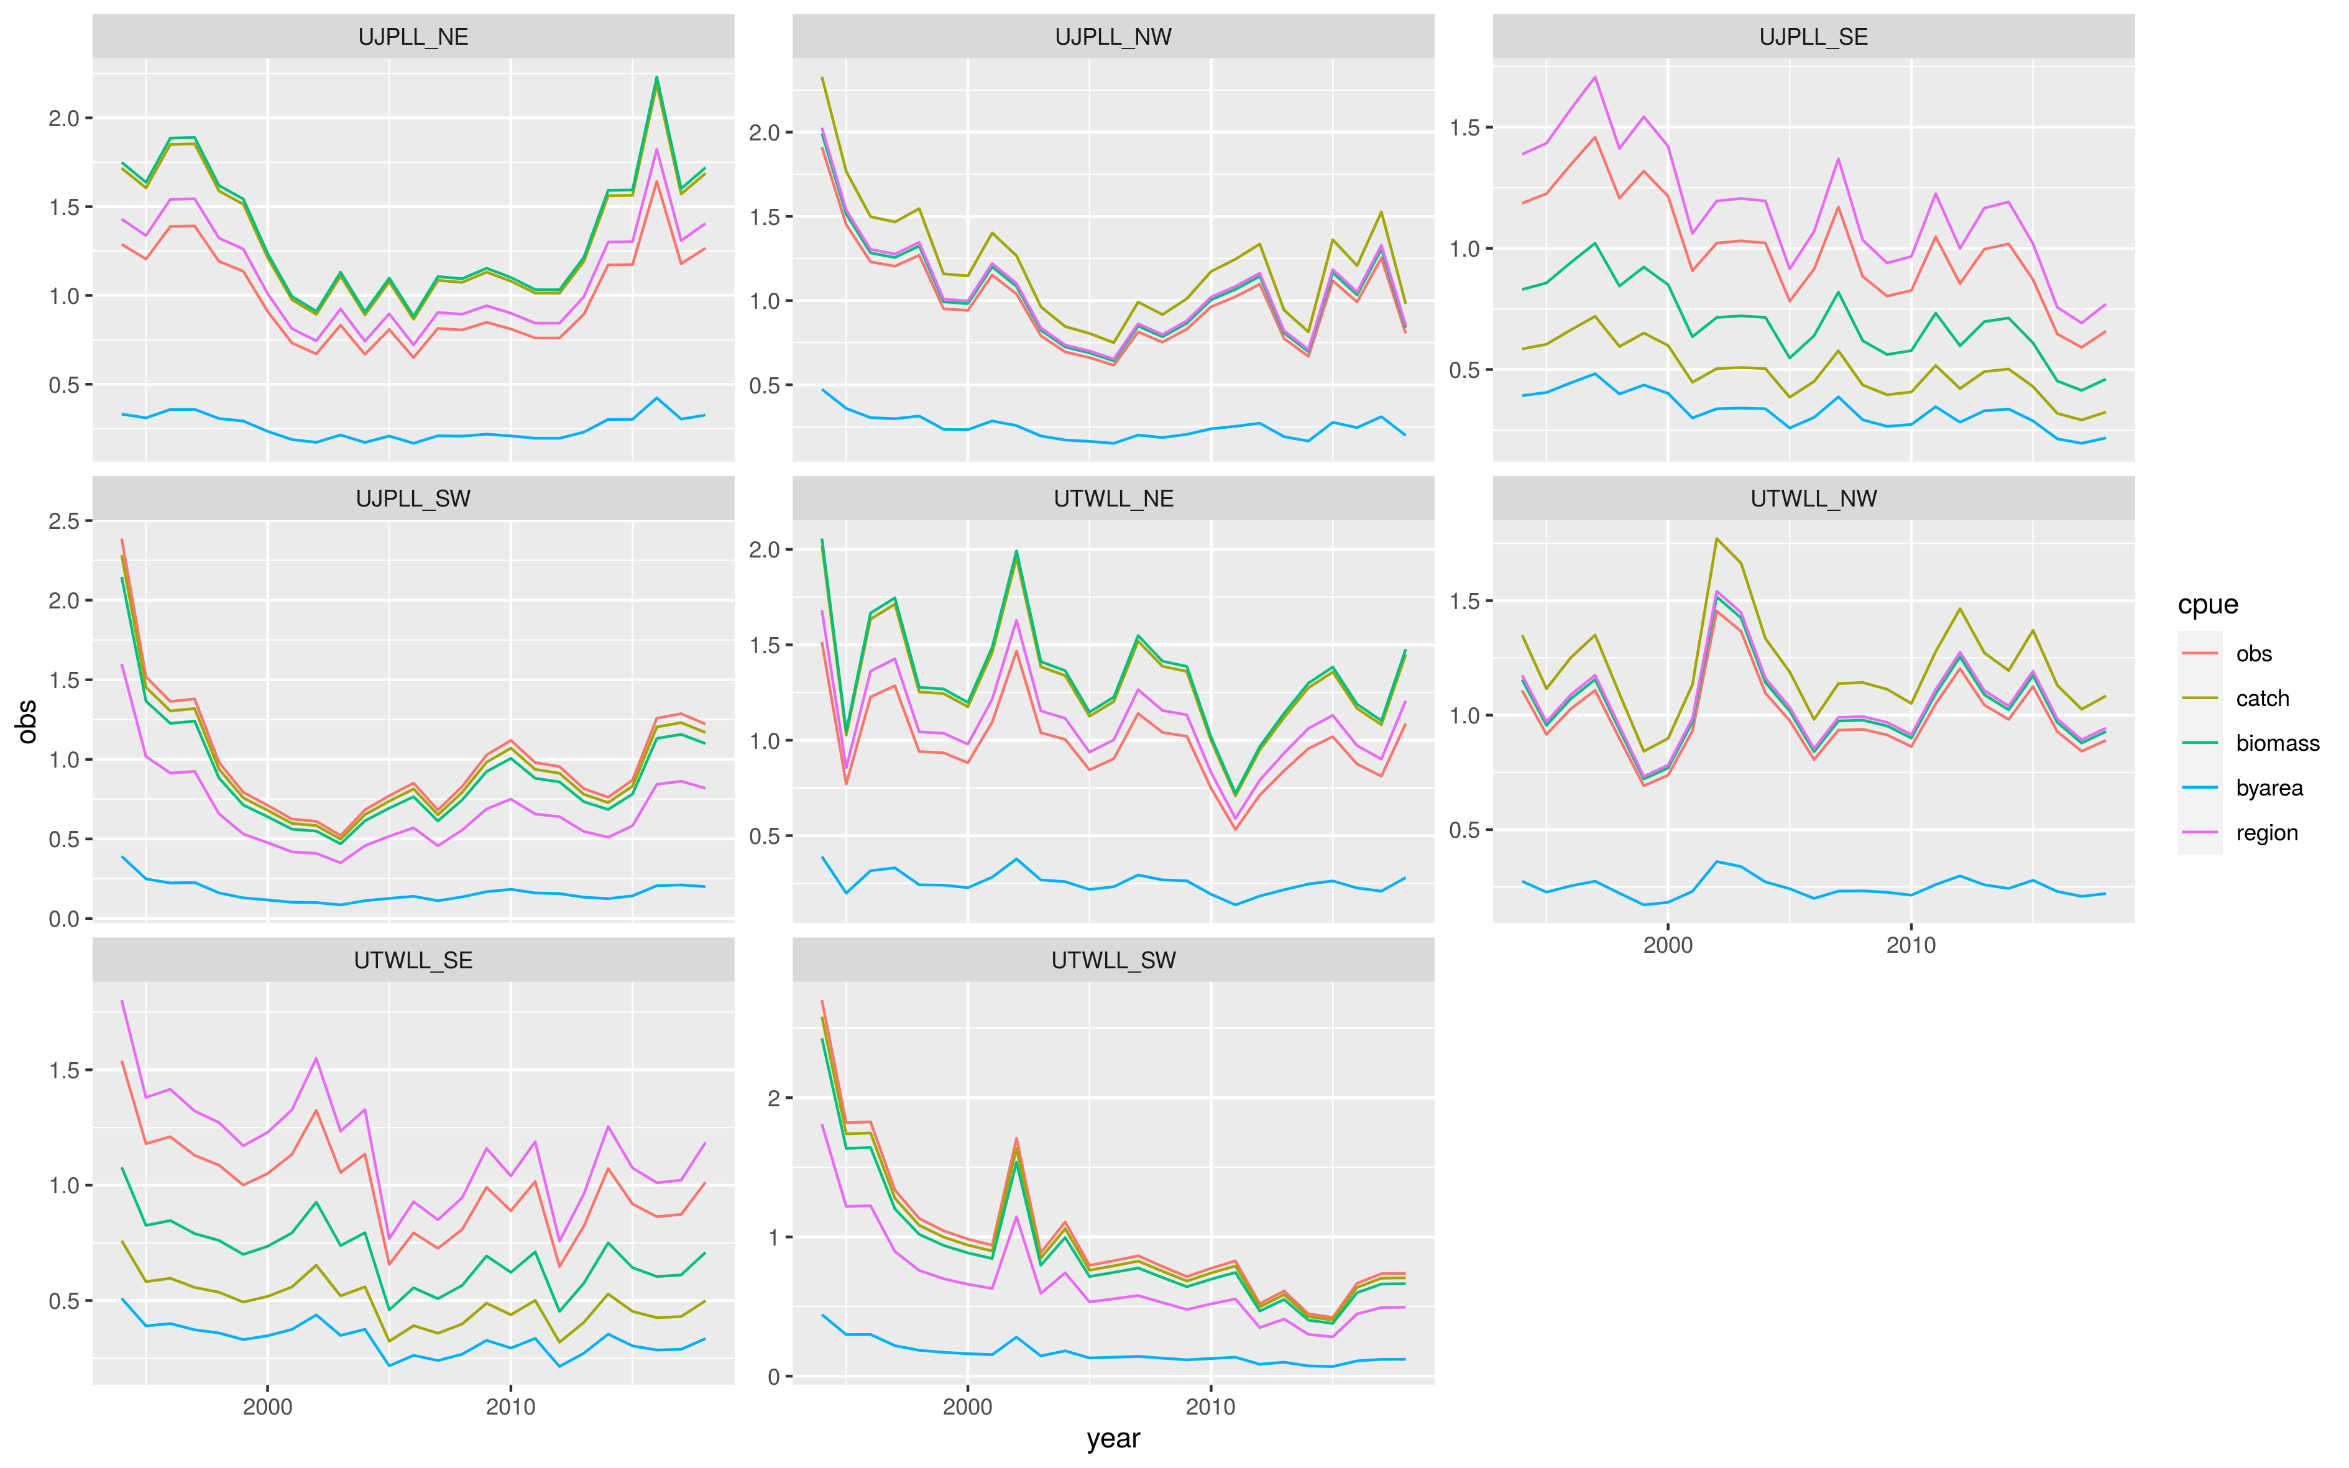
CPUE scaling

Slide 12
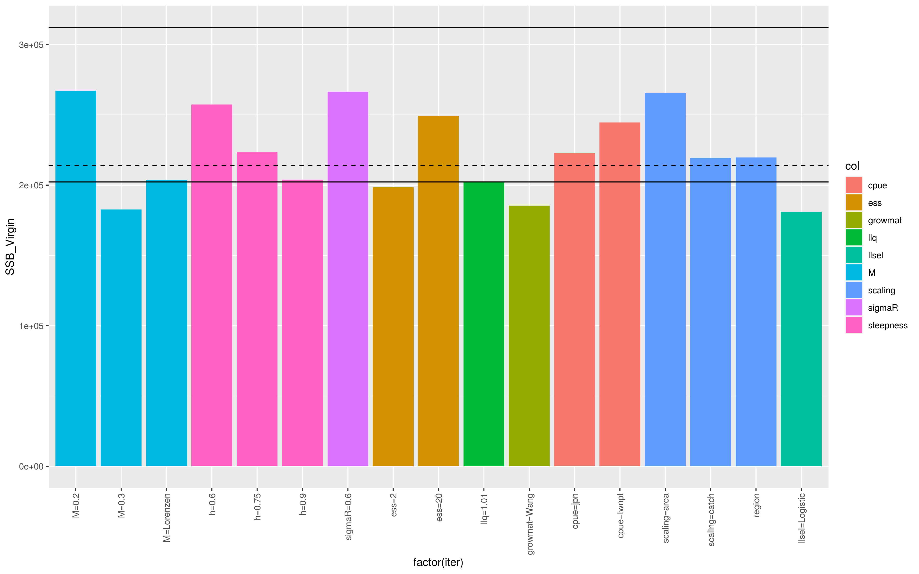
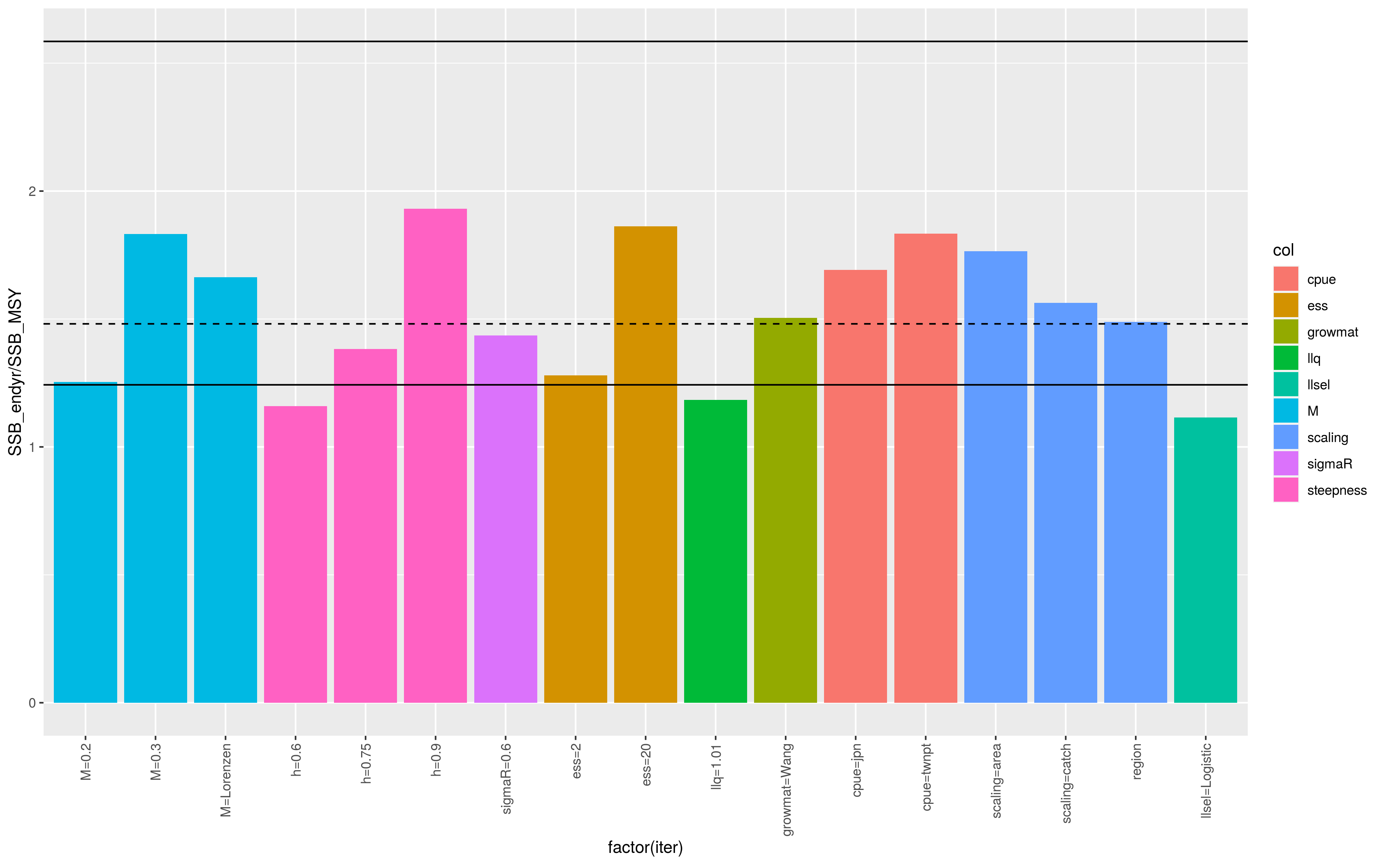
Main effects: SSB0 and SSB/SSBMSY by factor

Slide 13
Grid corners
Results in 1,728
  M = 0.2, 0.3, Lorenzen
  h = 0.6, 0.9
  SigmaR = 0.2, 0.6
  Growth&Mat = Farley et al., 2016, Wang et al., 2010
  ESS = 2,20
  CPUE = JPNlate+PRT, JPNlate, TWNlate+PRT
  Scaling = biomass, catch, area
  Selectivity = Double normal, Logistic
Only steepness is reduced

Slide 14
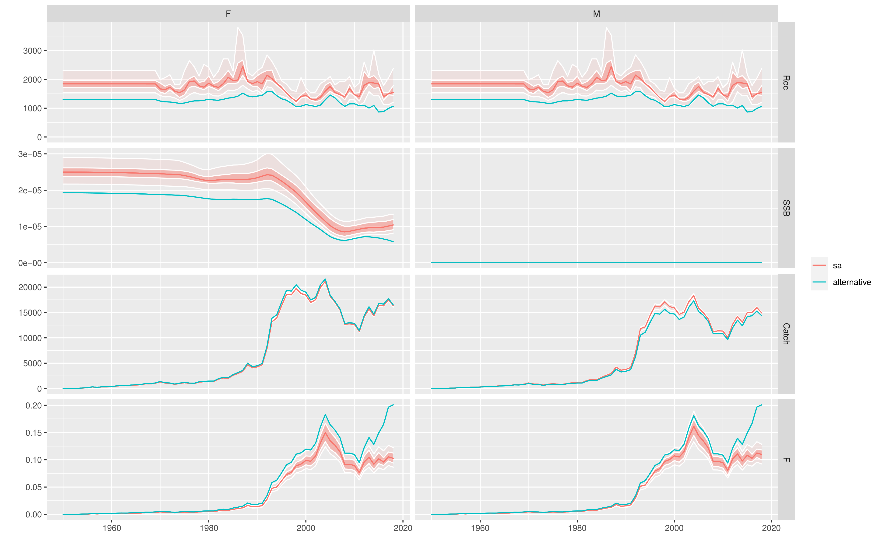
Possible robustness test
Doubts on increasing JPN series in the North
  remove CPUE from 2010-2018 in the NW and NE

Slide 15
Future work/questions
Run Corners and inspect models
Model dropping/weighting based on reliability?
Define and implement robustness tests

