Slide 1

Tuna: Overfishing, Overfished and Understanding Risk/ An approach to assess Indian Ocean reference Points

Slide 2
Overview
Context and why this is important
Defining Overfishing vs Overfished
Understanding Risk and Putting Res 13/10 in context.
Issues of tradeoffs

Slide 3
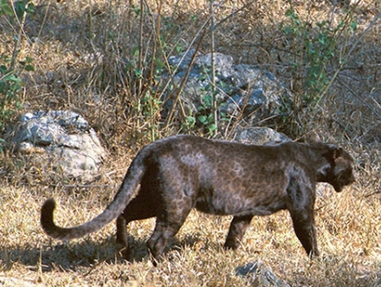
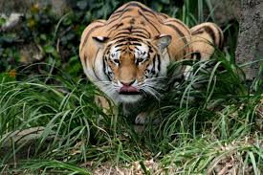

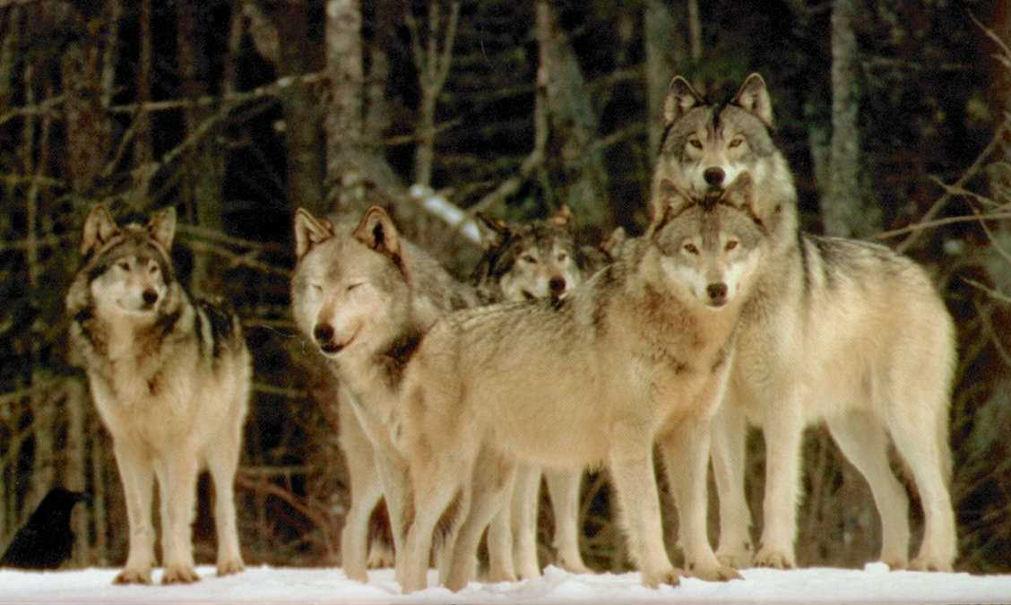

Slide 4
Importance in Population Control/i.e. Role of the predator- I
Predators usually kill the sick, weak or aged.
This helps to let the rest of the prey have greater access to the available food supply.
It also improves the genetic stock.

Slide 5
Role of top predators-II
Diversity (Paigne 1966) vs homogeneity in ecosystems.
Top predators are replaced by the lower trophic levels, and equilibrium is reached at a newer levels.
Keystone indicator of health of an ecosystem.

Slide 6


Sharks:
Focussed attention by NGO’s and countries to ban shark fishing and minimize by-catch (PRIMARILY as they are a top predator, and a keystone indicator of ocean health)

Slide 7
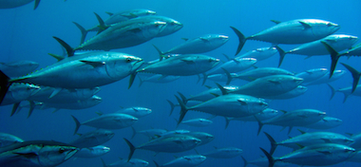
But….So are
Tuna….Wolves of the sea

Slide 8
What we want to avoid?

Slide 9
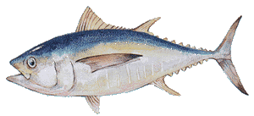
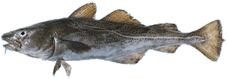

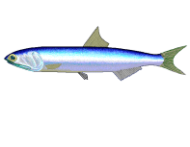
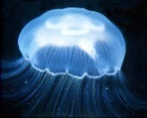
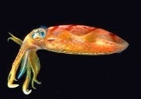
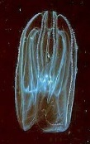
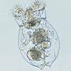
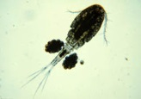
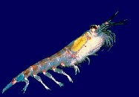
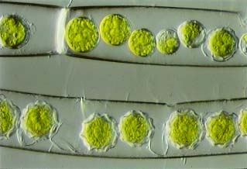
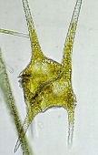
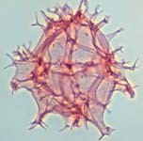
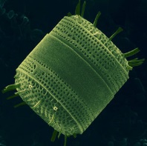
Fishing Down Marine Food Webs : Sequential Collapse and Replacement
4
3
Trophic Level
2
1

Slide 10





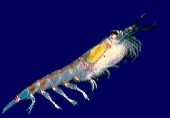
Fishing Down Food Webs: Sequential Addition
4
3
Trophic Level
2
1

Slide 11
Why we are here?
Management Procedures are:
An Agreed basis for making management decisions in response to defined indicators. The components of which include:
mechanisms, including data collection
evaluation of trends and status and a decision rule, that aim to apply the precautionary approach to the management of fish stocks.

Slide 12
Context – historical development
Precautionary Approach FAO 1996
MSY
Rest in Peace
Kobe Process Begins
IOTC
& CCSBT
1993
ICCAT
1969
WCPFC 2004
IWC
1946
IATTC
1949
CCSBT
Management Procedure
UN Convention on the
Law of the Sea
IWC
Revised
Management Procedure
UN Fish Stocks Agreement 1995
Courtesy: C. Davies CSIRO
Notes:
Historical Development of international fisheries management and science
The tuna and billfish fisheries of the Indian Ocean share much of the history of the other oceans in terms of the parallel and inter-related development of the fisheries and the associated international policy, law, management and science.
This slide provides a summary of the major developments and illustrates that:
The timing of tuna RFMO developments varies considerably among oceans;
The time-lag between practical experience, scientific opinion and this being reflected in international policy and implemented through management, can be substantial, and;
The considerable policy and scientific momentum now being directed toward implementation of management measures that are robust to uncertainty in the fisheries management system (i.e. consistent with the Precautionary Approach), over the past two decades.
It is worth noting that there is similar, and in many cases more advanced, action at a national level within national jurisdictions.
The joint tuna regional fisheries management organization process (known as the Kobe process) began in 2007, and has played a key role in moving tuna Regional Fisheries Management Organizations towards a more consistent, sustainable and science-based management approach, and is credited for supplying impetus for the development of tuna Management Strategy Evaluation methods (other than southern bluefin tuna, which began the process years earlier).
The current GEF-FAO-WWF project provides resources and institutional commitments to capitalise on this momentum and accelerate the development and implementation of better management approaches for these globally important fisheries.

Slide 13
The Kobe Process Introduces Phase Plots and Decision Matrices to Tuna RFMOs
Notes:
Kobe Plot and Decision Matrices
One of the important developments of the Kobe process has been the development of standard ways of presenting advice on the current status of the stock (spawning biomass, SSB) and the level of fishing (fishing mortality, F) and the potential consequences of different management actions (i.e. changes in effort or catch).
The following four slides provide some simple guidance on the interpretation of the standard Kobe plot and an idealised version of how a fishery would move through the different quadrants as it develops and management action is implemented in response to advice on stock status and levels of fishing.

Slide 14
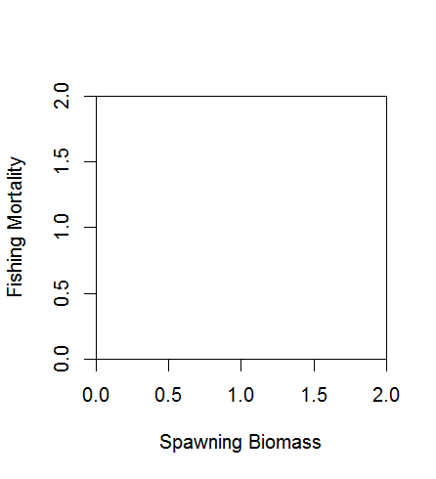
The Kobe Plot (a fishery summary)
Biomass Reference Point
Biomass
too low
Biomass
okay
Courtesy: C. Davies CSIRO

Slide 15
The Kobe Plot (a fishery summary)
Fishing
too much
Fishing Mortality Reference Point
Fishing
level okay
Courtesy: C. Davies CSIRO

Slide 16
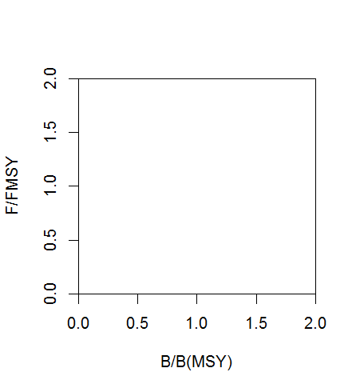
The Kobe Plot Where is your fishery now?
Biomass Low
Fishing Rate High
Biomass OK
Fishing Rate High
Fishing Mortality
Biomass Low
Fishing Rate OK
Biomass OK
Fishing Rate OK
Courtesy: C. Davies CSIRO
Spawning Biomass

Slide 17
The Kobe Plot A common fishery story
You are here
Over-fishing and
Over-fished
Over-Fishing
Fishing Mortality
Effort Reduced
Fishing Effort increases
Biomass
rebuilt
Over-fished
but recovering
Fishery begins
Courtesy: C. Davies CSIRO
Spawning Biomass

Slide 18

Stock status
Stocks under IOTC mandate are in relatively good shape (at optimal utilization), but no room for further fleet expansion.
Stock | Indicators | Advice
Bigeye | F₂₀₁₂/F_{MSY}= 0.42 (0.21–0.80) SB₂₀₁₂SB_{MSY}= 1.44 (0.87–2.22) C₂₀₁₃=109.3Kt | Probably not overfished, and overfishing is probably not occurring. Probably near full utilization
Yellowfin | F_{2010/}F_{MSY}=0.69 (0.59–0.90) SB_{2010/}SB_{MSY}= 1.24 (0.91–1.40) C₂₀₁₃=402 Kt | Probably not overfished, and overfishing is probably not occurring. Probably near full utilization
Skipjack | F_{2013/}F_{MSY}= 0.62 (0.49-0.75) SB_{2013/}SB_{MSY}= 1.59(1.13–2.14) C₂₀₁₃=424.6 Kt | Highly productive species and robust to overfishing. Probably near full utilization
Albacore | F_{2012/}F_{MSY =} 0.69 (0.23–1.4) SB₂₀₁₂SB_{MSY}=1.09 (0.34–2.2) C₂₀₁₃=38.3 Kt | F approaching MSY levels. Further declines likely due to effort displacement (piracy). Almost exclusively LL.
Swordfish | F_{2013/}F_{MSY}= 0.34(0.28-0.40) SB_{2013/}SB_{MSY}= 3.1 (2.44-3.75) C₂₀₁₃=31.8 Kt | The overall stock size and fishing pressure are estimated to be within acceptable limits
Notes:
Add some Kobe plots

Slide 19
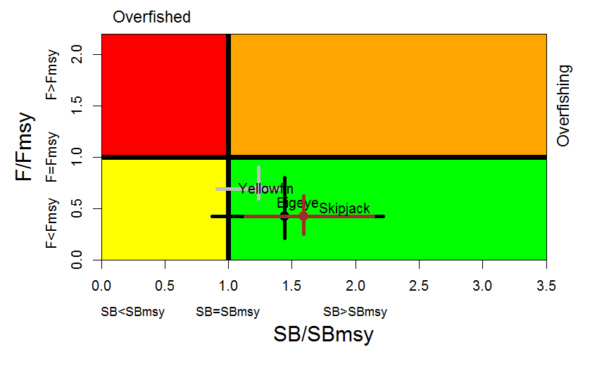

Slide 20
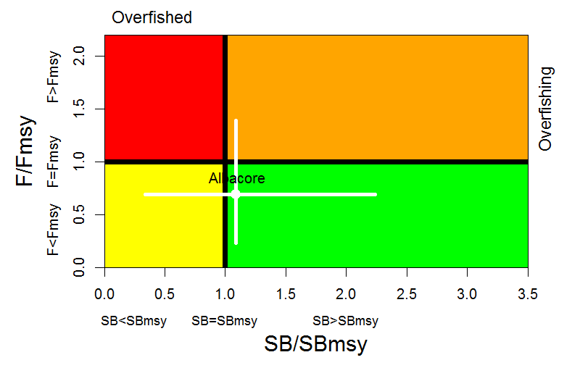

Slide 21
Background-Point 4 in Resolution 13/10
In addition the IOTC Scientific Committee shall develop and assess potential harvest control rules (HCRs) to be applied, considering the status of the stocks against the reference points assessed in paragraph 3 for albacore, bigeye tuna, skipjack tuna, yellowfin tuna and swordfish. Based on the results of the MSE and considering the guidelines set forth in the UNFSA and in Article V of the IOTC Agreement, the IOTC Scientific Committee will recommend to the Commission HCRs for these tuna and tuna-like species, which among other factors, taking account of the following objectives:
a) For stocks which assessed status will match with the lower right (green) quadrant of the Kobe Plot, aim at maintaining the stocks in a high probability within this quadrant;
b) For stocks which assessed status will match with the upper right (orange) quadrant of the Kobe Plot, aim at ending overfishing with a high probability in as short a period as possible;
c) For stocks which assessed status will match with the lower left (yellow) quadrant of the Kobe plot, aim at rebuilding these stocks in as short a period as possible;
d) For stocks which assessed status will match with the upper left quadrant (red), aim at ending overfishing with a high probability and at rebuilding the biomass of these stocks in as short a period as possible.

Slide 22
Objectives
Green Zone with high probability
In case of not green zone, come back as quick as possible with high probability.
Other Priorities (Social)
Employment/stability of catch
Maximum Economic Yield Vs Maximum Sustainable Yield.
Expanding Fleet Capacity/ Opportunity (Industry)
Conserving stocks for Intrinsic Benefits (Enviros)

Slide 23
Harvest Control Rules (HCR) -Objectives
F
Rebuilding plan
P(F<F_{MSY})=«high» in a «short» period
P(F<F_{MSY})=«high» in a «short» period
F_{MSY}
Rebuild the stock in a «short» period
P(F<F_{MSY})=«high»
B
Objectives of management measures under each Kobe quadrant according to [Rec 13-10]
B_{MSY}
Courtesy: ICCAT

Slide 24
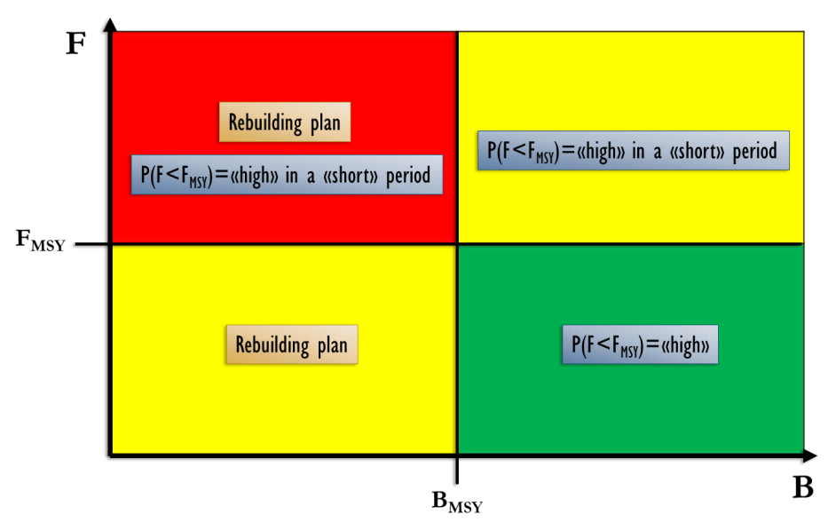
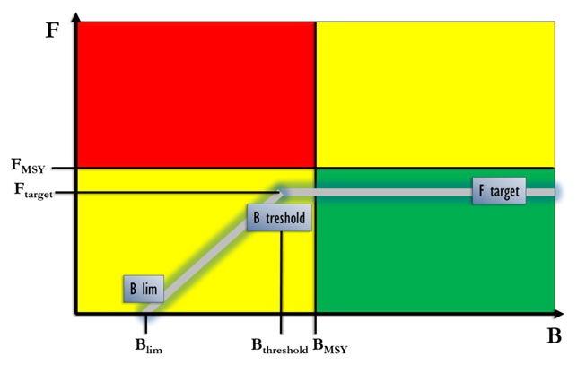
Harvest Control Rules (HCR)
IPCC: 80%
Canada: 75%
MSC: 70%-80%
HIGH probability
USA: 10 years or 1.5 generations
Australia: 10 years + 1 generation
MSC: 2 generations
SHORT period
F target
[0.7, 0.75, 0.8, 0.85, 0.9 and 1] x F_{MSY}
B threshold
[0.6, 0.8 and 1] x B_{MSY}
B lim
0.4B_{MSY}
Courtesy: ICCAT

Slide 25
Inherently this involves a risk: Biomass/Minimizing Risk (Probability)
Spawning Biomass has been low for some years:
Are these low Sp Biomass due to a passing weakness in year class strengths, and no additional action should be taken?
Or
Is this the start of overfishing, and additional action is warranted?

Slide 26
Defining Risk
You’re a farmer who’s just brought in his crop of soy beans. Do you sell now, or store the beans for sale later. You run a risk that the price will rise later if you sell now, and you run a risk of falling prices if you store the grain.
You’re an equities investor holding some stock. Do you sell or continue holding? You too run a risk that price will rise later if you sell now, and you too run a risk if you hold now and the share price falls.
You’re owner of a fishing boat business, booking clients for the upcoming season. Do you add an extra boat and crew to increase catch? You run a risk of having too many clients if regulations unexpectedly reduce harvest. You also run a risk of having too few clients if regulations are unexpectedly relaxed.

Slide 27
Defining Risk/Probability
You’re a farmer who’s just brought in his crop of soy beans. Do you sell now, or store the beans for sale later. You run a risk that the price will rise later if you sell now, and you run a risk if you store now and the price will fall.
You’re an equities investor holding some stock. Do you sell or continue holding? You too run a risk that price will rise later if you sell now, and you too run a risk if you hold now and the share price falls.
You’re owner of a fishing boat business, booking clients for the upcoming season. Do you add an extra boat and crew to increase catch? You run a risk of having too many clients if regulations unexpectedly reduce harvest. You also run a risk of having too few clients if regulations are unexpectedly relaxed.

Slide 28
Defining Risk
You’re a farmer who’s just brought in his crop of soy beans. Do you sell now, or store the beans for sale later. You run a risk that the price will rise later if you sell now, and you run a risk if you store now and the price will fall.
You’re an equities investor holding some stock. Do you sell or continue holding? You too run a risk that price will rise later if you sell now, and you too run a risk if you hold now and the share price falls.
You’re owner of a fishing boat business, booking clients for the upcoming season. Do you add an extra boat and crew for increasing catch? You run a risk of having too many clients if regulations unexpectedly reduce harvest. You also run a risk of having too few clients if regulations are unexpectedly relaxed.

Slide 29
The Day to day terminologies of risk
Weather - Probability
Sports - Odds
Gambling – Bets
Adverse events- Low probability
Weather – Hurricanes/Cyclones
Sports – Australia wins the World Cup Football
Ireland wins World Cup Cricket

Slide 30
You’re a Fisheries Manager and Spawning Biomass has been low….
Risk for the fisheries manager is the probability of making the wrong decision:
Unnecessarily Restricting Fisheries when fishing is optimal; or
Not Protecting Stocks when they are overfished.

Slide 31
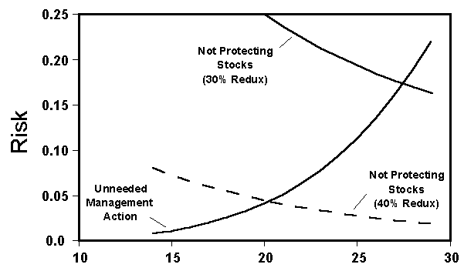
Biomass
Notes:
Depending on how low we drop the limit the risk of Restricting a fishery when it isn’t required drops. But the type II error, i.e. the risk of failing to protect a stock when required increases. Need to balance the two out (Tradeoff)

Slide 32
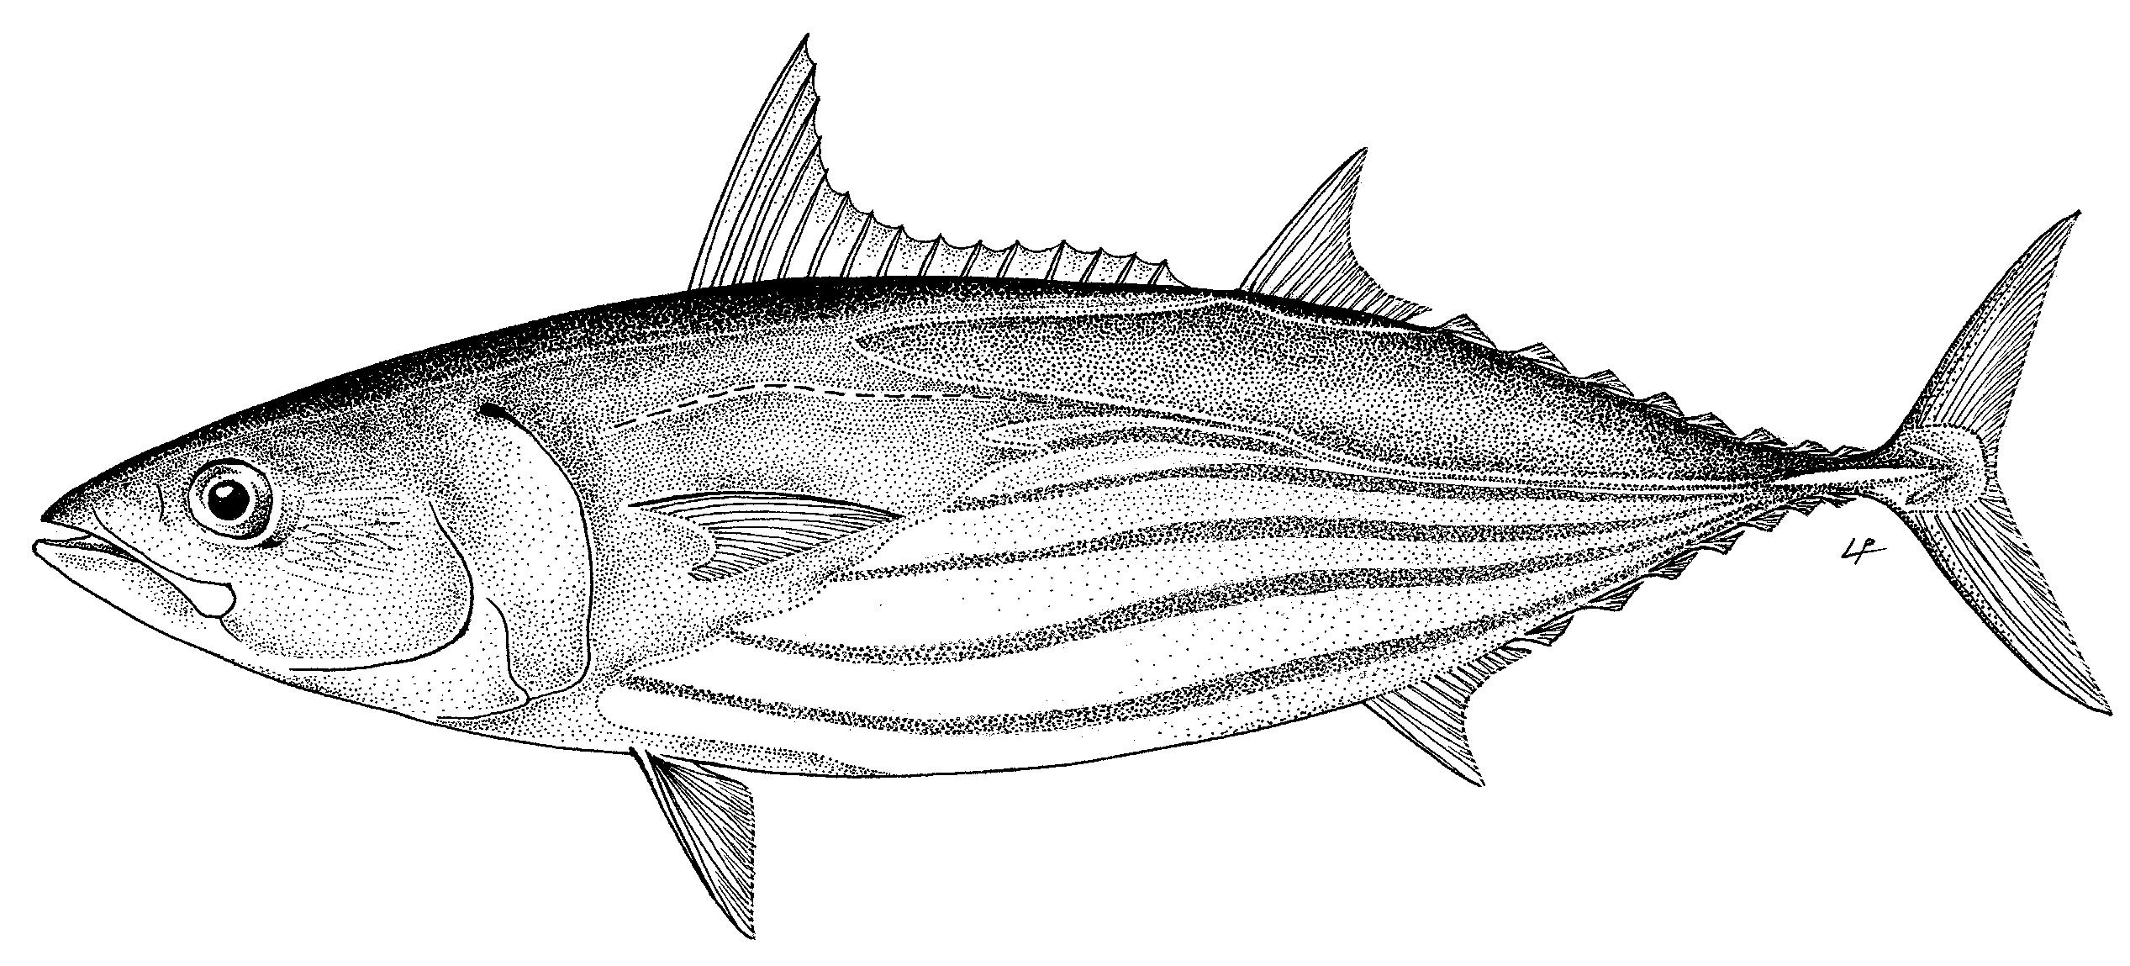
Skipjack Like Stock IO

Slide 33
Skipjack Life History Parameters IO

Slide 34
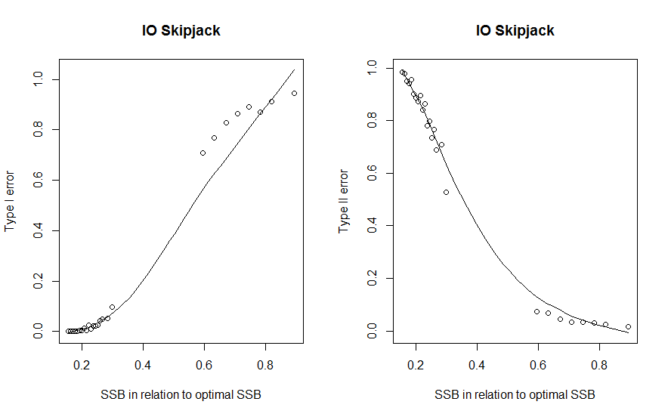

Slide 35
 |  | Harvest Rate (F/F_{MSY})
 |  | 0.25 | 0.5 | 0.75 | 1 | 1.25 | 1.5
Auto-correlation | 0.1 | 0 | 0 | 0 | 1 | 1 | 3
 | 0.15 | 0 | 0 | 0 | 1 | 1 | 3
 | 0.2 | 0 | 0 | 0 | 1 | 1 | 3
 | 0.25 | 0 | 0 | 0 | 1 | 2 | 3
 | 0.3 | 0 | 0 | 1 | 1 | 2 | 3
 | 0.35 | 0 | 0 | 1 | 1 | 2 | 3
 | 0.4 | 0 | 0 | 1 | 1 | 2 | 3
 | 0.45 | 0 | 0 | 1 | 1 | 2 | 4
 | 0.5 | 0 | 0 | 1 | 1 | 2 | 4
 | 0.55 | 0 | 1 | 1 | 2 | 3 | 4
 | 0.6 | 0 | 1 | 2 | 2 | 3 | 4
 | 0.65 | 0 | 1 | 2 | 2 | 3 | 5
 | 0.7 | 0 | 1 | 2 | 2 | 3 | +76
 | 0.75 | 1 | 2 | 2 | 3 | 4 | +76
 | 0.8 | 3 | 3 | 3 | 3 | 4 | +76
 | 0.85 | 3 | 4 | 4 | 4 | 20 | +76
 | 0.9 | 4 | 5 | 4 | 6 | 64 | +76
Simple HCR and Recovery Time (Target)
 |  | Harvest Rate (F/F_{MSY})
 |  | 0.25 | 0.5 | 0.75 | 1 | 1.25 | 1.5
Auto-correlation | 0.1 | 0 | 1 | 1 | 3 | 7 | +76
 | 0.15 | 0 | 1 | 2 | 3 | 7 | +76
 | 0.2 | 1 | 1 | 2 | 3 | 7 | +76
 | 0.25 | 1 | 1 | 2 | 3 | 7 | +76
 | 0.3 | 1 | 1 | 2 | 4 | 8 | +76
 | 0.35 | 1 | 1 | 2 | 4 | 8 | +76
 | 0.4 | 1 | 1 | 2 | 4 | 71 | +76
 | 0.45 | 1 | 2 | 3 | 4 | 73 | +76
 | 0.5 | 1 | 2 | 3 | 5 | 75 | +76
 | 0.55 | 2 | 2 | 3 | 5 | +76 | +76
 | 0.6 | 2 | 2 | 3 | 5 | +76 | +76
 | 0.65 | 2 | 3 | 4 | 6 | +76 | +76
 | 0.7 | 3 | 3 | 4 | 6 | +76 | +76
 | 0.75 | 3 | 4 | 5 | 17 | +76 | +76
 | 0.8 | 4 | 4 | 6 | 21 | +76 | +76
 | 0.85 | 5 | 6 | 10 | 41 | +76 | +76
 | 0.9 | 6 | 7 | 18 | +76 | +76 | +76
Simple HCR and Recovery Time (Limit)

Slide 36
Evaluation: Yellowfin Like Stock IO

Slide 37
Life-history Parameters: YFT

Slide 38
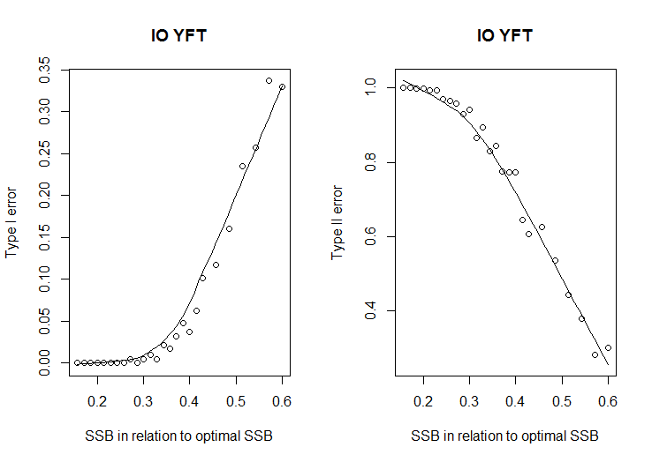

Slide 39
 |  | Harvest Rate (F/F_{MSY})
 |  | 0.4 | 0.8 | 1.2 | 1.6 | 2 | 2.4
Auto-correlation | 0.1 | 0 | 0 | 1 | 2 | 4 | +76
 | 0.15 | 0 | 0 | 1 | 2 | 4 | +76
 | 0.2 | 0 | 0 | 1 | 2 | 4 | +76
 | 0.25 | 0 | 1 | 1 | 2 | 4 | +76
 | 0.3 | 0 | 1 | 1 | 2 | 5 | +76
 | 0.35 | 0 | 1 | 2 | 3 | 5 | +76
 | 0.4 | 0 | 1 | 2 | 3 | 5 | +76
 | 0.45 | 0 | 1 | 2 | 3 | 5 | +76
 | 0.5 | 0 | 1 | 2 | 3 | 26 | +76
 | 0.55 | 0 | 1 | 2 | 4 | 49 | +76
 | 0.6 | 0 | 1 | 3 | 4 | 40 | +76
 | 0.65 | 0 | 2 | 3 | 4 | 41 | +76
 | 0.7 | 2 | 2 | 3 | 5 | 47 | +76
 | 0.75 | 2 | 4 | 4 | 5 | 67 | +76
 | 0.8 | 3 | 4 | 5 | 10 | +76 | +76
 | 0.85 | 3 | 5 | 5 | 18 | +76 | +76
 | 0.9 | 5 | 5 | 7 | 50 | +76 | +76
Simple HCR and Recovery Time (Target)
 |  | Harvest Rate (F/F_{MSY})
 |  | 0.4 | 0.8 | 1.2 | 1.6 | 2 | 2.4
Auto-correlation | 0.1 | 0 | 0 | 38 | 4 | +76 | +76
 | 0.15 | 0 | 0 | 38 | 14 | +76 | +76
 | 0.2 | 0 | 0 | 36 | 14 | +76 | +76
 | 0.25 | 0 | 6 | 36 | 14 | +76 | +76
 | 0.3 | 0 | 7 | 34 | 14 | +76 | +76
 | 0.35 | 0 | 8 | 31 | 18 | +76 | +76
 | 0.4 | 0 | 7 | 31 | 28 | +76 | +76
 | 0.45 | 0 | 8 | 34 | 28 | +76 | +76
 | 0.5 | 0 | 11 | 35 | 30 | +76 | +76
 | 0.55 | 0 | 13 | 33 | 33 | +76 | +76
 | 0.6 | 0 | 15 | 33 | 37 | +76 | +76
 | 0.65 | 0 | 17 | 32 | 36 | +76 | +76
 | 0.7 | 6 | 18 | 33 | 35 | +76 | +76
 | 0.75 | 7 | 19 | 34 | 36 | +76 | +76
 | 0.8 | 10 | 22 | 36 | +76 | +76 | +76
 | 0.85 | 12 | 26 | 36 | +76 | +76 | +76
 | 0.9 | 16 | 31 | 39 | +76 | +76 | +76
Simple HCR and Recovery Time (Limit)

Slide 40
Conclusions-I Evaluating Current Reference Points
Risks of falling below 40% of S_{MSY} are below 7% and 10% for albacore and skipjack respectively if fished at optimal levels.
For bigeye and yellowfin these risks are less than 1% respectively to fall below 50% of S_{MSY} and 40% S_{MSY} respectively.
Risks of failing to detect an issue with overfishing is less than 2% for albacore at levels exceeding optimal fishing levels (about 1.2 times F_{MSY}), about 40% for skipjack, and about 60% for bigeye and yellowfin at these reference points.

Slide 41
Conclusions-II
Assuming we can estimate reference points with certainty and implement management without error (BOTH BIG ASSUMPTIONS):
Target reference points should be limits probably if we want to preserve the stocks
Current limits maybe too optimistic.
Probably F_{limit} should be 1.2 for most Tuna stocks to recover stocks within 3-4 generations for most Tuna stocks (20-40 years depending on the species)
Probably B_{limit} should be 0.8 for most Tuna stocks to minimize risk of overfishing (between 0.1-0.2).

Slide 42
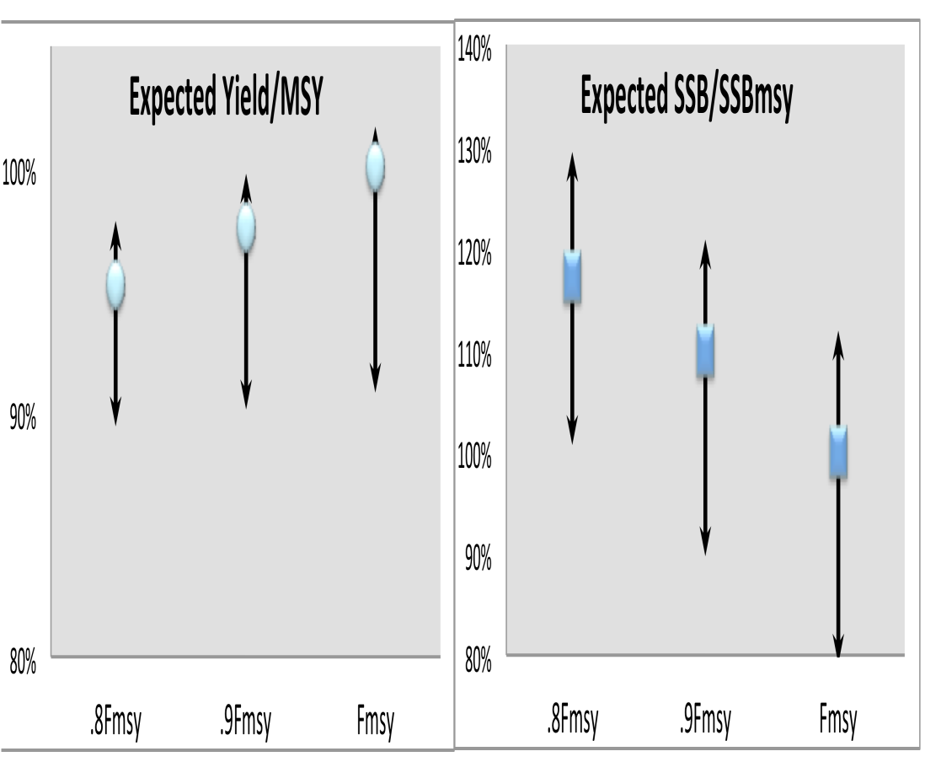
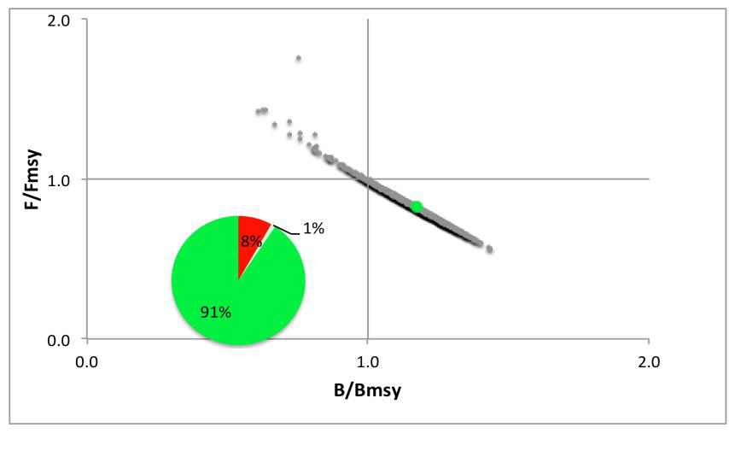
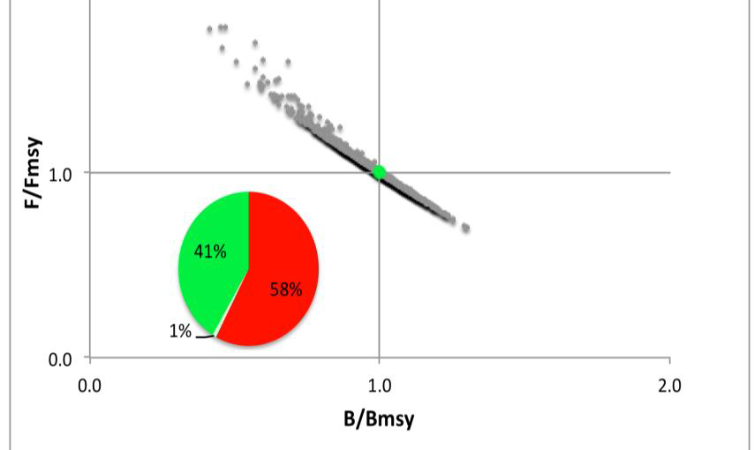
Tradeoffs – Catch Vs Sp. Biomass
Target F_{MSY}
Target 0.8 F_{MSY}

Slide 43
Inherently what you need to decide
Balance long-term yield to long-term stock biomass.
In case of adverse conditions, evaluate how long it may take to recover.
Take a lot of pain now for benefits later or less now for longer rebuilding time

Slide 44
Acknowledgements
Campbell Davies & Dale Kolody
Iago Mosqueira
Jerry Scott
Victor Restrepo
Ray Hilborn
Dave Bernard

