Slide 1

Sales Meeting
December-04
TFTs
Basic Concepts

Slide 2
TFTs Basic Concepts

Slide 3
TFT-LCD Basic Concepts
What is TFT LCD?
LCD Lighting Theory
Liquid Crystal Operation
TFT Pixel Element
Driving Methods of LCD
Passive Matrix LCD Problems
TFT-based Active Matrix LCDs (AMLCD)
AMLCDs: Operation
Advantages of the active matrix (AM) approach.
Color Filters (RGB)
Display Mode
Backlights
TFT Resolutions

Slide 4
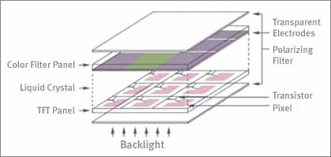
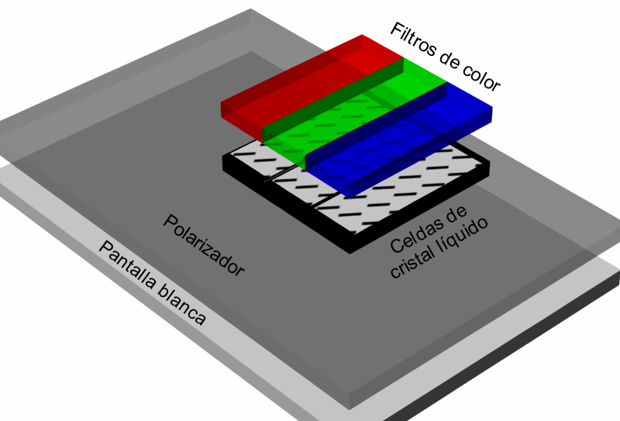
Basic Concepts
What is TFT LCD?
  TFT LCD (Thin Film Transistor Liquid Crystal Display) has a sandwich-like structure with liquid crystal filled between two glass plates.

Slide 5
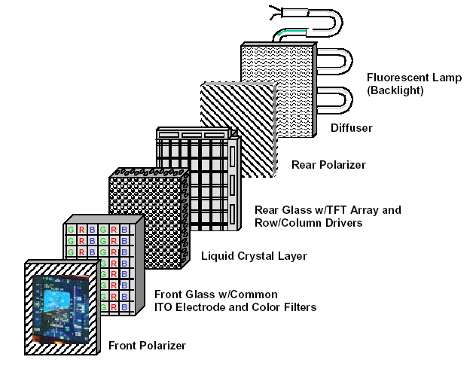
Basic Concepts
What is TFT LCD?

Slide 6
Basic Concepts
What is TFT LCD?
TFT Glass has as many TFTs as the number of pixels displayed.
A Color Filter Glass has color filter which generates color.
Liquid crystals move according to the difference in voltage between the Color Filter Glass and the TFT Glass.
The amount of light supplied by Back Light is determined by the amount of movement of the liquid crystals in such a way as to generate color.

Slide 7
Basic Concepts
LCD Lighting Theory
Liquid crystal will rotates into different angles according to the charges applied to each pixel.
Why we need to control the LC's standing angle lies within millions of pixels?
Because we need to use LC's optic rotation nature to control the amount of light passing through the LCD panel.
Light from the back light module travels from the TFT panel through ITO electrode, turned by Liquid Crystal and reaches the LCD panel on the top.

Slide 8
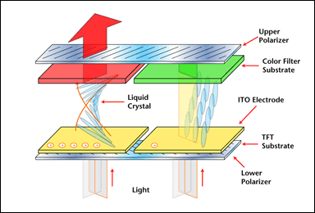
Basic Concepts
LCD Lighting Theory

Slide 9
Basic Concepts
Liquid Crystal Operation
With no voltage applied across the pixel, the LC molecules twist to align to the rubbing of the glass plates. Light entering the first polarizer is twisted and can exit the second polarizer --> pixel is ON
With a voltage applied across the pixel, the LC molecules untwist to align with the electric field. Light entering the first polarizer cannot exit the second polarizer --> pixel is OFF.

Slide 10
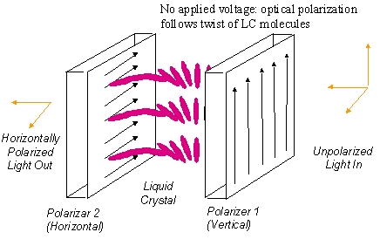
Basic Concepts
Liquid Crystal Pixel: ON

Slide 11
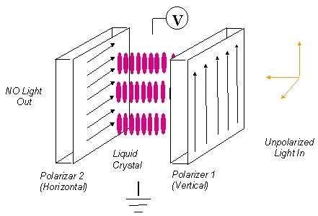
Basic Concepts
Liquid Crystal Pixel: OFF

Slide 12
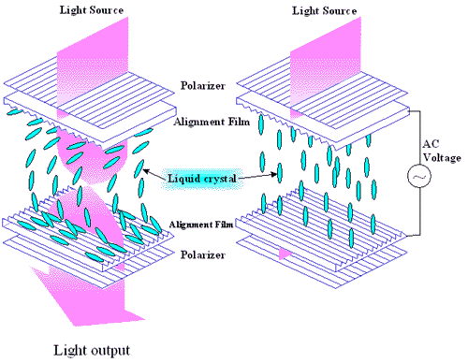
Basic Concepts
Operation of twisted nematic
field effect mode liquid crystal cell.

Slide 13
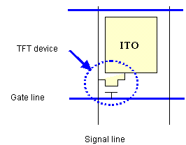
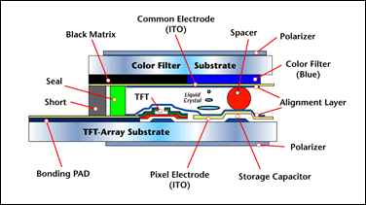
Basic Concepts
TFT Pixel Element
A TFT substrate is composed of a matrix of pixels and ITO region ( a transparent electric conducting film)each with a TFT device and is so called array. Thousands or millions of these pixels together create an image on the display. The diagram below shows the simple structure of a pixel

Slide 14
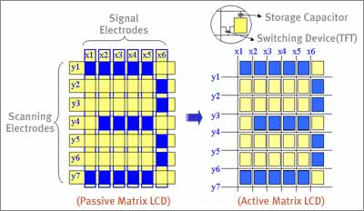
Basic Concepts
Driving Methods of LCD
Passive Matrix: (PMLCD)
Simple matrix type was used in the first stage of LCDs. In this method, the transparent electrodes are set on X and Y axis.
There is not switching device.
Active Matrix: (AMLCD)
A switching device and a storage capacitor are integrated at the each cross point of the electrodes

Slide 15
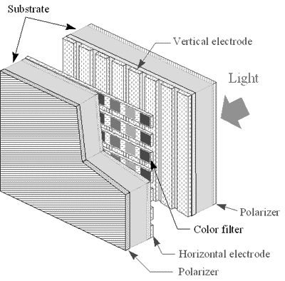
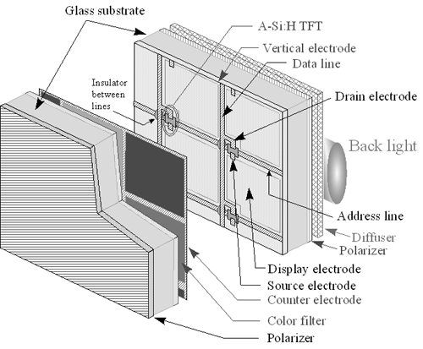
Basic Concepts
Basic configuration of an AMLCD;
this structure is the typical
transmissive color TFT-LCD
Schematic representation of
simple matrix LCDs

Slide 16
Basic Concepts
Passive Matrix LCD Problems:
Display Size is limited because the more rows, the shorter time the on-voltage can be applied, resulting in poor contrast ratio, narrow viewing angle, and fewer gray levels.
Crosstalk occurs when neighboring pixel voltages affect each other, reducing the gray scale, contrast, and viewing angle.
Submarining occurs when slow-to-respond LC materials cannot respond quickly enough and the picture can disappear temporarily.
One Solution: placing a switch at each pixel, such as a transistor or diode --> pixel matrix becomes “active.”

Slide 17
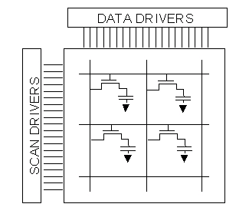
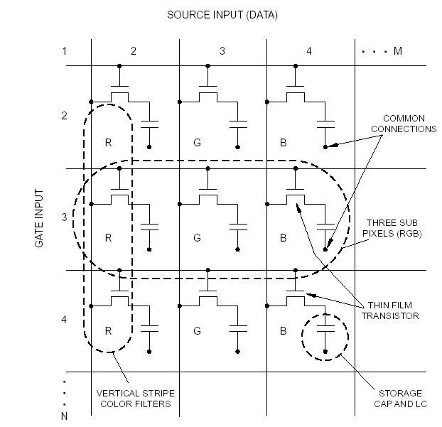
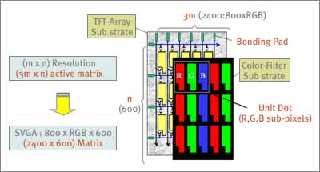
Basic Concepts
TFT-based Active Matrix LCDs (AMLCD)

Slide 18
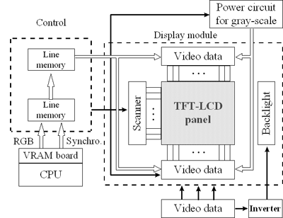
Basic Concepts
schematic diagram of TFT-LCD array with controllers,
power supply, and driver circuits

Slide 19
Basic Concepts
AMLCDs: Operation
Switching element at each pixel. Individual pixels isolated from each other. Thin Film Transistors most commonly used.
Horizontal scan lines address gates of the TFTs.
Data applied through vertical lines (drain), changing the polarization and optical transparency of the liquid crystal cell.
Many passive display problems eliminated:
    pixel isolation eliminates crosstalk
    isolation from the column line permits the pixel capacitor to remain charged, so that faster responding liquid crystals can be used.
    Larger displays can be realized.

Slide 20
Basic Concepts
Advantages of the active matrix (AM) approach.
Higher sizes
Higher contrast
Higher gray scale
Higher resolution
Higher viewing angle
Faster response. Eliminates “ghosting”
Better control of the color

Slide 21
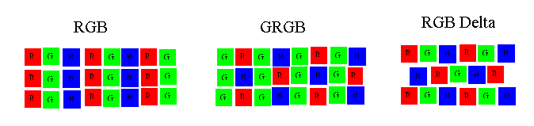
Basic Concepts
Color Filters (RGB)
Conventional color displays use a pixel arrangement called RGB. In this arrangement, red, green and blue pixels are arranged in equal proportion.
      at high pixel densities, RGB arrangement is adequate,
      when the number of pixels is limited, the image may appear fuzzy. To compensate for this, a GRGB arrangement can be used

Slide 22
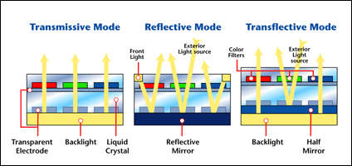
Basic Concepts
Display Mode
Transmissive type TFT LCD: the light travels from the backlight through color filter and LC then appears on the panel. (high brightness but more power consumption).
Reflective type TFT LCD contains a reflective mirror, utilizing the external light for image display. power saving, and light-weight (without backlight). Ideal for viewing with external light sources.

Slide 23
Basic Concepts
Display Mode
Transflective type TFT LCD is a promising displaying device for both outdoor and indoor applications. Benefits of adopting Transflective technology includes:
      Power saving
      Sun light readability
      Indoor readability
      Light-weight

Slide 24
Basic Concepts
Backlights: CCFL
Advantages | Disadvantages
Simple Design | Narrow Drive Temperature
Good for Color LCD | High Frequency & AC Signal Operation
Good Uniformity | Needs DC/AC inverter
High Brightness
Long Life
Low Heat Generation

Slide 25
Basic Concepts
Backlights: CCFL
Driving Voltages 100 ~ 400Vac, 30 ~ 50KHz (DC/AC Inverter required)
Brightness (Min) 1,000 cd/m2 (direct application) 450 cd/m2 (side application)
Luminous Color White
Life Time 15,000 ~ 20,000 Hrs
Operating Temperature 0 ~ +60° c
Storage Temperature -20 ~ +70° c

Slide 26
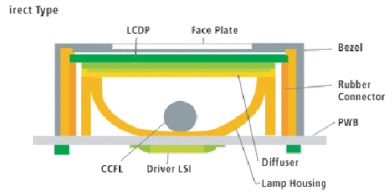
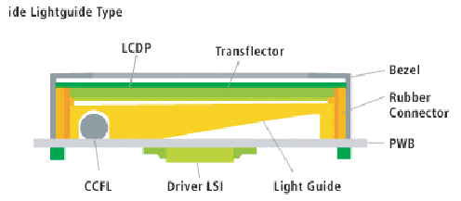
Basic Concepts
Backlights: CCFL Backlight Structure
Direct Type
Side Lightguide Type

Slide 27
Basic Concepts
Backlights: LED
Advantages | Disadvantages
Very Long Life | Low Uniformity
Wide Temperature | Thickness
DC Single Operation | Less brightness than CCFL
Various Colors
High Brightness
Low Power Comsumption

Slide 28
Basic Concepts
Backlights: LED
Driving Voltages 2.1V ~ 8Vdc
Brightness (Min) 70 cd/m2 5 ~ 30 cd/m2
Luminous Color Yellow-Green, White, Green, Blue, Amber, Red
Life Time 100,000 Hrs
Operating Temperature -20 ~ +70° c
Storage Temperature - -20 ~ +85° c

Slide 29
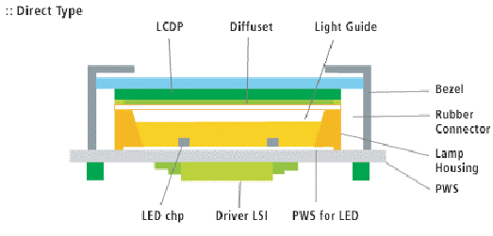
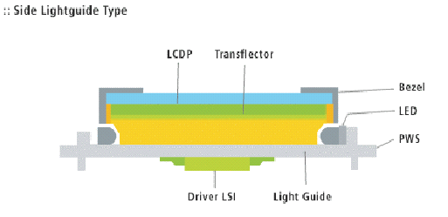
Basic Concepts
Backlights: LED Backlight structure
Direct Type
Side Lightguide Type

Slide 30
Basic Concepts
TFT Resolutions
Display Format | Columns | Rows | Number of Pixels
VGA | 640 | 480 | 307,200
SVGA | 800 | 600 | 480,000
XGA | 1024 | 768 | 786,432
SXGA | 1280 | 1024 | 1,310,720
UXGA | 1600 | 1200 | 1,920,000
QXGA | 2048 | 1536 | 3,145,728
QSXGA | 2560 | 2048 | 5,242,800
QUXGA | 3200 | 2400 | 7,680,000

