Slide 1



S M A R T C IT Y
w it h A R D U IN O
Simone Benedetto – 0 5 2 2 5 0 13 3 4
S a le r n o D a n ie le - 0 5 2 2 5 0 13 5 7

Slide 2

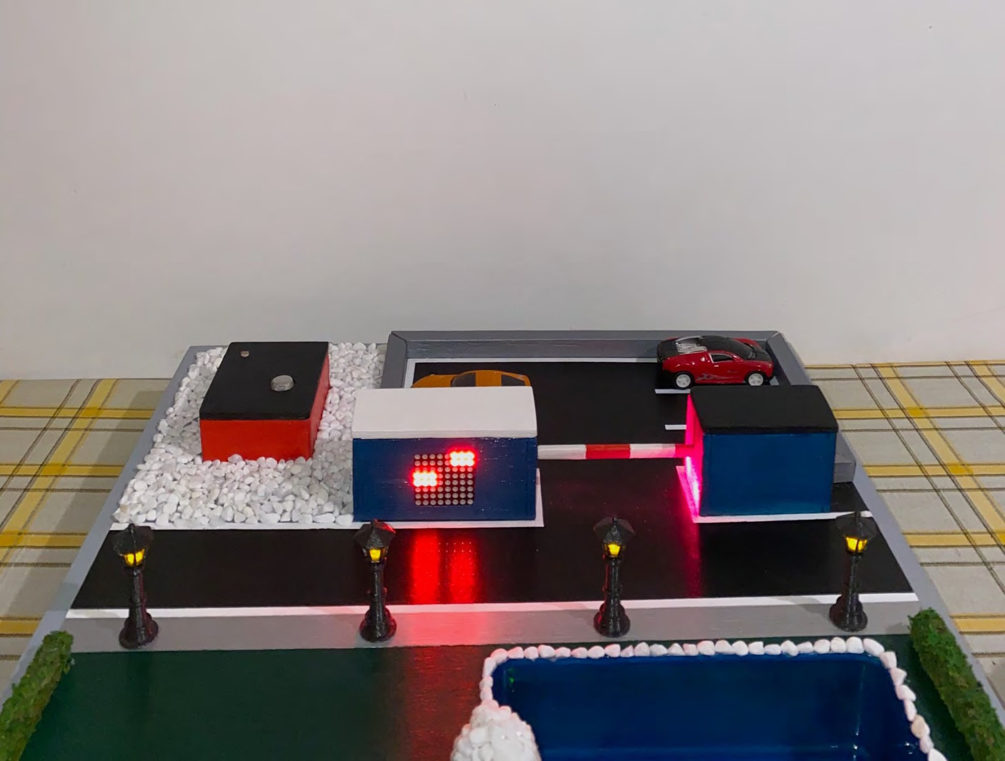
IN T R O D U C T IO N
This p r o je c t
IoT smart city
t r e a t s t he d e v e lop m e nt of a n
using
Arduino .
be equipped
:
The smart
city will functionalities
lighting ;
parking ;
with the
following
Smart
Smart
Air quality monitoring
Flood management
;
.

Slide 3
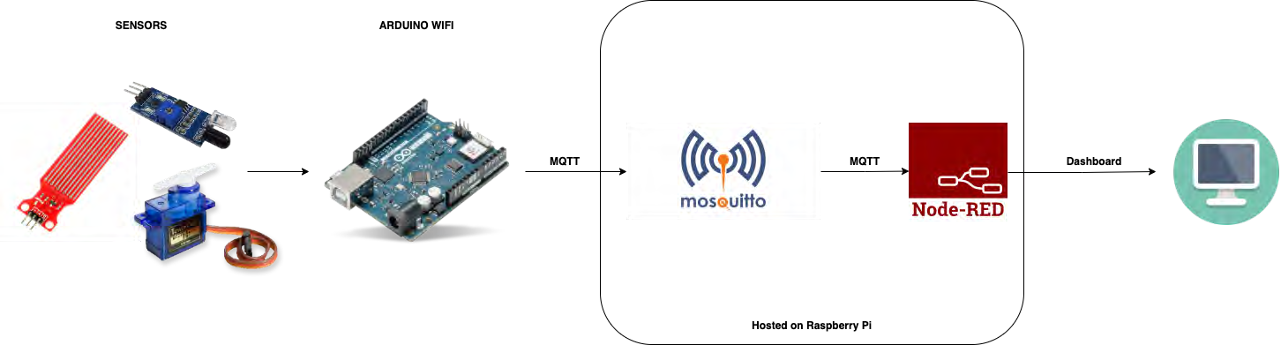
A R C H IT E C T U R E

Slide 4

S IN G L E S E C T IO N H A R D W A R E A N D
W IR IN G

Slide 5
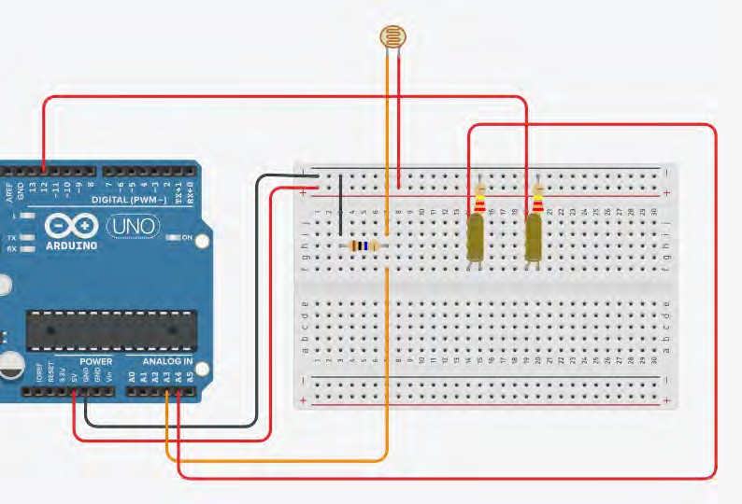
S M A R T L IG H T IN G
Light Sensor (Photoresistor);
Resistor 10k ohm;
Resistor 220 ohm (2x);
Yellow LED 5mm (6x);

Slide 6
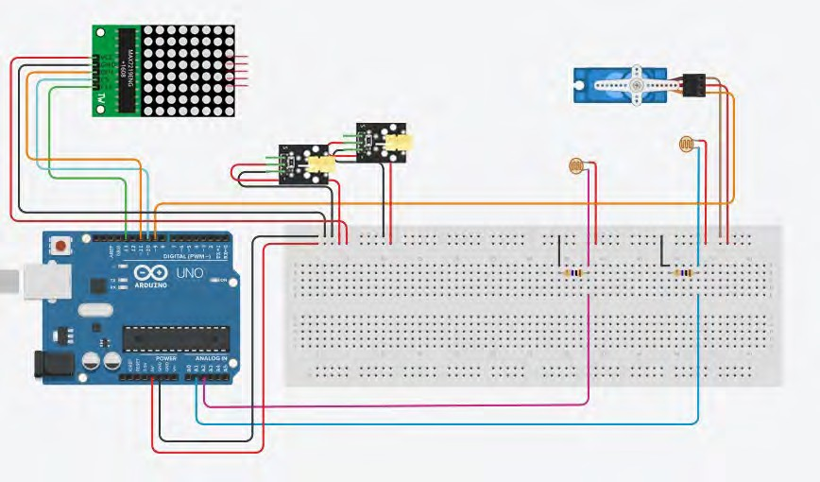
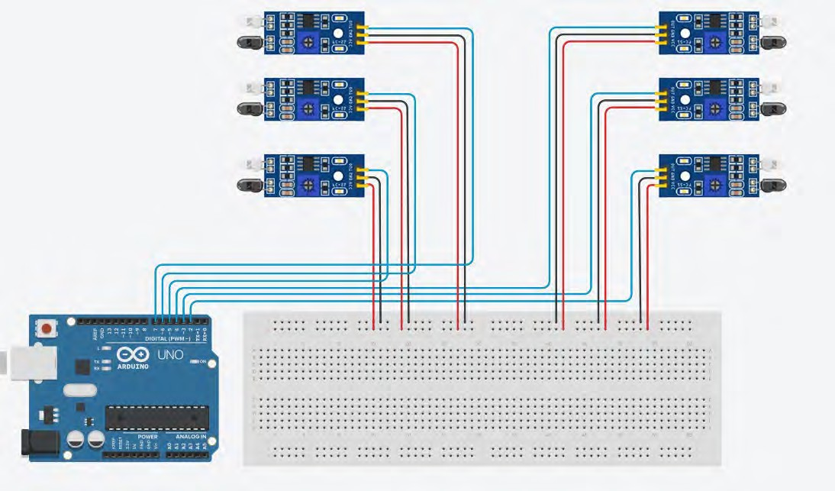
S M A R T P A R K IN G
IR Infrared Obstacle Avoidance Sensor Module (6x);
Light Sensor (Photoresistor) (2x);
Resistor 10k ohm (2x);
KY - 008 Laser Module (2x);
Servo micro TowerPro sg90 9g;
8x8 Dot Led Matrix Module;

Slide 7
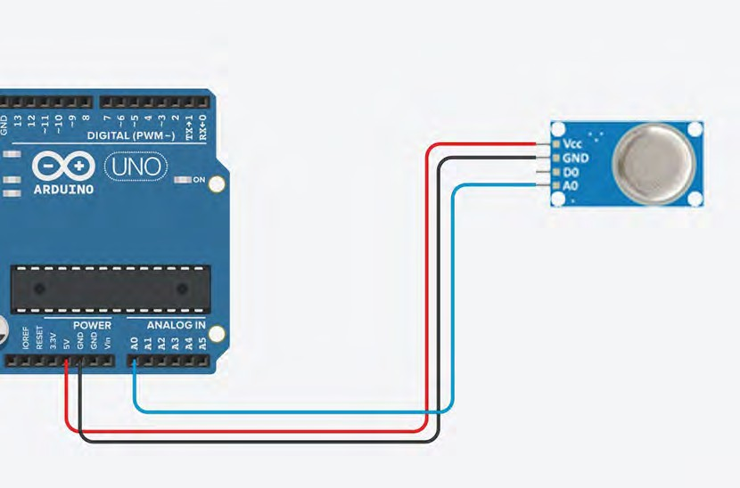
A IR Q U A L IT Y M O N IT O R IN G
MQ2 Air Quality Sensor;

Slide 8
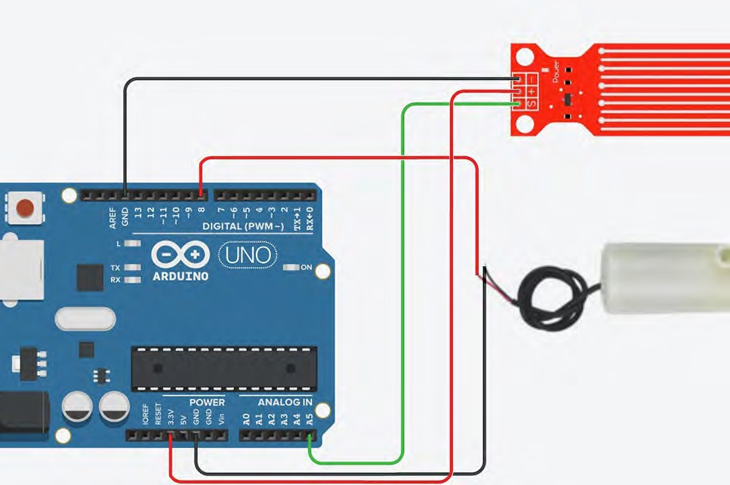
F L O O D
M A N A G E M E N T
Water Sensor;
Water pump 5V;

Slide 9
C O M M U N IC A T IO N
M Q T T

Slide 10
S T R E E T
L IG H T S
We publish messages on the topic
“topic/
street_lights
” .
The messages have the following format:
{ lights_status
: value }
The variable
value
can be 0
if the lights
are OFF, and 1
if they
are ON.

Slide 11
A IR Q U A L IT Y M O N IT O R IN G
We publish messages on the topic
“topic/
air_quality
” .
The messages have the following format:
{ air_quality_status
: value }
The variable
value
can be
0 if the air
quality
is GOOD, and
1 if it is BAD .

Slide 12
F L O O D
M A N A G E M E N T
We publish messages on the topic
“topic/
flood_management
” .
The messages have the following format:
{ flood_status
: value }
The variable
value
is the water
level .

Slide 13
P A R K IN G
We publish messages on the topic
“topic/parking”
.
The messages have the following format:
{free:
value
, slot1:
status
, slot2:
status
, slot3:
status
, slot4:
status
, slot5:
status
, slot6:
status }
The variable it is busy .
value
is the number
of free
slots
and status
that
can be 1
if the slot
is free, 0 if

Slide 14
W E B A P P L IC A T IO N

Slide 15
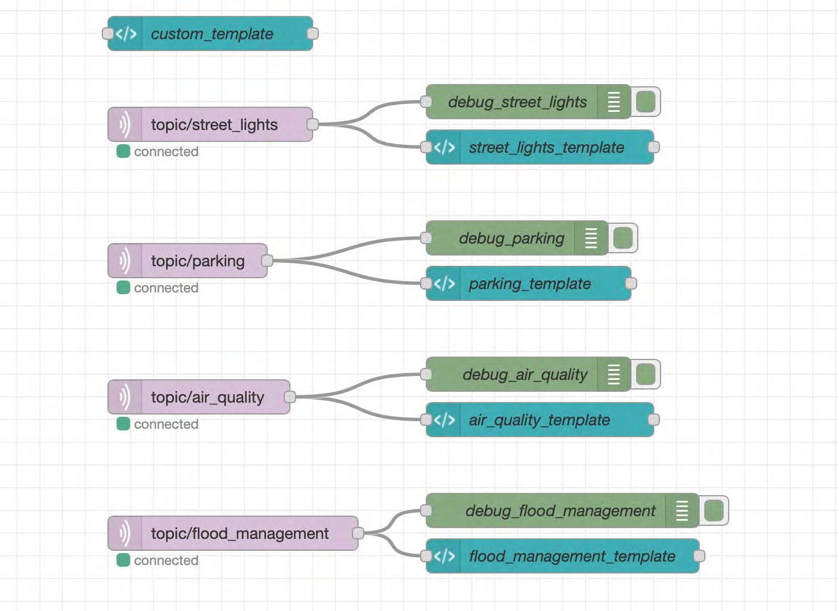
F L O W
To b u ild
Node - Red ,
our w e b a p p lic a t io n
a
w e us e d
for wiring
and online
programming
tool APIs
together services .
hardware devices,

Slide 16
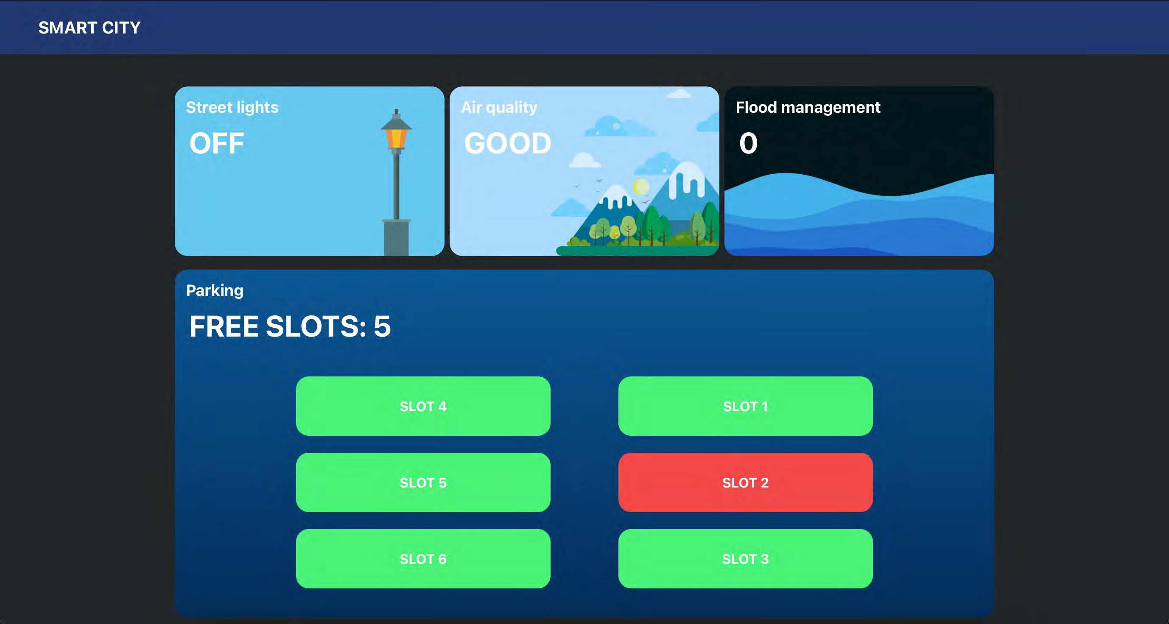
D A S H B O A R D

Slide 17
F IN A L R E S U L T

Slide 18


L IG H T IN G
S M A R T

Slide 19

A IR Q U A L IT Y M O N IT O R IN G

Slide 20

P A R K IN G
S M A R T

Slide 21

M A N A G E M E N T
F L O O D

Slide 22
T H A N K Y O U
F O R Y O U R A T T E N T IO N
Simone Benedetto – 0 5 2 2 5 0 13 3 4
S a le r n o D a n ie le - 0 5 2 2 5 0 13 5 7

