Slide 1
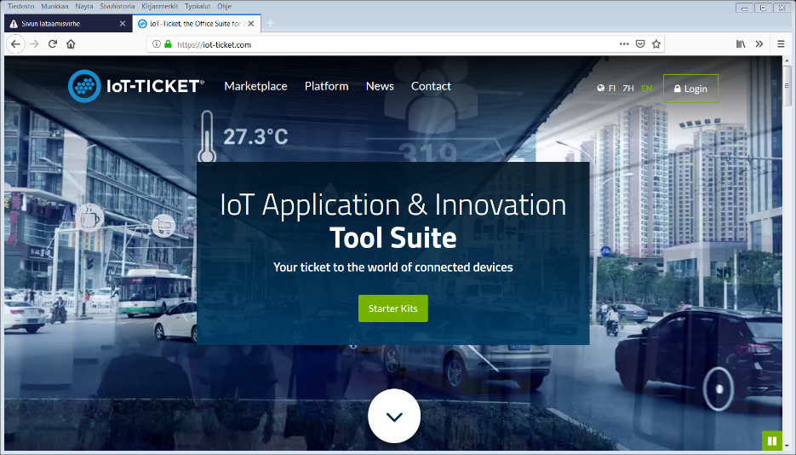
IoT-platforms – IoT-ticket
What is IoT ticket ?
IoT-Ticket is a complete Internet of Things (IoT) platform covering data acquisition, reporting, dashboard and analytics. It enables operational efficiency and business model innovation for companies. The platform supports supervisory monitoring, control, automation and advanced reporting functionalities.

Slide 2
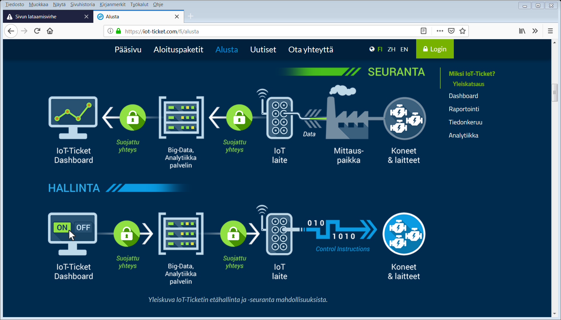
IoT-platforms – IoT-ticket

Slide 3
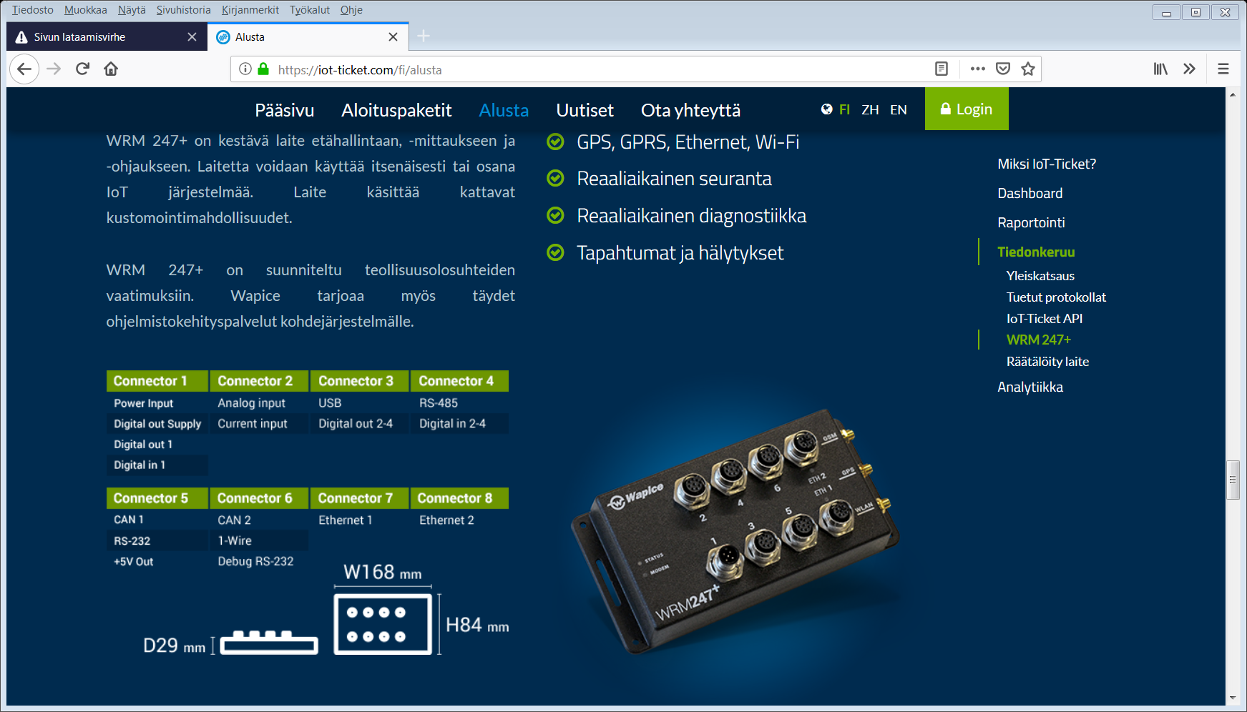
IoT-platforms – IoT-ticket

Slide 4
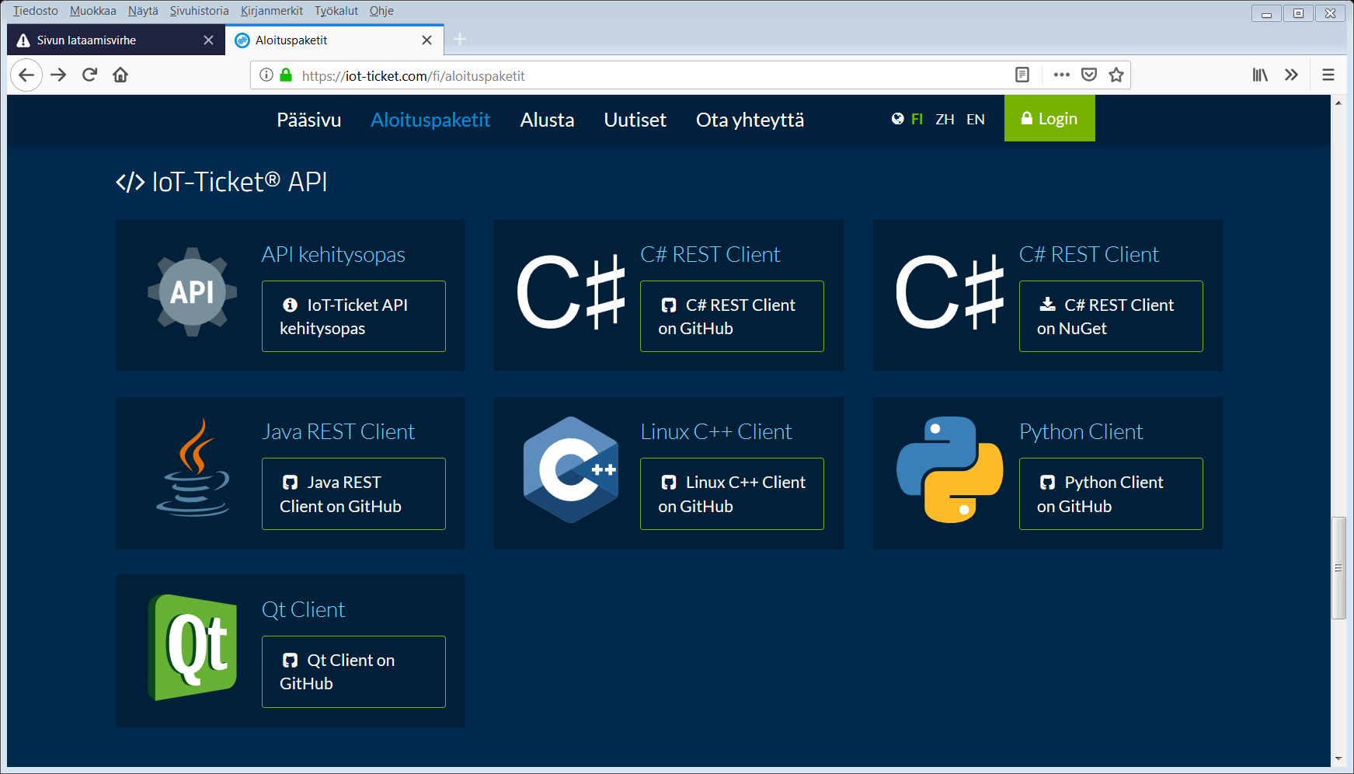
IoT-platforms – IoT-ticket

Slide 5
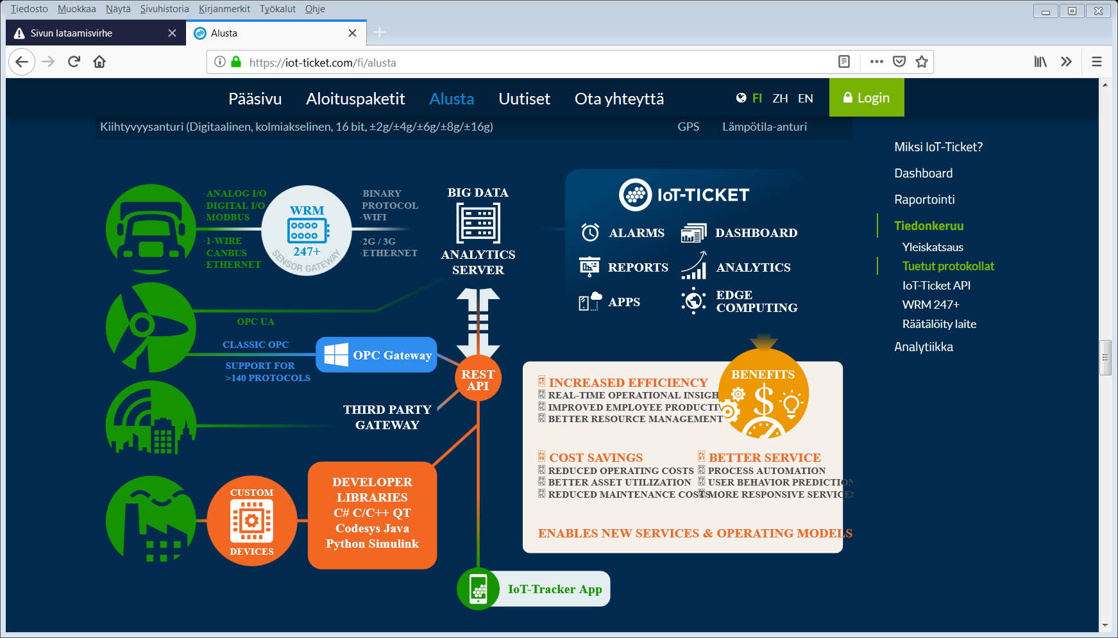
IoT-platforms – IoT-ticket

Slide 6
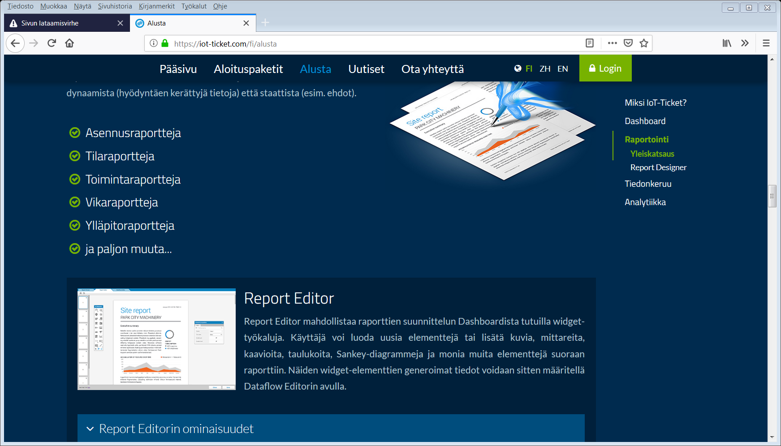
IoT-platforms – IoT-ticket

Slide 7
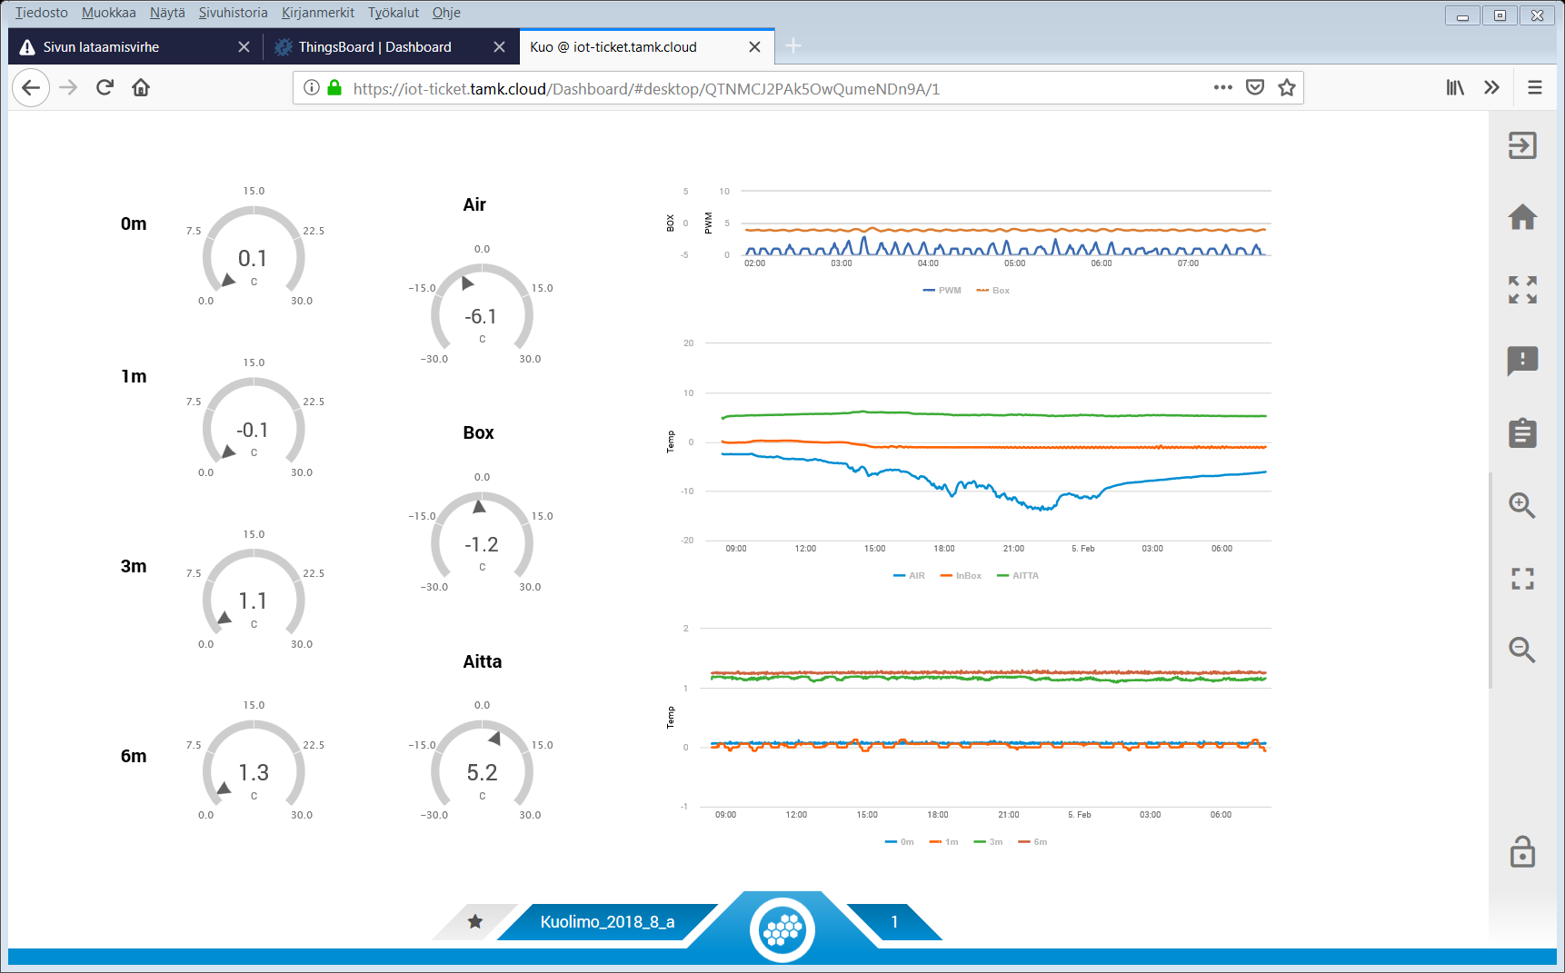
IoT-platforms – IoT-ticket

Slide 8
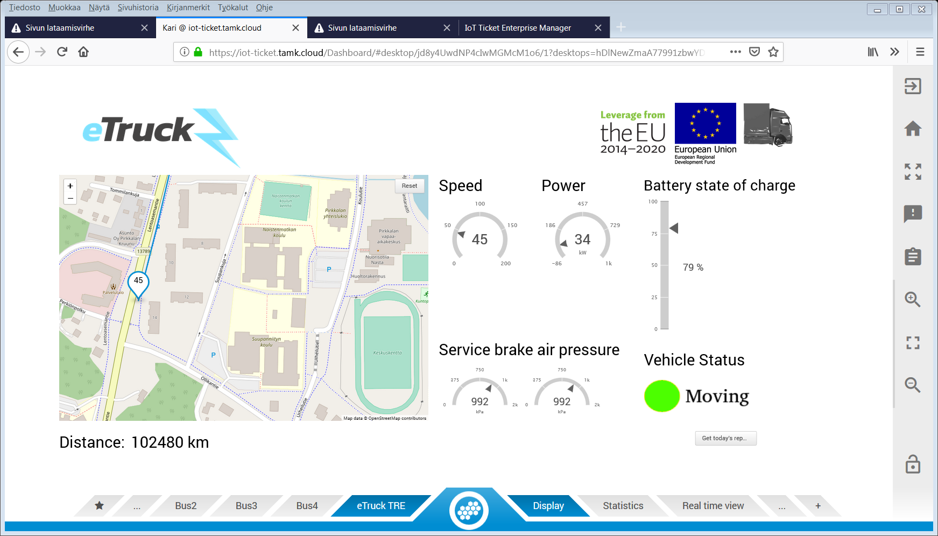
IoT-platforms – IoT-ticket

Slide 9
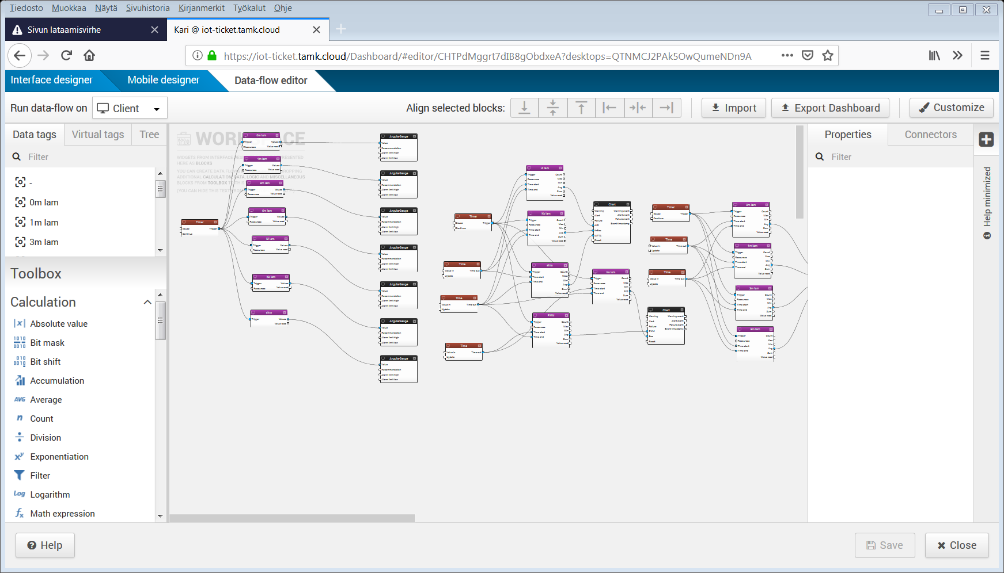
IoT-platforms – IoT-ticket

Slide 10
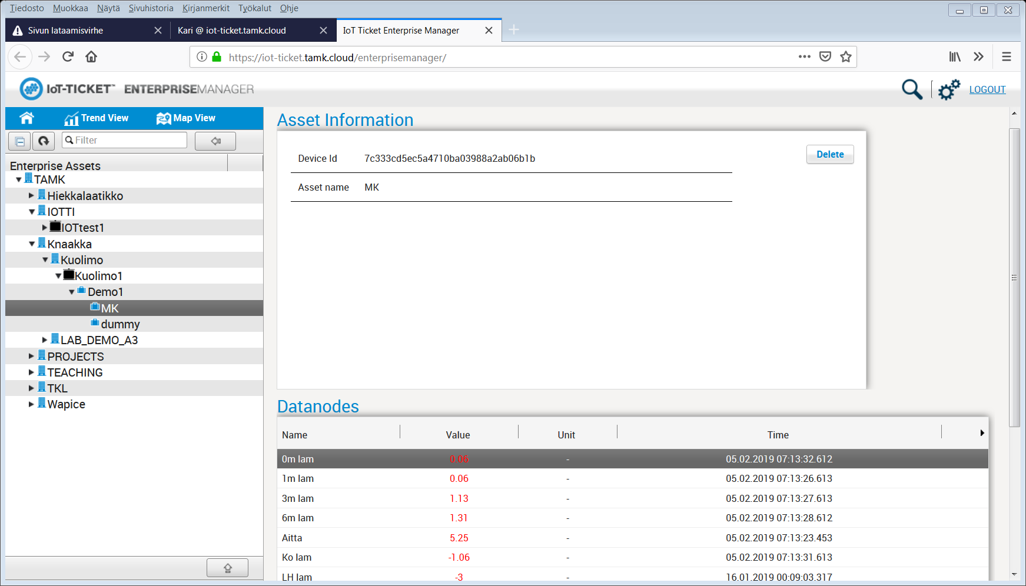
IoT-platforms – IoT-ticket

Slide 11
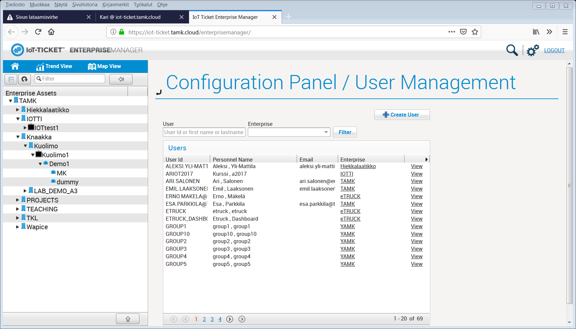
IoT-platforms – IoT-ticket

Slide 12
IoT-platforms – IoT-ticket
curl -X POST
--user wrmuser: wrmpassword \
-H "Content-Type:application/json" \
-d '{ "name":"OPC Server",
"manufacturer":"HP",
"type":"PC",
"attributes":[ {"key":"OS","value":"Windows 7"},
{"key":"Screen-size","value":"1960*1800"}
]}' \"https://{server-url}/devices"
[{"name": "Temperature","path": "MainEngine/Core", "v": 60,"ts": 1414488510057,"unit": "c"},
{"name":"Latitude","v":63,"dataType":"long"},{"name":" Latitude ","v": 65},{"name": " Latitude ","v": 67}]

Slide 13
IoT-platforms – IoT-ticket

