Slide 1
IoTTi demo example IoT ticket
2019
https://www.iot-ticket.com/

Slide 2
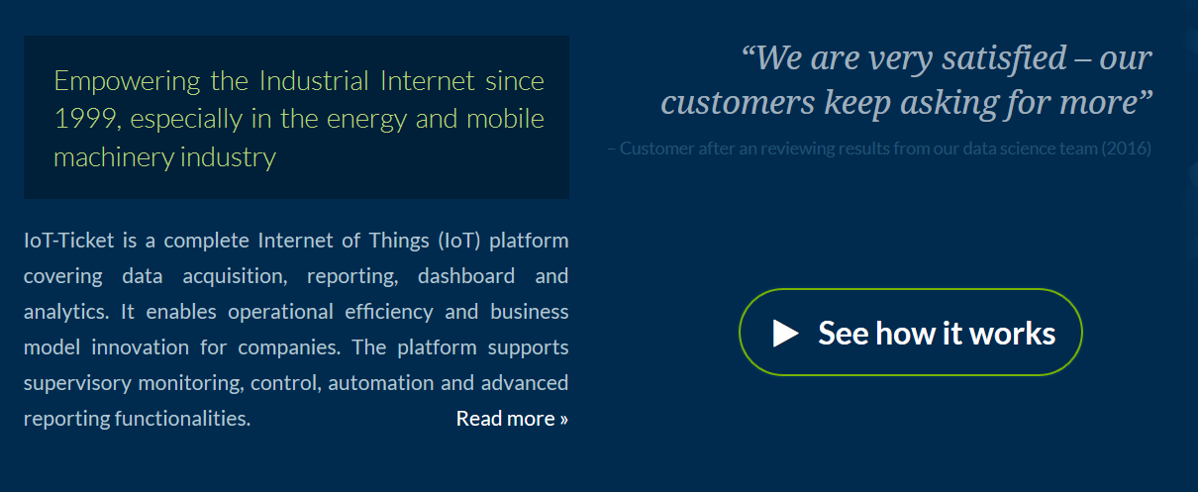
Wapice
https://www.iot-ticket.com/

Slide 3
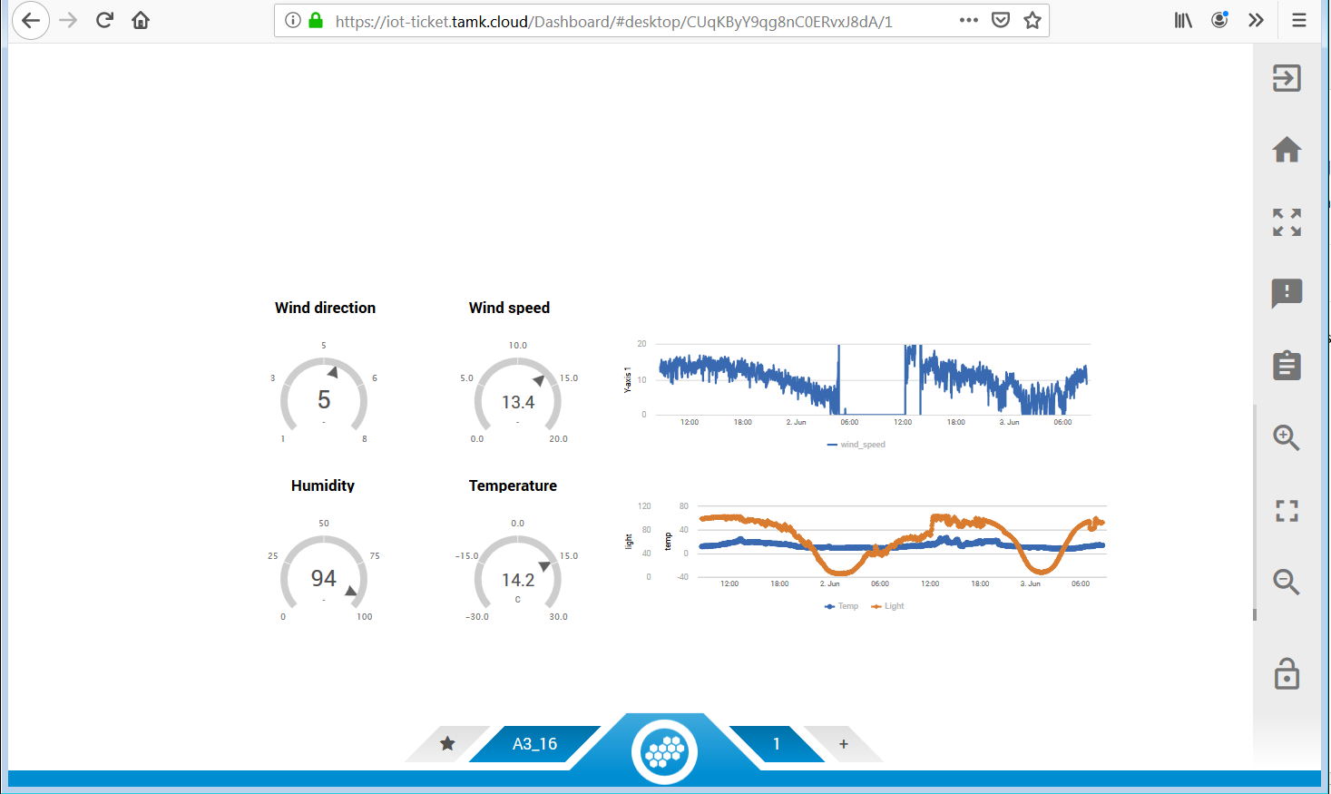
IoT-ticket – IoTTi demo example
prerequisites
username is available for IoT-ticket
IoTTi sensors are sending data or other sensors available

Slide 4
IoT-ticket
IoTTi weather station demo example

Slide 5
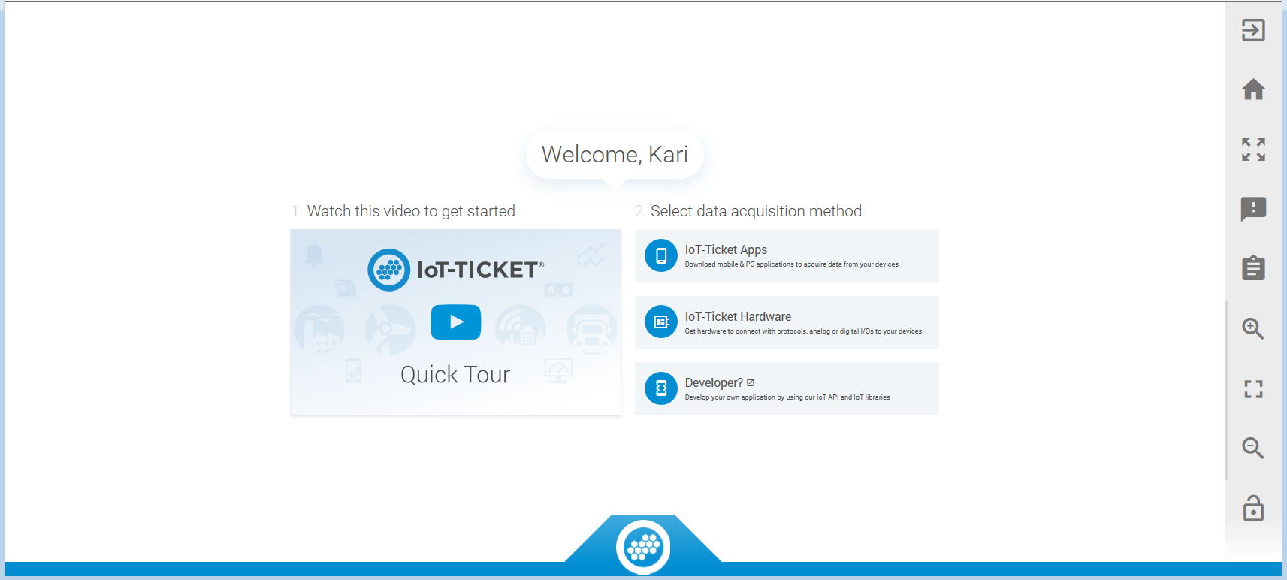
IoT-ticket
Home screen

Slide 6
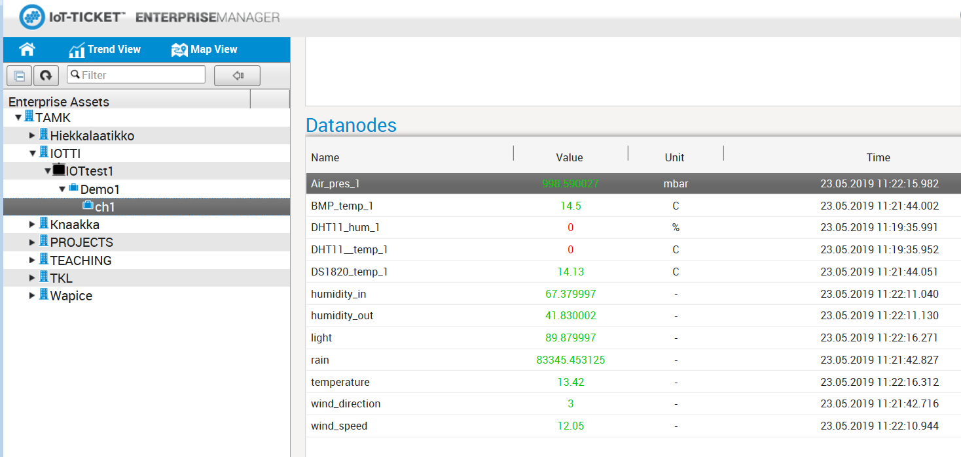
IoT-ticket
Enterprice manager
datanodes
check first that data is coming
see Time and value font is green

Slide 7
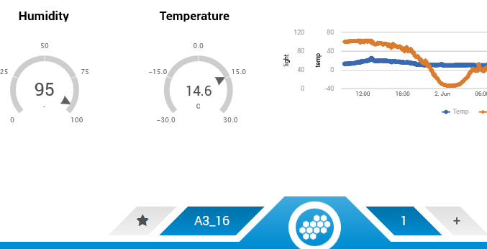
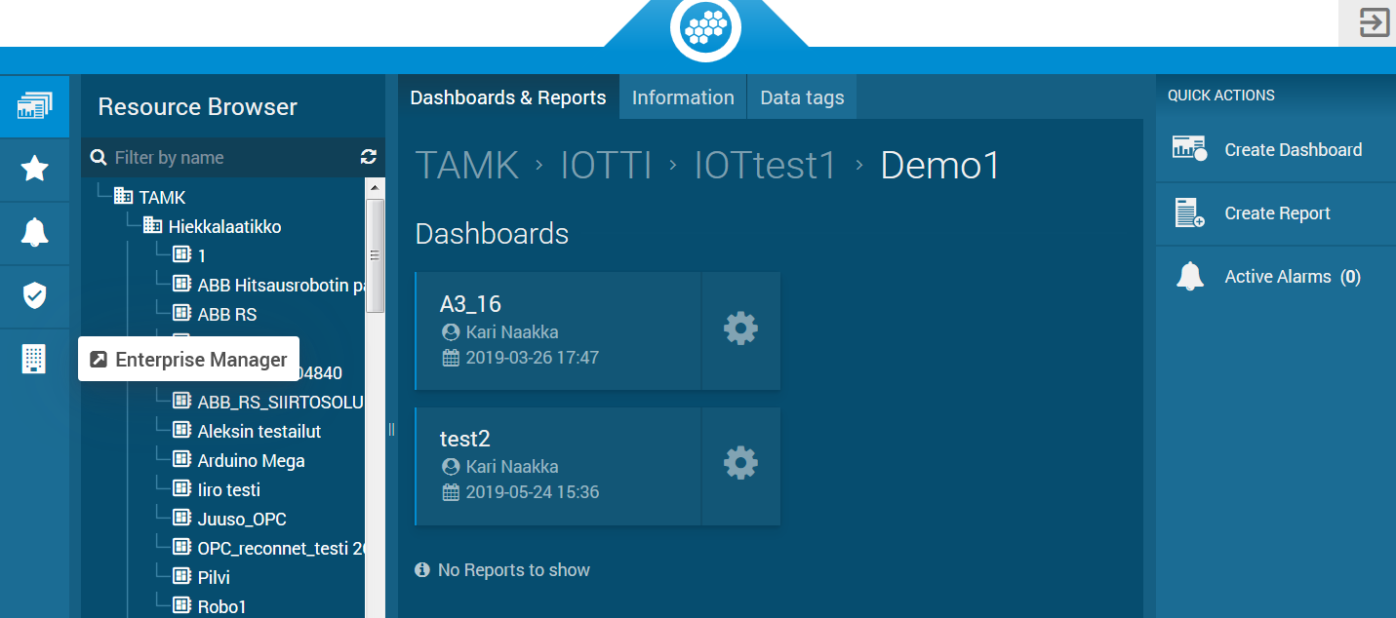
IoT-ticket
create new dashboard

Slide 8
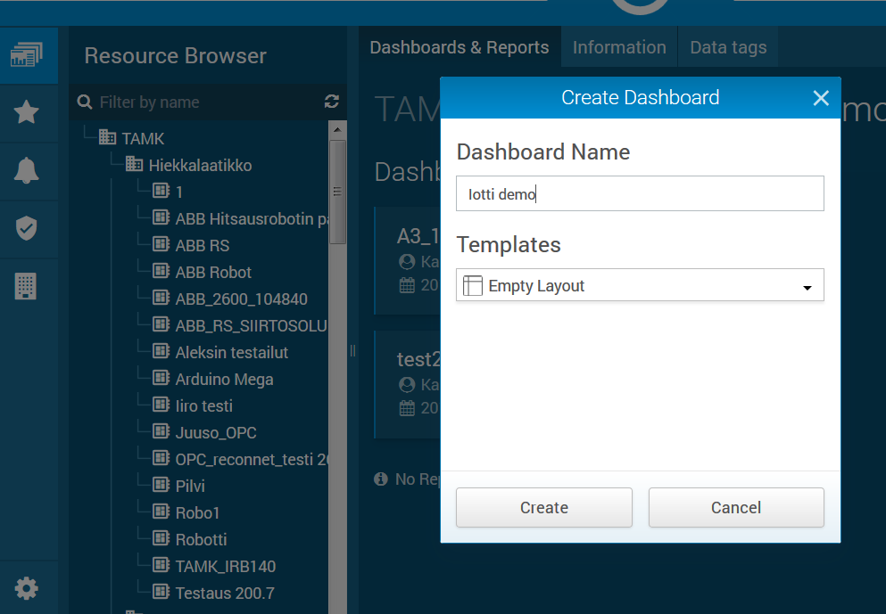
IoT-ticket
dashboard name “Iotti demo”
> Create

Slide 9
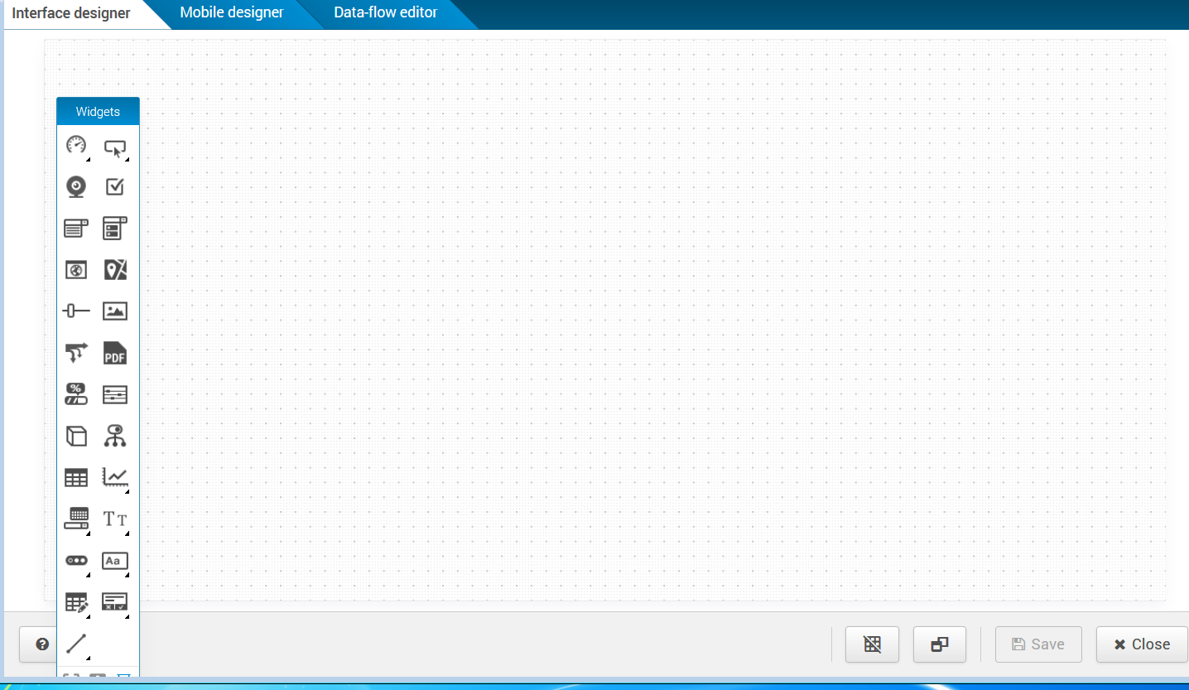
IoT-ticket
empty dashboard
pick graphical components from left panel

Slide 10
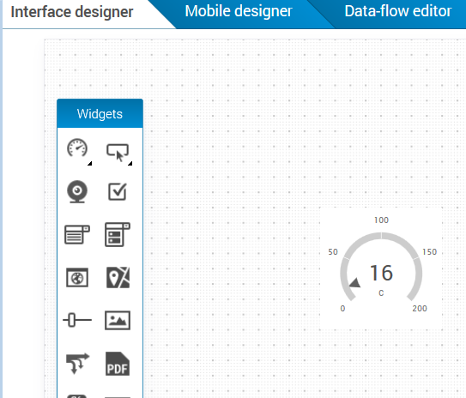
IoT-ticket
add annular gauge

Slide 11
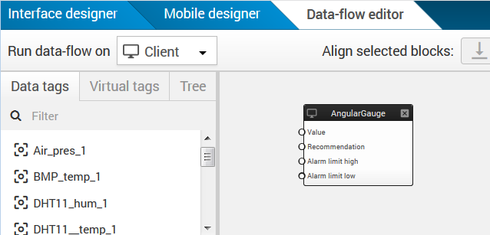
IoT-ticket
go data-flow editor
available sensors

Slide 12
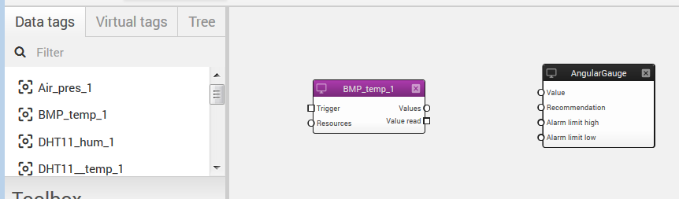
IoT-ticket
add BMP_temp_1 sensor

Slide 13
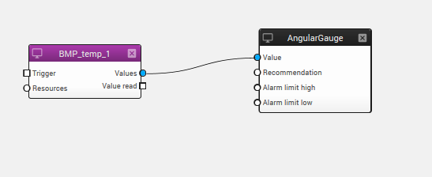
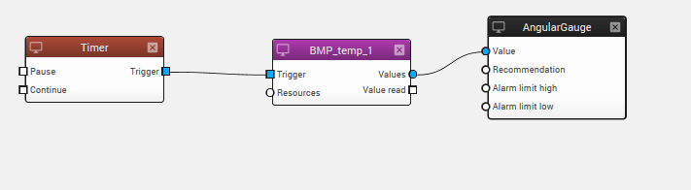
IoT-ticket
connect graphical component to sensor
add timer to trigger sensor updates
save

Slide 14
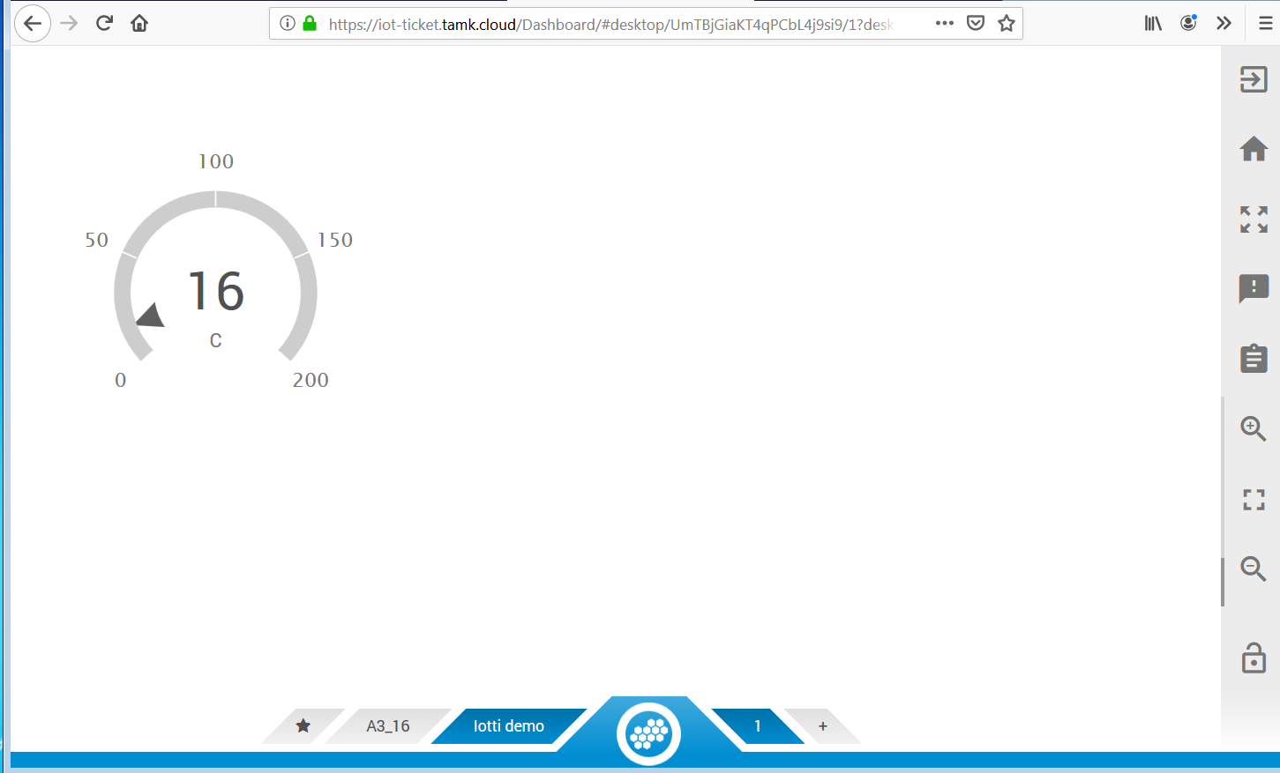
IoT-ticket
working dashboard with one sensor “BMP_temp_1

Slide 15
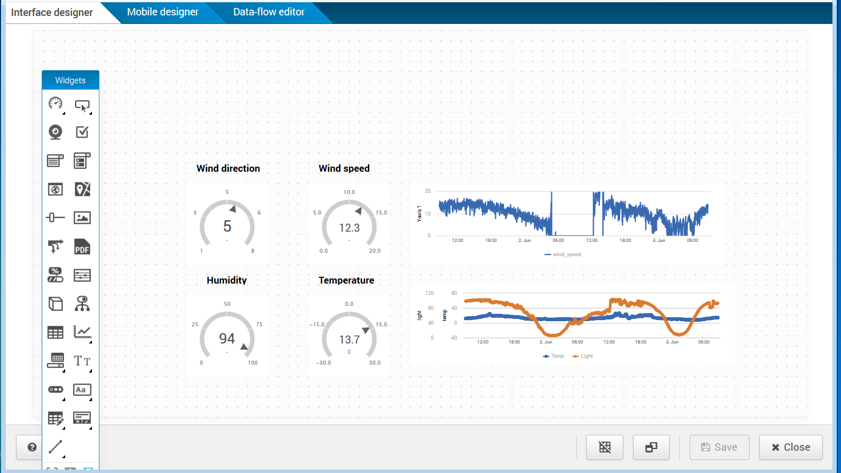
IoT-ticket
IoTTi example
Graphical editing mode
pick graphical components from left panel

Slide 16
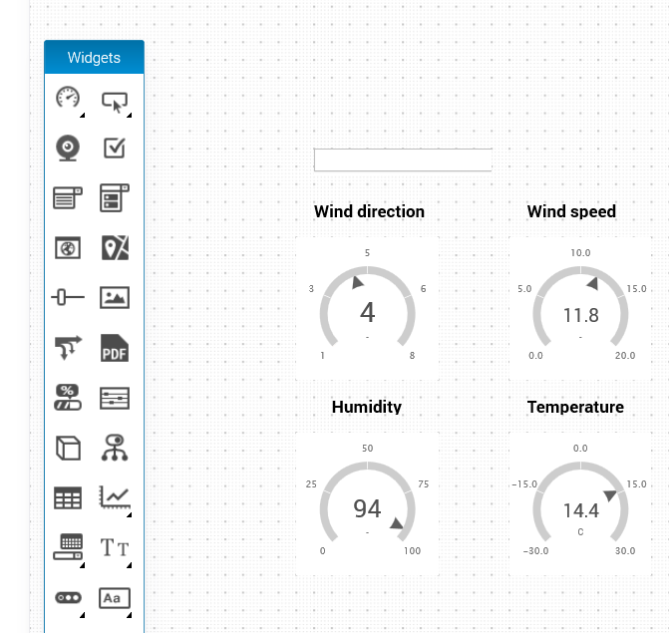
IoT-ticket
Add air-pressure display
> pick textbox

Slide 17
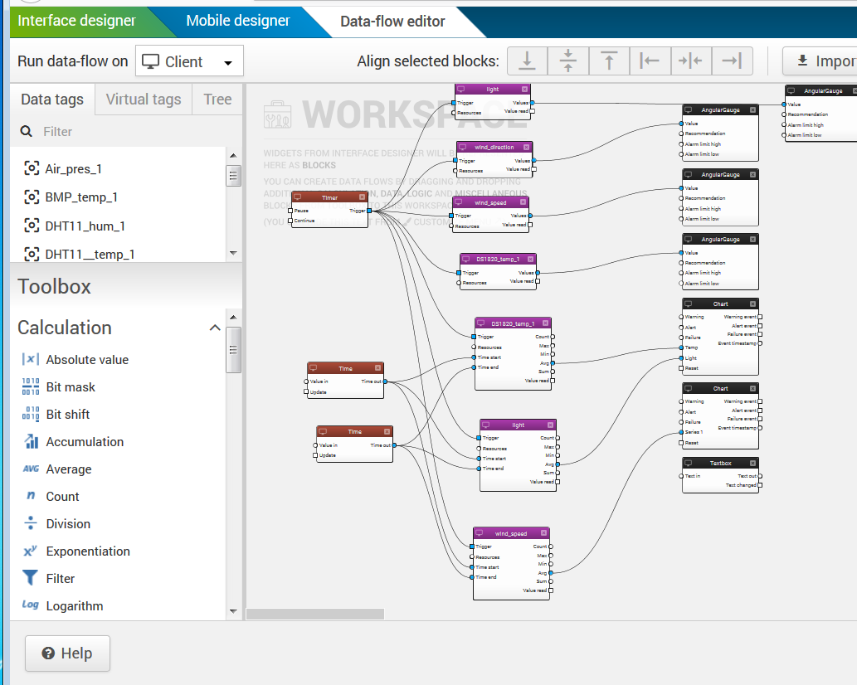
IoT-ticket
go to data-flow editor
textbox in data-flow editor

Slide 18
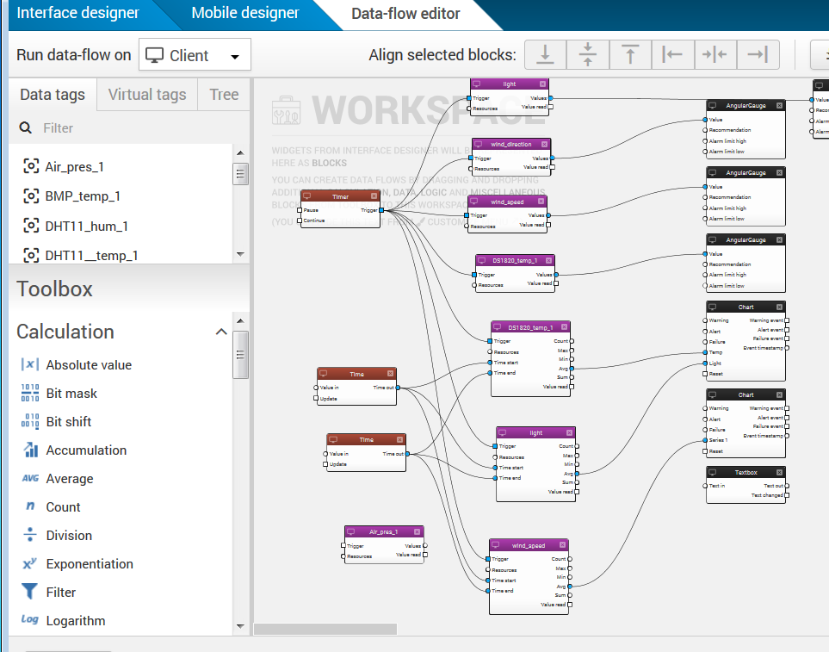
IoT-ticket
connect sensor (Air_pres_1) to textbox

Slide 19
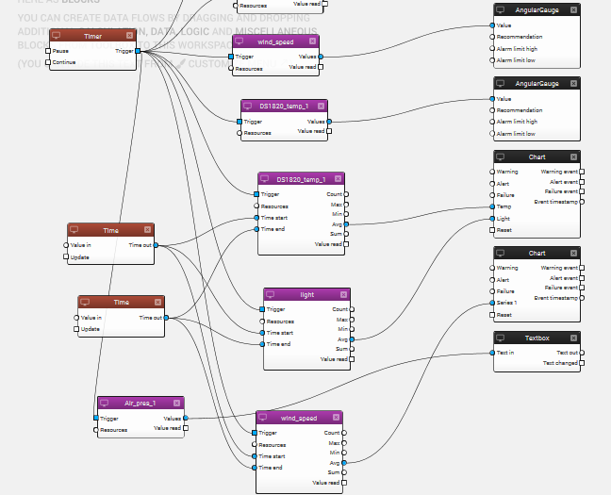
IoT-ticket
connect sensor (Air_pres_1) to textbox
add trigger to sensor
save

Slide 20
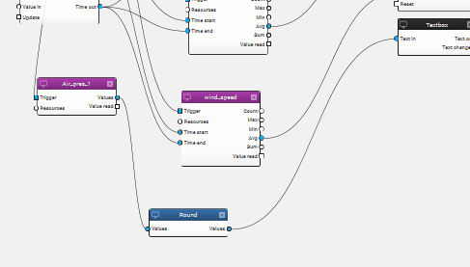
IoT-ticket
round number zero desimal

Slide 21
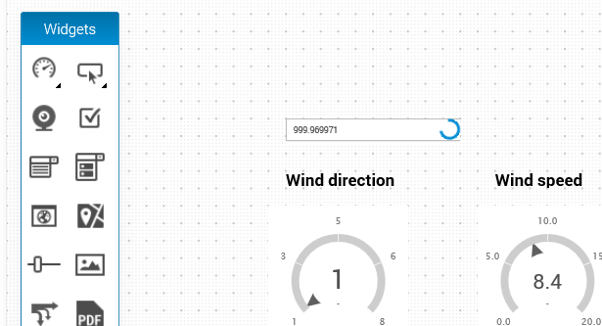
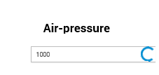
IoT-ticket
Now air-pressure value is readable in dashboard
Add label

Slide 22
IoT-ticket
REST API
https://iot-ticket.com/images/Files/IoT-Ticket.com_IoT_API.pdf

Slide 23
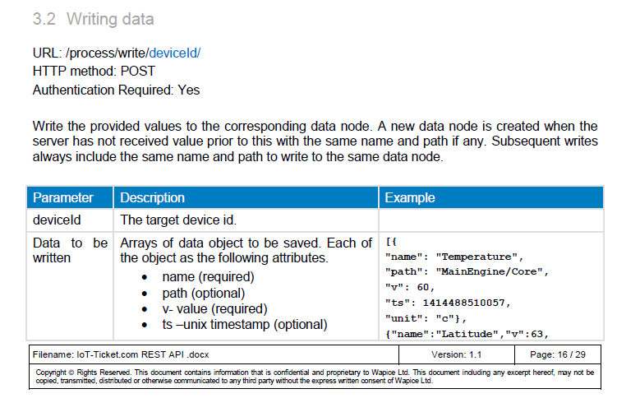
IoT-ticket
REST API
write data to db

Slide 24
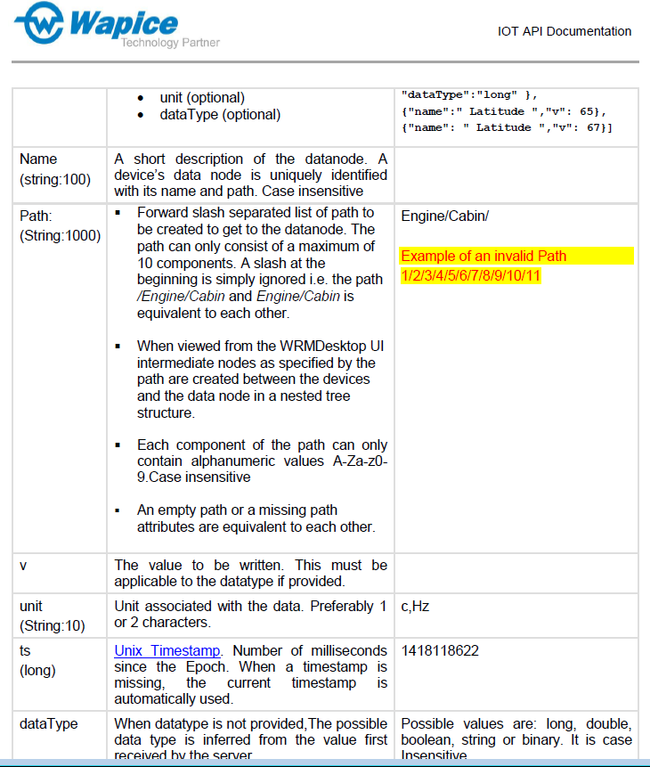
IoT-ticket
REST API
write data to db

Slide 25
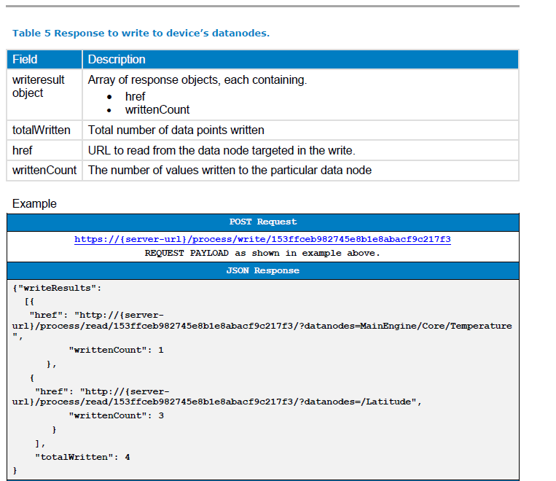
IoT-ticket
REST API
server responce

