Slide 1
from MQTT to Thingsboard MQTT ++client
These slides explain briefly how IoTTi gateway C++ client for Thingsboard works.
C++ client subsribes to listen IoTTi MQTT messages and when message (=measurement comes) comes, client send it to Thingsboard.
C++ code could compiled in all environments that support needed libraries:
Needed non standard C++ libraries
#include <jsoncpp/json/json.h>
#include <mosquittopp.h>
#include <curl/curl.h>

Slide 2
from MQTT to IoT-ticket MQTT ++client
Main.cpp
Create 3 threads
MQTT message handling
timing for run indicator
Start threads

Slide 3
from MQTT to IoT-ticket MQTT ++client
mqtt_config.h
Configuration file to define incoming and outgoing mqtt settings.
#define in_topic incoming topic
#define in_host_addr mqtt broker ip address
#define in_port_number incoming port number
#define out_host_addr thingsboard ip address
#define user_name thingsbaard user name
#define pass_wd thingsboar password (NULL)

Slide 4
from MQTT to IoT-ticket MQTT ++client
main.cpp
Class for received mqtt messages and class for published mqtt messages
Mqtt_in: handles incoming MQTT messaging
Mqtt_out: handles MQTT messaging sending to Thingsboard

Slide 5
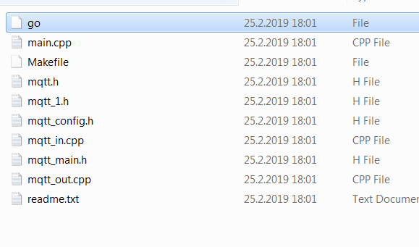
from MQTT to Thingsboard MQTT ++client
receive MQTT message
convert message to TB syntax
send to Thingsboard by MQTT

Slide 6
from MQTT to IoT-ticket MQTT ++client
MQTT
mqtt_th: Thread that handles MQTT messaging
tmr_th: Timer thread that is timing run indicator

Slide 7
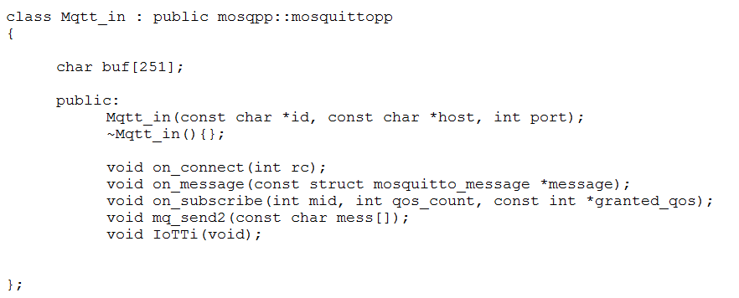
from MQTT to Thingsboard MQTT ++client
Incoming MQTT message handling

Slide 8
from MQTT to IoT-ticket MQTT ++client
on_message
Check right topic Check right message prefix
call IoTTi(…)
parse out from message S_name sensor name S_value sensor value
create published mqtt message to Thingsboard
call mqt_out.publish(….) / from class Mqtt_out
IoTTi()

Slide 9
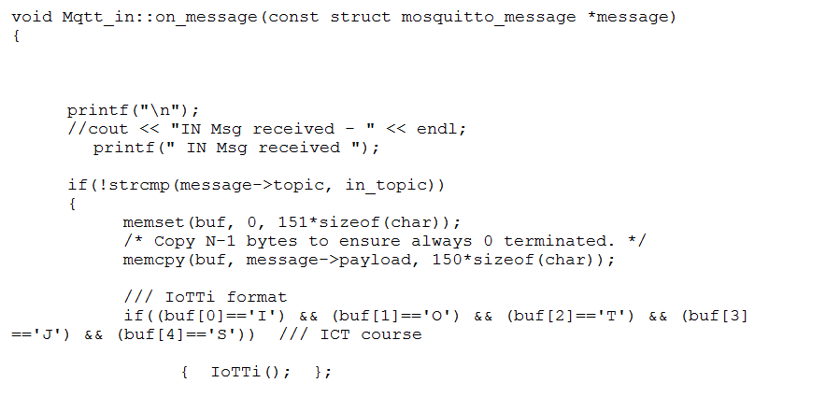
from MQTT to Thingsboard MQTT ++client
read MQTT message
convert message to TB syntax
send to Thingsboard by MQTT

Slide 10
from MQTT to Thingsboard MQTT ++client
read MQTT message
convert incoming message to TB syntax
send to Thingsboard by MQTT
JSON tags:
S_path string
S_name string
S_value integer or float
S_unit string
S_data string
to TB message format:
{ “ temperature2 “ : 19.9 } “

Slide 11
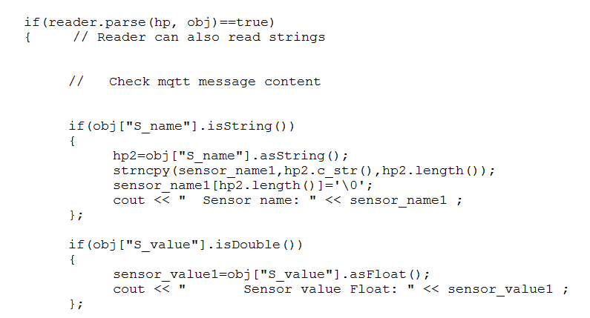
from MQTT to Thingsboard MQTT ++client
read MQTT message
convert message to TB syntax
send to Thingsboard by MQTT

Slide 12
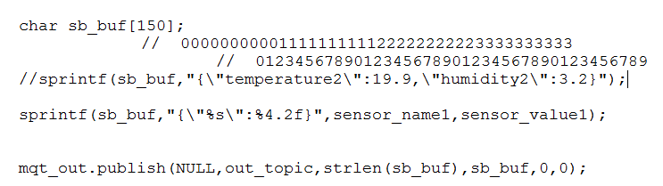
from MQTT to Thingsboard MQTT ++client
read MQTT message
convert message to TB syntax
send to Thingsboard by MQTT

