Slide 1
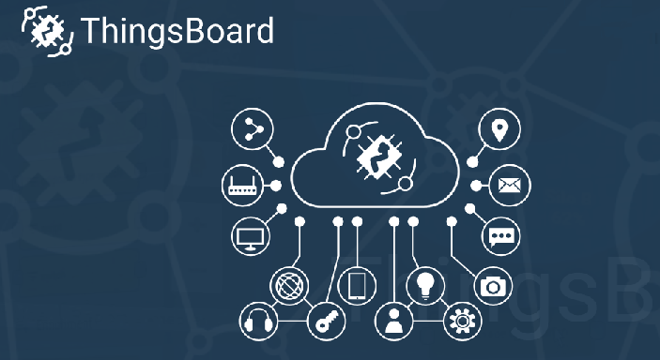
IoTTi weather data > Thingsboard
In next slides there are short example
how to use IoTTi weather station signals with Thingsboard ?
Using Thingsboard tutorial
https://thingsboard.io/docs/getting-started-guides/helloworld/

Slide 2
IoTTi weather data > Thingsboard
prerequisites:
username is available for Thingsboard
IoTTi sensors are sending data or other sensors available

Slide 3
IoTTi – Thingsboard
Here we are using MQTT interface.
MQTT Device API

Slide 4
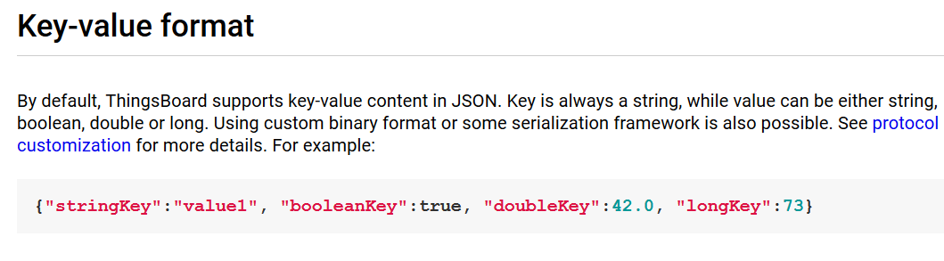
IoTTi – Thingsboard
MQTT basics
MQTT is a lightweight publish-subscribe messaging protocol which probably makes it the most suitable for various IoT devices. ThingsBoard server nodes act as an MQTT Broker that supports QoS levels 0 (at most once) and 1 (at least once) and a set of predefined topics.

Slide 5
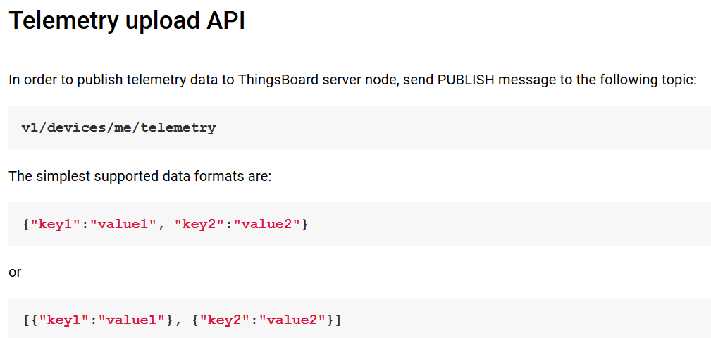
IoTTi – Thingsboard

Slide 6
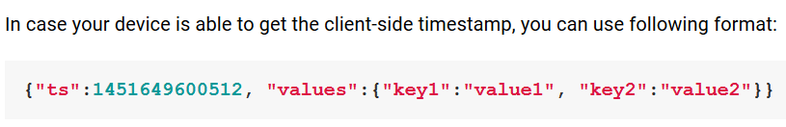
IoTTi – Thingsboard
# Publish data as an object without timestamp (server-side timestamp will be used)
mosquitto_pub -d -h "127.0.0.1" -t "v1/devices/me/telemetry" -u "$ACCESS_TOKEN" -f "telemetry-data-as-object.json"

Slide 7
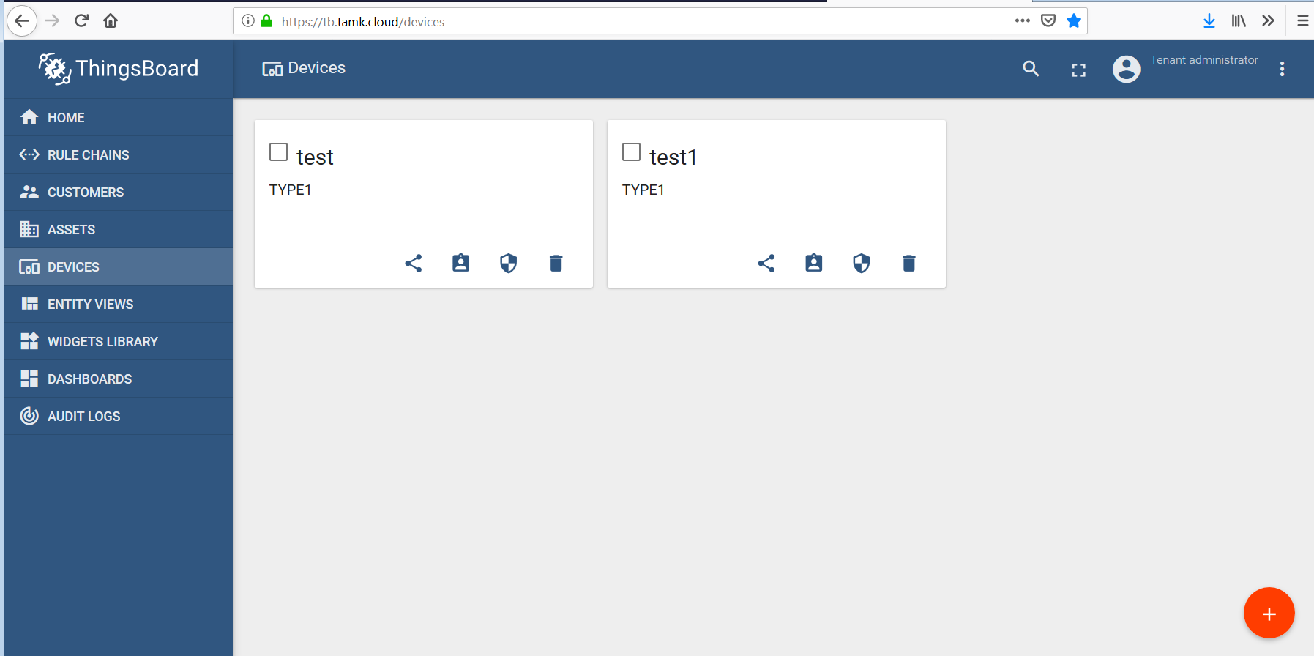
IoTTi – Thingsboard
IoTTi - Device creation
> add new device

Slide 8
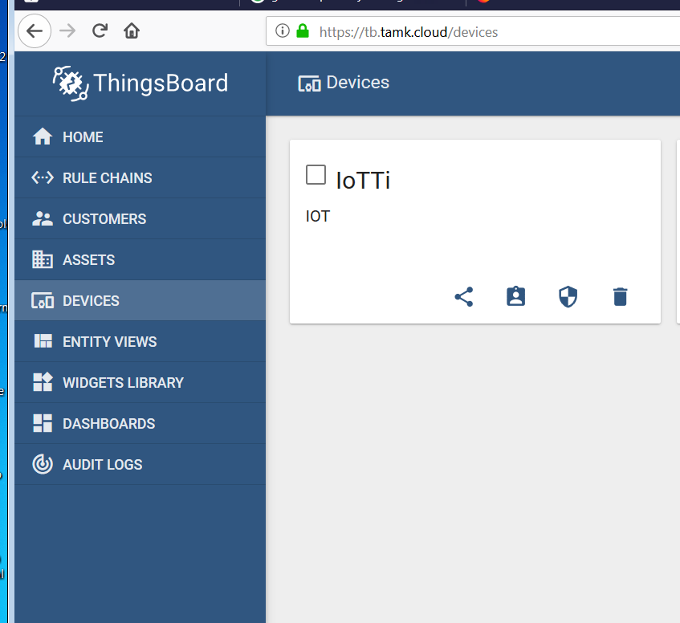
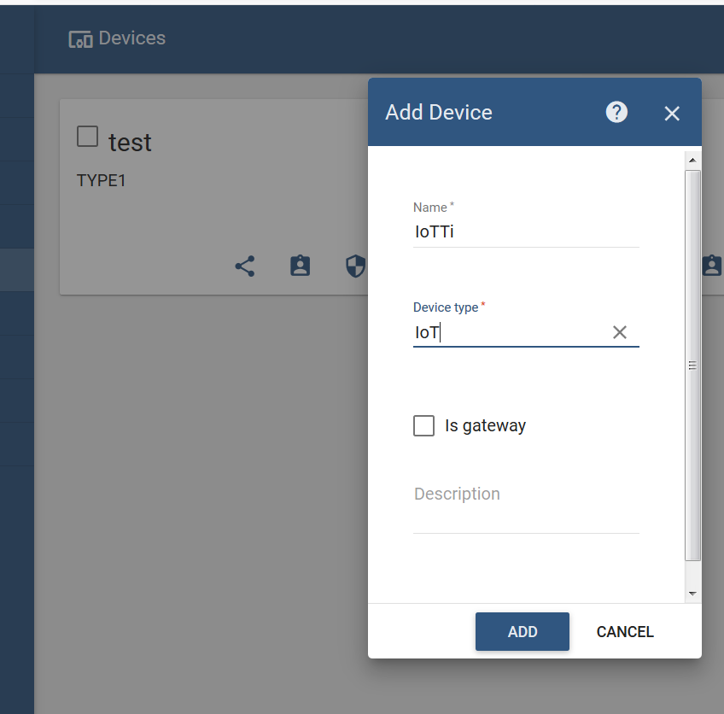
IoTTi – Thingsboard
IoTTi - Device creation
> device name IoTTi

Slide 9
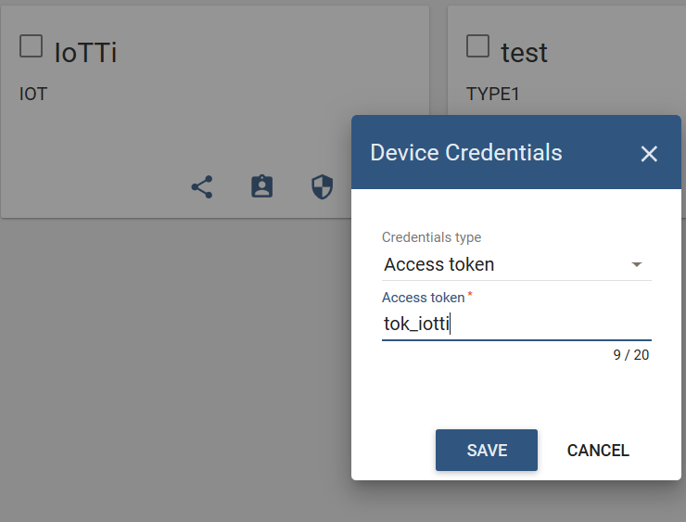
IoTTi – Thingsboard
IoTTi - Device creation
define Access token
tok_iotti
= same as mqtt username

Slide 10
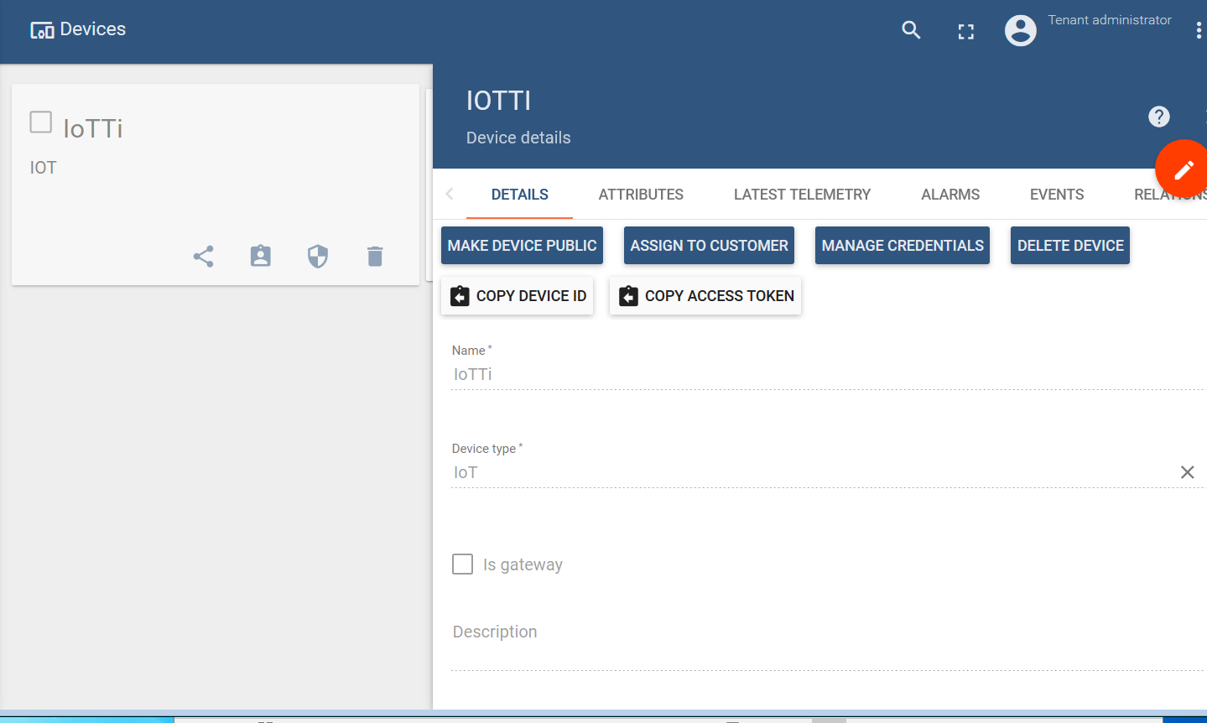
IoTTi – Thingsboard
Device details
check latest telemetry to verify that C++ client is sending data

Slide 11
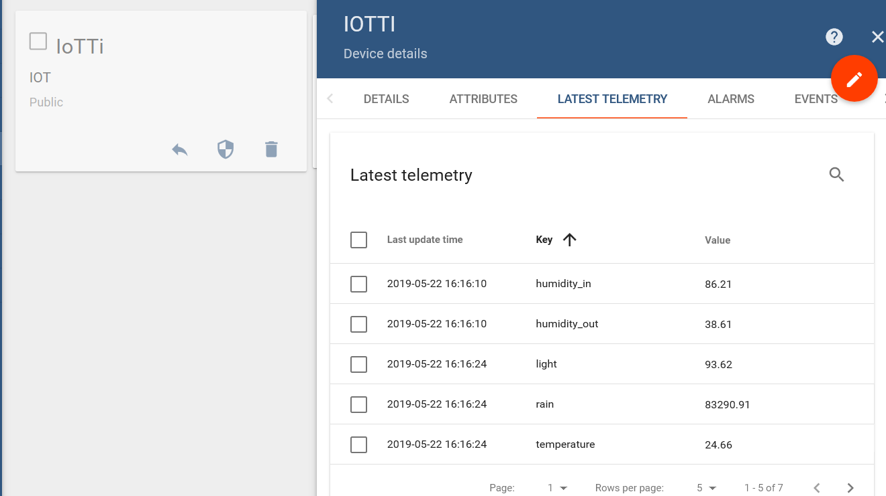
IoTTi – Thingsboard
check latest telemetry

Slide 12
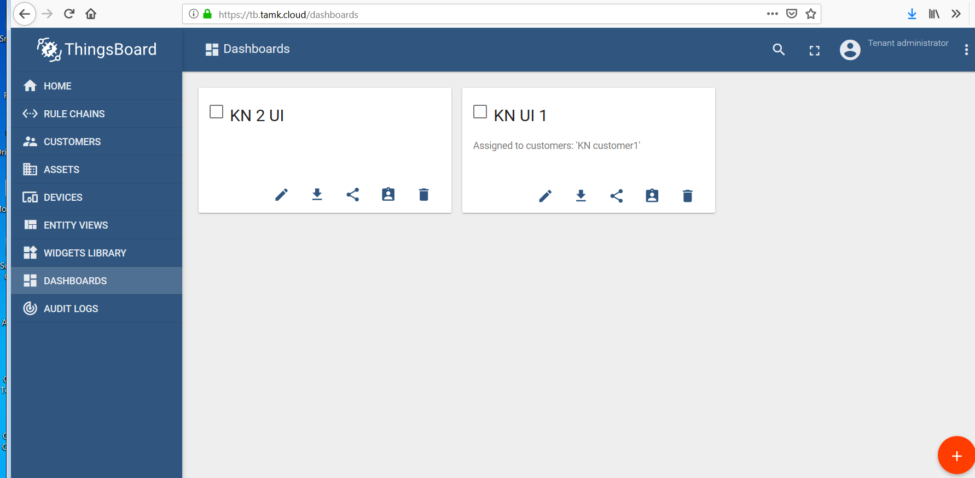
IoTTi – Thingsboard
Create IoTTi dashboard
>create new dashboard

Slide 13
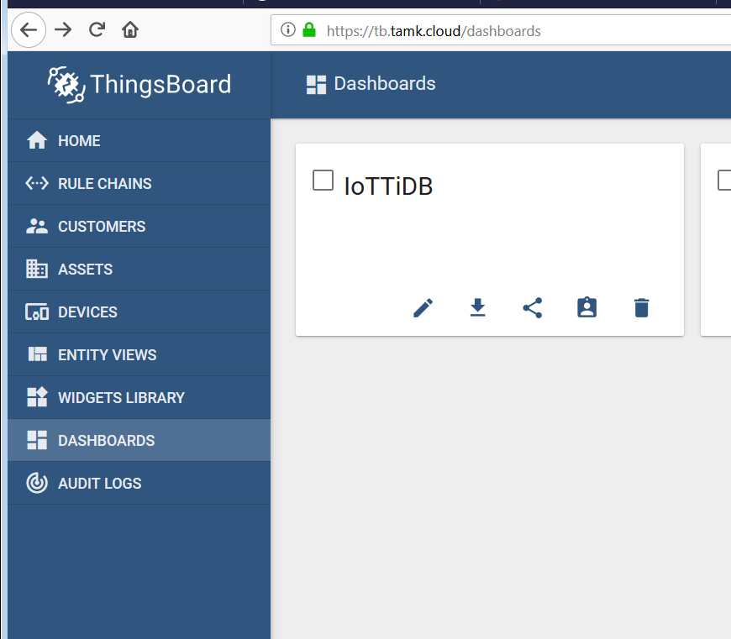
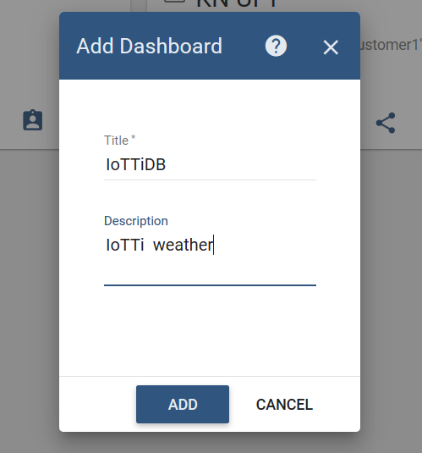
IoTTi – Thingsboard
Create IoTTi dashboard
>create new dashboard
=IoTTiDB

Slide 14
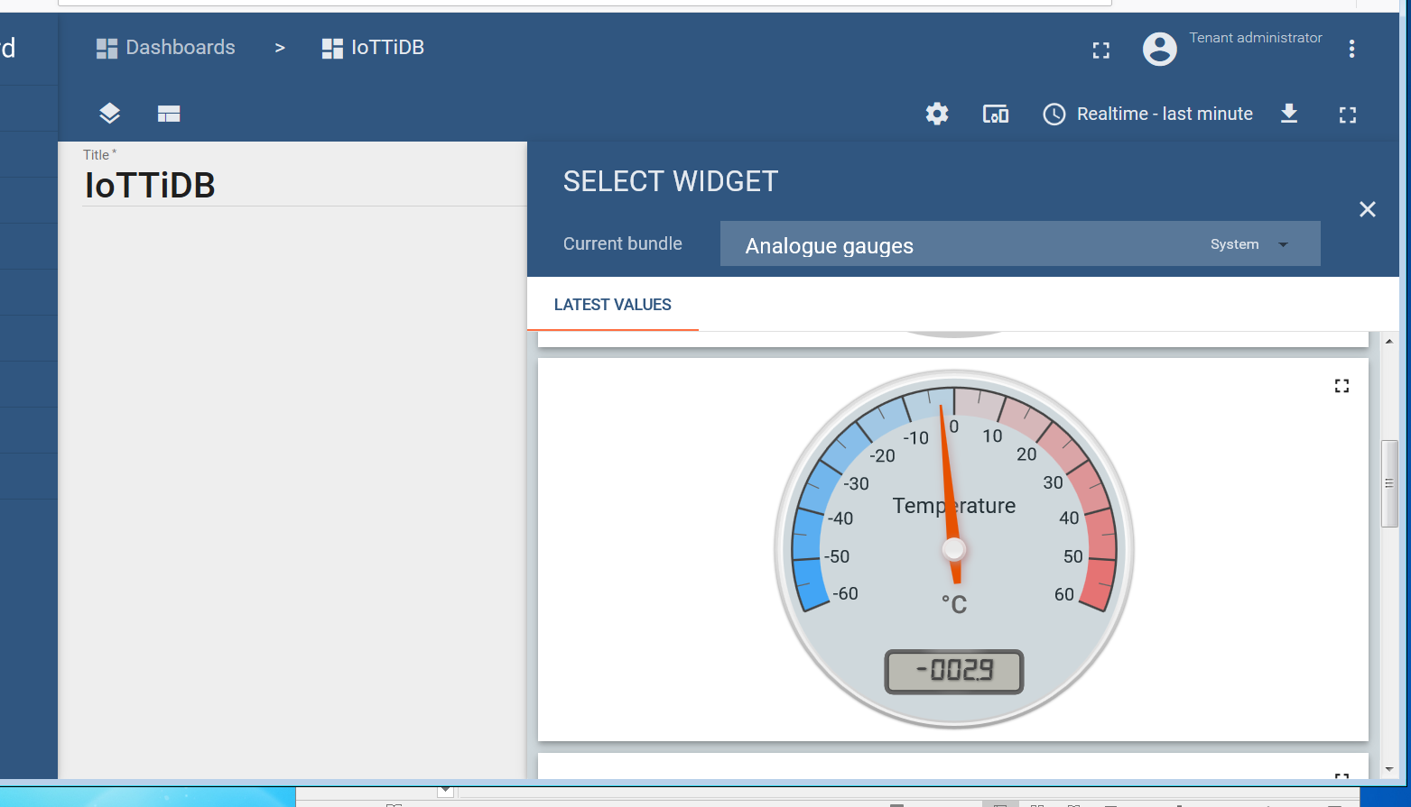
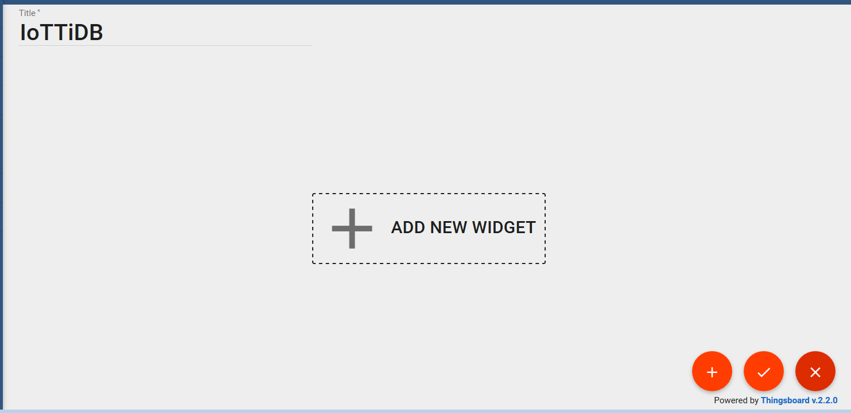
IoTTi – Thingsboard
Add new WIDGETS
> analog gauge

Slide 15
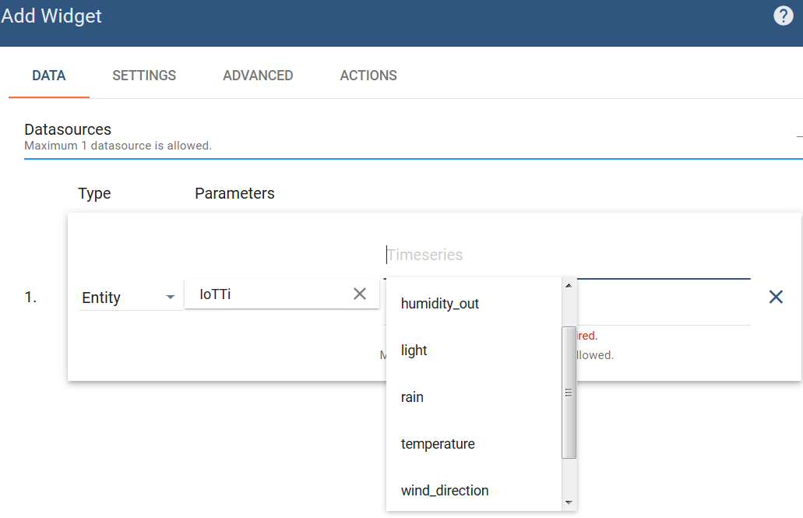
IoTTi – Thingsboard
Add datasource
(Timeseries)

Slide 16
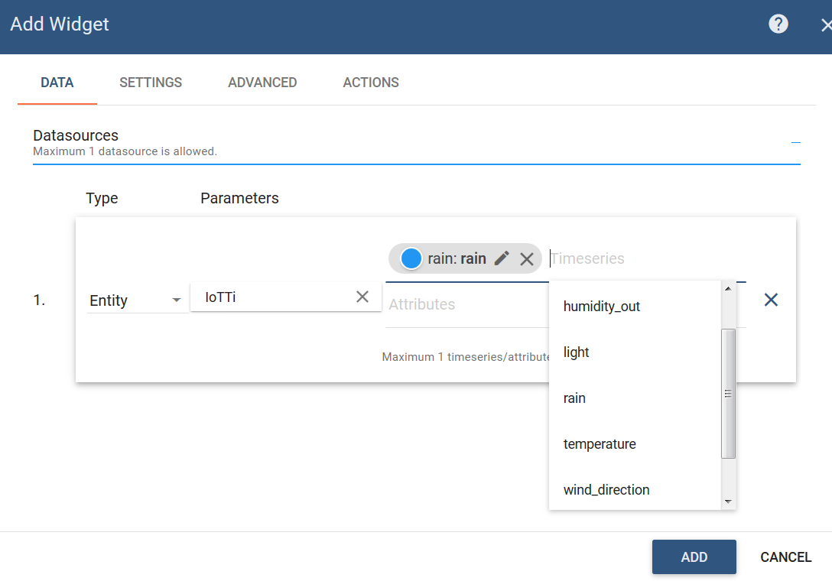
IoTTi – Thingsboard
Add datasource

Slide 17
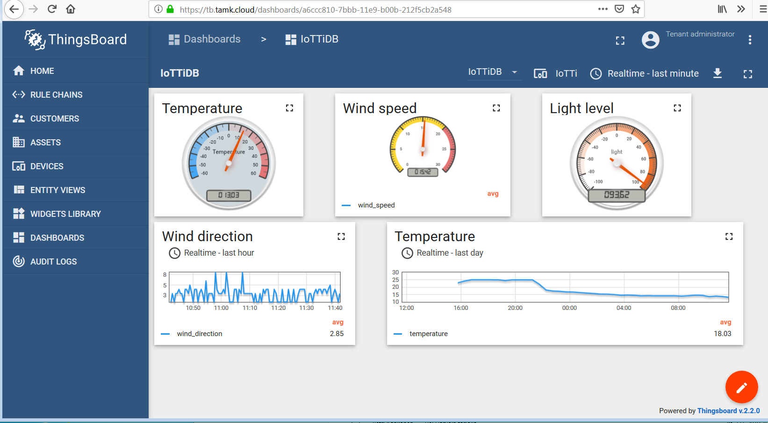
IoTTi – Thingsboard

Slide 18
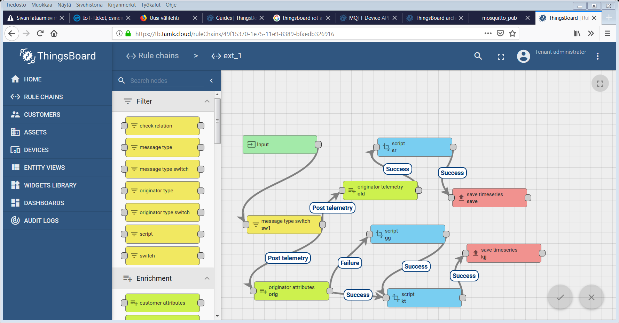
IoTTi – Thingsboard
Add processing for signals

Slide 19
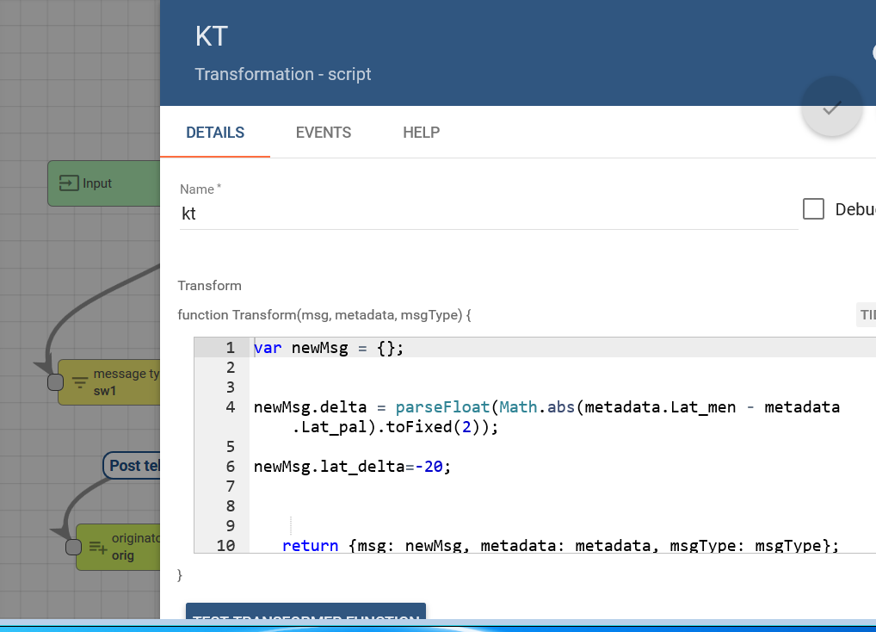
IoTTi – Thingsboard
Add processing for signals

