Slide 1
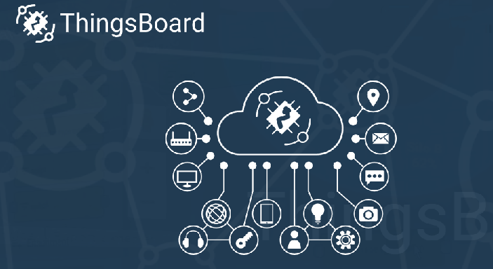
IoT-platforms – Thingboard
What is Thingboard ?
ThingsBoard is an open-source IoT platform for data collection, processing, visualization, and device management.
It enables device connectivity via industry standard IoT protocols - MQTT, CoAP and HTTP and supports both cloud and on-premises deployments. ThingsBoard combines scalability, fault-tolerance and performance so you will never lose your data.

Slide 2
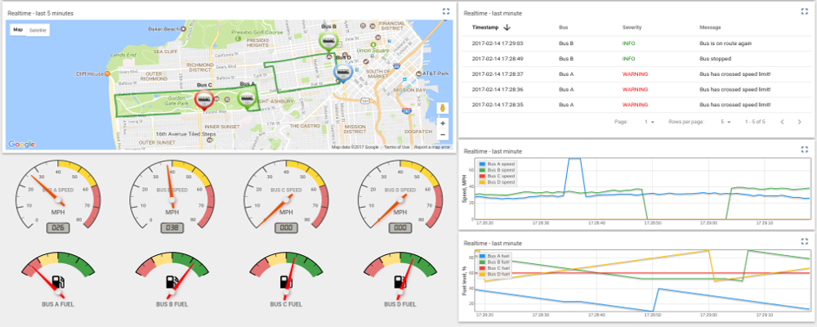
IoT-platforms – Thingboard

Slide 3
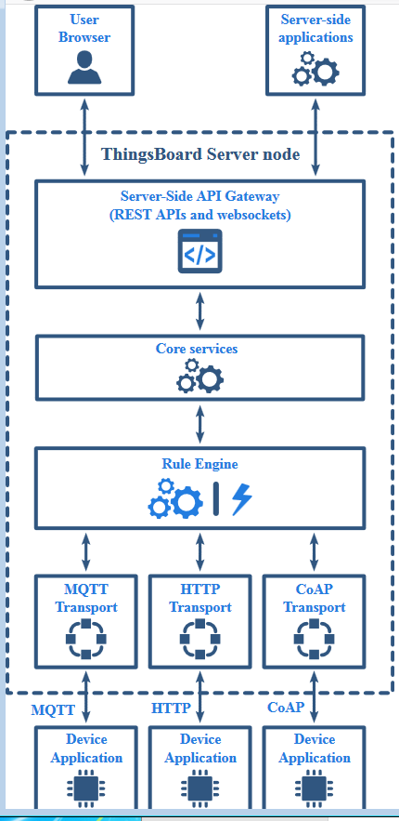
IoT-platforms – Thingboard

Slide 4
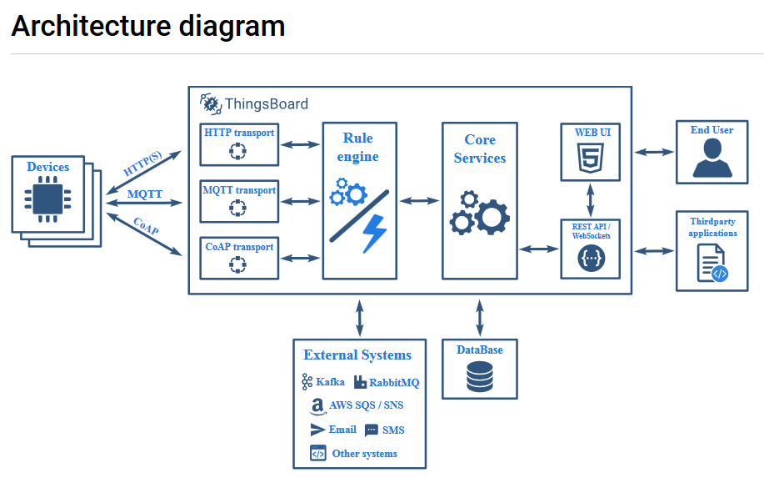
IoT-platforms – Thingboard

Slide 5
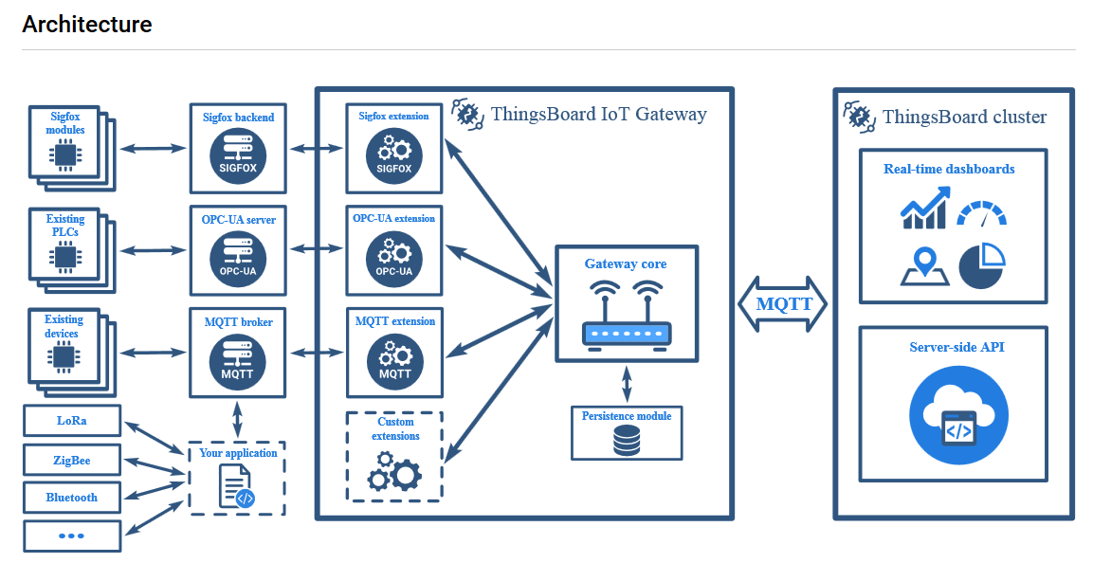
IoT-platforms – Thingboard

Slide 6
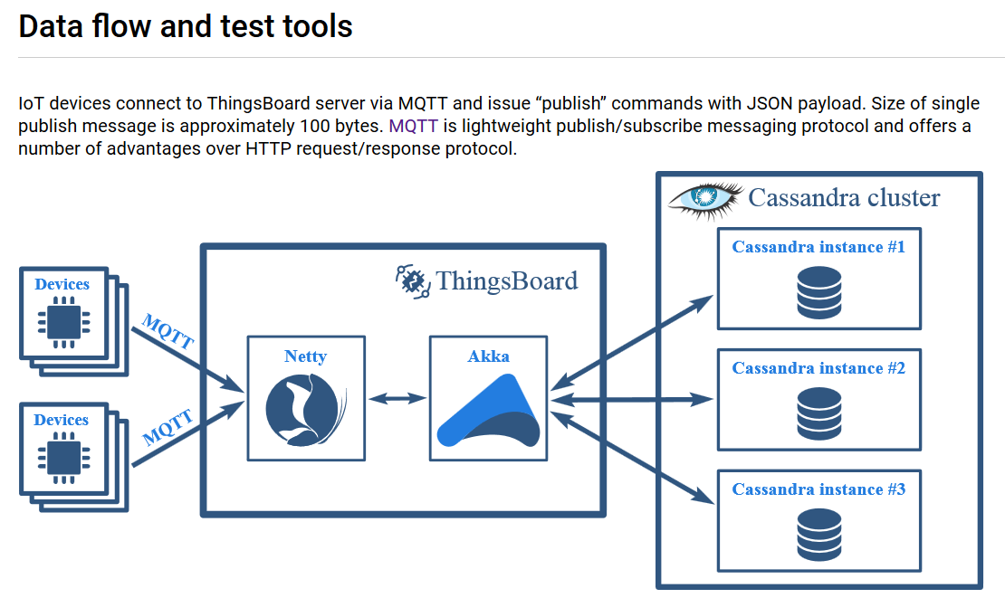
IoT-platforms – Thingboard

Slide 7
IoT-platforms – Thingboard
ThingsBoard API reference
Device Connectivity Protocols
MQTT Device API
CoAP Device API
HTTP Device API
Administration REST API
MQTT Gateway API Reference

Slide 8
IoT-platforms – Thingboard

Slide 9
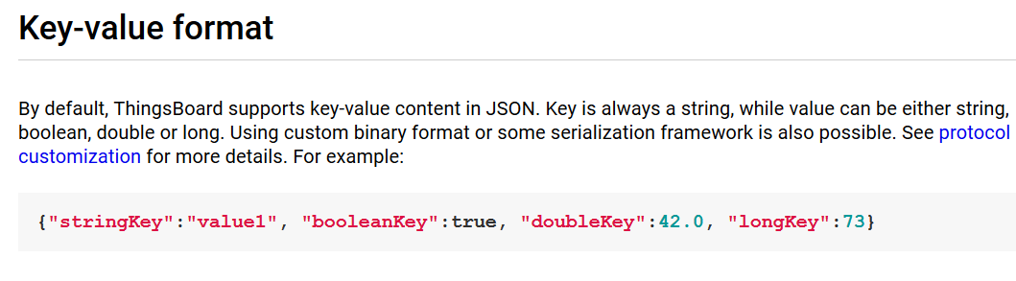
IoT-platforms – Thingboard
MQTT basics
MQTT is a lightweight publish-subscribe messaging protocol which probably makes it the most suitable for various IoT devices. ThingsBoard server nodes act as an MQTT Broker that supports QoS levels 0 (at most once) and 1 (at least once) and a set of predefined topics.

Slide 10
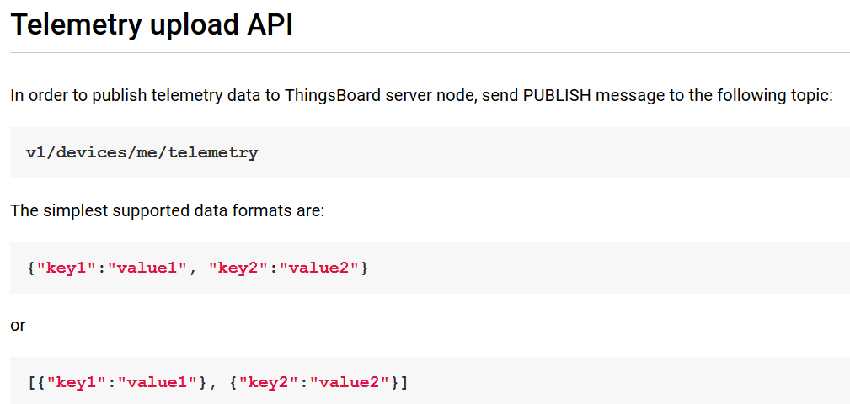
IoT-platforms – Thingboard

Slide 11
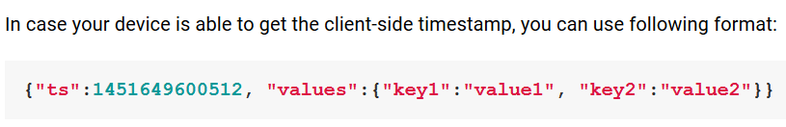
IoT-platforms – Thingboard
# Publish data as an object without timestamp (server-side timestamp will be used)
mosquitto_pub -d -h "127.0.0.1" -t "v1/devices/me/telemetry" -u "$ACCESS_TOKEN" -f "telemetry-data-as-object.json"

Slide 12
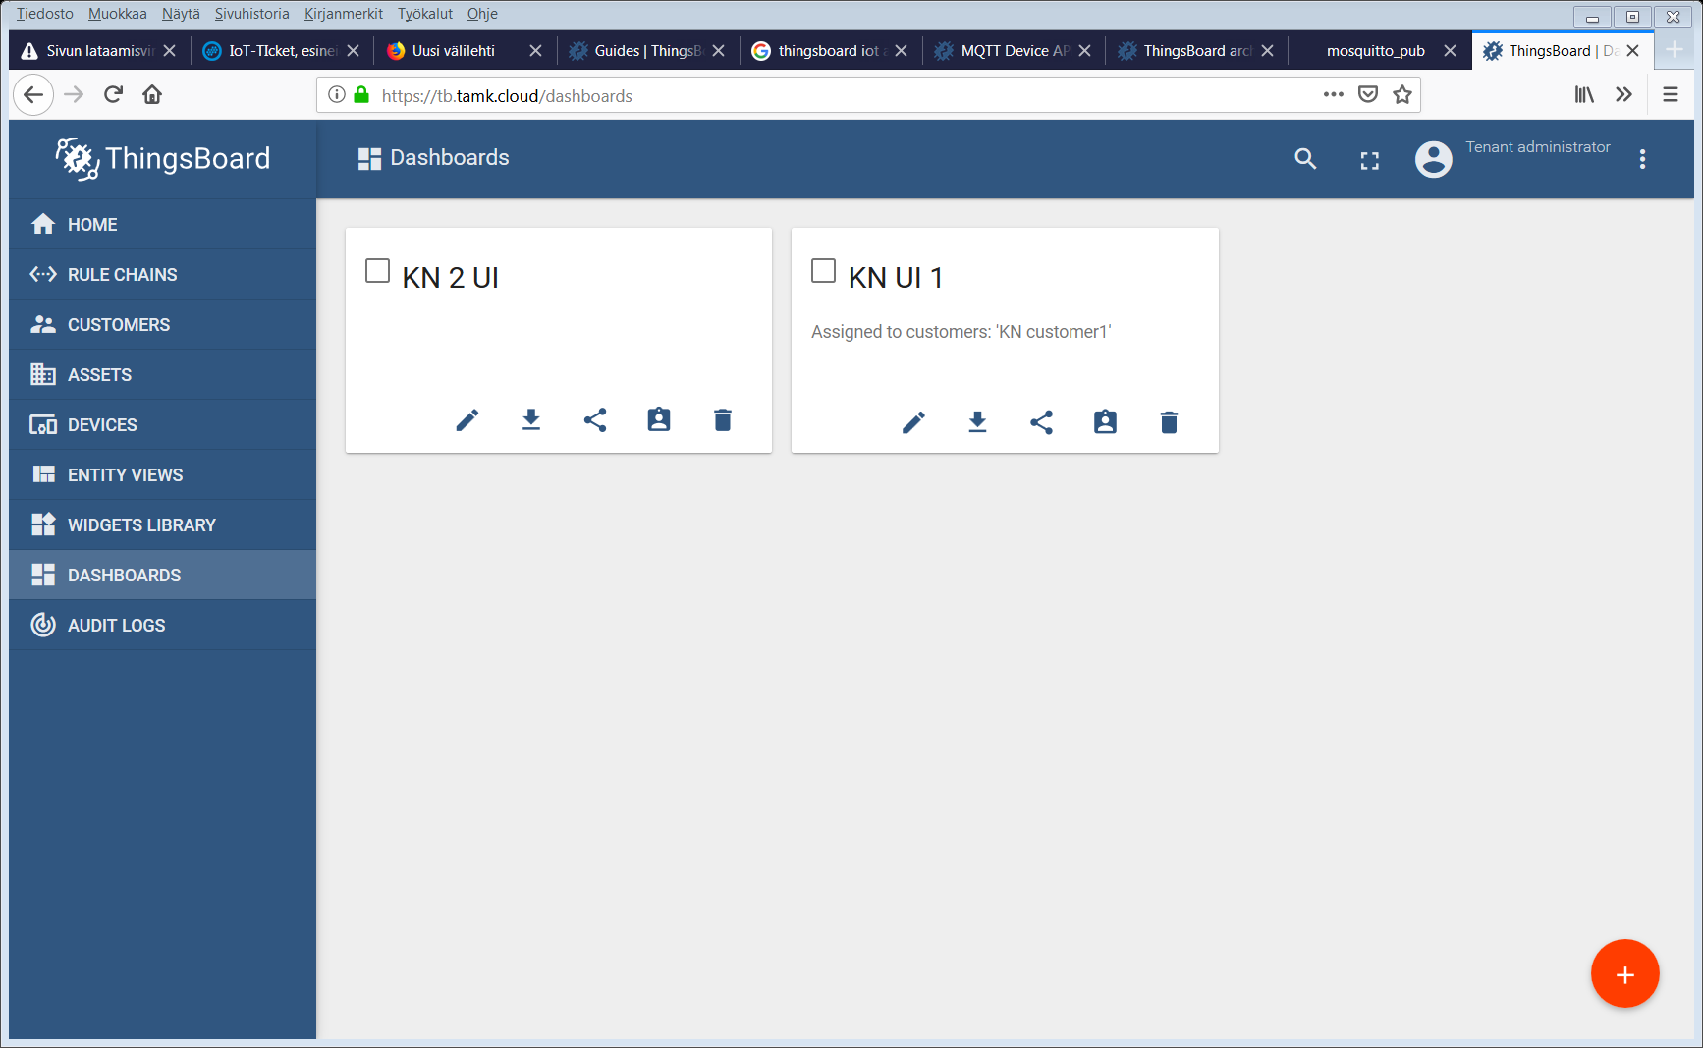
IoT-platforms – Thingboard

Slide 13
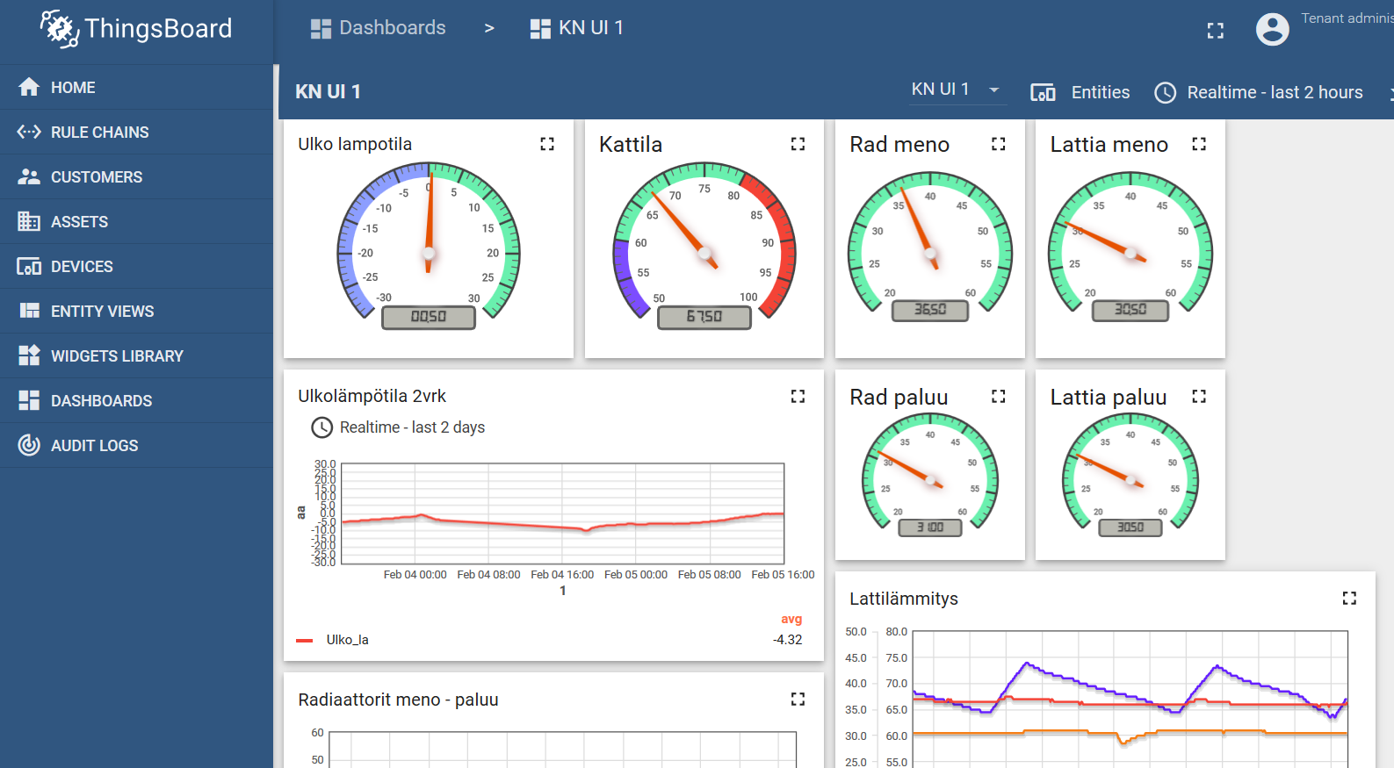
IoT-platforms – Thingboard

Slide 14
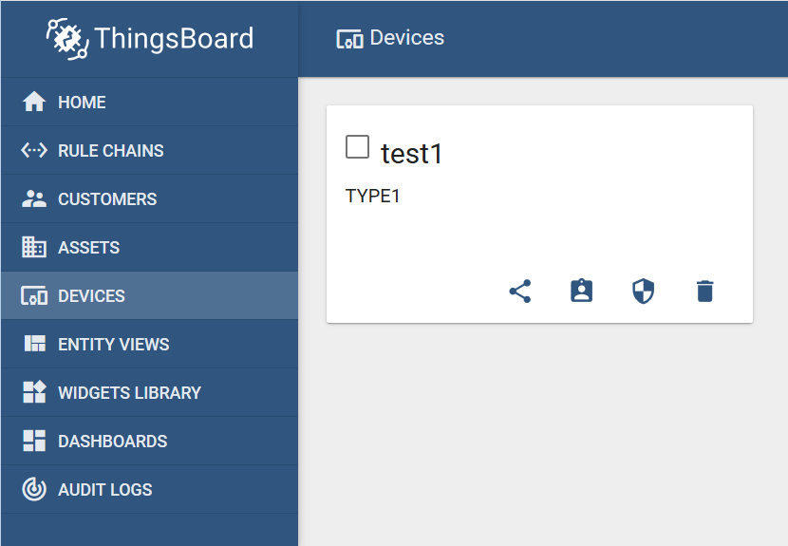
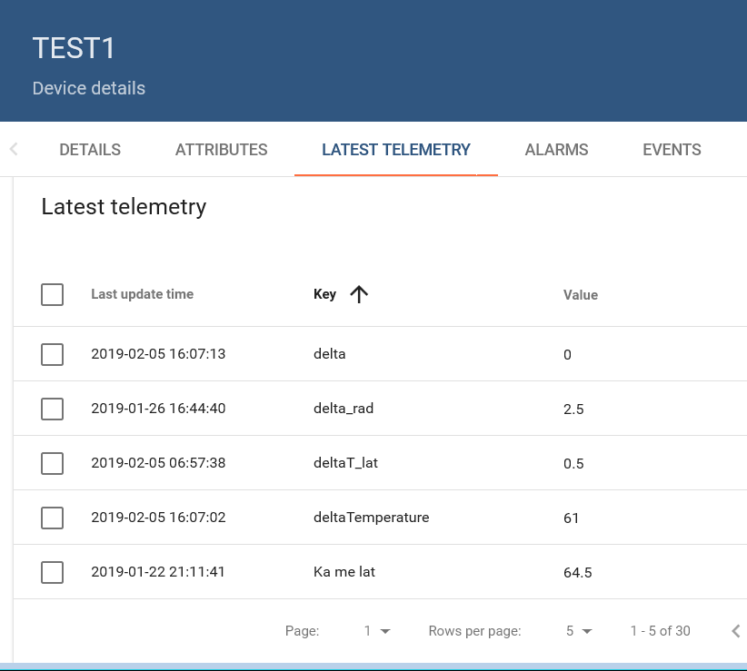
IoT-platforms – Thingboard

Slide 15
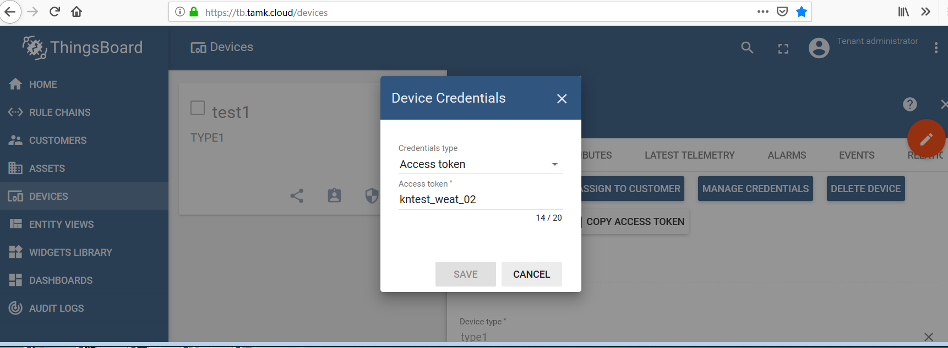
IoT-platforms – Thingboard

Slide 16
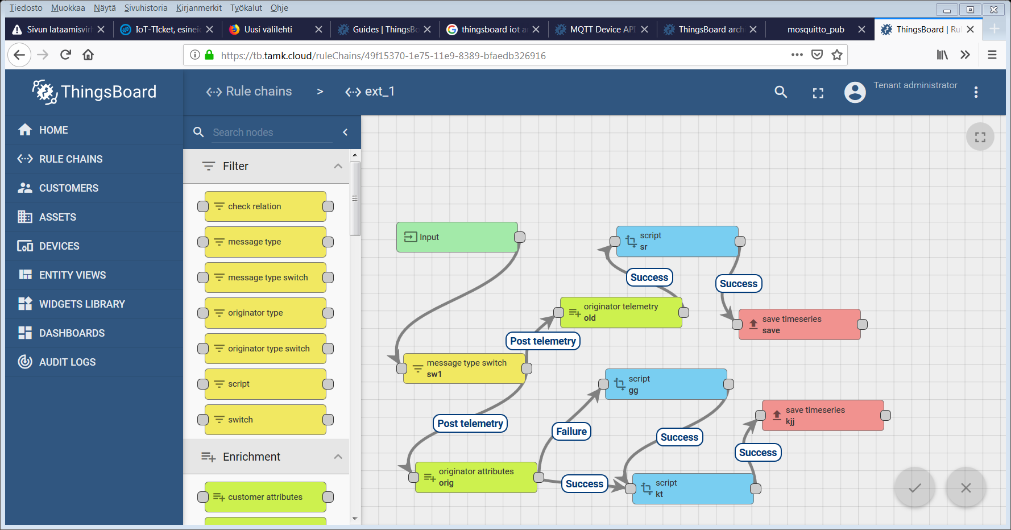
IoT-platforms – Thingboard

Slide 17
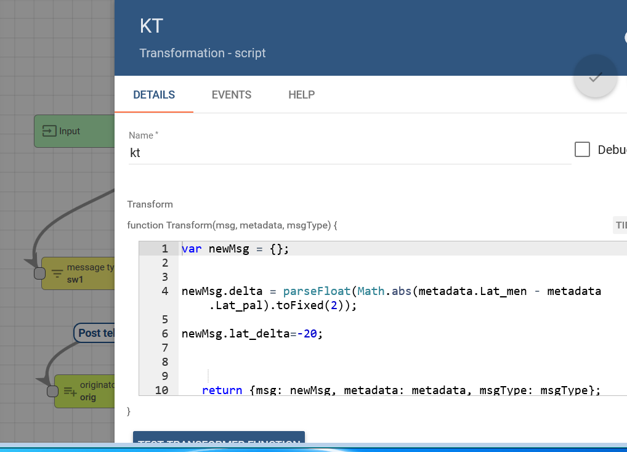
IoT-platforms – Thingboard

Slide 18
IoT-platforms – Thingboard

Slide 19
IoT-platforms – Thingboard

