Slide 1

Mars IoT Monitoring and Automation Platform
Team: 404 Nation
Course: Laboratory of Advanced Programming
Professor:
Massimo Mecella

Slide 2

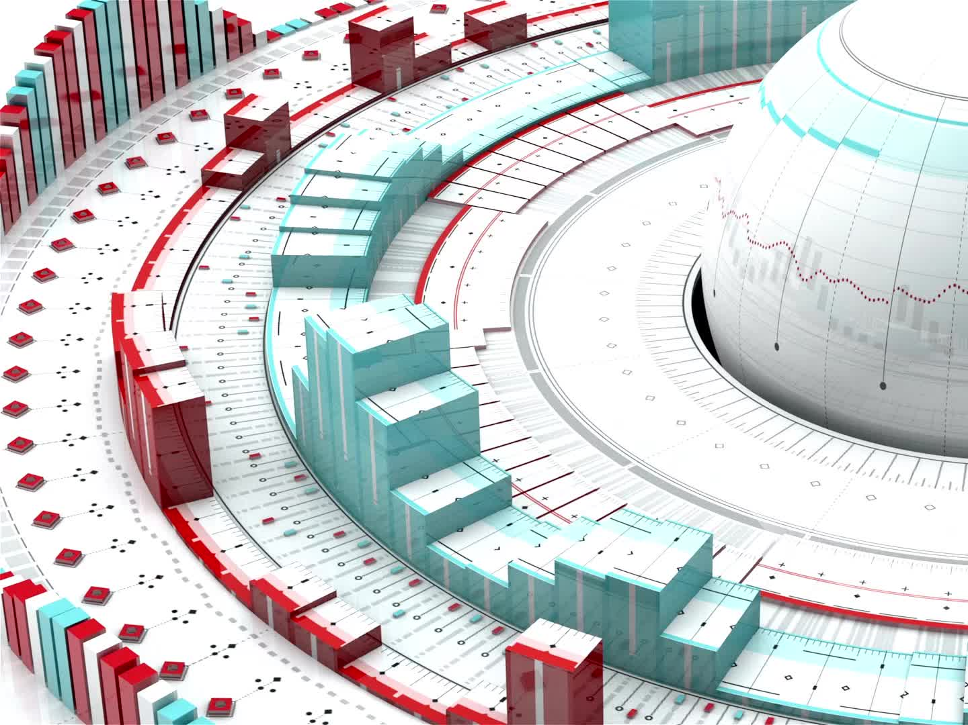
Project Context
Based on a Mars simulation environment provided by the instructor
Simulator generates synthetic IoT sensor data
Goal: build a data processing platform around the simulator
Uses a microservice architecture

Slide 3

Provided Component
Mars IoT Simulator
Simulates environmental sensors on Mars
Generates telemetry data
Provides an API for sensor readings

Slide 4
Implemented Components
Data ingestion service
RabbitMQ messaging integration
Automation rule processing
Backend API service
React frontend dashboard
Docker deployment architecture

Slide 5
Project Objectives
Real-time data processing pipeline
Event-driven communication
Microservice architecture
Automation rule evaluation
Monitoring dashboard
Docker container deployment

Slide 6
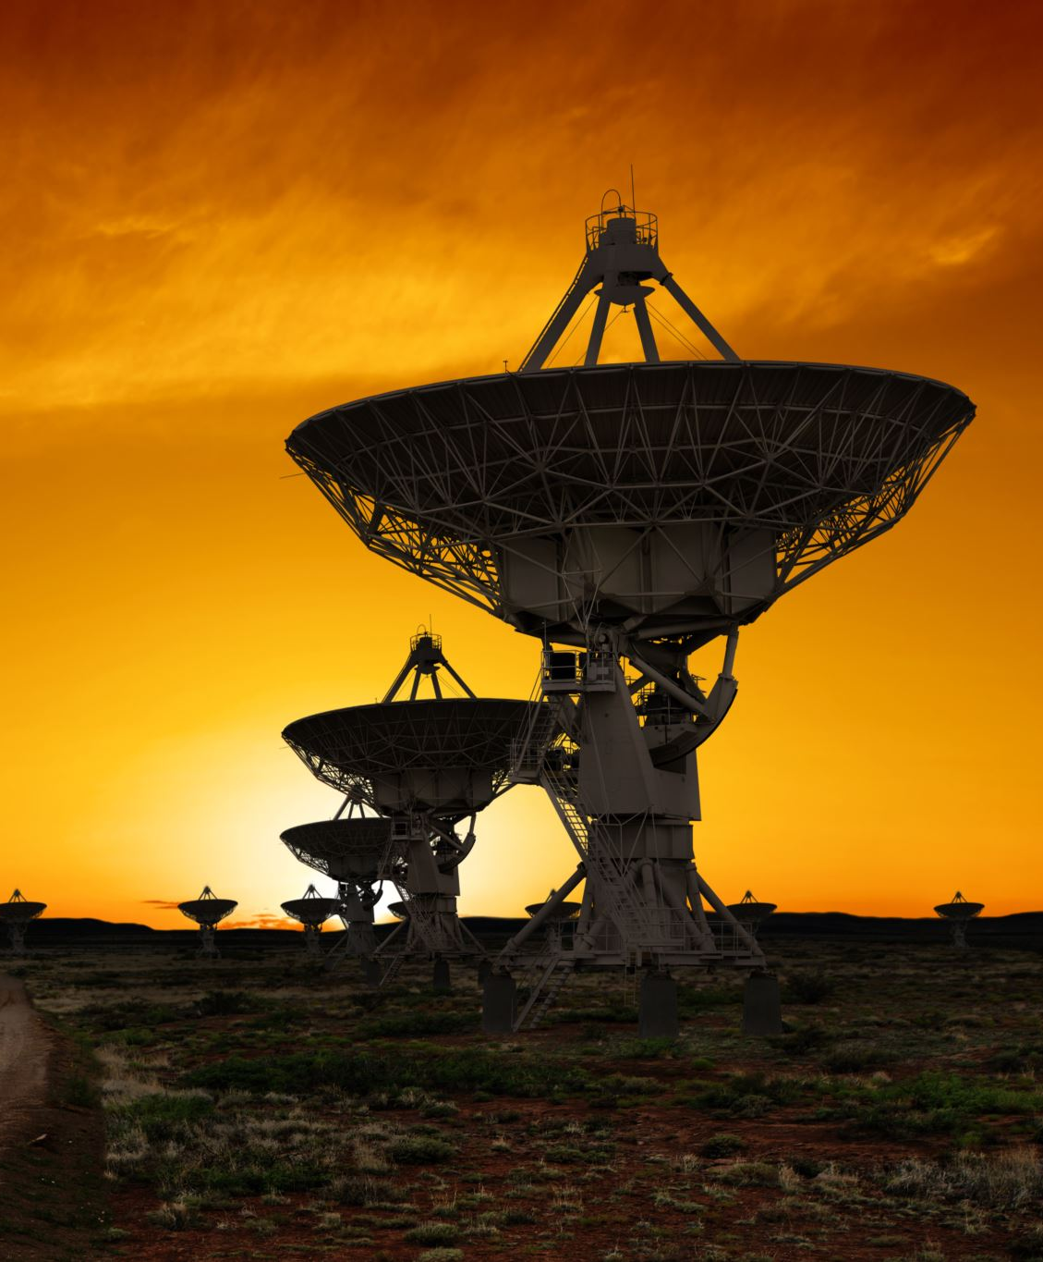
High-Level Architecture
Mars Simulator (provided)
Ingestion Service
RabbitMQ Broker
Automation Service
API Service
Frontend Dashboard
SQLite Database

Slide 7

Technology Stack
Python microservices
RabbitMQ messaging
React frontend
Docker & Docker Compose
SQLite database
REST APIs and WebSockets

Slide 8
Ingestion Service
Fetches sensor data from simulator
Transforms data
Publishes messages to RabbitMQ

Slide 9
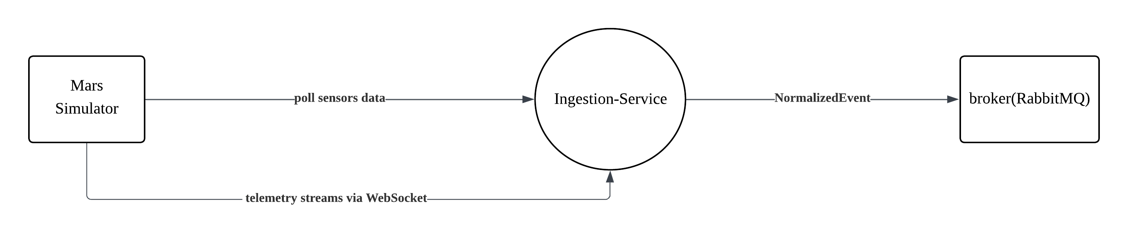
Ingestion service arhitecture

Slide 10
RabbitMQ Message Broker
Handles asynchronous communication
Receives data from ingestion service
Distributes messages to consumers
Decouples system services

Slide 11
Automation Service
Consumes messages from RabbitMQ
Evaluates automation rules
Triggers actions when conditions are met
Stores rules in SQLite database

Slide 12
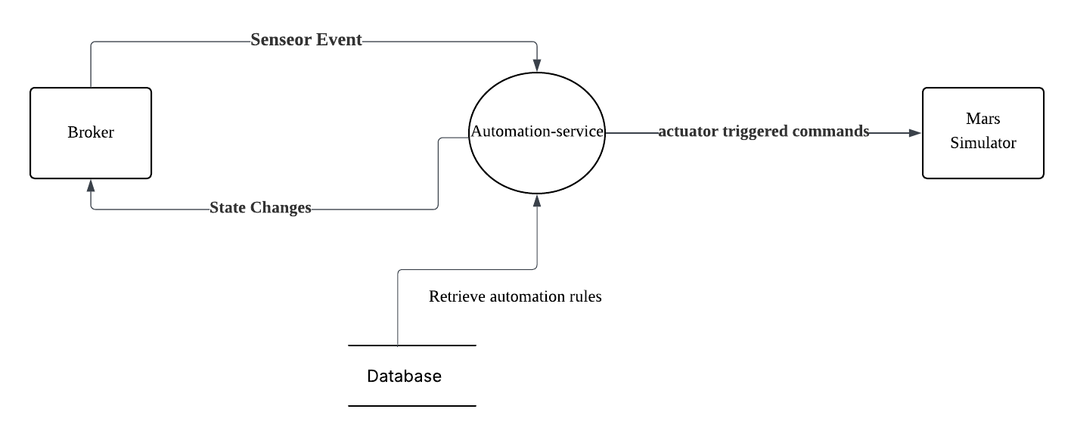
Automation service arhitecture

Slide 13
API Service
Backend-for-frontend service
Provides REST endpoints
Handles WebSocket updates
Delivers data to frontend dashboard

Slide 14
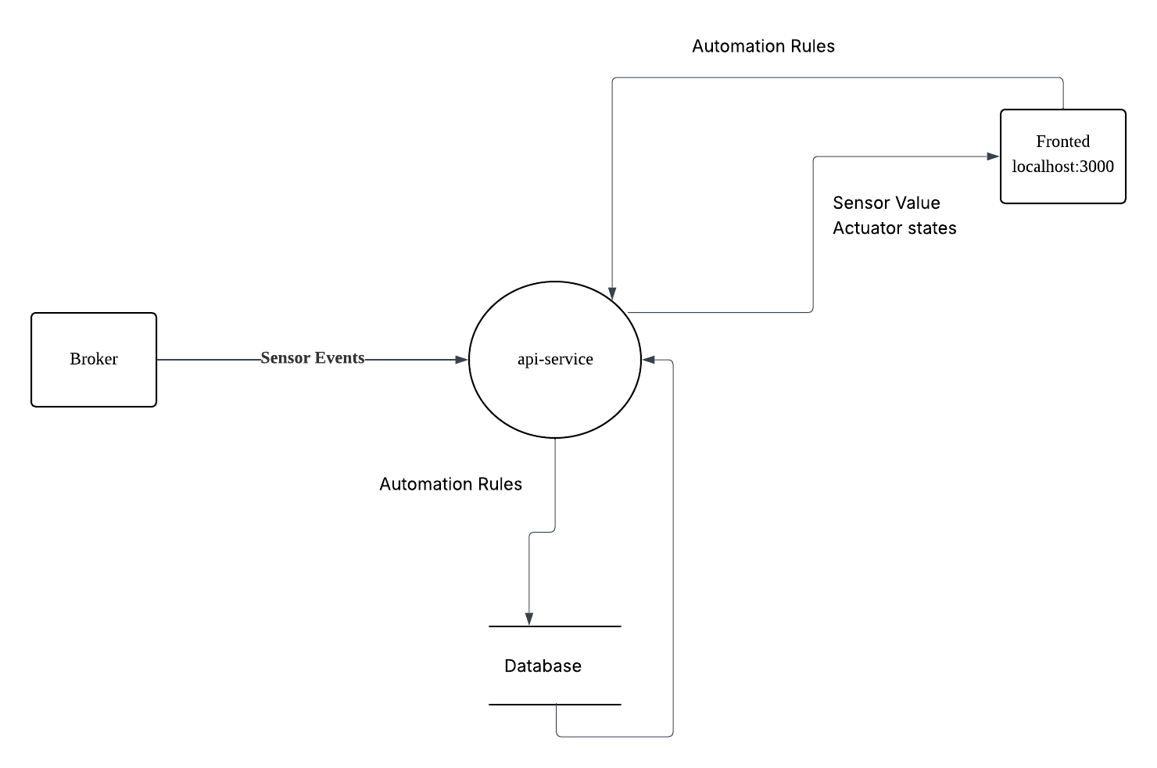
API service arhitecture

Slide 15
Database Layer
SQLite database
Stores automation rules
Lightweight embedded database

Slide 16
Frontend Dashboard
Built with React
Displays sensor data
Shows automation events
Real-time updates

Slide 17

Docker Deployment
All components run in containers
Docker Compose orchestrates services
Provides reproducible environments
Manages networking and volumes

Slide 18
Data Flow
Simulator generates data
Ingestion service retrieves data
RabbitMQ distributes messages
Automation service processes events
API exposes data
Frontend displays results

Slide 19
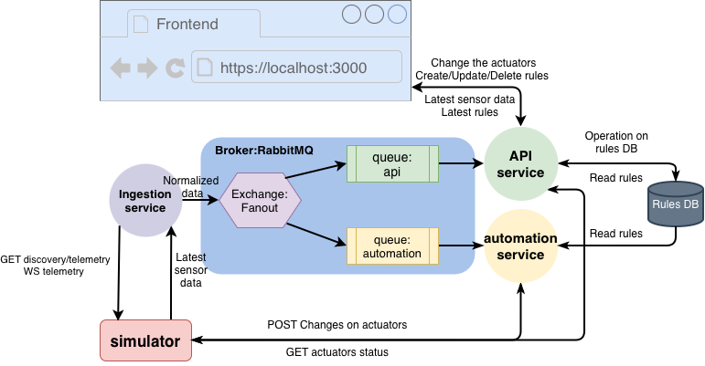
SYSTEM Architecture DIAGRAM

Slide 20
Key Features
Event-driven architecture
Real-time processing
Microservice design
Containerized deployment
Interactive monitoring dashboard

Slide 21
Challenges and Solutions
Service communication → RabbitMQ
Container orchestration → Docker Compose
Data persistence → Docker volumes
Real-time updates → WebSockets

Slide 22

Conclusion
Demonstrates microservice-based IoT data processing
Event-driven architecture
Containerized deployment
Real-time monitoring dashboard

