Slide 1
bpftrace
# biolatency.bt
Attaching 3 probes...
Tracing block device I/O... Hit Ctrl-C to end.
^C
@usecs:
[256, 512) 2 | |
[512, 1K) 10 |@ |
[1K, 2K) 426 |@@@@@@@@@@@@@@@@@@@@@@@@@@@@@@@@@@@@@@@@@@@@@@@@@@@@|
[2K, 4K) 230 |@@@@@@@@@@@@@@@@@@@@@@@@@@@@ |
[4K, 8K) 9 |@ |
[8K, 16K) 128 |@@@@@@@@@@@@@@@ |
[16K, 32K) 68 |@@@@@@@@ |
[32K, 64K) 0 | |
[64K, 128K) 0 | |
[128K, 256K) 10 |@ |
Your name here
These are sample bpftrace slides that I (Brendan Gregg) have
created, and I give you (anyone) permission to use some or all
of them to give bpftrace conference/meetup talks. The
LibreOffice source is at https://github.com/iovisor/bpf-docs
Just edit/delete the red text!
Conference name
Month Year
Notes:
Tomorrow will mark my 5 years at Netflix, and 5 years working on Linux full time. We’ve come a long way

Slide 2
Experience: Your story here
Best way to start is to tell your own story of using bpftrace to solve a problem. Don’t have a good story to tell yet? You could try:
- running execsnoop.bt on a production server for 60 minutes. What did you see?
- running opensnoop.bt during application startup. Anything surprising?
- running tcpconnect.bt: any unexpected connections?
- running tcpretrans.bt on a busy server: any pattern to the retransmits?
- running biosnoop.bt, biolatency.bt, and bitesize.bt to examine disk workloads.
- working through docs/tutorial_one_liners.md with some workloads.
- developing your own one-liners and tools to solve something.
Also consider starting with a live demo.

Slide 3
Experience: your story here
# opensnoop.bt
Attaching 3 probes...
Tracing open syscalls... Hit Ctrl-C to end.
PID COMM FD ERR PATH
2440 snmp-pass 4 0 /proc/cpuinfo
2440 snmp-pass 4 0 /proc/stat
25706 ls 3 0 /etc/ld.so.cache
25706 ls 3 0 /lib/x86_64-linux-gnu/libselinux.so.1
25706 ls 3 0 /lib/x86_64-linux-gnu/libc.so.6
25706 ls 3 0 /lib/x86_64-linux-gnu/libpcre.so.3
25706 ls 3 0 /lib/x86_64-linux-gnu/libdl.so.2
25706 ls 3 0 /lib/x86_64-linux-gnu/libpthread.so.0
25706 ls 3 0 /proc/filesystems
25706 ls 3 0 /usr/lib/locale/locale-archive
25706 ls 3 0 .
1744 snmpd 8 0 /proc/net/dev
1744 snmpd 21 0 /proc/net/if_inet6
[...]
Highlight the
interesting bits

Slide 4
eBPF: extended Berkeley Packet Filter
User-Defined BPF Programs
Kernel
SDN Configuration
Runtime
Event Targets
DDoS Mitigation
verifier
sockets
Intrusion Detection
kprobes
Container Security
BPF
uprobes
Observability
tracepoints
Firewalls (bpfilter)
BPF actions
perf_events
Device Drivers
…

Slide 5
bpftrace: BPF observability front-end
https://github.com/iovisor/bpftrace
Built from the ground-up for BPF and Linux
Used in production at Netflix, Facebook, etc
Custom one-liners
Tools
Linux 4.9+

Slide 6
bpftrace One-liners
# Files opened by process
bpftrace -e 't:syscalls:sys_enter_open { printf("%s %s\n", comm,
str(args->filename)) }'
# Read size distribution by process
bpftrace -e 't:syscalls:sys_exit_read { @[comm] = hist(args->ret) }'
# Count VFS calls
bpftrace -e 'kprobe:vfs_* { @[func]++ }'
# Show vfs_read latency as a histogram
bpftrace -e 'k:vfs_read { @[tid] = nsecs }
kr:vfs_read /@[tid]/ { @ns = hist(nsecs - @[tid]); delete(@tid) }’
# Trace user-level function
bpftrace -e 'uretprobe:bash:readline { printf(“%s\n”, str(retval)) }’
…

Slide 7
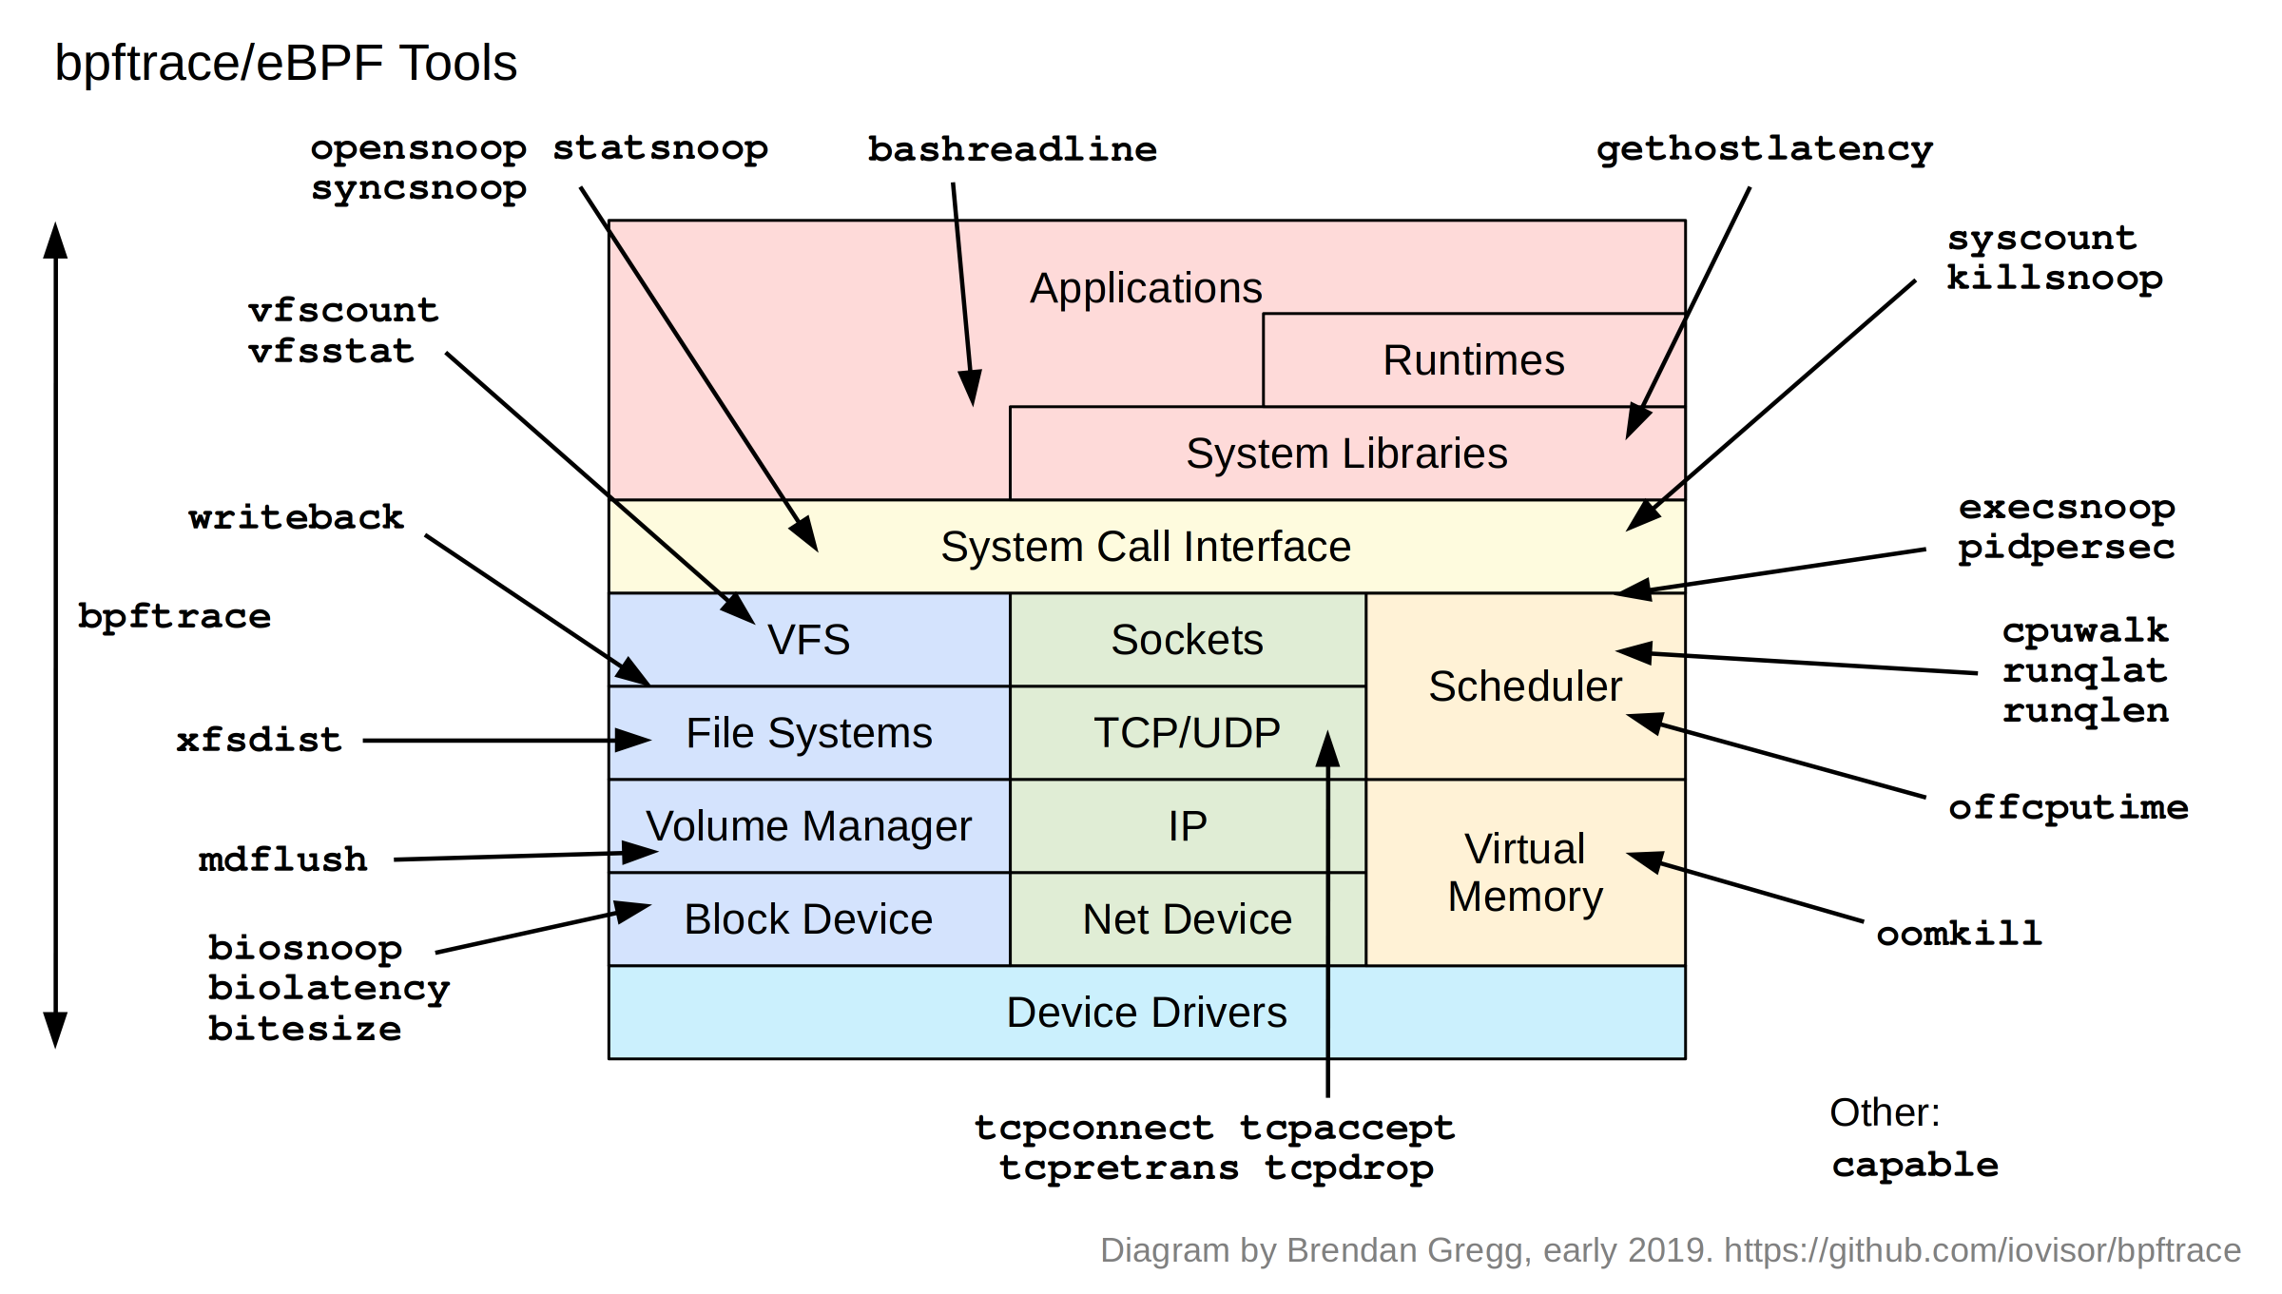
bpftrace Tools

Slide 8
Tool: gethostlatency
# gethostlatency.bt
Attaching 7 probes...
Tracing getaddr/gethost calls... Hit Ctrl-C to end.
TIME PID COMM LATms HOST
02:52:05 19105 curl 81 www.netflix.com
02:52:12 19111 curl 17 www.netflix.com
02:52:19 19116 curl 9 www.facebook.com
02:52:23 19118 curl 3 www.facebook.com
This is an example of user-level tracing, rather than kernel-level tracing:
it’s tracing the resolver calls from libc. You could include the source to show that.

Slide 9
Tool: runqlen
# runqlen.bt
Attaching 2 probes...
Sampling run queue length at 99 Hertz... Hit Ctrl-C to end.
^C
@runqlen:
[0, 1) 1967 |@@@@@@@@@@@@@@@@@@@@@@@@@@@@@@@@@@@@@@@@@@@@@@@@@@@@|
[1, 2) 0 | |
[2, 3) 0 | |
[3, 4) 306 |@@@@@@@@ |
There’s also runqlat, which shows the latency when waiting for a turn on-CPU,
but runqlat traces every context switch which can add some overhead.
runqlen, on the other hand, simply samples the length of the run queues.
It’s not as useful as runqlat, however, it has a tiny and fixed cost.

Slide 10
Tool: more one-liner or tool screenshots
# …
Also add more case studies if you have them
Also consider using bpftrace to dump data that you then visualize as graphs, scatter
plots, line graphs, flame graphs, etc. Eg, save the output of biosnoop.bt to a file, then
import it into Google spreadsheets and do a scatter plot of the TIME and LAT columns.

Slide 11
bpftrace Syntax
bpftrace -e ‘k:do_nanosleep /pid > 100/ { @[comm]++ }’
Probe
Action
Filter
(optional)

Slide 12
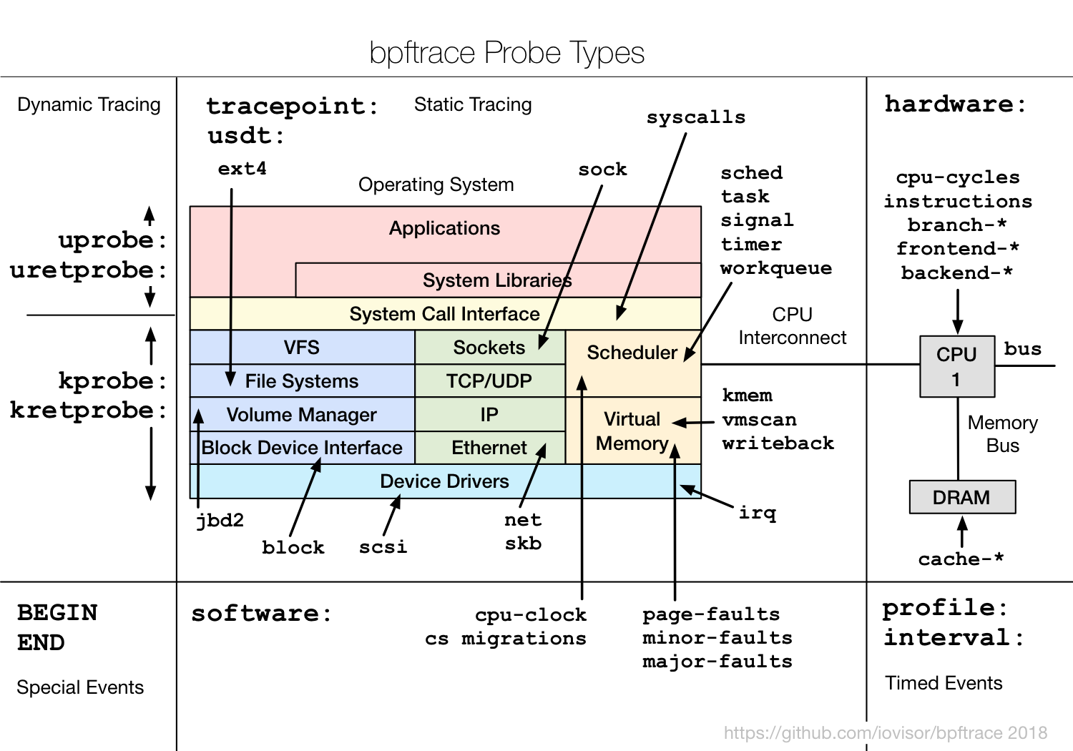
Probes

Slide 13
Probe Type Shortcuts
tracepoint | t | Kernel static tracepoints
usdt | U | User-level statically defined tracing
kprobe | k | Kernel function tracing
kretprobe | kr | Kernel function returns
uprobe | u | User-level function tracing
uretprobe | ur | User-level function returns
profile | p | Timed sampling across all CPUs
interval | i | Interval output
software | s | Kernel software events
hardware | h | Processor hardware events

Slide 14
Filters
/pid == 181/
/comm != “sshd”/
/@ts[tid]/

Slide 15
Actions
Per-event output
  printf()
  system()
  join()
  time()
Map Summaries
  @ = count() or @++
  @ = hist()
  …
The following is in the https://github.com/iovisor/bpftrace/blob/master/docs/reference_guide.md

Slide 16
Functions
hist(n) Log2 histogram
lhist(n, min, max, step) Linear hist.
count() Count events
sum(n) Sum value
min(n) Minimum value
max(n) Maximum value
avg(n) Average value
stats(n) Statistics
str(s) String
ksym(p) Resolve kernel addr
usym(p) Resolve user addr
kaddr(n) Resolve kernel symbol
uaddr(n) Resolve user symbol
printf(fmt, ...) Print formatted
print(@x[,top[,div]]) Print map
ntop([af,]addr) IP address to string
delete(@x) Delete map element
clear(@x) Delete all keys/values
reg(n) Register lookup
join(a) Join string array
time(fmt) Print formatted time
system(fmt) Run shell command
cat(file) Print file contents
exit() Quit bpftrace

Slide 17
Variable Types
Basic Variables
  @global
  @thread_local[tid]
  $scratch
Associative Arrays
  @array[key] = value
Buitins
  pid
  ...

Slide 18
Builtin Variables
pid Process ID (kernel tgid)
tid Thread ID (kernel pid)
cgroup Current Cgroup ID
uid User ID
gid Group ID
nsecs Nanosecond timestamp
cpu Processor ID
comm Process name
kstack Kernel stack trace
ustack User stack trace
arg0, arg1, ... Function args
retval Return value
args Tracepoint args
func Function name
probe Full probe name
curtask Curr task_struct (u64)
rand Random number (u32)

Slide 19
Tool: biolatency
# biolatency.bt
Attaching 3 probes...
Tracing block device I/O... Hit Ctrl-C to end.
^C
@usecs:
[256, 512) 2 | |
[512, 1K) 10 |@ |
[1K, 2K) 426 |@@@@@@@@@@@@@@@@@@@@@@@@@@@@@@@@@@@@@@@@@@@@@@@@@@@@|
[2K, 4K) 230 |@@@@@@@@@@@@@@@@@@@@@@@@@@@@ |
[4K, 8K) 9 |@ |
[8K, 16K) 128 |@@@@@@@@@@@@@@@ |
[16K, 32K) 68 |@@@@@@@@ |
[32K, 64K) 0 | |
[64K, 128K) 0 | |
[128K, 256K) 10 |@ |

Slide 20
Tool: biolatency
#!/usr/local/bin/bpftrace
BEGIN
{
printf("Tracing block device I/O... Hit Ctrl-C to end.\n");
}
kprobe:blk_account_io_start
{
@start[arg0] = nsecs;
}
kprobe:blk_account_io_done
/@start[arg0]/
{
@usecs = hist((nsecs - @start[arg0]) / 1000);
delete(@start[arg0]);
}
Notes:
Average latency (iostat/sar) may not be representitive with multiple modes or outliers. The "count" column is summarized in-kernel.

Slide 21
Advanced tool: runqlat
#!/usr/local/bin/bpftrace
#include <linux/sched.h>
// Until BTF is available, we'll need to declare some of this struct manually,
// since it isn't avaible to be #included. This will need maintenance to match
// your kernel version. It is from kernel/sched/sched.h:
struct cfs_rq_partial {
struct load_weight load;
unsigned long runnable_weight;
unsigned int nr_running;
unsigned int h_nr_running;
};
BEGIN {
printf("Sampling run queue length at 99 Hertz... Hit Ctrl-C to end.\n");
}
profile:hz:99 {
$task = (struct task_struct *)curtask;
$my_q = (struct cfs_rq_partial *)$task->se.cfs_rq;
$len = $my_q->nr_running;
$len = $len > 0 ? $len - 1 : 0; // subtract currently runing task
@runqlen = lhist($len, 0, 100, 1);
}
Just an example to show that yes, we can walk structs
Many kernel structs are in the kernel headers
package, which bpftrace will use. But sometimes
a struct is missing, and we declare some here.
BTF (BPF Type Format) will solve this problem
in the future by adding a lightweight debuginfo
to the kernel. See:
https://www.kernel.org/doc/Documentation/bpf/btf.rst
Lots of info can be found from
task_struct
Notes:
Average latency (iostat/sar) may not be representitive with multiple modes or outliers. The "count" column is summarized in-kernel.

Slide 22
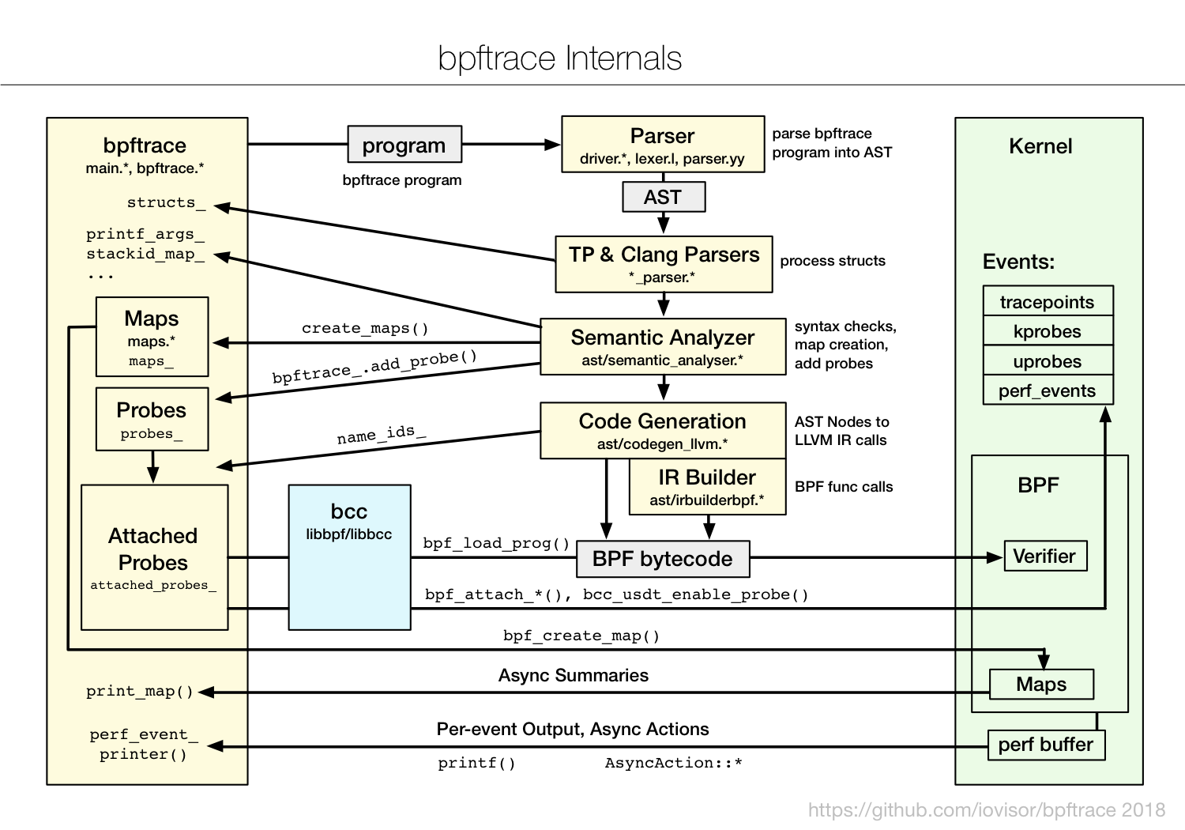
bpftrace Internals
Future versions may use a builtin BPF compiler,
avoiding the LLVM/Clang dependencies

Slide 23
bpftrace Development
v0.80
Jan-2019
v0.9.1
Jun-2019
v0.90
Mar-2019
v1.0
?2019
Dec 2016
Oct 2018
Major Features (v1)
Minor Features (v1)
...
API Stability
Stable Docs
Known Bug Fixes
More Bug Fixes
Packaging

Slide 24
ply: a lightweight BPF-based front-end
# ply 'tracepoint:syscalls/sys_enter_open {
printf("PID: %d (%s) opening: %s\n", pid, comm, str(data->filename)); }'
ply: active
PID: 22737 (Chrome_IOThread) opening: /dev/shm/.org.chromium.Chromium.dh4msB
PID: 22737 (Chrome_IOThread) opening: /dev/shm/.org.chromium.Chromium.dh4msB
PID: 22737 (Chrome_IOThread) opening: /dev/shm/.org.chromium.Chromium.2mIlx4
[...]
Can be worth mentioning, as it is lightweight (little dependencies, although
bpftrace may head in that direction too) and suited for some environments.
It is also built from the ground-up for BPF and Linux.
It is more limited in functionality. Syntax very similar to bpftrace.
https://github.com/iovisor/ply

Slide 25
Takeaway: bpftrace all the things!

Slide 26
URLs
https://github.com/iovisor/bpftrace
  https://github.com/iovisor/bpftrace/blob/master/docs/tutorial_one_liners.md
  https://github.com/iovisor/bpftrace/blob/master/docs/reference_guide.md
http://www.brendangregg.com/ebpf.html#bpftrace
http://www.brendangregg.com/bpfperftools.html
https://github.com/iovisor/kubectl-trace
https://tracker.debian.org/pkg/bpftrace

Slide 27
Thanks
bpftrace
  Alastair Robertson (creator)
  Netflix: Brendan Gregg, Matheus Marchini
  Sthima: Willian Gaspar
  Facebook: Jon Haslam, Dan Xu
  Augusto Mecking Caringi, Dale Hamel, ...
eBPF & bcc
  Facebook: Alexei Starovoitov, Teng Qin, Yonghong Song, Martin Lau, Mark Drayton, …
  Netflix: Brendan Gregg
  VMware: Brenden Blanco
  Daniel Borkmann, David S. Miller, Sasha Goldsthein, Paul Chaignon, …
Slides from Brendan Gregg, used with permission

