Slide 1
RESEARCH MEETING / 15 MIN
OPAL 1: growth by
recorded label
The effect of nickel on growth is undetermined from this export.
Experiment 67 • Exploratory synthesis • 2026-04-08 — 2026-05-07
Notes:
Opening (~0:45). Frame the question and answer. Saved exploratory evidence only; treatment semantics and an early proxy discontinuity remain unresolved.

Slide 2
Study design at a glance
The export supports a structured description—not confirmed dose groups
Recorded label | Plants | Genotypes | Status in this analysis
0 | 60 | 12 | Categorical; not confirmed control
50 | 59 | 12 | Categorical; meaning/unit unconfirmed
100 | 59 | 12 | Categorical; meaning/unit unconfirmed
200 | 59 | 12 | Categorical; meaning/unit unconfirmed
500 | 60 | 12 | Categorical; meaning/unit unconfirmed
1000 | 60 | 12 | Categorical; meaning/unit unconfirmed
DESIGN UNITS
GENOTYPES
CELLS
ROUNDS
359 plants
12
72 × 4–5 plants
22 dates
OPAL 1 / EXPERIMENT 67 / EXPLORATORY
02
Notes:
~1:00. Experiment 67: 2026.04.09_OPAL.0002_Weston_PC, APPL-CORE v6. Table is editable. Six recorded categories have near-balanced plant counts; treatment identity, dose units and control mapping are not established.

Slide 3
What was measured—and what it is not
22 rounds • 2026-04-08 to 2026-05-07 • timestamps have no UTC offset
01
02
03
S3D design
→
Two features
→
Vendor proxy
359 plants
12 genotypes
Projected area
mm²
Height × area
mm³; not mass
Processing: plant × date × trait summaries; repeated same-day scans averaged before trajectories/slopes.
7,794 plant-date-trait rows after selection. Feature QC flags are empty; no rows excluded. Five exact-zero area values and source outliers retained.
OPAL 1 / EXPERIMENT 67 / EXPLORATORY
03
Notes:
~1:00. Analysis metadata reports 7,794 plant-date-trait rows. Source feature geometry not independently recomputed. No timezone conversion applied.

Slide 4
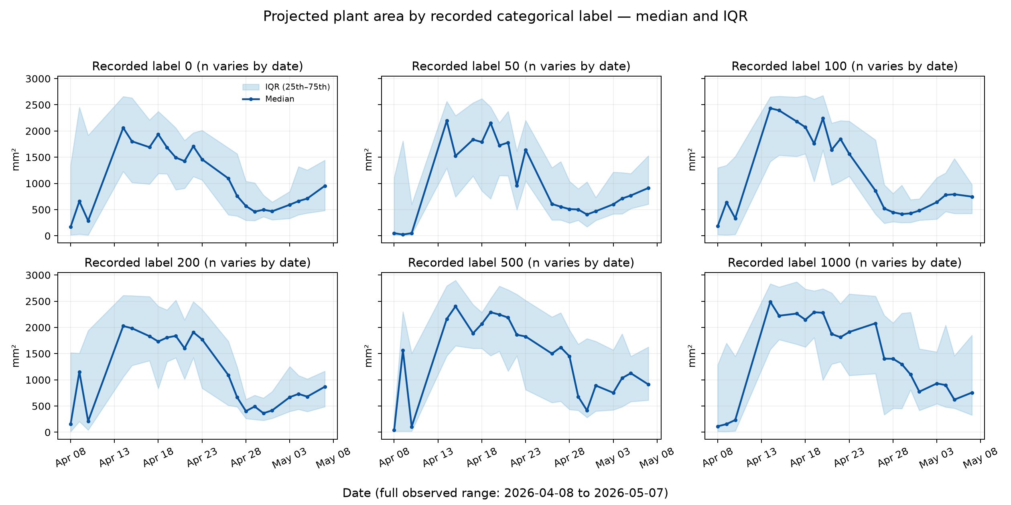
Projected area: trajectories vary across labels
Median with IQR (25th–75th percentile); full observed date range retained
READOUT
No consistent penalty pattern is evident in these descriptive trajectories.
Wide within-label spread; sample counts vary by date. IQR is not a confidence interval.
labels remain categorical
OPAL 1 / EXPERIMENT 67 / EXPLORATORY
04
Notes:
~1:40. Figures use the existing saved source plot, including retained zeros. Share the y-axis across six label panels. Avoid interpreting label order as a dose gradient.

Slide 5
Per-plant area slopes: all IQRs cross zero
Median and IQR of plant-level linear slopes (mm²/day); plant is replication unit
Label 0
-4.0
Label 50
+7.1
Label 100
-13.3
Label 200
-11.4
Label 500
+1.6
Label 1000
+8.2
-50
0
50
Ranges show 25th–75th percentile across plants—not confidence intervals or treatment-effect estimates.
OPAL 1 / EXPERIMENT 67 / EXPLORATORY
05
Notes:
~1:35. Slopes/IQRs transcribed from saved robust summary: label 0 −4.03 [−40.24,18.68]; 50 +7.06 [−32.39,21.70]; 100 −13.34 [−36.20,24.55]; 200 −11.43 [−51.37,13.81]; 500 +1.60 [−19.05,29.46]; 1000 +8.18 [−29.05,40.28]. Values are descriptive and genotype-unadjusted; early proxy break further limits growth-rate interpretation.

Slide 6
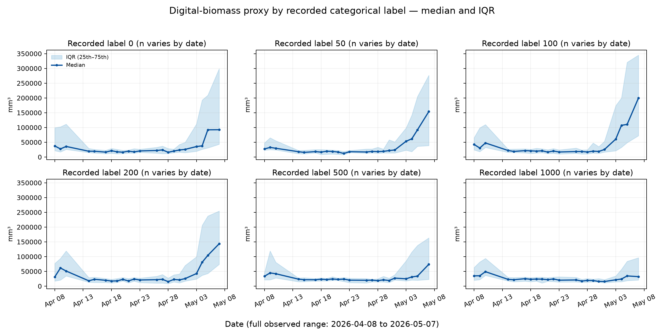
The vendor proxy breaks sharply early in the series
Digital biomass is vendor height × area (mm³), not measured plant mass
OBSERVED DISCORDANCE
Proxy median
44,553 → 20,820.85 mm³
Area median
174 → 2,164.5 mm²
April 10 → April 14. Cause is not established by exported QC/status.
OPAL 1 / EXPERIMENT 67 / EXPLORATORY
06
Notes:
~1:45. In paired 108 plants, median within-plant proxy change is −33,240.65 mm³ (median percentage change −68.01%), while median area change is +889.5 mm². The group medians shown here are overall observations; do not infer biomass loss.

Slide 7
Paired dates tell a discordant measurement story
Overall date medians above; paired within-plant changes below (n=108 matched plants)
PROXY
AREA
Digital-biomass proxy
Projected area
44,553 mm³
→
20,820.85 mm³
174 mm²
→
2,164.5 mm²
−33,240.65 mm³ median paired change
+889.5 mm² median paired change
Interpretation: proxy and area move in opposite directions. This is a quality/measurement question—not evidence of biological biomass loss.
OPAL 1 / EXPERIMENT 67 / EXPLORATORY
07
Notes:
~1:15. Paired change statistics from saved detailed exploratory analysis. Median percentage proxy change was −68.01%. Exported event status is Ok for these early rounds; QC flags are empty. Causal mechanism unknown.

Slide 8
Separate what is observed from what remains unknown
Use the evidence to target follow-up; do not fill metadata gaps with assumptions
SUPPORTED BY SAVED EXPORT
NOT ESTABLISHED
359 plants; 12 genotypes; six labels
Which labels represent nickel
22 rounds; 7,794 rows after selection
Dose unit or concentration convention
No QC exclusions; five area zeros retained
Whether any label is the control
Area slope IQR spans zero for every label
Cause of April 10–14 proxy discontinuity
OPAL 1 / EXPERIMENT 67 / EXPLORATORY
08
Notes:
~1:10. Do not overstate vendor proxy data or infer a cause. Small genotype × label cells (4–5 plants) and no genotype adjustment also constrain interpretation.

Slide 9
DECISION / RESEARCH MEETING
Do not make a nickel growth claim yet.
Biological effect = UNDETERMINED from this export
01
02
03
Verify treatment mapping
Resolve proxy discontinuity
Then estimate response
Owner confirms identity, control, units
APPL/S3D review of acquisition and analysis
Genotype-aware repeated-measures analysis
Decision gate: proceed to biological interpretation only after label semantics and proxy quality are resolved.
Notes:
Closing decision slide (~1:20 plus discussion). The proposed sequence does not presume that treatment effects will be found. Plant is experimental unit; report estimates, uncertainty and sensitivity analyses after verifying semantics and quality.

Slide 10
Owner questions that unblock the next analysis
Discussion / assign follow-up
TREATMENT
Which recorded labels map to nickel, control and what dose units?
MEASUREMENT
What changed between April 10 and April 14 in S3D acquisition or processing?
TIME
What timezone applies to timestamp strings; are cross-sensor joins valid?
OPAL 1 / EXPERIMENT 67 / EXPLORATORY
10
Notes:
Discussion. Capture owner, answer, evidence artifact and date for each item. Source documentation records that timestamp strings carry no UTC offset and full protocol/action bodies are not exported.

Slide 11
Source basis and quality guardrails
Backup / provenance
ANALYSIS INPUTS
INTERPRETATION LIMITS
Reviewed meeting summary
Detailed exploratory report
Analysis metadata and saved summary tables
Existing projected-area and digital-proxy figures
IQR = 25th–75th percentile, not CI
Date coverage varies
Source zeros/outliers retained
Timestamps lack UTC offset
No causal or genotype-adjusted estimate
Experiment 67 • APPL-CORE export v6 • source export manifest SHA-256 recorded in analysis: 76bf90275f7a98392fc6d1363b46cc3a28142ebfd219c8705e19636604771757
OPAL 1 / EXPERIMENT 67 / EXPLORATORY
11
Notes:
Backup. Saved analysis records schema validation and matching loader/view fingerprints. Inputs are in workspace sources/. Outputs here are a synthesis; source files are unchanged.

