Slide 1
Evidence slide 1
Notes:
Speaker evidence 1

Slide 2
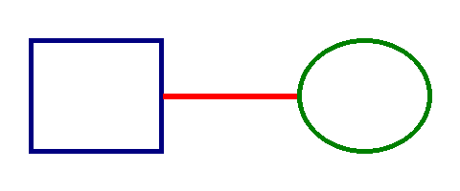
Evidence slide 2
Notes:
Speaker evidence 2

