Slide 1
Database JDBC Overview CS 4640 Programming Languages for Web Applications

Slide 2
JDBC
JDBC API allows Java programs to connect to databases
Database access is the same for all database vendors
The JVM uses a JDBC driver to translate generalized JDBC calls into vendor specific database calls
JDBC != Java Database Connectivity
http://java.sun.com/docs/books/jdbc/intro.html
Excerpt :
“JDBC (TM) is a Java (TM) API for executing SQL statements. (As a point of interest, JDBC is a trademarked name and is not an acronym; nevertheless, JDBC is often thought of as standing for `Java Database Connectivity’.) ”

Slide 3
Pure Java Driver (Type 4)
There are four general types of JDBC drivers
We will look at Type 4
DB Client
Server
Java
Application
Data Source
JDBC
API
JDBC Driver
Type 4 drivers are
Efficient
Simple to use and deploy
Most commonly used

Slide 4
Typical JDBC Programming Process
Load the database driver
Obtain a connection
Create and execute statements
executeQuery – to execute SQL select statements
executeUpdate – to execute SQL statements that update a table
Use result sets to navigate through the results
Close the connection

Slide 5
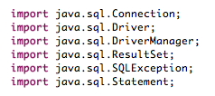
Simple Example

Slide 6
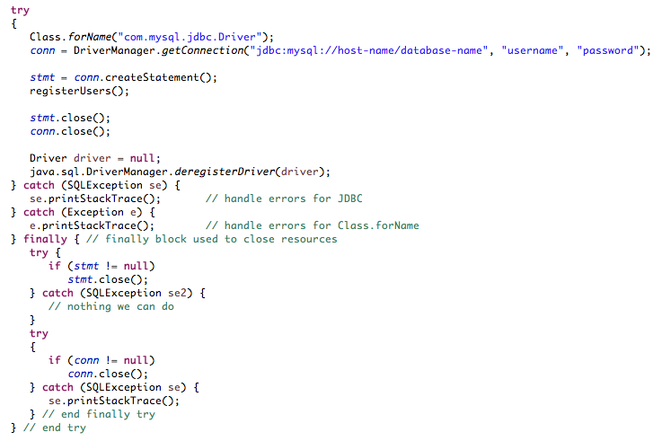
Simple Example (2)
Load and register the database driver using ClassLoader
Create SQL statement object
Connect to
a database
DB-related processes
Close SQL statement object and connection
Unregister the driver
SEVERE: The web application [/this-context] registered the JDBC driver
[com.mysql.jdbc.Driver] but failed to unregister it when the web
application was stopped. To prevent a memory leak, the JDBC Driver has
been forcibly unregistered.

Slide 7
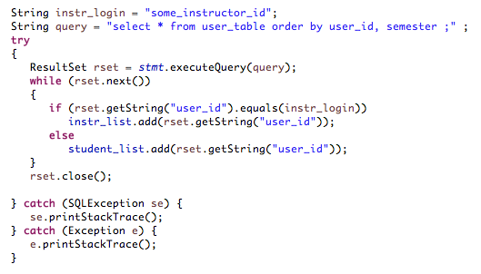
Simple Example (select)
Prepare a query
Execute a query and store all rows retrieved in a ResultSet object
More rows?
Access a value of
column “user_id”
Close a ResultSet object
By default, a ResultSet object is read-only and has a cursor that moves forward only, i.e., next().

Slide 8
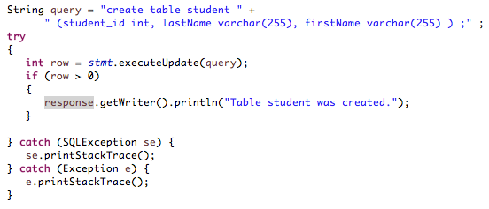
Simple Example (create table)
Prepare a query
Execute a query to create a table
Successfully create a table?

Slide 9
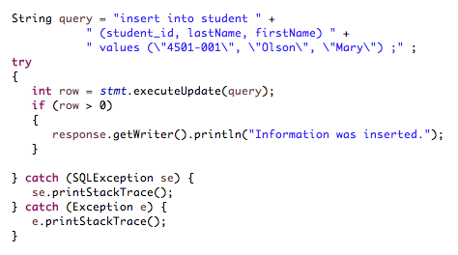
Simple Example (insert)
Prepare a query
Execute a query to insert information into a table
Successfully insert information?

Slide 10
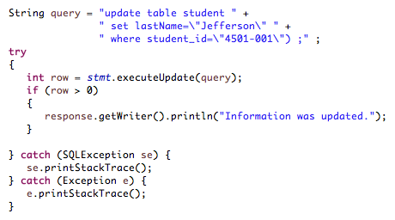
Simple Example (update)
Prepare a query
Execute a query to update information
Successfully update information?
By careful !!
update without a “where” clause will update all rows in the table

Slide 11
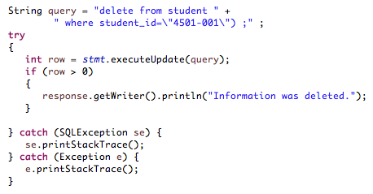
Simple Example (delete)
Prepare a query
Execute a query to update information
Successfully update information?
By careful !!
delete from student; or
delete * from student;
will delete all rows in the table

Slide 12
JDBC Summary
Most large web apps use databases to make data persistent
The techniques for accessing databases from Java programs are identical in web apps as in stand-alone Java programs
Read further for information on how to set up, use a database, and how to construct SQL queries

