Slide 1
Automatic Femur Segmentation using Random Forest
Iwan Paolucci, Severin Tobler
University of Bern
16. December 2015, Medical Image Analysis Lab

Slide 2
Introduction
Femoral implants

Slide 3
Pipeline
MR
Pre-Process
Feature Extraction
RF
Post-Process
Segmented Volume
DICE
Volume Rending
Model

Slide 4
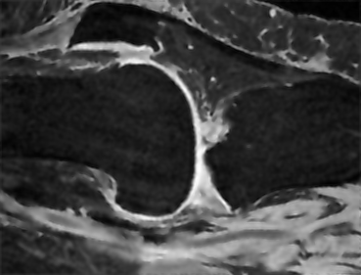
Pre-Process
Normalization
Noise removal
3D Wiener filter

Slide 5
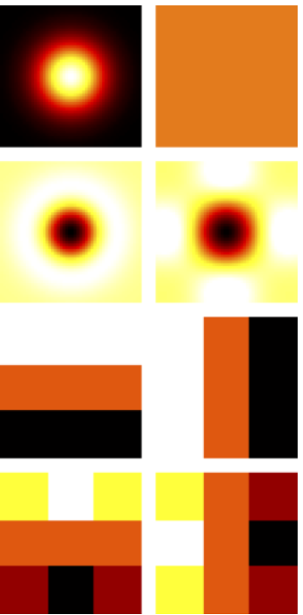
Feature Extraction
Standard deviation
Entropy
Relative position (3D)
Gaussian
Average
Laplacian of Gaussian
Laplacian
Prewitt (horizontal and vertical)
Sobel (horizontal and vertical)

Slide 6
Post-Processing
Threshold
Morphological opening
Keep largest volume
Fill holes

Slide 7
Results

Slide 8
Conclusion

