Slide 1
Personalized Femoral Implant Planning by Automatic Femur Segmentation
Iwan Paolucci, Severin Tobler
The Tree Nurses
University of Bern
16. December 2015, Medical Image Analysis Lab

Slide 2
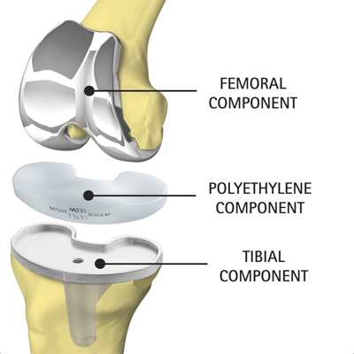
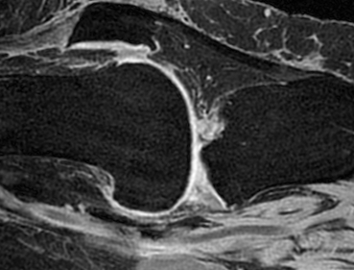
Introduction
Goal: DICE 0.95 with 0.05 std

Slide 3
Methods – Algorithm Pipeline
MR Data
Pre-Process
Feature Extraction
Random Forest
Post-Process
Segmented Volume
Tree Model

Slide 4

Methods – Pre-Process
Normalization
Noise removal
3D Wiener filter

Slide 5
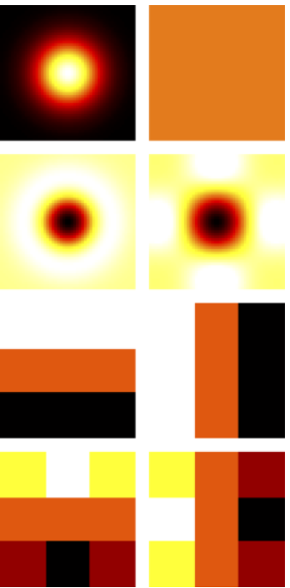
Methods – Feature Extraction
Relative position (3D)
Standard deviation
Entropy
Gaussian
Average
Laplacian of Gaussian
Laplacian
Prewitt (horizontal and vertical)
Sobel (horizontal and vertical)
Notes:
Total 13 features
Filters are applied on 2D slides
Random Forest

Slide 6
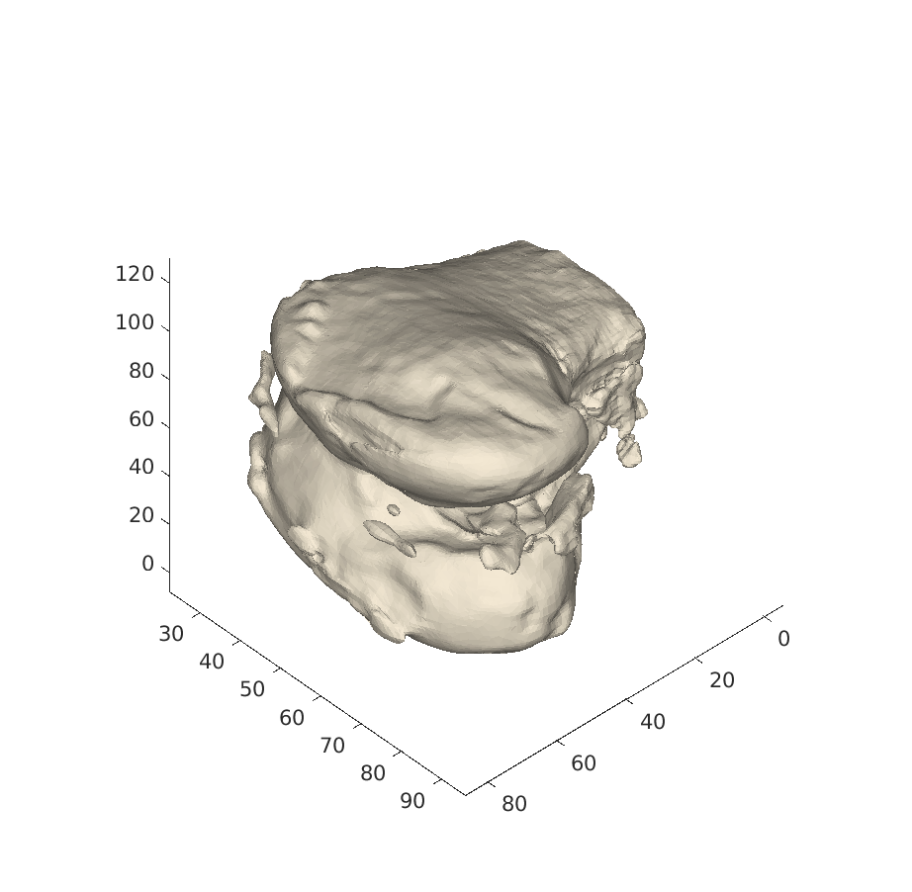
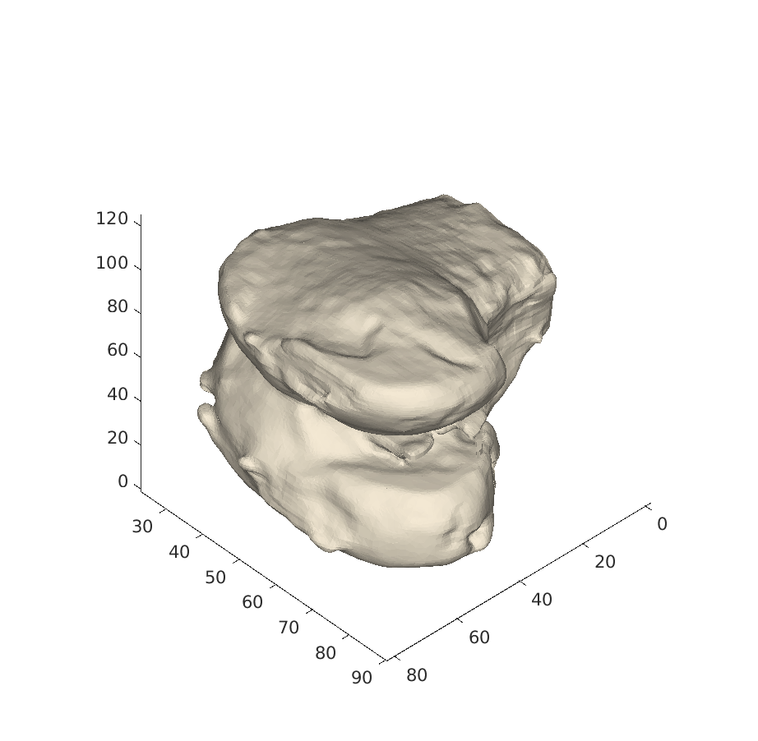
Methods – Post-Processing
Morphological opening
Keep largest area / volume
Fill holes
Notes:
Opening: erosion, dilatation
No thresholding (0.5)

Slide 7
Results
DICE 0.86 with 0.04 std
DICE 0.91 with 0.03 std
Notes:
5 fold cross validation
Dice interpretation: DICE 0.91 with 0.03 std; goal: 0.95 with 0.05 std
RF: num: 20, max: 0.9283, min: 0.7770, mean: 0.8603, median: 0.8573, range: 0.1513, std: 0.0432
PP: num: 20, max: 0.9590, min: 0.8495, mean: 0.9108, median: 0.9002, range: 0.1094, std: 0.0313
Improvement in every case

Slide 8
Discussion
Objective best and worst case:
Notes:
Slim & Fast, performs on a commercial laptop (5MB (tree model), computation time 2.5 min (whole segmentation))
Segmentation is always the Femur
Front part of the bone is still ‘good’ => femoral implant
computation time: 2.5 min (whole segmentation)
Mean: 2.5 min +- 0.5 min
Core 2 duo 1.8 GHz, 6 MB L2 Cash, 4 GB RAM

Slide 9
Outlook
Include prior information
Investigate 3D features
Extend to further bone structure
Notes:
Prior information: eg include gender/age/weight/height, ASM

Slide 10
Thanks for your attention!
Questions?

Slide 11
Results Cross Validation (5 fold)

Slide 12
Random Forest
15 Trees
Leaf size of 1
Trained on 15 volumes
1 % Sample proportion
13 Features
~ 5 MB

