Slide 1
Automatic Femur Segmentation for Femoral Implant Design
Iwan Paolucci, Severin Tobler
University of Bern
16. December 2015, Medical Image Analysis Lab

Slide 2
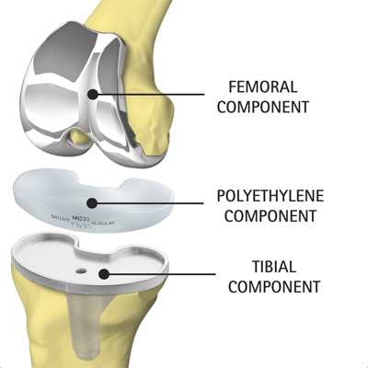
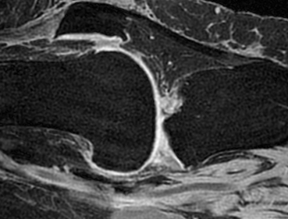
Introduction
Goal: DICE 0.95 with 0.05 std

Slide 3
Methods – Algorithm Pipeline
MR Data
Pre-Process
Feature Extraction
Random Forest
Post-Process
Segmented Volume
Tree Model

Slide 4

Methods – Pre-Process
Normalization
Noise removal
3D Wiener filter

Slide 5
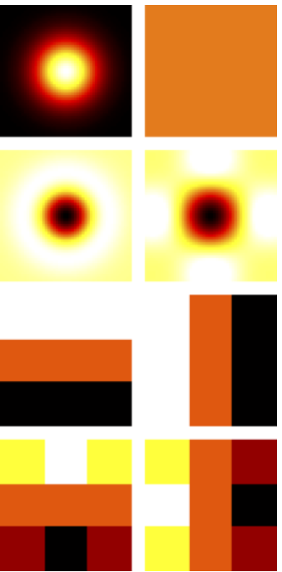
Methods – Feature Extraction
Standard deviation
Entropy
Relative position (3D)
Gaussian
Average
Laplacian of Gaussian
Laplacian
Prewitt (horizontal and vertical)
Sobel (horizontal and vertical)

Slide 6
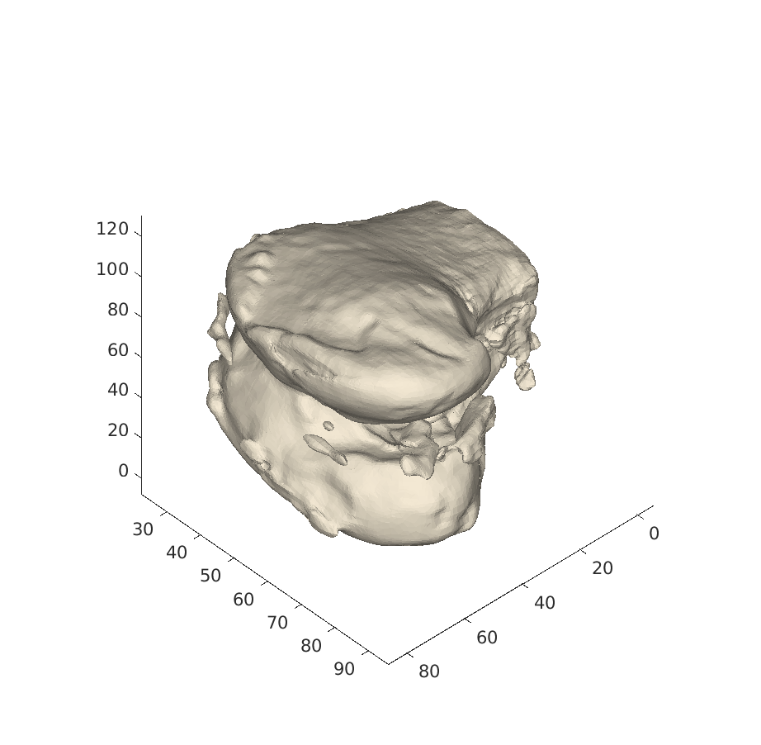
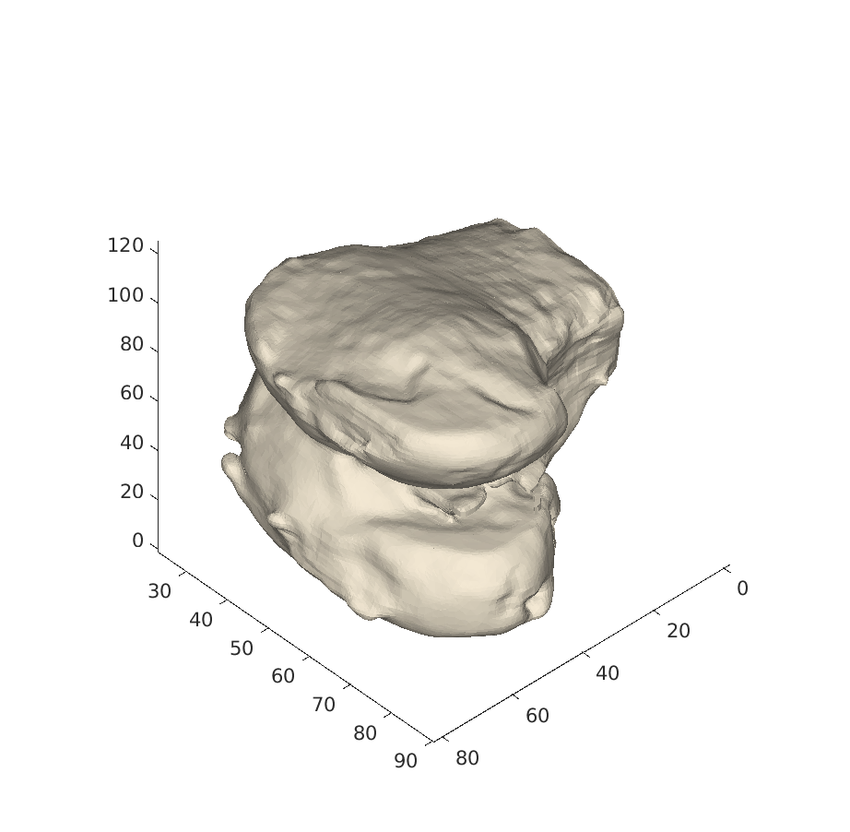
Methods – Post-Processing
Morphological opening
Keep largest area / volume
Fill holes

Slide 7
Results
DICE 0.86 with 0.04 std
DICE 0.91 with 0.03 std
Notes:
RF: num: 20, max: 0.9283, min: 0.7770, mean: 0.8603, median: 0.8573, range: 0.1513, std: 0.0432
PP: num: 20, max: 0.9590, min: 0.8495, mean: 0.9108, median: 0.9002, range: 0.1094, std: 0.0313

Slide 8
Discussion
Slim & Fast
Best / Worst case
Segmentation is always the Femur
Dice interpretation

Slide 9
Outlook
Include prior information
Investigate 3D features
Extend to further bone structure

Slide 10
Thanks for your attention!
Questions?

Slide 11
Results Cross Validation (5 fold)

Slide 12
Tested but was not good…
ASM
3D filter for features
Histogram bins as features
Skewness as features

