Slide 1


FPGA-Based Real-Time Implementation of AES Algorithm for Video Encryption & Decryption
ECE 532 – Digital System Design
Hao Gu, Yucheng Tao, Shan Liu
Spring, 2017

Slide 2
Overview
Motivation
Goals
System Design
Changes
Block diagram
Algorithm
Implementation
IP list
Design process
FPGA-Based Real-Time Implementation of AE Algorithm for Video Encryption

Slide 3
Motivation
Security technologies is important to deal with the use of multimedia.
Video encryption algorithms implemented in hardware improves performance of multimedia encryption system.
Reconfigurable devices and HDL accelerates the design of encryption technology in FPGA.
FPGA-Based Real-Time Implementation of AES Algorithm for Video Encryption

Slide 4
Goals
Main Goals
Design AES encryption and decryption in hardware.
Build custom IP for AES.
Achieve real-time video (1920*1080, 60fps) encryption processor implemented targeting Nexys Video FPGA.
Optional Goals
Achieve real-time video (1920*1080, 60fps) decryption.
√
√
TOTAL PORTS | HDMI IN | HDMI OUT | USB (UART) | USB (JTAG)
FPGA-Based Real-Time Implementation of AES Algorithm for Video Encryption

Slide 5
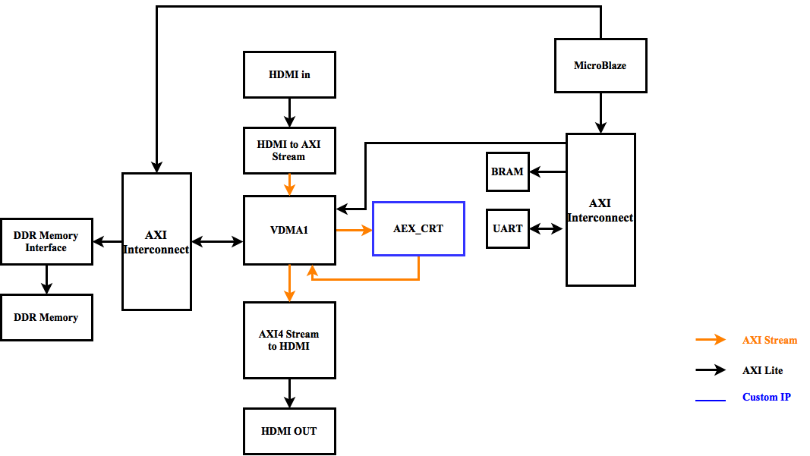
System Design – Original Block Diagram
FPGA-Based Real-Time Implementation of AES Algorithm for Video Encryption

Slide 6
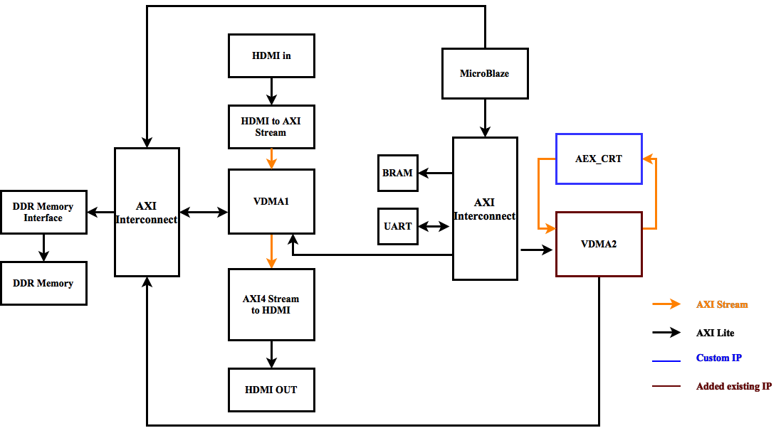
System Design – Final Block diagram
FPGA-Based Real-Time Implementation of AES Algorithm for Video Encryption

Slide 7
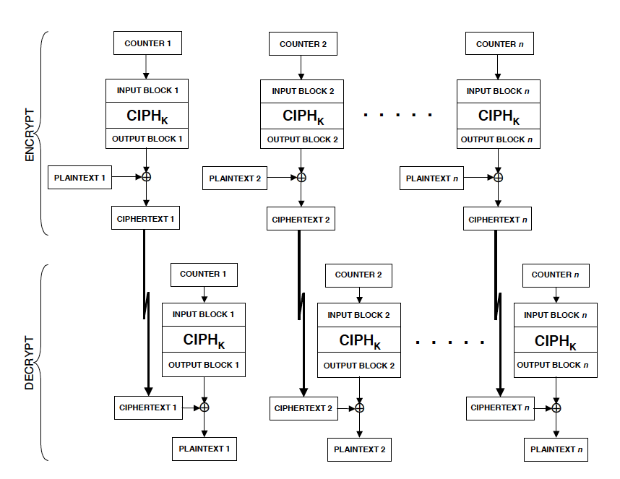
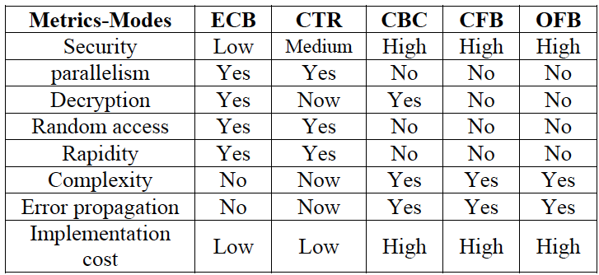
System Design -- Algorithm
AES – CTR Mode
√
Reference: FIPS-197 specification
FPGA-Based Real-Time Implementation of AES Algorithm for Video Encryption

Slide 8
Implementation – IP List
IP | Source | Function
Video in to AXI4 Stream | Xilinx | RGB stream to AXI4 Stream
AXI VDMA | Xilinx | Direct memory access between memory and AXI4-Stream video type targeted peripherals
AXI4 Stream to video out | Xilinx | AXI4 Stream to RGB stream
DDR Memory Interface | Xilinx | Memory controller, physical interface for DDR Memory
Microblaze | Xilinx | General purpose soft processor, system controller
AXI Uartlite | Xilinx | Interface and controller between UART data transmission and AXI-interface
BRAM | Xilinx | Configurable memory
AES_CTR | Group | Encrypt and decrypt data and send to VDMA
RGB to DVI | DIGILENT | Video encoder
DVI to RGB | DIGILENT | Video decoder
FPGA-Based Real-Time Implementation of AES Algorithm for Video Encryption

Slide 9
Implementation – Design Process
Achieve AES CTR in software.
Design AES CRT in hardware.
Design custom IP.
Build other parts of the whole systems.
Connect custom IP with the system.
FPGA-Based Real-Time Implementation of AES Algorithm for Video Encryption

Slide 10
Challenge
Connect custom IP into the system !
Speed up our custom IP.
Hand shaking signals.
Protocols – AXI Lite & AXI Stream.
FPGA-Based Real-Time Implementation of AES Algorithm for Video Encryption

Slide 11
Learned
Digital system design.
Technical skills: Vivado and SDK, testbench.
Do enough research before starting, but not think to innovate at the first time.
Group communication.
FPGA-Based Real-Time Implementation of AES Algorithm for Video Encryption

Slide 12
Thanks!
Demo!
FPGA-Based Real-Time Implementation of AES Algorithm for Video Encryption

