Slide 1

重构IT职业教育新生态
削峰

Slide 2

目 录
CONTENTS
1
使用场景
2
消息队列
3
削峰填谷

Slide 3
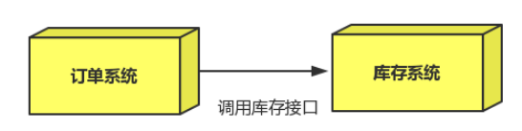
应用解耦

Slide 4
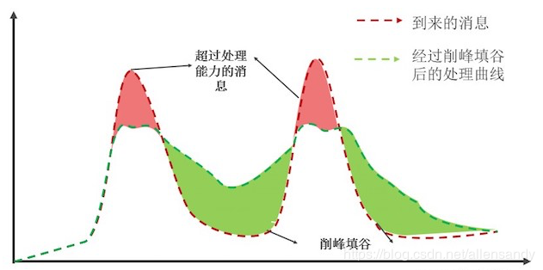
应用解耦

Slide 5
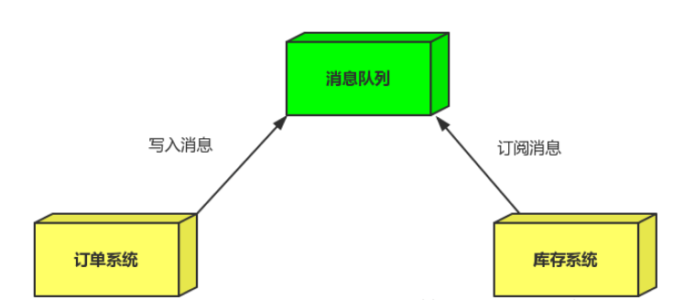
应用解耦

Slide 6
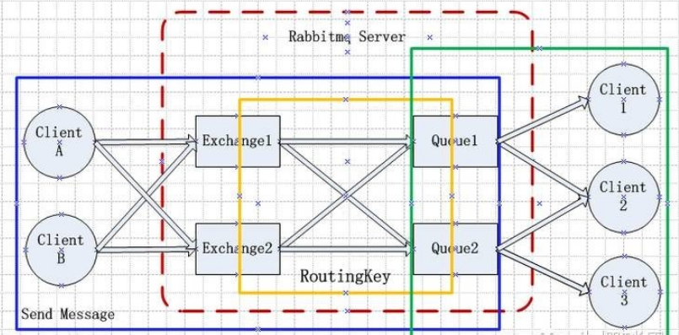
系统架构

Slide 7
Boot下的MQ
<dependency>
<groupId>org.springframework.boot</groupId>
<artifactId>spring-boot-starter-amqp</artifactId>
</dependency>

Slide 8
Boot下的MQ
spring:
rabbitmq:
addresses: localhost
port: 5672
username: guest
password: guest
publisher-returns: true
publisher-confirms: true
listener:
simple:
acknowledge-mode: manual
prefetch: 1
direct:
acknowledge-mode: manual
prefetch: 1

Slide 9
Boot下的MQ
@Component
@RabbitListener(queues="directhanqueue2")
public class Receive {
@RabbitHandler
public void rev(String msg,Channel channel,Message message) throws IOException, InterruptedException {
Thread.sleep(10000);
System.out.println("接受到消息1"+msg);
channel.basicAck(message.getMessageProperties().getDeliveryTag(), false);
}
}

