Slide 1







UVic PHARMACY EHR MANAGEMENT SYSTEM
Student: Paras Rana – V01044062
HINF 200: Principles of health databased design
Instructor: Alex kuo

Slide 2

Background Information
Overview of Current Pharmacy Operations – Manual and Error prone documentation and record keeping.
Importance of EHR in Pharmacy Management- efficiency, reliability, and patient safety.
Objectives of Implementing EHR system – Streamlined operations, Improved Patient Outcomes, Enhanced data management
Key benefits expected – Reduced Errors, Better Management of Medication, Regulatory Compliance.
Notes:
The traditional methods involved in pharmacy management include the manual data entry and management. The traditional methods face limitations such as errors in records and documentation and risk of patient safety. Electronic Health Records provides a framework for pharmacies to improve efficiency, accuracy, and patient safety by integrating pharmacy records in a database with defined functions. The current project aimed to develop a Pharmacy EHR management system to streamline operations, enhance data management and improve patient outcomes. The Pharmacy EHR management system has numerous benefits including reduced errors, better management of medication and inventory, regulatory compliance, data security, and enhanced patient outcomes.

Slide 3

Objectives and Goals of Pharmacy EHR System
Increased operational efficiency by reducing manual functions and automated data processing and management.
Improved accuracy in patient medication records to improve patient safety.
Ensure regulatory compliance on including data security, data management, and inventory data management.
Notes:
Pharmacies play a significant role in the healthcare environment and improving patient outcomes. The main objectives and goals of a Pharmacy EHR management system include increasing operational efficiency, improved accuracy in record keeping, enhanced patient safety, and regulatory compliance. Notably, the development and integration of a Pharmacy EHR system will enable the pharmacy comply with regulations, reduce errors caused by manual data handling, and promote patient safety.

Slide 4

Scope of the Project
Conceptualization Phase – Define the Functions of the EHR System.
Development Phase – Identify and Modify existing EHR systems to conform to the concept.
Testing Phase- Involve to test the System
Implementation Phase- Integrate the System in a Pharmacy
Project Timeline- 4 weeks.
Notes:
The scope of the current project follows a project timeline of 4 weeks to cover each scope. The first step is the Conceptualization of the functions of the desired Pharmacy EHR management system. The second phase is the development phase where the researchers will identify and modify or configure EHR system to align with the intended objectives based on pharmacy operations. The third phase is the testing phase and patients at UVic will test the system and provide feedback. The final process is the implementation where the EHR system will be integrated into a pharmacy.

Slide 5


System Design
The System Design refers to the Key features and functions of the system. The proposed prototype has the following features and functions
Patient Registration and Management.
Prescription Handling.
Medical Inventory Management
Billing and Insurance Processing
Notes:
The key features of the Pharmacy EHRManagement System include patient registration and management, efficient handling of prescriptions, comprehensive management of medication inventory, and a streamlined billing and insurance processing.

Slide 6

Methodology
The UVic Pharmacy EHR Management System Project utilized the following methodology
Research and Planning - Understand EHR Systems and Solutions
System Design – Features and Functionality.
Development and Customization – Pharmacy Environment.
Testing and Quality Assurance – Obtain Feedback from Stakeholders.
Deployment and Training - Integration of Pharmacy EHR System into pharmacy operations and training staff how to use it.
Notes:
The EHR Management System development utilized a structured methodology. The first step involved research and planning to define and understand existing EHR systems and solutions. The research step helps familiarize with the current technological trends and regulatory compliance to ensure the prototype is feasible in the operational environment.

Slide 7

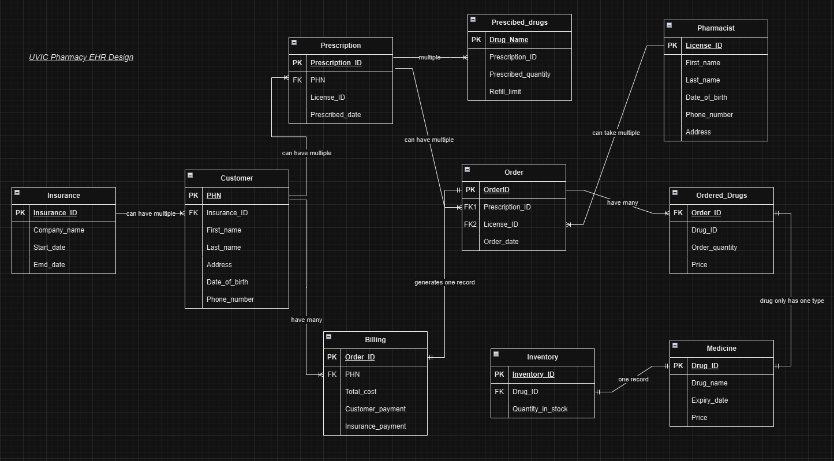
ERD Design

Slide 8


UVic Pharmacy application Demo
Application Link
Admin View Pharmacist View Customer View

Slide 9

Systems Demo of Functions: Patient Registration and Management
The Patient Registration and Management feature allows the Pharmacist to onboard a new patient or manage existing patients in the system.
The function entails;
Patient Demographics.
Insurance Details.
Tracking Patient Visits/Prescriptions
Notes:
The pharmacy EHR management system captures and stores patient demographic information, processes insurance details, and tracks patient visits. The functions enables accurate and up-to-date records are available and helps in care coordination.

Slide 10

Systems Demo: Prescription Management
The system’s prescription management feature entails the following;
Recording and Storing Prescription Details
Providing Patient Information to Pharmacist.
Tracking Prescribed Drugs, and Refill Limits
Notes:
Prescription management is a key feature in the EHR system. The functions allows the pharmacy to record prescription details and avail them to pharmacists with the patient information. The system then tracks the prescribed drugs and refill limits to ensure accurate dispensing of drugs.

Slide 11


Medication Inventory Management
The medication inventory management function allows the pharmacy to efficiently manage inventory.
The functions include;
Tracking Stock Levels of Different Drugs.
Monitoring Expiry Dates .
Ensuring Timely Replenishment.
Notes:
The Pharmacy EHR system includes a medication inventory management function that tracks the drug stock levels, monitors the expiry dates and ensures timely replenishment. The function improves operational efficiency by helping the pharmacy avoid shortages and wastage

Slide 12


Systems Demo: Billing and Payment Processing
The Billing and Payment Processing feature has the following functions:
Calculating Total Costs
Generating Billing Statements
Customer and Insurance Payment Processing
Notes:
The billing and payment processing feature allows efficient financial management. The function calculates the total costs for orders and handles payments from insurance providers and customers. Moreover, the function provides detailed billing statement for easier reconciliation, transparency, and accuracy.

Slide 13

Issues in Conducting the Project
The following concerns and challenges were encountered in the project
Patient data security and privacy concerns.
Challenges in integration with existing systems.
Challenges with Regulatory Concerns.
User Training and Adoption.
Notes:
We encountered several challenges and issues while developing the system. The most significant challenges include data security and privacy concerns, challenges in integration with existing systems, need for comprehensive user training and adoption, and ensuring compliance with regulatory standards.

Slide 14


Lessons Learned
Importance of Comprehensive Planning and Research.
The need for updated data security measures and access control.
The value of User-Feedback and Training.
The advantages of cross-functional collaboration.
Notes:
The project ingrained numerous lessons including the importance of thorough research and planning before developing a system. Similarly, the need for improved data security measures to mitigate the risks and adversity of data breach and ensure patient safety. Also, use feedback and training are invaluable for system adoption. Notably, cross-functional collaboration helped brainstorm and solve challenges to enhance the project outcomes.

Slide 15
Conclusion : Q&A Session
Pharmacy EHR System provides a unique advantage in improving operational efficiency.
Future enhancements such as AI and Analytics will help address critical pharmacy operation needs.
Thank you.
Feel Free to Ask Questions?

