Slide 1
BUILD WITH AI · TRACK 4
Agri AI Network
One AI advisor for every smallholder's own field,
one interoperable agriculture data network for every state.
Farmer app · agri-ai-network-farmer-web-847963771142.asia-south1.run.app
Officer dashboard · agri-ai-network-officer-dashboard-847963771142.asia-south1.run.app
Code · github.com/ipavanreddy/agri-ai-network
Notes:
Open with the one-line promise. Live URLs on screen; the demo follows the PRD §44 story.

Slide 2
PROBLEM
Fit 20%
Farm decisions ignore data that already exists
• 86 % of India's ~146 million farm holdings are small or marginal (Agriculture Census 2015-16).
• Weather forecasts, Soil Health Cards, satellite imagery and state records exist, but in separate systems, formats and languages.
• Advice arrives generic, late, in English, or not at all; a leaf spot is diagnosed by guesswork.
• Every state builds its own portal, so nothing is shared and officers see districts, not fields.
The farmer's questions
Is my crop healthy? Should I irrigate? What is this spot on the leaf? What should I sow next?
The officer's questions
Which districts are at risk this week? Where are disease hotspots? Can I trust the AI advice going out?
The state's question
Can we join a national network without rebuilding our systems?
Agri AI Network · Build with AI · Track 4
2
Notes:
Problem-solution fit (20%): localized intelligence, crop risk, weather uncertainty, disease, climate resilience.

Slide 3
SOLUTION
Fit 20%
Farm → Data → AI → Advisory → Diagnosis → Action
1 Field
2 Intelligence
3 Farm Health
Search the village, tap the field corners, pick the crop
Live weather, Soil Health Card, SoilGrids, Sentinel-2 NDVI
Explainable 0-100 score; missing data is never invented
4 Advisory
5 Crop Doctor
6 Voice
Gemini: observed → interpretation → action + regenerative practice
Leaf photo → Gemini multimodal → condition, confidence, nearest KVK
Ask in Telugu or Hindi, hear the answer grounded in the field
Two roles only: the Farmer acts on advice; the Agriculture Officer sees the region and approves every AI output before it counts.
Agri AI Network · Build with AI · Track 4
3
Notes:
This is the single continuous journey shown in the demo video.

Slide 4
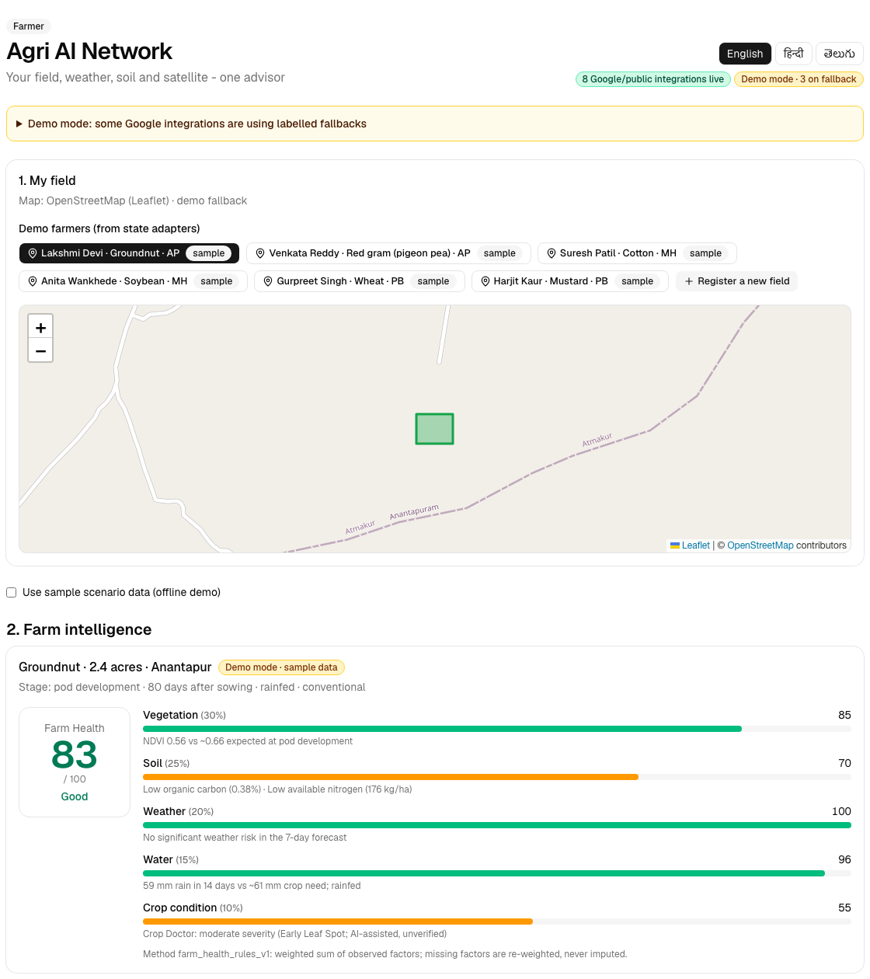
PRODUCT · FARMER APP
The farmer sees one field, one score, one next action
• Every card shows its source and freshness, with Live or Sample · synthetic badges.
• Farm Health = Vegetation 30 % + Soil 25 % + Weather 20 % + Water 15 % + Crop condition 10 %.
• Advisory in English, हिन्दी, తెలుగు; the same advice is translated, not re-analysed.
• Crop Doctor links straight to the nearest agriculture office with road distance and drive time.
• Works offline for demos: 'Use sample scenario data' replays a labelled dry-spell story.
Agri AI Network · Build with AI · Track 4
4
Notes:
Screenshot from the running app (OpenStreetMap basemap in the screenshot; Google Maps satellite in production).

Slide 5
AI / TECHNICAL EXECUTION
AI 25%
Gemini reasons over facts; it never invents them
Structured orchestration
Gemini 2.5 Flash on Vertex AI
Google AI services
Canonical field context in, Pydantic-validated JSON out (generate_structured).
Every record stores model_name, model_version, prompt_version (ai/prompts/*_v1.md).
Advisory, crop-option explanation, voice Q&A.
Multimodal Crop Doctor: condition, symptoms, likelihoods, confidence, expert-review flag.
Speech-to-Text + Text-to-Speech (en/hi/te-IN).
Cloud Translation for localised advisories.
Earth Engine Sentinel-2 NDVI/NDMI per field polygon.
Grounding and safety
Honest fallbacks
Observed data → AI interpretation → recommendation kept as separate fields.
Deterministic Farm Health rules; Gemini explains, rules score.
Crop Doctor is always preliminary, with a disclaimer and a human officer review.
Each integration is probed with a real call; the UI shows what is live and what is on a labelled fallback.
Without keys the full journey still runs on deterministic rules and labelled sample data.
Agri AI Network · Build with AI · Track 4
5
Notes:
AI/technical execution (25%): Gemini, Gemini multimodal, Vertex AI, Earth Engine, structured orchestration.

Slide 6
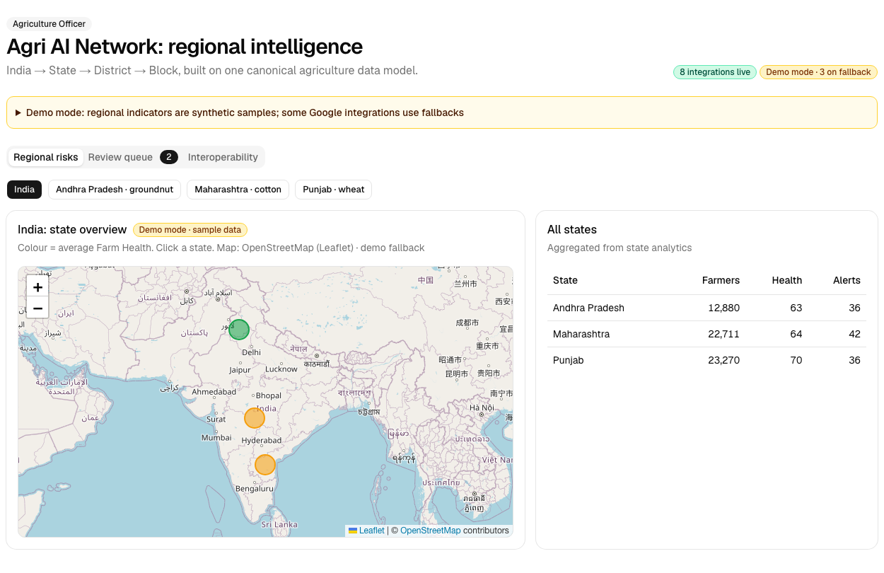
PRODUCT · OFFICER DASHBOARD
Officers see state → district → block, and approve the AI
• Regional risk map, crop distribution, weather risk, water stress and disease / stress hotspots.
• Indicators served from BigQuery; platform activity live from the field records.
• Review queue: every advisory, crop plan and diagnosis starts as pending; the farmer sees approve or reject.
• Interoperability tab: raw state record → adapter → identical canonical record.
Agri AI Network · Build with AI · Track 4
6
Notes:
FR-09 and the human-in-the-loop requirement for consequential actions.

Slide 7
DEPTH & REACH ACROSS INDIA
Reach 20%
A new state is a config file and a data export, not a rebuild
State export
Declarative adapter
(data/adapters/*.json)
Canonical schema
(Pydantic → JSON Schema)
Shared APIs + AI
→
→
→
Andhra Pradesh
Maharashtra
Punjab
Groundnut · e-Crop + Soil Health Card format · Telugu · codes GN, RG
Cotton · MahaDBT format · Marathi → Hindi fallback · codes kapus, tur
Wheat · land records + PAU soil lab · kanal → acres · codes kanak, sarson
• Adapters declare field paths, crop code tables, unit conversions (ha/kanal → acres, g/kg → %, kg/acre → kg/ha), date formats and language fallbacks. One engine applies them all.
• Farm Health, Gemini advisory, Crop Doctor, voice and the officer view run unchanged for every state.
Agri AI Network · Build with AI · Track 4
7
Notes:
Depth & reach (20%): state-independent model, multi-state config, multi-language, reusable APIs.

Slide 8
DEPLOYABILITY & SCALABILITY
Deploy 20%
Cloud-native: one command deploys the network
Running on Google Cloud
API-first, modular
3 Cloud Run services (API + 2 Next.js apps), asia-south1, built by Cloud Build.
Secrets in Secret Manager; Vertex AI, BigQuery and Cloud Storage via the service account.
infrastructure/cloud-run/deploy.sh: repeatable; Gemini key attached automatically when it exists.
Documented REST API (/docs), canonical JSON Schemas, versioned prompts.
Domain modules (farms, intelligence, advisory, crops, diagnosis, localization, interop, analytics) can split into separate services when load demands.
Hackathon
District pilot
State rollout
National network
3 states · 3 languages · real + labelled sample data
1 state, many districts, government feeds
State models, officer workflows, more languages
Shared contracts, model registry, inter-state exchange
Agri AI Network · Build with AI · Track 4
8
Notes:
Deployability (20%): cloud-native services, API-first, adapters, standard schemas, modular AI, deployed app.

Slide 9
IMPACT POTENTIAL
Impact 15%
Impact: better decisions on millions of small fields
Crop resilience
Water efficiency
Disease response
Early NDVI dips and weather risk flagged before yield is lost.
Irrigate only when 14-day rain and forecast say so.
Photo to preliminary diagnosis in seconds, plus the nearest KVK.
Soil health
Climate adaptation
Officer reach
Soil Health Card data turned into one regenerative practice per field.
Crop options scored for local climate risk and rotation value.
One dashboard across districts, with human approval of AI advice.
What we will measure in a pilot: advisories acted on, irrigation events avoided, time from symptom to officer contact, share of AI outputs approved, farmers reached per officer.
Agri AI Network · Build with AI · Track 4
9
Notes:
Impact (15%): small and marginal farmers; resilience, water, disease, soil, climate.

Slide 10
CROSS-BORDER · BRICS PORTABILITY
Built for India, portable across borders
• Nothing in the core is India-specific: the canonical schema, Farm Health rules and AI prompts take any country's records through an adapter.
• Language is configuration: add Portuguese, Russian, Chinese, Arabic or Swahili strings and speech locales.
• Global public data already in the loop: Sentinel-2 (Earth Engine), Open-Meteo, ISRIC SoilGrids.
• Each partner keeps its data sovereign and runs its own Cloud Run deployment; only schemas and models are shared.
Same adapter pattern
Brazil's state rural registries, South Africa's provincial extension data or Ethiopia's woreda soil maps map to the same canonical records.
Shared intelligence, local control
Common data contracts enable cross-border pest and weather early warnings without moving farmer data.
Global South scale
Smallholders produce a large share of food in BRICS+ countries; one open architecture serves them all.
Agri AI Network · Build with AI · Track 4
10
Notes:
Portability story: adapters + canonical schema + config-driven language.

Slide 11
STATUS AND ROADMAP
What runs today, and what switches on next
Live on real Google services
Code complete, switching on next
Gemini 2.5 Flash on Vertex AI (advisory, crop options, Crop Doctor, voice Q&A)
Cloud Speech-to-Text, Text-to-Speech, Translation
Maps Geocoding, Places, Routes + Maps JavaScript basemap
BigQuery regional indicators · Cloud Storage crop photos
Open-Meteo weather, ISRIC SoilGrids texture
Cloud Run, Cloud Build, Artifact Registry, Secret Manager
Earth Engine Sentinel-2 NDVI: waiting for project registration (sample series until then, labelled).
Firestore + Firebase Auth: waiting for Firebase on the project (SQLite fallback).
Real state feeds replace the labelled sample exports: a data change, not a code change.
Next: Marathi and Punjabi, crop-specific disease models on Vertex AI, SMS / IVR channel for feature phones.
Agri AI Network · Build with AI · Track 4
11
Notes:
Be explicit about what is live vs demo; the apps show the same split in their header badges.

Slide 12
One field → one district → one state → a national network
Agri AI Network turns India's scattered agriculture data into advice a farmer can act on today,
and gives every state a way to join without rebuilding.
Try it · agri-ai-network-farmer-web-847963771142.asia-south1.run.app
Officer view · agri-ai-network-officer-dashboard-847963771142.asia-south1.run.app
Source · github.com/ipavanreddy/agri-ai-network
Thank you
Agri AI Network · Build with AI · Track 4
Agri AI Network · Build with AI · Track 4
12
12

