Slide 1
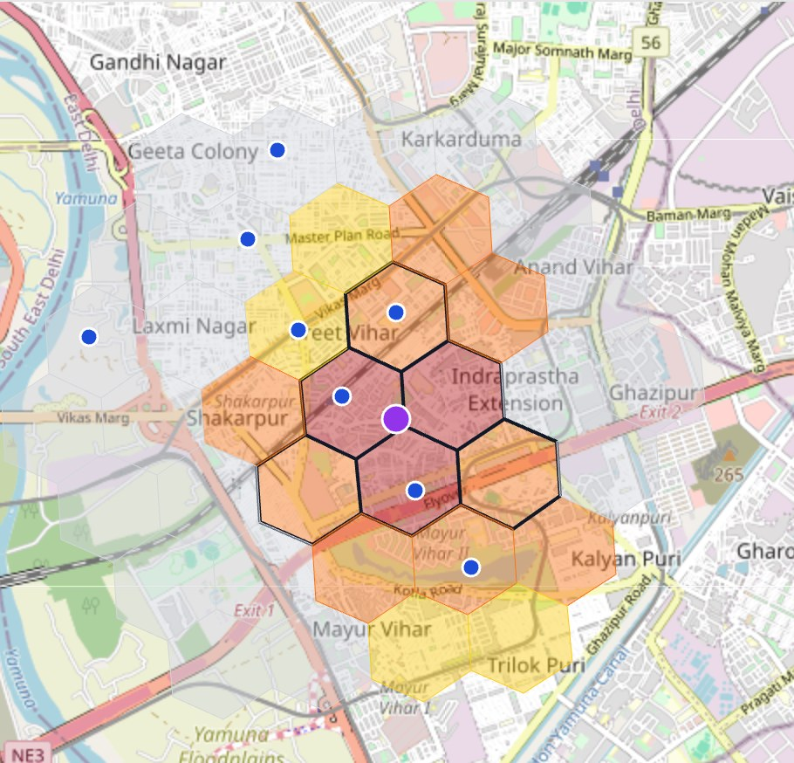

SPONTOM ENTERPRISE PRIVATE LIMITED
Build with AI (Google) • Track 2
Vayu
Drishti
From a citizen’s photo
to an officer’s action.
Hyper-local air-quality intelligence that fuses citizen, sensor, satellite and weather evidence for the officer who can act.
GEMINI-POWERED
OFFICER-APPROVED
FEDERATED
A working prototype by Spontom Enterprise Private Limited
DPIIT Recognised • Visakhapatnam • September 2026
Prototype screenshot: East Delhi hotspot, ~1 km H3 grid, sample data • Map © OpenStreetMap contributors
Notes:
VayuDrishti means 'air vision'. It turns a citizen's photo of smoke into an evidence-backed, officer-approved action. Gemini checks the photo, the platform fuses it with sensor, satellite and weather signals on a one-kilometre grid, and the responsible pollution-control officer receives a transparent score, a likely source and a recommended inspection. The image is a real screenshot of our officer dashboard running on labelled sample data.

Slide 2
01 — PROBLEM UNDERSTANDING
SPONTOM
ENTERPRISE PRIVATE LIMITED
The station reads the city. The smoke is on one street.
India monitors macro-level air quality well, but misses hyper-local events such as night-time industrial smoke. [1]
One station average hides a street-level event.
SIGNALS
SILOS
?
REACT
›
›
›
Stations, sensors, photos, satellite
Held in separate systems
No fused, verified evidence
Action after the peak
4.9 km
249
66
to nearest station
µg/m³ local PM2.5
score · alert at 70
FOCUSED PROBLEM
Near an East Delhi industrial estate the cell reads 249 µg/m³ against 112 at the station. It scores 66, so nobody is alerted.
Officers lack verified, located evidence of hyper-local events in time to inspect.
THE LOCAL BLIND SPOT
Consequence
Sources go undetected, inspections are poorly targeted and smoke crosses state lines unannounced.
[1] VayuDrishti PRD §2.1. [2] CPCB National AQI. Numbers: VayuDrishti demo run on labelled sample data (ITO sample station, simulated sensors), not real readings.
SPONTOM ENTERPRISE PRIVATE LIMITED • VAYUDRISHTI
DPIIT RECOGNISED • VISAKHAPATNAM
2
Notes:
Official stations give a reliable city-level picture, but a station about five kilometres away cannot see smoke from one industrial estate at 3 a.m. In our demo scenario the local cell reads 249 micrograms against 112 at the station, yet its Hotspot Confidence is 66, just under Delhi's threshold of 70, so no one is alerted. The signals that would reveal the event exist but sit in separate systems. The result is reactive enforcement and poorly targeted inspections. These figures come from our labelled sample data, not real CPCB readings.

Slide 3
02 — PROPOSED SOLUTION
SPONTOM
ENTERPRISE PRIVATE LIMITED
VayuDrishti turns scattered signals into one inspection.
Gemini works only on structured evidence; every consequential step waits for an officer.
AI ACTION BRIEF • GEMINI 2.5 FLASH
DRAFT • NEEDS APPROVAL
01
SEE
Citizen photo, sensors, satellite and weather fused on a ~1 km grid.
Sangrur–Patiala belt, Punjab • 95/100 • severe
1
Likely source: crop residue burning (confidence 0.95).
02
SCORE + BRIEF
Transparent Hotspot Confidence; Gemini drafts likely source and inspection.
2
Evidence: PM2.5 226.4 µg/m³ (indicative) • 39 fires upwind.
3
Recommended: dispatch cluster nodal officer / field team.
03
HUMAN DECISION
Officer approves actions; advisories go out in hi/pa/en with voice.
4
Outlook: ~287 µg/m³ (Severe) at +48 h.
↺
Uncertainty stated: nearest official station 53.1 km away.
Prompt action_brief_v2 • numbers checked vs evidence
APPROVE ACTIONS
Real Gemini output read from the deployed API (30 Sep 2026), generated on labelled sample sensor/satellite data; wording condensed.
SPONTOM ENTERPRISE PRIVATE LIMITED • VAYUDRISHTI
DPIIT RECOGNISED • VISAKHAPATNAM
3
Notes:
The solution has three moves. First, see: every signal lands on the same one-kilometre hexagon grid. Second, score and brief: a transparent weighted score decides whether this is a hotspot, and Gemini drafts a likely source and inspection using only the jurisdiction's own action rules. Third, a human decides. On the right is a real brief Gemini produced in our deployed API for a Punjab crop-burning hotspot, including its own statement of uncertainty.

Slide 4
03 — HOW IT WORKS
SPONTOM
ENTERPRISE PRIVATE LIMITED
From one photo to an approved action in seven steps.
Machines gather and rank evidence; people approve anything that leaves the system.
1
2
3
4
5
6
7
›
›
›
›
›
›
REPORT
VERIFY
FUSE
SCORE
BRIEF
APPROVE
ADVISE
Photo + voice note
Gemini photo check
Sensor • satellite • weather
Hotspot Confidence
Likely source + actions
Officer decides
hi / pa / en voice
TIER 0 • AUTOMATIC
TIER 1 • OFFICER
TIER 2 • CROSS-STATE
Photo check, fusion and scoring run in seconds. Nothing public goes out unapproved.
Scores at or above the threshold (Delhi 70, Maharashtra 65) reach the jurisdiction’s inbox.
An upwind hotspot (Punjab → Delhi NCR) becomes an officer-approved cross-boundary alert.
CALIBRATION ASSUMPTION
Weights 35/25/25/15 and thresholds are configured defaults to tune against pilot inspection outcomes.
Hotspot Confidence = sensor anomaly 35% • satellite 25% • citizen reports 25% • weather plausibility 15% (services/api/app/hotspots/confidence.py).
SPONTOM ENTERPRISE PRIVATE LIMITED • VAYUDRISHTI
DPIIT RECOGNISED • VISAKHAPATNAM
4
Notes:
Here is the loop. A citizen reports by photo and voice, Gemini verifies the photo, and the platform fuses it with sensor, satellite and weather evidence. The score is a transparent weighted sum you can inspect factor by factor. Above the threshold, an alert reaches the officer for that jurisdiction; if the smoke is heading into another state, the officer can approve a cross-boundary alert. The weights and thresholds are defaults we expect to calibrate during a pilot.

Slide 5
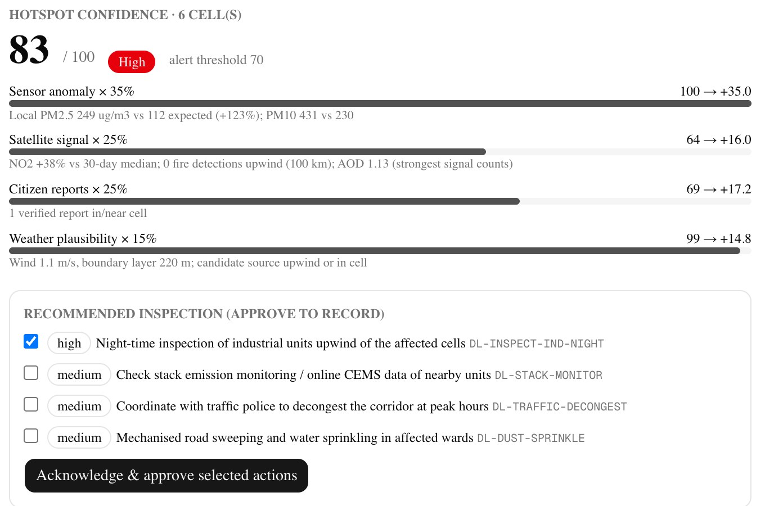
04 — USERS & CONTEXT
SPONTOM
ENTERPRISE PRIVATE LIMITED
Design for the officer first; connect the people around her.
Two app roles (PRD §7): Environmental Officer (primary) and Citizen Reporter (secondary).
01
CITIZEN
Reports by photo or voice in Hindi, Punjabi or English; sees status and hears advisories.
Reporter (secondary)
02
FIELD TEAM
Gets a located, prioritised inspection instead of a city-wide average.
Acts on approval
03
NEIGHBOUR SPCB
Receives approved alerts for upwind smoke, e.g. Punjab → Delhi NCR.
Cross-boundary
04
CAQM / STATE
Sees audit trails and when a GRAP-stage review is recommended.
ENVIRONMENTAL OFFICER • PRIMARY USER
Oversight
One alert: score, evidence and an inspection to approve
CONSTRAINT → DESIGN RESPONSE
FEW STAFF
ranked, located briefs
LANGUAGE
hi / pa / en + voice
PATCHY DATA
freshness + labels
Screenshot: officer dashboard, local demo run on labelled sample data. Stakeholders beyond the two roles are reached through approved alerts.
SPONTOM ENTERPRISE PRIVATE LIMITED • VAYUDRISHTI
DPIIT RECOGNISED • VISAKHAPATNAM
5
Notes:
Our primary user is the environmental officer at a State Pollution Control Board or municipal clean-air cell, with few field staff and a duty to justify every action with evidence. Around her are citizens who report and receive advisories, field teams who inspect, neighbouring state boards who need warning of incoming smoke, and oversight bodies such as CAQM. Each constraint maps to a design response: ranked briefs for scarce staff, three languages with voice, and visible data freshness when some signals are missing.

Slide 6
05 — JOURNEY
SPONTOM
ENTERPRISE PRIVATE LIMITED
Scenario A: night-time smoke in East Delhi.
One Hindi voice report pushes a hidden hotspot over the threshold (PRD §43–44).
BEFORE
CITIZEN, IN HINDI
FUSION
OFFICER
Station reads 112
›
Photo + voice note
›
Hotspot 83 / 100
›
Approves inspection
Sample station 4.9 km away; the local cell scores 66, under 70.
Gemini: industrial emission, severity 4/5, confidence 0.86.
Sensor +35 • satellite +16 • report +17.2 • weather +14.8.
Night-time check of upwind units; action recorded, alert closed.
OUTCOME
One photo → one approved inspection.
+
Voice advisory in hi / pa after approval
✓
Audit trail for every step
↗
Cross-boundary alert if upwind
24 h outlook: ~201 µg/m³ (185–218), Very Poor.
WHY OFFICERS RETURN
Prioritised, located work where every number is traceable to a source and a timestamp.
Local demo run, 30 Sep 2026, on labelled sample/simulated data; routed to the DPCC demo inbox. Live Gemini values vary by a point or two.
SPONTOM ENTERPRISE PRIVATE LIMITED • VAYUDRISHTI
DPIIT RECOGNISED • VISAKHAPATNAM
6
Notes:
This is our demo scenario. Before the report, the local cell scores 66 and the inbox is empty. A resident reports in Hindi by voice with a photo of a chimney; Gemini classifies it as an industrial emission, severity four of five. The score jumps to 83, with every factor visible, and the alert reaches the Delhi Pollution Control Committee demo inbox. The officer approves a night-time inspection, records the action and closes the alert, and an approved advisory is read aloud in Hindi or Punjabi.

Slide 7
06 — INNOVATION & DIFFERENTIATION
SPONTOM
ENTERPRISE PRIVATE LIMITED
Not another AQI dashboard. A bridge from evidence to action.
Existing systems do essential work; VayuDrishti focuses on the local event nobody has verified yet.
APPROACH
WHAT IT CONTRIBUTES
REMAINING BOUNDARY / GAP
CPCB stations + National AQI
Regulatory-grade readings and a public AQI scale [2]
Sparse stations can miss a street-level event [1]
SAFAR / IITM forecasts
City-scale AQI and forecasts for major metros [3]
Forecasts, not a verified-report-to-inspection workflow
GRAP (CAQM)
Staged, region-wide measures for Delhi NCR [4]
Region-wide; does not locate a specific source
Complaint apps / portals
Citizens can flag visible pollution
Reports hard to verify; not fused with sensors or satellite [1]
VayuDrishti
Verified photo + sensor + satellite + weather → brief → approval
Complements the above; accuracy unvalidated beyond sample data
DISTINCTIVE CAPABILITY
A verified citizen photo becomes an officer-approved, cross-state-aware inspection.
[1] PRD §2.1. [2] CPCB National AQI. [3] SAFAR, IITM Pune (MoES). [4] Commission for Air Quality Management.
SPONTOM ENTERPRISE PRIVATE LIMITED • VAYUDRISHTI
DPIIT RECOGNISED • VISAKHAPATNAM
7
Notes:
We are not replacing any of these. CPCB stations remain the regulatory reference, SAFAR and IITM provide city-scale forecasts, and GRAP drives region-wide measures in Delhi NCR. What is missing is a workflow that takes a local, citizen-reported event, verifies it against independent evidence and puts a located inspection in front of the right officer. Our honest limit: the platform's accuracy has only been shown on sample data so far.

Slide 8
07 — TECHNOLOGY & GOOGLE AI
SPONTOM
ENTERPRISE PRIVATE LIMITED
Bounded AI on a federated evidence grid.
Gemini interprets structured evidence; it never invents measurements.
01
CITIZEN CHANNEL
Next.js app • photo + voice (Speech-to-Text) • hi/pa/en • Maps geocoding
GOOGLE AI INTEGRATION MAP
Gemini 2.5 Flash (Vertex AI): photo, brief, advisory [7]
02
STATE ADAPTERS
3 vendor feeds → canonical schema • κ-Köhler humidity calibration [6]
Translation • Text-to-Speech • Speech-to-Text
Maps • BigQuery • Cloud Storage • Cloud Run
FUSION GRID
H3 res 8 (~1 km) • Earth Engine layers [5] • 24–72 h shared forecast model
WIRED
Earth Engine + Vertex Model Registry: on sample until access
03
04
DECISION LAYER
Gemini on the evidence bundle • action rules only • numeric grounding check
REAL-VS-SAMPLE RULE
Live
Gemini, Translation, TTS/STT, Maps, BigQuery, GCS
05
OFFICER + DELIVERY
Inbox • approve / record / close • Translation + TTS • BigQuery audit
Sample
EE layers, CPCB station, low-cost sensors: labelled
Freshness
Each signal shows source + age; header badge: live vs sample
[5] Earth Engine catalogue (Sentinel-5P NO2, FIRMS). [6] Crilley et al. (2018), AMT. [7] Gemini 2.5 Flash on Vertex AI.
SPONTOM ENTERPRISE PRIVATE LIMITED • VAYUDRISHTI
DPIIT RECOGNISED • VISAKHAPATNAM
8
Notes:
Architecturally, five layers. Citizens report through a web app with voice and three languages. State adapters map differently formatted sensor feeds into one canonical schema, with a humidity correction for low-cost sensors. Everything lands on an H3 grid, and Gemini is used as a bounded decision layer: it sees only the evidence bundle, may only recommend the jurisdiction's configured actions, and any number it cites is checked. Gemini, Translation, speech, Maps, BigQuery and Cloud Storage are live; Earth Engine and the model registry are wired but run on labelled samples until access is granted.

Slide 9
08 — RESPONSIBLE AI & DATA
SPONTOM
ENTERPRISE PRIVATE LIMITED
Likely source, not a verdict. Humans decide.
The platform guides inspections; it does not enforce, penalise or broadcast on its own (PRD §6).
HUMAN APPROVAL
NO AUTO-BROADCAST • NO ENFORCEMENT
SAFETY BY DESIGN
Alerts
Start as pending review; the officer approves, records the action and closes.
GROUNDING
Gemini sees only the evidence bundle; never invents measurements.
Transfers
Cross-boundary alerts and public advisories each need explicit approval.
NUMERIC CHECK
Numbers absent from the evidence are flagged as warnings.
RULE BOUND
Actions outside the jurisdiction’s rules are dropped.
DO NOT COLLECT / CLAIM
PROVENANCE
Model, version and prompt version stored on every AI record.
Reporter identity beyond a pseudonym
HONEST DATA
Low-cost sensors labelled indicative; sample data labelled.
Precise reporter locations in public views
PHOTO CHECK
Irrelevant or poor photos are rejected and kept out of the score.
“Polluter” labels: only a likely source
PRD §6, §35, §52. Roadmap: face and number-plate blurring before any public display; role enforcement and login.
SPONTOM ENTERPRISE PRIVATE LIMITED • VAYUDRISHTI
DPIIT RECOGNISED • VISAKHAPATNAM
9
Notes:
Responsible design here means three things. First, nothing consequential happens automatically: alerts, cross-boundary transfers and public advisories each need an officer's approval. Second, we collect little: reporters are pseudonymous and precise locations are not shown publicly, and we never call anyone a polluter, only a likely source to guide inspection. Third, Gemini is grounded: it sees only structured evidence, its numbers are checked, its actions are limited to the jurisdiction's rules, and every output carries model and prompt provenance.

Slide 10
09 — OUTCOMES, VALIDATION & SCALE
SPONTOM
ENTERPRISE PRIVATE LIMITED
Earn the right to scale, one clean-air cell at a time.
The first proof is not app activity. It is a verified hotspot that led to a timely inspection.
01
02
03
04
MEASURE WITH
DETECTION
›
RESPONSE
›
TARGETING
›
HEALTH
Alert-to-action time (audit trail)
Photo check vs labelled set
Forecast MAE vs persistence
Sensor error vs co-located station
Hotspots found outside station coverage
Alert-to-action time falls
Inspections guided by evidence
Less exposure during spikes
VALIDATION GATES
OWNERSHIP + SCALE
1
CITY PILOT
2
CALIBRATE + BACKTEST
3
CLAIM CAREFULLY
1 clean-air cell + SPCB; 10–20 co-located sensors (PRD §50)
Refit calibration; forecast must beat persistence at 24 h
Report hit rate per inspection; no health claims yet
Owner
State Pollution Control Board / city clean-air cell
Channel
SPCB field teams; neighbour boards via adapters
Scale
New state = JSON adapter + language pack
BUDGET ROUTE
NCAP city clean-air action-plan funding (MoEFCC), tracked on PRANA [8]; pilot fit to confirm with the SPCB.
Current model accuracy uses simulated histories (e.g. Delhi 24 h MAE 13.8 vs 16.7 persistence) and demonstrates the method only.
SPONTOM ENTERPRISE PRIVATE LIMITED • VAYUDRISHTI
DPIIT RECOGNISED • VISAKHAPATNAM
10
Notes:
We want to earn scale through evidence. The outcome chain runs from detecting hotspots the network misses, to faster alert-to-action times, better-targeted inspections and, eventually, less exposure. A city pilot with one clean-air cell and ten to twenty co-located sensors lets us recalibrate and check that the forecast beats persistence. The owner is the State Pollution Control Board, and the natural budget route is the city clean-air action plans under NCAP, which we would confirm with the board. Today's forecast numbers come from simulated history, so we present them as a method, not a result.

Slide 11
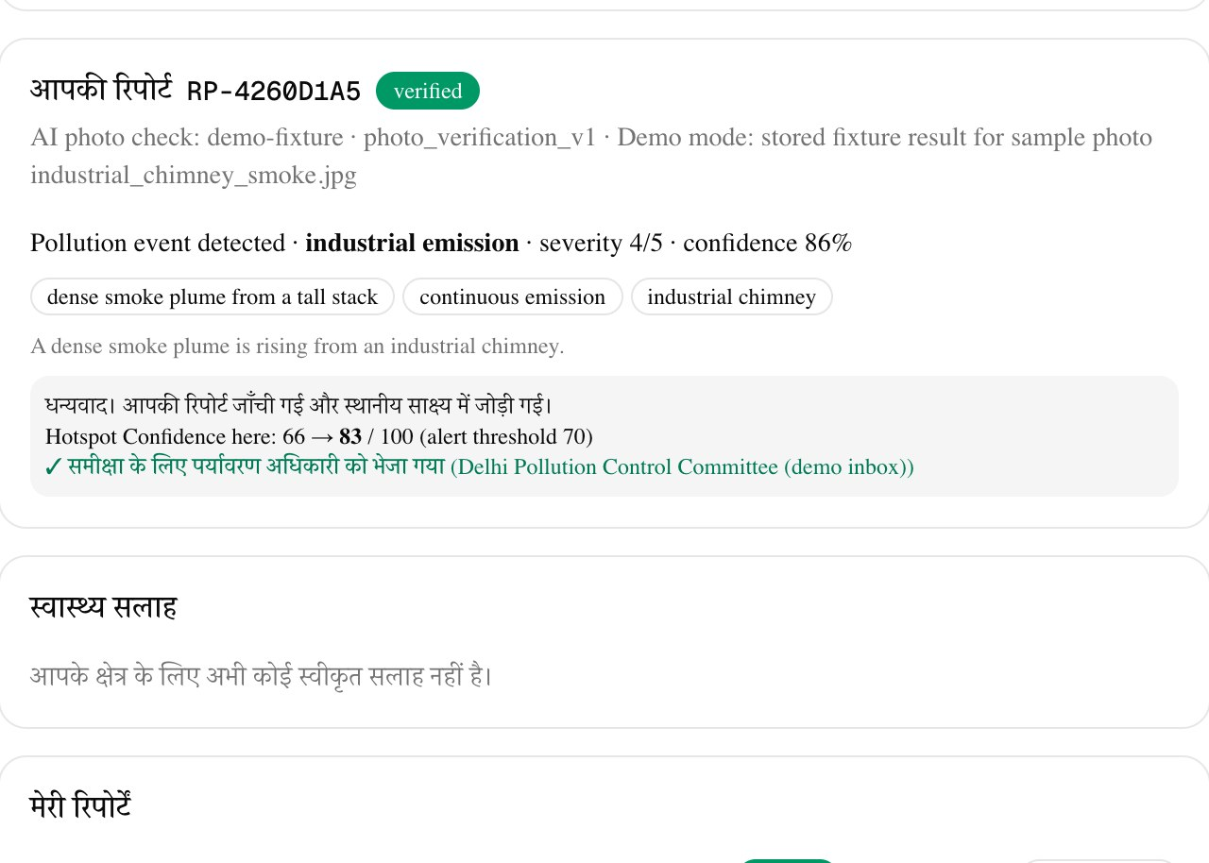
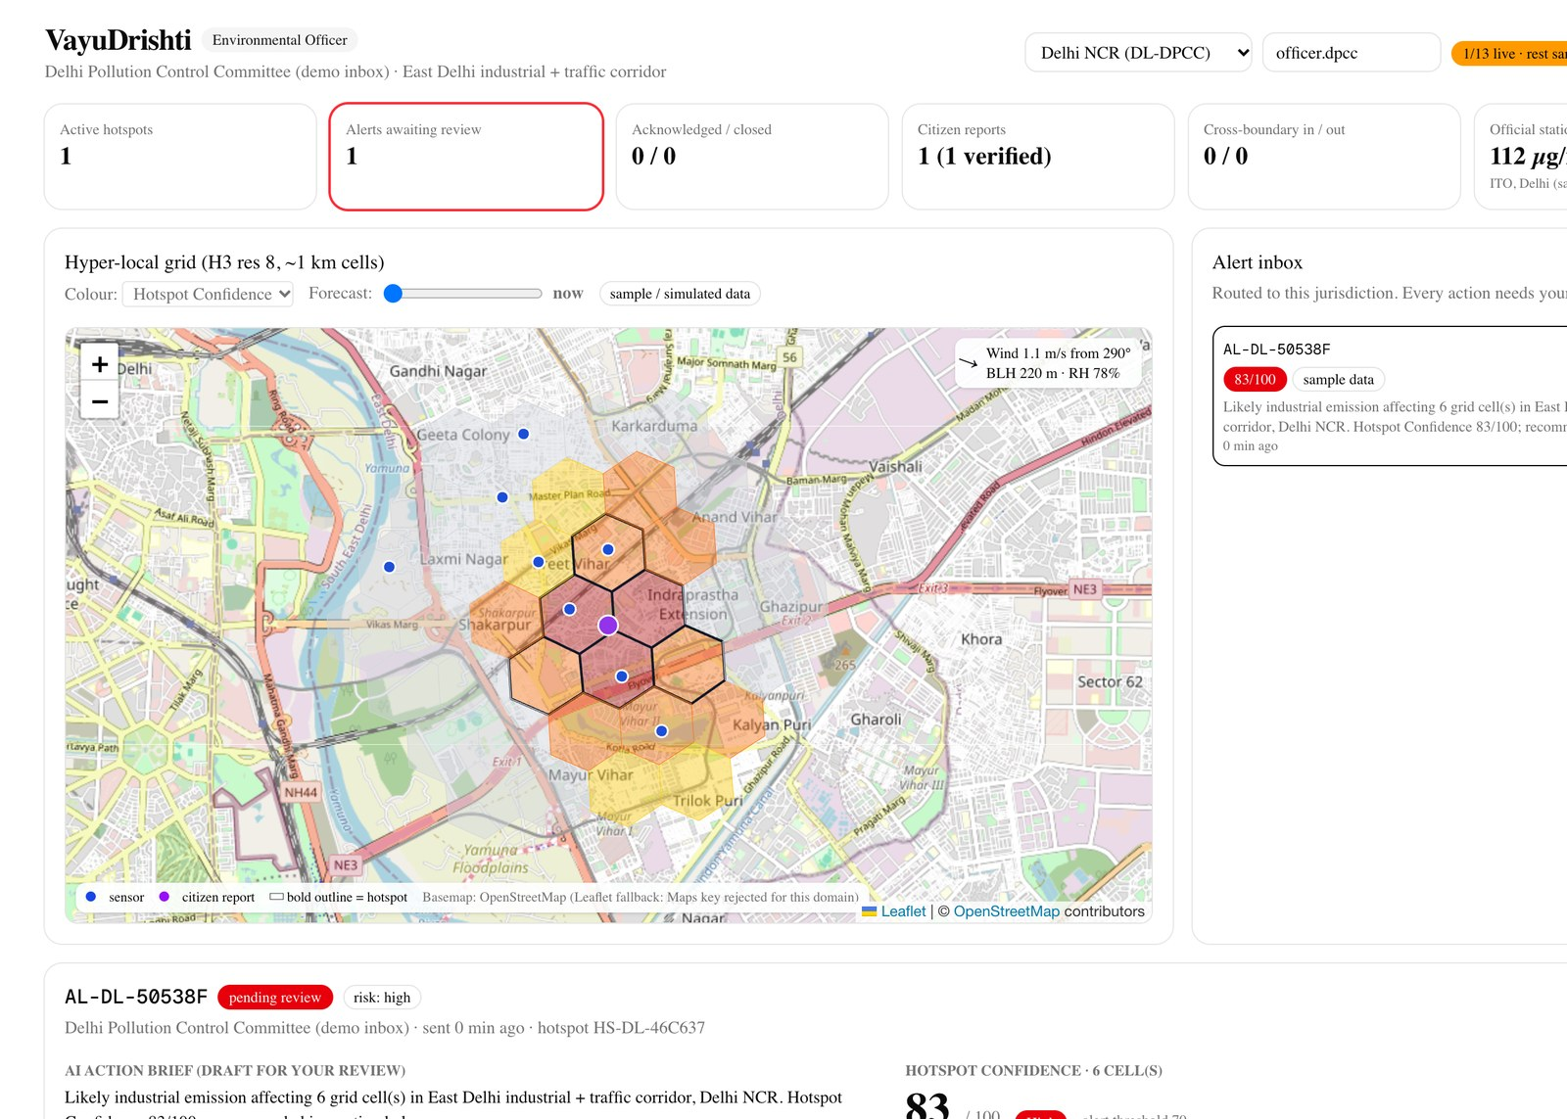
10 — LIVE PROTOTYPE
SPONTOM
ENTERPRISE PRIVATE LIMITED
Working today, end to end.
The header badge in both apps shows which integrations are live and which run on sample data.
EVALUATION ALIGNMENT
25%
AI / TECHNICAL EXECUTION
Gemini multimodal + schema-validated briefs, numeric grounding, provenance
20%
PROBLEM-SOLUTION FIT
Finds events stations miss; routes evidence to the officer who can act
Citizen app: Hindi report, AI verdict, 66 → 83
Officer dashboard: hotspot map + alert inbox
20%
DEPTH & REACH ACROSS INDIA
3 state adapters, canonical schema, hi/pa/en voice, cross-state alert
TRY IT
20%
DEPLOYABILITY & SCALABILITY
Citizen app
https://air-quality-network-citizen-web-847963771142.asia-south1.run.app
Cloud Run + BigQuery + GCS; a new state is a JSON adapter
Officer dashboard
https://air-quality-network-officer-dashboard-847963771142.asia-south1.run.app
API (/docs)
https://air-quality-network-api-847963771142.asia-south1.run.app/docs
15%
IMPACT POTENTIAL
Source
https://github.com/ipavanreddy/air-quality-network
India’s most polluted corridors; approved health advisories
Screenshots: local run on labelled sample data, 30 Sep 2026. Map © OpenStreetMap contributors; sample photo CC BY-SA (THIRD_PARTY.md).
SPONTOM ENTERPRISE PRIVATE LIMITED • VAYUDRISHTI
DPIIT RECOGNISED • VISAKHAPATNAM
11
Notes:
Everything you have seen runs today. On the left, the citizen app in Hindi after submitting a report: Gemini's verdict and the score moving from 66 to 83. Next to it, the officer dashboard with the hotspot on the grid and the alert waiting for review. The links take you to the deployed apps, the API documentation and the source. On the right is how we map to each of the five evaluation criteria.

Slide 12
APPENDIX — REFERENCES
SPONTOM
ENTERPRISE PRIVATE LIMITED
Problem evidence & public systems
Numbered references correspond to citations in the core proposal.
[1]
VayuDrishti PRD (Track 2 brief)
docs/PRD.md §2 (problem), §43–44 (scenarios), §50 (scale). Challenge framing and demo design.
LOCAL EVIDENCE
[2]
CPCB: National Air Quality Index
Central Pollution Control Board. AQI categories and the national real-time monitoring network.
Official source ↗
[3]
SAFAR, IITM Pune (MoES)
System of Air Quality and Weather Forecasting and Research: AQI and forecasts for Delhi, Pune, Mumbai, Ahmedabad.
Official source ↗
[4]
Commission for Air Quality Management
Statutory body for Delhi NCR and adjoining areas; administers the Graded Response Action Plan (GRAP).
Official source ↗
SPONTOM ENTERPRISE PRIVATE LIMITED • VAYUDRISHTI
DPIIT RECOGNISED • VISAKHAPATNAM
12
Notes:
These references support the problem and differentiation slides. The PRD is our own specification of the challenge. CPCB, SAFAR and CAQM are the official systems we complement rather than replace.

Slide 13
APPENDIX — REFERENCES
SPONTOM
ENTERPRISE PRIVATE LIMITED
Data, methods & funding route
Datasets and models are also listed with licences in THIRD_PARTY.md.
[5]
Earth Engine data catalogue
Sentinel-5P TROPOMI NO2 (COPERNICUS/S5P/OFFL/L3_NO2); NASA FIRMS, MAIAC AOD, ERA5-Land and GFS are also catalogued.
Dataset ↗
[6]
Crilley et al. (2018)
“Evaluation of a low-cost optical particle counter (Alphasense OPC-N2) for ambient air monitoring.” Atmos. Meas. Tech. 11, 709–720. Basis of the κ-Köhler humidity correction.
Paper ↗
[7]
Gemini 2.5 Flash on Vertex AI
Google Cloud model documentation for the model used for photo verification, action briefs and advisories.
Model docs ↗
[8]
PRANA: NCAP portal (CPCB)
Portal for Regulation of Air-pollution in Non-Attainment cities: tracks city action plans under the National Clean Air Programme.
Official source ↗
SPONTOM ENTERPRISE PRIVATE LIMITED • VAYUDRISHTI
DPIIT RECOGNISED • VISAKHAPATNAM
13
Notes:
The second reference slide covers the data and methods behind the technology slide, the model documentation for Gemini, and the PRANA portal, which tracks city clean-air action plans under NCAP and is our proposed budget route. Every dataset and library, with licences, is listed in THIRD_PARTY.md in the repository.

