Slide 1


SPONTOM ENTERPRISE PRIVATE LIMITED
Build with AI (Google) • Track 1
JanVaani
From a citizen’s voice
to an evidenced priority.
Multilingual citizen requests become explainable, human-decided infrastructure recommendations.
GEMINI ON VERTEX AI
HUMAN-DECIDED
A prototype by Spontom Enterprise Private Limited
DPIIT Recognised • Visakhapatnam • September 2026
Illustrative image generated with Gemini 2.5 Flash Image (Google)
Notes:
JanVaani means ‘the people’s voice’. It lets any citizen say what their village or ward needs, in Hindi, Telugu or English, by voice, text or chat. Gemini on Vertex AI structures each request, and planning officers get a transparent ranking with a number-checked evidence brief. A human makes every decision, and the citizen hears back in their own language.

Slide 2
01 — PROBLEM UNDERSTANDING
SPONTOM
ENTERPRISE PRIVATE LIMITED
Citizens ask. Nobody adds the requests up.
Development needs arrive through many channels and languages and rarely reach the planning table as evidence.
One unbridged river, many voices, no project.
ASK
SCATTER
?
PLAN
›
›
›
Portal, helpline, Gram Sabha, chat
Many channels, many languages
Never deduplicated or set against gap data
Budgets follow other signals
146
132
0
requests
citizens
projects on record
FOCUSED PROBLEM
Sonbarsa, Gaya: every monsoon the river cuts the village off and children miss school. Each request arrives alone.
Planners cannot see consolidated, located citizen demand next to infrastructure-gap and investment data.
THE AGGREGATION GAP
Consequence
Spending can misalign with need; louder, better-connected areas can dominate; citizens never hear back.
Numbers: Sonbarsa cluster in JanVaani’s synthetic sample data, not official statistics. [1] Track 1 brief and PRD §2. [2] CPGRAMS.
SPONTOM ENTERPRISE PRIVATE LIMITED • JANVAANI
DPIIT RECOGNISED • VISAKHAPATNAM
2
Notes:
The problem is not that citizens stay silent. They ask through grievance portals, helplines, Gram Sabhas and messaging apps, in many languages. Those requests are rarely deduplicated, located to an administrative code, or compared with infrastructure-gap and investment data. In our sample, one bridge need near Sonbarsa in Gaya has 146 requests from 132 citizens and no project on record. These are synthetic numbers, but the pattern is the one the Track 1 brief describes.

Slide 3
02 — PROPOSED SOLUTION
SPONTOM
ENTERPRISE PRIVATE LIMITED
JanVaani turns scattered requests into ranked evidence.
One pipeline from a voice note to an officer’s decision, and back to the citizen in their language.
EVIDENCE BRIEF
NUMBER-CHECKED
01
HEAR
Voice, text or chat in Hindi, Telugu or English; original words kept.
Roads & Bridges – Sonbarsa, Kurmawan, Belhari (Gaya)
1
Priority Score 85.6 / 100 (High), rank 1 of 7 clusters in Bihar.
02
AGGREGATE + SCORE
Gemini structures, locates and clusters; a transparent formula ranks.
2
147 requests from 133 unique citizens; 78 in the last 30 days.
3
“Every monsoon, children are unable to attend school for three months.”
03
HUMAN DECISION
Officer approves, defers or rejects; the citizen sees the status.
4
No sanctioned, ongoing or completed project recorded.
↺
Uncertainty: exact bridge site not specified; Census 2011 base.
Number check: 49 numbers, 0 ungrounded
APPROVE / DEFER
Real output of gemini-2.5-flash (prompt evidence_brief_v1), 30 Sep 2026, over synthetic sample data; lines shortened for the slide.
SPONTOM ENTERPRISE PRIVATE LIMITED • JANVAANI
DPIIT RECOGNISED • VISAKHAPATNAM
3
Notes:
The right panel is a real evidence brief the prototype generated with Gemini 2.5 Flash, shortened to fit. Gemini only sees structured data: the score breakdown, citizen quotes, indicators with sources, and investments. An automatic check then confirmed that all 49 numbers in the brief exist in that input. The officer decides; nothing is sanctioned automatically.

Slide 4
03 — HOW IT WORKS
SPONTOM
ENTERPRISE PRIVATE LIMITED
Seven steps from a voice note to a decision.
Observed data, AI interpretation and the recommendation stay separate at every step.
1
2
3
4
5
6
7
›
›
›
›
›
›
SPEAK
UNDERSTAND
LOCATE
CLUSTER
FUSE + SCORE
BRIEF
DECIDE
Voice, text, chat
Gemini JSON
LGD code + H3
Gemini embeddings
5 factors, no AI
Numbers checked
Officer; citizen told
TIER 0 • AUTOMATED
TIER 1 • DISTRICT OFFICER
TIER 2 • STATE / NATIONAL
Understand, locate and cluster; ask one clarifying question if a place is ambiguous.
Review ranking and brief, adjust the policy lens, then approve, defer or reject.
Compare districts on the same canonical schema (roadmap: Phase 3–4).
DESIGN ASSUMPTION
Officer review time per brief and state escalation rules must be tested in a district pilot.
Pipeline: services/api/app/pipeline (intake → understanding → location → clustering → fusion → scoring → brief). PRD §8, §50.
SPONTOM ENTERPRISE PRIVATE LIMITED • JANVAANI
DPIIT RECOGNISED • VISAKHAPATNAM
4
Notes:
Here is the journey. The citizen speaks; Cloud Speech-to-Text and Translation keep the original and add English. Gemini returns schema-validated JSON, the place resolves to an LGD-style code and an H3 cell, and Gemini embeddings join it to a demand cluster. Fusion and scoring are deterministic, not AI. Gemini writes the brief, the officer decides, and the status flows back to the citizen.

Slide 5

04 — USERS & CONTEXT
SPONTOM
ENTERPRISE PRIVATE LIMITED
Design for the citizen first; equip the officer.
Two roles in the product: Citizen and Planning Officer. Others appear in the pilot workflow.
01
DISTRICT OFFICER
Needs a defensible, sourced ranking, not an inbox of 1,000 messages.
Planning Officer
02
STATE DEPT.
Compares districts; onboards via an adapter config, not new code.
Planning Officer (state)
03
BLOCK ENGINEER
Confirms site and scope before a project report is prepared.
Field verification
04
CSC / ASHA
Records requests for citizens without a smartphone.
CITIZEN • PRIMARY USER
Assisted capture (roadmap)
Speaks Hindi • mobile-first • may have limited literacy
CONSTRAINT → DESIGN RESPONSE
LOW LITERACY
voice + spoken reply
MANY LANGUAGES
HI • TE • EN
VAGUE PLACE
one clarifying question
Illustrative image generated with Gemini 2.5 Flash Image (Google). Personas from PRD §7 and §53; validate locally.
SPONTOM ENTERPRISE PRIVATE LIMITED • JANVAANI
DPIIT RECOGNISED • VISAKHAPATNAM
5
Notes:
The primary user is the citizen: rural or urban, mobile-first, often more comfortable speaking than typing. So JanVaani accepts voice notes and replies with spoken confirmation from Cloud Text-to-Speech. The planning officer needs the opposite: a short, sourced and auditable ranking. Block engineers and assisted-capture workers are part of the pilot workflow, not extra app roles.

Slide 6
05 — JOURNEY
SPONTOM
ENTERPRISE PRIVATE LIMITED
A parent in Gaya, from voice note to recommendation.
Scenario A (PRD §43–44), run against the prototype on 30 September 2026 with synthetic sample data.
BEFORE
HINDI REQUEST
CLUSTER
OFFICER
Monsoon cut-off
›
Understood in ~3 s
›
Joins 146 others
›
85.6 / 100, rank 1 of 7
No bridge at Sonbarsa; children miss school for three months.
Roads & bridges • urgency high • children • place matched (90%)
147 requests from 133 unique citizens (sample).
Vulnerability to 40%: a water cluster moves #3 → #2; change logged.
OUTCOME
Approved for field verification.
+
Brief: 49 numbers checked, 0 ungrounded
✓
Block engineer verifies the site
↗
Citizen notified in her language
Her status check now reads “Recommended” in Hindi.
WHY IT SUSTAINS
Citizens see their request move, so they keep reporting; officers get evidence they can defend.
Timings and scores from the local prototype run (gemini-2.5-flash, extract_v1 / evidence_brief_v1); all data synthetic.
SPONTOM ENTERPRISE PRIVATE LIMITED • JANVAANI
DPIIT RECOGNISED • VISAKHAPATNAM
6
Notes:
This is Scenario A from the PRD, which we ran live. The Hindi request was understood in about three seconds: roads and bridges, high urgency, children affected. On confirmation it joined the Sonbarsa cluster, now 147 requests from 133 unique citizens, ranked first in Bihar at 85.6. When the officer raised the vulnerability weight to 40 percent, a drinking-water cluster moved from third to second, and the change was logged. The officer approved it for field verification, and the parent’s status now reads ‘Recommended’ in Hindi.

Slide 7
06 — INNOVATION & DIFFERENTIATION
SPONTOM
ENTERPRISE PRIVATE LIMITED
Not another grievance portal. A demand-to-plan bridge.
Existing systems do valuable work; JanVaani adds the missing aggregation and evidence layer between them.
APPROACH
WHAT IT CONTRIBUTES
REMAINING GAP FOR PLANNING
CPGRAMS / state portals
Grievance lodging and tracking to closure across departments
Built for individual cases, not aggregated development demand
Gram Sabha / GPDP
Statutory, participatory village planning (e-GramSwaraj)
Periodic meetings; hard to compare across villages with gap data
Mission Antyodaya
Village-level infrastructure-gap survey and ranking
Official data, but not citizens’ voiced needs between rounds
Generic AI chatbot
Fast multilingual conversation
No LGD mapping, deduplication, sourced score or human decision
JanVaani
Voice → located, deduplicated clusters fused with gap, vulnerability, investment
Adapter design for these systems; synthetic data; unvalidated in field
DISTINCTIVE CAPABILITY
Per-capita unique-citizen demand, set against official gaps, with a number-checked brief.
[2] CPGRAMS. [3] Mission Antyodaya. [4] e-GramSwaraj (GPDP). Integrations with these systems are adapter designs, not built (PRD §6).
SPONTOM ENTERPRISE PRIVATE LIMITED • JANVAANI
DPIIT RECOGNISED • VISAKHAPATNAM
7
Notes:
We are not replacing any of these. CPGRAMS and state portals resolve individual grievances; Gram Sabhas and GPDP are the statutory planning process; Mission Antyodaya measures village gaps. What is missing is a layer that turns voiced demand into located, deduplicated evidence and sets it against those official gaps. That is JanVaani’s contribution, and we are explicit that it is not yet field-validated.

Slide 8
07 — TECHNOLOGY & GOOGLE AI
SPONTOM
ENTERPRISE PRIVATE LIMITED
Bounded AI on Google Cloud, not an open chatbot.
Gemini interprets; deterministic code scores; people decide. Every AI record stores model, version and prompt.
01
CHANNELS
Next.js citizen app (text, voice, chat tab) • Telegram webhook
GOOGLE AI INTEGRATION MAP
Gemini 2.5 Flash + embeddings on Vertex AI
02
UNDERSTANDING
Gemini 2.5 Flash • schema-validated JSON • versioned prompts
Speech-to-Text • Translation • Text-to-Speech
Maps • BigQuery • Cloud Storage • Cloud Run
LOCATION + CLUSTERS
LGD-style codes + H3 cells • Gemini embeddings similarity
PLANNED
Firebase auth • BigQuery ML forecasting
03
04
FUSION + SCORE
State adapters → canonical schema • 5-factor deterministic score
REAL VS DEMO RULES
Status badge
Live / demo / fallback shown per integration
05
BRIEF + DECISION
Gemini brief from structured input • number check • human decision
Data
Every value has source + year; synthetic flagged
Fallback
Labelled fixture or template; model_name shown
[7] Gemini 2.5 Flash on Vertex AI. Known gaps (README): Firebase not provisioned; Telegram delivery needs a bot token.
SPONTOM ENTERPRISE PRIVATE LIMITED • JANVAANI
DPIIT RECOGNISED • VISAKHAPATNAM
8
Notes:
Gemini has two bounded jobs: structured extraction and grounded briefs, both schema-validated with versioned prompts. Embeddings drive clustering. Speech-to-Text, Translation and Text-to-Speech make it multilingual. Maps handles geocoding and the hotspot map, and BigQuery, Cloud Storage and Cloud Run carry the data and hosting. Every integration has a labelled fallback, and the header badge tells the viewer exactly what is live.

Slide 9
08 — RESPONSIBLE AI & DATA
SPONTOM
ENTERPRISE PRIVATE LIMITED
AI may interpret. It may not invent or decide.
Trust rules are enforced in the pipeline, not written into a policy document afterwards.
PSEUDONYMOUS
NO PHONE NUMBERS IN THE OFFICER VIEW
SAFETY BY DESIGN
Citizen ID
Phone and chat IDs stored only as a salted hash.
NO INVENTED FACTS
Every brief number is checked against the input data.
Correction
Citizen confirms or corrects category and place first.
SCORE IS NOT AI
Deterministic formula; AI text cannot change the rank.
HUMAN DECISION
Approve, defer or reject; nothing is sanctioned automatically.
DO NOT COLLECT / DO
FAIRNESS
Unique citizens per 10k people; repeats never inflate demand.
Aadhaar or identity verification
PROVENANCE
model_name, model_version, prompt_version on every AI record.
Automated sanction or budget release
CONSENT
Record consent at first contact (DPDP Act 2023): pilot requirement.
Numbers the citizen did not say (removed)
[8] Digital Personal Data Protection Act, 2023. Bias toward connected areas: per-capita normalisation now; assisted capture on the roadmap.
SPONTOM ENTERPRISE PRIVATE LIMITED • JANVAANI
DPIIT RECOGNISED • VISAKHAPATNAM
9
Notes:
Three rules matter most. Gemini cannot add numbers: anything the citizen did not say is stripped, and every number in a brief is verified against the input. The rank comes from a deterministic formula that AI cannot change. And a human decides. Demand counts unique citizens per ten thousand people, so repeat messages or big villages do not dominate. Consent capture under the DPDP Act is a pilot requirement we still have to build.

Slide 10
09 — OUTCOMES, VALIDATION & SCALE
SPONTOM
ENTERPRISE PRIVATE LIMITED
Prove adoption in one district before scaling.
The first proof is not app usage; it is recommendations that officers adopt into real plans.
01
02
03
04
MEASURE WITH
HEARD
›
AGGREGATED
›
ADOPTED
›
ALIGNED
Category accuracy (target ≥85%)
LGD match rate (ambiguous names)
Officer time per brief
Citizens getting status updates
Requests captured in 3 languages
Unique-citizen clusters per LGD unit
Recommendations enter district plans
Spending follows measured need
VALIDATION GATES
OWNERSHIP + SCALE
1
DISTRICT PILOT
2
VALIDATE AI
3
CLAIM CAREFULLY
1 aspirational district • WhatsApp • CSC-assisted capture • weekly review
Field-labelled sample; audit cluster purity and LGD matches
Adoption is not impact; before/after comparisons are associational
Owner
District Collector / District Planning Officer
Channel
State Planning Dept. → District Planning Committee
Gate
DPDP consent • real LGD/Census feeds • language QA
BUDGET ROUTE
Works via existing GPDP and scheme budgets (e.g. PMGSY); pilot platform cost from state e-governance funds, to confirm. [4]
Current evidence: 100% category accuracy on 39 live Gemini calls (EN/HI/TE, synthetic text), a sanity check, not a field result [1]. [6] NITI Aayog ADP.
SPONTOM ENTERPRISE PRIVATE LIMITED • JANVAANI
DPIIT RECOGNISED • VISAKHAPATNAM
10
Notes:
We want to earn the right to scale. Phase two is one aspirational district with WhatsApp and CSC-assisted capture, and a weekly review with the district planning officer. We measure accuracy on field-labelled requests against the PRD’s 85 percent target, LGD match rates, officer time and whether citizens get status updates. Works would be funded through existing GPDP and scheme budgets; the platform pilot’s funding line still has to be confirmed with the state.

Slide 11
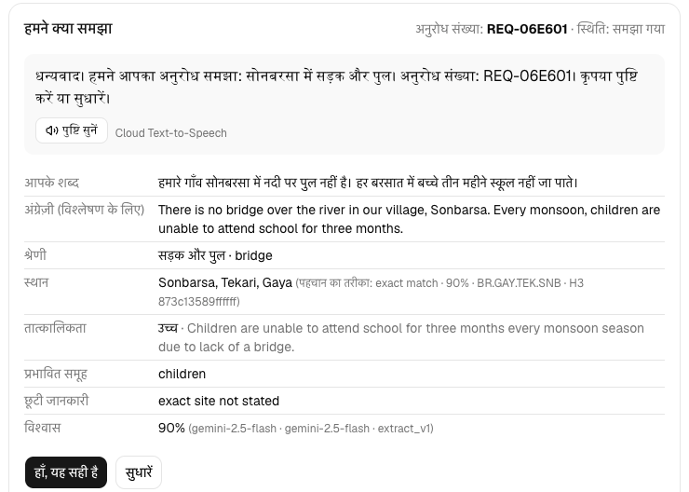
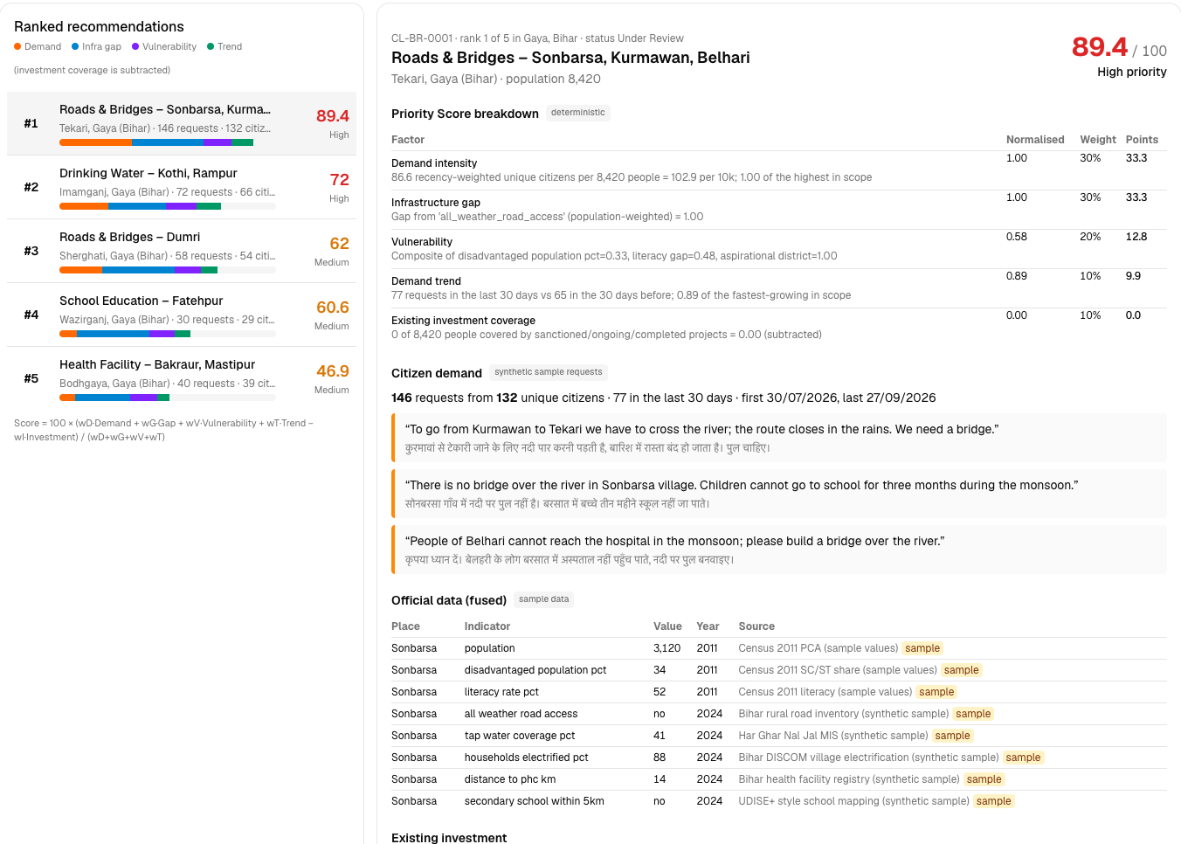
10 — LIVE PROTOTYPE
SPONTOM
ENTERPRISE PRIVATE LIMITED
Working today, end to end.
Two apps and one API on Google Cloud; three states, three languages, three channels.
EVALUATION ALIGNMENT
25%
AI / TECHNICAL EXECUTION
Gemini JSON + embeddings, Speech/Translation/TTS, number check
20%
PROBLEM-SOLUTION FIT
One journey: voice note → officer decision → citizen status
Citizen app: Hindi request understood
Officer dashboard: ranking + breakdown
20%
DEPTH & REACH ACROSS INDIA
HI/TE/EN • web, voice, chat • Bihar, AP, Maharashtra adapters
TRY IT
20%
DEPLOYABILITY & SCALABILITY
Citizen app
civic-demand-network-citizen-web-847963771142.asia-south1.run.app
Cloud Run, Secret Manager, BigQuery sink; state = config
Officer dashboard
civic-demand-network-officer-dashboard-847963771142.asia-south1.run.app
API (OpenAPI)
civic-demand-network-api-847963771142.asia-south1.run.app/docs
15%
IMPACT POTENTIAL
Source
github.com/ipavanreddy/civic-demand-network
Per-capita demand, vulnerability weight, investment subtracted
Screenshots: local run, 30 Sep 2026, synthetic sample data. Weights from the Track 1 evaluation criteria (PRD §55).
SPONTOM ENTERPRISE PRIVATE LIMITED • JANVAANI
DPIIT RECOGNISED • VISAKHAPATNAM
11
Notes:
Everything you have seen runs today. The citizen app on the left handles text, voice and a chat-bot tab in three languages; the officer dashboard on the right shows the hotspot map, the ranking and the full score breakdown. Bihar, Andhra Pradesh and Maharashtra each come in with different data shapes and map to one canonical schema through adapter configs. The links are live, and the source is public.

Slide 12
APPENDIX — REFERENCES
SPONTOM
ENTERPRISE PRIVATE LIMITED
Challenge evidence & government sources
Numbered references correspond to citations in the core proposal.
[1]
JanVaani PRD & submission pack
Track 1 challenge framing (PRD §2–3, §43–55) and the live extraction evaluation of 30 Sep 2026 (docs/SUBMISSION.md).
LOCAL EVIDENCE
[2]
CPGRAMS
Centralized Public Grievance Redress and Monitoring System, DARPG, Government of India.
OPEN SOURCE ↗
[3]
Mission Antyodaya
Village-level infrastructure-gap survey, Ministry of Rural Development.
OPEN SOURCE ↗
[4]
e-GramSwaraj (GPDP)
Gram Panchayat Development Plan planning and reporting, Ministry of Panchayati Raj.
OPEN SOURCE ↗
SPONTOM ENTERPRISE PRIVATE LIMITED • JANVAANI
DPIIT RECOGNISED • VISAKHAPATNAM
12
Notes:
These are the sources behind the problem framing and the comparison slide. Reference one is our own PRD and the recorded evaluation run. References two to four are the government systems JanVaani is designed to complement rather than replace.

Slide 13
APPENDIX — REFERENCES
SPONTOM
ENTERPRISE PRIVATE LIMITED
Data, AI & governance sources
Sample data is modelled on these sources; no values are copied (see THIRD_PARTY.md).
[5]
Local Government Directory
LGD administrative codes, Ministry of Panchayati Raj. JanVaani uses LGD-style sample codes.
OPEN SOURCE ↗
[6]
Aspirational Districts Programme
NITI Aayog district list; used as a vulnerability flag and for pilot selection.
OPEN SOURCE ↗
[7]
Gemini 2.5 Flash on Vertex AI
Model documentation, Google Cloud. Used for extraction and evidence briefs.
OPEN SOURCE ↗
[8]
DPDP Act, 2023
Digital Personal Data Protection framework, Ministry of Electronics and IT.
OPEN SOURCE ↗
SPONTOM ENTERPRISE PRIVATE LIMITED • JANVAANI
DPIIT RECOGNISED • VISAKHAPATNAM
13
Notes:
The sample data is modelled on LGD, Census 2011, the Aspirational Districts list and scheme MIS structures, but it contains no copied values. Every figure in this deck from the product is synthetic and labelled as such, as it is in the app itself.

