Slide 1
TatRaksha
Cyclone anticipatory action & early warning: from an IMD bulletin to village-level action, 72 hours before landfall
Gemini 3.7 Flash · Earth Engine · Google Maps · Speech & Translation · BigQuery · Cloud Run
Build with AI hackathon · Track 5
Demo: Odisha / Cyclone Fani 2019 and West Bengal / Cyclone Amphan 2020 replays (sample data, labelled)

Slide 2
72 hours, one officer, hundreds of villages
Problem fit · 20 %
“Who do I evacuate, what do I protect, and what do I tell people, in their language, before the roads flood?”
Forecasts are regional
Hazards compound
Warnings are slow
• IMD bulletins give track, wind and surge guidance for a coastline
• Officers must translate them into villages, shelters and substations by hand
• Surge, rain-flooding and wind hit different villages at different times
• Shelters look fine on paper but are cut off when access roads flood
• Advisories are drafted manually per area and language
• No standard format, no audit trail, money for relief arrives after the event
India's east coast faces 4–5 cyclones a year; the Bay of Bengal has produced most of the deadliest cyclones on record.
TatRaksha · Build with AI 2026 · Track 5
2

Slide 3
One journey: bulletin → action
Problem fit · 20 %
Gemini parses bulletin; officer verifies track
Surge + rain-flood + wind swath
Village Risk + shelter cut-off
Gemini multimodal situation report
Advisory → approval → CAP 1.2 → dispatch
District Disaster Management Officer
State EOC Officer
• Replay slider T-72 → T-6 h; every bulletin re-runs the pipeline
• Ranked villages with a transparent 30/25/15/15/15 breakdown
• Shelters cut off by flooded roads + Google Routes drive time
• Situation report with actions per role and deadlines
• Odia / Bengali / English advisories with voice, approved before release
• Districts and blocks side by side (Odisha, West Bengal)
• Parametric trigger probability and payout range (sample policies)
• Predicted vs observed flooding for the replay
• Advisory, dispatch and audit logs (BigQuery)
TatRaksha · Build with AI 2026 · Track 5
3

Slide 4
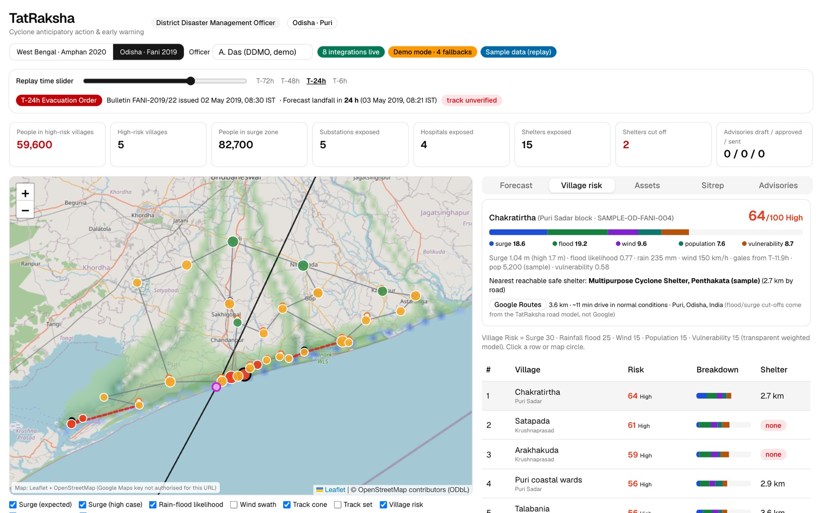
Who is at risk, and can they reach a shelter?
• 59,600 people in High-risk villages at T-24 h (Fani replay)
• 2 shelters cut off by the flood-aware road model
• Google Routes 3.6 km · ~11 min to the assigned shelter
• Every layer labelled screening estimate, sample data, source + time
TatRaksha · Build with AI 2026 · Track 5
4

Slide 5
Gemini reads and reasons; it never measures
AI & technical · 25 %
1 · Bulletin → track
2 · Multimodal sitrep
3 · Advisory drafting
Text/PDF bulletin to schema-validated JSON track; cross-checked by a deterministic parser; officer verifies.
Hazard-map image + bulletin + exposure tables in one call → headline, key numbers, actions by role with deadlines, uncertainties.
English drafts with six mandatory fields; rejected if a field is missing. Odia/Bengali from approved templates.
Trust by construction
• Observed data → model estimate → AI interpretation → recommendation, kept separate in the data and UI
• Every number in the report is checked against the pipeline output; ungrounded items are removed and listed
• Each AI record stores model_name, model_version, prompt_version (versioned prompts in ai/prompts/)
• Rate limits or failures fall back to a labelled deterministic path; the live/demo badge is verified by real calls
TatRaksha · Build with AI 2026 · Track 5
5

Slide 6
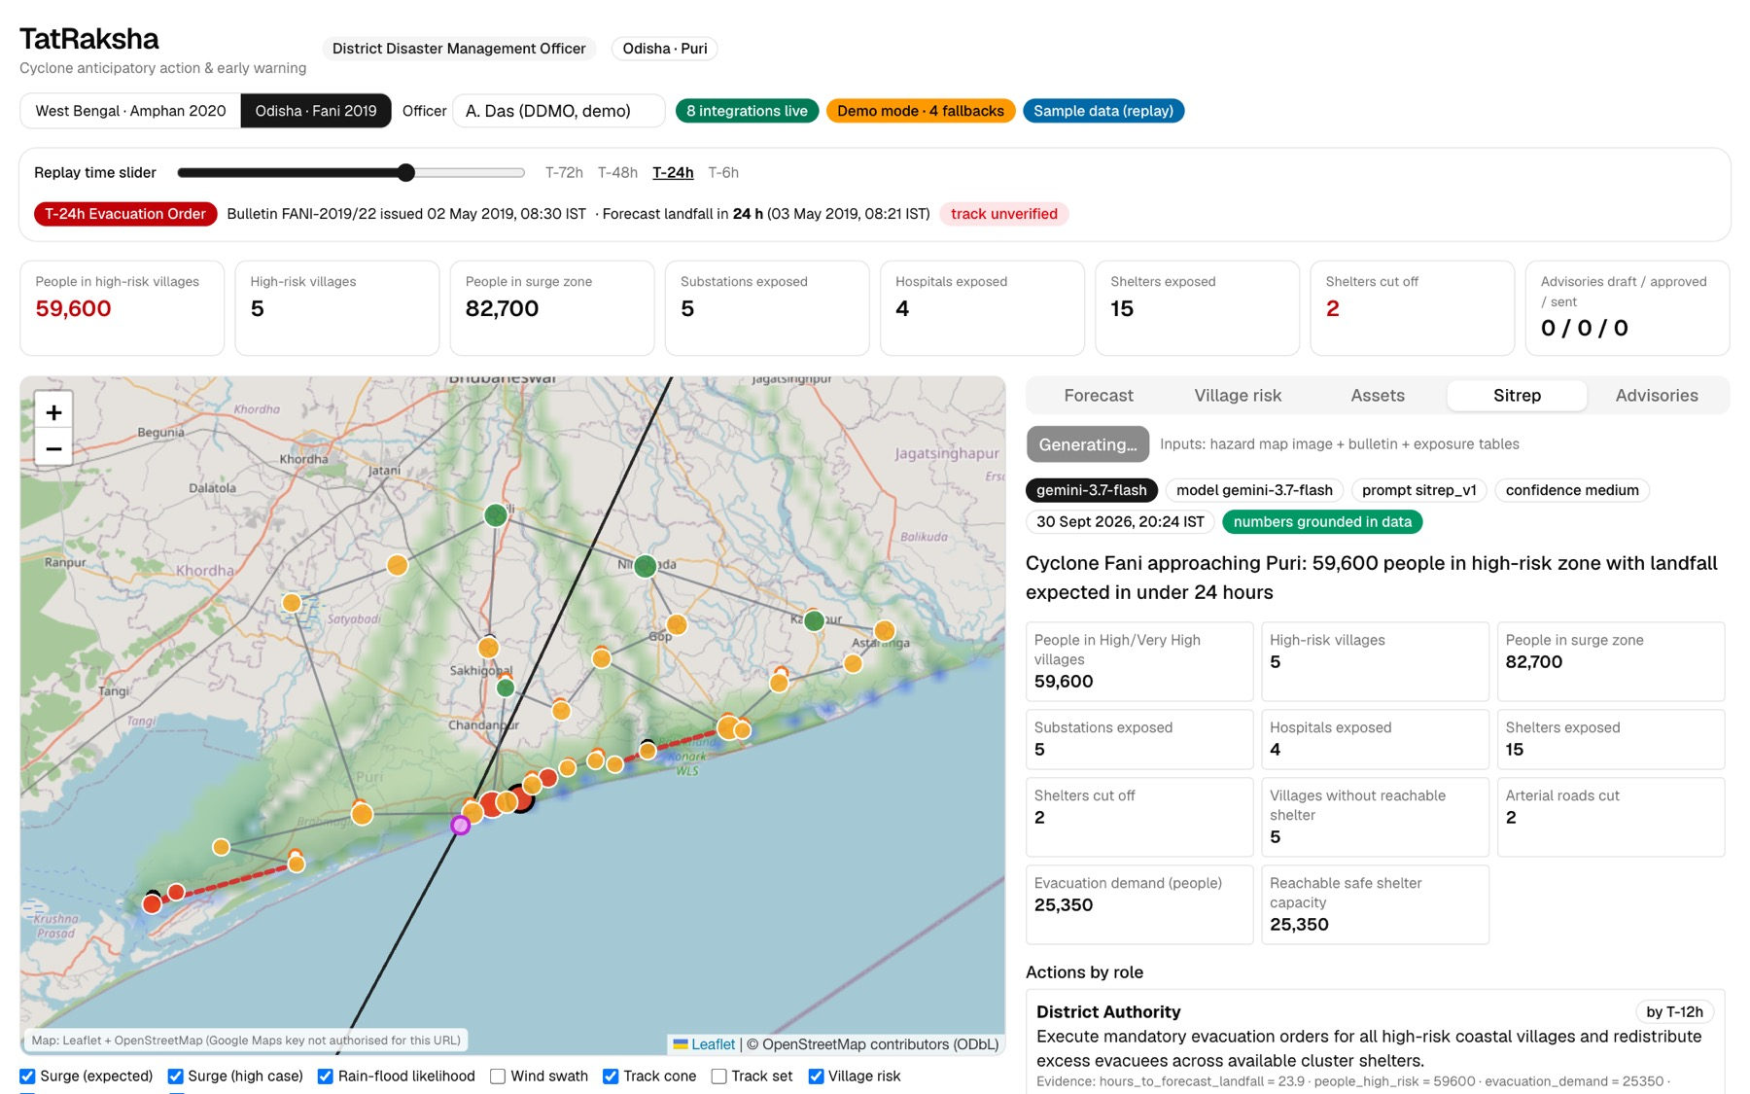
Google AI & Cloud stack, live in the prototype
AI & technical · 25 %
Gemini 3.7 Flash (Vertex AI)
parse · sitrep · drafts
Maps JS · Routes · Geocoding
basemap · shelter drive time
Text-to-Speech · Speech-to-Text
voice advisory + read-back
Cloud Translation
back-translation for review
BigQuery
audit + dispatch log
Cloud Storage
map renders · CAP · audio
Cloud Run · Secret Manager
API + 2 dashboards
Earth Engine
DEM, water, rain, WorldPop (ready)
TatRaksha · Build with AI 2026 · Track 5
6

Slide 7
Transparent hazard models an officer can explain
AI & technical · 25 %
Storm surge (screening)
Rain-flood + wind
• Inverse barometer + wind set-up × shelf factor, right-of-track peak
• Bathtub fill connected to the sea; expected vs high case
• Labelled: defer to official IMD / INCOIS guidance
• Rain-flood likelihood from 72 h rain, low-lying terrain, drainage
• Modified Rankine wind swath, gale arrival time per village
• Validated against observed flooding in each replay
Village Risk score (0–100)
• Surge 30 · Rainfall flood 25 · Wind 15 · Population 15 · Vulnerability 15, weights set per state in its adapter
• Road-network cut-off: a shelter counts only if it is dry and reachable on roads that stay open
• Earth Engine path (Copernicus DEM, JRC water, GPM IMERG, WorldPop, Open Buildings) swaps in real layers
TatRaksha · Build with AI 2026 · Track 5
7

Slide 8
Warnings people understand, released by a human
Impact · 15 %
Draft per village, audience, stage
Back-translation + review
Officer approval
CAP 1.2 (validated)
SMS · voice · feed (sandbox)
Languages and voice
Standards and accountability
• English, Odia, Bengali; mandatory fields preserved (what, where, when, action, shelter, authority)
• Cloud Text-to-Speech voice advisory; Speech-to-Text reads it back
• Adding Telugu or Tamil is a template + config change
• CAP 1.2: the format of India's national alert gateway (NDMA)
• Consequential actions need human approval; two roles only
• Every draft, approval and dispatch in an append-only audit log (BigQuery)
TatRaksha · Build with AI 2026 · Track 5
8

Slide 9
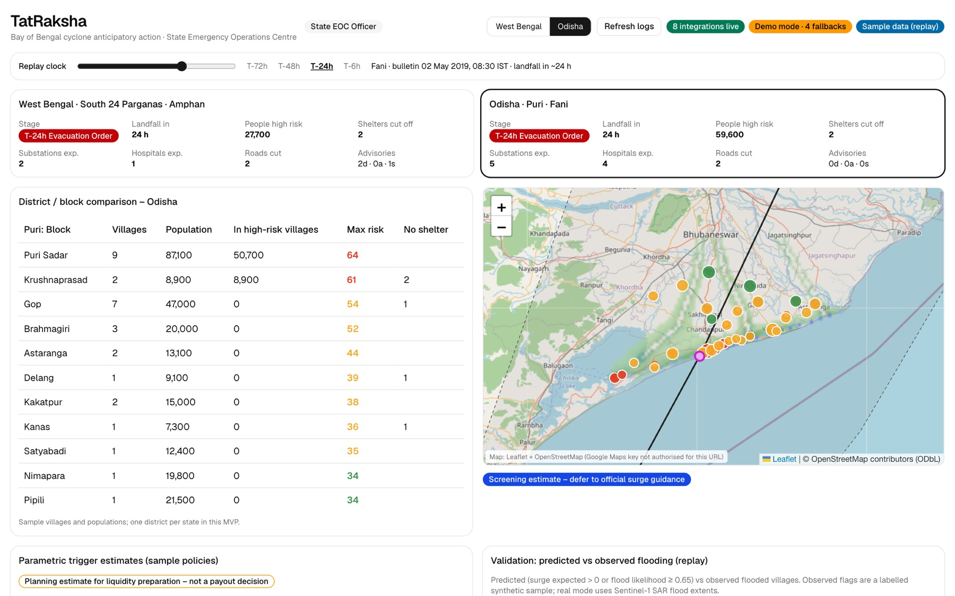
Built for every coastal state, not one district
Depth & reach · 20 %
• Canonical disaster-risk schema (villages, shelters, assets, roads, hazards, advisories)
• State adapters in JSON districts, languages, authority, CAP sender, risk weights, field mapping
• Two states live Odisha (Fani 2019), West Bengal (Amphan 2020) on the same services
• Global layers Earth Engine datasets cover every Indian coast out of the box
• Onboarding a state adapter + data files + approved templates, no code fork
TatRaksha · Build with AI 2026 · Track 5
9

Slide 10
Cloud-native, API-first, pilot-ready
Deployability · 20 %
One village
One district
One state
All coastal states
Bay of Bengal region
Regional network
Deployable today
Pilot path
• Cloud Run (asia-south1): FastAPI + two Next.js apps, one repeatable deploy script
• Secrets in Secret Manager; service-account auth; public repo, no keys in git
• Every integration degrades to a labelled demo mode, so it runs anywhere
• REST API (PRD §37) + CAP feed for state alert gateways
• Shadow mode next cyclone season alongside the OSDMA / WBDMD process
• Compare Village Risk and cut-offs with observed flooding (built-in validation)
• Firestore + Earth Engine switch on by configuration
• Vertex AI flood model trained on Sentinel-1 flood extents
TatRaksha · Build with AI 2026 · Track 5
10

Slide 11
Earlier, targeted evacuation and faster money
Impact · 15 %
Lives
Infrastructure
Liquidity
Evacuation orders reach the highest-risk villages first, with a reachable shelter named in the advisory and in the local language.
Exposed substations, hospitals and roads flagged 24–72 h ahead so utilities can harden and pre-position crews.
Parametric trigger estimates let insurers and the state prepare payouts before landfall.
Cross-border and BRICS portability
• Bangladesh and Myanmar share the Bay of Bengal cyclones: Bangla and Burmese are configuration, CAP is international
• State adapter → country adapter: the same canonical model serves any national met service and alert gateway
TatRaksha · Build with AI 2026 · Track 5
11

Slide 12
Where we are, honestly
Working now
Next
• Full journey: bulletin → hazards → village risk → Gemini sitrep → approved CAP advisory
• Live: Gemini 3.7 Flash, Maps Routes/Geocoding, Translation, TTS, STT, BigQuery, Cloud Storage
• Two states, three languages, State EOC with parametric and validation
• 40 API tests incl. an end-to-end journey; deployable Docker images
• Earth Engine registration → real DEM, rainfall and population layers
• Vertex AI flood model; live IMD forecast ingest
• Native-speaker review of Odia/Bengali templates; Odia voice
• Andhra Pradesh rain-flood scenario; SMS/voice sandbox providers
• Shadow-mode pilot with one coastal district
TatRaksha · Build with AI 2026 · Track 5
12

