Slide 1
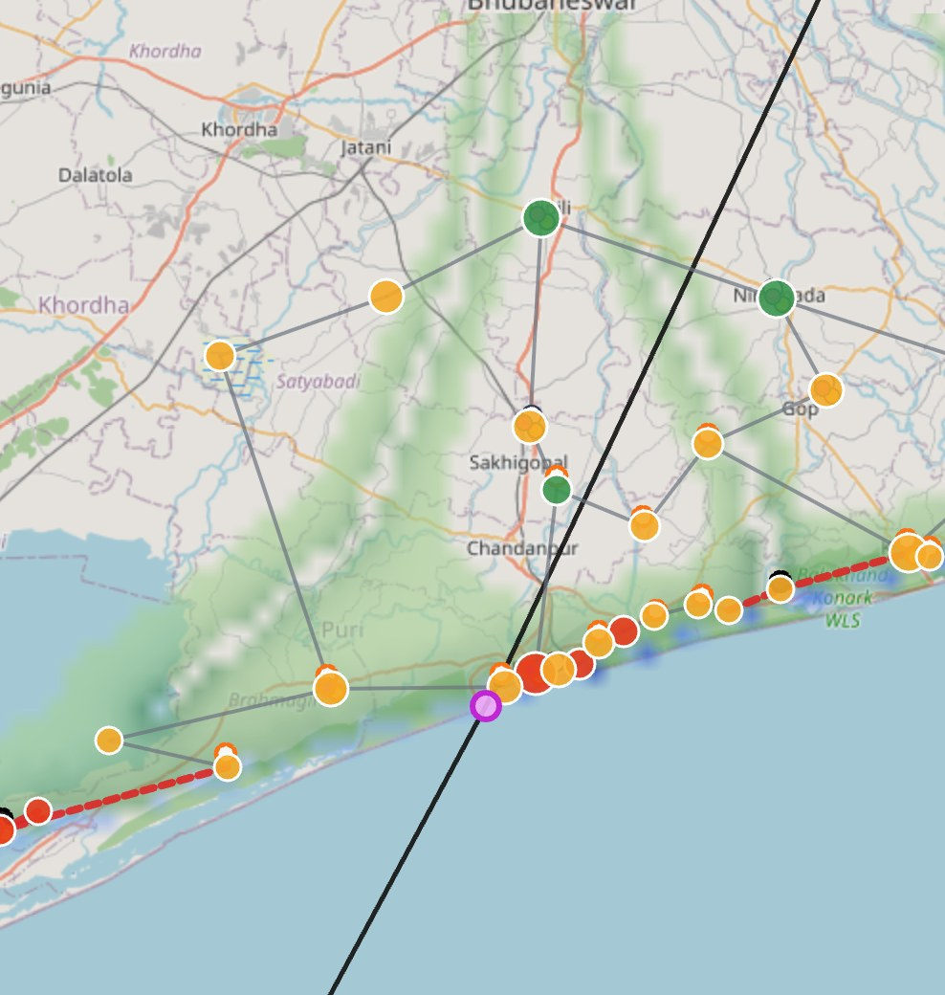

SPONTOM ENTERPRISE PRIVATE LIMITED
Build with AI (Google) • Track 5
TatRaksha
From a cyclone bulletin
to village-level action.
Impact forecasts, a Gemini situation report and approved multilingual warnings for Bay of Bengal districts.
GEMINI 3.7 FLASH
HUMAN-APPROVED
A prototype by Spontom Enterprise Private Limited
DPIIT Recognised • Visakhapatnam • September 2026
App screenshot: Fani 2019 replay, Puri, T-24h (sample data). Map © OpenStreetMap contributors (ODbL).
Notes:
TatRaksha, meaning coast protector, turns an official IMD cyclone bulletin into village-level action up to 72 hours before landfall. The image is a real screenshot of our district dashboard replaying Cyclone Fani over Puri at T-24 hours. Gemini 3.7 Flash reads the bulletin and the hazard map, transparent models rank every village, and the district officer approves every warning. Everything you see is running code; replay data is sample data and labelled as such.

Slide 2
01 — PROBLEM UNDERSTANDING
SPONTOM
ENTERPRISE PRIVATE LIMITED
The forecast is regional. The decisions are local.
A district officer must turn each new bulletin into who to evacuate, what to protect and what to say.
One bulletin. Hundreds of local decisions.
BULLETIN
COMPILE
?
WARN
›
›
›
Track, wind, surge text
Lists, maps, phone calls
Who floods? Which road cuts?
Drafted by hand, per language
72
30
1
hours
villages
officer
FOCUSED PROBLEM
Fani replay, T-24h: 59,600 people in high-risk villages; 5 villages with no shelter reachable by road.
Officers lack a village-level impact picture that updates with every bulletin.
LOCAL-IMPACT GAP
Consequence
Evacuation is late or mistargeted, shelters turn out unreachable, warnings lag in local languages.
[1] IMD RSMC bulletins give regional track/surge guidance. [7] Replay figures: TatRaksha Fani 2019 sample data (synthetic terrain), not official statistics.
SPONTOM ENTERPRISE PRIVATE LIMITED • TATRAKSHA
DPIIT RECOGNISED • VISAKHAPATNAM
2
Notes:
IMD issues excellent regional bulletins: track, intensity and surge guidance for a coastline. But the district officer has to answer local questions: which villages flood, which roads get cut, which shelters become unreachable, and what to tell people in Odia. Today that means compiling lists and making phone calls, again for every new bulletin. In our Fani replay at T-24 hours, 59,600 people are in high-risk villages and five villages have no shelter reachable by road. Those numbers come from our sample replay data, not official statistics.

Slide 3
02 — PROPOSED SOLUTION
SPONTOM
ENTERPRISE PRIVATE LIMITED
TatRaksha turns each bulletin into an approved warning.
One pipeline from the official forecast to a CAP 1.2 alert, with a human decision at the end.
ADVISORY DRAFT • SATAPADA
NEEDS APPROVAL
01
IMPACT FORECAST
Surge, rain-flood and wind give every village a transparent Village Risk score.
Evacuation order • Fani • T-24h • English
1
What: winds up to 170 km/h, heavy rain and flooding
02
GEMINI REASONING
Multimodal situation report from hazard map, bulletin and tables; numbers checked.
2
Where: Satapada, Krushnaprasad block, Puri
3
When: from 02-05-2019 17:27 IST
03
APPROVED WARNING
Odia, Bengali or English advisory; officer approves; CAP 1.2; sandbox dispatch.
4
Action: Leave now for the cyclone shelter. Do not wait.
↺
No shelter reachable by road: strong building on high ground; call 1070.
Issued by Collector & DM, Puri (DDMA)
APPROVE → CAP
Real output of the app (advisory_v1, gemini-3.7-flash) on the Fani 2019 replay at T-24h; replay data are samples. [4] OASIS CAP 1.2.
SPONTOM ENTERPRISE PRIVATE LIMITED • TATRAKSHA
DPIIT RECOGNISED • VISAKHAPATNAM
3
Notes:
TatRaksha is one pipeline. First, an impact forecast: screening surge, rainfall flood likelihood and wind give every village a transparent Village Risk score. Second, Gemini 3.7 Flash writes a situation report from the hazard map image, the bulletin and the exposure tables, and every number is checked against the data. Third, an advisory with six mandatory fields, which the officer must approve before it becomes a CAP 1.2 message. On the right is the real draft the app produced for Satapada, a village the road model found has no reachable shelter.

Slide 4
03 — HOW IT WORKS
SPONTOM
ENTERPRISE PRIVATE LIMITED
Every new bulletin re-runs the whole chain.
Observed data, model estimates, AI interpretation and recommendation stay separate and labelled.
1
2
3
4
5
6
7
›
›
›
›
›
›
PARSE
VERIFY
HAZARDS
EXPOSURE
SITREP
APPROVE
DISPATCH
Gemini reads bulletin
Officer checks track
Surge, flood, wind
Risk + road cut-off
Multimodal Gemini
Advisory → CAP 1.2
Sandbox + audit
AUTO • PER BULLETIN
OFFICER • DECIDES
STATE EOC • COMPARES
Parse, 9-track set, hazards, Village Risk, cut-offs and sitrep draft re-run on each update.
Verifies the track, reviews translations, approves or edits each advisory before dispatch.
Sees districts side by side, advisory logs and parametric trigger estimates.
HUMAN GATE
No advisory is dispatched without the district officer's approval; parametric numbers are planning estimates.
Journey per PRD §8. Warning stages follow the PRD: T-72h Watch → T-48h Warning → T-24h Evacuation Order → T-6h Final Warning.
SPONTOM ENTERPRISE PRIVATE LIMITED • TATRAKSHA
DPIIT RECOGNISED • VISAKHAPATNAM
4
Notes:
Here is the loop. Gemini parses the bulletin, and a deterministic parser cross-checks it before the officer verifies the track. The hazard models, the exposure and road cut-off analysis and the situation report all re-run automatically whenever a new bulletin arrives. The officer stays in charge of every consequential step, and the State EOC sees all districts plus parametric trigger estimates. Nothing reaches the public without human approval.

Slide 5
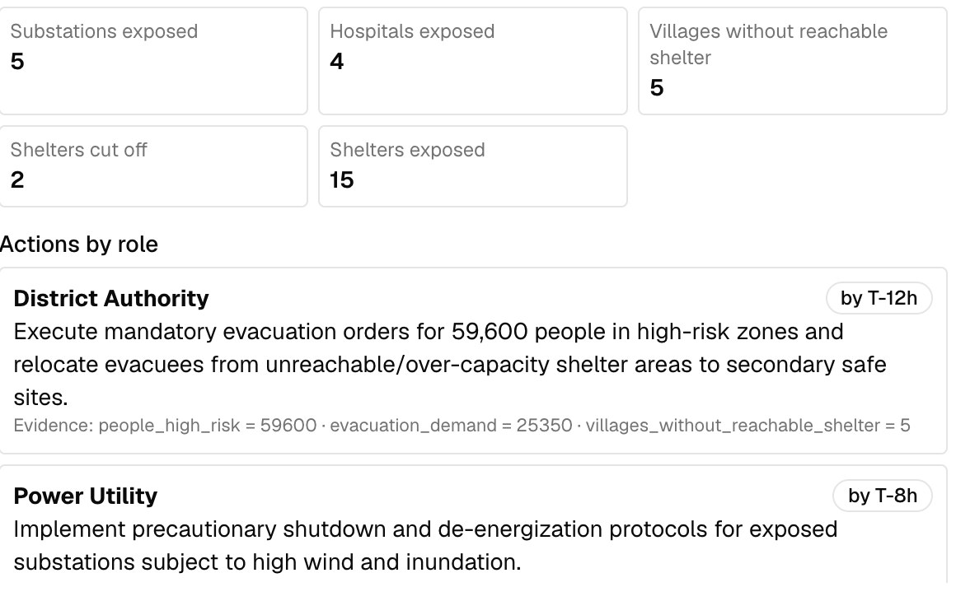
04 — USERS & CONTEXT
SPONTOM
ENTERPRISE PRIVATE LIMITED
Built for the district officer, useful to the state.
Two app roles only. Everyone else receives role-specific actions or public advisories.
01
STATE EOC OFFICER
Compares districts, reviews advisories, sees parametric triggers.
Secondary user
02
COLLECTOR & DM
Named on every advisory; approval runs through the DDMA.
Issuing authority
03
LINE DEPARTMENTS
Power, health, police, fisheries get tasks with deadlines, e.g. power by T-8h.
Action owners
04
COASTAL PUBLIC
Fishers and villagers get warnings in Odia, Bengali or English; no app login.
DISTRICT OFFICER • PRIMARY USER
Recipients
Gemini sitrep: actions by role, with deadlines and evidence
CONSTRAINT → DESIGN RESPONSE
UPDATES
re-run per bulletin
LANGUAGES
templates + voice
DATA GAPS
labels + freshness
Roles from PRD §7. Screenshot: live sitrep on the Fani replay (gemini-3.7-flash, sitrep_v1); figures are from sample data.
SPONTOM ENTERPRISE PRIVATE LIMITED • TATRAKSHA
DPIIT RECOGNISED • VISAKHAPATNAM
5
Notes:
Our primary user is the District Disaster Management Officer: accountable, time-pressed and coordinating many departments. The State EOC Officer is the second role, with a read-focused view across districts. The Collector's name goes on every advisory, line departments receive actions with deadlines, and the public receives warnings without ever logging in. The screenshot shows what the officer gets from Gemini: actions by role, each with a deadline and the data behind it.

Slide 6
05 — JOURNEY
SPONTOM
ENTERPRISE PRIVATE LIMITED
Fani 2019 replay: Satapada at T-24 hours.
Scenario A of PRD §43: Odisha, Puri district, Odia, storm surge plus wind. All figures from sample replay data.
T-72H WATCH
T-24H UPDATE
EXPOSURE
ADVISORY
Bulletin parsed
›
Hazards re-run
›
Satapada: risk 61
›
Officer approves
14,100 people in 3 high-risk villages.
Surge 1.66 m expected, 1.89 m high; cone 77 km.
No shelter reachable by road; 2 roads cut.
Odia draft, back-translated, then CAP 1.2.
GEMINI SITUATION REPORT • T-24H
Evacuate by T-12h.
+
59,600 people in high-risk villages
✓
Power: 5 substations by T-8h
↗
Penthakata: 23,600 assigned, 1,650 seats
Evidence-linked actions:
WHY TRUST IT
Numbers checked against the pipeline (grounded: true); model, version and prompt stored with the report.
Sample data on the synthetic terrain grid; surge is a screening estimate – defer to official surge guidance. Captured from the app, 30 Sep 2026.
SPONTOM ENTERPRISE PRIVATE LIMITED • TATRAKSHA
DPIIT RECOGNISED • VISAKHAPATNAM
6
Notes:
Let me walk through the demo. At T-72 hours Gemini parses the bulletin and three villages with 14,100 people are already high risk. At T-24 hours the hazards re-run: expected surge 1.66 metres, high case 1.89, and the network model finds two roads cut. Satapada scores 61 and has no shelter reachable by road, so its advisory tells people to go to a strong building on high ground and call 1070. Gemini's report sets the deadline and flags that one shelter is assigned far more people than it can hold.

Slide 7
06 — INNOVATION & DIFFERENTIATION
SPONTOM
ENTERPRISE PRIVATE LIMITED
Not a new forecast. The missing local-impact layer.
India's systems forecast and disseminate well; TatRaksha connects the forecast to village-level decisions.
APPROACH
WHAT IT CONTRIBUTES
REMAINING BOUNDARY / GAP
IMD RSMC bulletins
Authoritative track, intensity, surge guidance
Coast/district scale; local impact is compiled by hand
INCOIS ocean services
Storm-surge and high-wave forecasts for the coast
Hazard, not people, shelters or roads
NDMA SACHET (CAP)
Standard, geo-targeted alert dissemination
Delivers a message; does not decide who or what
Generic AI assistant
Fast drafting and summarising
No grounding, approval gate or audit trail
TatRaksha
Village risk + road cut-off + grounded Gemini sitrep + CAP
Screening models; needs field validation; unproven
DISTINCTIVE CAPABILITY
Feeds official forecasts in and CAP alerts out: it complements, not replaces, national systems.
[1] IMD RSMC New Delhi. [2] INCOIS. [3] NDMA SACHET. TatRaksha consumes official forecasts and defers to official surge guidance.
SPONTOM ENTERPRISE PRIVATE LIMITED • TATRAKSHA
DPIIT RECOGNISED • VISAKHAPATNAM
7
Notes:
We are not building another forecast or another alert gateway. IMD provides the authoritative forecast, INCOIS the ocean-state and surge products, and NDMA's CAP-based SACHET system delivers the alert. What sits between them today is manual work: which villages, which roads, which shelters, which words. TatRaksha fills that gap, and because it outputs CAP 1.2 it plugs into the existing alert infrastructure. Our honest boundary: the hazard models are screening level and need field validation.

Slide 8
07 — TECHNOLOGY & GOOGLE AI
SPONTOM
ENTERPRISE PRIVATE LIMITED
Bounded Gemini on transparent hazard models.
Gemini reads and reasons; it never measures. Every AI output is schema-validated JSON.
01
OFFICIAL INPUTS
IMD bulletin text/PDF • state adapter JSON • canonical schema
GOOGLE AI INTEGRATION MAP
Live: Gemini 3.7 Flash on Vertex AI
02
HAZARD ENGINE
Screening surge • rain-flood heuristic • Rankine wind • 9-track set
Live: Maps Routes, Translation, TTS, STT
Live: BigQuery audit, Cloud Storage archive
EXPOSURE + ROUTING
Village Risk 30/25/15/15/15 • road cut-off • Google Routes
NEXT
Earth Engine layers wired; Vertex AI flood model.
03
04
GEMINI LAYER
Gemini 3.7 Flash: parse, multimodal sitrep, drafts; versioned prompts
REAL VS DEMO, AND FRESHNESS
Startup probe
One live call per integration; the badge shows what truly works
05
DELIVERY + AUDIT
CAP 1.2 • TTS/STT • sandbox dispatch • BigQuery audit • Cloud Run
Sample flag
Replay data carry is_sample in the data and the UI
Stale input
A newer bulletin marks the analysis out of date
[6] Earth Engine data catalog. Rain-flood likelihood is a transparent heuristic until the Vertex AI model is trained (PRD §12).
SPONTOM ENTERPRISE PRIVATE LIMITED • TATRAKSHA
DPIIT RECOGNISED • VISAKHAPATNAM
8
Notes:
The architecture is layered. Hazards and exposure are transparent formulas an officer can explain, so Gemini is never asked to invent a measurement. Gemini 3.7 Flash does three bounded jobs: parse the bulletin, reason over the hazard map image and tables for the situation report, and draft English advisories, all as schema-validated JSON with model and prompt versions stored. Maps, Translation, Text-to-Speech, Speech-to-Text, BigQuery and Cloud Storage are live; Earth Engine is wired in, and the Vertex AI flood model is next. A startup probe makes one real call per integration so the badge shows what actually works.

Slide 9
08 — RESPONSIBLE AI & DATA
SPONTOM
ENTERPRISE PRIVATE LIMITED
Life-safety AI must be checkable and overridable.
Prefer caution, show uncertainty, and keep a human decision on every warning.
HUMAN APPROVAL
EVERY ADVISORY, EVERY DISPATCH
SAFETY BY DESIGN
Grounded numbers
Sitrep figures checked against the pipeline; ungrounded items removed and listed.
SCREENING LABEL
Surge is shown as a screening estimate; defer to official guidance.
Provenance
model_name, model_version and prompt_version stored on every AI record.
UNCERTAINTY
Track cone, expected vs high surge, and listed uncertainties.
WORDING
Odia/Bengali from pre-approved templates; back-translation for review.
DO NOT DO / COLLECT
MANDATORY FIELDS
What, where, when, action, shelter, authority, or rejected.
Invent forecast, surge or exposure numbers
ACCESS
Two roles; district officers act only on their own district.
Store citizens' phone numbers (gateways hold them)
AUDIT
Append-only audit and dispatch logs streamed to BigQuery.
Send real public alerts from the MVP (sandbox only)
Rules from PRD §35 and §52. [4] OASIS CAP 1.2. Odia/Bengali templates are sample translations pending native-speaker review.
SPONTOM ENTERPRISE PRIVATE LIMITED • TATRAKSHA
DPIIT RECOGNISED • VISAKHAPATNAM
9
Notes:
In life-safety work, the AI must be checkable and overridable. Every number in the situation report is checked against the pipeline output, and anything ungrounded is removed and shown. Life-safety wording in Odia and Bengali comes from pre-approved templates, with machine back-translation only to help the reviewer. We never invent measurements, never store citizens' phone numbers, and send nothing real from the prototype. Every approval and dispatch lands in an append-only audit log.

Slide 10
09 — OUTCOMES, VALIDATION & SCALE
SPONTOM
ENTERPRISE PRIVATE LIMITED
Prove it in shadow mode before anyone relies on it.
The first proof is earlier, better-targeted action, not app usage.
01
02
03
04
MEASURE WITH
LEAD TIME
›
TARGETING
›
REACH
›
LIQUIDITY
Predicted vs observed flooding
Warning lead time per village
Advisory delivery success
Trigger hit/miss on past cyclones
Village-level warning 24–72 h out
Highest-risk villages move first
Warnings in the local language
Funds prepared before landfall
VALIDATION GATES
OWNERSHIP + SCALE
1
TABLETOP
2
SHADOW SEASON
3
CLAIM CAREFULLY
Replay Fani and Amphan with DDMA staff; score actionability
Run beside the official process, Oct–Dec peak; no public alerts
Sample replay: hit rate 1.0, false-alarm ratio 0.5; not a field result
Owner
State SDMA (e.g. OSDMA) + DDMAs
Channel
State EOC → DDMAs; CAP to NDMA gateway [3]
Gate
Official surge feed • language review • data MoU
BUDGET ROUTE
Candidate: SDMF / SDRF preparedness and capacity-building windows under XV-FC guidelines; confirm with the SDMA. [8]
Phases per PRD §50: district pilot → state → all coastal states → Bay of Bengal (Bangladesh, Myanmar, Sri Lanka). [5] NCRMP shelters and warning systems.
SPONTOM ENTERPRISE PRIVATE LIMITED • TATRAKSHA
DPIIT RECOGNISED • VISAKHAPATNAM
10
Notes:
We want to earn trust before anyone relies on this. Phase one is a tabletop exercise replaying Fani and Amphan with district staff. Phase two runs TatRaksha in shadow mode alongside the official process during the October to December peak, with no public alerts. On our sample replay the validation shows every observed flooded village was flagged, at a false-alarm ratio of 0.5, which is deliberately cautious but not a field result. The natural owner is the state disaster management authority, funded through the Finance Commission disaster funds, which we still need to confirm with the state.

Slide 11
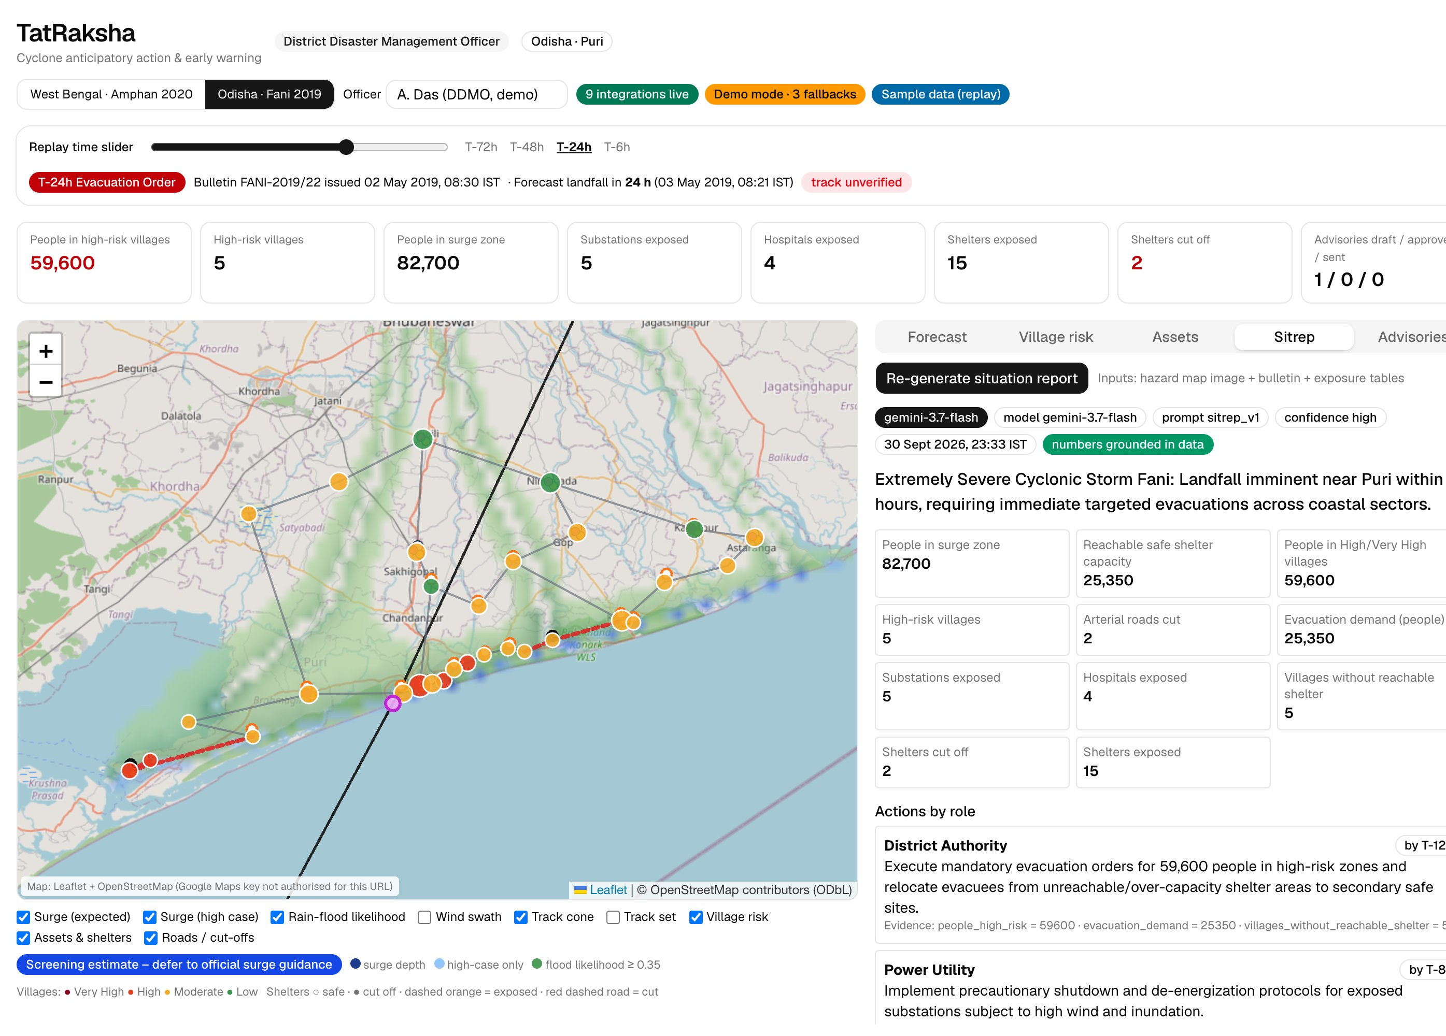
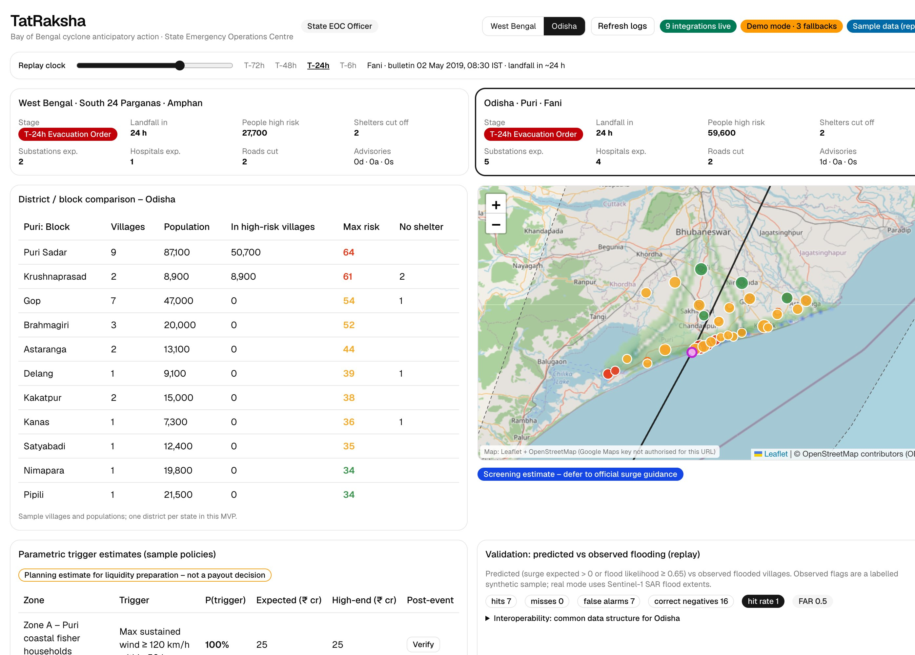
10 — LIVE PROTOTYPE
SPONTOM
ENTERPRISE PRIVATE LIMITED
Working today, end to end.
Two dashboards and one API on Cloud Run (asia-south1). Replays: Odisha / Fani 2019 and West Bengal / Amphan 2020.
EVALUATION ALIGNMENT
25%
AI / TECHNICAL EXECUTION
Gemini 3.7 Flash parse + multimodal sitrep; schema-validated, grounded
20%
PROBLEM-SOLUTION FIT
Surge, rain-flood, infrastructure exposure and dispatch all built
District dashboard: map + Gemini sitrep
State EOC: district and block comparison
20%
DEPTH & REACH ACROSS INDIA
Canonical schema, 2 state adapters, 3 languages, CAP 1.2
TRY IT
20%
DEPLOYABILITY & SCALABILITY
District dashboard
cyclone-risk-network-district-dashboard-847963771142.asia-south1.run.app
Cloud Run, one deploy script, labelled demo fallbacks
State EOC dashboard
cyclone-risk-network-state-eoc-dashboard-847963771142.asia-south1.run.app
API (/docs)
cyclone-risk-network-api-847963771142.asia-south1.run.app/docs
15%
IMPACT POTENTIAL
Source
github.com/ipavanreddy/cyclone-risk-network
Earlier, targeted evacuation; parametric liquidity (sample policies)
Screenshots from the running app (30 Sep 2026, replay sample data). A new state joins by a JSON adapter, not a code fork.
SPONTOM ENTERPRISE PRIVATE LIMITED • TATRAKSHA
DPIIT RECOGNISED • VISAKHAPATNAM
11
Notes:
This is the working prototype. On the left, the district dashboard with the Fani replay map and a live Gemini situation report; on the right, the State EOC comparing blocks and districts. Both run on Cloud Run in Mumbai with the API, and every integration falls back to a labelled demo mode. Against the evaluation criteria: meaningful Gemini use, every clause of the brief built, two states and three languages on one schema, and a one-command deploy. Try it at the links shown.

Slide 12
APPENDIX — REFERENCES
SPONTOM
ENTERPRISE PRIVATE LIMITED
Forecast, alerting and programme sources
Numbered references correspond to citations in the core slides.
[1]
IMD RSMC New Delhi
Tropical cyclone bulletins and reports, including Fani (2019) and Amphan (2020); used to reconstruct the sample replays.
OFFICIAL SOURCE ↗
[2]
INCOIS
Indian National Centre for Ocean Information Services: storm-surge and high-wave services for India's coast.
OFFICIAL SOURCE ↗
[3]
NDMA SACHET
National Disaster Management Authority's CAP-based integrated alert system for geo-targeted dissemination.
OFFICIAL SOURCE ↗
[4]
OASIS CAP v1.2
Common Alerting Protocol 1.2 standard; TatRaksha generates and validates CAP 1.2 messages.
STANDARD ↗
SPONTOM ENTERPRISE PRIVATE LIMITED • TATRAKSHA
DPIIT RECOGNISED • VISAKHAPATNAM
12
Notes:
These are the sources behind the claims on the core slides. IMD's regional centre provides the bulletins we consume and the public facts used to reconstruct our sample replays. INCOIS provides official surge and wave services, and NDMA's SACHET system is the CAP-based alert channel we plug into. CAP 1.2 is the open OASIS standard our advisories follow.

Slide 13
APPENDIX — REFERENCES
SPONTOM
ENTERPRISE PRIVATE LIMITED
Programme, data and funding sources
Numbered references correspond to citations in the core slides.
[5]
NCRMP (NDMA)
National Cyclone Risk Mitigation Project: multipurpose cyclone shelters and early-warning dissemination in coastal states.
OFFICIAL SOURCE ↗
[6]
Earth Engine data catalog
Copernicus DEM, GPM IMERG rainfall, JRC Surface Water, WorldPop, Open Buildings layers used by the Earth Engine path.
DATASETS ↗
[7]
TatRaksha replay data (sample)
data/replays/: reconstructed tracks and bulletins, synthetic terrain, sample villages, shelters, roads; flagged is_sample.
LOCAL EVIDENCE
[8]
MHA Disaster Management Division
SDRF / SDMF guidelines under the XV Finance Commission award; candidate budget route for a state pilot.
OFFICIAL SOURCE ↗
SPONTOM ENTERPRISE PRIVATE LIMITED • TATRAKSHA
DPIIT RECOGNISED • VISAKHAPATNAM
13
Notes:
The National Cyclone Risk Mitigation Project built much of the shelter and warning infrastructure we model. The Earth Engine catalogue lists the open datasets our geospatial path uses. Reference seven is our own sample replay data, clearly flagged in the data and the UI. Reference eight is the Ministry of Home Affairs guidance on state disaster response and mitigation funds, our candidate budget route to confirm with the state.

