Slide 1


SPONTOM ENTERPRISE PRIVATE LIMITED
Build with AI (Google) • Track 3
PHC
Pulse
No stock-out here while the
same medicine expires next door.
Voice and photo stock reporting, demand forecasts and optimised transfers for Primary Health Centres, approved by the District Health Officer.
AI-ASSISTED
OFFICER-APPROVED
STATE-READY
A concept proposal and working prototype by Spontom Enterprise Private Limited
DPIIT Recognised • Visakhapatnam • September 2026
Illustrative image generated with Gemini 2.5 Flash Image (Google). Not a real person or facility.
Notes:
PHC Pulse is our answer to Track 3: national-scale health resource and supply chain management for Primary Health Centres. A PHC nurse reports stock in seconds by voice or by photographing the paper register. The system turns that into days of cover, forecasts and warnings, and proposes transfers between nearby facilities. Nothing moves until the District Health Officer approves. Everything you will see runs today on Google Cloud, on clearly labelled synthetic data.

Slide 2
01 — PROBLEM UNDERSTANDING
SPONTOM
ENTERPRISE PRIVATE LIMITED
Stock-outs and expiry sit side by side.
31,882 PHCs are the first point of care [2]; their stock data sits in registers, spreadsheets and separate systems [1].
One nurse, one register, one flood week.
COUNT
REPORT
?
INDENT
›
›
›
Paper register at the PHC
Periodic and late
Nobody sees the surplus next door
Fixed cycle, 10-day lead time
3.6×
2.5
450
ORS + zinc use
days of ORS left
sachets expiring nearby
FOCUSED PROBLEM
Kavitha copies stock into a paper register each evening. The district sees it days later, after the ORS has run out.
Districts cannot see in time which PHC will run out, or which nearby PHC can spare the same medicine.
SYNTHETIC SCENARIO
Consequence
Patients buy medicines or travel further; surplus expires on another shelf. [1]
[1] Track 3 brief; PHC Pulse PRD §2. [2] MoHFW, Health Dynamics of India 2022–23. Card figures: synthetic scenario A (PHC Melur, Madurai).
SPONTOM ENTERPRISE PRIVATE LIMITED • PHC PULSE
DPIIT RECOGNISED • VISAKHAPATNAM
2
Notes:
India has 31,882 Primary Health Centres, according to the Ministry's Health Dynamics of India 2022–23. Stock is still counted into paper registers and reported periodically. In our flood-week scenario, ORS and zinc use is 3.6 times normal, PHC Melur has two and a half days of ORS left, and a PHC 54 minutes away holds 450 sachets that expire in December. The problem is not a lack of medicine in the district. It is that nobody can see both facts at the same time.

Slide 3
02 — PROPOSED SOLUTION
SPONTOM
ENTERPRISE PRIVATE LIMITED
From a spoken report to an approved transfer.
Staff report in their language; AI structures and forecasts; an optimiser proposes; the officer decides.
PROPOSED TRANSFER
AWAITING DHO
01
REPORT
Voice in Tamil, Hindi or English, a register photo or text. Gemini extracts; staff confirm.
451 ORS sachets • PHC Thirumangalam II → PHC Melur
1
Melur: 2.5 → 10.3 days of cover (stock-out risk 99.8%)
02
SEE + FORECAST
Days of cover, readiness score, 8-week forecast and possible-surge signals.
2
Donor keeps 50.6 days; its safety stock is 45 days
3
Uses 450 sachets that expire on 6 Dec 2026
03
OPTIMISE + APPROVE
OR-Tools proposes transfers; Gemini explains; the DHO approves each one.
4
54 min drive (Google Routes API) • 7.8 stock-out days avoided
↺
Gemini flags: Melur report is 30 h old; surge unverified
Gemini 2.5 Flash • explain_transfer_v1
APPROVE
Real optimiser and Gemini output from the local build (30 Sep 2026) on synthetic data. Quantities come from OR-Tools; Gemini cannot change them.
SPONTOM ENTERPRISE PRIVATE LIMITED • PHC PULSE
DPIIT RECOGNISED • VISAKHAPATNAM
3
Notes:
The solution is one loop. Staff report the way they already work, by speaking or by photographing the register. The platform shows days of cover, a readiness score, an eight-week forecast and possible surges. The panel on the right is real output: OR-Tools proposed 451 ORS sachets from Thirumangalam II to Melur on Google Routes drive times, and Gemini explained why, including what it is unsure about. The officer approves or rejects.

Slide 4
03 — HOW IT WORKS
SPONTOM
ENTERPRISE PRIVATE LIMITED
One journey from report to receipt.
Observed data, then AI interpretation, then a recommendation, then a human decision (PRD §35).
1
2
3
4
5
6
7
›
›
›
›
›
›
SPEAK
EXTRACT
CONFIRM
SEE
FORECAST
OPTIMISE
APPROVE
Voice, photo, text or form
Gemini → validated JSON
Staff edit, then save
Cover + readiness
8 weeks + surge check
OR-Tools transfers
DHO → dispatch → receipt
TIER 0 • AUTOMATIC
TIER 1 • DHO REVIEW
TIER 2 • STATE
Cover, risk, forecasts and surge checks recompute on every confirmed report.
The officer verifies surge signals and approves or rejects each proposed transfer.
Gaps local surplus cannot cover go to a state indent; cross-district moves follow state policy.
DESIGN ASSUMPTION
The 45-day donor safety stock, 30-day target cover and readiness weights are defaults to set with each state.
Readiness = stock cover 40 • beds 20 • staff 20 • reporting freshness 10 • surge stability 10 (PRD §13; weights per state).
SPONTOM ENTERPRISE PRIVATE LIMITED • PHC PULSE
DPIIT RECOGNISED • VISAKHAPATNAM
4
Notes:
Here is the full journey. A report is extracted by Gemini into schema-validated JSON, and the nurse confirms it before anything is saved. Cover, readiness, forecasts and surge checks then update automatically. The optimiser proposes transfers, and the District Health Officer approves them, after which the facilities dispatch and confirm receipt. Anything the district cannot cover escalates to the state. The thresholds are defaults that each state sets; they are not validated norms yet.

Slide 5

04 — USERS & CONTEXT
SPONTOM
ENTERPRISE PRIVATE LIMITED
Design for the PHC nurse; serve the district.
Two roles in the product: PHC Staff and District Health Officer (PRD §7). No patient-level data.
01
PHC COLLEAGUES
Same app and facility scope: report stock, update beds, confirm receipts.
Pharmacist / MO
02
DISTRICT OFFICER
Needs trusted cover, risk and transfers for 32 facilities, not phone calls.
DHO • approver
03
DRUG WAREHOUSE
10-day indent lead time; forecast shortfalls show what to send first.
District supply
04
STATE HEALTH DEPT
Sets weights, adapter and transfer policy; sees aggregates, not raw data.
KAVITHA • STAFF NURSE (PERSONA)
Configures + scales
PHC Melur • 6 beds • 7 staff • one paper register
CONSTRAINT → DESIGN RESPONSE
LITTLE TIME
voice report in seconds
LANGUAGE
Tamil • Hindi • English
PAPER REGISTER
photo, Gemini reads
Illustrative image generated with Gemini 2.5 Flash Image (Google). Persona from PRD §7 and scenario A; facility figures are synthetic.
SPONTOM ENTERPRISE PRIVATE LIMITED • PHC PULSE
DPIIT RECOGNISED • VISAKHAPATNAM
5
Notes:
We designed for the PHC nurse first, because she is the source of the data and the first to feel a stock-out. She is busy, mobile-first and often prefers speaking Tamil or Hindi to typing. Around her are colleagues who use the same app, the District Health Officer who approves transfers across about 32 facilities, the district warehouse, and the state health department, which configures the platform. Each constraint maps to a design response: voice, three languages and register photos.

Slide 6
05 — JOURNEY
SPONTOM
ENTERPRISE PRIVATE LIMITED
Scenario A: a flood week in Madurai, end to end.
Tamil Nadu • Madurai • post-flood diarrhoea • ORS stock-out risk (PRD §43, synthetic data).
PHC MELUR • TAMIL VOICE
INSTANTLY
DISTRICT VIEW
OPTIMISER
Stock report
›
Days of cover
›
Possible surge
›
12 transfers proposed
“ORS 40 packets… Amoxicillin finished” → 3 items matched, confirmed.
ORS 2.5 days • stock-out risk ≈100% • readiness 61/100.
ORS + zinc 3.6× normal across 8 facilities; DHO verifies.
8,142 ORS sachets on Routes drive times; each needs approval.
AFTER APPROVAL
Melur receives 885 sachets from two donors.
+
DHO approves 451 + 434 sachets
✓
Donors stay at ≥ 45 days of cover
↗
Receipt closes the loop in the app
Both PHCs are notified in their own language:
WHY OFFICERS TRUST IT
Every record carries source, time and model version; unverified surges and old reports are flagged.
All figures from the synthetic dataset (local run, 30 Sep 2026). The Tamil sentence is the demo script from docs/SUBMISSION.md.
SPONTOM ENTERPRISE PRIVATE LIMITED • PHC PULSE
DPIIT RECOGNISED • VISAKHAPATNAM
6
Notes:
This is demo scenario A. The nurse at PHC Melur speaks her stock report in Tamil; Gemini matches three medicines and she confirms. Instantly she sees ORS at two and a half days of cover and a readiness of 61. At district level, ORS and zinc use is 3.6 times normal across eight facilities, which is shown as a possible signal for the officer to verify. The optimiser proposes twelve transfers, two of them into Melur totalling 885 sachets, and the officer approves each one.

Slide 7
06 — INNOVATION & DIFFERENTIATION
SPONTOM
ENTERPRISE PRIVATE LIMITED
Complements state systems; closes the transfer gap.
Existing systems solve real parts of the problem. PHC Pulse plugs in through adapters instead of replacing them.
APPROACH
WHAT IT CONTRIBUTES
WHERE PHC PULSE ADDS
Paper register + periodic report
Familiar, offline, the facility’s official record
Photo of the same register becomes structured stock
DVDMS / state drug software
Procurement, warehouse and facility inventory (NHM FDSI) [3]
Voice capture at PHCs; optimised facility-to-facility transfers
HMIS
National service-delivery reporting [4]
Daily stock decisions, not monthly indicators
IDSP / IHIP
Disease surveillance and outbreak reporting [5]
Medicine-use surge as a possible signal for the DHO to verify
PHC Pulse
Voice/photo → forecast → OR-Tools transfer → DHO approval; state adapters
Prototype on synthetic data; not yet field-validated
DISTINCTIVE CAPABILITY
A spoken PHC report becomes an explained, officer-approved transfer.
[3] NHM Free Drugs Service Initiative guidelines. [4] HMIS. [5] IHIP. Features of state deployments vary; PHC Pulse integrates rather than replaces.
SPONTOM ENTERPRISE PRIVATE LIMITED • PHC PULSE
DPIIT RECOGNISED • VISAKHAPATNAM
7
Notes:
We are not replacing anything. Paper registers remain the official record, and PHC Pulse reads them. DVDMS, the state drug distribution software supported under NHM's Free Drugs Service Initiative, manages procurement and inventory; we add frontline voice capture and optimised transfers between facilities, connected through an adapter. HMIS is for service reporting, and IHIP for surveillance; our medicine-use surge signal can feed that verification. Our honest limit is that we have only run on synthetic data so far.

Slide 8
07 — TECHNOLOGY & GOOGLE AI
SPONTOM
ENTERPRISE PRIVATE LIMITED
Bounded AI on Google Cloud, not a chatbot.
Every Google integration sits behind an adapter with a labelled fallback, so the journey never silently breaks.
01
CAPTURE
Speech-to-Text (ta/hi/en) • register photo • text • form • staff confirmation
GOOGLE AI INTEGRATION MAP
Gemini: extraction, register reading, explanations
02
AI EXTRACTION
Gemini 2.5 Flash on Vertex AI • schema-validated JSON • unknown codes rejected
Speech, TTS, Translation • OR-Tools on Maps Routes
BigQuery ledger • BQML ARIMA_PLUS (1,536 series)
CANONICAL DATA
TN / UP / OD adapters → canonical schema • BigQuery ledger
NOT YET
Firestore alerts, Firebase Auth, Model Registry
03
04
DECISION LAYER
Shared 8-week forecast • surge rules • OR-Tools min-cost flow on Routes times
REAL-VS-DEMO RULE
Live
Probed at start-up; the badge shows live only if the call passes
05
DELIVERY
PHC app (EN/HI/TA, TTS) • DHO dashboard with Maps • 3 Cloud Run services
Fallback
Labelled demo mode (rule parser, haversine); never silent
Freshness
Every record has source + time; reports > 72 h are flagged
Shared forecast, synthetic data only: WAPE 0.134–0.145 vs 0.172–0.189 for same-week-last-year across the three states (model card).
SPONTOM ENTERPRISE PRIVATE LIMITED • PHC PULSE
DPIIT RECOGNISED • VISAKHAPATNAM
8
Notes:
The architecture has five layers. Capture uses Cloud Speech-to-Text in Tamil, Hindi and English. Gemini 2.5 Flash on Vertex AI returns schema-validated JSON and rejects unknown drug codes. State adapters map three different export formats to one canonical schema, with BigQuery as the ledger. The decision layer is a shared forecast, surge rules and an OR-Tools min-cost flow on Google Routes drive times. Each integration is probed at start-up, and anything running on a fallback is labelled as demo.

Slide 9
08 — RESPONSIBLE AI & DATA
SPONTOM
ENTERPRISE PRIVATE LIMITED
AI proposes. People confirm and approve.
Reported data, AI interpretation and recommendations are kept separate and labelled (PRD §35).
HUMAN APPROVAL
NOTHING MOVES WITHOUT THE DHO
SAFETY BY DESIGN
Staff confirm
AI-extracted stock is editable; nothing reaches the ledger unconfirmed.
SCHEMA-BOUND
Gemini returns schema-validated JSON; unknown drug codes are rejected.
DHO approves
Every transfer and every surge notice needs officer review first.
OPTIMISER DECIDES
OR-Tools sets quantities; Gemini explains but cannot change them.
SAFETY STOCK
Donors never drop below their safety cover (45 days by default).
NEVER
PROVENANCE
Every AI output stores model name, version and prompt version.
Store patient-level or personal health data
STAFF PRIVACY
Check-in, not tracking; dashboards show aggregate presence only.
Invent quantities: unclear values stay blank
DATA STAYS IN STATE
States share models and aggregate metrics, never facility data.
Present a surge as a confirmed outbreak
Register photos and voice recordings are kept in Cloud Storage for audit; retention limits are a pilot decision (PRD §52).
SPONTOM ENTERPRISE PRIVATE LIMITED • PHC PULSE
DPIIT RECOGNISED • VISAKHAPATNAM
9
Notes:
Responsibility is built into the flow, not added later. Staff confirm every extraction, and the officer approves every transfer and every surge notice. We never store patient data, never invent a quantity, and never call a surge an outbreak. The optimiser decides quantities and Gemini only explains them. Every AI output records its model and prompt version, and states share models and metrics, not facility data.

Slide 10
09 — OUTCOMES, VALIDATION & SCALE
SPONTOM
ENTERPRISE PRIVATE LIMITED
Prove fewer stock-out days, then scale by state.
The first proof is not app usage. It is medicine on the shelf when patients arrive.
01
02
03
04
MEASURE WITH
REPORTING
›
VISIBILITY
›
ACTION
›
PATIENT SIGNAL
Stock-out days per tracer medicine [3]
Near-expiry units moved vs expired
Warning lead time before stock-out
Reporting rate + extraction accuracy
Daily stock by voice or photo
Cover the DHO trusts
Approved transfers before stock-out
Fewer stock-out days, less expiry
VALIDATION GATES
OWNERSHIP + SCALE
1
DISTRICT PILOT
2
COMPARE FAIRLY
3
CLAIM CAREFULLY
1 district, 20–40 PHCs; real opening stock via the state adapter
Pilot vs matched blocks; baseline stock-out days from state records
Synthetic results show feasibility only; publish real accuracy and limits
Owner
State Health Dept / State NHM
Channel
DHO + district drug warehouse
Gate
Data access • language QA • DHO capacity
BUDGET ROUTE
NHM Free Drugs Service Initiative support for IT-enabled drug supply chains, via the State PIP. [3]
Scale path (PRD §50): district pilot → state integration with drug-distribution software → shared model registry across states.
SPONTOM ENTERPRISE PRIVATE LIMITED • PHC PULSE
DPIIT RECOGNISED • VISAKHAPATNAM
10
Notes:
We will measure what the Free Drugs Service Initiative already tracks: stock-out days for essential medicines, plus expiry avoided and warning lead time. The pilot is one district with 20 to 40 PHCs, compared against matched blocks, and we will not claim more than the data supports. The natural owner is the State Health Department under NHM, working through the District Health Officer and the district drug warehouse. The budget route already exists: NHM's support for IT-enabled drug supply chains, proposed through the state's Programme Implementation Plan.

Slide 11
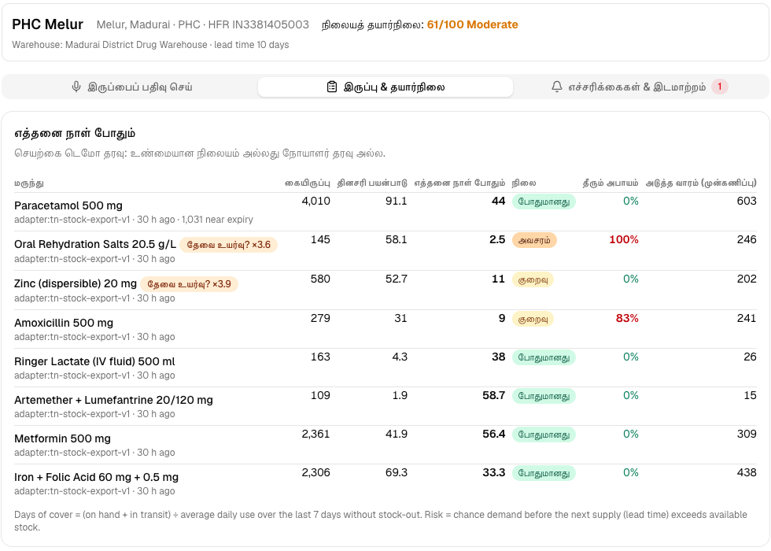
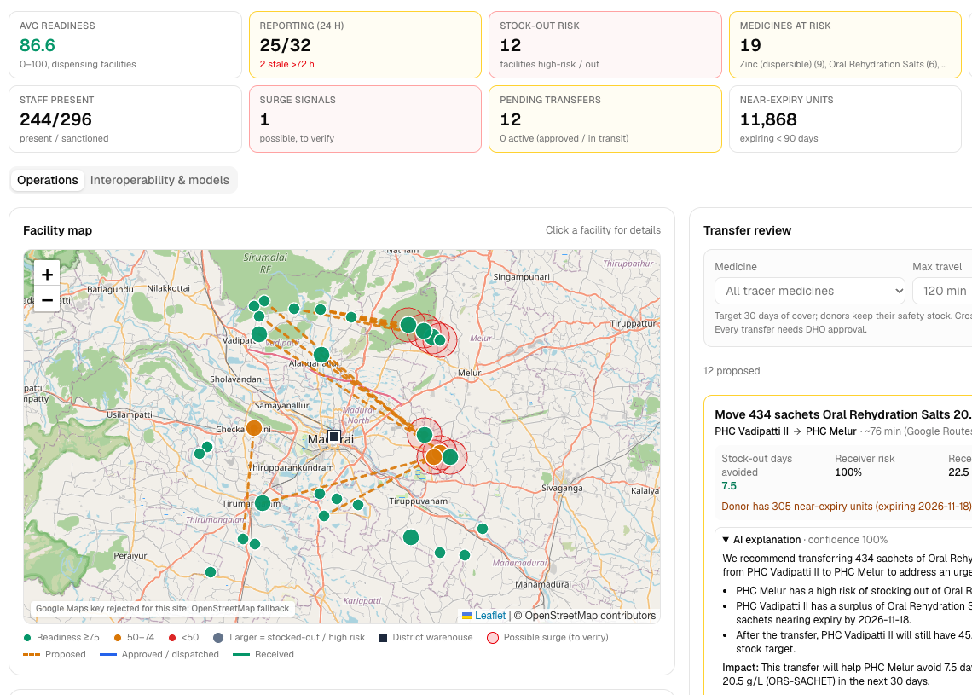
10 — LIVE PROTOTYPE
SPONTOM
ENTERPRISE PRIVATE LIMITED
Working today, end to end.
Three Cloud Run services in asia-south1 (Mumbai). All data is synthetic and labelled as such.
EVALUATION ALIGNMENT
25%
AI / TECHNICAL EXECUTION
Gemini extraction and register reading, OR-Tools on Routes times, validated JSON
20%
PROBLEM-SOLUTION FIT
Report → cover → forecast → warning → transfer → approval in one journey
PHC staff app • Tamil • PHC Melur stock
DHO dashboard • map, KPIs, transfer review
20%
DEPTH & REACH ACROSS INDIA
3 state adapters, EN/HI/TA voice, one shared model with per-state accuracy
TRY IT
20%
DEPLOYABILITY & SCALABILITY
PHC staff app
https://health-resource-network-phc-web-847963771142.asia-south1.run.app
3 Cloud Run services; onboarding a new state is a config file
DHO dashboard
https://health-resource-network-officer-dashboard-847963771142.asia-south1.run.app
API (OpenAPI)
https://health-resource-network-api-847963771142.asia-south1.run.app/docs
15%
IMPACT POTENTIAL
Source
https://github.com/ipavanreddy/health-resource-network
31,882 PHCs [2]; outcome = FDSI stock-out-day indicator [3]
Screenshots: local build, 30 Sep 2026, synthetic data. Locally the map uses the OpenStreetMap fallback.
SPONTOM ENTERPRISE PRIVATE LIMITED • PHC PULSE
DPIIT RECOGNISED • VISAKHAPATNAM
11
Notes:
Everything on these slides runs today. On the left are the PHC staff app in Tamil and the District Health Officer dashboard with the map, KPIs and transfer review. The links go to the live Cloud Run services, the API documentation and the public source code. Against the five evaluation criteria: Gemini and OR-Tools do real work, one journey fits the brief, three states and three languages show reach, a new state is a configuration file, and the impact is measured in stock-out days.

Slide 12
APPENDIX — REFERENCES
SPONTOM
ENTERPRISE PRIVATE LIMITED
Challenge evidence & public health sources
Numbered references correspond to citations in the core proposal.
[1]
Track 3 brief and PHC Pulse PRD
Challenge statement and product requirements (docs/PRD.md), incl. demo scenarios §43 and scale plan §50. Synthetic dataset: data/generator/synth.py.
LOCAL EVIDENCE
[2]
MoHFW (2024), Health Dynamics of India 2022–23
Formerly Rural Health Statistics. 31,882 PHCs and 47,932 staff nurses at PHCs as of 31 March 2023 (PIB release, 9 Sep 2024).
OPEN SOURCE ↗
[3]
NHM Free Drugs Service Initiative guidelines
Supports IT-enabled supply chains such as DVDMS; stock-out days as an indicator; redistribute near-expiry drugs to facilities in need; PIPs.
OPEN SOURCE ↗
[4]
Health Management Information System (HMIS)
MoHFW portal for facility-level service-delivery reporting and publications.
OPEN SOURCE ↗
SPONTOM ENTERPRISE PRIVATE LIMITED • PHC PULSE
DPIIT RECOGNISED • VISAKHAPATNAM
12
Notes:
These are the sources behind the numbers. The facility and staffing figures come from the Ministry's Health Dynamics of India 2022–23, released through PIB. The outcome indicator, the redistribution principle and the budget route come from NHM's Free Drugs Service Initiative guidelines. Everything about our own scenario comes from the PRD and the synthetic dataset in the repository.

Slide 13
APPENDIX — REFERENCES
SPONTOM
ENTERPRISE PRIVATE LIMITED
Platform, registry & technology sources
Systems PHC Pulse complements, and the Google technology it runs on.
[5]
Integrated Health Information Platform (IHIP)
MoHFW platform for disease surveillance under IDSP; where possible-surge signals would be verified.
OPEN SOURCE ↗
[6]
ABDM Health Facility Registry
National facility identifiers; PHC Pulse uses the HFR ID format as the facility key (synthetic IDs only).
OPEN SOURCE ↗
[7]
Google OR-Tools: minimum cost flow
Open-source solver (SimpleMinCostFlow) used for redistribution under donor safety-stock limits.
OPEN SOURCE ↗
[8]
Gemini models on Vertex AI
Gemini 2.5 Flash for stock extraction, register reading and transfer explanations.
OPEN SOURCE ↗
SPONTOM ENTERPRISE PRIVATE LIMITED • PHC PULSE
DPIIT RECOGNISED • VISAKHAPATNAM
13
Notes:
The second page lists the national platforms PHC Pulse is designed to work alongside: IHIP for surveillance and the ABDM Health Facility Registry for facility identifiers. It also lists the Google technology the prototype runs on: OR-Tools for the optimiser and Gemini on Vertex AI. All reused datasets, models and libraries are also listed in THIRD_PARTY.md in the repository.

