Slide 1
PHC Pulse
Speak or photograph the stock register. Know where medicines will run out,
and move surplus there before they do.
AI-powered federated health resource & supply chain intelligence for India's Primary Health Centres
Gemini on Vertex AI
Speech · TTS · Translation
OR-Tools + Routes API
BigQuery + BQML
Cloud Run
Build with AI (Google) hackathon · Track 3 · github.com/ipavanreddy/health-resource-network

Slide 2
One PHC runs out while the next has stock near expiry
Problem fit · 20%
Invisible stock
Surges noticed late
Fragmented systems
Stock lives in paper registers and late spreadsheets. Nobody sees days of cover until a patient is turned away.
A post-flood diarrhoea spike or a dengue season shows up in consumption days before it shows up in reports.
Every state exports stock in its own format, codes and units, so nothing is comparable across facilities, districts or states.
Who feels it
• PHC staff nurse reports stock after a full clinic day, often in Tamil or Hindi, often on a basic phone.
• District Health Officer has 30+ facilities and no single view of stock, beds, staff and early warnings.
• Patients in rural blocks a stock-out means a longer trip, or no treatment at all.
PHC Pulse · Build with AI · Track 3
2

Slide 3
One journey: spoken report to approved transfer
Solution
Report
Confirm
See
Predict
Redistribute
Approve
Voice, register photo, text or form · EN / HI / TA
Gemini extracts; staff confirm; ledger updates
Days of cover, beds, staff, readiness 0–100
8-week forecast, stock-out risk, possible surge
OR-Tools on real drive times + Gemini explanation
DHO approves → both PHCs notified → received
Two roles, one platform
PHC Staff app (mobile first)
District Health Officer dashboard
Report stock in their own language, hear it read back, see what is running low, and receive and confirm transfers.
Map of readiness and risk, possible surge clusters to verify, optimiser proposals to approve, emergency what-if, and cross-state interoperability.
PHC Pulse · Build with AI · Track 3
3

Slide 4
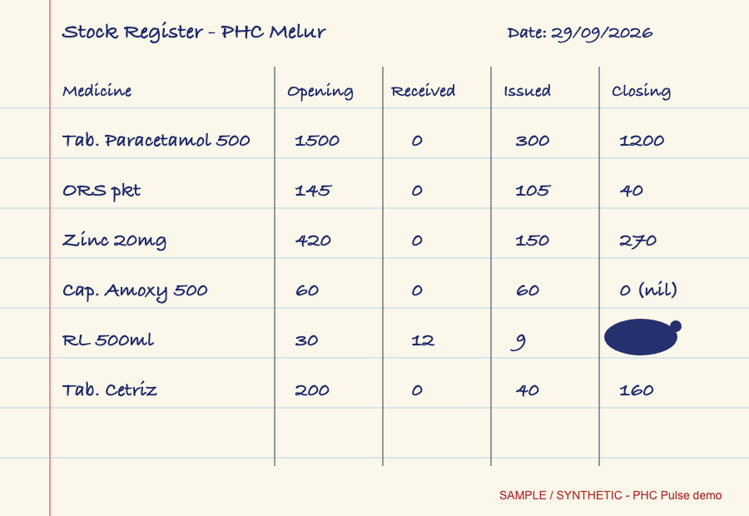
Capture that fits a nurse's evening: talk, or take a photo
AI / technical · 25%
• Voice in Tamil / Hindi / English Cloud Speech-to-Text, then Gemini maps each spoken name to the essential medicines master. A noisy transcript (“ஓவர் s40”) still resolves to ORS: 40.
• Register photo Gemini multimodal reads handwriting into a strict JSON schema.
• Never invents a number Unstated quantity = null; unknown drug codes rejected; staff confirm before the ledger changes.
• Spoken confirmation Cloud Text-to-Speech reads the result back in the staff member's language.
• Traceable every AI record stores model, version and prompt version; originals kept in Cloud Storage.
Synthetic register page. Gemini reads all six rows, returns closing = null with the cell flagged as illegible under the ink blot, and flags “Tab. Cetriz” as not in the medicine list.
PHC Pulse · Build with AI · Track 3
4

Slide 5
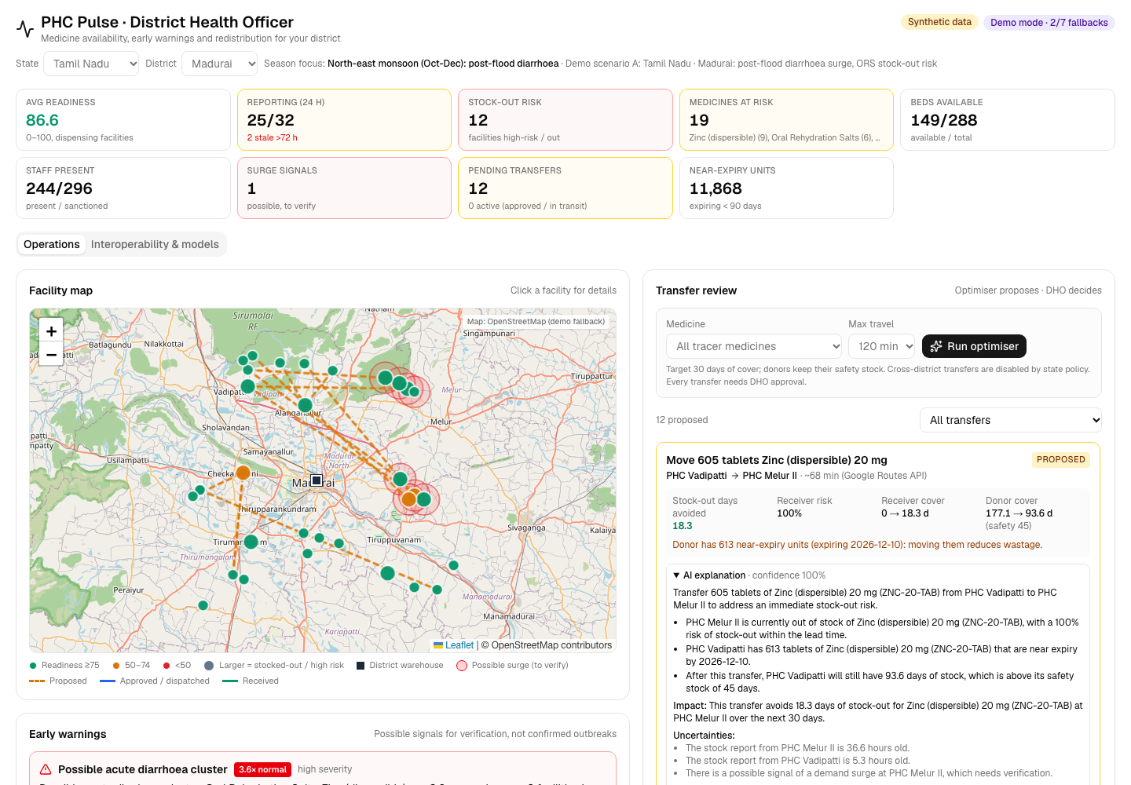
Signals to approved transfer, with a human in the loop
AI / technical · 25%
• Forecast 8-week low / expected / high per facility × medicine; stock-out weeks are excluded so censored demand is not learned.
• Early warning stock-out risk plus surge detection, shown as a possible signal the DHO verifies.
• Optimiser OR-Tools min-cost flow on Routes API drive times; donors never drop below 45 days of safety stock; near-expiry stock is preferred.
• Explanation Gemini explains each transfer in the officer's language but cannot change quantities.
• Approval nothing moves without the DHO.
Live DHO dashboard, Madurai (synthetic data): surge cluster, proposed routes, Gemini explanation.
PHC Pulse · Build with AI · Track 3
5

Slide 6
Google AI doing real work, verified live
AI / technical · 25%
Gemini 2.5 Flash (Vertex AI)
Voice/text extraction, register photo reading, transfer explanations
Live
Speech-to-Text · Text-to-Speech · Translation
Tamil / Hindi voice reports and spoken confirmations
Live
OR-Tools
Min-cost-flow redistribution with safety-stock constraints
Live
Maps Routes API + Maps JS
Real drive times; facility and route map
Live
BigQuery
Append-only ledger of stock transactions, transfers and AI outputs
Live
BigQuery ML ARIMA_PLUS
Shared demand model over 1,536 facility × medicine series
Trained
Cloud Storage
Original register photos and voice recordings
Live
Cloud Run + Secret Manager
Three services in asia-south1; keys never in code
Live
Every adapter has a labelled fallback. The app's badge shows only integrations that pass a start-up probe.
PHC Pulse · Build with AI · Track 3
6

Slide 7
India's diversity: 3 states, 3 languages, 1 shared model
Depth & reach · 20%
Tamil Nadu · Madurai
Uttar Pradesh · Gorakhpur
Odisha · Koraput
Post-flood diarrhoea → ORS and zinc
Tamil voice
Vector-borne season → paracetamol and IV fluids
Hindi voice
Malaria season → antimalarial redistribution
English
Onboarding a state is a configuration file
State export
(own codes, units, dates)
Declarative adapter
(data/adapters/*.json)
Canonical schema
(canonical_v1)
Shared forecast model
+ shared AI services
• Per-state config languages, readiness weights, safety stock, cross-district transfer policy, model choice.
• Models travel, data doesn't states share model weights and accuracy; facility-level data stays in the state.
PHC Pulse · Build with AI · Track 3
7

Slide 8
Deployable today; plugs into existing state systems
Deployability · 20%
Cloud-native and API-first
Integrates, doesn't replace
Three Cloud Run services (API + two Next.js apps) in asia-south1, one repeatable deploy script, secrets in Secret Manager, OpenAPI for every endpoint.
Adapters read the stock exports states already produce, so no state has to swap its existing drug distribution system.
Scale path
One PHC
One block
One district
One state
Many states
National network
• Stateless services scale horizontally BigQuery becomes the read path beyond the pilot; Firestore for real-time updates.
• Works on the phones staff already have mobile-first web app with voice, no install.
PHC Pulse · Build with AI · Track 3
8

Slide 9
Fewer stock-outs where rural patients need the medicine
Impact · 15%
12
~277
~53 min
0
transfers proposed in one optimiser run for Madurai district
facility-days of stock-out avoided over the next 30 days
average drive time per transfer (Google Routes API)
donors taken below their 45-day safety stock
Demo figures from the synthetic Madurai dataset, not a field result.
• Patients essential medicines on the shelf during floods, dengue and malaria seasons.
• Staff reporting takes seconds instead of an evening of copying; alerts arrive in their own language.
• Districts surplus and near-expiry stock is moved instead of wasted, and surges are seen days earlier.
• What a pilot would measure stock-out days per tracer medicine, reporting freshness, time from alert to receipt, near-expiry write-offs.
PHC Pulse · Build with AI · Track 3
9

Slide 10
Portable beyond India: a template for BRICS health systems
Portability
Same canonical model
Any language
Data sovereignty
A new country adds an adapter and a drug-code map (for example, to its national essential medicines list or the WHO EML). Capture, forecasting, optimiser and dashboards are unchanged.
Gemini, Speech-to-Text, Text-to-Speech and Translation cover Portuguese, Russian, Mandarin, Arabic, Amharic, isiZulu and more. The UI strings are one table.
Deploy per country in its own Google Cloud region. Countries share models and aggregate accuracy, never facility-level records.
• Configurable policy readiness weights, safety stock and cross-border transfer rules per country.
• Shared learning a regional model registry lets a country with little history start from its neighbours' model and publish its own accuracy back.
• Same problem everywhere primary care facilities in Brazil, South Africa, Ethiopia and Indonesia face the same last-mile stock-outs.
PHC Pulse · Build with AI · Track 3
10

Slide 11
Try it, and help us pilot it in one district
Live now
Next 90 days
PHC Staff: health-resource-network-phc-web-847963771142.asia-south1.run.app
DHO dashboard: health-resource-network-officer-dashboard-847963771142.asia-south1.run.app
Code: github.com/ipavanreddy/health-resource-network
District pilot on real stock exports · Firebase Auth + Firestore real-time notifications · weather and surveillance covariates (Earth Engine) · offline sync for low-connectivity PHCs.
One polished journey: a nurse speaks, a forecast warns, an optimiser proposes, a person approves, medicine arrives.
All demo data is synthetic and labelled that way. No patient-level data is stored.
PHC Pulse · Build with AI · Track 3
11

