Slide 1

Team Name :
Team Leader Name :
Team Size :
Problem Statement : Problem 1 — Risk, Fraud and Regulatory Intelligence Copilot · Raqib

Slide 2

1 · Problem brief: financial-crime and risk work is manual and siloed
Banking & NBFC (GCC) · AML/CFT, sanctions, fraud, Basel III liquidity, IFRS 9 credit risk
Business problem
Job | Today | With Raqib
Alert triage | 5+ systems; policy looked up by hand | One evidence view + the governing clause
Explain a risk | Analyst writes SQL or raises a ticket | Plain-English question → governed answer
STR drafting | Written from scratch each time | Cited draft, amounts verified in code
LCR / NPL | Excel pack, days later | Live LCR trigger + NPL by sector
Audit trail | Emails and spreadsheets | Every question and tool action logged
Analysts triage monitoring alerts across core-banking screens, policy PDFs and spreadsheets, write every STR from scratch, and build LCR / NPL reporting in Excel. Decisions are slow, inconsistent and hard to evidence for the regulator.
Target users
FCC analyst (triage and investigate) · MLRO (decide and file STRs) · Treasury / Risk (LCR, NPL) · Internal Audit and Model Risk (oversight).
Industry context
UAE AML/CFT framework (Federal Decree-Law 20/2018), goAML STR filing, tipping-off prohibition, internal AED 55,000 cash threshold, Basel III LCR ≥ 100%, IFRS 9 staging.

Slide 3
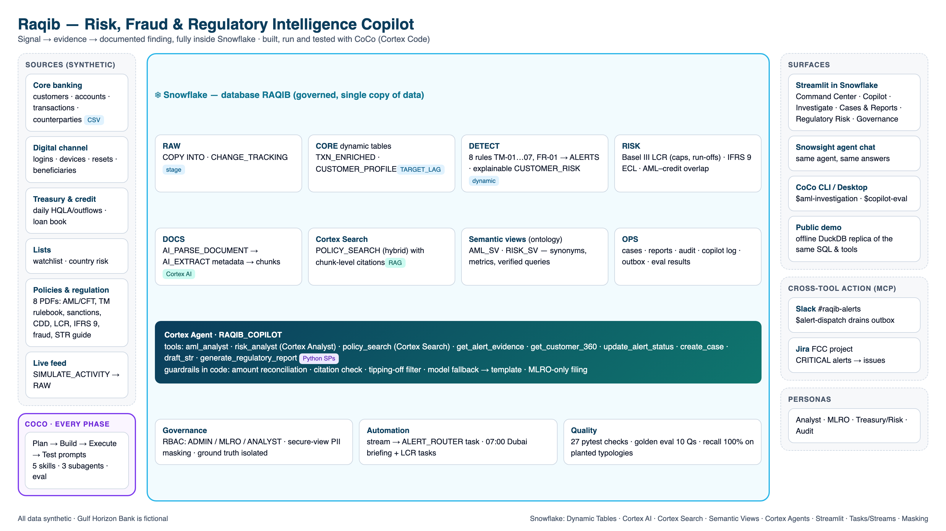
2 · Architecture: one governed platform, end to end
Data: structured core banking, digital, treasury and credit tables + unstructured policy PDFs. CoCo skills: synthetic-banking-data → aml-investigation → regulatory-report-drafter → copilot-eval → alert-dispatch.

Slide 4
3 · Impact: measured on the synthetic bank, built to scale
Measured = from the repo's automated tests and eval. Business outcomes are estimates to validate in a pilot.
100%
≤ 12
10 / 10
3 / 3
recall on 42 planted
typology scenarios (8 rules)
false-positive alerts per
rule on 2,150 customers
golden copilot questions
passed (incl. guardrails)
hallucination, tipping-off and
unauthorised filing blocked
Expected outcomes (estimates)
Scalability & beyond the demo
Alert triage: evidence + policy in one screen, so far less time per alert spent switching between systems
STR first draft in under 2 minutes instead of hours; analysts review rather than write
Consistent answers: one governed metric definition used by every team and surface
Audit-ready by default: every number traceable to transactions and a policy clause
Snowflake-native: dynamic tables and Cortex scale with warehouse size, and data never leaves the platform
New typology = one SQL view + rulebook entry + test; ontology extends via the semantic views
Reusable CoCo skills and tools port to any bank: swap table names, keep the guardrails
Next: trade-finance (TBML) rules, ML anomaly scores, goAML XML export, Arabic UI

Slide 5
Additional · CoCo across the whole lifecycle
Every phase runs as a CoCo prompt against Snowflake; sessions are the evidence (coco/EVIDENCE.md)
PLAN
BUILD
EXECUTE
TEST
Profile the data, frame personas, critique the data model / ontology / workflow, check rule ↔ policy thresholds
Generate and load data, then build dynamic tables, 8 rules, PDF → Cortex Search, tools, semantic views, agent and app, fixing errors in the repo
Inject live activity → new alert → case → STR → Slack/Jira via MCP; schedule tasks and CoCo runs
Recall and false-positive back-test, ontology consistency, masking / RBAC, guardrail and edge cases, golden eval
coco/01_plan.md
coco/02_build.md
coco/03_execute.md
coco/04_test.md
Real fixes CoCo made on the live account
Ingenuity in CoCo usage
Dynamic table over views → wrapped in DYNAMIC_TABLE_REFRESH_BOUNDARY
Semantic view metric rules → rewrote ECL / coverage metrics
No streams on FULL-refresh tables → poll-based alert router
Masking needs Enterprise → secure view with role check
5 skills, 3 subagents with HANDOFF + independent validation
Plan → build: CoCo's own review added the PIPELINE_HEALTH check
MCP + schedules: Slack / Jira dispatch, Snowflake tasks
6 custom tools: stored procedures the agent calls to act

Slide 6
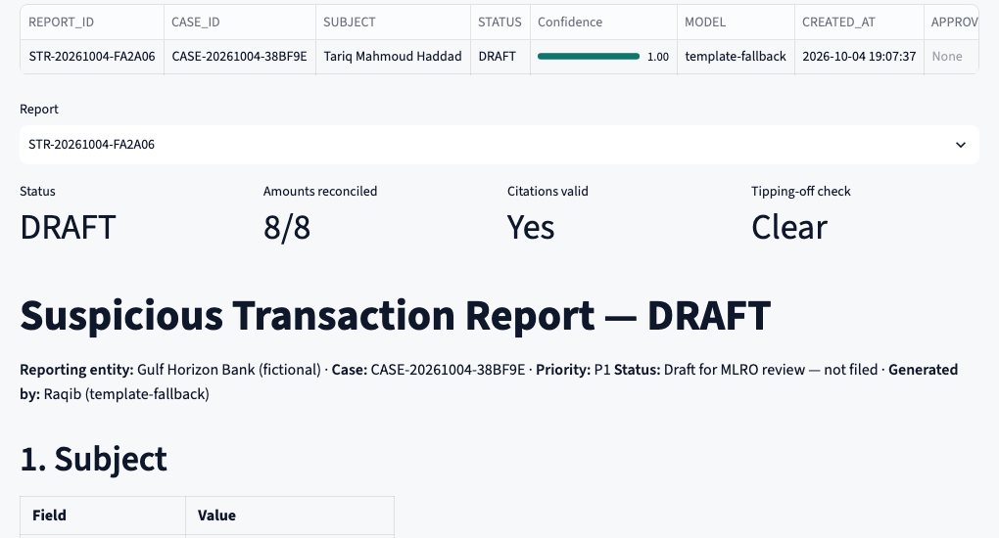
Additional · Governed, explainable, and safe by construction
Risk | Control (enforced in code / Snowflake)
Hallucinated numbers | Every AED amount reconciled to evidence; failing drafts cannot be filed
Fake citations | Cited chunk IDs must be among the retrieved policy passages
Tipping-off | Language filter + agent instructions; flagged text removed
Unauthorised filing | Agent has no filing tool; APPROVE_REPORT needs RAQIB_MLRO
PII exposure | Secure view masks Emirates ID / phone / email / DOB unless the MLRO role is active
Model outage | Primary → fallback model → deterministic template
Unknown entities | Explicit "not found" (tested), never a guess
Oversight | AUDIT_LOG + COPILOT_AUDIT + EVAL_RESULTS in Snowflake
Validated STR draft: 8/8 amounts reconciled, citations valid, tipping-off check clear. Only the MLRO can approve and file; a goAML reference is recorded and every step is logged.

Slide 7
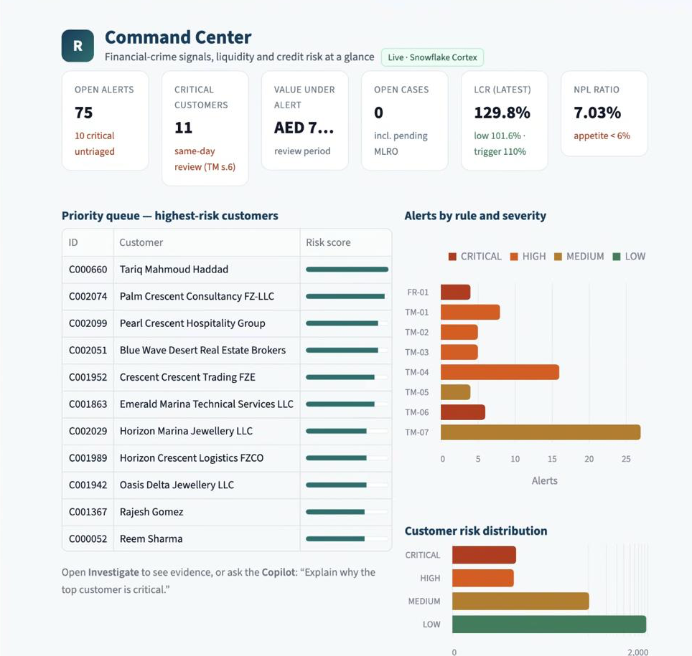
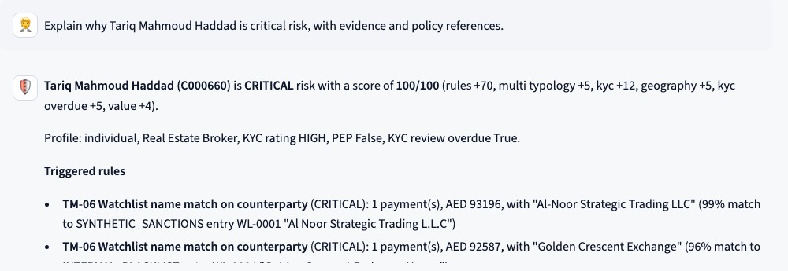
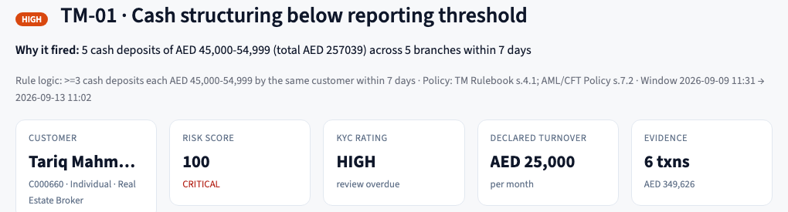
Additional · Product walkthrough (Streamlit in Snowflake)
Copilot: governed answer with rules, score breakdown and policy citations
Live in Snowflake: Command Center reading the deployed pipeline (Live · Snowflake Cortex)
Investigate: why the alert fired, against the KYC profile and evidence

Slide 8

GitHub github.com/ipavanreddy/raqib-snowflake-copilot
Live app Streamlit in Snowflake · RAQIB.APP.RAQIB_APP (Snowsight login)

