Slide 1
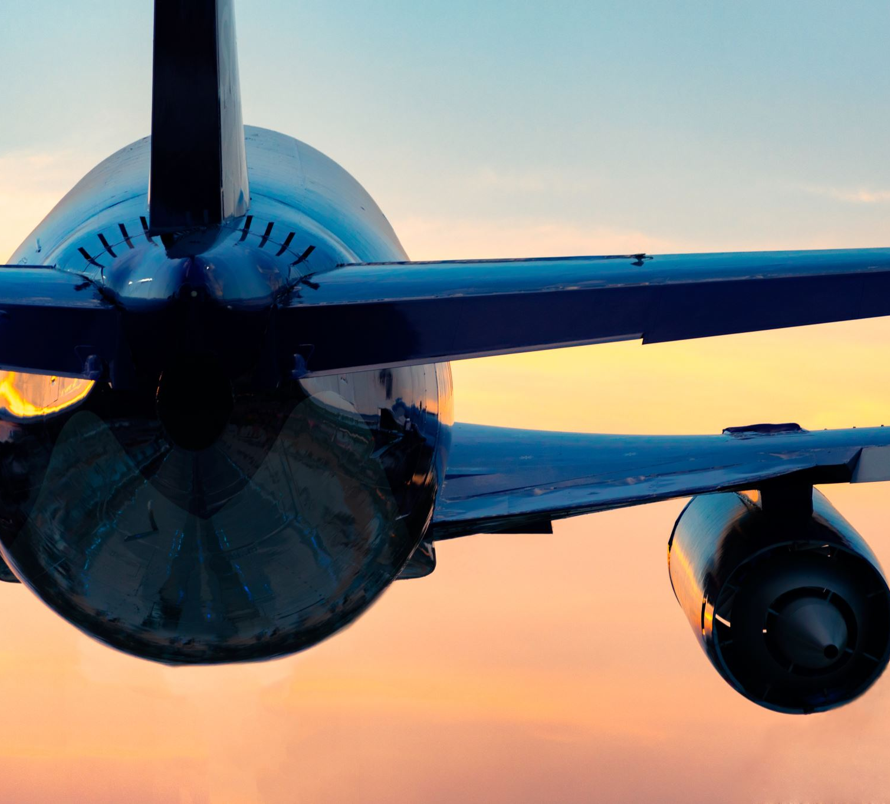
AIRLINE PASSENGER SATISFACTION ANALYSIS
Presented By:
Pawan Kalyan Ramisetty Narayanaswamy
Sai Harshith Reddy Gaddamidhi

Slide 2
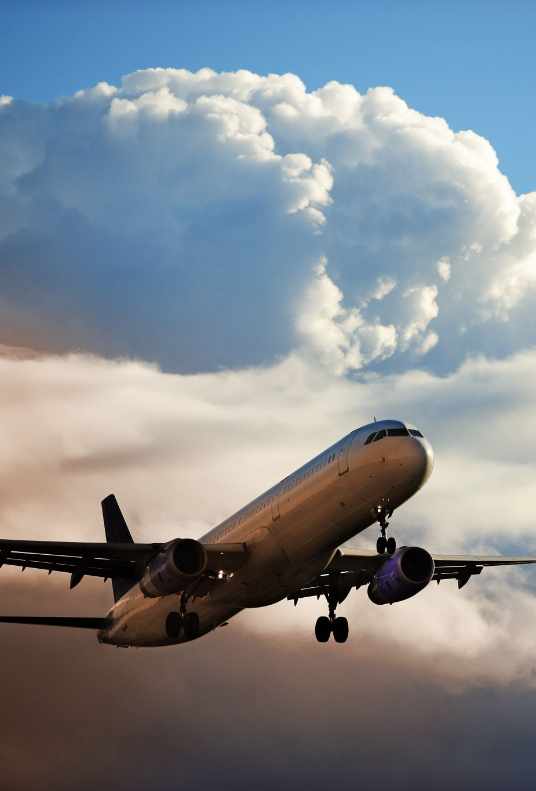
Scenario
The airline industry has been facing increasing scrutiny over customer satisfaction levels, with social media amplifying any negative experiences passenger's encounter. In response, an airline company decides to undertake a comprehensive analysis of customer reviews to identify key areas of improvement. The company aims to leverage this analysis to enhance passenger satisfaction, streamline operations, and improve overall service quality. By analyzing the dataset containing reviews from various airlines, the company hopes to benchmark its performance against competitors and identify best practices in the industry.

Slide 3

DATA SOURCE: https://www.kaggle.com/datasets/sujalsuthar/airlines-reviews
Target Audience :
The primary target audience for this analysis includes Airline Executives and Management Teams: To gain insights into customer satisfaction levels and identify areas for operational improvements.
Customer Service and Experience Managers: To understand specific grievances and areas where the customer service can be enhanced.
Marketing and Brand Managers: To identify strengths that can be leveraged in marketing campaigns and areas of weakness that need addressing to improve brand perception.
Operational and Flight Service Teams: To understand feedback related to in-flight services, boarding processes, and overall flight experience.
Big Idea Sentence
"Transforming passenger feedback into actionable insights to elevate the flying experience and foster brand loyalty.”
Conclusion Supported by the Data
After analyzing the dataset and creating visualizations in Tableau, the following conclusion can be drawn: The analysis of airline reviews highlights that customer service, flight delays, and cancellations are the most critical drivers of passenger dissatisfaction. A significant portion of negative reviews focuses on poor communication during service disruptions and perceived indifference from airline staff during service encounters. Conversely, positive reviews often commend airlines for punctual flights, friendly staff, and efficient boarding processes. By prioritizing improvements in customer communication, especially during delays and cancellations, and enhancing training for frontline staff to ensure a consistently positive interaction with passengers, airlines can significantly improve passenger satisfaction. This conclusion, supported by the data, underscores the importance of focusing on the human aspect of air travel and operational reliability. Airlines that excel in these areas are likely to see increased passenger loyalty and positive brand perception, setting them apart in a highly competitive industry.

Slide 4
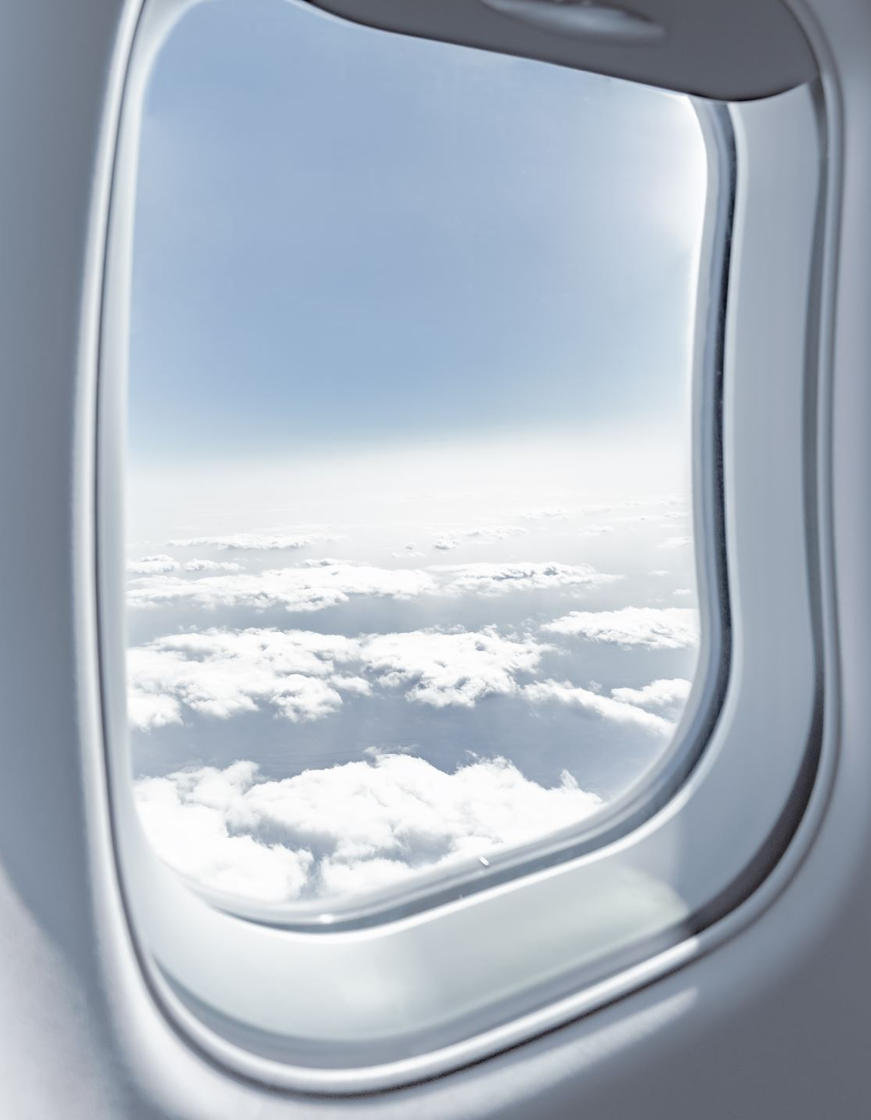
Airlines vs Staff Service :
This is a Vertical Bar Chart represents different airlines based on staff service ratings, with one airline significantly outperforming others.
Class vs staff services :
This is a Packed Bubble Chart that compares different airline service classes based on staff service ratings.
Airlines vs Food & Seat Comfort :
This is a Vertical Bar Chart comparing airlines based on food and beverage quality and seat comfort, with each airline's performance represented by the height of two-colored bars for each category.
Class vs measure values :
This is a Vertical Bar Chart showing a comparison of different service across airline classes such as Business, Economy, First and Premium Economy.
Year vs Ratings :
The is a Line graph visualization comparing the customer ratings in a year for each airline, with airline ratings varying drastically.

