Slide 1

Show-and-tell:
Browser test automation
Frank Lange
Leibniz-Institut für Pflanzenbiochemie
This work is licensed under a Creative Commons Attribution 4.0 International License.

Slide 2
Agenda
Unit tests – why we should write tests
Architecture of CRIMSy
What we test in CRIMSy & why we need frontend tests
Browser tests with Selenium & Co.
Dockerize browser tests

Slide 3
Where is the code?
https://github.com/ipb-halle/Show-And-Tell_Browser-Test-Automation

Slide 4
Unit tests – why we should write tests
See
code/1_unit_tests/

Slide 5
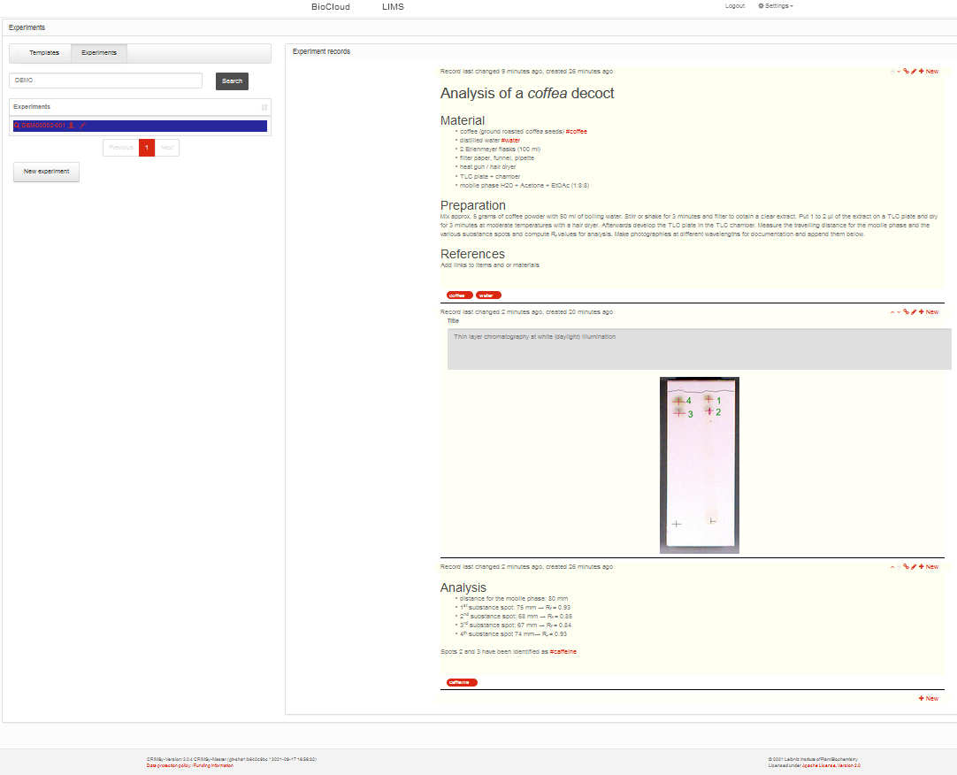
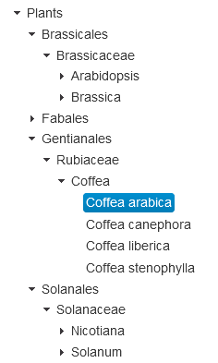
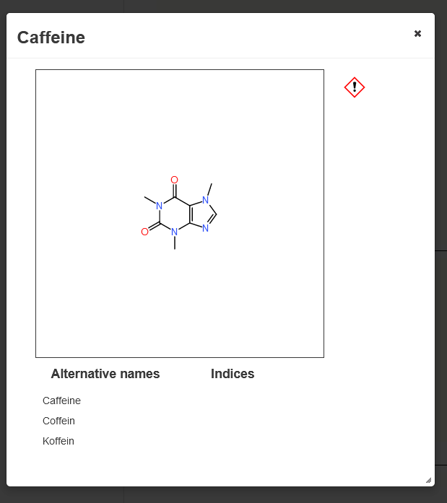
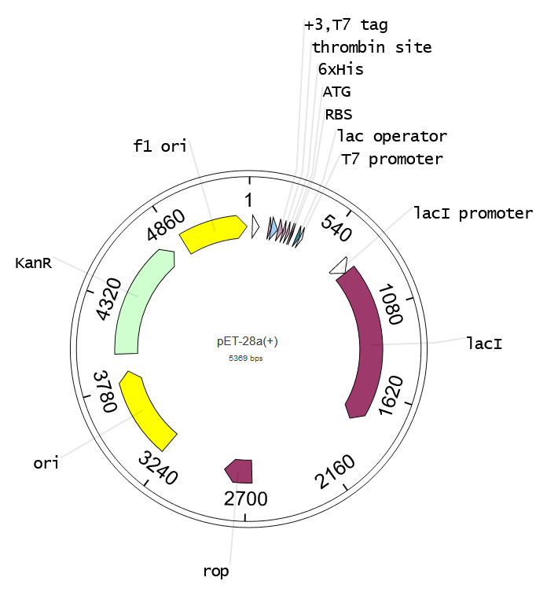
CRIMSy (Cloud Resource & Information Management System)
https://crimsy.org
GitHub:
https://github.com/ipb-halle/CRIMSy
Test setup:
https://github.com/ipb-halle/CRIMSy/wiki/Test-setup

Slide 6
CRIMSy's architecture
Browser
Other CRIMSy Nodes
HTTPS
Proxy Container
HTTP
JSF
REST endpoints
Other Servlets
LDAP server
JSF backing beans
JSF views
CDI
CDI
CDI
EJBs
PostgreSQL
business logic
DB interactions
DB transactions
Chemistry cartridge
JavaEE Application Server
JSF = Java Server Faces
EJB = Enterprise Java Beans
CDI = Context & Dependency Injection
Docker network

Slide 7
Test pyramid
more integration
slower
$$$
UI
Tests (aka E2E Tests)
Service Tests (aka Integration Tests)
CalculatorTest
Unit Tests
more isolation
faster
$
AdditionTest
https://martinfowler.com/articles/practical-test-pyramid.html

Slide 8
Service tests with Arquillian
Browser
Other CRIMSy Nodes
HTTPS
Proxy Container
HTTP
JSF
REST endpoints
Other Servlets
LDAP server
JSF backing beans
JSF views
CDI
CDI
CDI
EJBs
H2 in-memory DB
business logic
DB interactions
DB transactions
Chemistry cartridge
JavaEE Application Server
JSF = Java Server Faces
EJB = Enterprise Java Beans
CDI = Context & Dependency Injection
Docker network

Slide 9
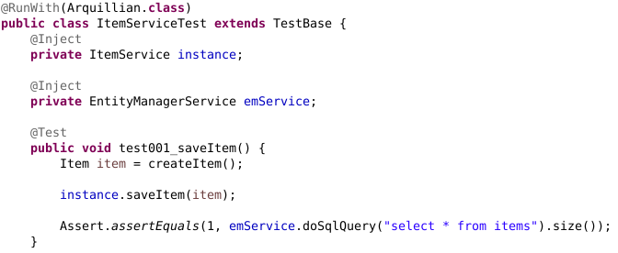
Service tests with Arquillian

Slide 10
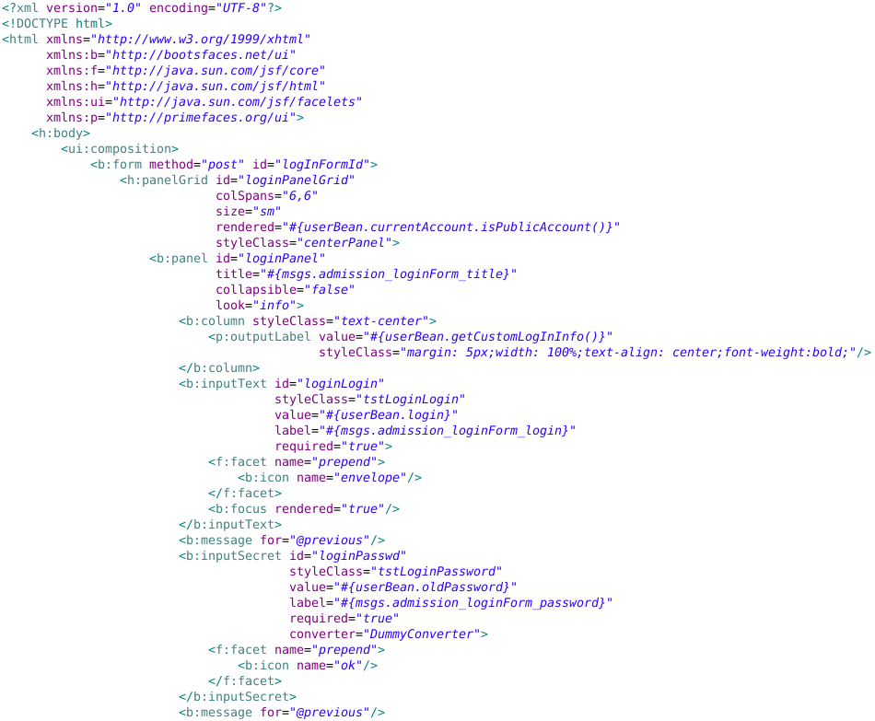
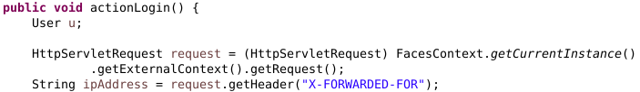

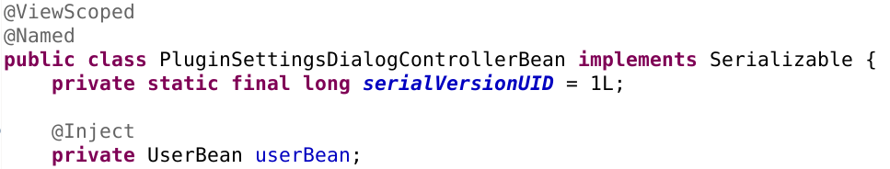
Testing JSF?
Facelet (JSF's templating language)
JSF's internal objects
== null
strange bean scopes
(tied to HTTP sessions/requests)
(almost) untestable!

Slide 11
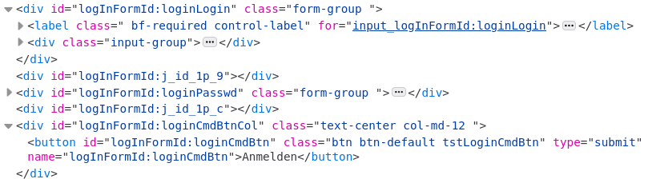
Testing JSF?
rendered HTML
Testable?

Slide 12
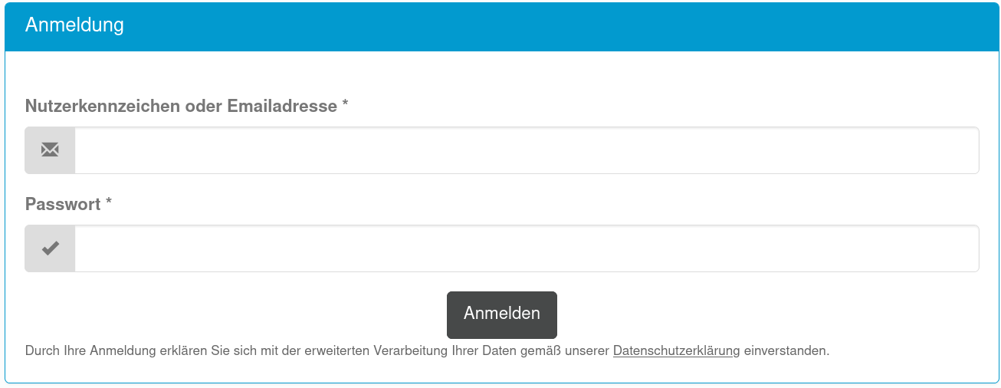
Testing JSF?
Website rendered in the browser
Testable!

Slide 13
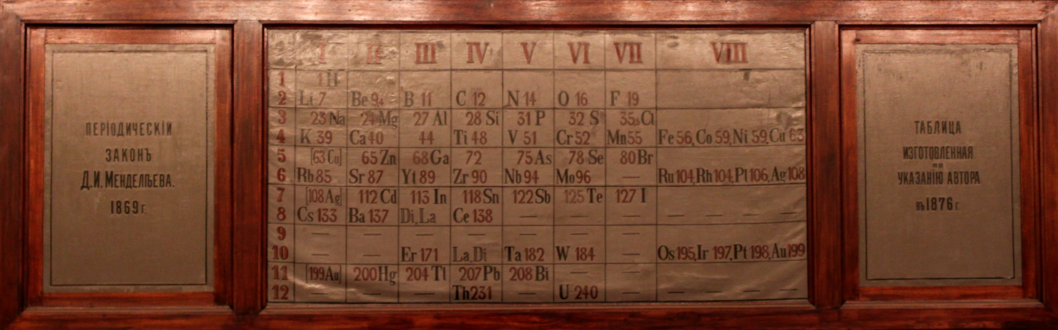
Browser tests with the Selenium WebDriver
https://www.selenium.dev/documentation/getting_started/
Supports: Java, Python, C#, Ruby, JS, PHP, ...
Saint-Petersburg - Mendeleevsky center - Periodic table 2.JPG, CC-BY 3.0, Wiki user Christophe.Finot

Slide 14
Browser tests with the Selenium WebDriver
See
code/2_selenium/

Slide 15
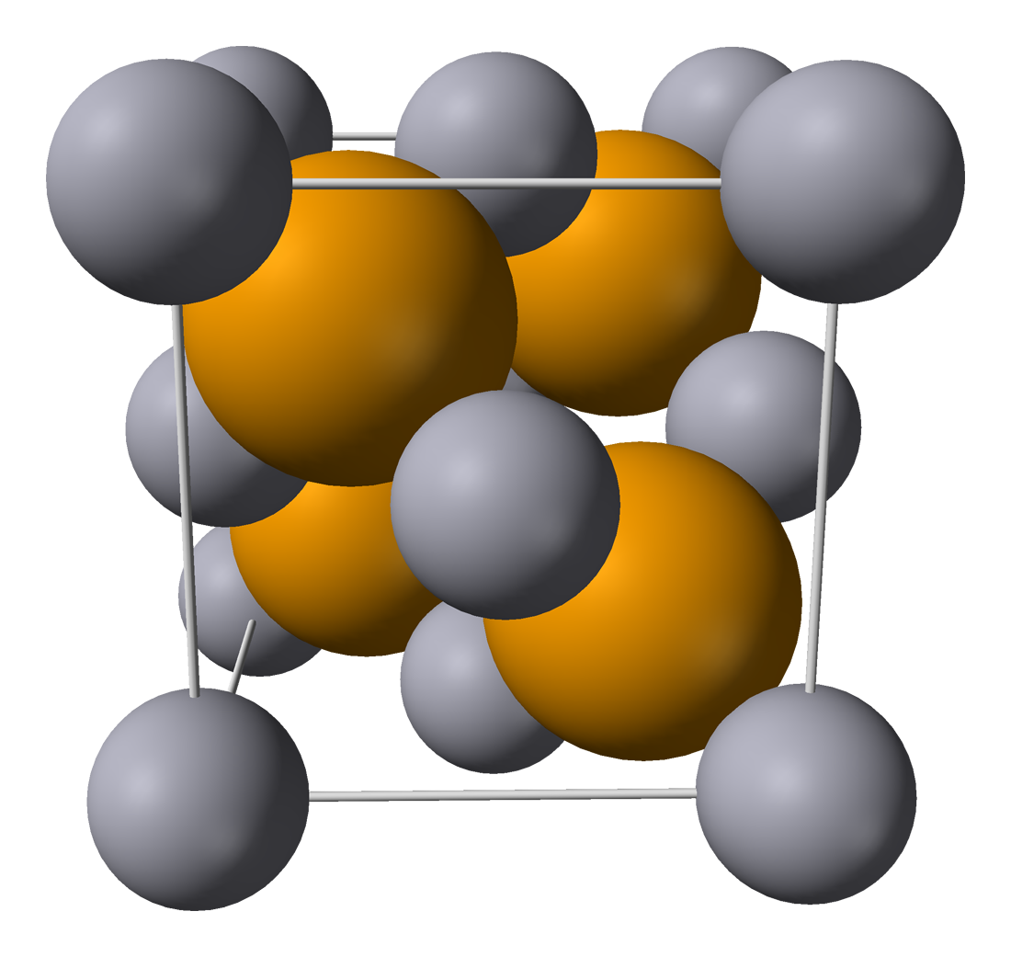
Browser tests with Selenide
https://selenide.org/quick-start.html
Java only :(
Ports: https://github.com/selenide/selenide/wiki/Ports-of-Selenide (Python, JS, PHP, C#)
Claims:
Concise fluent API for tests
Ajax support for stable tests
Powerful selectors
Simple configuration
Wikimedia Commons: Mercury(II)-selenide-unit-cell-3D-ionic.png

Slide 16
Browser tests with Selenide
See
code/3_selenide/

Slide 17
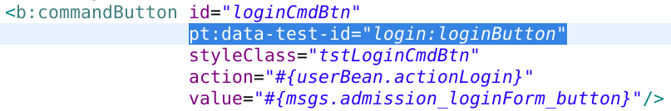
Element selectors
by ID: driver.findElement(By.id("dtLj_id_s:j_id_11"));
CSS selector: $("button[name=\"logInFormId:loginCmdBtn\"]").click();
XPATH selector: driver.findElement(By.xpath("//span[contains(.,\'Benzene\')]"));
by text: $(byText("Anmelden")).click();
…
Are your selectors stable?
Define your own test-IDs!
CSS selector: $("button[data-test-id=\"login:loginButton\"]").click();

Slide 18
Page objects
See
code/4_page_objects/

Slide 19
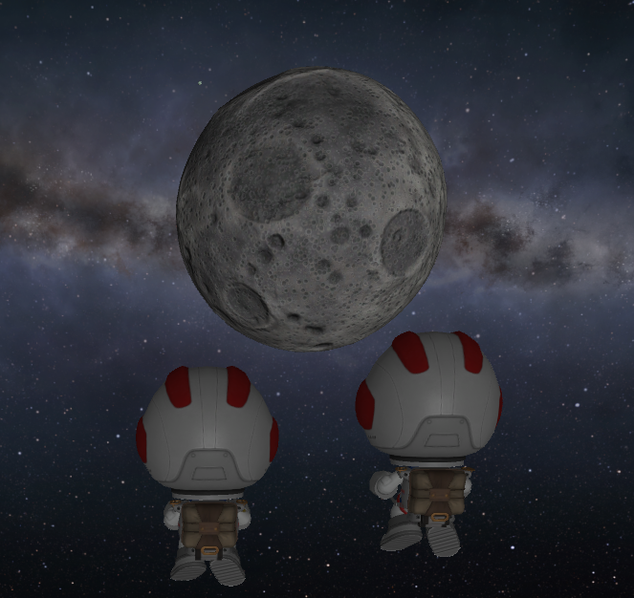
Dockerization with Selenoid
(= the geoid of the Moon; "σελήνη" = Moon)
https://aerokube.com/selenoid/latest/
See
code/5_selenoid/

Slide 20
Other browser test automation frameworks
Playwright: JS, Python, Java, C#, (Ruby)
also needs implicit waits for AJAX :(
Cypress: JS only
Puppeteer: JS only
See
code/6_playwright/

