Slide 1
From a business narrative to an
Entity - Relationship Model to a
Relational Database

Slide 2

Questions
How can we create an ER diagram from scratch?
How can we go from an ER diagram to a set of tables that are stored in a database (aka relational schema)?
Notes:
Last time we discussed ER diagrams.

Slide 3
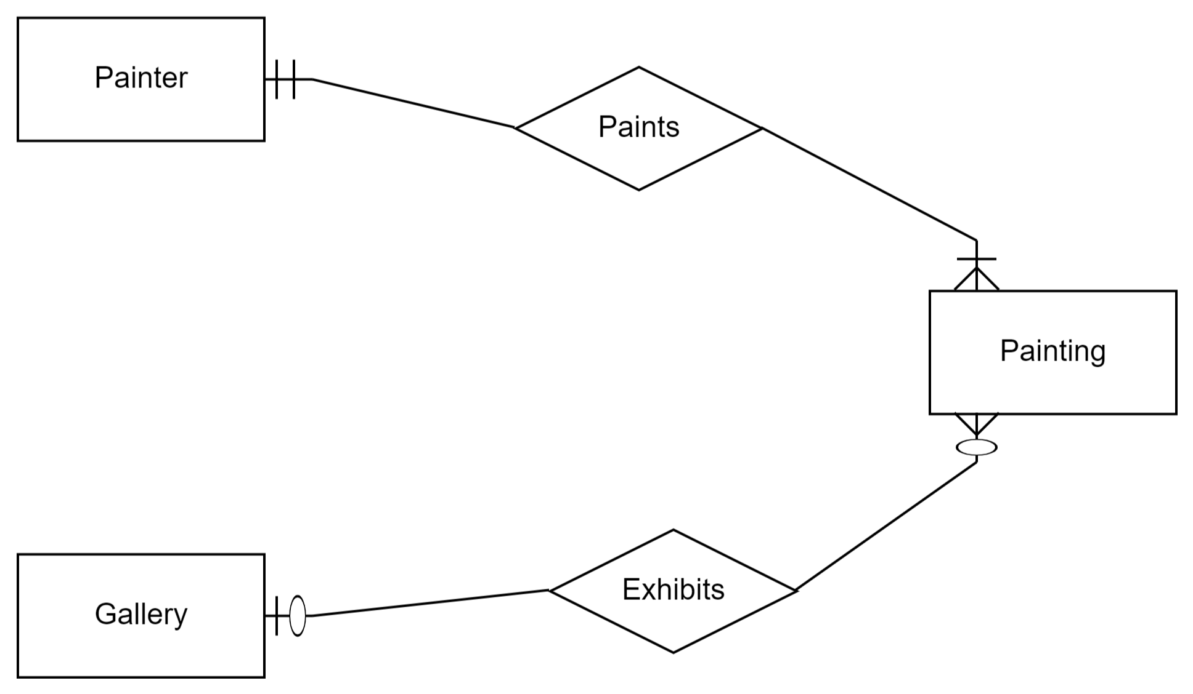
Existing ER Diagram

Slide 4
Additional Narrative
Augment the ER diagram using the following information:
Each painter has a name, date of birth
Each gallery has a name, address
Each painting has a name, date of creation
Each painting has an owner for whom we have name and address
The owner of a painting may change over time; we want to record the change of ownership by recording each purchase of the painting by a new owner (we can always assume that the prior owner was the seller); to identify a transaction we record a transaction id; for each transaction we also record the $ amount

Slide 5
From Narrative to ER diagram
The procedure for analysis:
Add entities and attributes
Determine primary keys (ideally, create artificial ones)
Identify relationships
Determine relationship cardinalities
Refine the ERD

Slide 6
Step 1: Identify Entities and Attributes
For entities, find nouns that describe people, places, things, and events
For attributes, look for details about the entities
Common decision: Attributes vs. Entities
Simplicity principal: consider as an attribute unless other details are presented.
Example : Should an address be an attribute or a separate entity? Advantages and disadvantages?
Notes:
For example, which one of the two should we choose?

Slide 7
Step 2: Determine primary keys
Stable: never change after assigned
Each entity should have one and only one (good choice: automatically generated values, eg StudentId, CourseId)
What about the following PKs for a person?
Credit card
Phone number
PassportID
SSN
Notes:
SSN: immigrants (outside US) don’t have one. PPl lose it . PPl don’t want to share their SSN.

Slide 8
Step 3: Identify Relationships and determine cardinalities
Identify relationships connecting previously identified entity types
Relationships = associations among nouns representing entity types
Identify maximum cardinalities and minimum cardinalities

Slide 9
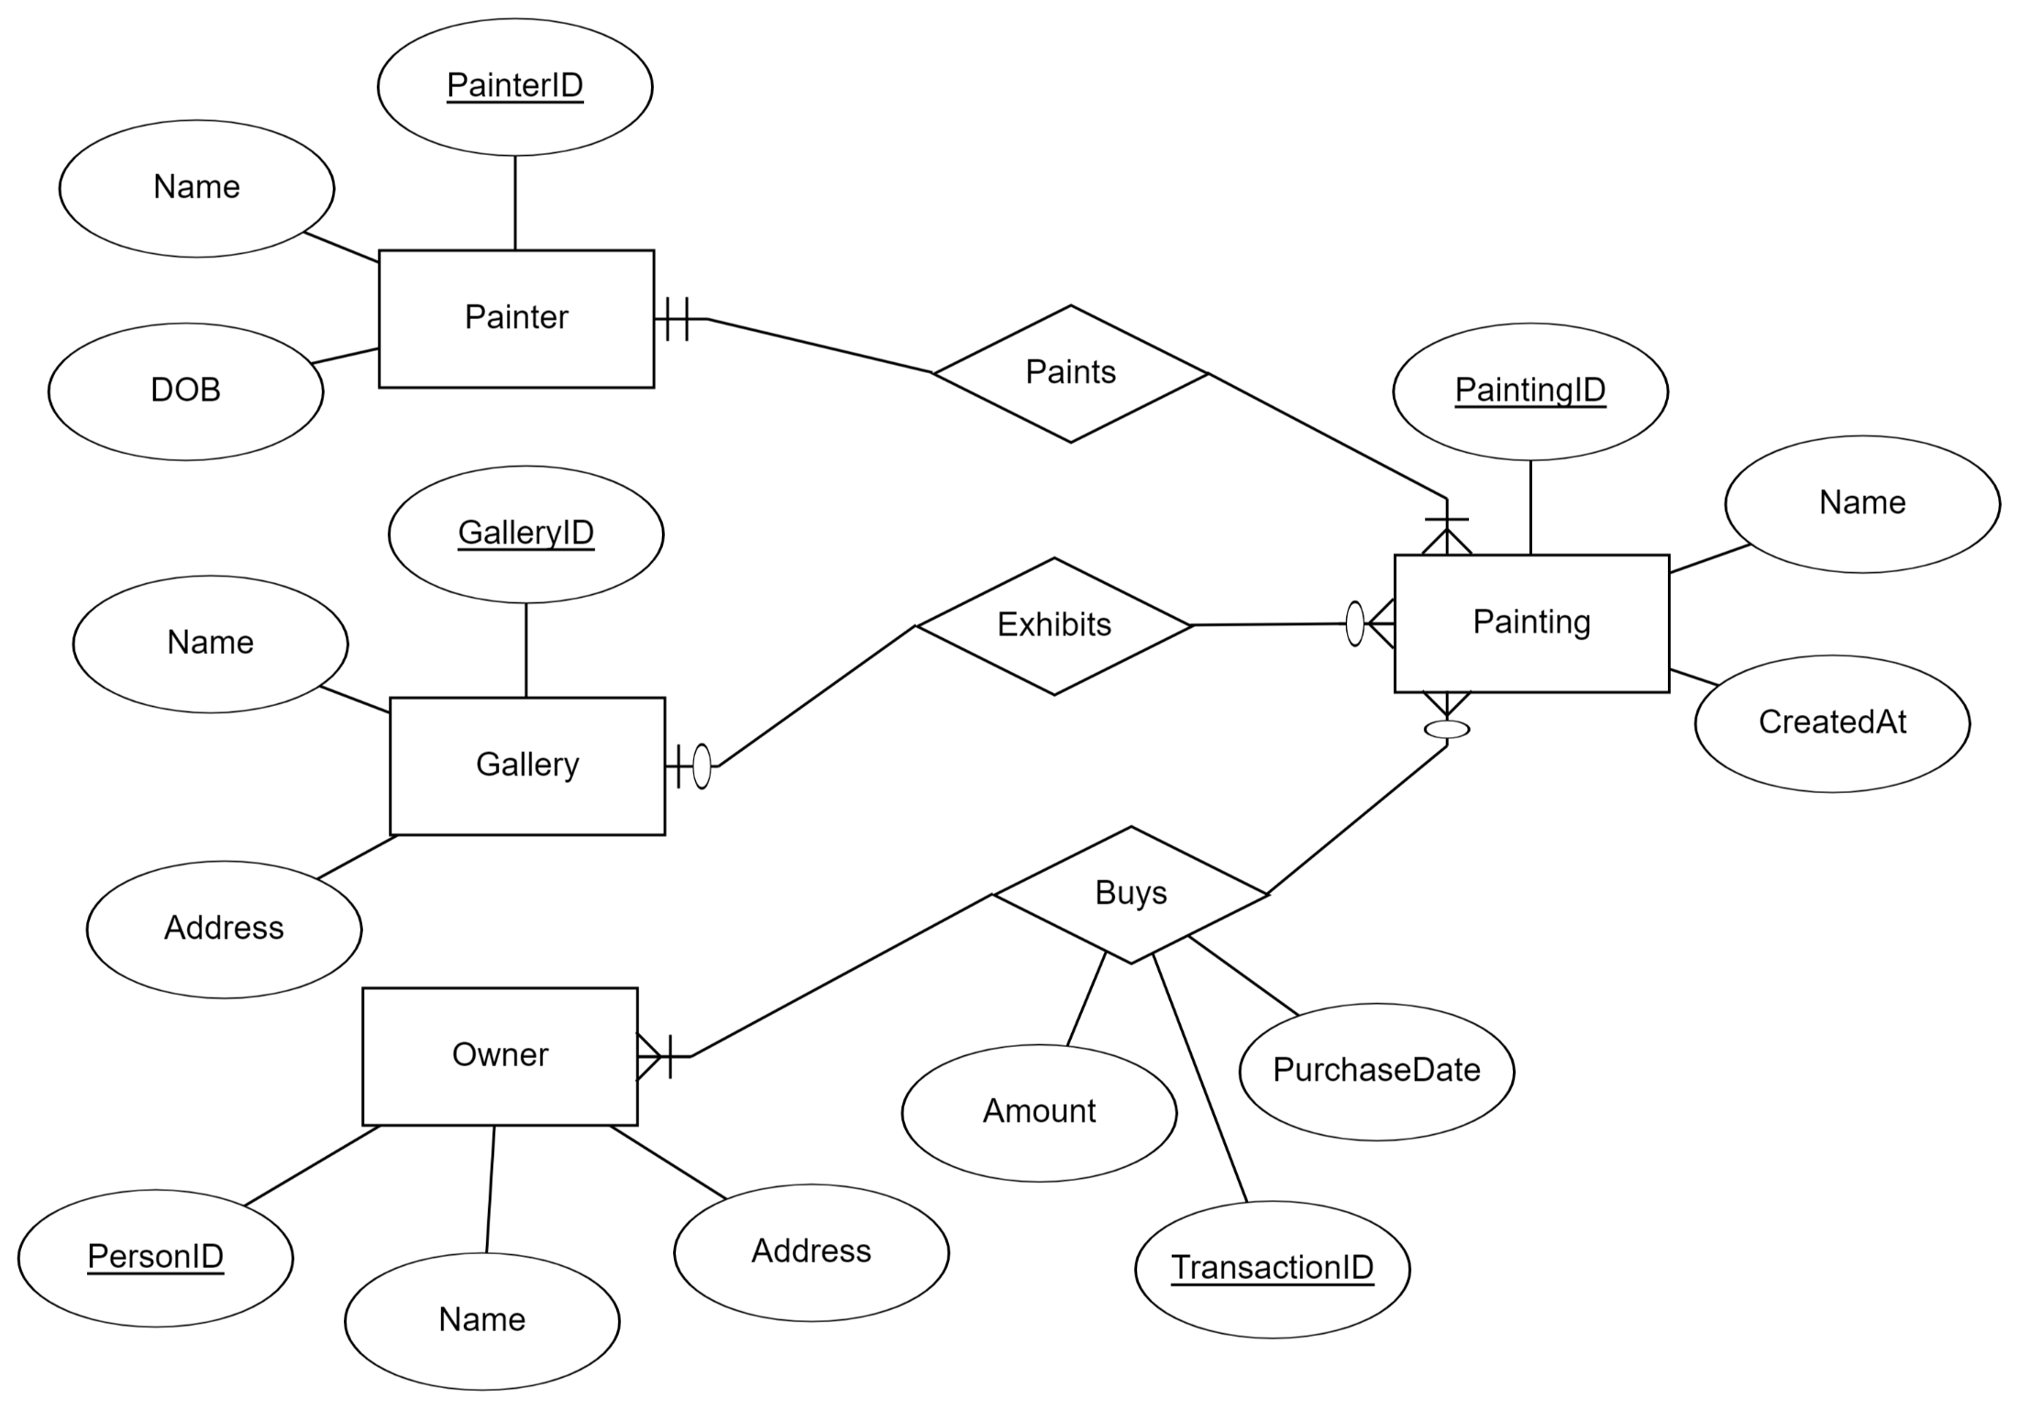

Slide 10
ERD refinements
We constructed initial ERD
Refinements are common
Example of refinements:
Attributes -> Entities
Splitting compound attributes
Data types becoming ENUM entries

Slide 11
Attribute or Entity?
We often need to decide whether something is an entity or an attribute (e.g., an address)
A free-form attribute allows the introduction of data quality issues (e.g., “California” vs “CA”).
When we have a limit number of values, that are unlikely to change in the future, then we make the data type of the attribute an “ENUM” where we list all the possible values, eg ENUM(“Alabama”, “Alaska”,… “Wyoming”) which limits and standardizes the values for the attribute.
We make the attribute a separate entity when we want to add new values over time, or want to keep more information about the attribute value (e.g. “keep extra information about the address, such as owned/rented, estimated home value, commercial/residential, etc”)
The common decision is “keep things as attributes” unless you are ready to handle the extra complexity

Slide 12
ER Diagram → Relational Model
Step 0: Ensure
All entities have attributes and primary keys
All relationships are fully specified (min/max cardinalities on both sides)
Step 1: Entities
Step 2: Many-to-many relationships
Step 3: One-to-many relationships
Step 4: One-to-one relationships

Slide 14

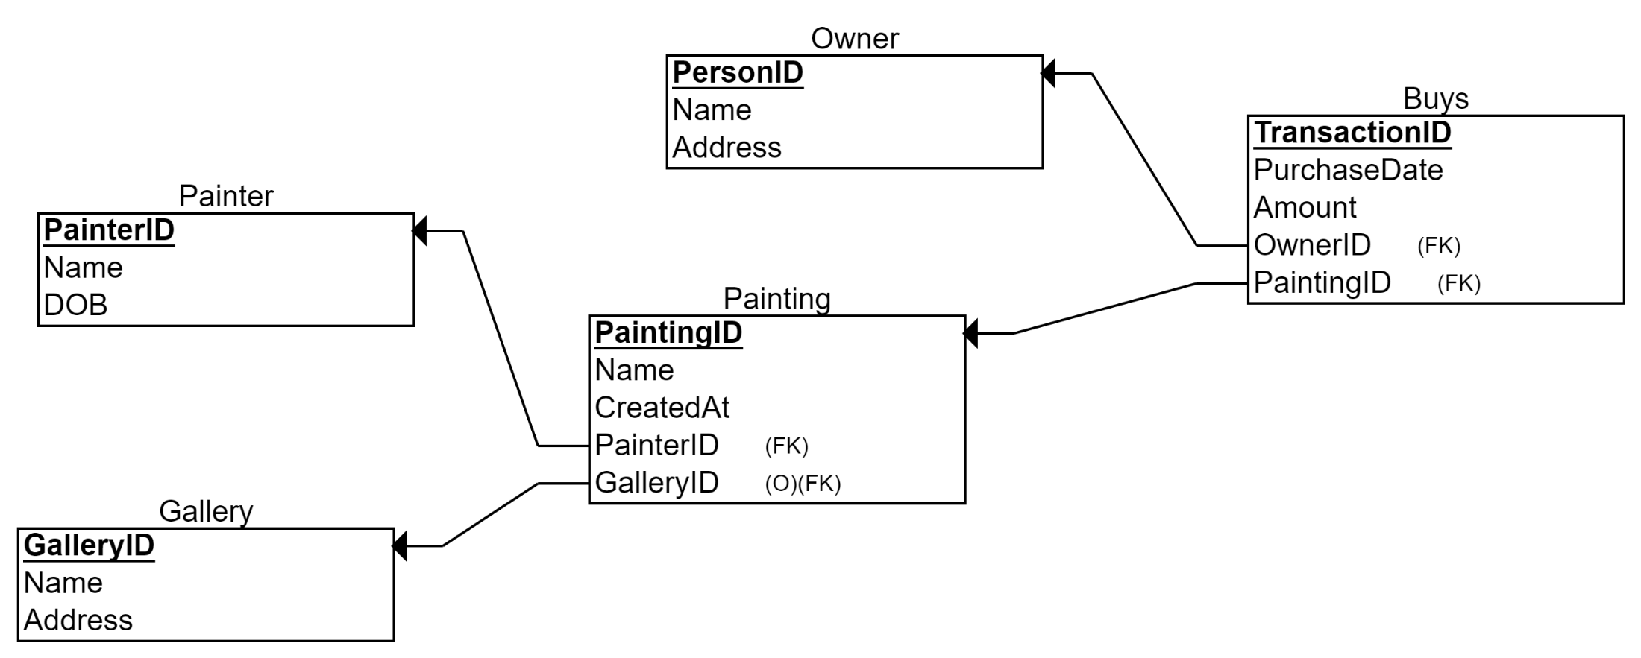
Step 1: Entities
ER Diagram
Relational Schema
Painter
Actual data
PainterID | Name | DOB
P1278 | Frank Stella | May 12, 1936
P982 | Cecilia Vicuña | July 22, 1948
P1908 | George Condo | Dec 10, 1957
… | … | …
We do this mapping for all our entities in the ER Diagram, creating one table per entity

Slide 15
Step 2: Converting relationships into a relational schema: One to many relationships
For each One-to-Many relationship
Add a foreign key (FK) to the table corresponding to the “many” entity
A foreign key is an attribute that can only take values that appear as primary keys in the referenced table
When participation is mandatory, we do not allow the foreign key to be empty

Slide 16
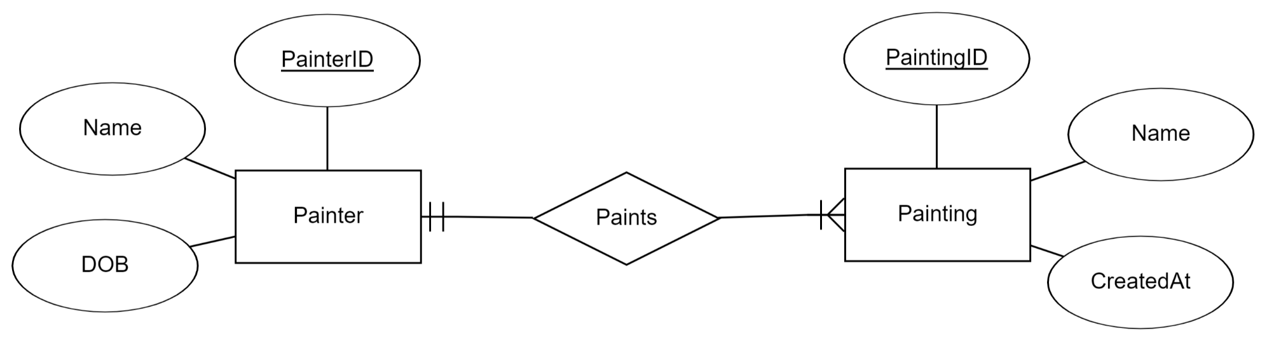
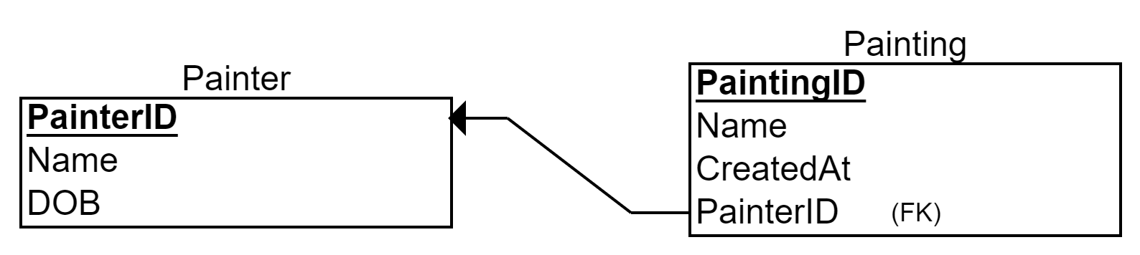
Step 2: Example
ER Diagram
Foreign Key
Relational Schema

Slide 17
Step 3: One to one Relationships
We treat One-to-One relationship similarly as we treat One-to-Many relationship
Option 1: Add a Foreign Key to either of the two tables
Option 2: Merge the two tables (sometimes ok, sometimes bad style)

Slide 18
Step 4: Many to many relationships
Need to introduce bridge table (Each Many-to-Many relationship becomes a separate table)
Often, the primary key of the bridge table is the combination of the primary keys of the entity types participating in the relationship
Each of the connected entities is represented by its primary key, stored in the bridge table as a foreign key, pointing to the original entity table

Slide 19

Step 4: Owner-Buys-Painting

Slide 20
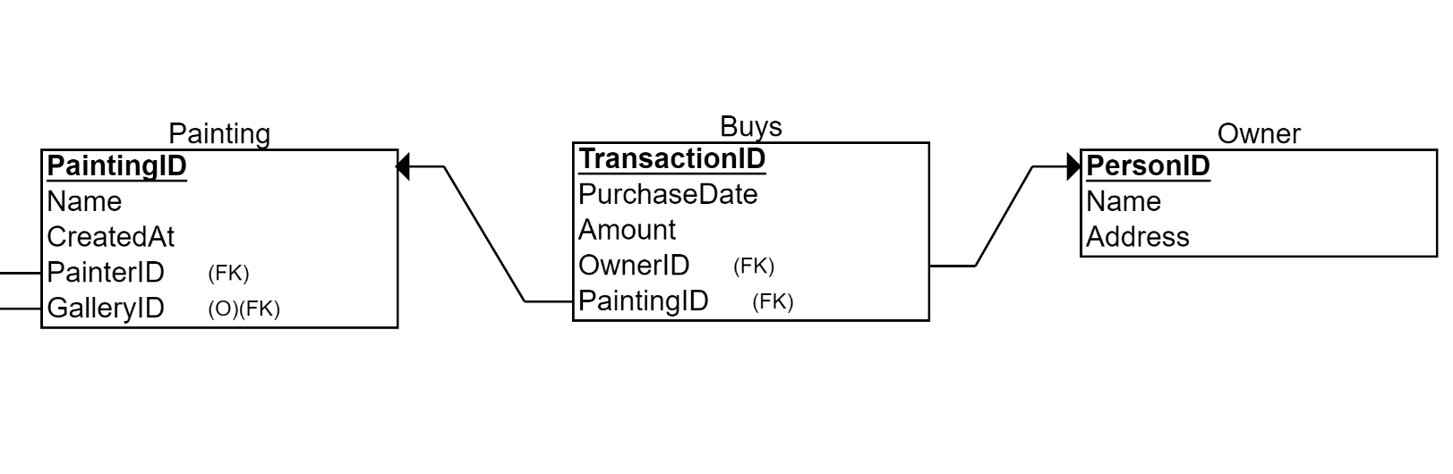
Step 4: Example
Bridge Table
TransactionId | PaintingID | OwnerID | Amount | PurchaseDate
T1510 | P1 | R1 | $1.13M | Feb 13, 2014
PaintingID | Name | CreatedAt | …
P1 | Mickey | 2012
PersonID | Name | Address
R1 | Elon Musk | 1355 Market St

Slide 21
Relational Schema

Slide 22
Final Results
Painter (PainterID, Name, DOB)
Gallery (GalleryID, Name, Address)
Owner (PersonID, Name, Address)
Painting (PaintingID, Name, CreatedAt, PainterID, GalleryID)
Buys (TransactionID, PurchaseDate, Amount, OwnerID, PaintingID)

Slide 23
When using ERD Plus
Ensure that in your ER diagram all entities have attributes and primary keys
Ensure that all relationships are fully specified in terms of cardinalities (min and max, both sides)
From main menu, select the ER diagram and “Convert to Relational Schema”
Check that everything looks ok in terms of attributes, primary and foreign keys.
Change the data type for each attribute

Slide 24
Summary of ER modeling
ER model is popular for conceptual design
Constructs are expressive, intuitive and graphical.
Basic constructs: entity types, relationships (cardinalities), and attributes
ER modeling is subjective!
There are often many ways to model a given scenario!
Analyzing alternatives is key
ER modeling is iterative!
Resulting diagram should be analyzed and refined further.

Slide 25
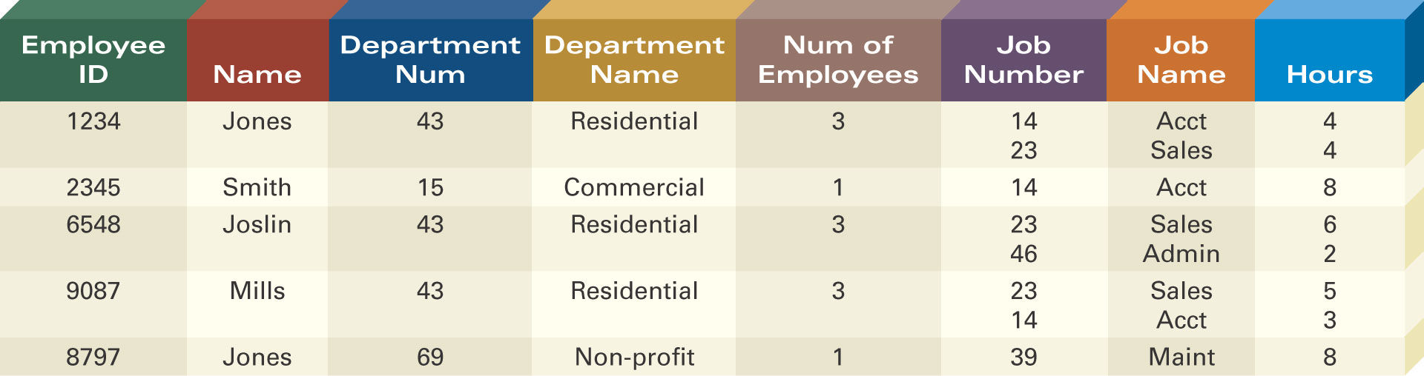
Defining Entity Classes and Primary Keys
What are the entity classes and primary keys for the report below?
What entities/tables should we create?
Are there fields that are redundant once you create the tables?

