Slide 1
SQL: Joins
A SQL join clause combines records from two or more tables in a database. (Wikipedia)

Slide 2
SQL Joins – Learning Objectives
By the end of this session, you will be able to:
Explain the purpose of SQL joins and when needed.
Write queries using:
Inner joins
Outer joins (left, right, full)
Self joins
Joins with composite keys
Apply semi-joins and anti-joins to filter data.
Interpret query results and troubleshoot incorrect joins.

Slide 3
SQL Joins – Roadmap
We’ll learn how to combine information from multiple tables using different join types:
Inner Join
Keep only matching rows across tables
Outer Join
Left / Right / Full joins
Keep unmatched rows too
Self Join
Join a table with itself (e.g., flight connections)
Composite Key Joins
When more than one column defines the relationship
Semi-Join & Anti-Join
Filter existence or absence of matches

Slide 4
The need for joins: Currently awkward queries
Task: Find the genres of the movies directed by Steven Spielberg.
Current approach: Use the table directors to find the director ID for Steven Spielberg. Then use the directors_genres and find all genres for the director ID that corresponds to Steven Spielberg.

Slide 5
Inner Join
Student_Class
Class
student_id | class_id | Grade
1 | 1 | 19
2 | 1 | 16
3 | 1 | 20
2 | 2 | 18
1 | 3 | 19
1 | 4 | 14
class_id | Class
1 | Algebra
2 | Analysis
3 | Physics
4 | History
Question: Find the
class name for all the
classes that each student is taking (instead of just showing the class id).
SELECT student_id, class
FROM Student_Class INNER JOIN Class
ON Student_Class.class_id = Class.class_id

Slide 6
Inner Join
Student_Class
Class
student_id | class_id | Grade
1 | 1 | 19
2 | 1 | 16
3 | 1 | 20
2 | 2 | 18
1 | 3 | 19
1 | 4 | 14
class_id | Class
1 | Algebra
2 | Analysis
3 | Physics
4 | History
Question: Find the
class name for all the
classes that each student is taking (instead of just showing the class id).
SELECT student_id, class
FROM Student_Class S INNER JOIN Class C
ON S.class_id = C.class_id

Slide 7
Output of inner join
Inner Join
on
class_id
student_id | class_id | Grade
1 | 1 | 19
2 | 1 | 16
3 | 1 | 20
2 | 2 | 18
1 | 3 | 19
1 | 4 | 14
class_id | Class
1 | Algebra
2 | Analysis
3 | Physics
4 | History
student_id | Class
1 | Algebra
2 | Algebra
3 | Algebra
2 | Analysis
1 | Physics
1 | History

Slide 8
Simple Inner Joins Practice Queries: IMDB
List all the movies and their genres
List all the movies and their directors
List all the movies directed by Steven Spielberg

Slide 9
Expanded Practice: Inner joins Practice Queries
List all the movies from year 2000
List all the movies from year 2000 and their genres
List all the Drama movies from year 2000
List all the Drama movies from year 2000 with ratings
List the top-50 Drama movies from year 2000, based on the ratings
List all the movies where there is an actor with the role ‘James Bond’
List the actors who played ‘James Bond’
List the actors who played ‘James Bond’ and the name of the movie
Rank the result by (a) rating, and (b) year
List all the movies where Brad Pitt is playing
Exclude the movies where he plays “himself”
Rank the result by (a) movie rating, and (b) year

Slide 10
Expanded Practice: Inner Joins on Facebook DB
List all the Single students
List all the Single students who live in Palladium (as declared in the “Residence” attribute).
Allow for flexible matching of the “Residence” as people list Palladium in different manner (e.g “Palladium 101” vs “Palladium”)
List all the Single students LookingFor “random play”.
List their AIM and their gender in the results.
List all the students who have “The Killers” as favorite Music
List all the Finance students who like the book “1984”

Slide 11
Inner Joins with Composite Keys
When an entity has a composite key, then the join condition should include all attributes of the composite primary key
For example, show the album for each track in the music database
The album has a composite key (artist_id, album_id)
The attribute album_id alone is not a primary key
If you join just on album_id, the result is incorrect (why?)

Slide 12
Outer Join
Student_Class
Class
student_id | class_id | Grade
1 | 1 | 19
2 | 1 | 16
3 | 1 | 20
2 | 2 | 18
1 | 3 | 19
1 | 4 | 14
Question: For every class, list the students enrolled in the class.
Note: No class with class_id=5 exists in the Student_has_class table
class_id | Class
1 | Algebra
2 | Analysis
3 | Physics
4 | History
5 | Calculus
SELECT student_id, class
FROM Class c LEFT OUTER JOIN Student_Class s ON c.class_id = s.class_id
Refers to the table on the “left” side of the join: Class

Slide 13
Outer Join
student_id | class_id | Grade
1 | 1 | 19
2 | 1 | 16
3 | 1 | 20
2 | 2 | 18
1 | 3 | 19
1 | 4 | 14
class_id | Class
1 | Algebra
2 | Analysis
3 | Physics
4 | History
5 | Calculus
Left outer Join
on
class_id
Class | student_id
Algebra | 1
Algebra | 2
Algebra | 3
Analysis | 2
Physics | 1
History | 1
Calculus | NULL
A left outer join returns all the values that an inner join returns, plus all values in the "left" table that do not match any entry to the right table.

Slide 14
Outer Joins Practice Queries
Important: Understand why we need an outer joins here
List all the movies and their genres; show null if they do not have a genre
List all the students and their Concentration; show null if they have not listed a concentration

Slide 15
Self Joins
List the movies in the database that have both drama and comedy listed among their genres
List the Profile IDs and for students majoring in computer science and another concentration (Concentration table); show the second concentration as well
In the Flights database, use the m_ticket_prices table:
Create a list of all the possible flights with one stop, with a start in JFK and end in LAX. For each such origin-stop-dest triplet, calculate the total price of the ticket and the total mileage by summing the fare and mileage of each component.
Ensure that the origin and destination are different and that the same carrier operates the two flights.

Slide 16
SemiJoins and AntiJoins
Often, we use joins to compare entries across two tables with no intention of showing information from both tables.
Semijoin:
(Inner) Join tables A and B
Show only matching rows from A
Antijoin:
(Outer) Join tables A and B
Show non-matching rows from A

Slide 17
Practice SemiJoins and AntiJoins
Facebook database, using the Profiles and Concentration tables:
Inner join: List the profileID, the name of the student, and their concentration(s)
(Left) Semi-join: List the profileID, the name of the student, for students that have listed "Finance" as their concentration
Left join: List the profileID, the name of the student, and their concentration(s), including all students that have not listed a concentration
(Left) Anti-join: List the profileID and the name of the student, for all students that have not listed a concentration

Slide 18
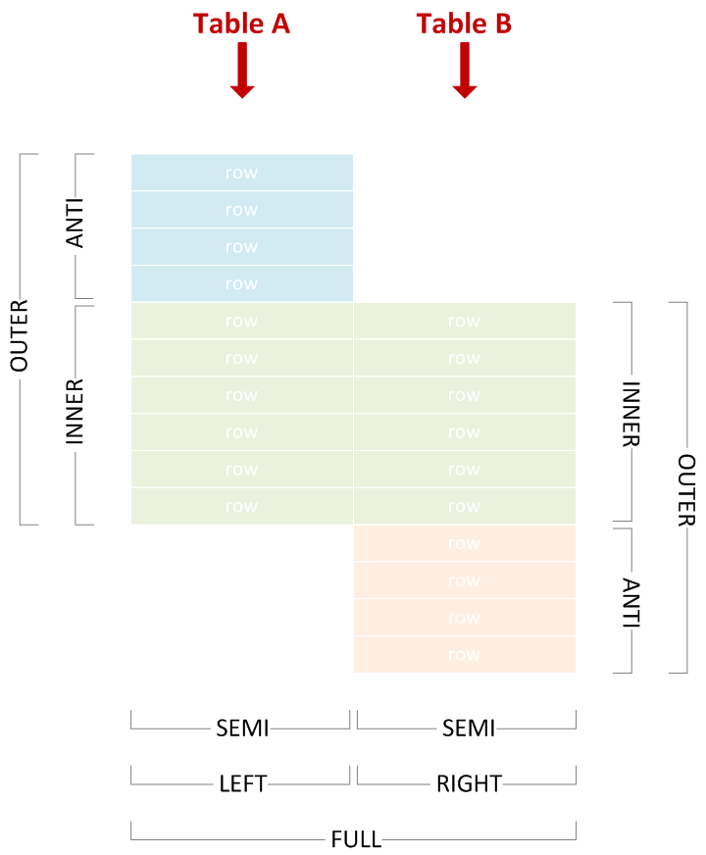
https://bit.ly/joins_explained

