Slide 1
Window Queries

Slide 2
Aggregation vs window functions
In groupby-aggregation functions, have as input a group of rows, and we get back one value per group (e.g., count rows in group, avg value of an attribute, etc)
With window functions, we calculate functions over a group of rows (we call this a “window”), but we return a value for each row that belongs to the window.

Slide 3
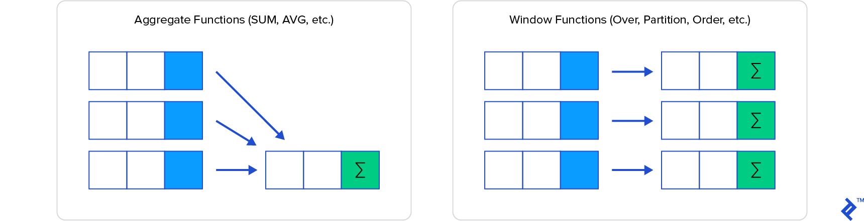
Aggregation vs window functions
In groupby-aggregation functions, have as input a group of rows, and we get back one value per group (e.g., count rows in group, avg value of an attribute, etc)
With window functions, we calculate functions over a group of rows (we call this a “window”), but we return a value for each row that belongs to the window.

Slide 4
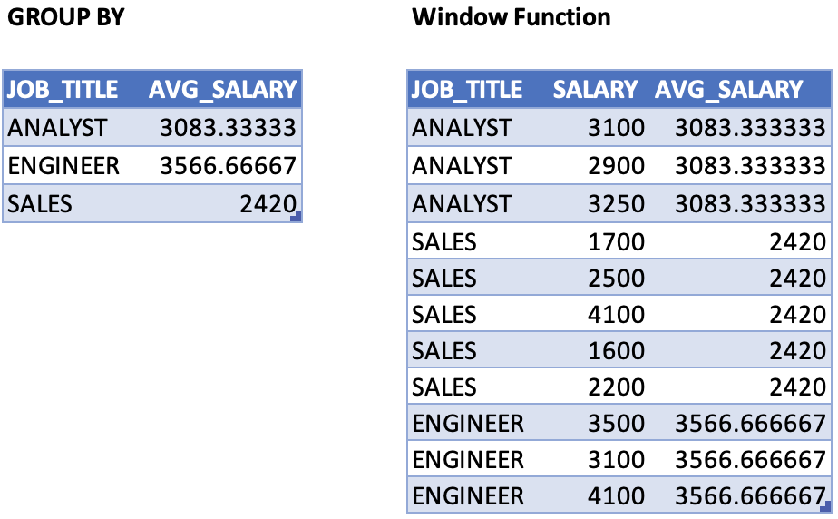
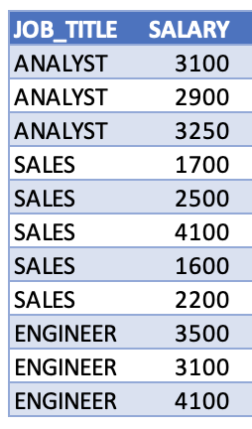
Example: GROUP BY versus Window Function
SELECT JOB_TITLE, AVG(SALARY)
FROM Table
GROUP BY JOB_TITLE
SELECT *, AVG(SALARY) OVER(PARTITION BY JOB_TITLE)
FROM Table
Do not worry about the query syntax yet, we will study this soon

Slide 5
Window Functions
Ranking
RANK()
ROW_NUMBER()
DENSE_RANK()
PERCENT_RANK()
NTILE(n)
Value
LAG()
LEAD()
FIRST_VALUE()
LAST_VALUE()
NTH_VALUE()
Aggregate
AVG()
SUM()
COUNT()
MIN()
MAX()
STDDEV()

Slide 6
Window Functions: Ranking
Ranking
RANK()
ROW_NUMBER()
DENSE_RANK()
PERCENT_RANK()
NTILE(n)
Value
LAG()
LEAD()
FIRST_VALUE()
LAST_VALUE()
NTH_VALUE()
Aggregate
AVG()
SUM()
COUNT()
MIN()
MAX()
STDDEV()

Slide 7
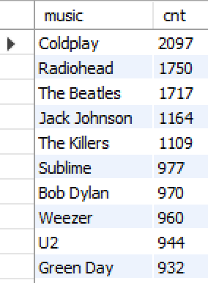
Simple Example: RANK()
Setup
Create a (temporary) table with the most popular music on Facebook:
CREATE TEMPORARY TABLE popular_music AS
SELECT Music AS music, COUNT(ProfileID) AS cnt
FROM FavoriteMusic
GROUP BY Music
ORDER BY cnt DESC;

Slide 8
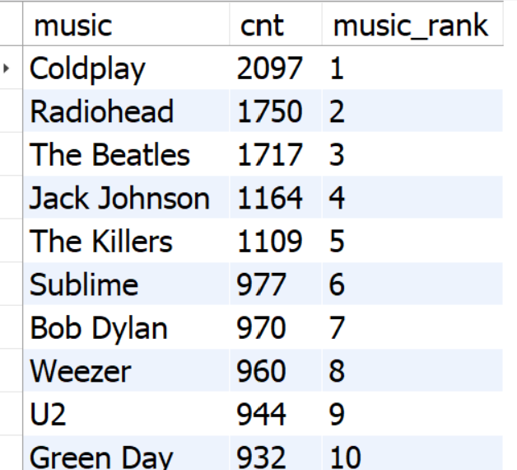
Simple Example: RANK()
Using the popular_music table, calculate the rank of each music, which is rank 1 for the most popular, rank 2 for next most popular, etc.
SELECT music, cnt,
RANK() OVER (ORDER BY cnt DESC) AS music_rank FROM popular_music;
RANK(): the function applied to each row in the window
OVER (ORDER BY cnt DESC): the window (in this case, the whole table, ordered by descending counts)

Slide 9
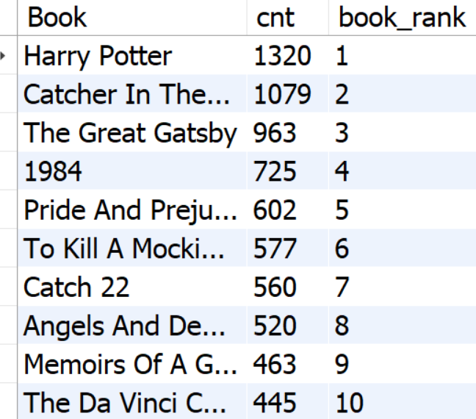
Let’s practice RANK
Create a popular_books table on Facebook, and then calculate the rank of each book, with rank 1 for the most popular, rank 2 for next most popular, etc.

Slide 10
OVER (PARTITION BY …)
So far, our “OVER()” clauses only included an ORDER BY clause and operated on the full table.
The OVER(PARTITION BY …) clause allows us to apply the functions within groups (i.e., “partitions”)

Slide 11
Partitioning Example: RANK()
Create a (temporary) table with the most popular music on Facebook:
CREATE TEMPORARY TABLE popular_music_and_gender AS
SELECT M.Music, P.Sex, COUNT(P.ProfileID) AS cnt
FROM FavoriteMusic M JOIN Profiles P ON P.ProfileID = M.ProfileID
WHERE P.Sex IS NOT NULL
GROUP BY M.Music, P.Sex
ORDER BY cnt DESC;
SELECT Music, Sex,
RANK()
OVER (PARTITION BY Sex ORDER BY cnt DESC) AS music_rank
FROM popular_music_and_gender;
RANK(): the function applied to each row in the window
OVER (PARTITION BY Sex ORDER BY cnt DESC): the window (in this case, music counts grouped by “Sex”, ordered by descending counts)

Slide 12
Partitioning Example: RANK()
Create a (temporary) table with the most popular music on Facebook:
CREATE TEMPORARY TABLE popular_music_and_gender AS
SELECT M.Music, P.Sex, COUNT(P.ProfileID) AS cnt
FROM FavoriteMusic M JOIN Profiles P ON P.ProfileID = M.ProfileID
WHERE P.Sex IS NOT NULL
GROUP BY M.Music, P.Sex
ORDER BY cnt DESC;
SELECT Music, Sex,
RANK()
OVER (PARTITION BY Sex ORDER BY cnt DESC) AS music_rank
FROM popular_music_and_gender;
RANK(): the function applied to each row in the window
OVER (PARTITION BY Sex ORDER BY cnt DESC): the window (in this case, music counts grouped by “Sex”, ordered by descending counts)

Slide 13
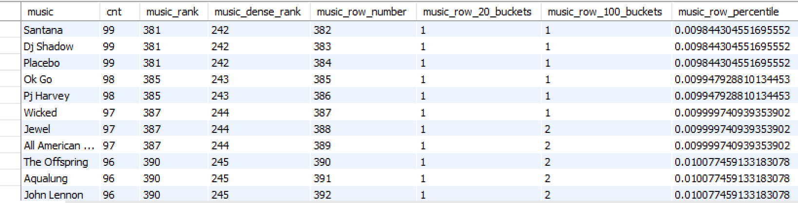
Other ranking functions
ROW_NUMBER(): Order of the row in results, no ties (1,2,3,4…)
RANK(): Ties have same rank, gap in rank after a tie (1,2,2,4,…)
DENSE_RANK(): Ties have same rank, no gap after a tie (1,2,2,3,…)
NTILE(n): Create n ranked buckets and assign each value to a bucket
PERCENT_RANK(): Percentile score, a normalized value from 0 to 1, with 0 to the highest ranked element, 1 to the lowest rank.
SELECT music, cnt
, RANK() OVER (ORDER BY cnt DESC) AS music_rank
, DENSE_RANK() OVER (ORDER BY cnt DESC) AS music_dense_rank
, ROW_NUMBER() OVER (ORDER BY cnt DESC) AS music_row_number
, NTILE(20) OVER (ORDER BY cnt DESC) AS music_row_20_buckets
, NTILE(100) OVER (ORDER BY cnt DESC) AS music_row_100_buckets
, PERCENT_RANK() OVER (ORDER BY cnt DESC) AS music_row_percentile
FROM popular_music;

Slide 14
WINDOW clause: Named Windows (optional)
Sometimes, we may want to define a window once and use it multiple tines.
To do this, we use a WINDOW clause.
The WINDOW clause falls between the positions of the HAVING and ORDER BY clauses.
Consider this query, which defines the same window multiple times:
SELECT music, cnt
, RANK() OVER w AS music_rank
, DENSE_RANK() OVER w AS music_dense_rank
, ROW_NUMBER() OVER w AS music_row_number
, NTILE(20) OVER w AS music_row_20_buckets
, NTILE(100) OVER w AS music_row_100_buckets
, PERCENT_RANK() OVER w2 AS music_row_percentile
FROM popular_music
WINDOW w AS (ORDER BY cnt DESC)
, w2 AS (ORDER BY cnt)

Slide 15
Practice query
In the IMDb database, the following query calculates statistics for all actors that played in more than 10 rated movies.
CREATE TEMPORARY TABLE actor_stats AS
SELECT A.*
, ROUND(AVG(M.rating),2) AS avg_rating
, COUNT(*) AS num_roles
, COUNT(M.rating) AS rated_movies
FROM actors A
JOIN roles R ON A.id = R.actor_id
JOIN movies M ON M.id = R.movie_id
GROUP BY A.id
HAVING rated_movies >= 10
Write a query that calculates the rank of each actor, across the three metrics (avg_rating, num_roles, rated_movies), creating three new attributes:
rating_rank
roles_rank
ratedmovies_rank
Next, separate the statistics by gender

Slide 16
Window Functions: Value / Offset
Ranking
RANK()
ROW_NUMBER()
DENSE_RANK()
PERCENT_RANK()
NTILE(n)
Value
LAG()
LEAD()
FIRST_VALUE()
LAST_VALUE()
NTH_VALUE()
Aggregate
AVG()
SUM()
COUNT()
MIN()
MAX()
STDDEV()

Slide 17
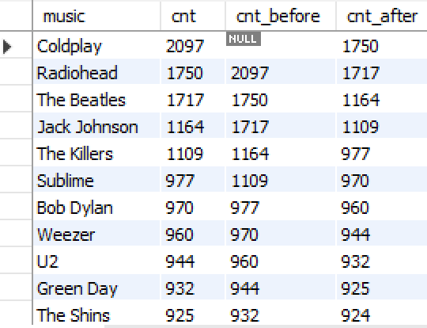
Value / offset functions
LAG(attr): The value of attr from the row before the current one
LEAD(attr): The value of attr from the row after the current one
SELECT music
, cnt
, LAG(cnt) OVER (ORDER BY cnt DESC) AS cnt_before
, LEAD(cnt) OVER (ORDER BY cnt DESC) AS cnt_after
FROM popular_music
LAG(cnt)
LEAD(cnt)

Slide 18
Practice query
In the collisions database, the following query calculates the number of traffic accidents in NYC, on a daily basis:
CREATE TEMPORARY TABLE daily_accidents AS
SELECT DATE(DATE_TIME) AS accident_date, COUNT(*) AS cnt
FROM collisions.collisions
GROUP BY DATE(DATE_TIME)
ORDER BY DATE(DATE_TIME);
Write a query that uses the “daily_accidents” temporary table: For each day, list not only the number of accidents on the day, but also the number of accidents the day before, 7 days before, and 365 days before, creating three new attributes:
cnt_day_before
cnt_week_before
cnt_year_before
(Optional) Calculate the difference of cnt with the variables above
(Optional) Add the same numbers but for next day, week, and year

Slide 19
Practice queries
In imdb database:
Return the top-3 movies from each year.
Return the best actor from each year. Try using the FIRST_VALUE()
In the flights database:
For each airline, list the top airports in terms of passengers and in terms of revenue
For each origin airport, show the top-3 the destinations in terms of total number of passengers (note: you need a subquery to filter based on the outcome of a window query)
Bonus: Use the NTH_VALUE() to arrange the first, second, and third in different columns
In the real_estate database (table nyc_transactions):
For each transaction, find the prior closing date and closing price for the house. Calculate the price difference, the percentage increase, and the average yearly appreciation.
Note 1: The DATEDIFF(date1, date2) function calculates the number of days between two dates.
Note 2: Given the original price p1, new price p2, and years y between the two, the average yearly appreciation is a = ( p2/p1 )^ (1/y) - 1

Slide 20
Average ROI of real estate transactions
WITH transactions AS (
SELECT property_id
, zipcode
, close_date, close_price
, LAG(close_date) OVER w AS prior_sale_date
, LAG(close_price) OVER w AS prior_sale_price
, DATEDIFF(close_date, LAG(close_date) OVER w) / 365 AS years_between_sales
, close_price - LAG(close_price) OVER w AS price_diff
, close_price / LAG(close_price) OVER w AS price_ratio
FROM nyc_transactions
WINDOW w AS (PARTITION BY property_id ORDER BY close_date)
)
SELECT zipcode
, COUNT(*) AS cnt
, AVG( POWER( price_ratio , 1/years_between_sales )- 1 ) AS avg_yearly_ROI
FROM transactions
WHERE years_between_sales>0.5
GROUP BY zipcode
HAVING cnt > 1000
ORDER BY avg_yearly_ROI DESC
;

Slide 21
Aggregate Functions and Windows

Slide 22
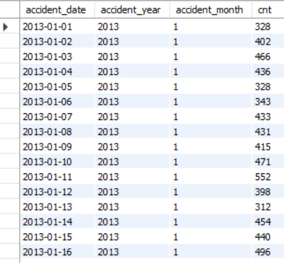
Setup: Daily Accidents in NYC
USE collisions; DROP TABLE IF EXISTS daily_accidents;
CREATE TEMPORARY TABLE daily_accidents AS
SELECT
DATE(DATE_TIME) AS accident_date,
YEAR(DATE_TIME) AS accident_year,
MONTH(DATE_TIME) AS accident_month,
COUNT(*) AS cnt
FROM collisions.collisions
WHERE DATE_TIME >= '2013-01-01’
GROUP BY
accident_date,
accident_year,
accident_month
ORDER BY accident_date;

Slide 23
Aggregate Functions using PARTITION BY: An alternative to GROUP BY queries

Slide 24
Aggregate functions / PARTITION BY
Behave similar to GROUP BY, but without collapsing rows into groups.
Show entries for daily accidents, but also show the total accidents in the year, and the average daily accidents in the year
SELECT *
, SUM(cnt) OVER w AS sum_accidents
, AVG(cnt) OVER w AS avg_accidents
FROM daily_accidents
WINDOW w AS (PARTITION BY accident_year)
SUM(cnt), AVG(cnt): the functions calculated; the total number of accident and the average number of accidents per day within the year
OVER (PARTITION BY accident_year): calculate sum and average across all days in a year

Slide 25
Aggregate functions / PARTITION BY
Augment the previous query to also show the monthly averages and sums
SELECT *
, SUM(cnt) OVER w_y AS sum_accidents_year
, AVG(cnt) OVER w_y AS avg_accidents_year
, SUM(cnt) OVER w_m AS sum_accidents_month
, AVG(cnt) OVER w_m AS avg_accidents_month
FROM daily_accidents
WINDOW
w_y AS (PARTITION BY accident_year) , w_m AS (PARTITION BY accident_year, accident_month)
SUM(cnt), AVG(cnt): the functions calculated; the total number of accident and the average number of accidents per day
w_y AS (PARTITION BY accident) calculate sum and average across all days in a year
w_m AS (PARTITION BY accident_year, accident_month) calculate sum and average for each month

Slide 26
Aggregate functions / PARTITION BY
In the flights database, show the average fare per mile for each flight, and compare it with the average fare per mile overall, the average for the origin airport, the destination airport, and the carrier average:
SELECT *,
AVG(fare_per_mile) OVER () AS overall_avg,
AVG(fare_per_mile) OVER (PARTITION BY origin) AS origin_avg,
AVG(fare_per_mile) OVER (PARTITION BY dest) AS dest_avg,
AVG(fare_per_mile) OVER (PARTITION BY carrier) AS carrier_avg
FROM flights.m_ticket_prices;
AVG(fare_per_mile): the function calculated OVER (): the window (in this case, the avg fare over all entries)
OVER (PARTITION BY origin): calculate average fare across all flights leaving from the origin airport
OVER (PARTITION BY dest): calculate average fare across all flights arriving to the dest airport
OVER (PARTITION BY carrier): calculate average fare across all flights of the carrier in general

Slide 27
Aggregate Functions using ORDER BY: Rolling Aggregates

Slide 28
Aggregate functions / OVER(ORDER BY)
Once we add ORDER BY in the OVER clause, the aggregate calculation becomes a rolling aggregation.
Show entries for daily accidents, but also show the total accidents in the year, and the average daily accidents in the year
SELECT *
, SUM(cnt) OVER w AS sum_accidents
, AVG(cnt) OVER w AS avg_accidents
FROM daily_accidents
WINDOW w AS (PARTITION BY accident_year ORDER BY accident_date)
SUM(cnt), AVG(cnt): the functions calculated; the rolling sum and rolling average of accidents per day, including every row appearing before in the partition
OVER (PARTITION BY accident_year ORDER BY accident_date): calculate rolling sum and averages, up to the current date of the year

Slide 29
Frames for Rolling Windows
Simply using ORDER BY uses every line from the beginning of the partition. We often want to calculate rolling sums and averages over a specific window (e.g. 7 days, a month, a year, etc)
SELECT *
, SUM(cnt) OVER w AS accidents_7day_total
, AVG(cnt) OVER w AS accidents_7day_daily_avg
, COUNT(cnt) OVER w AS days_in_window # just to see window size
FROM daily_accidents
WINDOW w AS (
ORDER BY accident_date
ROWS BETWEEN 6 PRECEDING AND CURRENT ROW)
ROWS BETWEEN 6 PRECEDING AND CURRENT ROW: use the last 6 entries and calculate sum, averages, (and count), including the current current date

Slide 30
ROWS vs RANGE (optional)
Sometimes we do not know the exact number of rows we want to use, but we’d rather define the window based on a range of values (e.g., include all entries that are using ORDER BY uses every line from the beginning of the partition. We often want to calculate rolling sums and averages over a specific window (e.g. 7 days, a month, a year, etc)
SELECT *
, SUM(cnt) OVER w AS accidents_7day_total
, AVG(cnt) OVER w AS accidents_7day_daily_avg
, COUNT(cnt) OVER w AS days_in_window # just to see window size
FROM daily_accidents
WINDOW w AS (
ORDER BY accident_date
RANGE BETWEEN INTERVAL 2 WEEK PRECEDING AND CURRENT ROW)
RANGE BETWEEN INTERVAL 2 WEEK PRECEDING AND CURRENT ROW): use the last 6 entries and calculate sum, averages, (and count), including the current current date

Slide 31
Practice queries
In facebook database:
Calculate the total number of user sign-ups over time (using the MemberSince attribute)
Calculate the weekly number of sign-ups.
Calculate the weekly growth rate over time (= number of weekly sign ups over total number of sign ups)
In the real_estate database (table nyc_transactions):
Calculate the total number of transactions on a “trailing 12 months” basis and the average price_per_square_feet over that window
Break down the results by zipcode

Slide 32
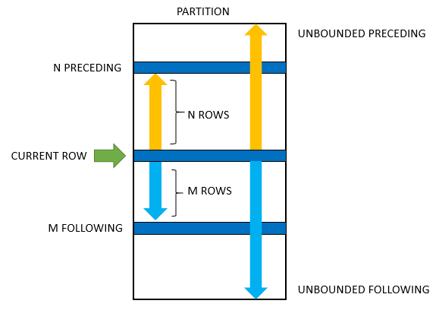
Frame Specification
https://www.sqltutorial.org/sql-window-functions/

Slide 33
Frame Specification
frame_clause:
{ROWS | RANGE} [BETWEEN] frame_start [AND frame_end]
ROWS: The frame is defined by beginning and ending row positions. Offsets are differences in row numbers from the current row number.
RANGE: The frame is defined by rows within a value range. Offsets are differences in row values from the current row value.
frame_start, frame_end: { CURRENT ROW | UNBOUNDED { PRECEDING | FOLLOWING } | expr { PRECEDING | FOLLOWING }
}
Defaults:
With ORDER BY: RANGE BETWEEN UNBOUNDED PRECEDING AND CURRENT ROW
Without ORDER BY: RANGE BETWEEN UNBOUNDED PRECEDING AND UNBOUNDED FOLLOWING
https://dev.mysql.com/doc/refman/8.0/en/window-functions-frames.html

