Slide 1
SQL Selection Queries

Slide 2
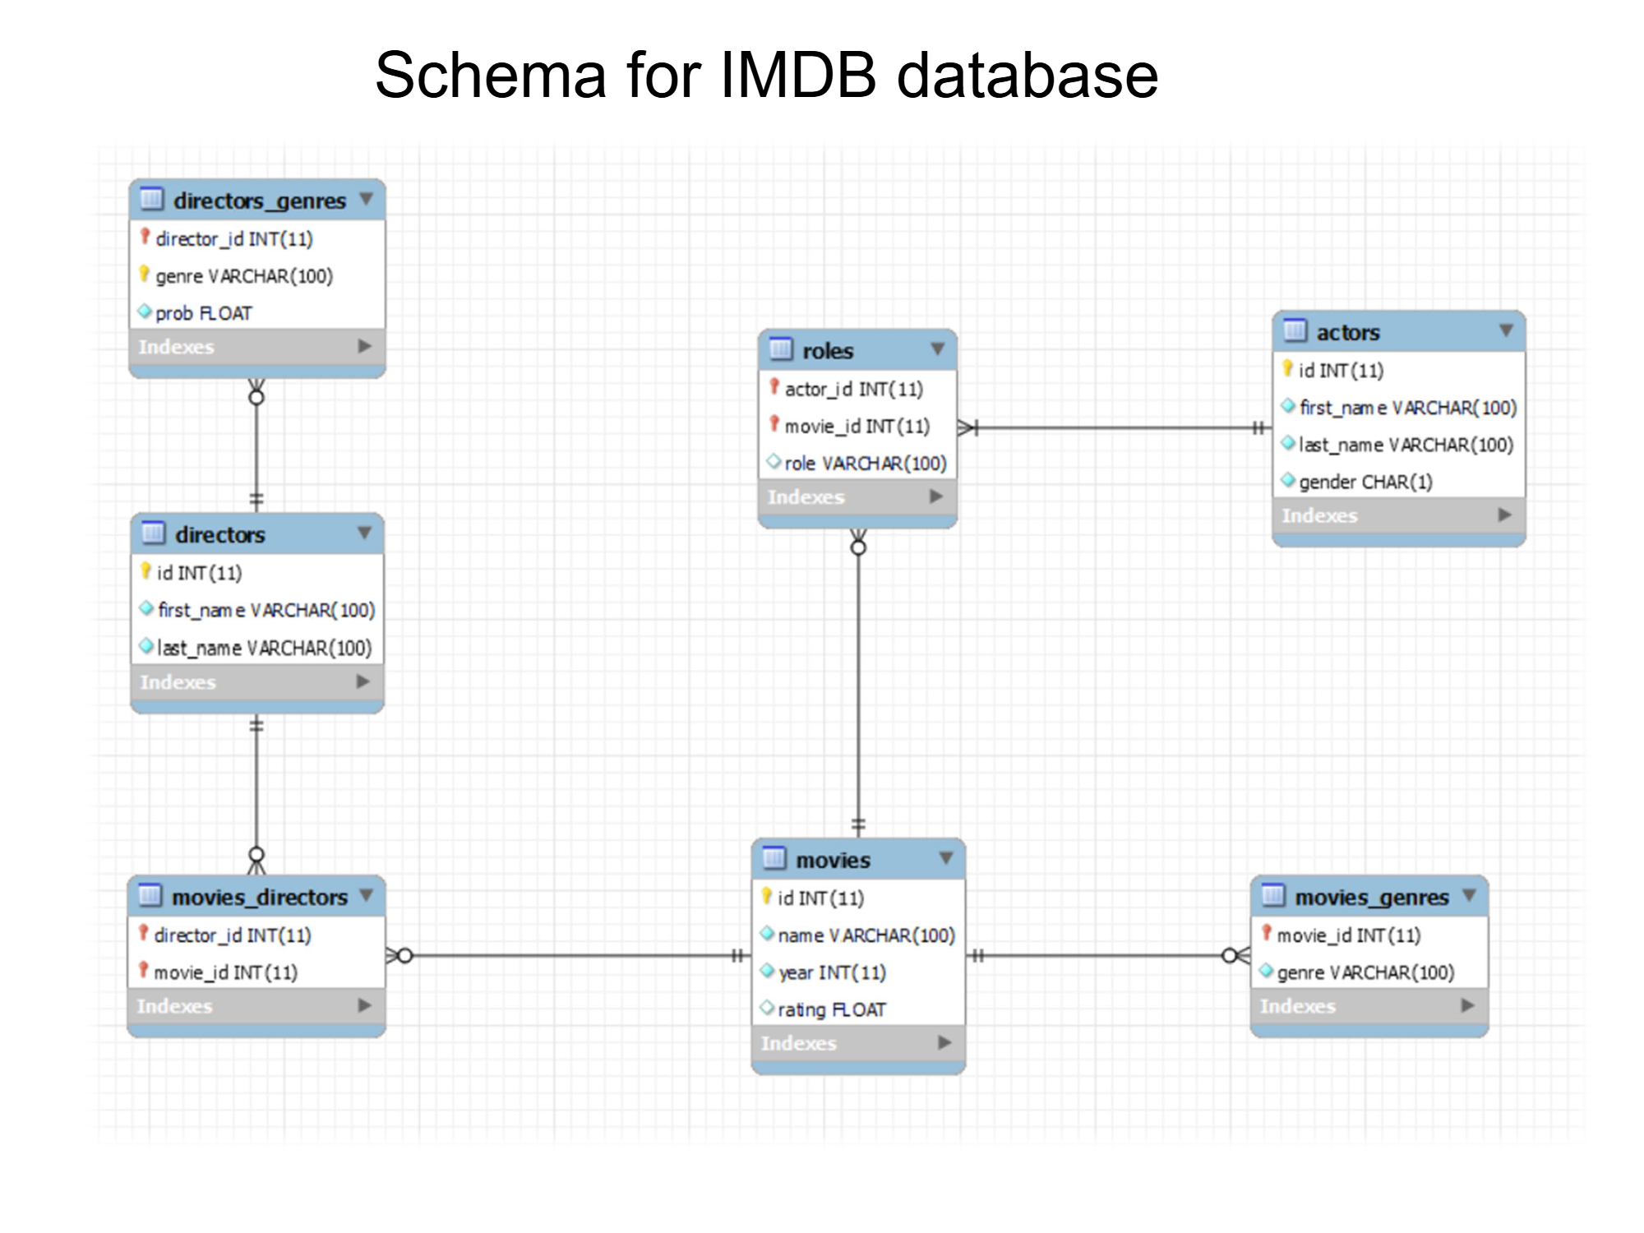
nyu-datasets.imdb

Slide 3
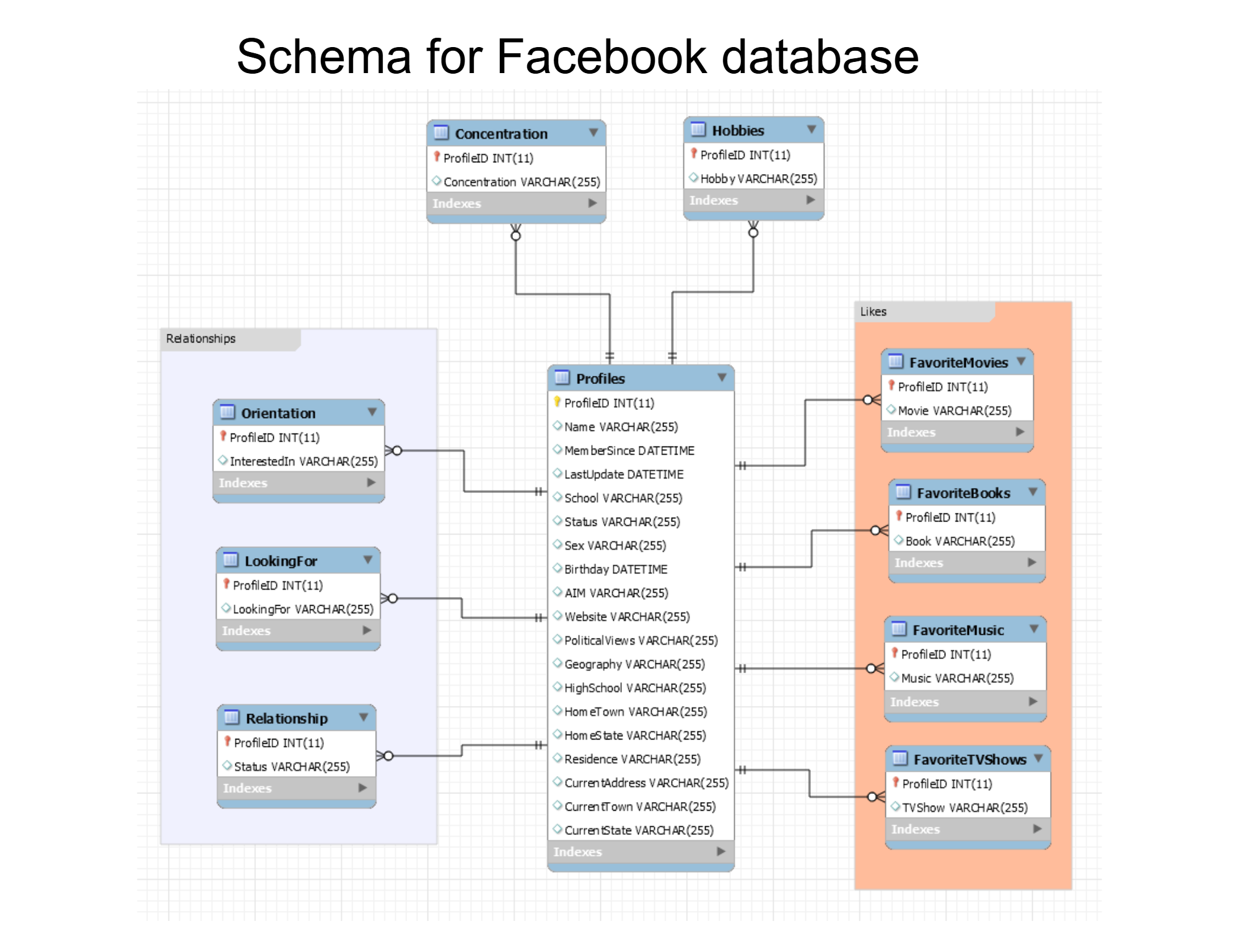
nyu-datasets.facebook

Slide 4
Learning Objectives
By the end of this session, you can:
(a) select columns;
(b) rename outputs;
(c) de-duplicate;
(d) sort and page results.

Slide 5
The SELECT * statement
SELECT *
FROM table_name;

Slide 6
Example: Show all the movies in the IMDB database
SELECT *
FROM nyu-datasets.imdb.movies;

Slide 7
Practice queries
IMDB Database (nyu-datasets.imdb)
Return all movies (nyu-datasets.imdb.movies)
Return all directors (nyu-datasets.imdb.directors)
Return all actors (nyu-datasets.imdb.actors)
Return all roles (nyu-datasets.imdb.roles)
Return all genres for the movies (nyu-datasets.imdb.movie_genres)
Facebook Database (nyu-datasets.facebook)
Return all students
Return the hobbies of all students
Return the relationship status for all students
Return what students are looking for

Slide 8
The SELECT statement
Good pattern: explicitly listing columns.
In general, we do not use “SELECT *” for anything beyond “quick and dirty” queries
SELECT column1, column2, ...
FROM table_name;

Slide 9
Example: Show the first and last names of actors
SELECT first_name, last_name
FROM nyu-datasets.imdb.actors;

Slide 10
Practice queries
IMDB Database
Return the first and last names of actors
Return year and rating for each movie
Facebook Database
Return Name, Sex, and Birthday of all students
Return Sex, and Political Views of all students
Return the Relationship status column

Slide 11
Aliases: The AS clause
Sometimes we want to rename a column to have a more descriptive name in the results. We use the AS clause. Use the aliases to label outputs; avoid spaces in alias names.
SELECT column1 AS name1, column2 AS name2, …
FROM table_name;

Slide 12
Practice queries
IMDB Database
Return id, first, and last names of actors. Rename id to actor_id
Return name, year, and rating for each movie. Rename name to movie_title, and year to release_year.
Facebook Database
Return Sex and Status of all students. Rename Sex to Gender and Status to UniversityStatus

Slide 13
The SELECT DISTINCT statement
Used to eliminate duplicates in the results. (Note: DISTINCT removes duplicate rows across the selected columns, not per column)
SELECT DISTINCT column1, column2, ...
FROM table_name

Slide 14
Practice queries
IMDB Database
Find all the movie genres
Facebook Database
Return the distinct PoliticalViews from the Profiles table
Return the distinct Sex values from the Profiles table
Find what students are “LookingFor”
Find all possible “Relationship” statuses
Find all possible Concentrations

Slide 15
The ORDER BY and LIMIT clause
ORDER BY: Used to sort the result rows based on attribute values
Can order in ascending (ASC, default) or descending (DESC) order
We can list multiple attributes for ordering. We order first using the first attribute, and if there are ties, we order using the second, etc.
The NULLS FIRST/LAST defines if we want empty cells to be first or last
Pro-tip: the “order by” attributes do not need to appear in the results
LIMIT n: Limits the number of rows in the results
OFFSET m: Omit the first m rows of the result, fetch the next n
SELECT column1, column2
FROM table_name
ORDER BY column1 DESC, column2 ASC NULLS LAST
LIMIT 10 OFFSET 0;
Portability notes
• MySQL/Postgres/SQLite: LIMIT n OFFSET m
• SQL Server: ORDER BY … OFFSET m ROWS FETCH NEXT n ROWS ONLY
• Oracle: FETCH FIRST n ROWS ONLY OFFSET m

Slide 16
Practice queries
IMDB Database
Find the top-10 ranked movies
Rank by rating first (descending order)
Break ties using year
Break remaining ties using name
List all the distinct years of the movies, in descending order
Facebook Database
List the first 50 students that joined Facebook at NYU (use the MemberSince attribute)
List the 10 students that have not updated their profiles for the longest time (use the LastUpdate attribute) – what is the problem?

Slide 17
Summary
Prefer explicit columns; avoid SELECT * beyond quick exploration
Label outputs with AS
Use DISTINCT to de‑duplicate rows
ORDER BY for sort; LIMIT/OFFSET for pagination
Practice queries on nyu-datasets.imdb and nyu-datasets.facebook

