Slide 1
Analyzing Thematic Alignment
in Scientific Journals
Using Sentence-BERT · BERTopic · UMAP
İpek İbrahimoğlu
May 2026
Trakya University · Computer Engineering
Erasmus+ Exchange, Università degli Studi di Milano

Slide 2
1 — Introduction
The Problem
Our Approach
Journals define scope via Aims & Scope statements
In practice, published content can drift over time
Detecting this drift is critical for bibliometrics, peer-review routing, and indexing
Keyword-based methods fail — same concepts appear under different vocabulary
Encode Aims & Scope + abstracts into the same vector space using Sentence-BERT
Measure alignment via cosine similarity → one score per paper
Detect thematic drift as a downward trend in annual mean scores
Identify which topics are driving the change using BERTopic

Slide 3
2 — Research Question & Pipeline
Can we quantitatively detect thematic drift in a scientific journal by measuring the semantic alignment between its published papers and its Aims & Scope?
1. Data
Collection
2. Encoding
3. Alignment
Scoring
4. Topic
Modeling
5. Analysis
arXiv API
cs.CL · 2015–2026
1,918 abstracts
Sentence-BERT
all-MiniLM-L6-v2
384-dim vectors
Cosine similarity
vs Aims & Scope
vector
BERTopic
UMAP + HDBSCAN
+ TF-IDF
Drift detection
Outlier flagging
Model comparison

Slide 4
3 — Methodology
Sentence-BERT
all-MiniLM-L6-v2
Transformer-based encoder trained with siamese network architecture. Maps sentences into a shared semantic vector space where cosine similarity reflects meaning similarity.
6-layer distilled model, 384-dimensional output. Fast and optimized for semantic similarity tasks. Validated against all-mpnet-base-v2 and allenai-specter.
BERTopic
Alignment Score
Unsupervised topic modeling: UMAP compresses vectors → HDBSCAN finds clusters → class-based TF-IDF generates labels. No pre-specified topic count.
A(pᵢ) = cosine_similarity(abstract_embedding, scope_vector)
Outlier threshold: bottom 5th percentile (score < 0.1435)

Slide 5
4 — Dataset & Key Statistics
1,918
0.282
96
−22%
Papers collected
(2015–2026)
Mean alignment
score
Outlier papers
(bottom 5%)
Drift from 2016
to 2026
Source: arXiv API — cs.CL category, 150–193 papers per year
Reference: Computational Linguistics journal Aims & Scope (fixed snapshot)
Score range: −0.004 to 0.566 · Std dev: 0.084
Outlier threshold: 0.1435 (5th percentile of distribution)

Slide 6
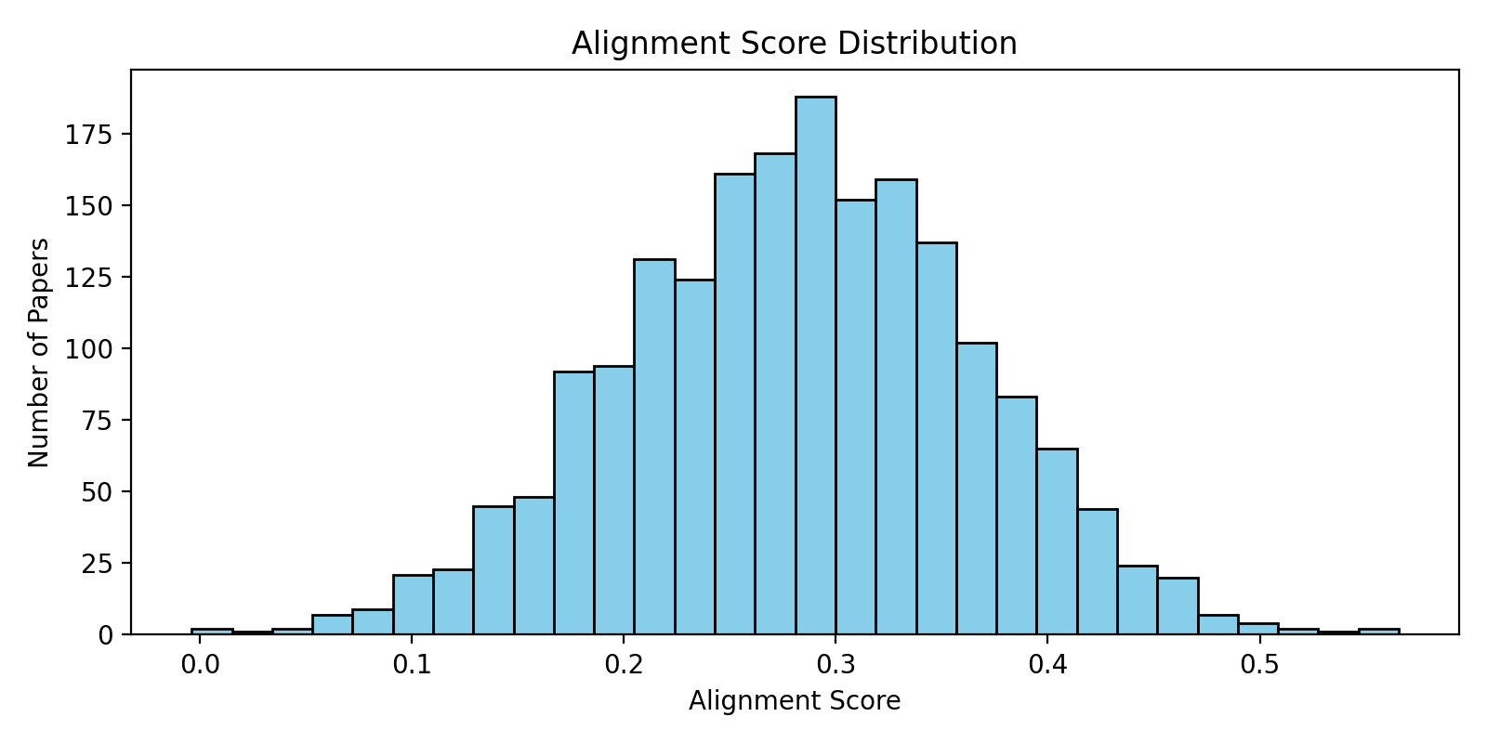
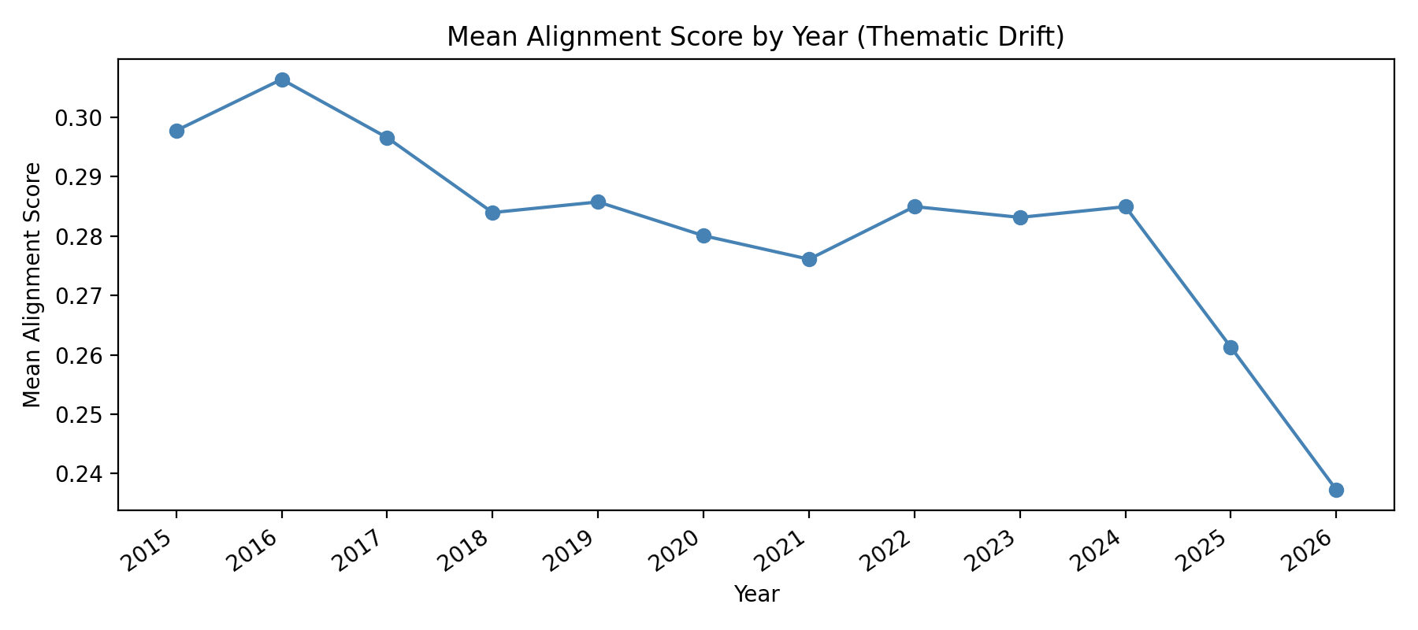
5 — Alignment Score Distribution
Fig 1: Global score distribution
Fig 2: Yearly mean alignment score
Unimodal distribution centered at 0.282 — no clean split between aligned/misaligned papers. Alignment peaked in 2016 (0.306) and declined steadily to 0.237 by 2026 — a 22% drop.

Slide 7
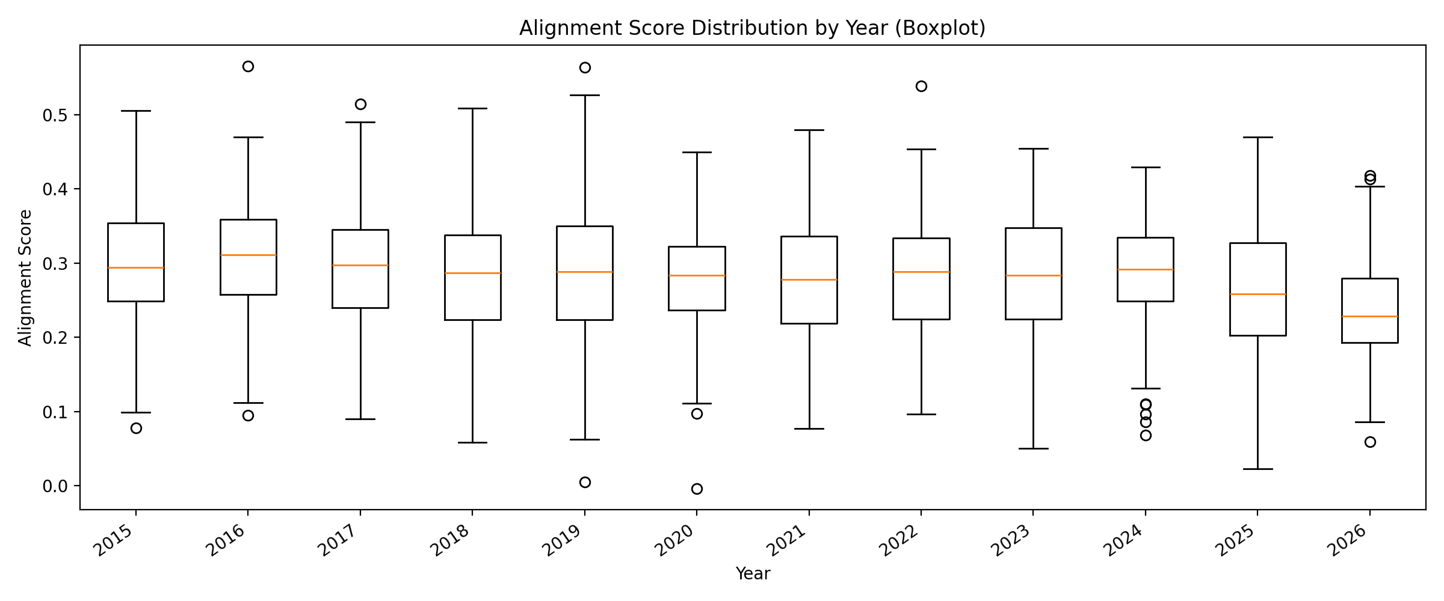
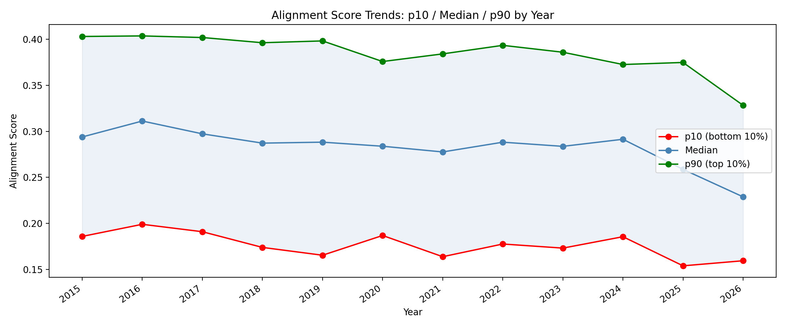
6 — Thematic Drift Over Time
Fig 3: Score distribution by year
Fig 4: p10 / median / p90 trends
Decline is consistent across the full distribution — not just extreme outliers
Increasing variance in 2025–2026 reflects growing heterogeneity of cs.CL category

Slide 8
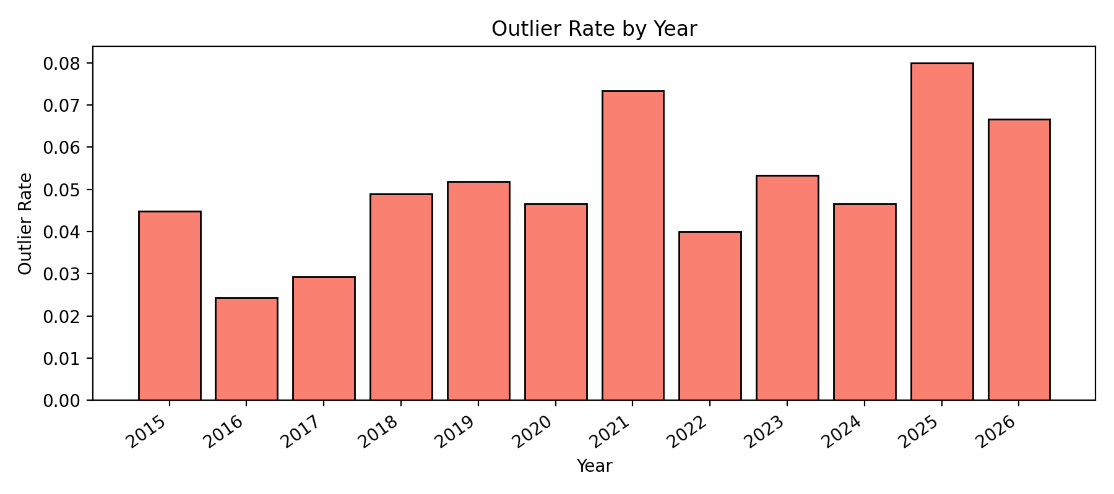
7 — Outlier Analysis
Most misaligned papers (qualitative validation):
Measuring University Impact:
Wikipedia approach
score: −0.004
Jointly optimal dereverberation
and beamforming
score: 0.005
FLowHigh: Audio
Super-Resolution
score: 0.023
Fig 5: Outlier rate by year
Spikes in 2021 (7.3%) and 2025 (8.0%) — consistent with LLM-driven category expansion

Slide 9
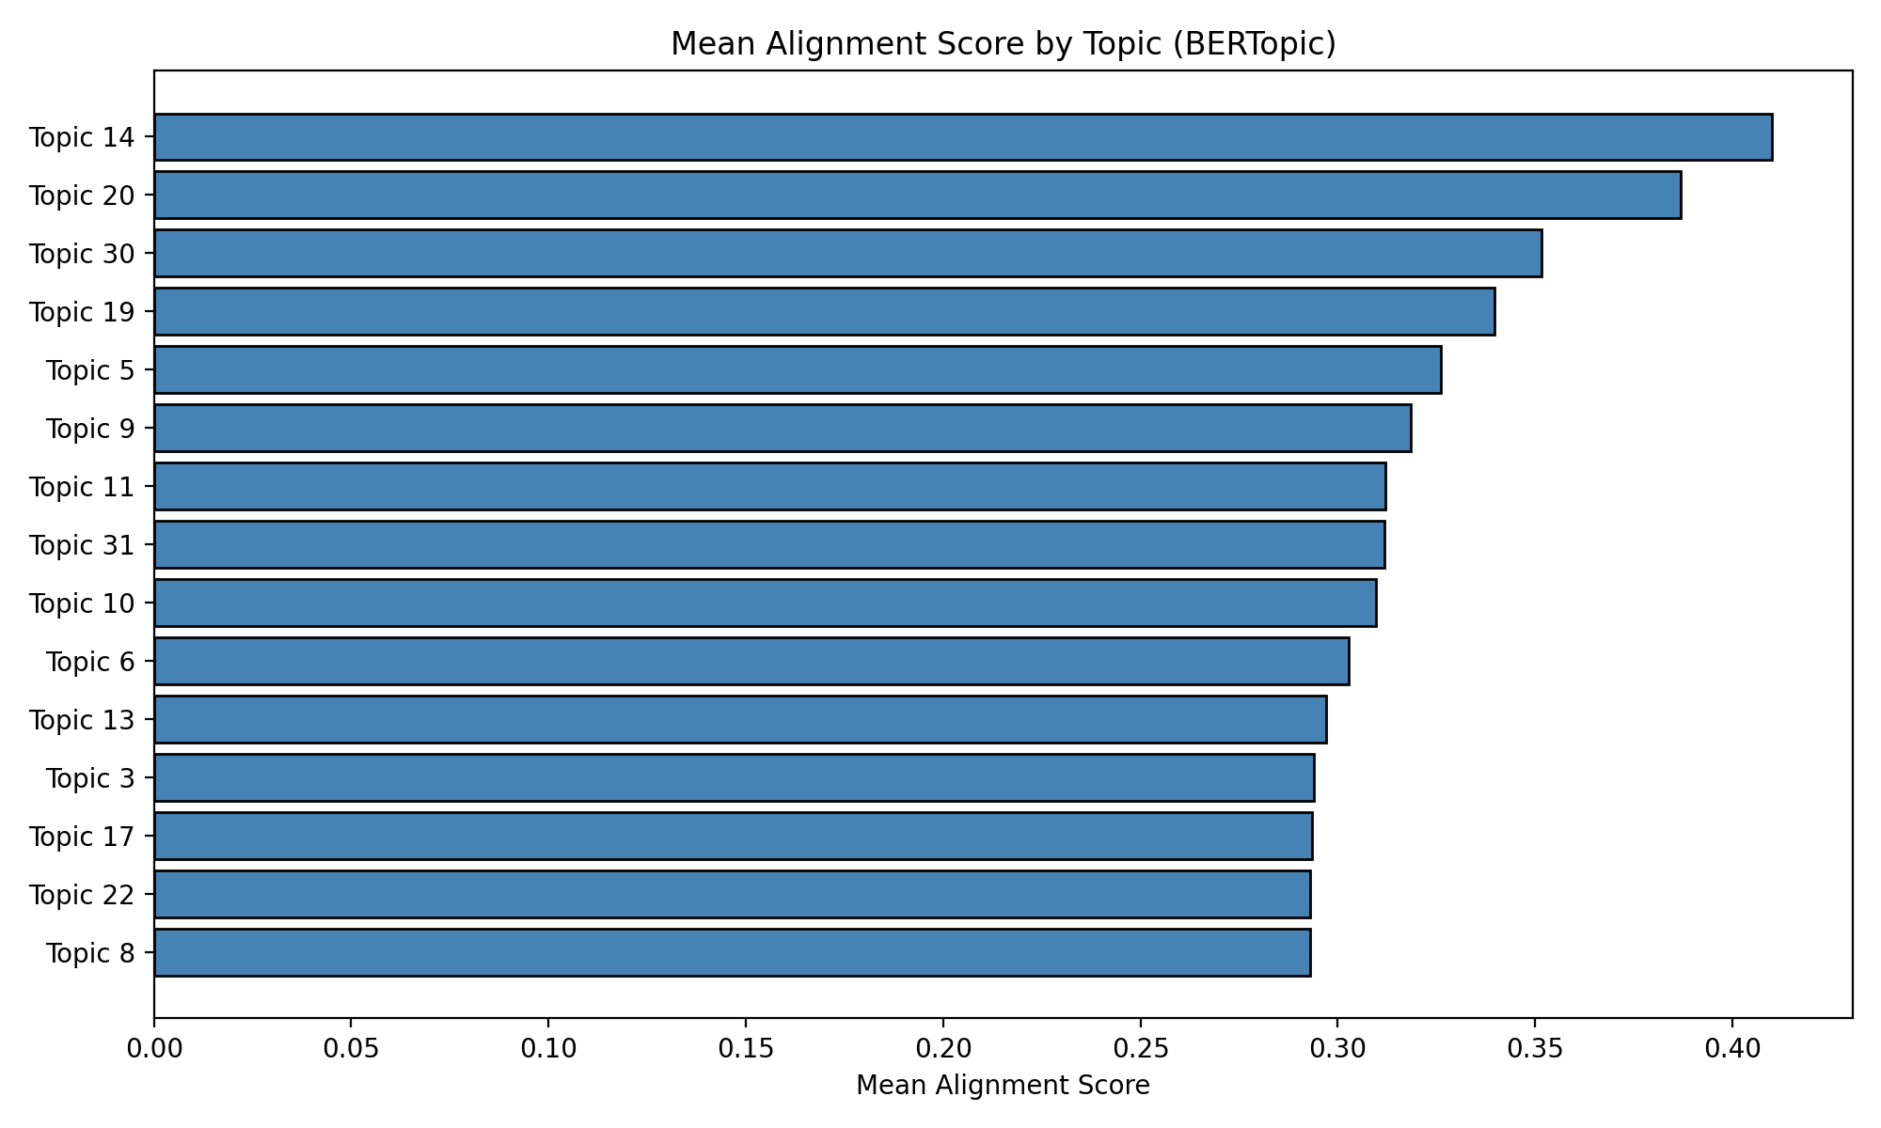
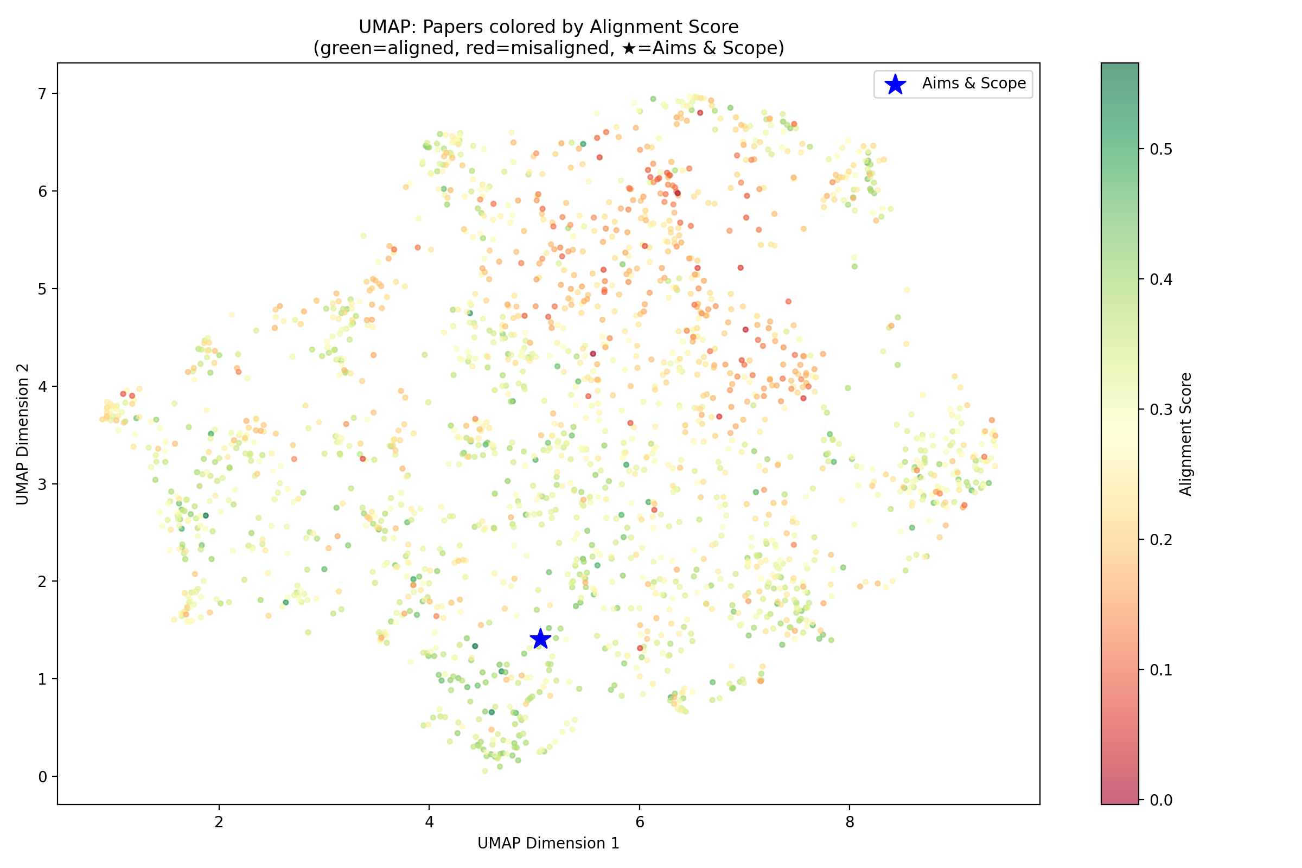
8 — Topic Structure (BERTopic)
Fig 6: Mean alignment by topic
Fig 7: UMAP colored by alignment (★ = Aims & Scope)
Most aligned: dependency parsing · natural language generation · morphological analysis Least aligned:
image/video processing · audio super-resolution · adversarial ML 38% in Topic −1 (noise — no coherent cluster)

Slide 10
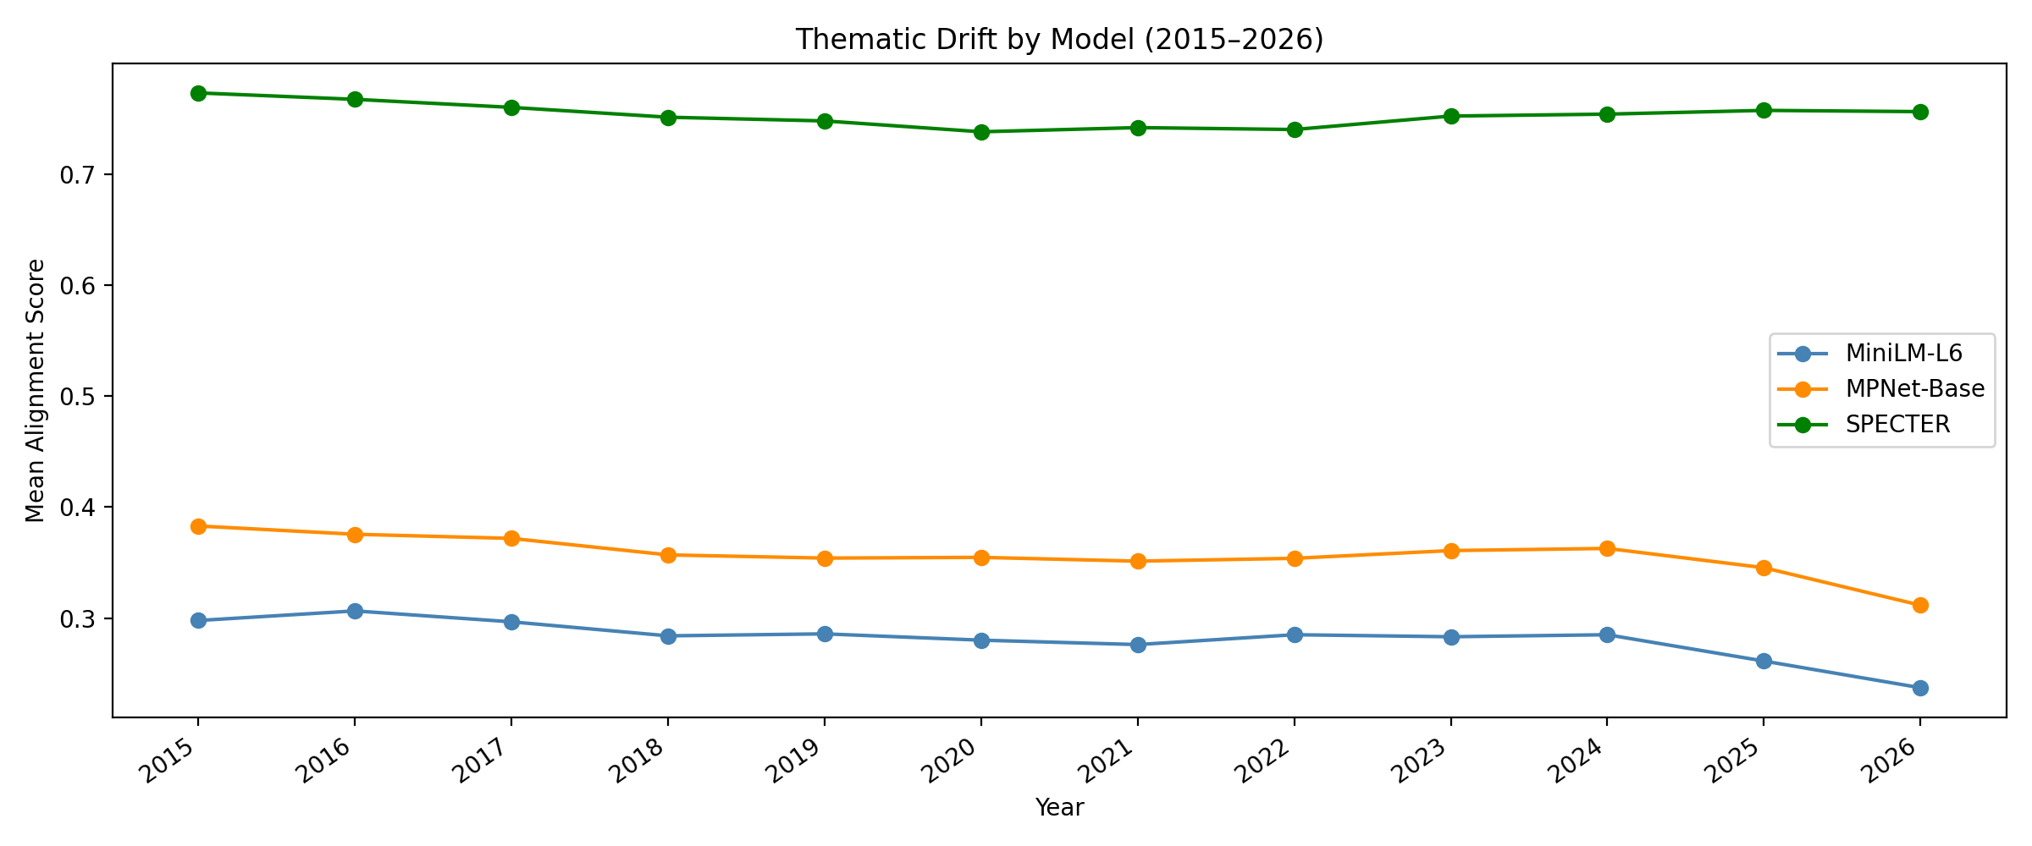
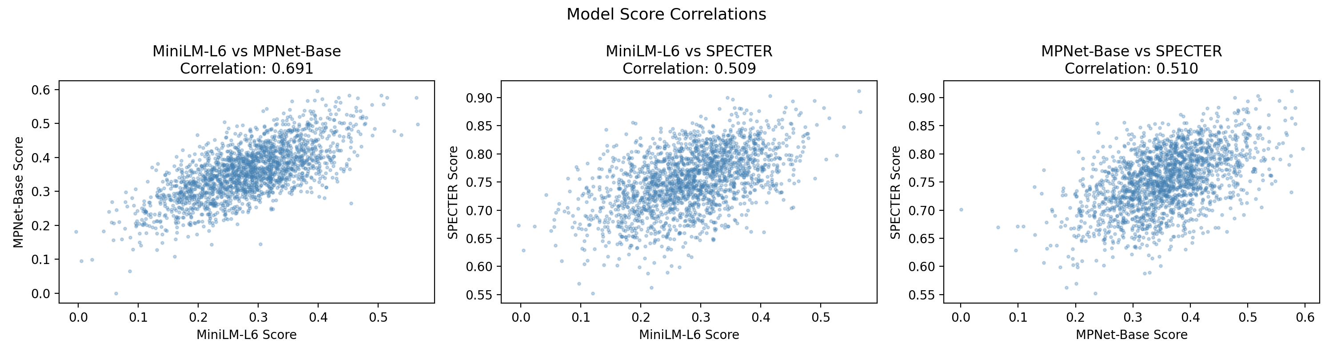
9 — Model Comparison (Robustness Check)
Fig 8: Drift by model
Fig 9: Pairwise score correlations
all-MiniLM-L6-v2
all-mpnet-base-v2
allenai-specter
General purpose · 6 layers · 22M params · Fast
General purpose · 12 layers · 109M params · Stronger
Scientific papers · 12 layers · Citation-based training

Slide 11
10 — Concluding Remarks
Key Findings
Limitations & Future Work
Alignment declined 22% from 2016 to 2026
Outlier rate nearly tripled: 2.4% → 8.0%
Driving themes: audio, image, adversarial ML
Findings robust across 3 encoder models
Pipeline generalizable to any journal
Abstracts only — full-text may differ
Single scope vector loses granularity
No baseline journal for comparison
Future: sentence-level scope decomposition
Future: multi-journal comparison

Slide 12
Thank you
Questions?
github.com/ipekibrahimoglu/NLP_ForFinal
ipekibrahimogluu@gmail.com
Reimers & Gurevych (2019) · Grootendorst (2022) · Picascia et al. (2025) · Hassan-Montero et al. (2014)

