Slide 1
Analyzing Thematic Alignment
in Scientific Journals
Using Sentence-BERT · BERTopic · UMAP
İpek İbrahimoğlu
June 2026
Università degli Studi di Milano
Notes:
Welcome. Today I present my NLP final project: Analyzing Thematic Alignment in Scientific Journals. Journal: Natural Language Engineering (Cambridge). 287 abstracts, 2015–2024.

Slide 2
1 — Introduction
The Problem
Our Approach
Journals define scope via Aims & Scope statements
In practice, published content can drift over time
Detecting this drift is critical for bibliometrics, peer-review routing, and indexing
Keyword-based methods fail — same concepts appear under different vocabulary
Encode Aims & Scope + abstracts into the same vector space using Sentence-BERT
Measure alignment via cosine similarity → one score per paper
Detect thematic drift as a downward trend in annual mean scores
Identify which topics are driving the change using BERTopic
Notes:
Problem: journals drift, hard to detect. Our approach: semantic embeddings, cosine similarity, BERTopic. Real journal publications, not arXiv preprints.

Slide 3
2 — Research Question & Pipeline
Can we quantitatively detect thematic drift in a scientific journal by measuring the semantic alignment between its published papers and its Aims & Scope?
1
2
3
4
5
Data
Collection
Encoding
Alignment
Scoring
Topic
Modeling
Analysis
Crossref API
2015–2024
287 abstracts
Sentence-BERT
all-MiniLM-L6-v2
384-dim vectors
Cosine similarity
vs Aims & Scope
vector
BERTopic
UMAP + HDBSCAN
+ TF-IDF
Drift detection
Outlier flagging
Model comparison
Notes:
5-step pipeline. Real NLE journal papers via Crossref + Semantic Scholar. SBERT embeddings. Cosine similarity = alignment score. BERTopic for topic clustering. Statistical analysis.

Slide 4
3 — Methodology
Sentence-BERT
all-MiniLM-L6-v2
Transformer encoder trained with siamese network. Maps text into a shared semantic vector space where cosine similarity reflects meaning similarity [1].
6-layer distilled model, 384-dimensional L2-normalized output. Fast and optimized for semantic similarity. Validated against all-mpnet-base-v2 and allenai-specter.
BERTopic
Alignment Score
Unsupervised topic modeling: UMAP compresses vectors → HDBSCAN finds clusters → class-based TF-IDF generates labels. random_state=42 for reproducibility [2, 5].
A(pᵢ) = cosine_similarity(abstract_embedding, scope_vector). Outlier threshold: bottom 5th percentile (score < 0.152). 15 outlier papers (5.2%).
Notes:
SBERT maps text to semantic space. MiniLM-L6 is fast and validated. BERTopic: UMAP+HDBSCAN+TF-IDF, reproducible. Alignment score = cosine similarity.

Slide 5
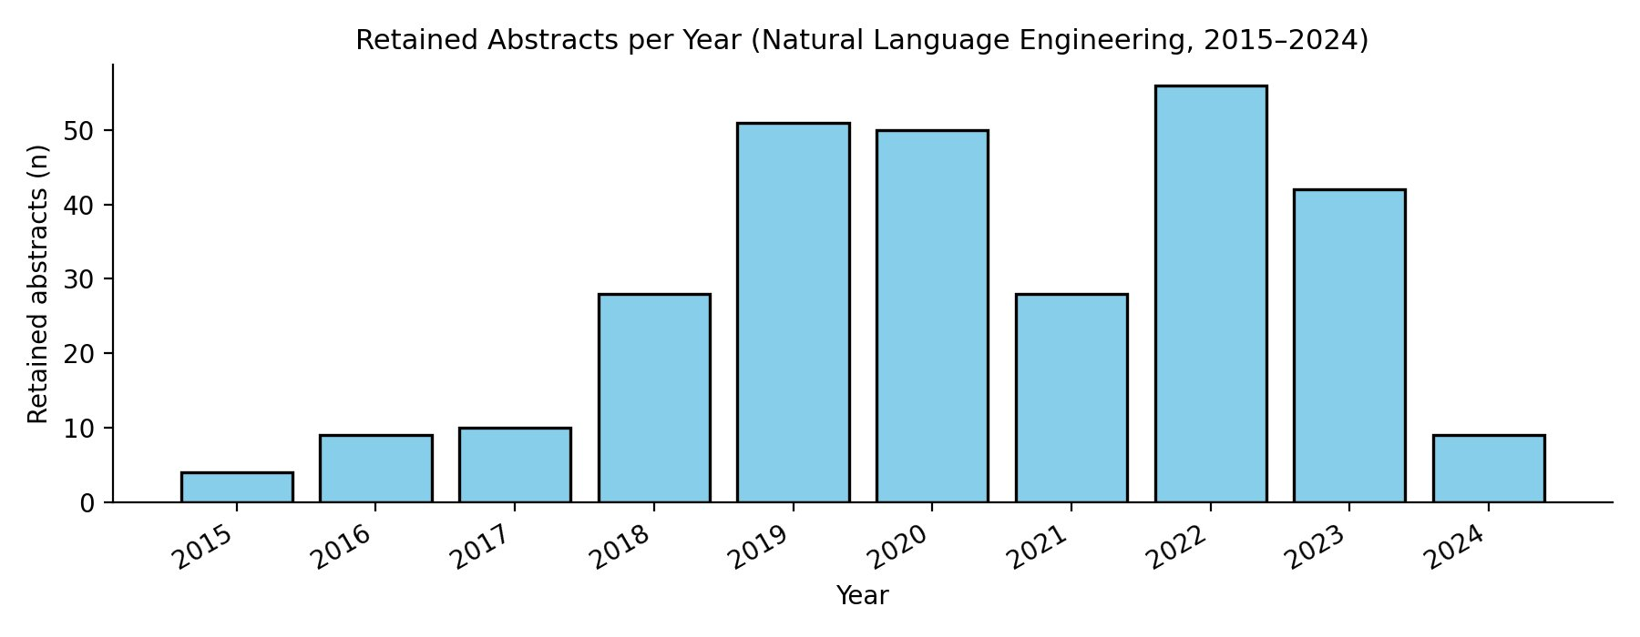
4 — Dataset & Key Statistics
287
0.358
15
−33%
Abstracts
retained
Mean alignment
score
Outlier papers
(5.2%)
Drift 2015
to 2024
Source: NLE journal (ISSN: 1351-3249) via Crossref + Semantic Scholar
Fully API-driven — no prebuilt dataset
Real journal publications, not arXiv preprints
2024 low count reflects indexing lag
Score range: −0.020 to 0.842 · Std dev: 0.111
Fig 1: Retained abstracts per year
Notes:
287 abstracts, mean 0.358, 15 outliers, 33% drift. Fully API-driven. Real NLE papers, not arXiv. 2024 low due to indexing lag.

Slide 6
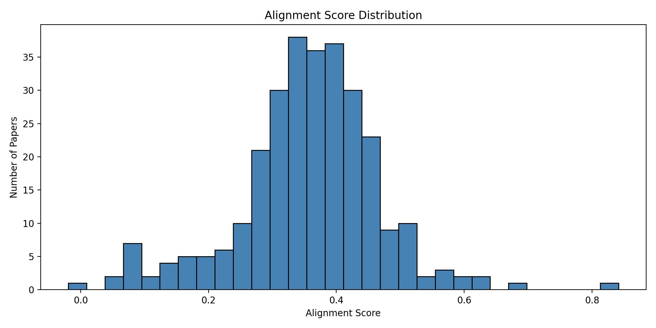
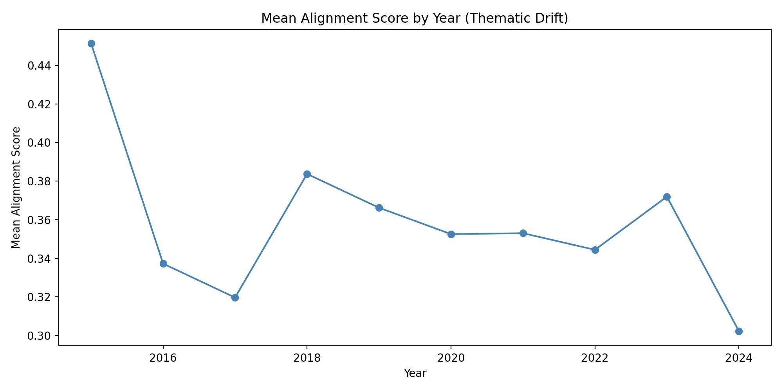
5 — Alignment Score Distribution
Fig 2: Global score distribution
Fig 3: Yearly mean alignment score
Unimodal distribution centered at 0.358 — no clean split between aligned/misaligned papers. Alignment peaked in 2015 (0.450) and declined to 0.303 by 2024 — a 33% drop.
Notes:
Unimodal: misalignment is a spectrum, not binary. Left tail = outlier papers. 2015 high due to small sample (n=4). Sharp drop in 2024.

Slide 7
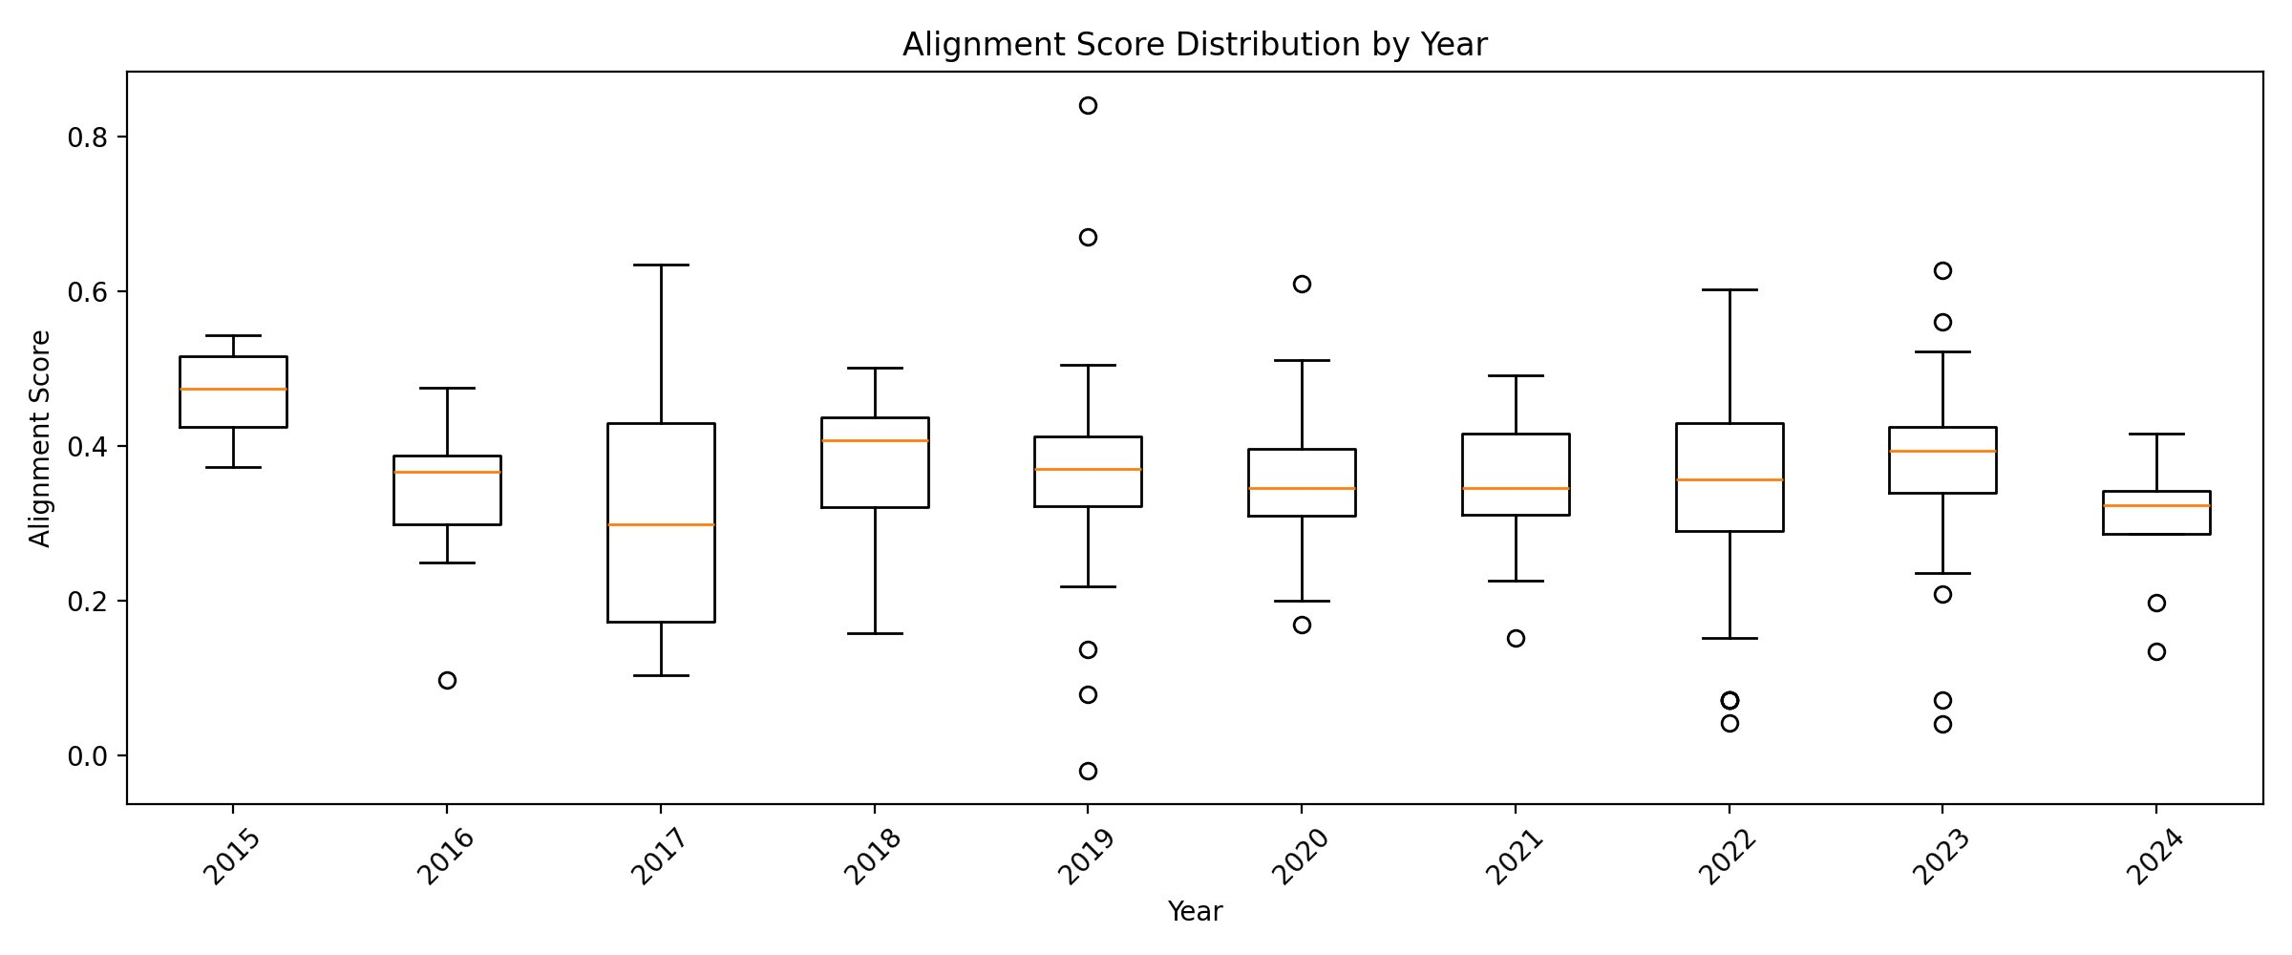
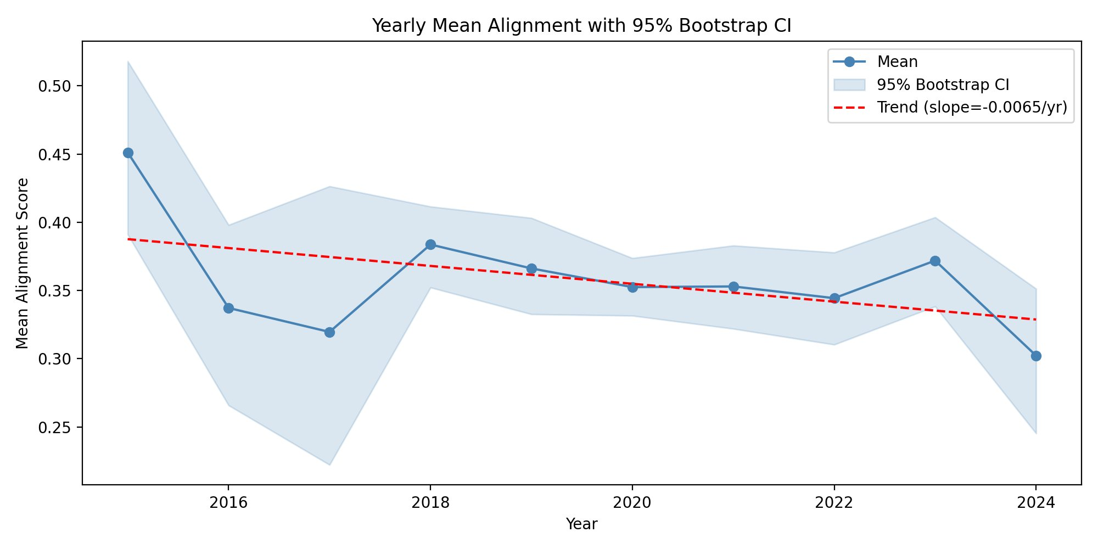
6 — Thematic Drift — Statistical Evidence
Fig 4: Score distribution by year (boxplot)
Fig 5: Yearly mean with 95% Bootstrap CI
−0.0065
ρ = −0.14
p < 0.001
H = 24.6
slope / yr
Spearman
significance
Kruskal-Wallis
Notes:
Boxplot: median (orange) shifts down. Bootstrap CI confirms trend is not noise. Spearman rho=-0.14 p<0.001, Kruskal-Wallis p=0.003. Broad-based decline across all percentiles.

Slide 8
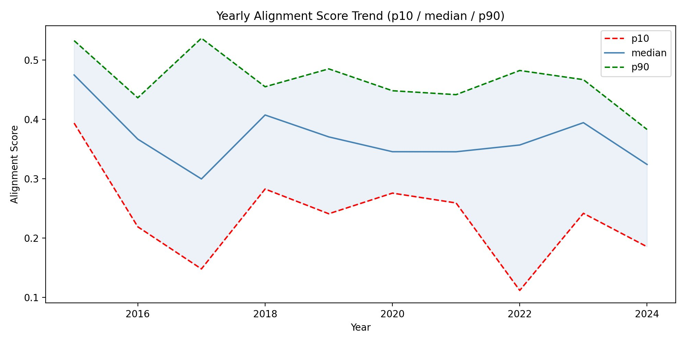
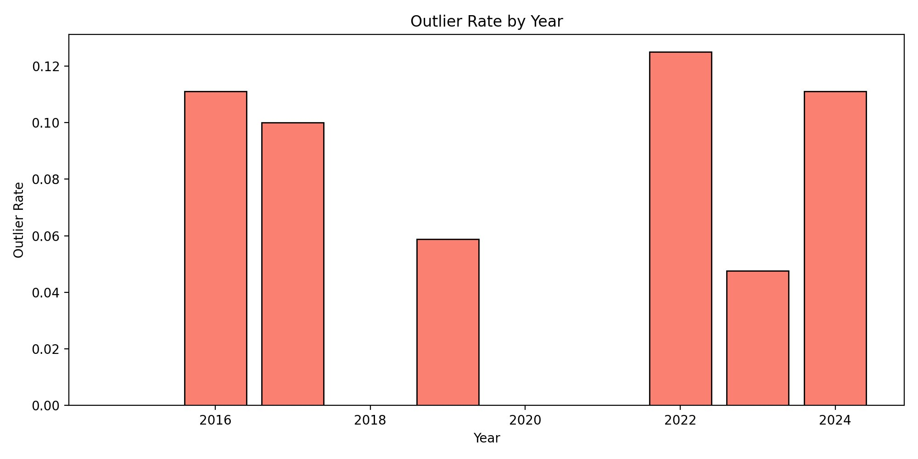
7 — Drift Depth & Outlier Analysis
Fig 6: Percentile trend (p10 / median / p90)
Fig 7: Outlier rate by year
p10, median AND p90 all decline → broad-based drift, not just extreme outliers. Spike in 2022 (12.3%) coincides with rapid NLP expansion. Most misaligned: Preface entry, score = −0.020.
Notes:
Drift is broad: all percentiles fall. Not just a few bad papers. Outlier spikes 2016, 2022, 2024. 2022 peak = NLP expansion. Most misaligned = Preface with no NLP content.

Slide 9
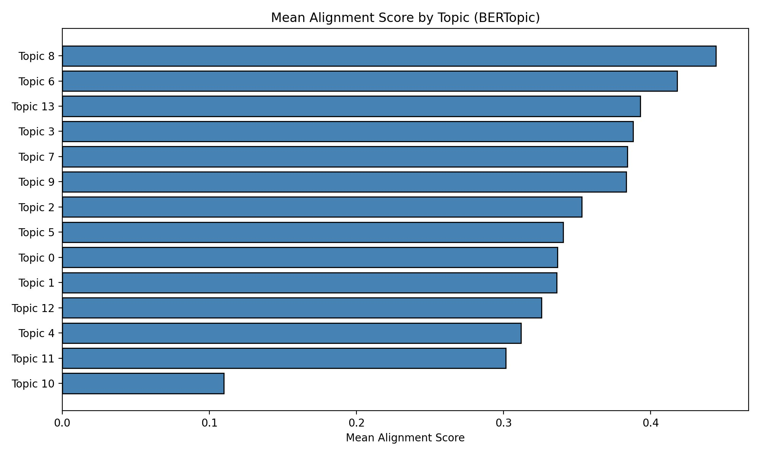
8 — Topic Structure — BERTopic
Most Aligned — Topic 8 (≈ 0.44)
Information extraction, question answering, relation detection
→ Core NLP tasks within journal scope
Least Aligned — Topic 10 (≈ 0.11)
Peripheral content, not core NLP
→ Identified cluster driving misalignment
Fig 8: Mean alignment by BERTopic topic
14 topics · UMAP + HDBSCAN + TF-IDF · random_state=42
Notes:
14 topics. Most aligned: Topic 8 = extraction, QA. Least aligned: Topic 10 = peripheral. Drift is topic-driven, identifiable, not random.

Slide 10
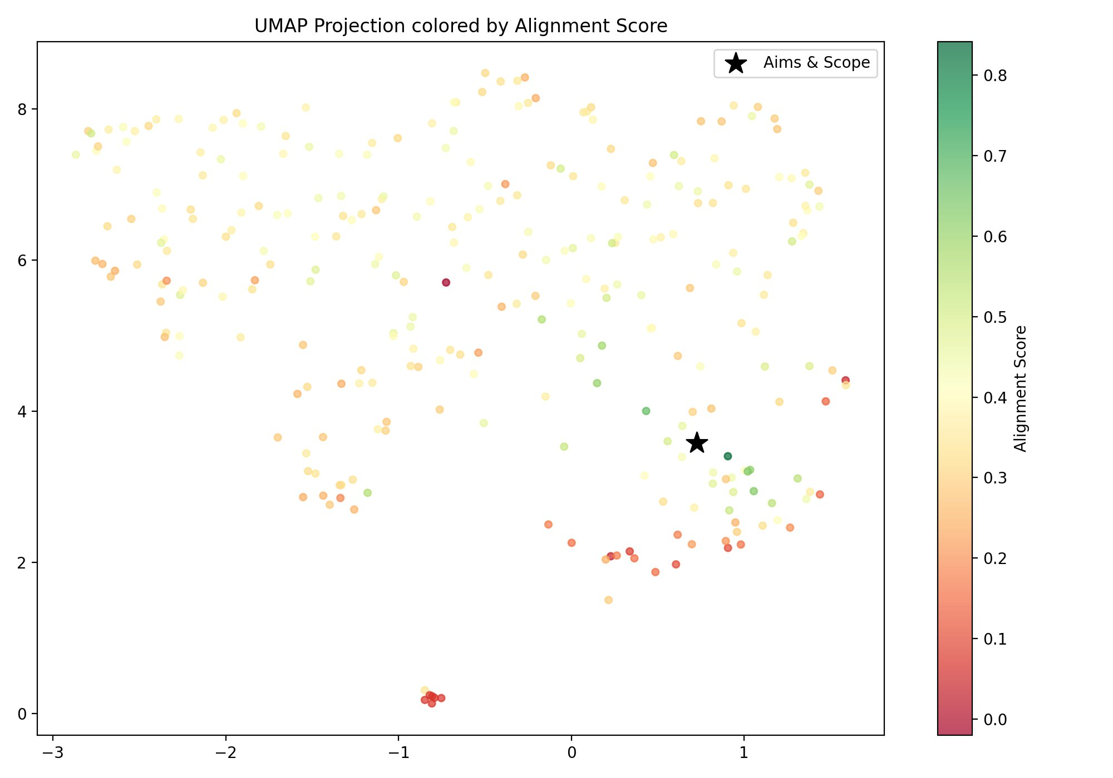
9 — UMAP Visualization
Reading the Map
★ = Aims & Scope reference
Green = high alignment
Red = low alignment
Papers near ★ score higher
Outlier cluster visible at bottom (score ≈ 0)
Fig 9: UMAP projection colored by alignment score (★ = Aims & Scope)
Notes:
UMAP: 384-dim → 2D. Papers near star score higher (green). Red cluster at bottom = outlier group. Visual confirmation of statistics.

Slide 11
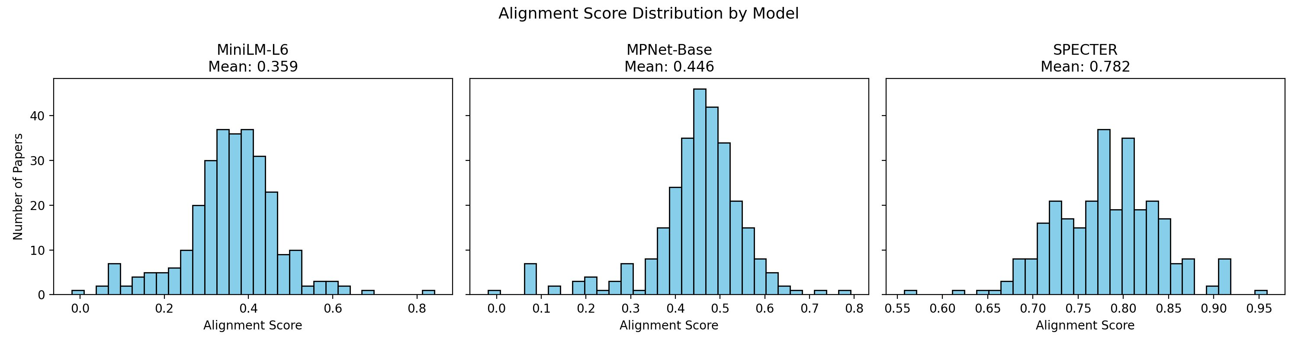
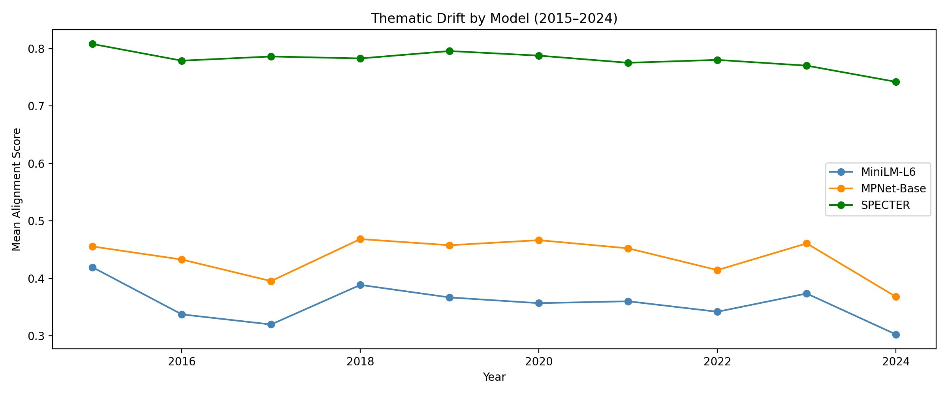
10 — Model Comparison — Robustness Check
Fig 10: Score distributions by model (MiniLM-L6: 0.359 · MPNet-Base: 0.446 · SPECTER: 0.782)
Correlations
MiniLM vs MPNet: 0.806
MiniLM vs SPECTER: 0.689
MPNet vs SPECTER: 0.612
→ All 3 agree on drift direction
Fig 11: Thematic drift by model (2015–2024)
Notes:
SPECTER higher (domain fine-tuning). All 3 agree on drift direction. High pairwise correlations = robust rankings. Threshold needs recalibration per model.

Slide 12
11 — Conclusions & Future Work
✓ Drift Detected
✓ Topic-Driven
✓ Robust Method
→ Future Work
Spearman ρ = −0.14
p < 0.001
Kruskal-Wallis
p = 0.003
Slope: −0.0065/yr
33% relative drop
2015 → 2024
14 topics identified
Most aligned:
Topic 8 (QA, extraction)
Least aligned:
Topic 10 (peripheral)
Drift identifiable
not uniform
3 encoder models
All agree on drift
direction
Correlations:
0.61 – 0.81
Real journal data
not arXiv proxy
Full-text analysis
beyond abstracts
Multi-journal
comparison
Citation-based
validation
Sentence-level
alignment
Notes:
Summary: drift real, significant, topic-driven, robust. Future: full-text, multi-journal, citation-based.

Slide 13
Thank You
İpek İbrahimoğlu · ipek.ibrahimoglu@studenti.unimi.it
287 abstracts
14 topics
3 models
p < 0.001
Notes:
Thank you. Open for questions.

