Slide 1
Product as Package
Release management

Slide 2
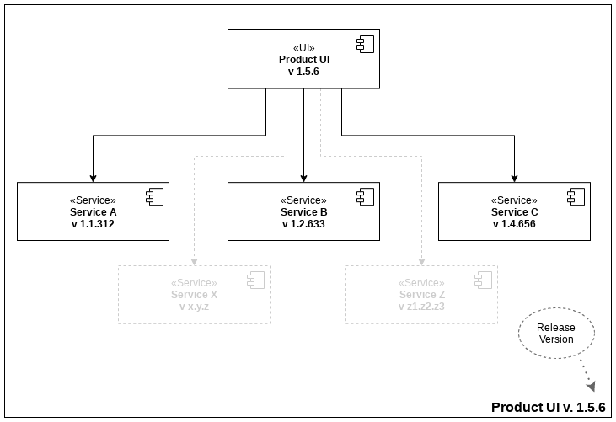
Release as a package
Entire product consists of multiple components and delivered as a package.
Product needs to be tested as a whole system even if individual components tested separately.
Versions of dependent components needs to be enforced and checked by UI on startup.
Monitoring statuses of individual components needs to be combined into aggregate system status.
Every service should have it’s own automated set of embedded integration tests.

Slide 3
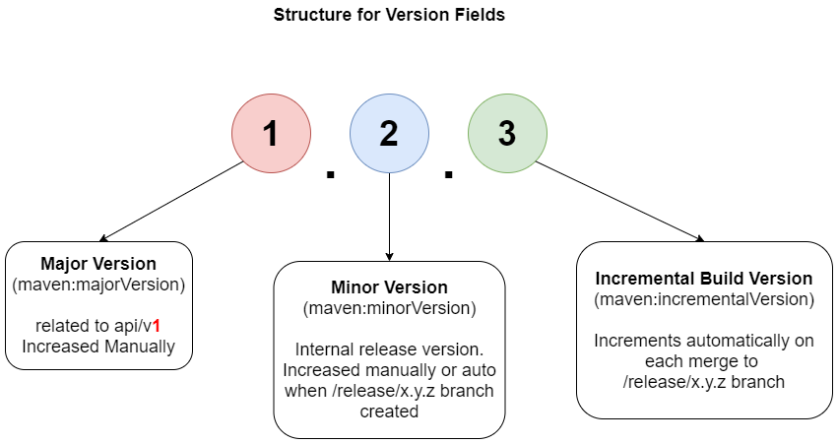
Proposed Version Strategy
Combination of “Major Version” + “Minor Version” is required for future UI compatibility and needs to be enforced (validated) by UI on start up (subject for further discussion) For ex. UI support service A version equals or higher 1.2.0 and refuses to start if its lower.

Slide 4
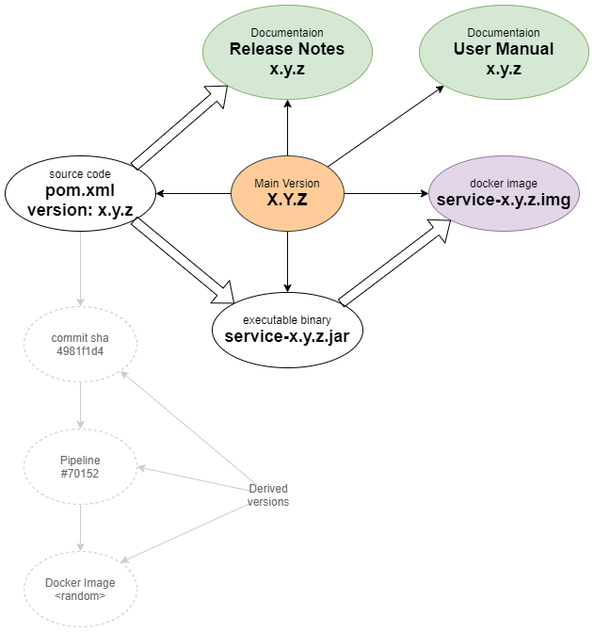
Single Version for all system modules
Human readable format
Auto incremented parts i.e Major, Minor, Build
Encoded into each system component for ex <version> tag in pom.xml, name of jar etc.
Simplify troubleshooting and bug recreation

Slide 5
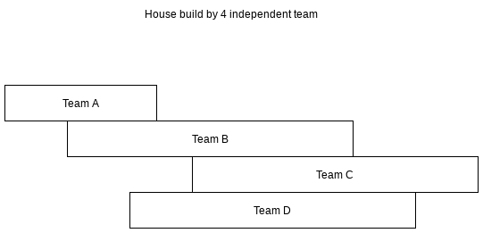
Breaking Conway’s law
System architecture reflects company's structure OR If you have four groups working on a compiler, you'll get a 4-pass compiler
The separate “Product Team” is required if we want deliver a single Product System. Some responsibilities for Product Team:
Coordinate system packages involved in release
Initial bug review, recreation (optional) and sorting

Slide 6
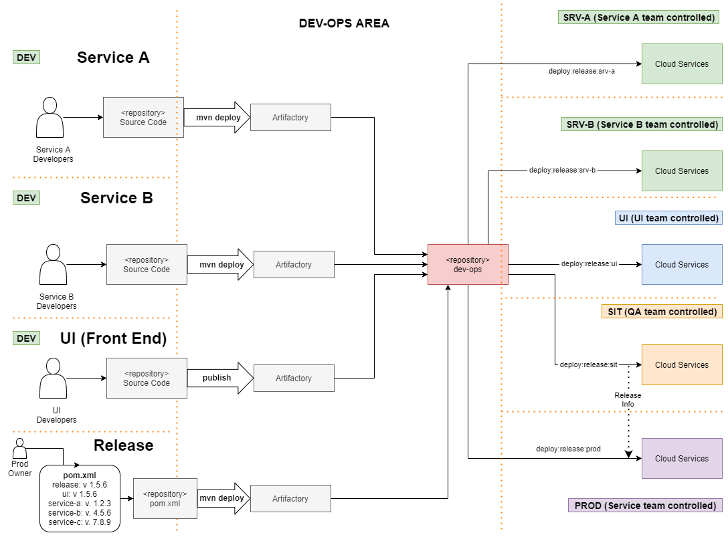
Environment Separation
2 repositories (Source Code and Deployment Pipelines) allow environment separation and access
Separate deployment pipeline for each execution environment
Team controlled environment

