Slide 1
PostgreSQL
vs
MySQL : The Showdown
Sean Mitchell
Ian Percy

Slide 2


Background
DB Benchmarking comparing two systems:
PostgreSQL
Performs well for complex operations and highly SQL compliant
MySQL
Performs well for online transactions especially heavy read operations

Slide 3
Benchmark Goals
Compare two systems for basic RDBMS capabilities:
Update
Join (Basic and Multi-Table)
Index operations
Goal: Observe DB performance after different set of stressors

Slide 4
Benchmark 3: Partial Index
Goal:
Determine effect of PostgreSQL’s Partial Index in optimization
Expected results:
PostgreSQL selection query with Partial Index will outperform MySQL standard selection

Slide 5
Benchmark 3: Partial Index Setup
CREATE INDEX idx_ten ON tmp(ten)
WHERE ten <=3
SELECT * FROM tmp
WHERE ten = 1
<- Create partial index
<- Query table on partial index

Slide 6
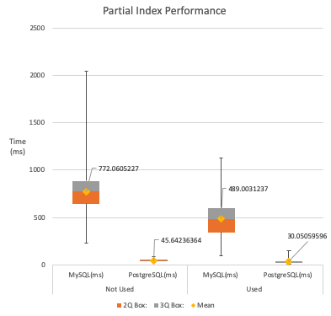
Benchmark 3: Partial Index
Results
Results were as expected with the PostgreSQL table having a Partial Index outperforming MySQL
Partial Index was used on the attribute “ten” for 10% selectivity
Large reduction in execution time
Learned: Partial index offers a valuable tool set addition for creating an index on a subset of records

Slide 7
Benchmark 1: Bulk Updates
Goal:
Cause RDBMS to perform bulk updates
Expected results:
MySQL handles updates more efficiently than PostgreSQL since they are done in-place

Slide 8
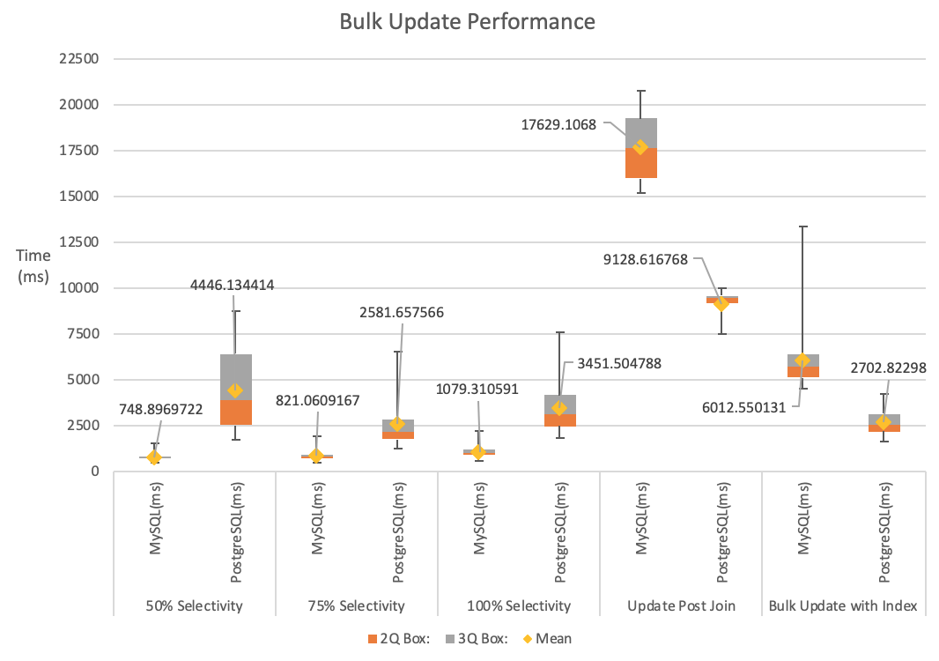
Benchmark 1: Bulk Updates
Results
Results were as expected with MySQL performing faster than PostgreSQL on 3 out of 5 tests
Interesting result that PostgreSQL performed updates to an index faster
Largest difference was on the “Update Post Join” test.
MySQL 17629 ms
PostgreSQL 9128 ms
Learned: MySQL handles bulk updates on average faster than PostgreSQL as long as they don’t involve an index or join.

Slide 9
Benchmark 2: Join Performance
Goal:
Analyze join performance
Expected results:
PostgreSQL and MySQL will perform similar on simple joins

Slide 10
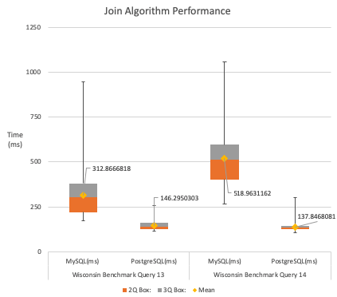
Benchmark 2: Join Performance
Results
Results were not as expected with PostgreSQL outperforming MySQL on both tests
PostgreSQL utilizes hash joins where MySQL will use nested loop joins
Differences of up to 3x longer execution time on average
Learned: MySQL has a large range in execution times. PostgreSQL handles joins consistently.

Slide 11
Benchmark 4: Multi-Table Join
Goal:
Analyze multi-way join performance
Expected results:
PostgreSQL will outperform MySQL due to increased join optimization

Slide 12
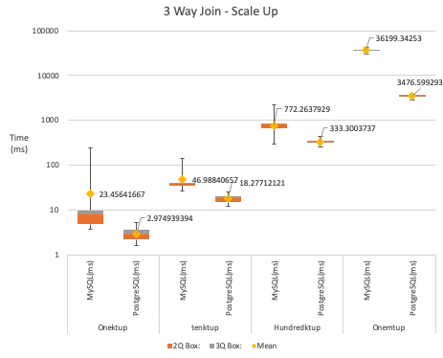
Benchmark 4: Multi-Table Join Results
Results were as expected with PostgreSQL outperforming MySQL on joins and complex queries
MySQL does not handle the scaleup of the complex join well showing a 46x increase in run time from 100k to 1 mill tuples
Learned: MySQL join scaleup is non-linear. PostgreSQL scaleup is linear. (for multi-table joins).

Slide 13
Conclusions
PostgreSQL and MySQL both have different areas of success based on the benchmarks
MySQL - processes transactions and updates efficiently
PostgreSQL - processes joins and indices efficiently

Slide 14
Conclusions (cont.)
Result reflections:
PostgreSQL would implement hash joins when MySQL would not have that option (resorting to nested loop join). The optimizer wouldn’t have that choice when creating query trees. This was reflected in our results showing PostgreSQL performing any joins with less execution time than MySQL.
MySQL had a range of query execution times, which is why we chose to use box plots instead of bar charts. This allowed us to show the range (min-max) for the queries. Interestingly enough, this shows the consistency of the optimizer for PostgreSQL versus the execution plans for the MySQL queries
One interesting result is the update on index (Benchmark 1). Both PostgreSQL and MySQL offer similar indexes and PostgreSQL doesn’t have a “clustered” index as we expect. However, on the updates to an index, PostgreSQL out performed MySQL. This could be in part because MySQL InnoDB builds tables on the clustered index and PostgreSQL uses a heap.

Slide 15
Adjustments to Benchmarks
After initial benchmark runs, some queries needed to be adjusted to get more gratifying results:
Partial Index needed to be switched to the “ten” field to allow for low selectivity to show the index effect on run time
Update after a join needed to be run on a smaller table (tenktup) due to extreme execution time
Decided to increase the table size of the scaleups much larger than originally planned
Ran the tests for 100 iterations to give a comfortable average

Slide 16
PostgreSQL vs. MySQL
Final thoughts about these DBs:
PostgreSQL
Performs a consistent set of query execution optimizations. Build for analytical queries those involving joins. Offers more SQL and ACID compliance, which allows for more features and optimizations (such as the hash join)
MySQL
Handles transactional queries adequately (Benchmark 1). Does not handle joins as well as PostgreSQL. Scaleup on joins is exponential as compared to the linear scaleup that PostgreSQL experiences (Benchmark 4). Viewing the query execution plans is much more difficult than those on PostgreSQL

Slide 17
Lessons Learned
Pay careful attention to SQL query syntax depending on the DBMS
Transaction commits are critical when working through the command line
Run queries on a cold cache (new session) to minimize effect on execution time

Slide 18
Questions?

