Slide 1
TE2003B SoC Design: Computer organisation & architecture Computer Arithmetic

Slide 2
References
The following material has been adopted and adapted from
Patterson, D. A., Hennessy, J. L., Computer Organization and design: The hardware/software interface – ARM edition, Morgan Kaufmann, 2017.
S. L. Harris and D. M. Harris, Digital design and computer architecture - ARM edition, Morgan Kaufmann, 2016.
J. Yiu, The definitive guide to ARM Cortex-M0 and Cortex-M0+ processors, Second edition, Elsevier, 2015.

Slide 3
Arithmetic for Computers
Operations on integers
Addition and subtraction
Multiplication and division
Dealing with overflow
Floating-point real numbers
Representation and operations

Slide 4
Integer operations

Slide 5
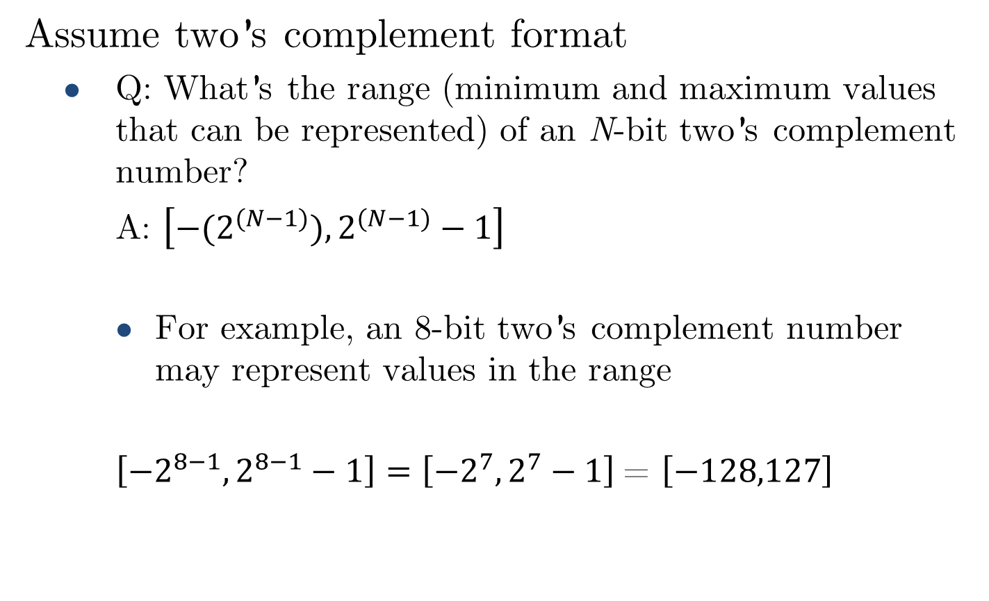
Two’s complement review
Assume two’s complement format
Q: What’s the range (minimum and maximum values that can be represented) of an N-bit two’s complement number?
A: $\left[{−(2}^{(N−1)}),2^{(N−1)}−1\right]$
For example, an 8-bit two’s complement number may represent values in the range
$\left[{−2}^{8−1},2^{8−1}−1\right]=\left[{−2}^{7},2^{7}−1\right]$= $\left[−128,127\right]$

Slide 6
Overflow & underflow
Q: What is overflow?
A: A condition when the result of a calculation exceeds the maximum value that can be represented in a numeric format.
Q: What is underflow?
A: A condition when the result of a calculation is smaller than the minimum value that can be represented in a numeric format.
Sometimes, the term overflow is used for describing both conditions.

Slide 7
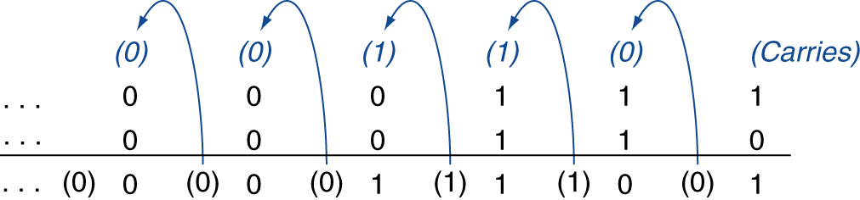
Integer addition
Example: 7 + 6
(+7)
(+6)
(+13)
Overflow if result out of range
Adding +ve and –ve operands, no overflow
Adding two +ve operands
Overflow if result sign is 1
Adding two –ve operands
Overflow if result sign is 0

Slide 8
Integer addition
Example: Adding two 4-bit two’s complement numbers
5 + 1
+5: 0101 +1: 0001 +6: 0110
3 + 6
+3: 0011 +6: 0110 -7: 1001
–2 + 5
-2: 1110 +5: 0101 +3: 0011
–7 +(–1)
-7: 1001 -1: 1111 -8: 1000
–3 +(–6)
-3: 1101 -6: 1010 +7: 0111
Overflow:+9 and -9
can not be represented in 4-bit
two’s complement.

Slide 9
Integer subtraction
Addition with negation of second operand
Example: 7 – 6 = 7 + (–6)
+7: 0000 0000 … 0000 0111 –6: 1111 1111 … 1111 1010 +1: 0000 0000 … 0000 0001
Overflow if result out of range
Subtracting two +ve or two –ve operands, no overflow
Subtracting +ve from –ve operand
Overflow if result sign is 0
Subtracting –ve from +ve operand
Overflow if result sign is 1

Slide 10
Integer subtraction
Example: Subtracting two 4-bit two’s complement numbers
5 – (+1)
+5: 0101 -1: 1111 +4: 0100
–3 – (+6)
-3: 1101 -6: 1010 +7: 0111
–2 – (–5)
-2: 1110 +5: 0101 +3: 0011
7 –(–1)
+7: 0111 +1: 0001 -8: 1000
Overflow: -9 and +8 can not be represented in 4-bit two’s complement.

Slide 11
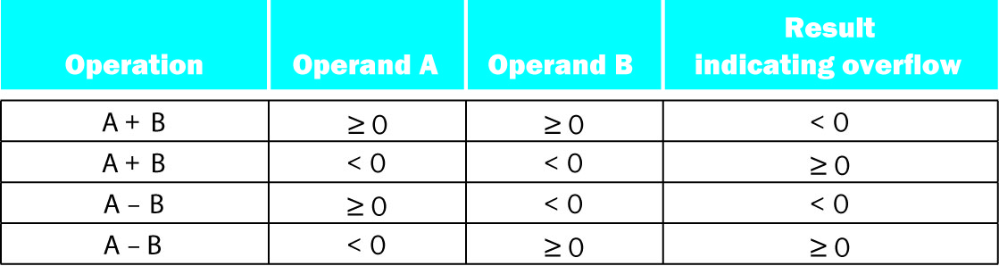
Addition & subtraction overflow summary
Overflow conditions for additions and subtraction in two’s complement.

Slide 12
Arithmetic for multimedia
Graphics and media processing operates on vectors of 8-bit and 16-bit data
Use 64-bit adder, with partitioned carry chain
Operate on 8×8-bit, 4×16-bit, or 2×32-bit vectors
SIMD (single-instruction, multiple-data)
Saturating operations
On overflow, result is largest representable value
e.g., clipping in audio, saturation in video

Slide 13
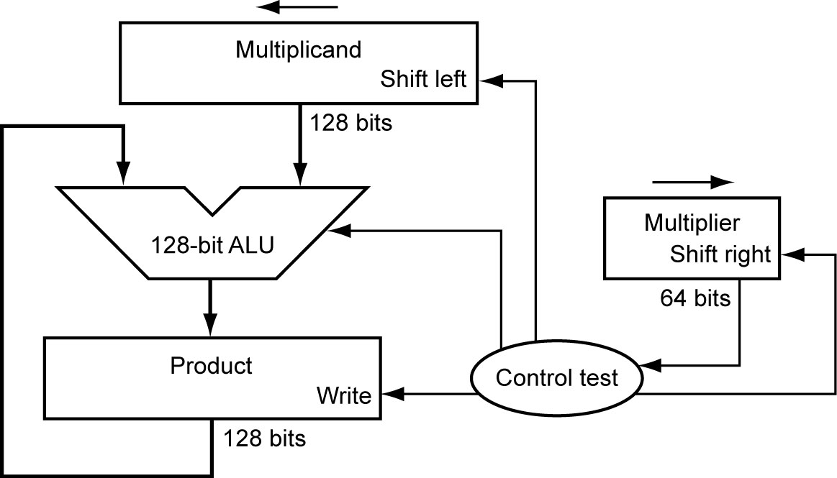

Multiplication
Start with long-multiplication approach
Assume we want to multiply two 64-bit numbers
multiplicand
1000
× 1001
1000
0000
0000
1000
01001000
multiplier
product
Length of product is the sum of operand lengths.
What can be improved in this architecture?
$$A_{M−bits}×B_{N−bits}=X_{\left(M+N\right)−bits}$$

Slide 14
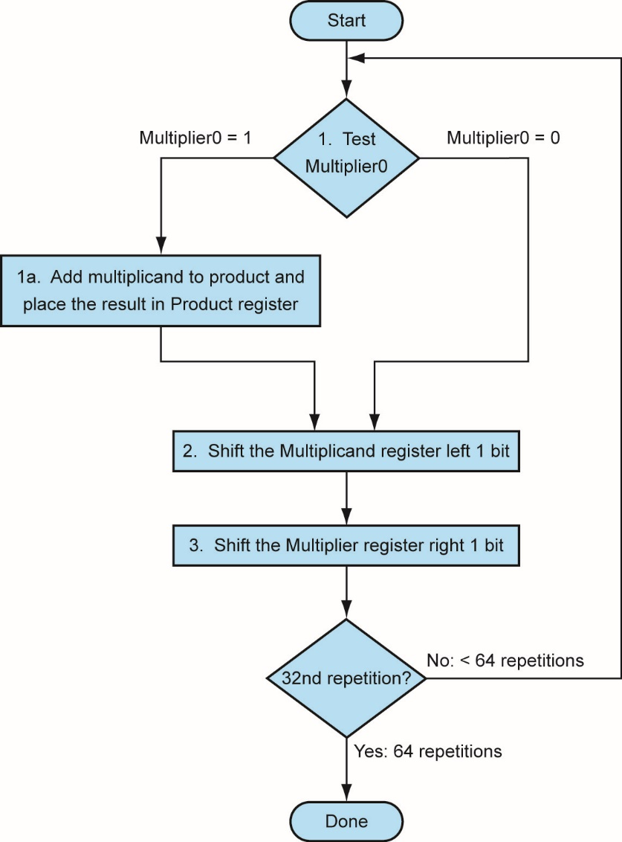
Multiplication hardware
There’s one error in the flow chart. Can you spot it?
What can be improved in this architecture?
LSB
64th repetition?
Initially 0

Slide 15
Multiplication hardware
This architecture has a major flaw.
Can you spot it?
LSB
For multiplying two N-bit number, it requires:
Two 2N-bit registers
One N-bit register
A 2N-bit ALU
This is a waste of resources!

Slide 16
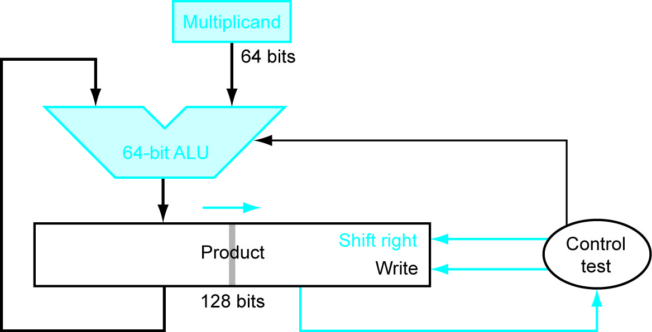
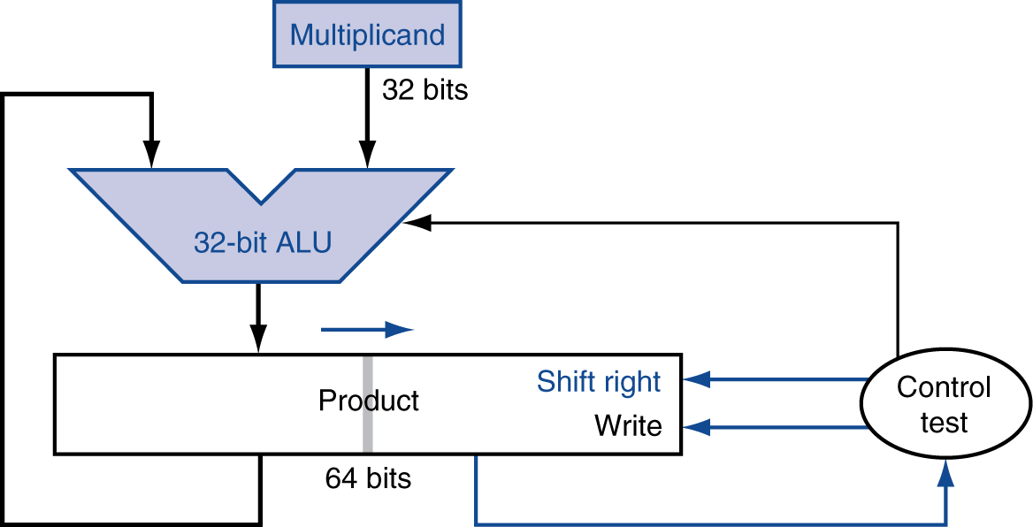
Optimised multiplier
Perform steps in parallel: add/shift
For multiplying two N-bit number, it requires:
One N-bit register
One 2N-bit register
An N-bit ALU
One cycle per partial-product addition
That’s ok, if frequency of multiplications is low

Slide 17
Optimised multiplier
Start
Load lower half of Product with Multiplier
YES
P[0] == 1?
NO
Add multiplicand to upper half of product
Shift product right
N^{th} repetition?
NO
YES
End

Slide 18

Optimised multiplier - example
Multiplicand = ${15}_{10}$: 1111
Multiplier = ${13}_{10}:$1101
STEP 0: Initialize registers
Multiplier loaded into lower half of product
1111
4-bit ALU
0000 1101

Slide 19

Optimised multiplier - example
Multiplicand = ${15}_{10}$: 1111
Multiplier = ${13}_{10}:$1101
STEP 1:
Product LSB == 1 : Add
Right shift product
0000
1111
4-bit ALU
0 1111
01111 1101

Slide 20
Optimised multiplier - example
Multiplicand = ${15}_{10}$: 1111
Multiplier = ${13}_{10}:$1101
STEP 1:
Product LSB == 1 : Add
Right shift product
1111
4-bit ALU
0111 1110

Slide 21
Optimised multiplier - example
Multiplicand = ${15}_{10}$: 1111
Multiplier = ${13}_{10}:$1101
STEP 2:
Product LSB == 0 : No Add
Right shift product
1111
4-bit ALU
0111 1110

Slide 22
Optimised multiplier - example
Multiplicand = ${15}_{10}$: 1111
Multiplier = ${13}_{10}:$1101
STEP 2:
Product LSB == 0 : No Add
Right shift product
1111
4-bit ALU
0011 1111

Slide 23
Optimised multiplier - example
Multiplicand = ${15}_{10}$: 1111
Multiplier = ${13}_{10}:$1101
STEP 3:
Product LSB == 1 : Add
Right shift product
0011
1111
4-bit ALU
1 0010
1 0010 1111

Slide 24
Optimised multiplier - example
Multiplicand = ${15}_{10}$: 1111
Multiplier = ${13}_{10}:$1101
STEP 3:
Product LSB == 1 : Add
Right shift product
1111
4-bit ALU
1001 0111

Slide 25
Optimised multiplier - example
Multiplicand = ${15}_{10}$: 1111
Multiplier = ${13}_{10}:$1101
STEP 4:
Product LSB == 1 : Add
Right shift product
1001
1111
4-bit ALU
1 1000
1 1000 0111

Slide 26
Optimised multiplier - example
Multiplicand = ${15}_{10}$: 1111
Multiplier = ${13}_{10}:$1101
STEP 4:
Product LSB == 1 : Add
Right shift product
1111
4-bit ALU
1100 0011

Slide 27
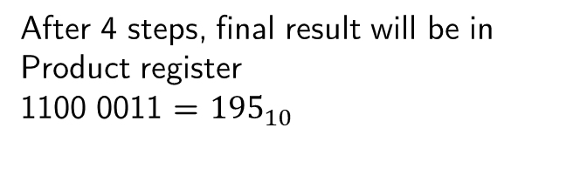
Optimised multiplier - example
Multiplicand = ${15}_{10}$: 1111
Multiplier = ${13}_{10}:$1101
After 4 steps, final result will be in Product register
1100 0011 = ${195}_{10}$
4-bit ALU
1100 0011

Slide 28
Signed multiplication
So far, we’ve only dealt with unsinged operands.
What happens in signed multiplication?
For adding two signed N-bit numbers:
Convert both multiplicand and multiplier to positive numbers and keep track of their respective sign.
Apply multiplication algorithm N-1 times.
Negate product if signs are not the same.
Alternatively, previous algorithm works for signed numbers as long as shifts are performed using sign extension.

Slide 29
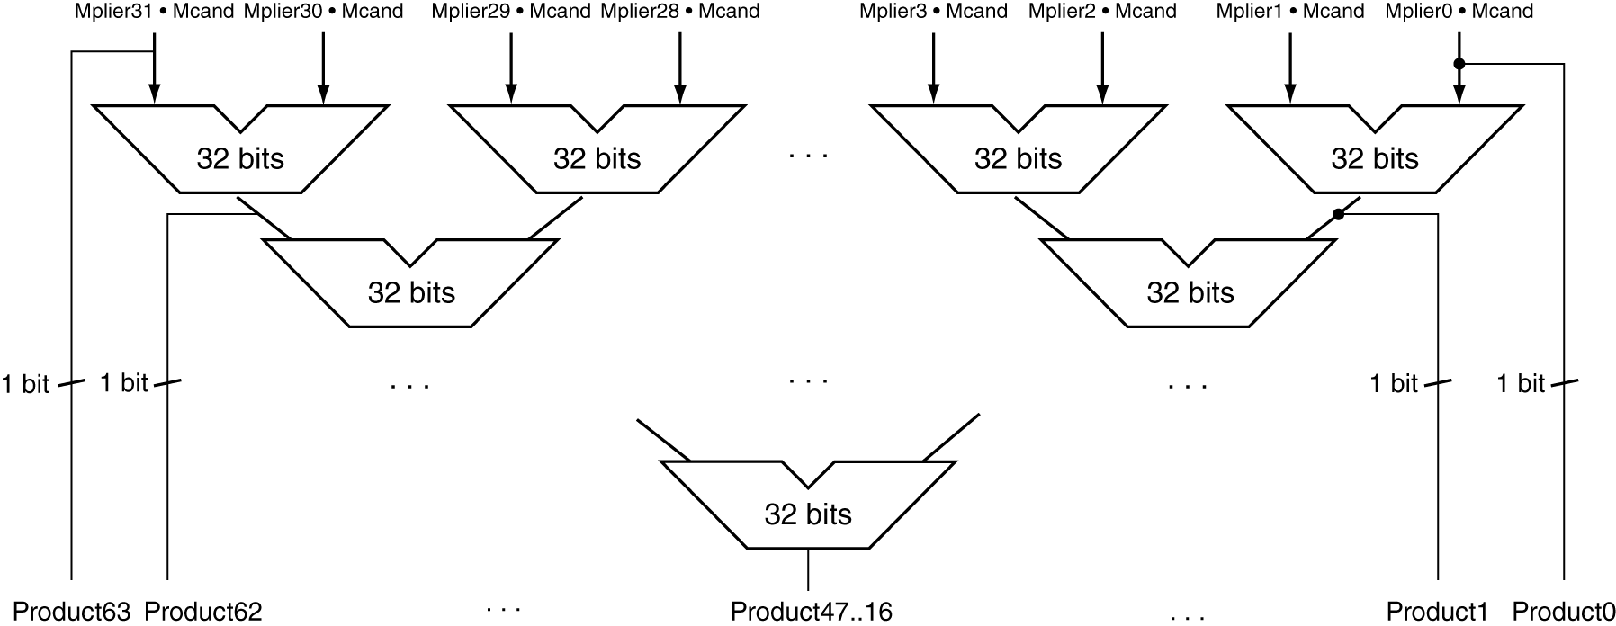
Faster Multiplier
Uses multiple adders
Cost/performance tradeoff
Use (N-1) N-bit adders in parallel, instead of a single N-bit adder (N-1) times.
Can be pipelined
Several multiplication performed in parallel

Slide 30
Cortex-M0+ multiplication
MULS
32-bit

Slide 31
Division
Check for 0 divisor
Long division approach
If divisor ≤ dividend bits
1 bit in quotient, subtract
Otherwise
0 bit in quotient, bring down next dividend bit
Restoring division
Do the subtract, and if remainder goes < 0, add divisor back
Signed division
Divide using absolute values
Adjust sign of quotient and remainder as required
quotient
dividend
1001
1000 1001010
-1000
10
101
1010
-1000
10
divisor
remainder
n-bit operands yield n-bit quotient and remainder

Slide 32
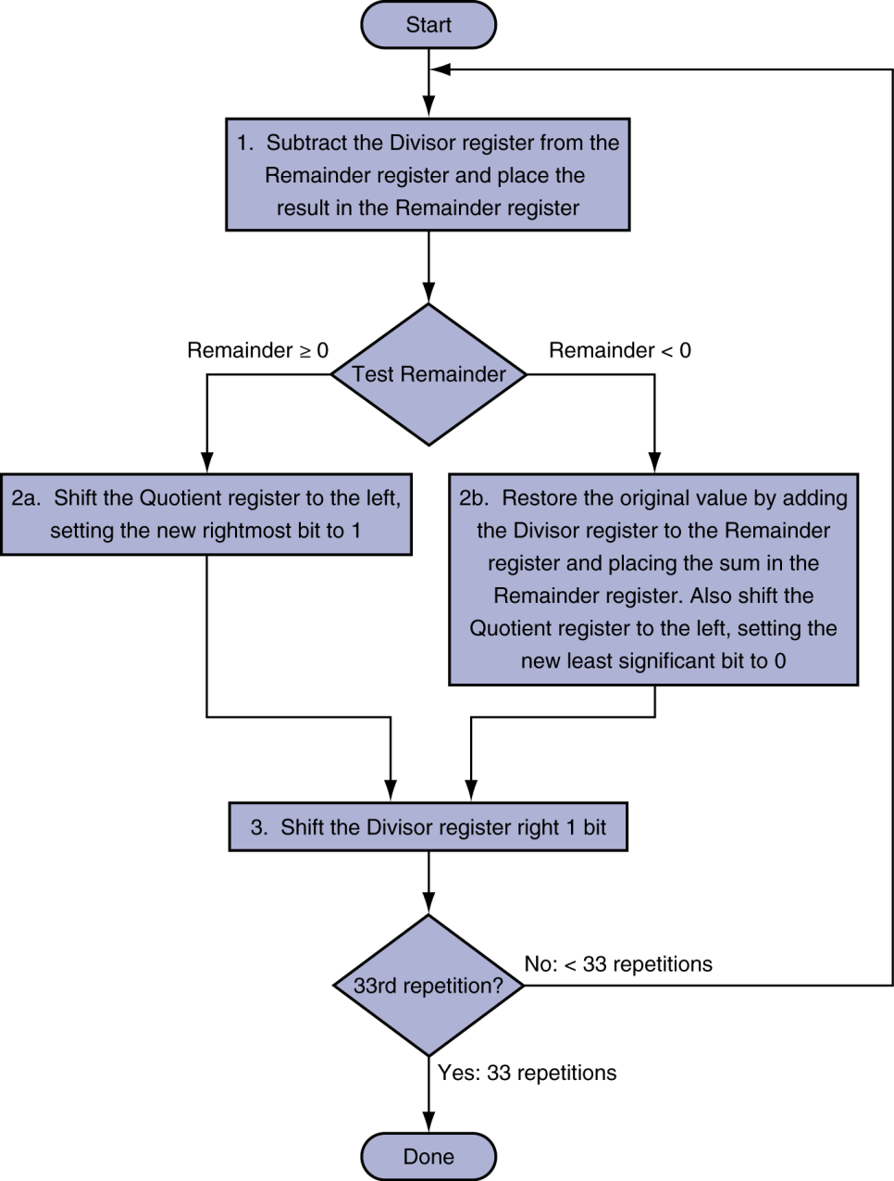
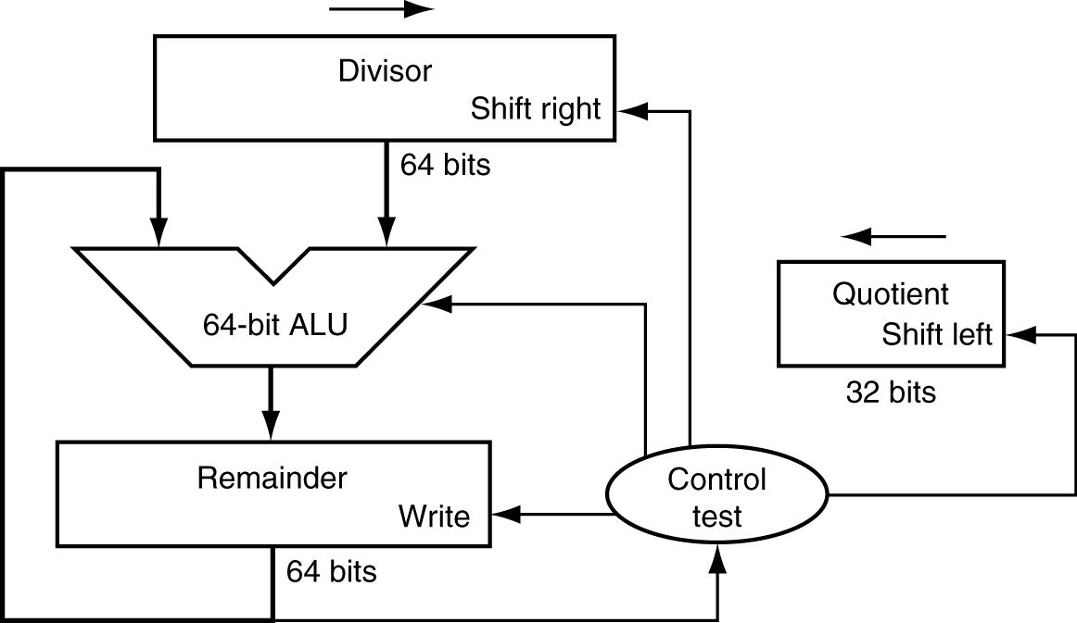
Division hardware
Initially divisor in left half
Initially dividend

Slide 33
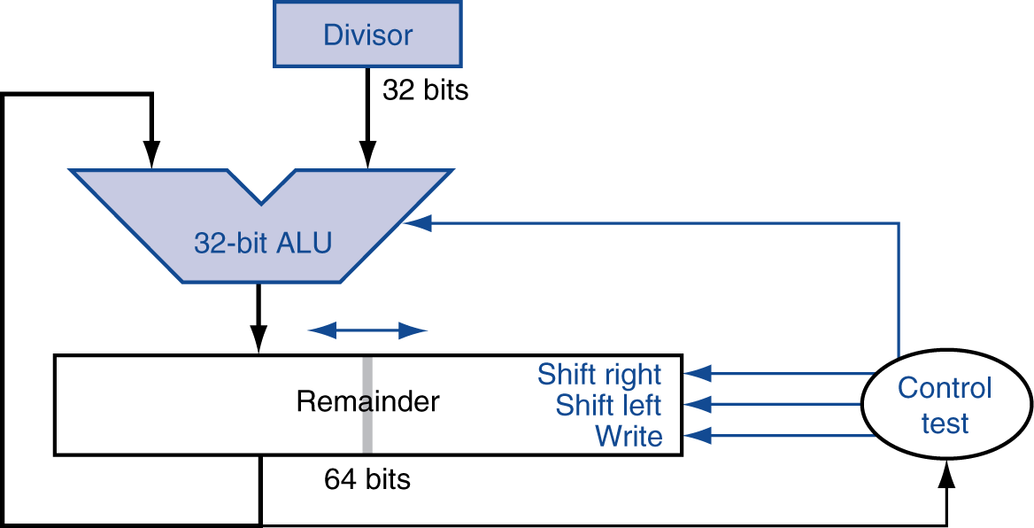
Optimized divider
One cycle per partial-remainder subtraction
Looks a lot like a multiplier!
Same hardware can be used for both

Slide 34
Faster Division
Can’t use parallel hardware as in multiplier
Subtraction is conditional on sign of remainder
Faster dividers (e.g. SRT division) generate multiple quotient bits per step
Still require multiple steps

Slide 35
LEGv8 Division
Two instructions:
SDIV (signed)
UDIV (unsigned)
Both instructions ignore overflow and division-by-zero

Slide 36
Fixed-point representation

Slide 37
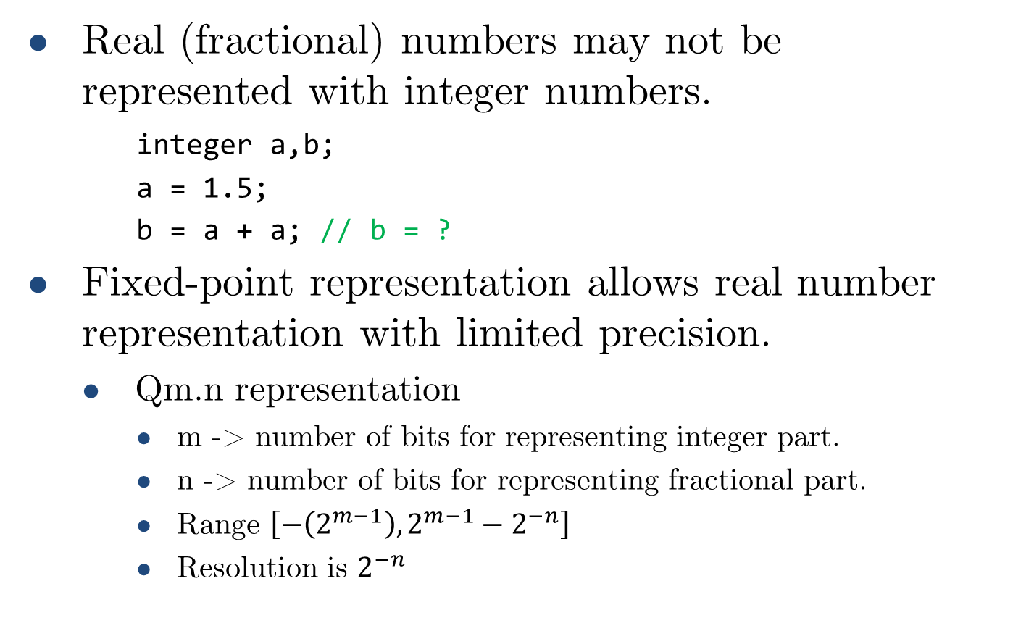
Fixed-point introduction
Real (fractional) numbers may not be represented with integer numbers.
integer a,b;
a = 1.5;
b = a + a; // b = ?
Fixed-point representation allows real number representation with limited precision.
Qm.n representation
m -> number of bits for representing integer part.
n -> number of bits for representing fractional part.
Range $\left[−\left(2^{m−1}\right),2^{m−1}−2^{−n}\right]$
Resolution is $2^{−n}$

Slide 38
Fixed-point
Fixed-point representation is suitable for embedded applications requiring limited degree of fractional precision.
DOOM (1993 videogame) originally used a Q16.16 format for all non-integer operations https://doomwiki.org/wiki/Fixed_point
What about high-precision applications?

Slide 39
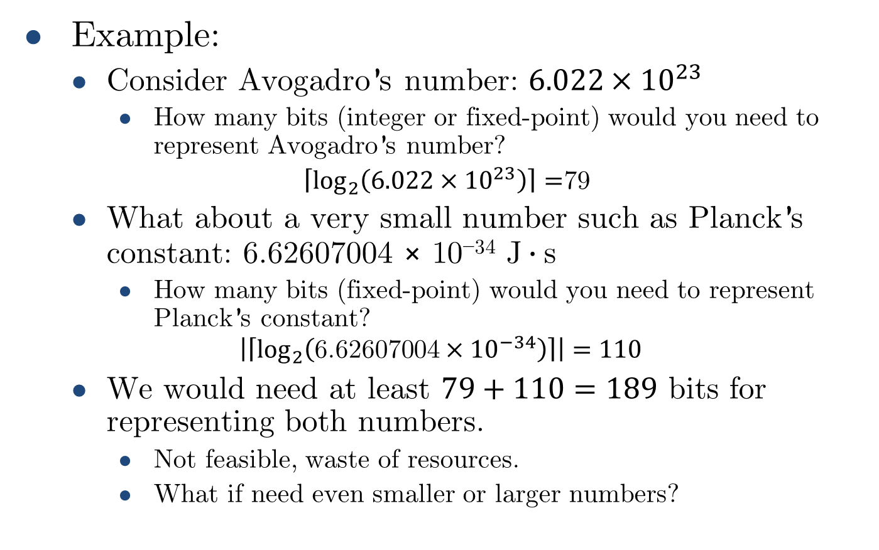
Fixed-point limitations
Example:
Consider Avogadro’s number: ${6.022×10}^{23}$
How many bits (integer or fixed-point) would you need to represent Avogadro’s number?
$\left\lceil \log_{2}\left({6.022×10}^{23}\right)\right\rceil =$79
What about a very small number such as Planck’s constant: $\text{6.62607004 × 10}\text{−34} \text{J}∙\text{s}$
How many bits (fixed-point) would you need to represent Planck’s constant?
$$\left|\left\lceil \log_{2}\left({\text{6.62607004}×10}^{−34}\right)\right\rceil \right|=110$$
We would need at least $79+110=189$ bits for representing both numbers.
Not feasible, waste of resources.
What if need even smaller or larger numbers?

Slide 40
Floating-point representation

Slide 41
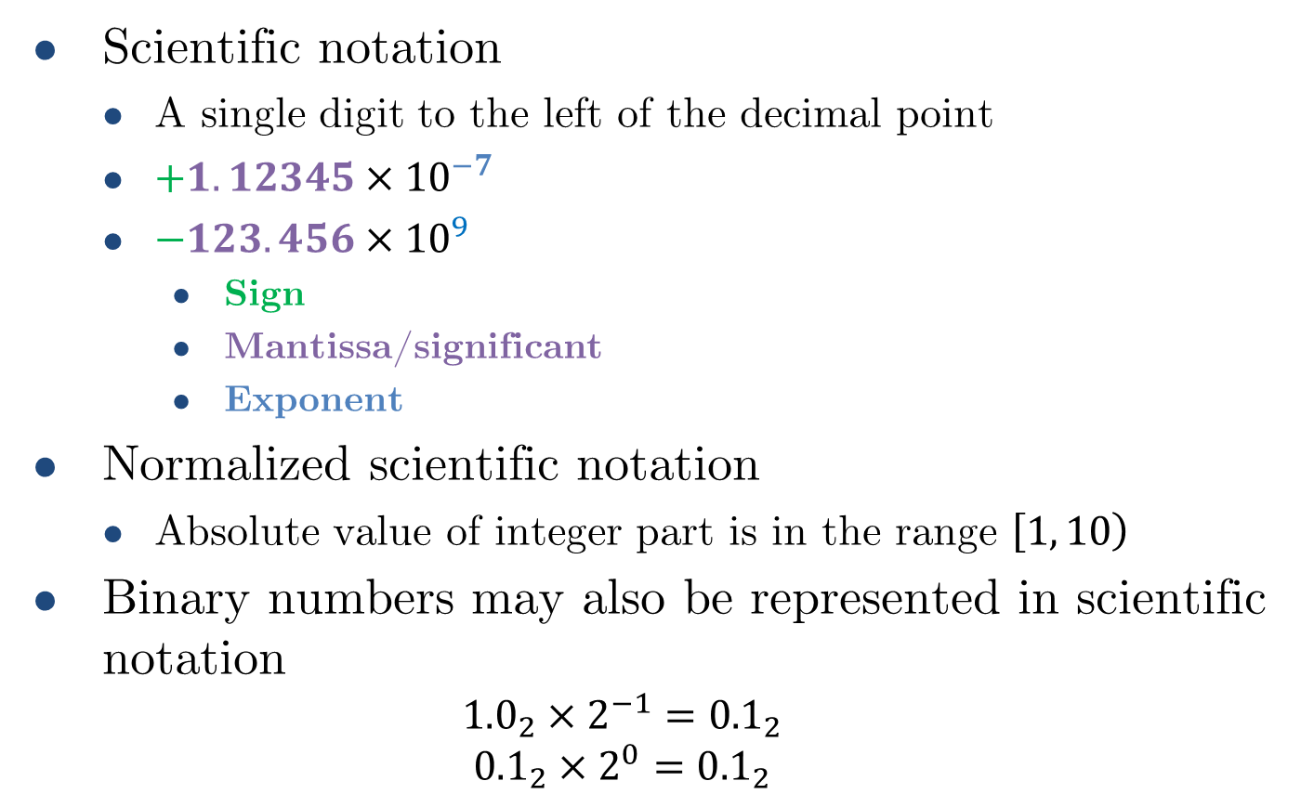
Floating-point
Scientific notation
A single digit to the left of the decimal point
$+1.12345{×10}^{−7}$
$−123.456{×10}^{9}$
Sign
Mantissa/significant
Exponent
Normalized scientific notation
Absolute value of integer part is in the range $\left[1,\left.10\right)\right.$
Binary numbers may also be represented in scientific notation
$${1.0}_{2}×2^{−1}={0.1}_{2}$$
$${0.1}_{2}×2^{0}={0.1}_{2}$$
normalized
not normalized
normalized
not normalized

Slide 42
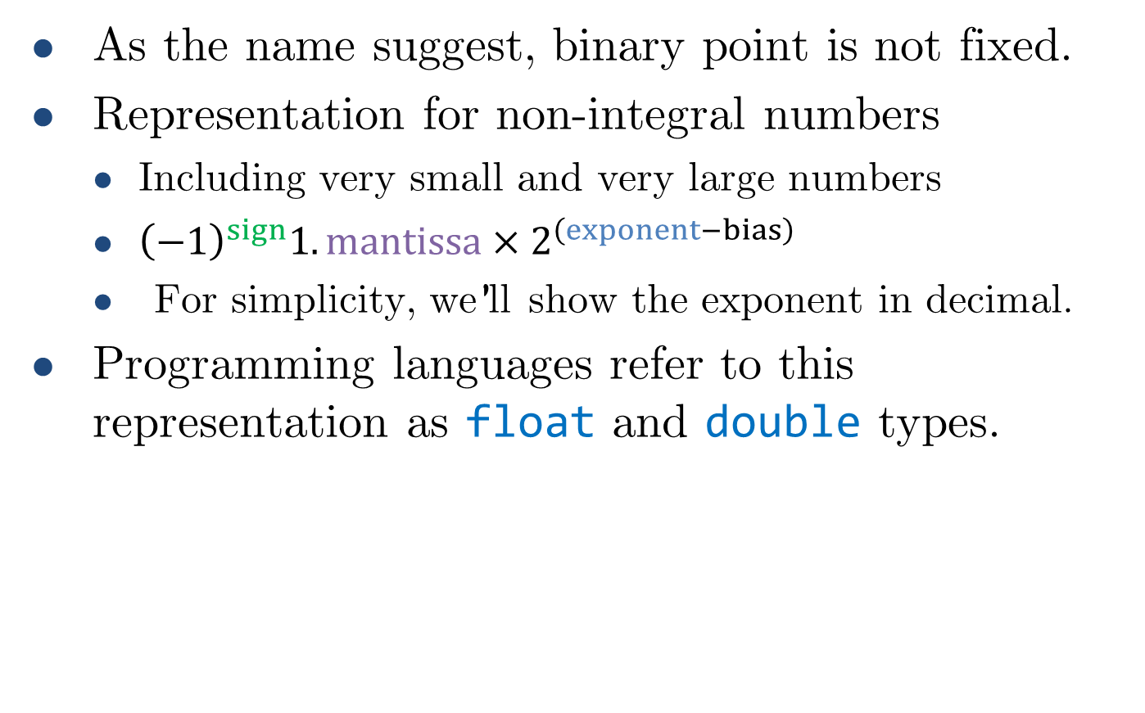
Floating-point
As the name suggest, binary point is not fixed.
Representation for non-integral numbers
Including very small and very large numbers
${\left(−1\right)}^{sign}1.mantissa×2^{\left(exponent−bias\right)}$
For simplicity, we’ll show the exponent in decimal.
Programming languages refer to this representation as float and double types.

Slide 43
Floating-point standard
Defined by IEEE Std 754-1985
Developed in response to divergence of representations
Portability issues for scientific code
Now almost universally adopted
Two representations
Single precision (32-bit)
Double precision (64-bit)
Simplifies exchange of data, arithmetic and increases accuracy.

Slide 44
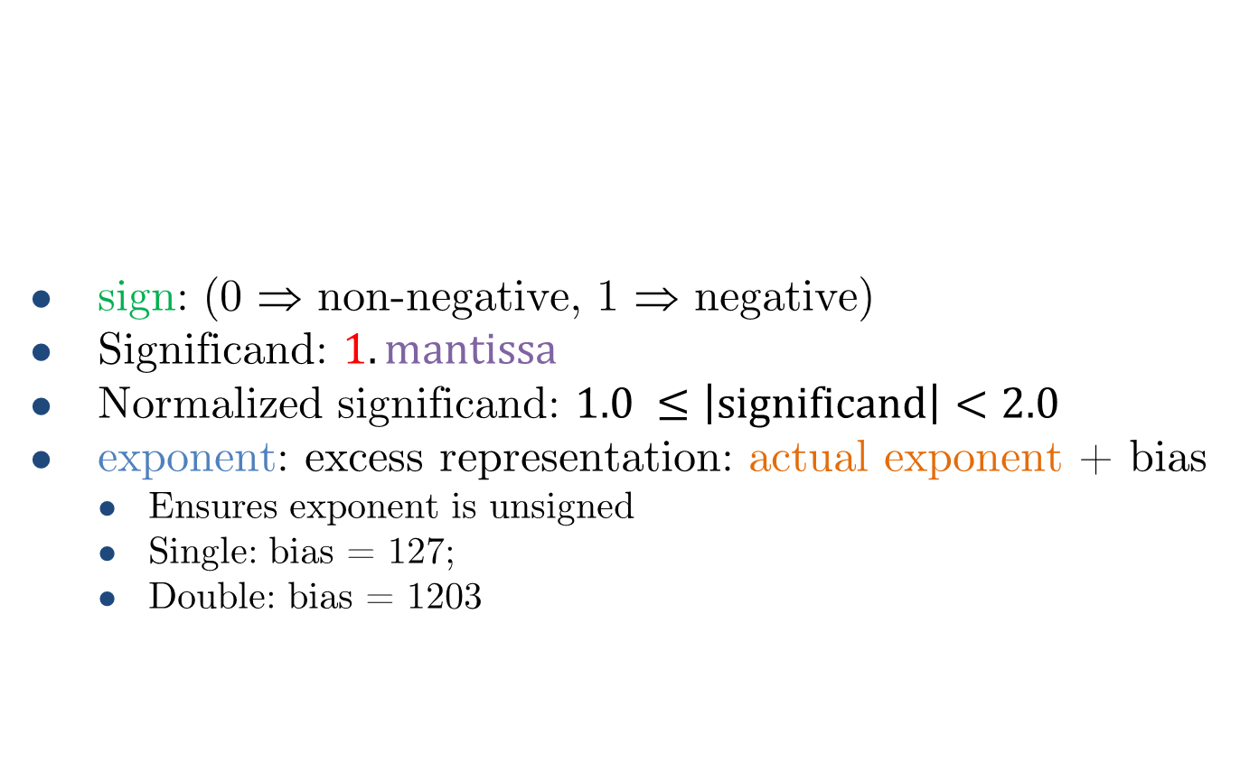
IEEE Floating-point format
single: 8 bits double: 11 bits
single: 23 bits double: 52 bits
sign: (0 ⇒ non-negative, 1 ⇒ negative)
Significand: $1.mantissa$
Normalized significand: $1.0 ≤\left|significand\right|<2.0$
exponent: excess representation: actual exponent + bias
Ensures exponent is unsigned
Single: bias = 127;
Double: bias = 1203
1 bit
sign
exponent
mantissa
Implicit 1
$${x= \left(−1\right)}^{sign}1.mantissa×2^{\left(exponent−bias\right)}$$

Slide 45
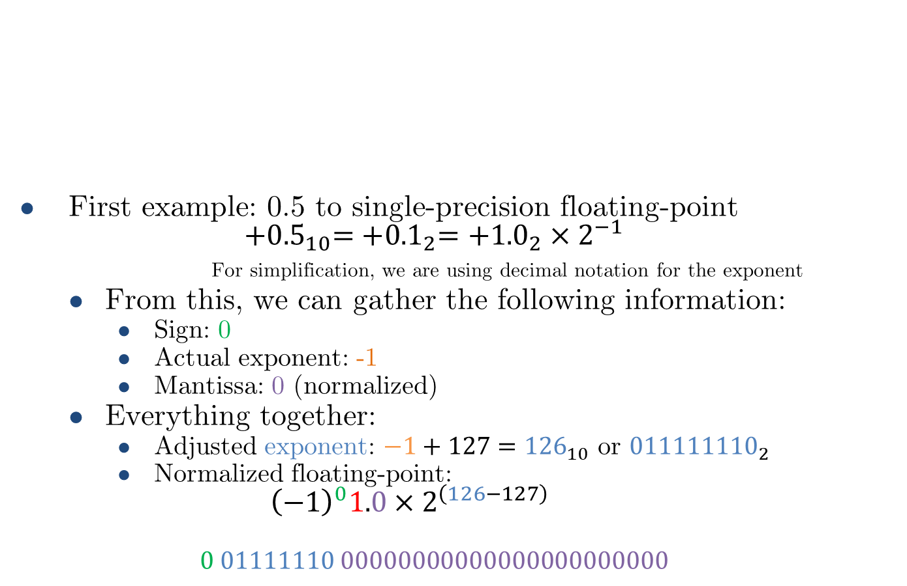

IEEE Floating-point format
single: 8 bits double: 11 bits
single: 23 bits double: 52 bits
First example: 0.5 to single-precision floating-point
$${+0.5}_{10}={+0.1}_{2}={+1.0}_{2}×2^{−1}$$
For simplification, we are using decimal notation for the exponent
From this, we can gather the following information:
Sign: 0
Actual exponent: -1
Mantissa: 0 (normalized)
Everything together:
Adjusted exponent: $−1+127={126}_{10}$ or ${011111110}_{2}$
Normalized floating-point:
$${\left(−1\right)}^{0}1.0×2^{\left(126−127\right)}$$
$$0 01111110 00000000000000000000000$$
1 bit
sign
exponent
mantissa
$${x= \left(−1\right)}^{sign}1.mantissa×2^{\left(exponent−bias\right)}$$

Slide 46
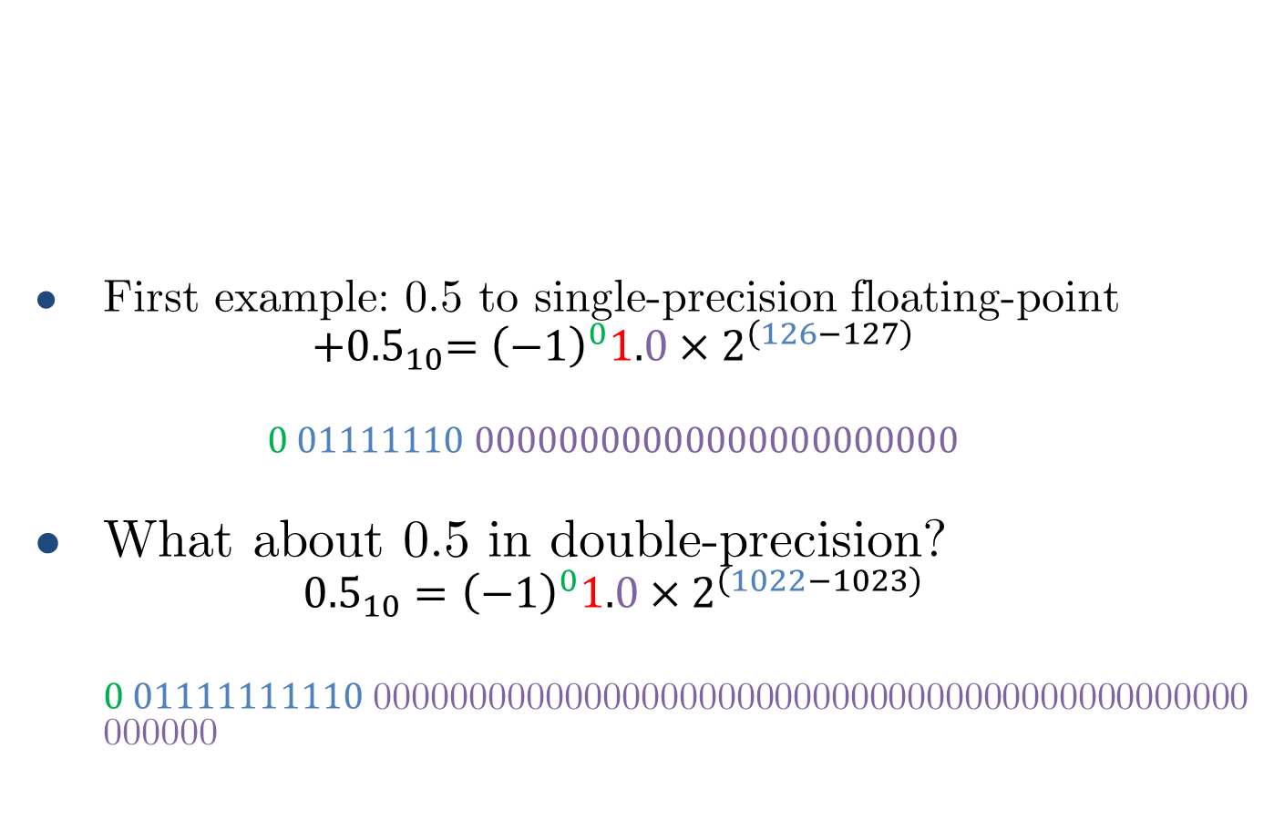
IEEE Floating-point format
single: 8 bits double: 11 bits
single: 23 bits double: 52 bits
First example: 0.5 to single-precision floating-point
$${+0.5}_{10}={\left(−1\right)}^{0}1.0×2^{\left(126−127\right)}$$
$$0 01111110 00000000000000000000000$$
What about 0.5 in double-precision?
$${0.5}_{10}={\left(−1\right)}^{0}1.0×2^{\left(1022−1023\right)}$$
$0 01111111110$0000000000000000000000000000000000000000000000000000
1 bit
sign
exponent
mantissa
$${x= \left(−1\right)}^{sign}1.mantissa×2^{\left(exponent−bias\right)}$$
This 1 is not actually required here

Slide 47
Floating-point example
Represent –0.75
–0.75 = (–1)¹ × 1.1₂ × 2^{–1}
sign = 1
mantissa = 1000…00₂
exponent = –1 + bias
Single: –1 + 127 = 126 = 01111110₂
Double: –1 + 1023 = 1022 = 01111111110₂
Single: 1011111101000…00
Double: 1011111111101000…00

Slide 48
Floating-point example
What number is represented by the single-precision float
11000000101000000000000000000000
sign = 1
mantissa = 01000…00₂
exponent = 10000001₂ = 129
x = (–1)¹ × (1 + .01₂) × 2^{(129 – 127)}
= (–1) × 1.25 × 2²
= –5.0

Slide 49
Single precision range
Exponents 00000000 and 11111111 reserved
Smallest value
Exponent: 00000001 ⇒ actual exponent = 1 – 127 = –126
Fraction: 000…00 ⇒ significand = 1.0
±1.0 × 2^{–126} ≈ ±1.2 × 10^{–38}
Largest value
exponent: 11111110 ⇒ actual exponent = 254 – 127 = +127
Fraction: 111…11 ⇒ significand ≈ 2.0
±2.0 × 2⁺¹²⁷ ≈ ±3.4 × 10⁺³⁸

Slide 50
Double precision range
Exponents 00000000000 and 11111111111 reserved
Smallest value
Exponent: 00000000001 ⇒ actual exponent = 1 – 1023 = –1022
Fraction: 000…00 ⇒ significand = 1.0
±1.0 × 2^{–1022} ≈ ±2.2 × 10^{–308}
Largest value
exponent: 11111111110 ⇒ actual exponent = 2046 – 1023 = +1023
Fraction: 111…11 ⇒ significand ≈ 2.0
±2.0 × 2⁺¹⁰²³ ≈ ±1.8 × 10⁺³⁰⁸

Slide 51

Floating-point precision
Relative precision
all fraction bits are significant
Single: approx. 2^{–23}
Equivalent to 23 $×$ log₁₀2 ≈ 7 decimal digits of precision
Double: approx. 2^{–52}
Equivalent to 52 $×$ log₁₀2 ≈ 16 decimal digits of precision

Slide 52

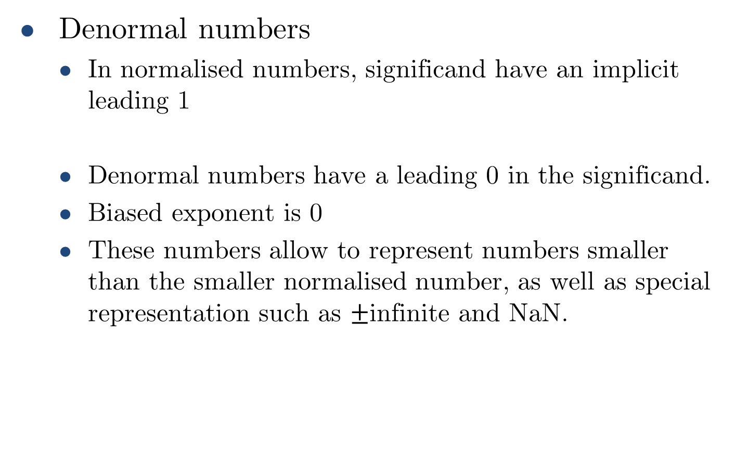
Floating-point special representation
Denormal numbers
In normalised numbers, significand have an implicit leading 1
Denormal numbers have a leading 0 in the significand.
Biased exponent is 0
These numbers allow to represent numbers smaller than the smaller normalised number, as well as special representation such as $±$infinite and NaN.
$${x= \left(−1\right)}^{sign}1.mantissa×2^{\left(exponent−bias\right)}$$

Slide 53

Denormal numbers
Smaller than normal numbers.
Allow for gradual underflow, with diminishing precision.
Zero
sign = 0,1
biased exponent = 0
mantissa = 0
$$x=(−1)^{sign}×(0.mantissa)×2^{0−bias}$$
$$x=(−1)^{sign}×(0+0)×2^{−bias}=±0.0$$
Two representations of 0.0!

Slide 54
Denormalized numbers
Smallest denormalized value
Single precision: ${±2^{−23}×2^{−126}≈1.4×10}^{−45}$
Single precision: 〖±2^(−23)×2^(−126)≈1.4×10〗^(−45)
Largest denormalized value
Single precision: ${±\left(1−2^{−23}\right)×2^{−126}≈±1.17×10}^{−38}$
Single precision: 〖±(1−2^(−23) )×2^(−126)≈±1.17×10〗^(−38)
Double precision: ${±2^{−52}×2^{−1022}≈4.9×10}^{−324}$
Double precision: 〖±2^(−52)×2^(−1022)≈4.9×10〗^(−324)
Double precision: ${±\left(1−2^{−52}\right)×2^{−1022}≈±2.22×10}^{−308}$
Double precision: 〖±(1−2^(−52) )×2^(−1022)≈±2.22×10〗^(−308)

Slide 55
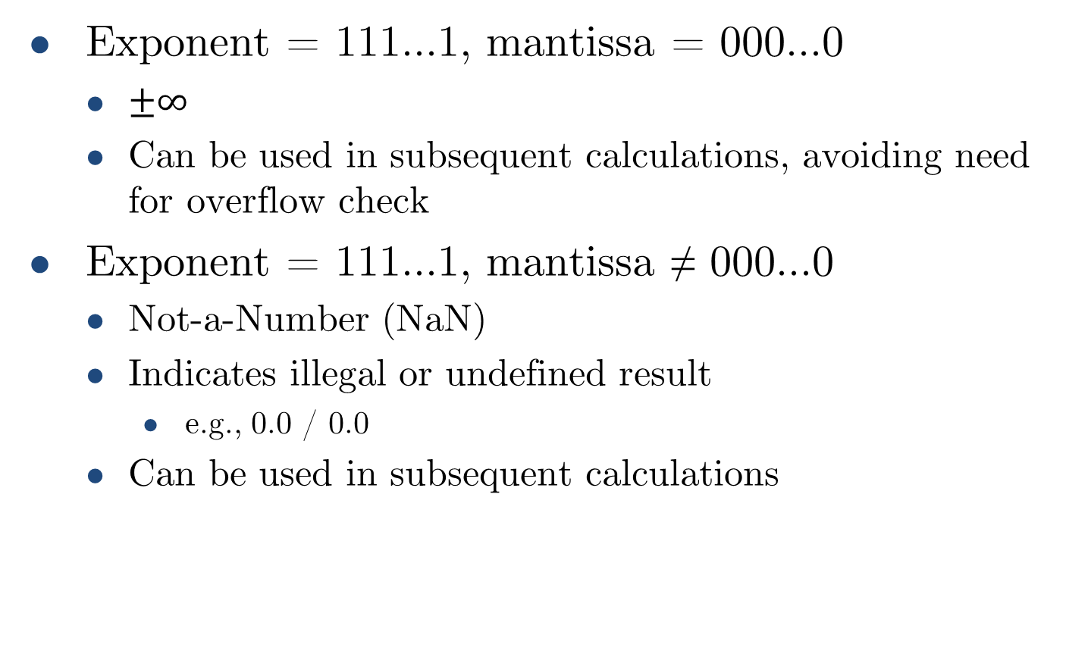
Infinities and NaNs
Exponent = 111...1, mantissa = 000...0
$±∞$
Can be used in subsequent calculations, avoiding need for overflow check
Exponent = 111...1, mantissa ≠ 000...0
Not-a-Number (NaN)
Indicates illegal or undefined result
e.g., 0.0 / 0.0
Can be used in subsequent calculations

Slide 56
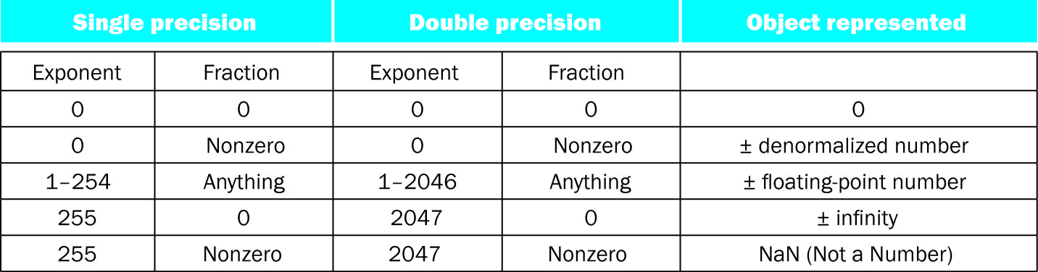
Floating-point special formats summary

Slide 57
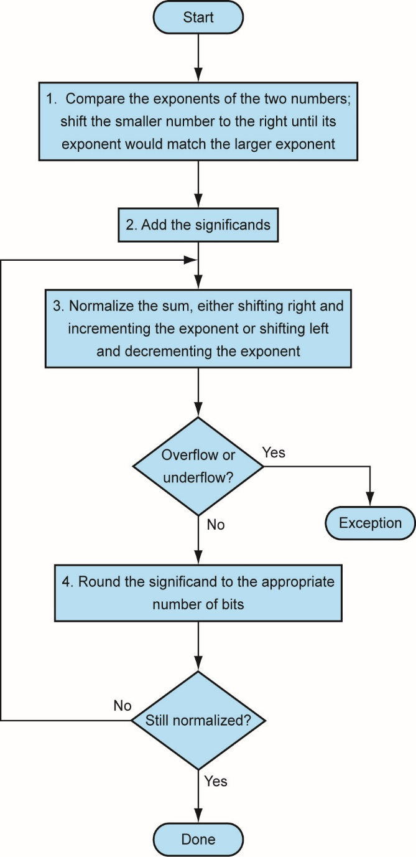
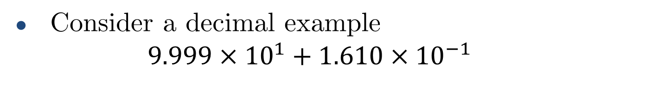
Floating-point addition
Consider a decimal example
$$9.999×{10}^{1}+1.610×{10}^{−1}$$
1. Align decimal points
Shift number with smaller exponent
9.999 × 10¹ + 0.016 × 10¹
9.999 × 10¹ + 0.016 × 10¹ = 10.015 × 10¹
3. Normalize result & check for over/underflow
1.0015 × 10²
4. Round and renormalize if necessary
1.002 × 10²
2. Add significands

Slide 58
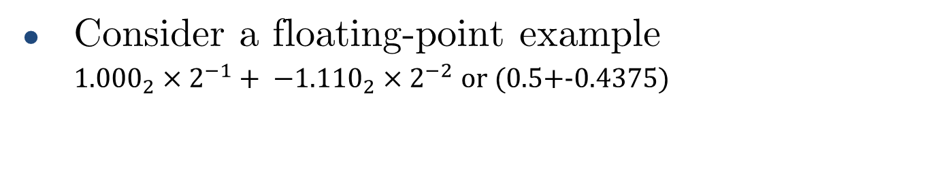
Floating-point addition
Consider a floating-point example
${1.000}_{2}×2^{−1}+ −{{1.110}_{2}×2}^{−2}$ or (0.5+-0.4375)
1. Align decimal points
Shift number with smaller exponent
$${1.000}_{2}×2^{−1}+ −{0.1110}_{2}×2^{−1}$$
〖1.000〗_2×2^(−1)+ −〖0.1110〗_2×2^(−1)
$$1.0002 × 2^{−1} + –0.1112 × 2^{−1} = 0.0012 × 2^{−1}$$
1.000₂ × 2^(−1) + –0.111₂ × 2^(−1) = 0.001₂ × 2^(−1)
3. Normalize result & check for over/underflow
$${1.0}_{2}×2^{−4}$$
〖1.0〗_2×2^(−4)
4. Round and renormalize if necessary
$${1.0}_{2}×2^{−4}=0.0625$$
〖1.0〗_2×2^(−4)=0.0625
2. Add significands

Slide 59
Floating-point adder hardware
Much more complex than integer adder.
Doing it in one clock cycle would take too long.
Much longer than integer operations.
Slower clock would penalize all instructions.
Floating-point adder usually takes several cycles
Can be pipelined

Slide 60
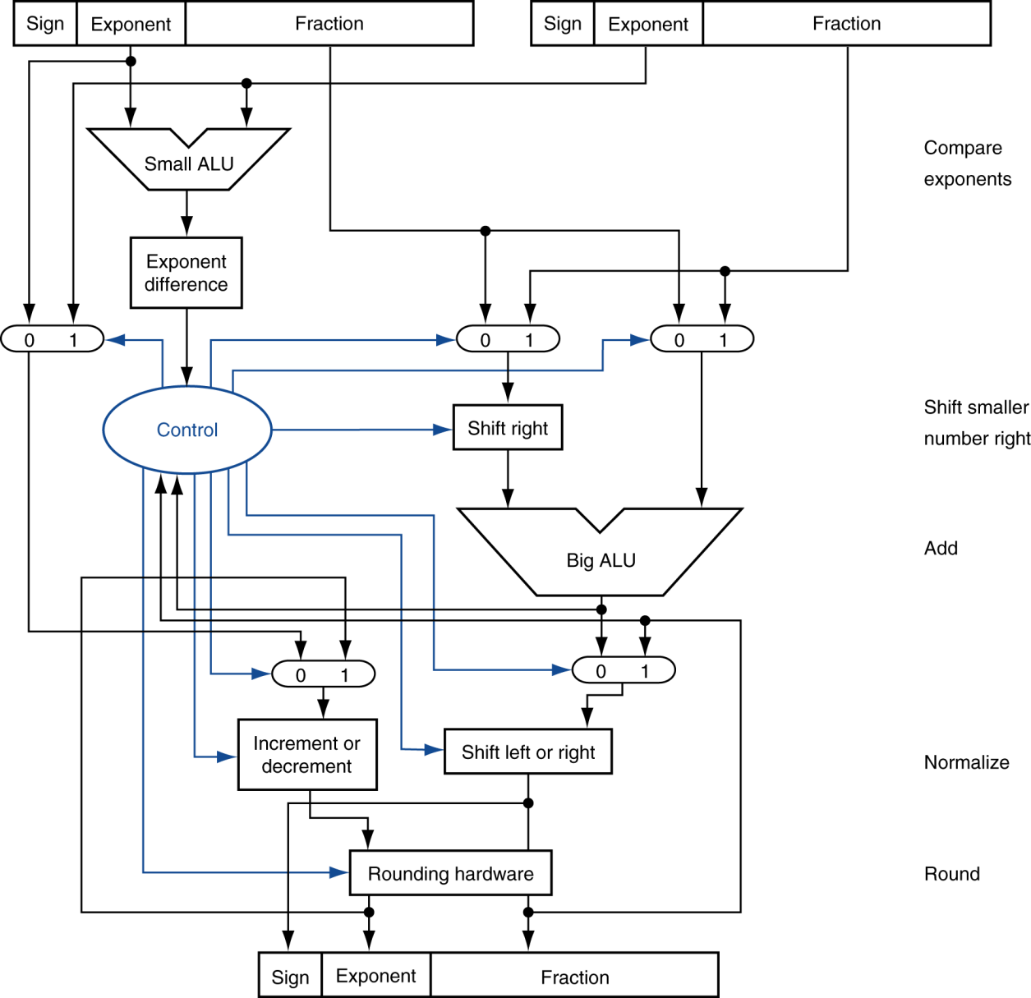

Floating-point adder hardware
Step 1
Step 2
Step 3
Step 4

Slide 61
Floating-point adder hardware
Step 1
Step 2
Step 3
Step 4

Slide 62
Floating-point adder hardware
Step 1
Step 2
Step 3
Step 4

Slide 63
Floating-point adder hardware
Step 1
Step 2
Step 3
Step 4

Slide 64
Floating-point adder hardware
Step 1
Step 2
Step 3
Step 4

Slide 65
Floating-point adder hardware
Step 1
Step 2
Step 3
Step 4

Slide 66
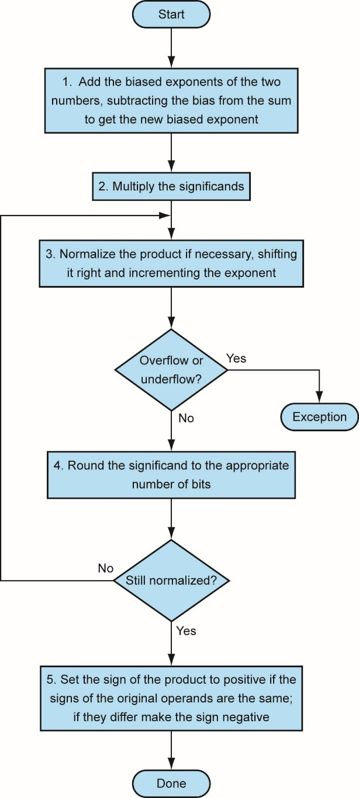
Floating-point multiplication
Consider a decimal example
$$1.110 × 1010 × 9.200 × {10}^{−5}$$
1.110 × 10¹⁰ × 9.200 × 10^(−5)
1. Add exponents
For biased exponents, subtract bias from sum
New exponent = 10 + –5 = 5
2. Multiply significands
$$1.110 × 9.200 = 10.212  10.212 × 105$$
1.110 × 9.200 = 10.212 ⇒ 10.212 × 10⁵
3. Normalize result & check for over/underflow
$$1.0212 × 106$$
1.0212 × 10⁶
4. Round and renormalize if necessary
$$1.021 × 106$$
1.021 × 10⁶
5. Determine sign of result from signs of operands
$$+1.021 × 106$$
+1.021 × 10⁶

Slide 67
Floating-point multiplication
Consider a floating-point example
$−14.25 ×3.125$ in decimal, or
−14.25 ×3.125 in decimal, or
1. Add exponents
Unbiased: 3 + 1 = 4
Biased: (3 + 127) + (1 + 127)$−127$
Biased: (3 + 127) + (1 + 127)−127
2. Multiply significands
$$−1.110012×1.10012$$
−1.11001₂×1.1001₂
3. Normalize result & check for over/underflow
$1.01100100012×2^{5}$ with no over/underflow
1.0110010001₂×2^5 with no over/underflow
4. Round and renormalize if necessary
$1.01100100012×2^{5}$(no change)
1.0110010001₂×2^5(no change)
5. Determine sign of result from signs of operands
$$–1.01100100012×2^{5}= –44.53125$$
–1.0110010001₂×2^5= –44.53125
$$= {10.110010001}_{2}$$
= 〖10.110010001〗_2
$$−1.110012×2^{3}×1.10012×2^{1}$$
−1.11001₂×2^3×1.1001₂×2^1
$$= 4 + 254 – 127 = 4 + 127$$
= 4 + 254 – 127 = 4 + 127
$$ 10.1100100012×2^{4}$$
⇒ 10.110010001₂×2^4

Slide 68
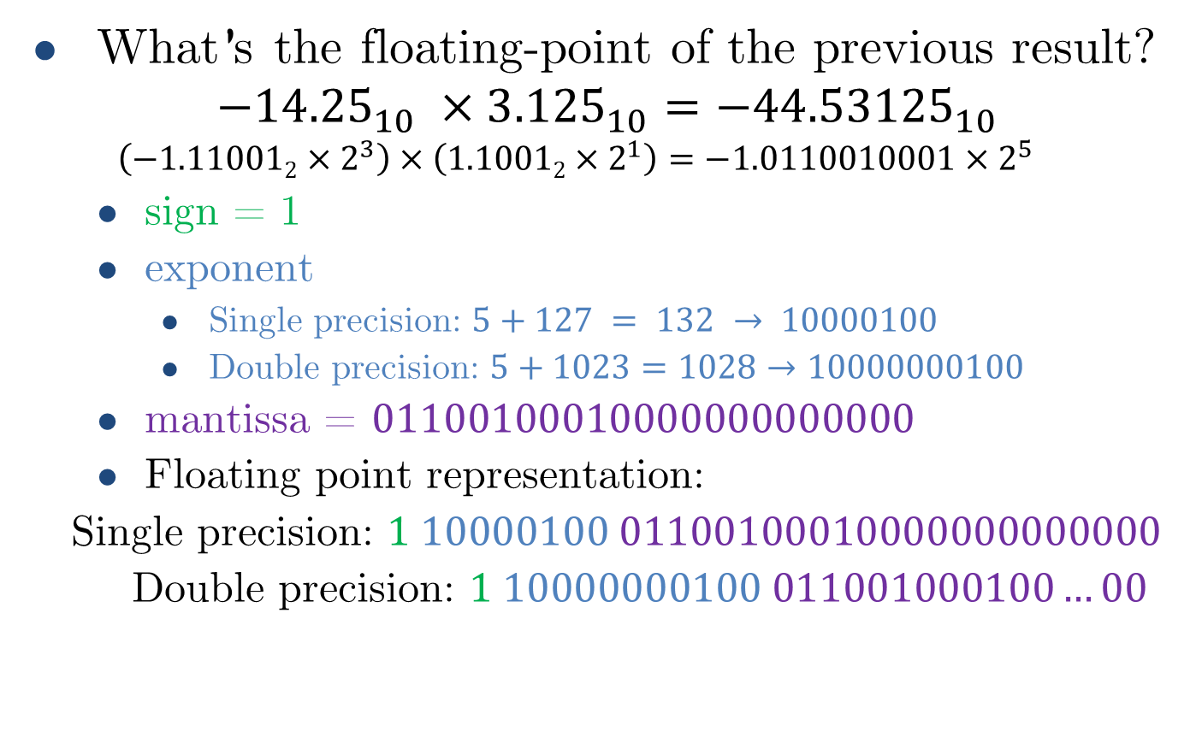
Floating-point multiplication
What’s the floating-point of the previous result?
$${−14.25}_{10} ×{3.125}_{10}={−44.53125}_{10}$$
$$\left(−1.110012×2^{3}\right)×\left(1.10012×2^{1}\right)=−1.0110010001×2^{5}$$
sign = 1
exponent
Single precision: $5+127 = 132 → 10000100$
Double precision: $5+1023=1028→10000000100$
mantissa = $01100100010000000000000$
Floating point representation:
Single precision: $1 10000100 01100100010000000000000$
Double precision: $1 10000000100 011001000100…00$

Slide 69
Floating-point arithmetic hardware
Floating-point multiplier is of similar complexity to floating-point adder
But uses a multiplier for significands instead of an adder
Floating-point arithmetic hardware usually does
Addition, subtraction, multiplication, division, reciprocal, square-root
Floating-point ↔ integer conversion
Operations usually takes several cycles
Can be pipelined

Slide 70
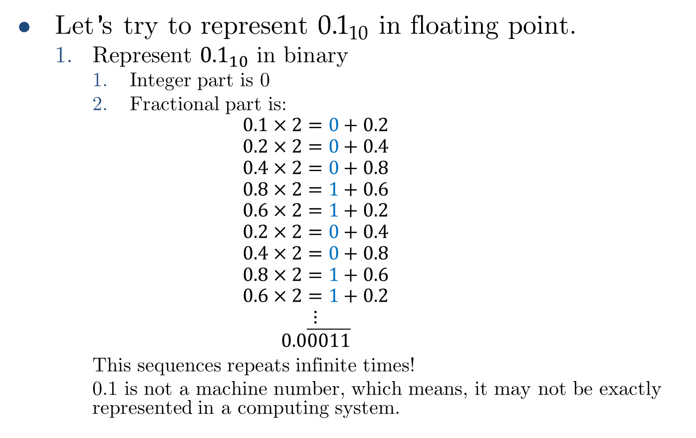
Floating-point rounding
Let’s try to represent ${0.1}_{10}$ in floating point.
Represent ${0.1}_{10}$ in binary
Integer part is 0
Fractional part is:
$$0.1×2=0+0.2$$
$$0.2×2=0+0.4$$
$$0.4×2=0+0.8$$
$$0.8×2=1+0.6$$
$$0.6×2=1+0.2$$
$$0.2×2=0+0.4$$
$$0.4×2=0+0.8$$
$$0.8×2=1+0.6$$
$$0.6×2=1+0.2$$
$$⋮$$
$$0.0\overline{0011}$$
This sequences repeats infinite times!
0.1 is not a machine number, which means, it may not be exactly represented in a computing system.

Slide 71
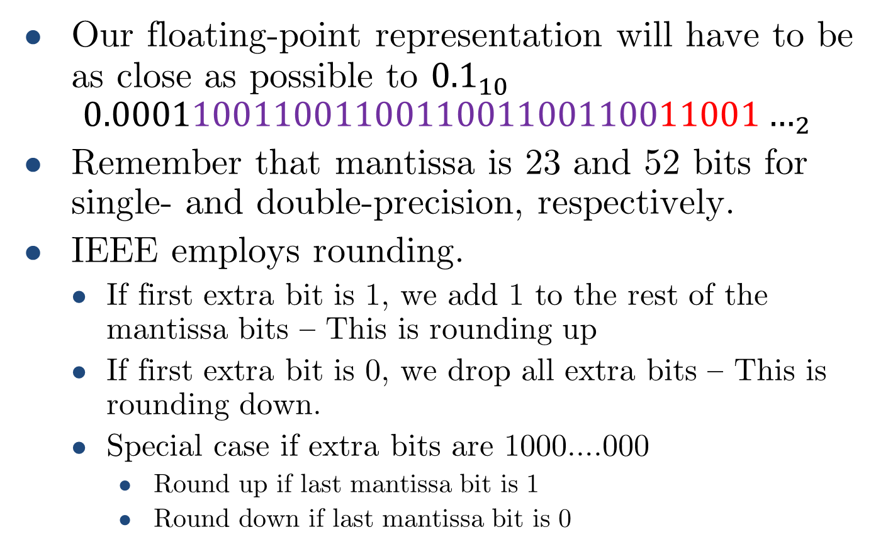
Floating-point rounding
Our floating-point representation will have to be as close as possible to ${0.1}_{10}$
$${0.00011001100110011001100110011001…}_{2}$$
Remember that mantissa is 23 and 52 bits for single- and double-precision, respectively.
IEEE employs rounding.
If first extra bit is 1, we add 1 to the rest of the mantissa bits – This is rounding up
If first extra bit is 0, we drop all extra bits – This is rounding down.
Special case if extra bits are 1000….000
Round up if last mantissa bit is 1
Round down if last mantissa bit is 0

Slide 72
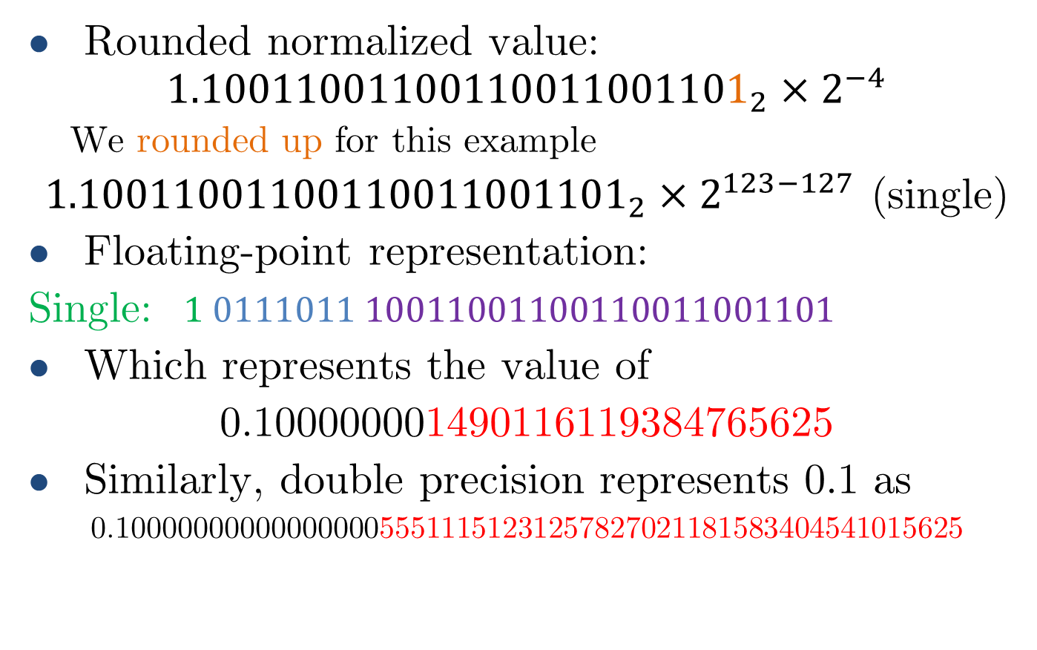
Floating-point rounding
Rounded normalized value:
$${1.10011001100110011001101}_{2}×2^{−4}$$
We rounded up for this example
${1.10011001100110011001101}_{2}×2^{123−127}$ (single)
Floating-point representation:
Single: $1 0111011 10011001100110011001101$
Which represents the value of
0.100000001490116119384765625
Similarly, double precision represents 0.1 as
0.1000000000000000055511151231257827021181583404541015625

Slide 73
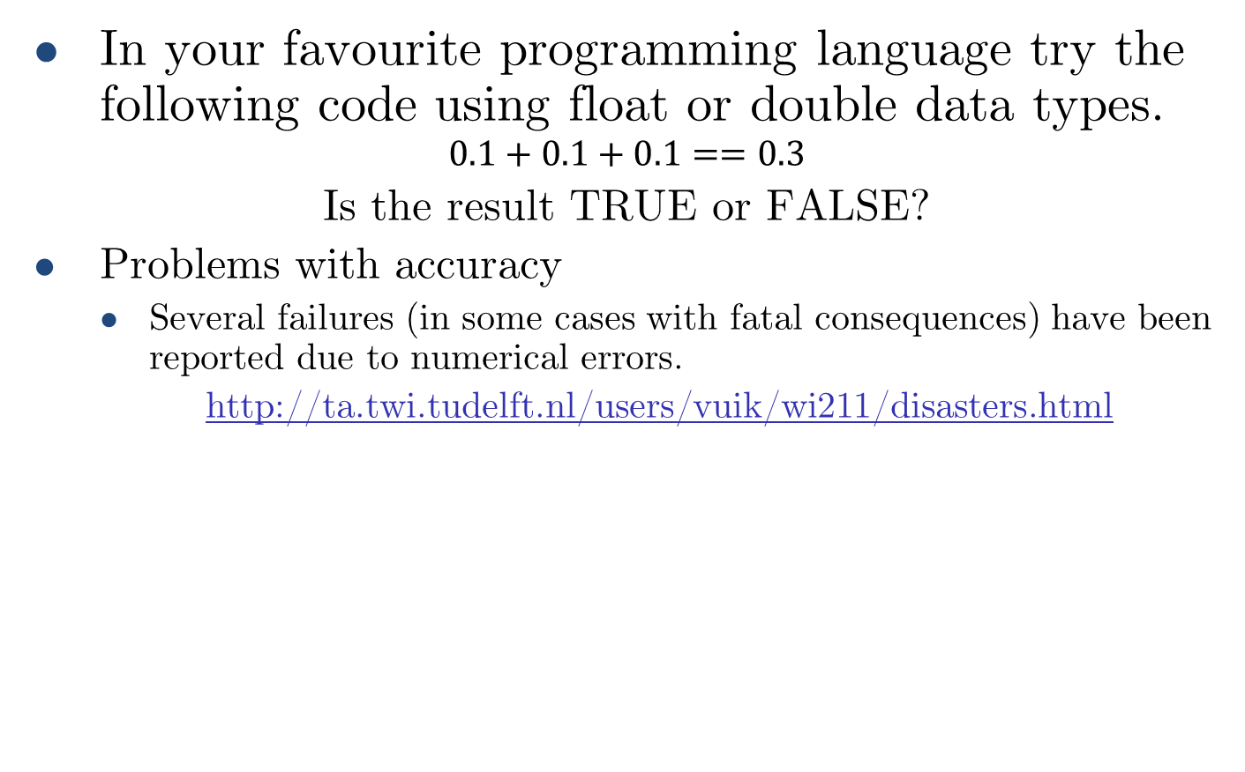
Floating-point rounding
In your favourite programming language try the following code using float or double data types.
$$0.1+0.1+0.1==0.3$$
Is the result TRUE or FALSE?
Problems with accuracy
Several failures (in some cases with fatal consequences) have been reported due to numerical errors.
http://ta.twi.tudelft.nl/users/vuik/wi211/disasters.html

Slide 74
Concluding Remarks
Bits have no inherent meaning
Interpretation depends on the instructions applied
Computer representations of numbers
Finite range and precision
Need to account for this in programs

Slide 75
Concluding Remarks
ISAs support arithmetic
Signed and unsigned integers
Floating-point approximation to reals
Bounded range and precision
Operations can overflow and underflow

Slide 76
Floating-point overflow/underflow

Slide 77
FP Instructions in LEGv8
Separate FP registers
32 single-precision: S0, …, S31
32 double-precision: DS0, …, D31
Sn stored in the lower 32 bits of Dn
FP instructions operate only on FP registers
Programs generally don’t do integer ops on FP data, or vice versa
More registers with minimal code-size impact
FP load and store instructions
LDURS, LDURD
STURS, STURD

Slide 78
FP Instructions in LEGv8
Single-precision arithmetic
FADDS, FSUBS, FMULS, FDIVS
e.g., FADDS S2, S4, S6
Double-precision arithmetic
FADDD, FSUBD, FMULD, FDIVD
e.g., FADDD D2, D4, D6
Single- and double-precision comparison
FCMPS, FCMPD
Sets or clears FP condition-code bits
Branch on FP condition code true or false
B.cond

Slide 79
FP Example: °F to °C
C code:
float f2c (float fahr) { return ((5.0/9.0)*(fahr - 32.0)); }
fahr in S12, result in S0, literals in global memory space
Compiled LEGv8 code:
f2c:
LDURS S16, [X27,const5] // S16 = 5.0 (5.0 in memory)
LDURS S18, [X27,const9] // S18 = 9.0 (9.0 in memory)
FDIVS S16, S16, S18 // S16 = 5.0 / 9.0
LDURS S18, [X27,const32] // S18 = 32.0
FSUBS S18, S12, S18 // S18 = fahr – 32.0
FMULS S0, S16, S18 // S0 = (5/9)*(fahr – 32.0)
BR LR // return

Slide 80
FP Example: Array Multiplication
X = X + Y × Z
All 32 × 32 matrices, 64-bit double-precision elements
C code:
void mm (double x[][], double y[][], double z[][]) { int i, j, k; for (i = 0; i! = 32; i = i + 1) for (j = 0; j! = 32; j = j + 1) for (k = 0; k! = 32; k = k + 1) x[i][j] = x[i][j] + y[i][k] * z[k][j]; }
Addresses of x, y, z in X0, X1, X2, and i, j, k in X19, X20, X21

Slide 81
FP Example: Array Multiplication
LEGv8 code:
mm:...
LDI X10, 32 // X10 = 32 (row size/loop end)
LDI X19, 0 // i = 0; initialize 1st for loop
L1: LDI X20, 0 // j = 0; restart 2nd for loop
L2: LDI X21, 0 // k = 0; restart 3rd for loop
LSL X11, X19, 5 // X11 = i * 2 5 (size of row of c)
ADD X11, X11, X20 // X11 = i * size(row) + j
LSL X11, X11, 3 // X11 = byte offset of [i][j]
ADD X11, X0, X11 // X11 = byte address of c[i][j]
LDURD D4, [X11,#0] // D4 = 8 bytes of c[i][j]
L3: LSL X9, X21, 5 // X9 = k * 2 5 (size of row of b)
ADD X9, X9, X20 // X9 = k * size(row) + j
LSL X9, X9, 3 // X9 = byte offset of [k][j]
ADD X9, X2, X9 // X9 = byte address of b[k][j]
LDURD D16, [X9,#0] // D16 = 8 bytes of b[k][j]
LSL X9, X19, 5 // X9 = i * 2 5 (size of row of a)

Slide 82
FP Example: Array Multiplication
… ADD X9, X9, X21 // X9 = i * size(row) + k
LSL X9, X9, 3 // X9 = byte offset of [i][k]
ADD X9, X1, X9 // X9 = byte address of a[i][k]
LDURD D18, [X9,#0] // D18 = 8 bytes of a[i][k]
FMULD D16, D18, D16 // D16 = a[i][k] * b[k][j]
FADDD D4, D4, D16 // f4 = c[i][j] + a[i][k] * b[k][j]
ADDI X21, X21, 1 // $k = k + 1
CMP X21, X10 // test k vs. 32
B.LT L3 // if (k < 32) go to L3
STURD D4, [X11,0] // = D4
ADDI X20, X20, #1 // $j = j + 1
CMP X20, X10 // test j vs. 32
B.LT L2 // if (j < 32) go to L2
ADDI X19, X19, #1 // $i = i + 1
CMP X19, X10 // test i vs. 32
B.LT L1 // if (i < 32) go to L1

Slide 83
Accurate Arithmetic
IEEE Std 754 specifies additional rounding control
Extra bits of precision (guard, round, sticky)
Choice of rounding modes
Allows programmer to fine-tune numerical behavior of a computation
Not all FP units implement all options
Most programming languages and FP libraries just use defaults
Trade-off between hardware complexity, performance, and market requirements

Slide 84
Subword Parallellism
Graphics and audio applications can take advantage of performing simultaneous operations on short vectors
Example: 128-bit adder:
Sixteen 8-bit adds
Eight 16-bit adds
Four 32-bit adds
Also called data-level parallelism, vector parallelism, or Single Instruction, Multiple Data (SIMD)

Slide 85
ARMv8 SIMD
32 128-bit registers (V0, …, V31)
Works with integer and FP
Examples:
16 8-bit integer adds:
ADD V1.16B, V2.16B, V3.16B
4 32-bit FP adds:
FADD V1.4S, V2.4S, V3.4S

Slide 86
Other ARMv8 Features
245 SIMD instructions, including:
Square root
Fused multiply-add, multiply-subtract
Convertion and scalar and vector round-to-integral
Structured (strided) vector load/stores
Saturating arithmetic

Slide 87
x86 FP Architecture
Originally based on 8087 FP coprocessor
8 × 80-bit extended-precision registers
Used as a push-down stack
Registers indexed from TOS: ST(0), ST(1), …
FP values are 32-bit or 64 in memory
Converted on load/store of memory operand
Integer operands can also be converted on load/store
Very difficult to generate and optimize code
Result: poor FP performance

Slide 88
x86 FP Instructions
Optional variations
I: integer operand
P: pop operand from stack
R: reverse operand order
But not all combinations allowed
Data transfer | Arithmetic | Compare | Transcendental
FILD mem/ST(i) FISTP mem/ST(i) FLDPI FLD1 FLDZ | FIADDP mem/ST(i) FISUBRP mem/ST(i) FIMULP mem/ST(i) FIDIVRP mem/ST(i) FSQRT FABS FRNDINT | FICOMP FIUCOMP FSTSW AX/mem | FPATAN F2XMI FCOS FPTAN FPREM FPSIN FYL2X

Slide 89
Streaming SIMD Extension 2 (SSE2)
Adds 4 × 128-bit registers
Extended to 8 registers in AMD64/EM64T
Can be used for multiple FP operands
2 × 64-bit double precision
4 × 32-bit double precision
Instructions operate on them simultaneously
Single-Instruction Multiple-Data

Slide 90
Matrix Multiply
Unoptimized code:
1. void dgemm (int n, double* A, double* B, double* C)
2. {
3. for (int i = 0; i < n; ++i)
4. for (int j = 0; j < n; ++j)
5. {
6. double cij = C[i+j*n]; /* cij = C[i][j] */
7. for(int k = 0; k < n; k++ )
8. cij += A[i+k*n] * B[k+j*n]; /* cij += A[i][k]*B[k][j] */
9. C[i+j*n] = cij; /* C[i][j] = cij */
10. }
11. }

Slide 91
Matrix Multiply
x86 assembly code:
1. vmovsd (%r10),%xmm0 # Load 1 element of C into %xmm0
2. mov %rsi,%rcx # register %rcx = %rsi
3. xor %eax,%eax # register %eax = 0
4. vmovsd (%rcx),%xmm1 # Load 1 element of B into %xmm1
5. add %r9,%rcx # register %rcx = %rcx + %r9
6. vmulsd (%r8,%rax,8),%xmm1,%xmm1 # Multiply %xmm1, element of A
7. add $0x1,%rax # register %rax = %rax + 1
8. cmp %eax,%edi # compare %eax to %edi
9. vaddsd %xmm1,%xmm0,%xmm0 # Add %xmm1, %xmm0
10. jg 30 <dgemm+0x30> # jump if %eax > %edi
11. add $0x1,%r11d # register %r11 = %r11 + 1
12. vmovsd %xmm0,(%r10) # Store %xmm0 into C element

Slide 92
Matrix Multiply
Optimized C code:
1. #include <x86intrin.h>
2. void dgemm (int n, double* A, double* B, double* C)
3. {
4. for ( int i = 0; i < n; i+=4 )
5. for ( int j = 0; j < n; j++ ) {
6. __m256d c0 = _mm256_load_pd(C+i+j*n); /* c0 = C[i][j] */
7. for( int k = 0; k < n; k++ )
8. c0 = _mm256_add_pd(c0, /* c0 += A[i][k]*B[k][j] */
9. _mm256_mul_pd(_mm256_load_pd(A+i+k*n),
10. _mm256_broadcast_sd(B+k+j*n)));
11. _mm256_store_pd(C+i+j*n, c0); /* C[i][j] = c0 */
12. }
13. }

Slide 93
Matrix Multiply
Optimized x86 assembly code:
1. vmovapd (%r11),%ymm0 # Load 4 elements of C into %ymm0
2. mov %rbx,%rcx # register %rcx = %rbx
3. xor %eax,%eax # register %eax = 0
4. vbroadcastsd (%rax,%r8,1),%ymm1 # Make 4 copies of B element
5. add $0x8,%rax # register %rax = %rax + 8
6. vmulpd (%rcx),%ymm1,%ymm1 # Parallel mul %ymm1,4 A elements
7. add %r9,%rcx # register %rcx = %rcx + %r9
8. cmp %r10,%rax # compare %r10 to %rax
9. vaddpd %ymm1,%ymm0,%ymm0 # Parallel add %ymm1, %ymm0
10. jne 50 <dgemm+0x50> # jump if not %r10 != %rax
11. add $0x1,%esi # register % esi = % esi + 1
12. vmovapd %ymm0,(%r11) # Store %ymm0 into 4 C elements

Slide 94
Right Shift and Division
Left shift by i places multiplies an integer by 2^{i}
Right shift divides by 2^{i}?
Only for unsigned integers
For signed integers
Arithmetic right shift: replicate the sign bit
e.g., –5 / 4
11111011₂ >> 2 = 11111110₂ = –2
Rounds toward –∞
c.f. 11111011₂ >>> 2 = 00111110₂ = +62

Slide 95
Associativity
Parallel programs may interleave operations in unexpected orders
Assumptions of associativity may fail
Need to validate parallel programs under varying degrees of parallelism

Slide 96
Who Cares About FP Accuracy?
Important for scientific code
But for everyday consumer use?
“My bank balance is out by 0.0002¢!” ☹
The Intel Pentium FDIV bug
The market expects accuracy
See Colwell, The Pentium Chronicles

