Slide 1
TE2003B SoC Design: Computer organisation & architecture Pipeline

Slide 2
References
The following material has been adopted and adapted from
Patterson, D. A., Hennessy, J. L., Computer Organization and design: The hardware/software interface – ARM edition, Morgan Kaufmann, 2017.
S. L. Harris and D. M. Harris, Digital design and computer architecture - ARM edition, Morgan Kaufmann, 2016.
J. Yiu, The definitive guide to ARM Cortex-M0 and Cortex-M0+ processors, Second edition, Elsevier, 2015.

Slide 3
Background
Performance Background
Clock frequency in ICs is determined by the longest propagation delay.
Propagation delay is the time it takes for a signal to propagate from
An input to a flip-flop
A flip-flop to an output
A flip-flop to another flip-flop
Notes:
Isaac Pérez Andrade
5 November 2020
TE2031 – MIPS design
3

Slide 4
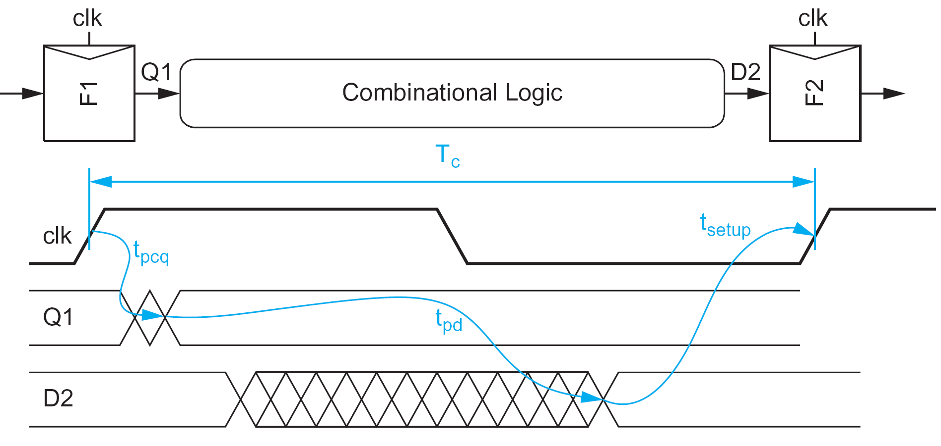
Propagation delay
Clock period should be larger than largest propagation delay
Tc > tpd

Slide 5
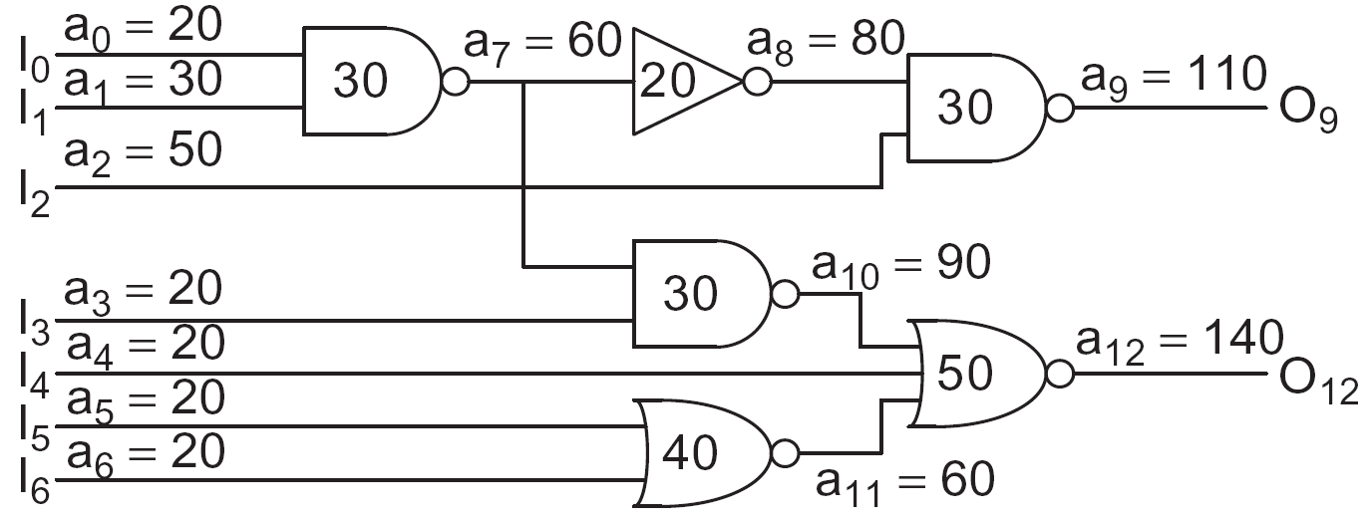
Critical path
Critical path is the longest propagation delay in a circuit.
It determines the minimum clock period of a circuit.
Which is the critical path in the following example?

Slide 6
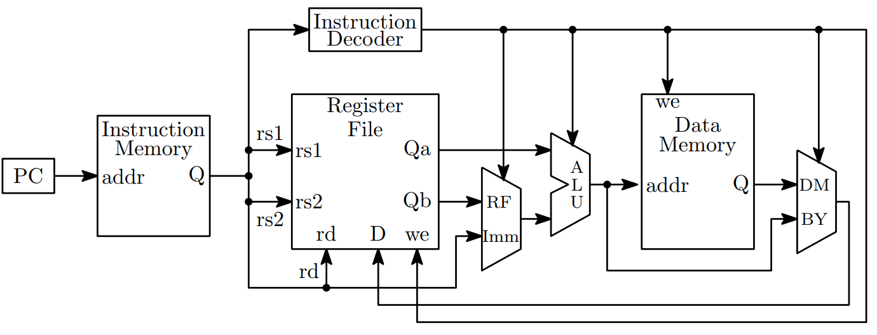
Critical path
Performance Background
Which is the critical path in this simplified microprocessor block diagram?
Which type of instruction takes the longest to execute?
Notes:
Isaac Pérez Andrade
5 November 2020
TE2031 – MIPS design
6

Slide 7
Critical path
Performance Issues
LDR (load) instruction.
PC → Instruction memory → register file → mux → ALU → data memory → mux → register file
Notes:
Isaac Pérez Andrade
5 November 2020
TE2031 – MIPS design
7

Slide 8
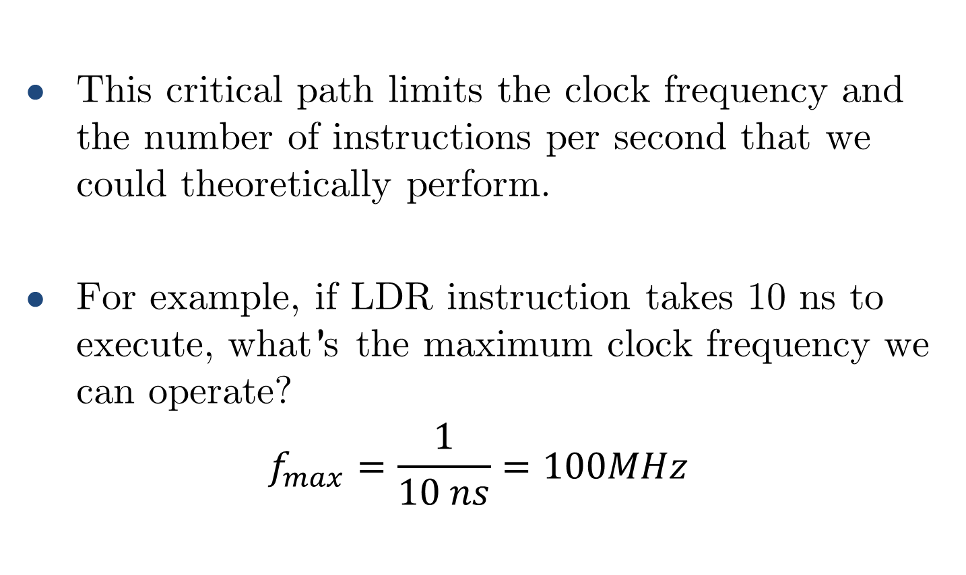
Critical path
This critical path limits the clock frequency and the number of instructions per second that we could theoretically perform.
For example, if LDR instruction takes 10 ns to execute, what’s the maximum clock frequency we can operate?
$$f_{max}=\frac{1}{10 ns}=100MHz$$

Slide 9
Critical path
What if we are required to run at a faster clock frequency?
For example, our processor must operate at 500 MHz or nobody would ever buy it!
We could try to reduce the length of the critical path.
Split the critical path into smaller logic chunks.
Include flip-flops in the boundary of each new logic chunk.

Slide 10
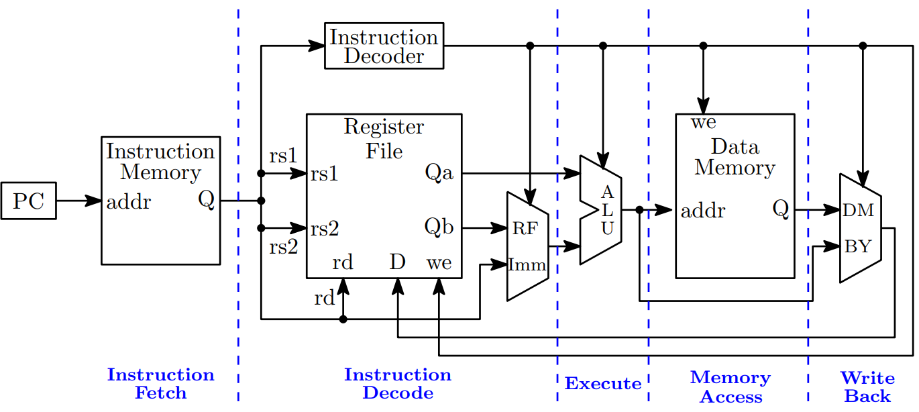
Splitting the critical path
We could split our single-cycle microprocessor execution into different stages.

Slide 11
Splitting the critical path
This is the principle behind pipelining.

Slide 12
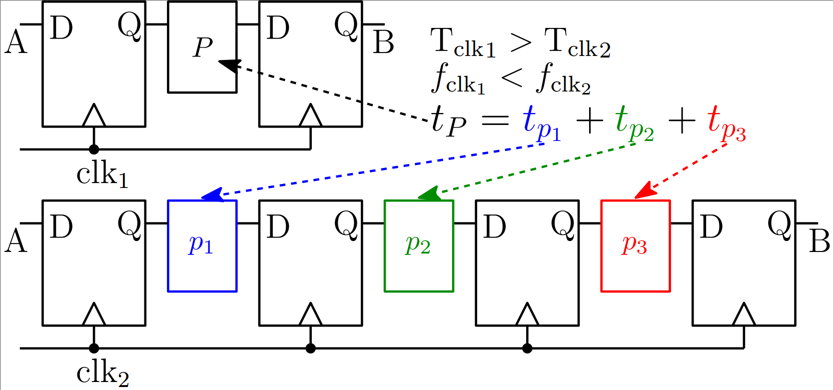
Pipelining basics
Pipelining consist in breaking down a single task into several stages.

Slide 13
Pipelining basics
Task from A to B takes the same time in both cases. What’s the advantage?

Slide 14
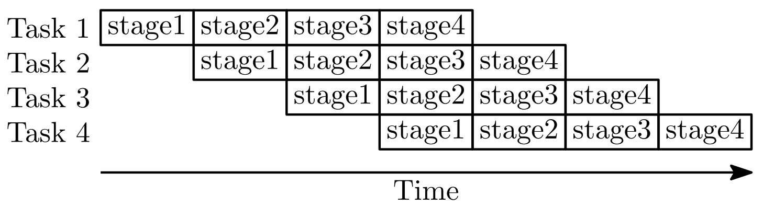
Pipeline basics
We can now perform tasks in parallel!

Slide 15
Pipeline analogy
Assume you work in a laundry shop.
You divide your job into the following stages.
Wash (stage1)
Dry (stage2)
Fold (stage3)
Store (stage4)
Assume each stage takes 30 minutes to complete.
How low would it take you to complete a single laundry task?

Slide 16
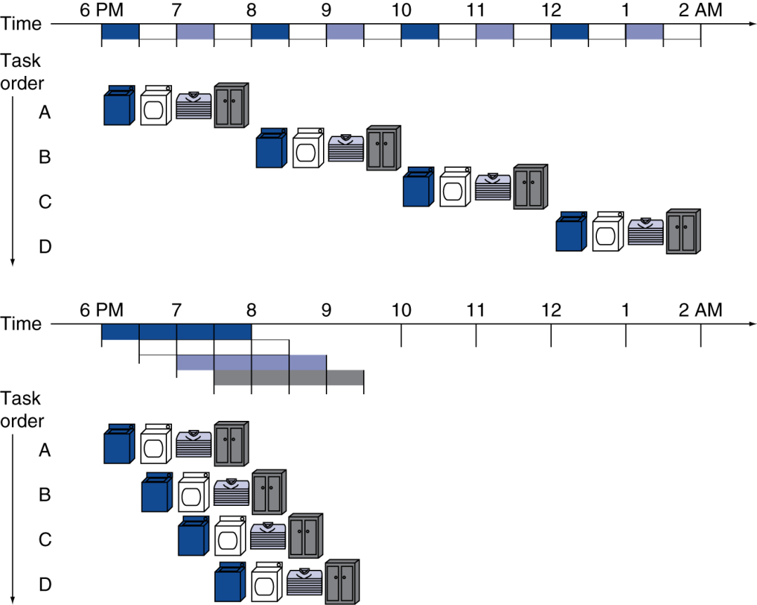

Pipeline analogy
30min x 4 stages = 2 hours
What about 4 laundry tasks?
$4×\left(30×4\right)=480 minutes=8 hours!$
What about 1000 laundry tasks?

Slide 17
Pipeline analogy
Improving our laundry efficiency.
Start a new load right after the washing machine becomes available.
Dry first load and wash second load at the same time.
Fold first load, dry second load and wash third load at the same time
Continue with this principle until you complete all four loads

Slide 18
Pipeline analogy
4 loads now take 3.5 hours, compared to 8 hours in a sequential scheme.

Slide 19
Pipeline speedup
How can we measure the performance improvement?
Four loads:
Speedup = 8/3.5 = 2.28
We are doing our job 2.3 times faster!
What about infinite number of loads?
Wind-down time
Start-up time
Full pipeline: All resources are used at the same time

Slide 20
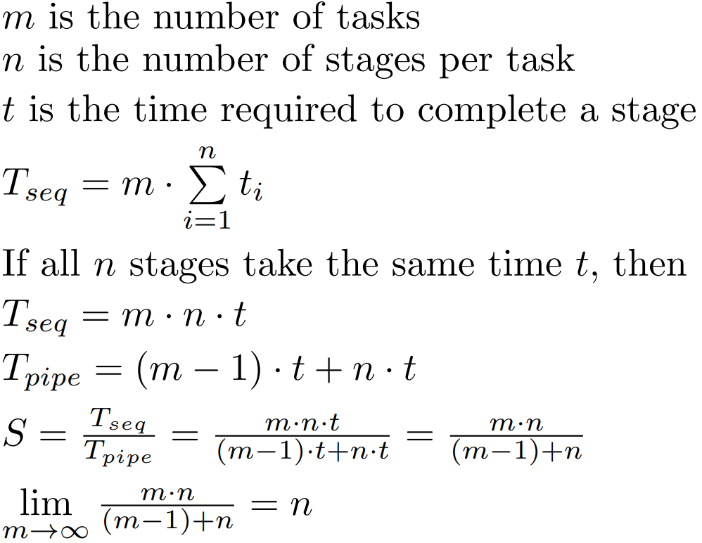



Pipeline speedup
Speedup with an infinite number of laundry loads.
$$nt$$
$$\left(m−1\right)t$$
$$T_{pipe}=\left(m−1\right)∙t+n∙t$$
Speedup is directly determined by the number of pipeline stages

Slide 21
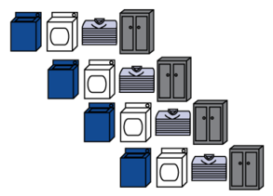

Pipeline speedup
Speedup for an infinite number of laundry loads
$$S≈4$$
Start-up time
Wind-down time
Full pipeline

Slide 22
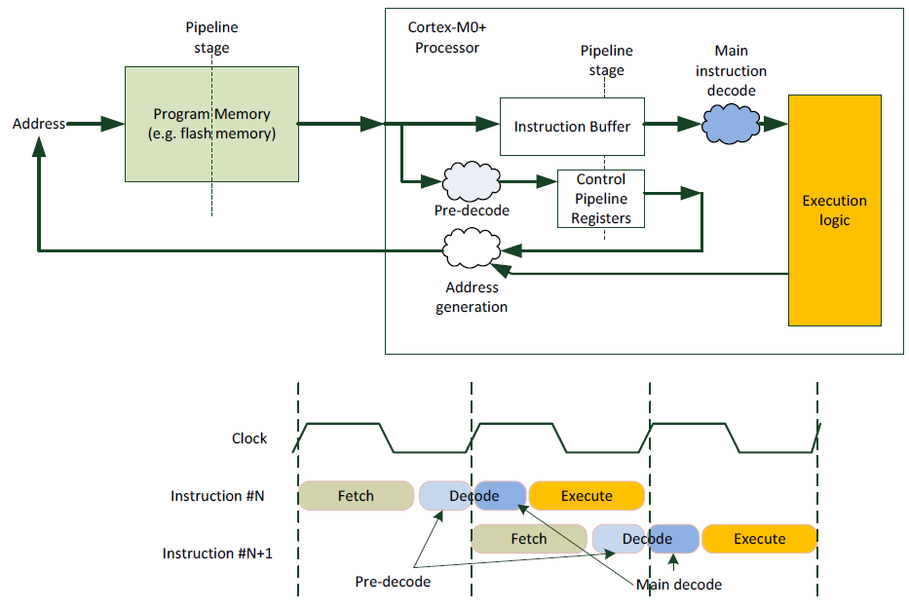
Cortex-M0+ pipeline
Cortex-M0+ implements a two-stage pipeline.
We will focus on a more general five-stage pipeline

Slide 23
ARM pipeline
ARM pipeline. Five instruction cycle stages, one step per stage.
IF: Instruction fetch from memory
ID: Instruction decode & register read
EX: Execute operation or calculate address
MEM: Access memory operand
WB: Write result back to register

Slide 24
Pipeline performance
Assume time for stages is
100ps for register read or write
200ps for other stages
Compare pipelined datapath with single-cycle datapath
Instr | Fetch | Decode | Execute | Memory access | Write back | Total
LDR | 200 ps | 100 ps | 200 ps | 200 ps | 100 ps | 800 ps
STR | 200 ps | 100 ps | 200 ps | 200 ps |  | 700 ps
R-Type | 200 ps | 100 ps | 200 ps |  | 100 ps | 600 ps
CBZ | 200 ps | 100 ps | 200 ps |  |  | 500 ps

Slide 25
Pipeline performance
Instr | Fetch | Decode | Execute | Memory access | Write back | Total
LDR | 200 ps | 100 ps | 200 ps | 200 ps | 100 ps | 800 ps
STR | 200 ps | 100 ps | 200 ps | 200 ps |  | 700 ps
R-Type | 200 ps | 100 ps | 200 ps |  | 100 ps | 600 ps
CBZ | 200 ps | 100 ps | 200 ps |  |  | 500 ps

Slide 26
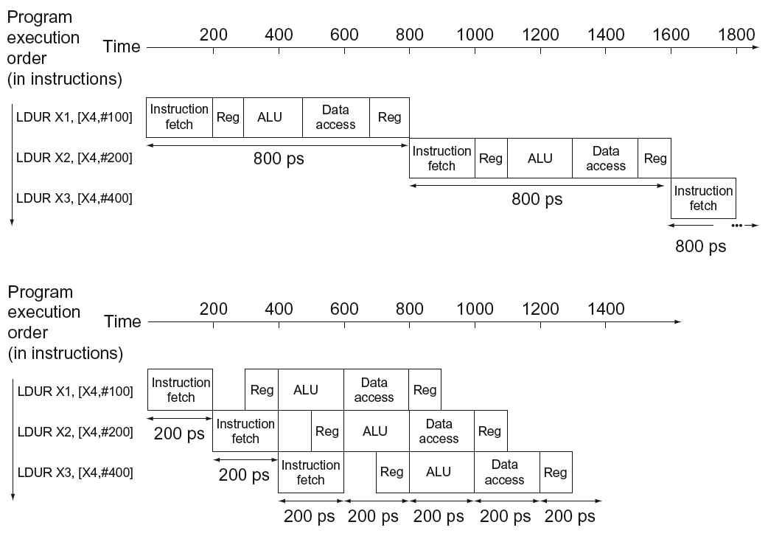
Pipeline performance
What’s the critical path?
What’s the critical path?
Single-cycle (T_{c}= 800ps) → 1 LDR takes 800 ps
Pipelined (T_{c}= 200ps) → 1 LDR takes 1000 ps

Slide 27
Pipeline speedup
Pipeline increases throughput.
Throughput. Number of tasks performed in a given time.
Instruction Level Parallelism (ILP).
Pipeline does not improve (reduce) instruction latency. In fact, instruction latency is usually increased.
Latency. Required time for completing a task.

Slide 28
Pipelining and ISA design
ARM ISA designed for pipelining
All instructions are 32-bits
Easier to fetch and decode in one cycle
Compared to Intel’s x86 ISA using between 1- to 17-byte instructions.
Few and regular instruction formats
Can decode and read registers in one step
Load/store addressing
Can calculate address in 3rd stage, access memory in 4th stage
Alignment of memory operands
Memory access takes only one cycle

Slide 29
Pipeline hazards

Slide 30
Hazards
Situations that prevent starting the next instruction in the next cycle.
Structure hazards
A required resource is busy
Data hazard
Need to wait for previous instruction to complete its data read/write
Control hazard
Deciding on control action depends on previous instruction

Slide 31
Structure hazards
Hardware cannot support the combination of instructions in the same clock cycle.
Conflict for use of a resource.
We require to use the dryer for two different sets of clothes exactly at the same time.
ARM pipeline with a single memory
Load/store requires data access
Instruction fetch would have to stall for that cycle
Would cause a pipeline “bubble”
Hence, pipelined datapaths require separate instruction/data memories
Or separate instruction/data caches

Slide 32
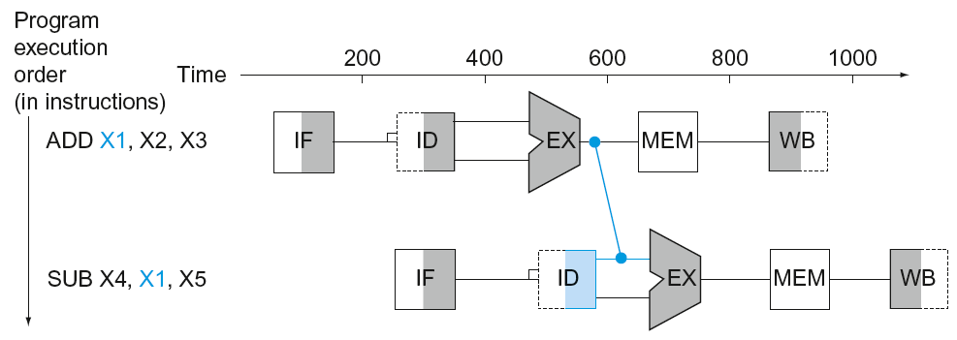
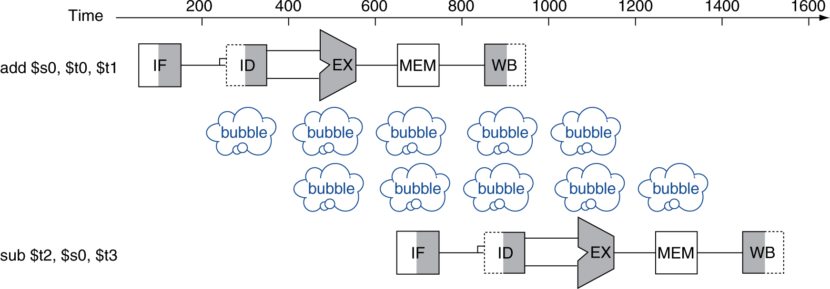
Data hazards
An instruction depends on completion of data access by a previous instruction
ADD x1, x2, x3
SUB x4, x1, x5
We can’t go back in time!

Slide 33
Data hazards
An instruction depends on completion of data access by a previous instruction
ADD x1, x2, x3
SUB x4, x1, x5
Instead of going back in time, we must stall (stop) the execution of instructions until we complete write back on first instruction

Slide 34
Data hazards
Compiler might detect this data dependency and insert bubbles (NOP instructions).
ADD x1, x2, x3
NOP
NOP
SUB x4, x1, x5
NOP instructions do not do anything.
Used for creating pipeline bubbles.

Slide 35
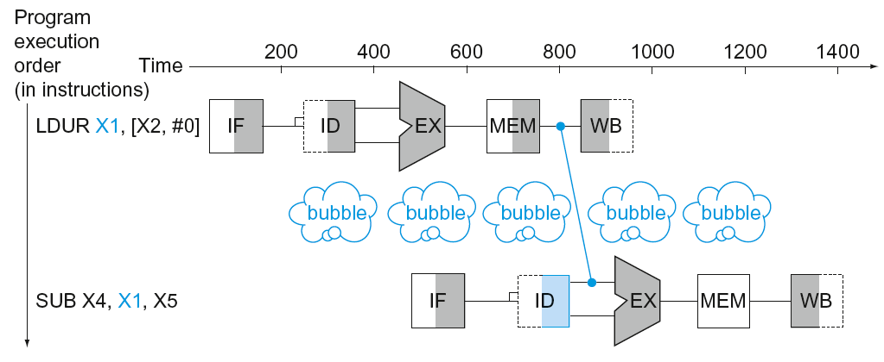
Data hazards
Load instruction
LDUR X1, [x2, #0]
SUB X4, X1, X5

Slide 36
Data hazards – forwarding (aka bypassing)
Forwarding tries to mitigate bubbles due to data hazards
ADD x1, x2, x3
SUB x4, x1, x5
Instead of waiting to a write back to occur, we take the required data directly from the execute stage.

Slide 37
Data hazards - forwarding (aka bypassing)
Use result when it is computed
Don’t wait for it to be stored in a register
Requires extra connections in the datapath

Slide 38
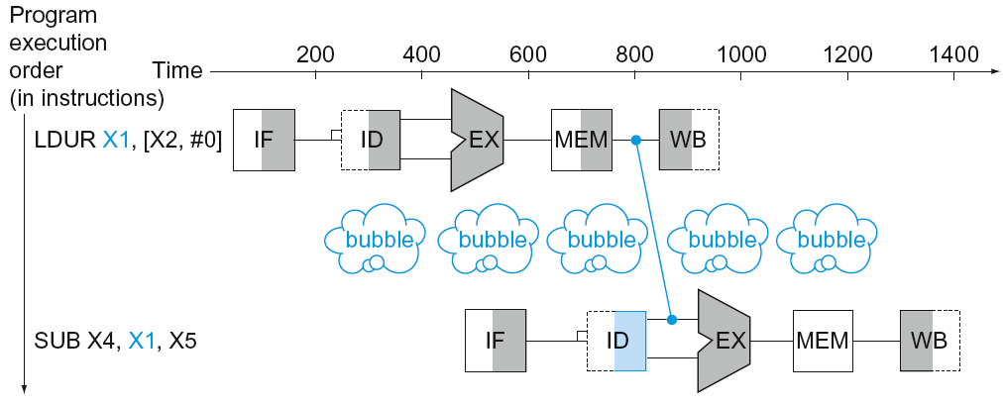
Data hazards
Can’t always avoid stalls by forwarding
If value not computed when needed
Can’t forward backward in time!

Slide 39
Code scheduling to avoid stalls
Reorder code to avoid use of load result in the next instruction
A = B + E;
C = B + F;
B = Mem[0]; E = Mem[4]; F = Mem[8]
LDR X1, [X0,#0] ; load B
LDR X2, [X0,#4] ; load E
ADD X3, X1, X2 ; A=B+E
STR X3, [X0,#40]; store A
LDR X4, [X0,#8] ; load F
ADD X5, X1, X4 ; C=B+F
STR X5, [X0,#44]; store C
LDR X1, [X0,#0]
LDR X2, [X0,#4]
LDR X4, [X0,#8]
ADD X3, X1, X2
STR X3, [X0,#40]
ADD X5, X1, X4
STR X5, [X0,#44]
stall
stall
13 cycles
11 cycles

Slide 40
Control hazards
Branch determines flow of control.
Fetching next instruction depends on branch outcome.
Pipeline can’t always fetch correct instruction
Still working on ID stage of branch.
Need to compare registers and compute target early in the pipeline.
Add hardware to do it in ID stage

Slide 41
Control hazards
if(a==0)
b = c + d
else
b = c - d
Example 1. Assume a != 0
CMP a, #0x00 ; Compare a==0
BEQ if_label ; Branch if a==0
else_label
SUB b, c, d ; else = Branch not taken
; b = c - d
:
if_label ; if = Branch taken
ADD b, c, d ; b = c + d

Slide 42
Control hazards
if(a==0)
b = c + d
else
b = c - d
Example 2. Assume a == 0
CMP a, #0x00 ; Compare a==0
BEQ if_label ; Branch if a==0
else_label
SUB b, c, d ; else = Branch not taken
; b = c - d
:
if_label ; if = Branch taken
ADD b, c, d ; b = c + d

Slide 43
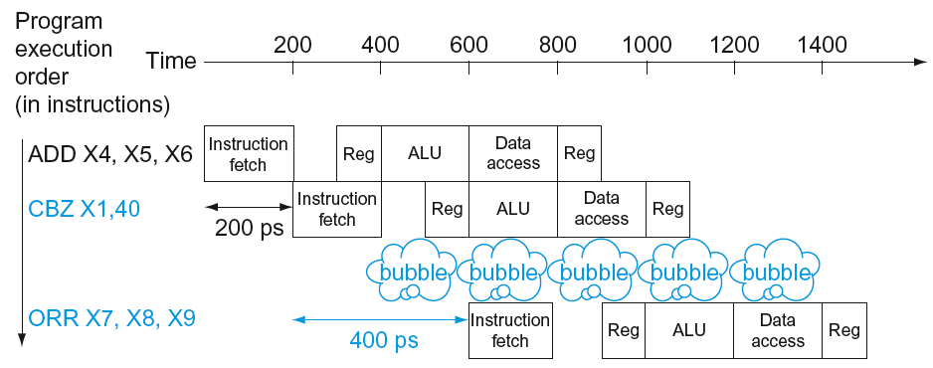
Control hazards
Example 1. a != 0: Branch not taken
Order of instructions is not modified
Instructions already in pipeline might continue to execute.
CMP a, #0x00
BEQ if_label
SUB b, c, d
AND e, f, g

Slide 44
Control hazards
Example 2. a == 0: Branch taken
Order of instructions is modified
Instructions already in pipeline will have to be discarded.
Pipeline will have to be started again with a penalty due to wasted instructions
CMP a, #0x00
BEQ if_label
SUB b, c, d
AND e, f, g
ADD b, c, d

Slide 45
Stall on branch
Wait until branch outcome determined before fetching next instruction
CMP a, #0x00
BEQ if_label
SUB b, c, d
AND e, f, g

Slide 46
Branch prediction
Longer pipelines can’t readily determine branch outcome early
Stall penalty becomes unacceptable
Predict outcome of branch
Only stall if prediction is wrong
In ARM pipeline
Can predict branches not taken
Fetch instruction after branch, with no delay

Slide 47
More-realistic branch prediction
Static branch prediction
Based on typical branch behavior
Example: loop and if-statement branches
Predict backward branches taken
Predict forward branches not taken
Dynamic branch prediction
Hardware measures actual branch behavior
e.g., record recent history of each branch
Assume future behavior will continue the trend
When wrong, stall while re-fetching, and update history

Slide 48
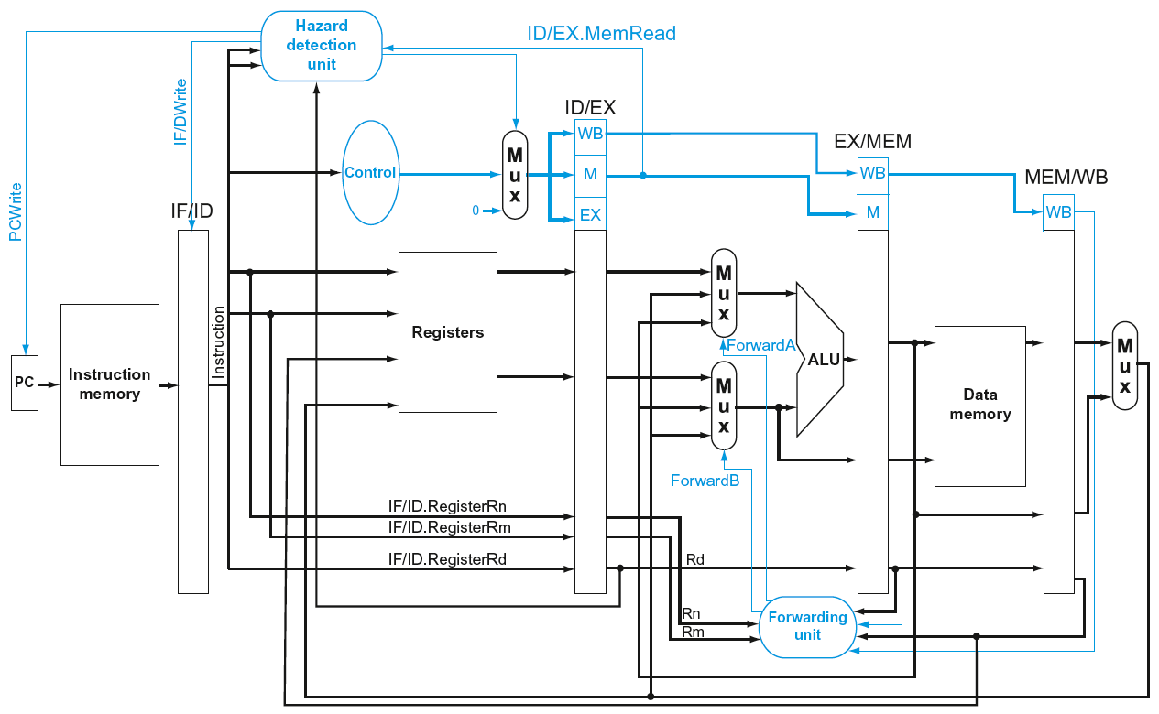
Pipeline uA

Slide 49
Pipeline summary
Pipelining improves performance by increasing instruction throughput.
Executes multiple instructions in parallel.
Each instruction has the same (or worse) latency.
Subject to hazards.
Structure, data, control.
Instruction set design affects complexity of pipeline implementation.

Slide 50
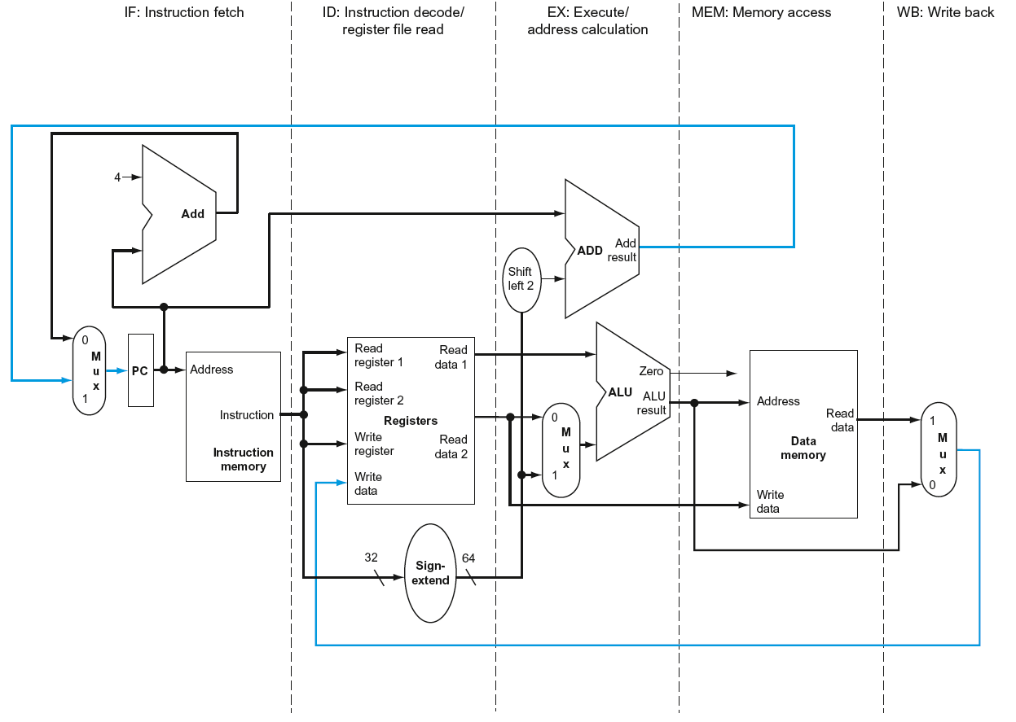
ARMv6-M Pipelined Datapath
§4.6 Pipelined Datapath and Control
MEM
Right-to-left flow leads to hazards
WB

Slide 51
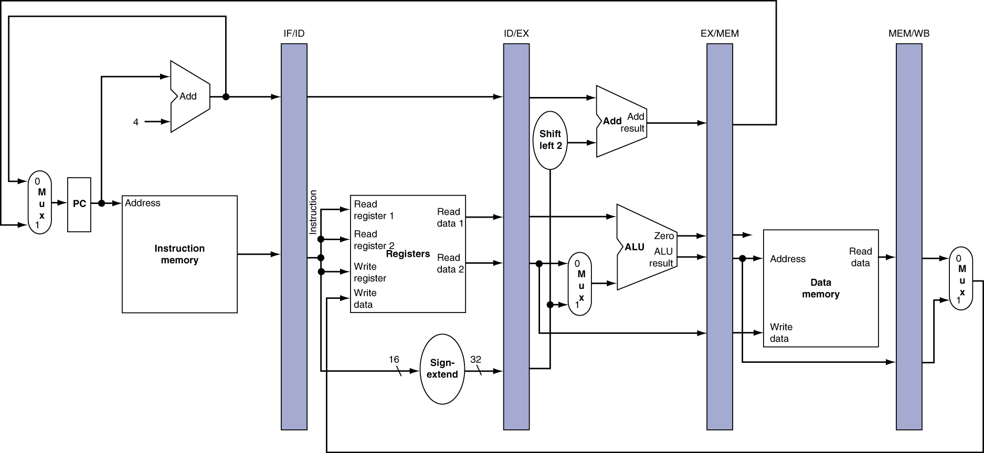
Pipeline registers
Need registers between stages
To hold information produced in previous cycle

Slide 52
Pipeline Operation
Cycle-by-cycle flow of instructions through the pipelined datapath
“Single-clock-cycle” pipeline diagram
Shows pipeline usage in a single cycle
Highlight resources used
c.f. “multi-clock-cycle” diagram
Graph of operation over time
We’ll look at “single-clock-cycle” diagrams for load & store

Slide 53
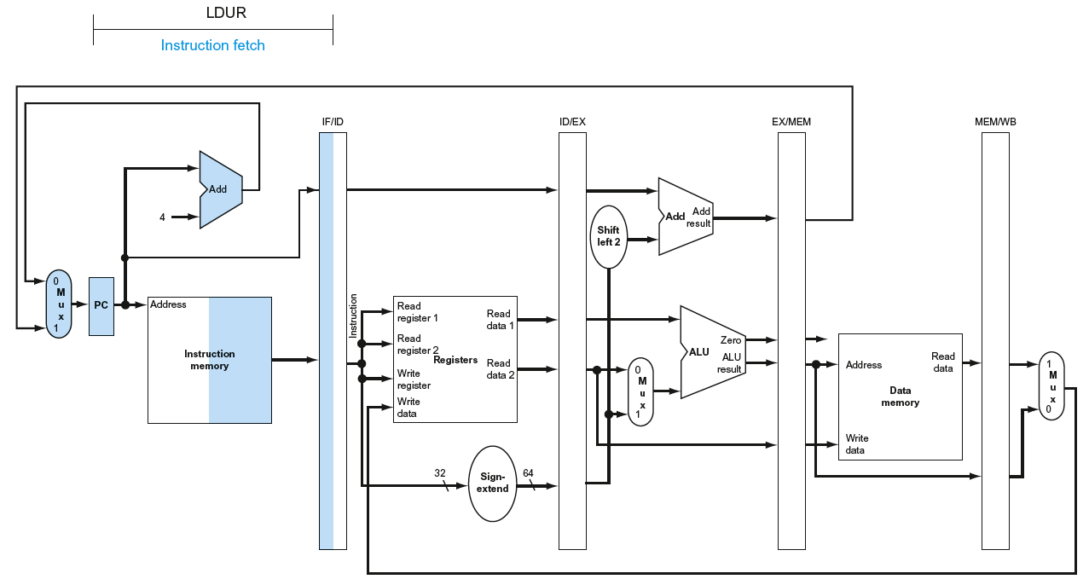
IF for Load, Store, …

Slide 54
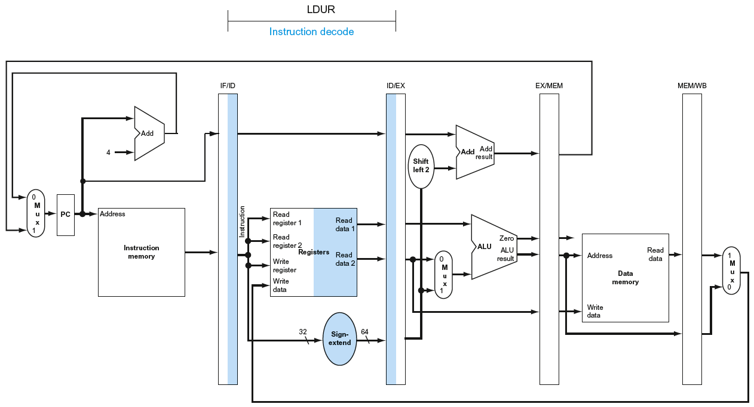
ID for Load, Store, …

Slide 55
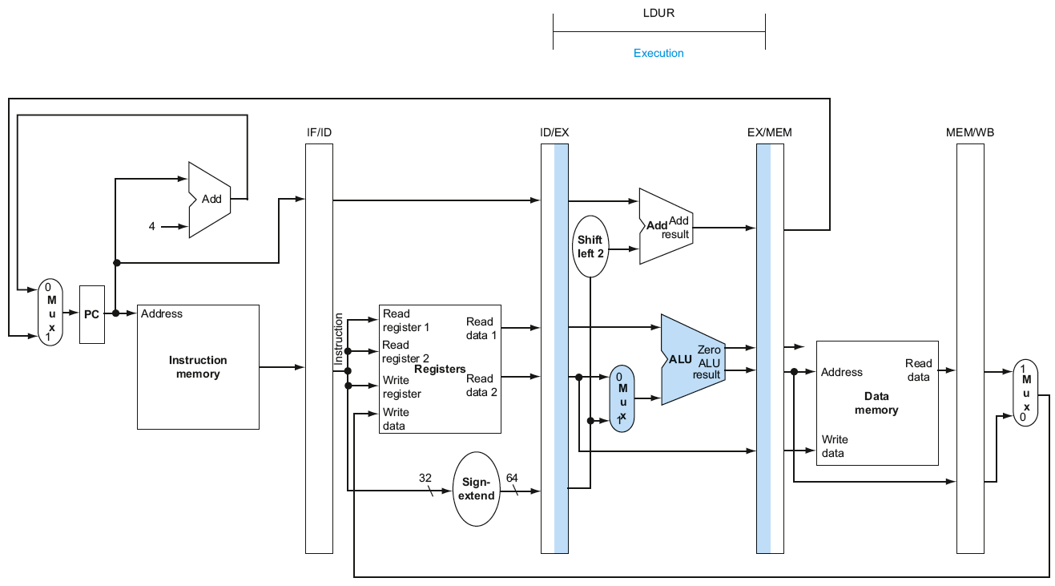
EX for Load

Slide 56
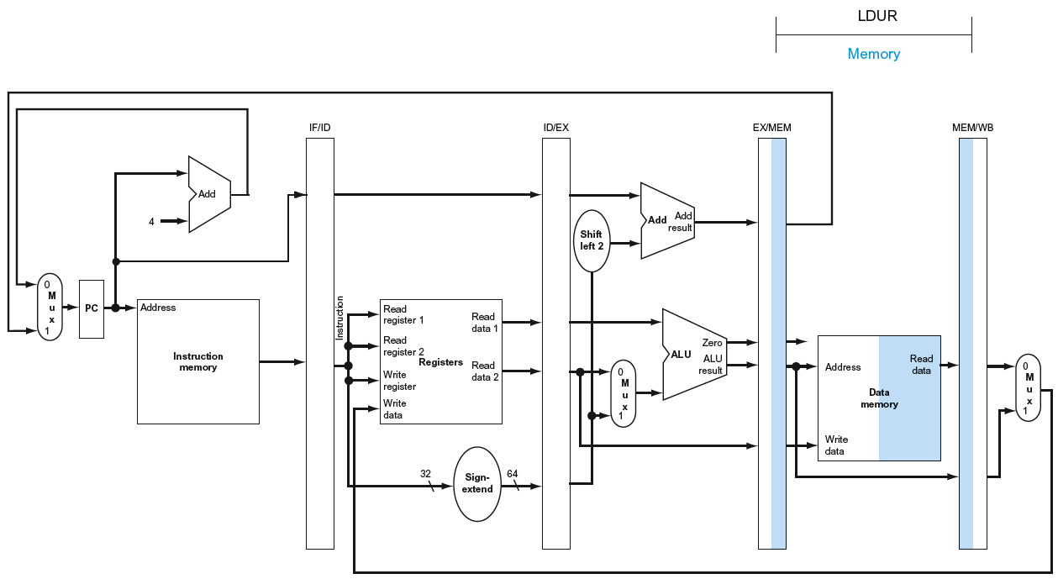
MEM for Load

Slide 57
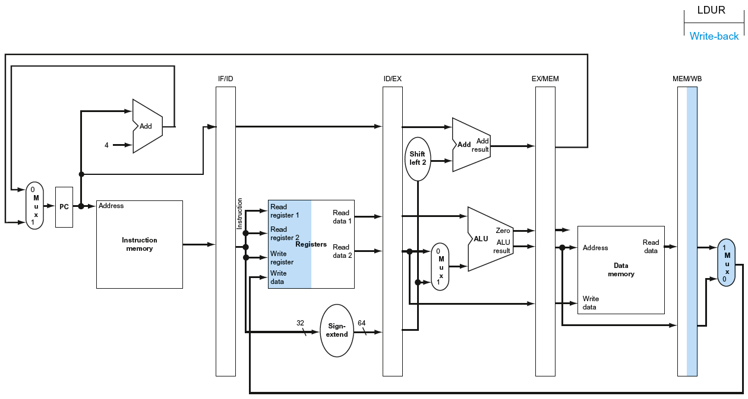
WB for Load
Wrong register number

Slide 58
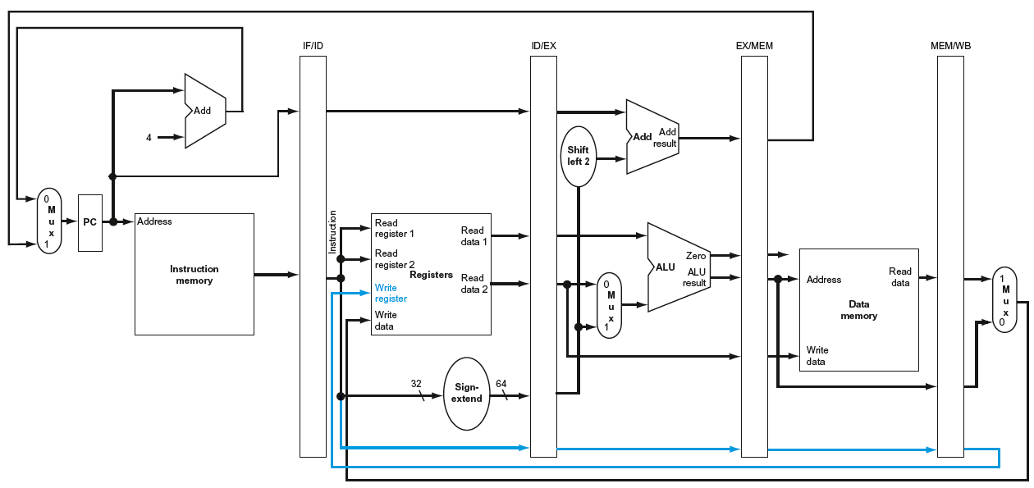
Corrected Datapath for Load

Slide 59
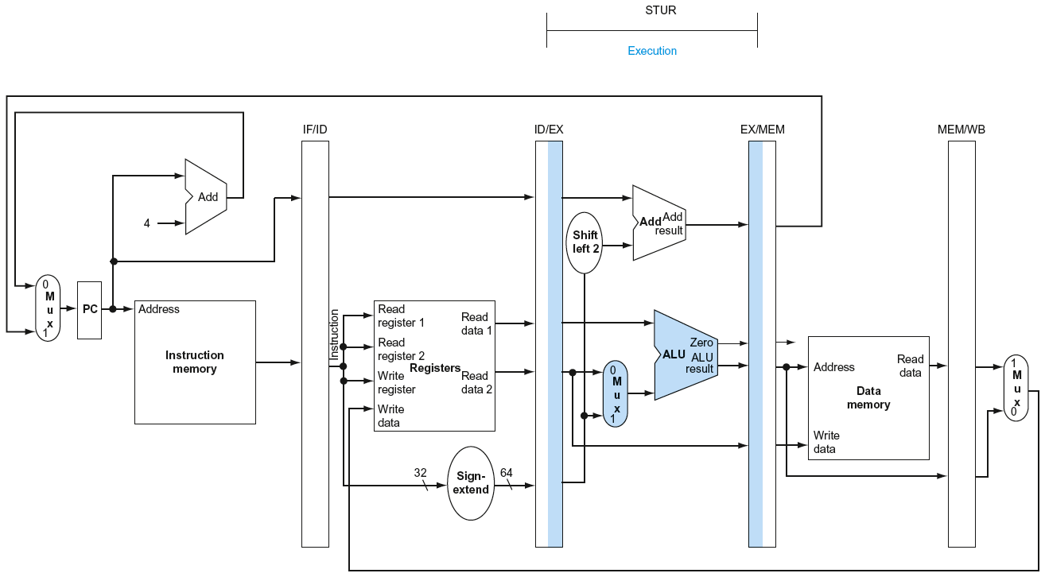
EX for Store

Slide 60
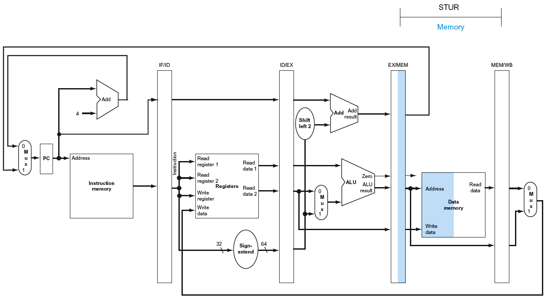
MEM for Store

Slide 61
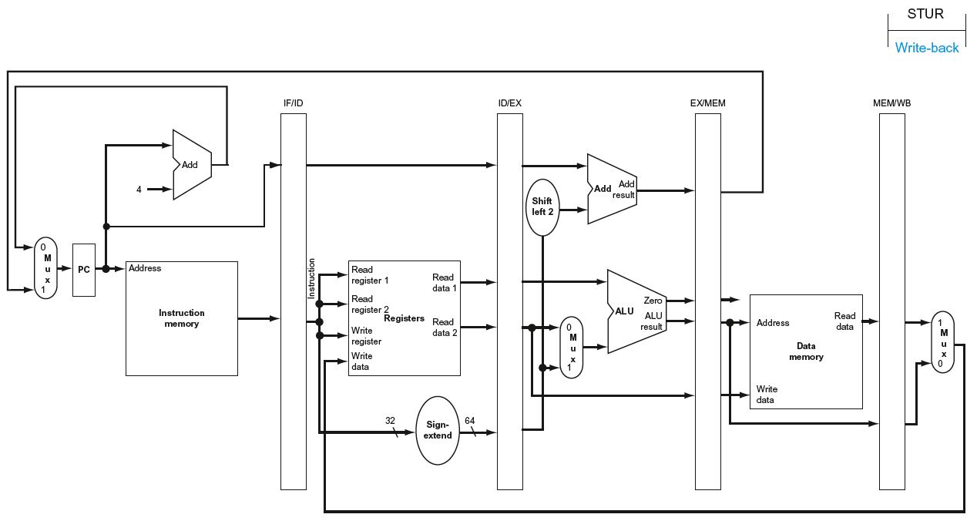
WB for Store

Slide 62
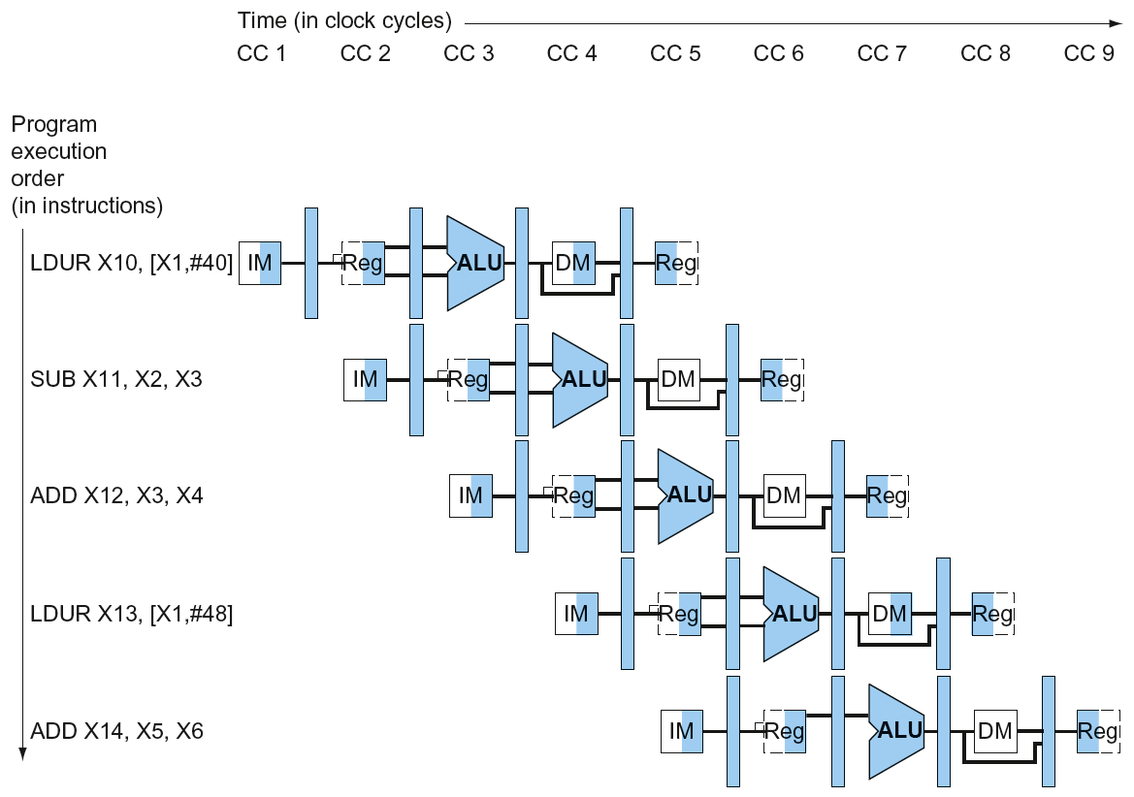
Multi-Cycle Pipeline Diagram
Form showing resource usage

Slide 63
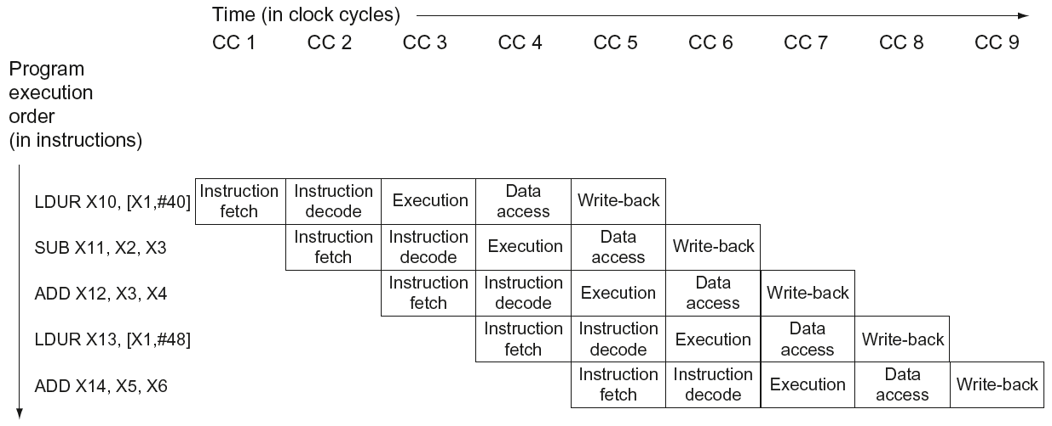
Multi-Cycle Pipeline Diagram
Traditional form

Slide 64
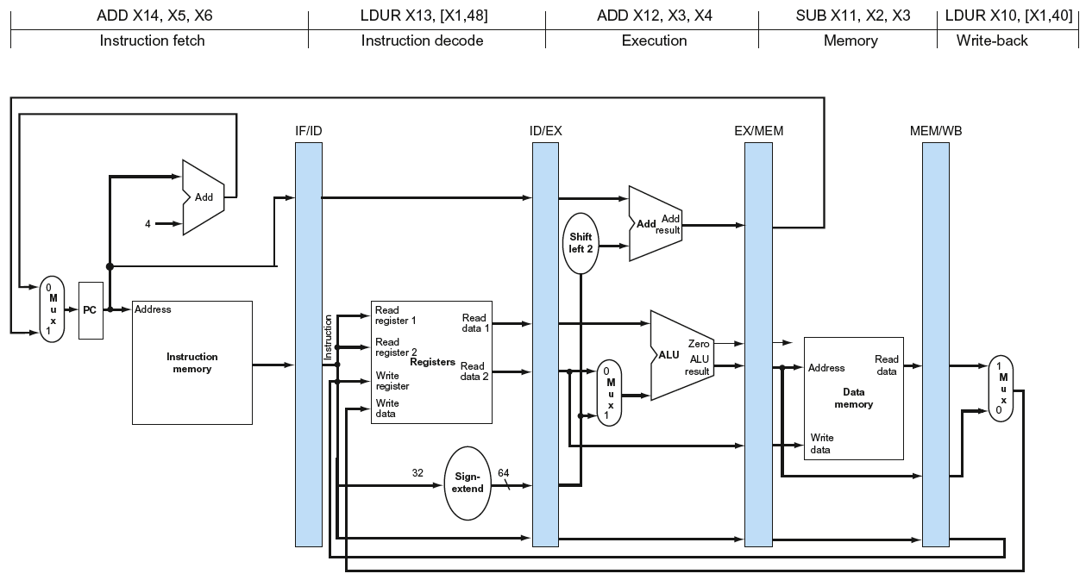
Single-Cycle Pipeline Diagram
State of pipeline in a given cycle

Slide 65
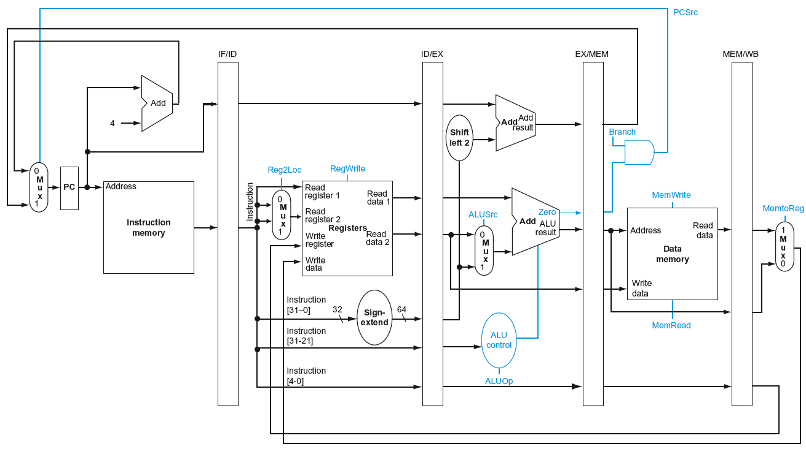
Pipelined Control (Simplified)

Slide 66
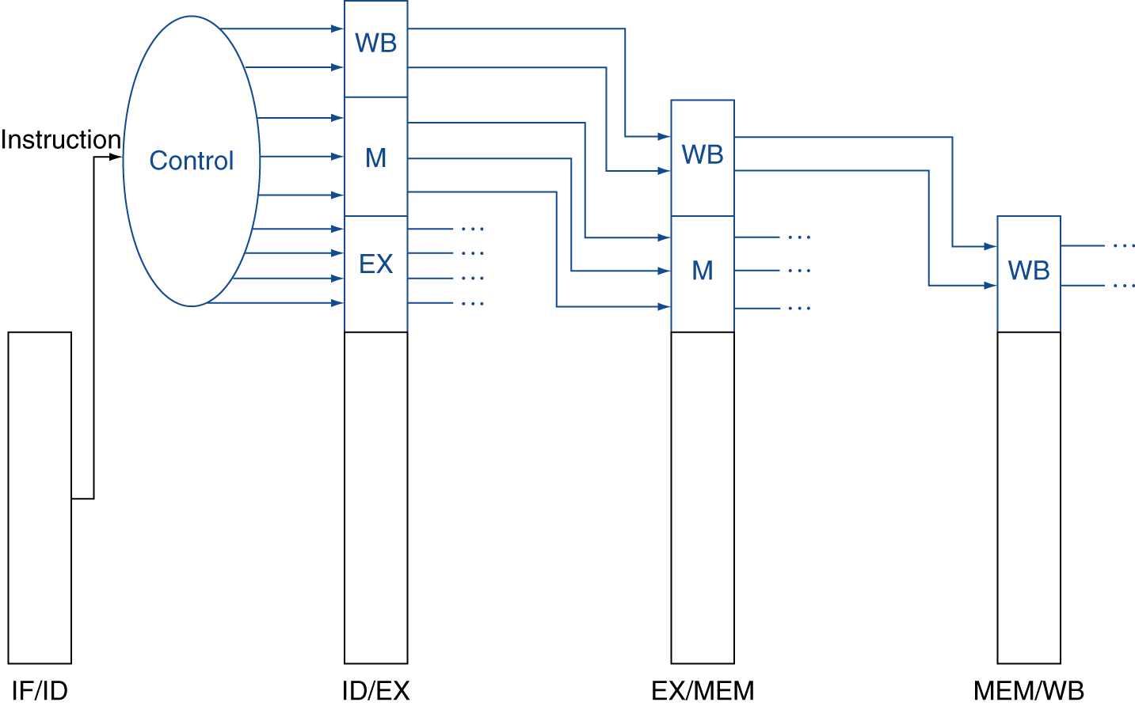
Pipelined Control
Control signals derived from instruction
As in single-cycle implementation

Slide 67
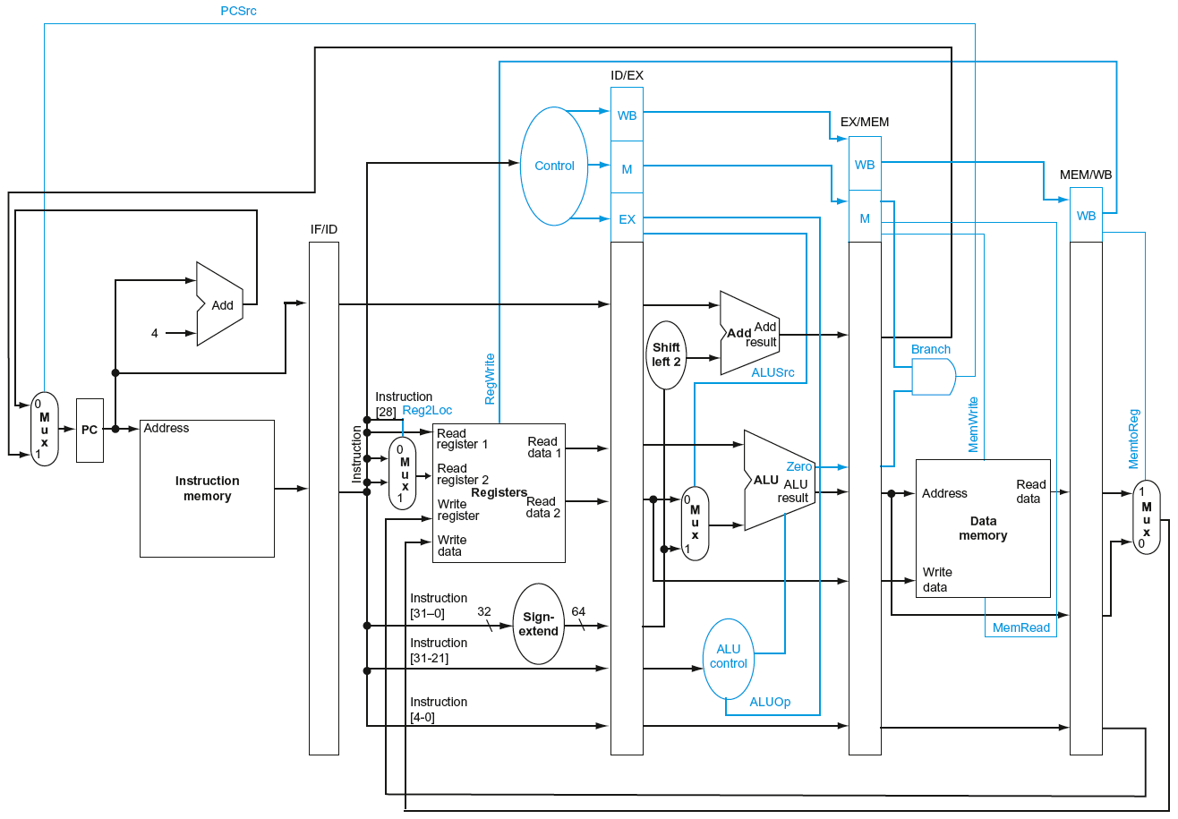
Pipelined Control

Slide 68
Data Hazards in ALU Instructions
Consider this sequence:
SUB X2, X1,X3 AND X12,X2,X5 OR X13,X6,X2 ADD X14,X2,X2 STUR X15,[X2,#100]
We can resolve hazards with forwarding
How do we detect when to forward?
§4.7 Data Hazards: Forwarding vs. Stalling

Slide 69
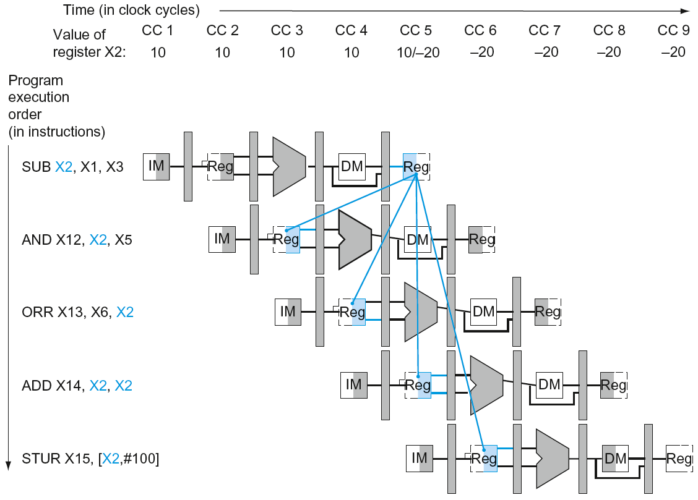
Dependencies & Forwarding

Slide 70
Detecting the Need to Forward
Pass register numbers along pipeline
e.g., ID/EX.RegisterRs = register number for Rs sitting in ID/EX pipeline register
ALU operand register numbers in EX stage are given by
ID/EX.RegisterRn1, ID/EX.RegisterRm2
Data hazards when
1a. EX/MEM.RegisterRd = ID/EX.RegisterRn1
1b. EX/MEM.RegisterRd = ID/EX.RegisterRm2
2a. MEM/WB.RegisterRd = ID/EX.RegisterRn1
2b. MEM/WB.RegisterRd = ID/EX.RegisterRm2
Fwd from EX/MEM pipeline reg
Fwd from MEM/WB pipeline reg

Slide 71
Detecting the Need to Forward
But only if forwarding instruction will write to a register!
EX/MEM.RegWrite, MEM/WB.RegWrite
And only if Rd for that instruction is not XZR
EX/MEM.RegisterRd ≠ 31, MEM/WB.RegisterRd ≠ 31

Slide 72
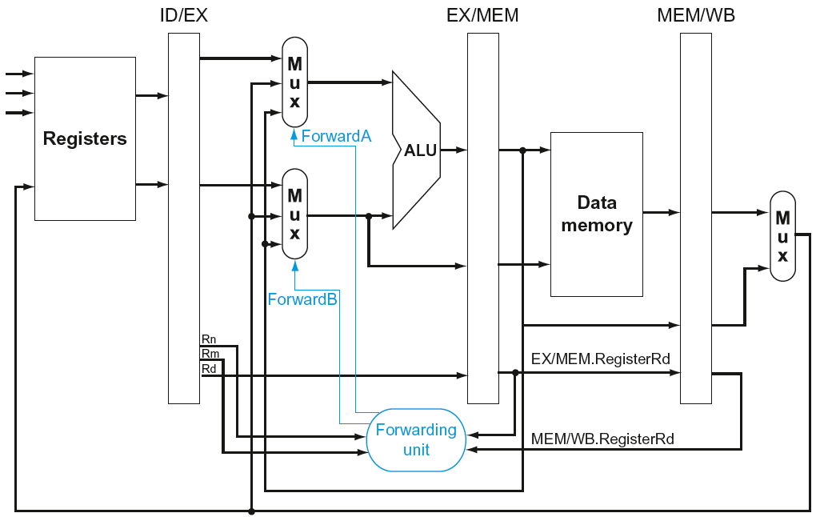
Forwarding Paths

Slide 73
Forwarding Conditions
Mux control | Source | Explanation
ForwardA = 00 | ID/EX | The first ALU operand comes from the register file.
ForwardA = 10 | EX/MEM | The first ALU operand is forwarded from the prior ALU result.
ForwardA = 01 | MEM/WB | The first ALU operand is forwarded from data memory or an earlier ALU result.
ForwardB = 00 | ID/EX | The second ALU operand comes from the register file.
ForwardB = 10 | EX/MEM | The second ALU operand is forwarded from the prior ALU result.
ForwardB = 01 | MEM/WB | The second ALU operand is forwarded from data memory or an earlier ALU result.

Slide 74
Double Data Hazard
Consider the sequence:
add X1,X1,X2 add X1,X1,X3 add X1,X1,X4
Both hazards occur
Want to use the most recent
Revise MEM hazard condition
Only fwd if EX hazard condition isn’t true

Slide 75
Revised Forwarding Condition
MEM hazard
if (MEM/WB.RegWrite
and (MEM/WB.RegisterRd ≠ 31)
and not(EX/MEM.RegWrite and (EX/MEM.RegisterRd ≠ 31)
and (EX/MEM.RegisterRd ≠ ID/EX.RegisterRn1))
and (MEM/WB.RegisterRd = ID/EX.RegisterRn1)) ForwardA = 01
if (MEM/WB.RegWrite
and (MEM/WB.RegisterRd ≠ 31)
and not(EX/MEM.RegWrite and (EX/MEM.RegisterRd ≠ 31)
and (EX/MEM.RegisterRd ≠ ID/EX.RegisterRm2))
and (MEM/WB.RegisterRd = ID/EX.RegisterRm2)) ForwardB = 01

Slide 76
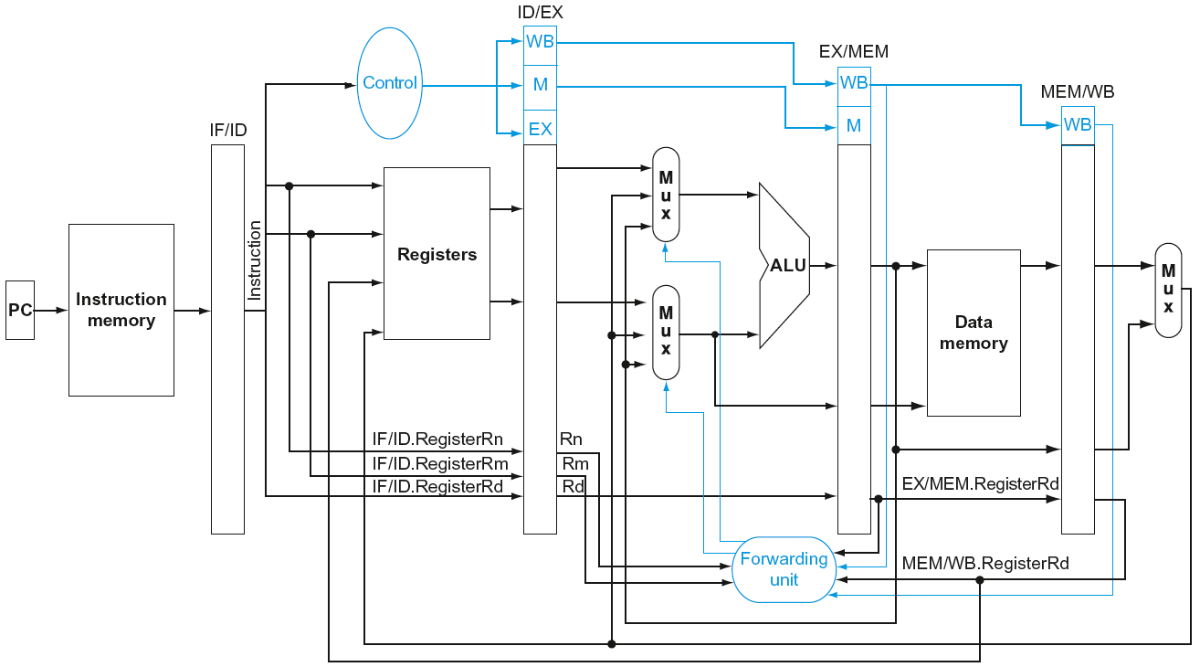
Datapath with Forwarding

Slide 77
Load-Use Hazard Detection
Check when using instruction is decoded in ID stage
ALU operand register numbers in ID stage are given by
IF/ID.RegisterRn1, IF/ID.RegisterRm2
Load-use hazard when
ID/EX.MemRead and ((ID/EX.RegisterRd = IF/ID.RegisterRn1) or (ID/EX.RegisterRd = IF/ID.RegisterRm1))
If detected, stall and insert bubble

Slide 78
How to Stall the Pipeline
Force control values in ID/EX register to 0
EX, MEM and WB do nop (no-operation)
Prevent update of PC and IF/ID register
Using instruction is decoded again
Following instruction is fetched again
1-cycle stall allows MEM to read data for LDUI
Can subsequently forward to EX stage

Slide 79
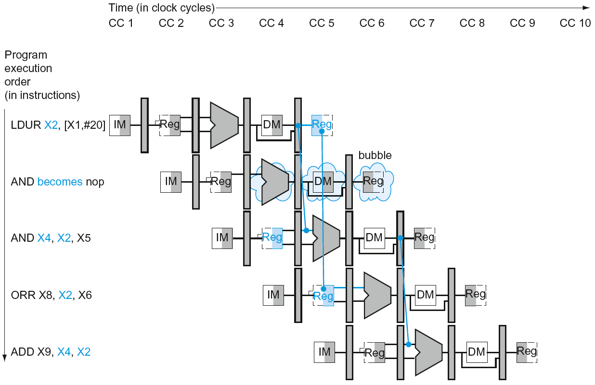
Load-Use Data Hazard
Stall inserted here

Slide 80
Datapath with Hazard Detection

Slide 81
Stalls and Performance
The BIG Picture
Stalls reduce performance
But are required to get correct results
Compiler can arrange code to avoid hazards and stalls
Requires knowledge of the pipeline structure

Slide 82
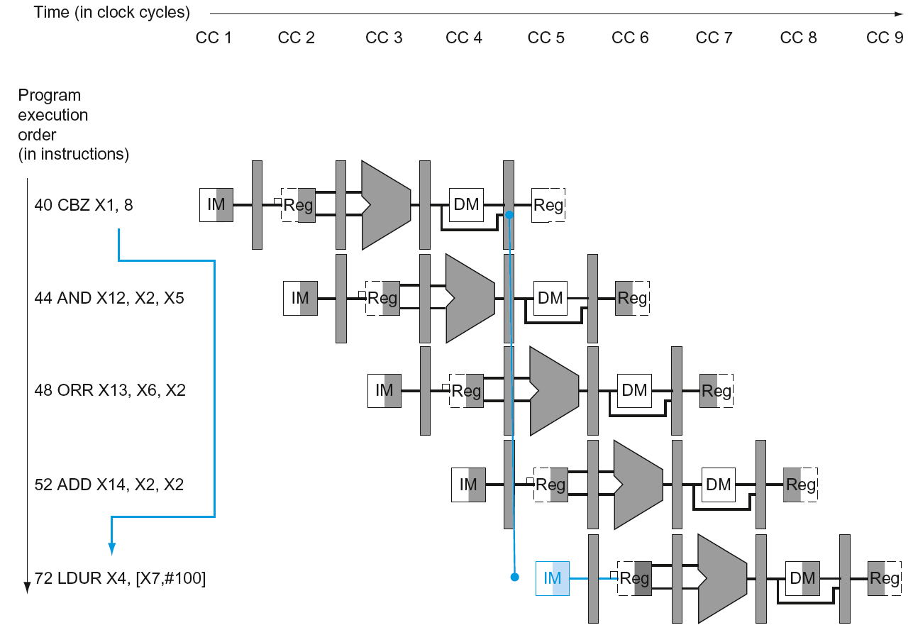
Branch Hazards
§4.8 Control Hazards
If branch outcome determined in MEM
Flush these instructions
(Set control values to 0)
PC

Slide 83
Reducing Branch Delay
Move hardware to determine outcome to ID stage
Target address adder
Register comparator
Example: branch taken
36: SUB X10, X4, X8 40: CBZ X1, X3, 8 44: AND X12, X2, X5 48: ORR X13, X2, X6 52: ADD X14, X4, X2 56: SUB X15, X6, X7 ... 72: LDUR X4, [X7,#50]

Slide 84
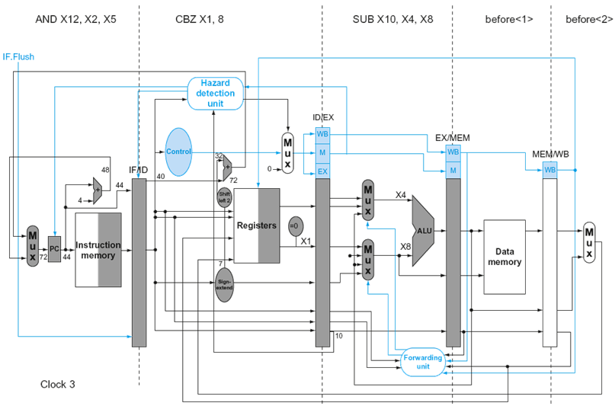
Example: Branch Taken

Slide 85
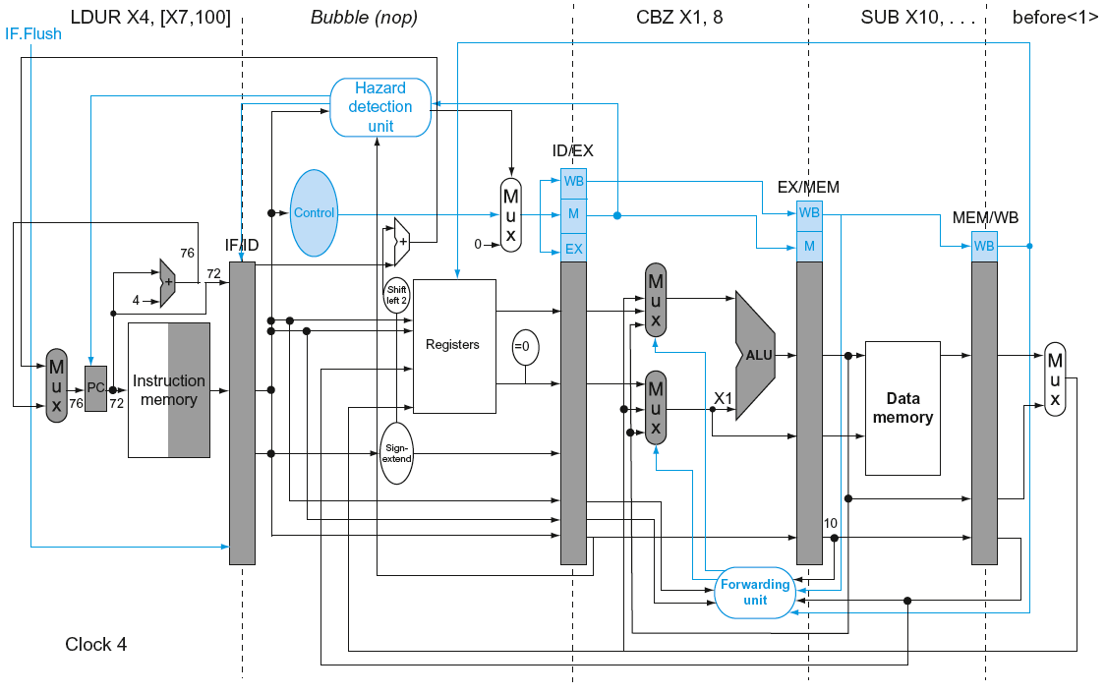
Example: Branch Taken

Slide 86
Dynamic Branch Prediction
In deeper and superscalar pipelines, branch penalty is more significant
Use dynamic prediction
Branch prediction buffer (aka branch history table)
Indexed by recent branch instruction addresses
Stores outcome (taken/not taken)
To execute a branch
Check table, expect the same outcome
Start fetching from fall-through or target
If wrong, flush pipeline and flip prediction

Slide 87
1-Bit Predictor: Shortcoming
Inner loop branches mispredicted twice!
outer: … … inner: …
…
CBZ …, …, inner … CBZ …, …, outer
Mispredict as taken on last iteration of inner loop
Then mispredict as not taken on first iteration of inner loop next time around

Slide 88
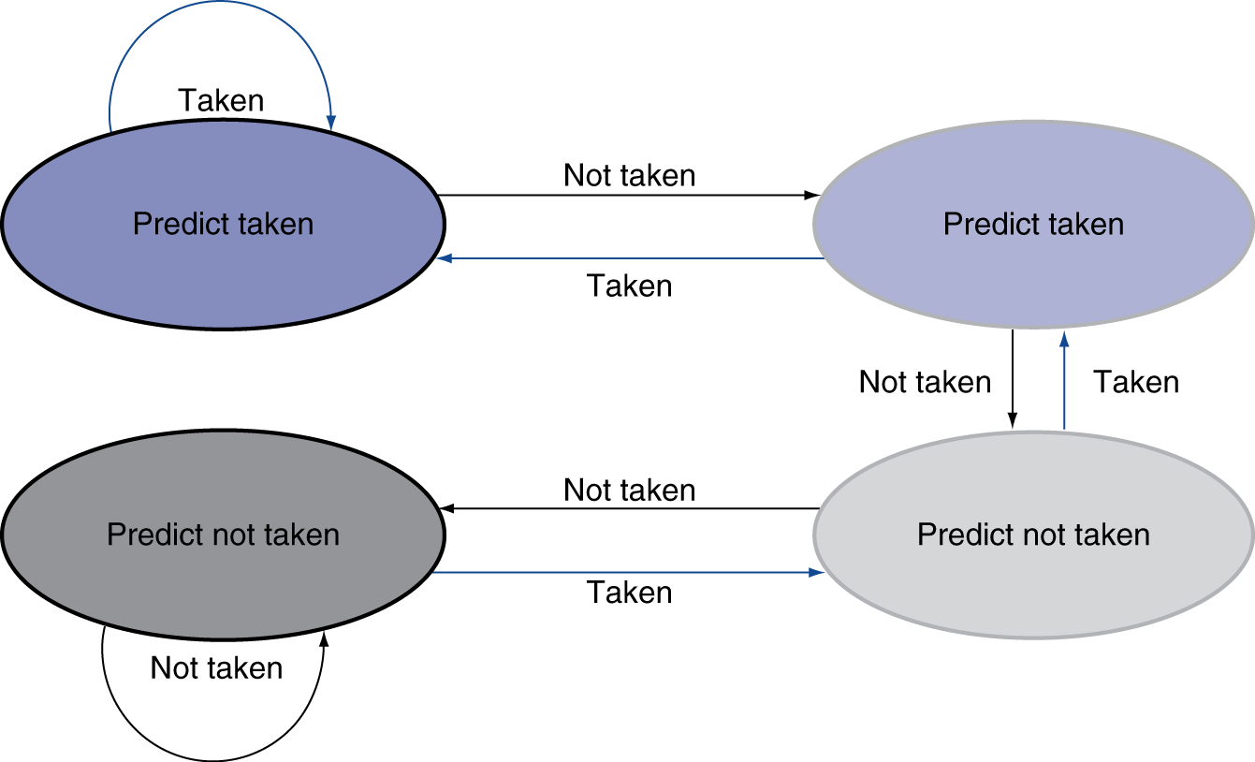
2-Bit Predictor
Only change prediction on two successive mispredictions

Slide 89
Calculating the Branch Target
Even with predictor, still need to calculate the target address
1-cycle penalty for a taken branch
Branch target buffer
Cache of target addresses
Indexed by PC when instruction fetched
If hit and instruction is branch predicted taken, can fetch target immediately

Slide 90
Exceptions and Interrupts
§4.9 Exceptions
“Unexpected” events requiring change in flow of control
Different ISAs use the terms differently
Exception
Arises within the CPU
e.g., undefined opcode, overflow, syscall, …
Interrupt
From an external I/O controller
Dealing with them without sacrificing performance is hard

Slide 91
Handling Exceptions
Save PC of offending (or interrupted) instruction
In ARMv6-M: Exception Link Register (ELR)
Save indication of the problem
In ARMv6-M: Exception Syndrome Rregister (ESR)
We’ll assume 1-bit
0 for undefined opcode, 1 for overflow

Slide 92
An Alternate Mechanism
Vectored Interrupts
Handler address determined by the cause
Exception vector address to be added to a vector table base register:
Unknown Reason: 00 0000_{two}
Overflow: 10 1100_{two}
…: 11 1111_{two}
Instructions either
Deal with the interrupt, or
Jump to real handler

Slide 93
Handler Actions
Read cause, and transfer to relevant handler
Determine action required
If restartable
Take corrective action
use EPC to return to program
Otherwise
Terminate program
Report error using EPC, cause, …

Slide 94
Exceptions in a Pipeline
Another form of control hazard
Consider overflow on add in EX stage
ADD X1, X2, X1
Prevent X1 from being clobbered
Complete previous instructions
Flush add and subsequent instructions
Set ESR and ELR register values
Transfer control to handler
Similar to mispredicted branch
Use much of the same hardware

Slide 95
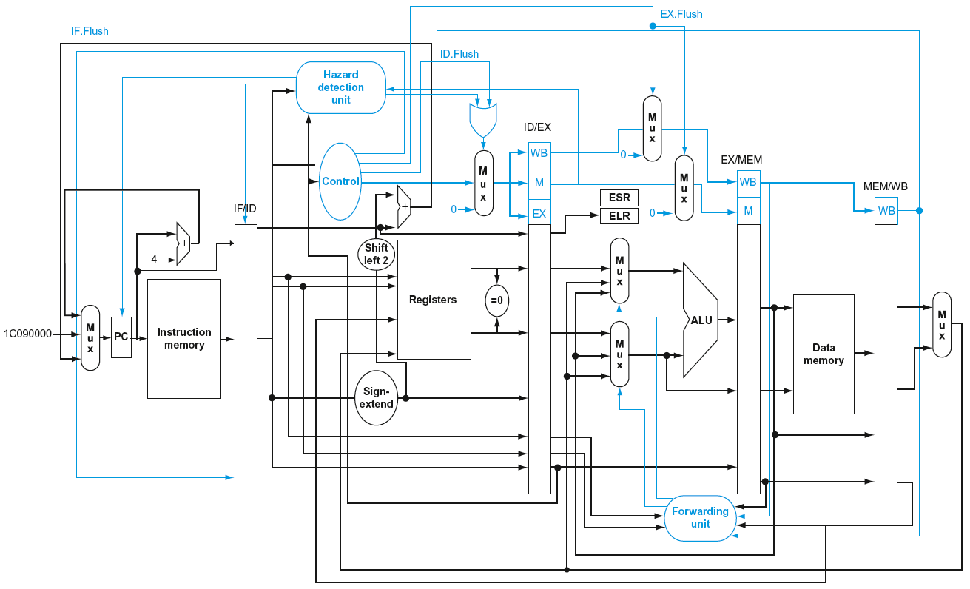
Pipeline with Exceptions

Slide 96
Exception Properties
Restartable exceptions
Pipeline can flush the instruction
Handler executes, then returns to the instruction
Refetched and executed from scratch
PC saved in ELR register
Identifies causing instruction
Actually PC + 4 is saved
Handler must adjust

Slide 97
Exception Example
Exception on ADD in
40 SUB X11, X2, X4 44 AND X12, X2, X5 48 ORR X13, X2, X6 4C ADD X1, X2, X1 50 SUB X15, X6, X7 54 LDUR X16, [X7,#100] …
Handler
80000180 STUR X26, [X0,#1000] 80000184 STUR X27, [X0,#1008] …

Slide 98
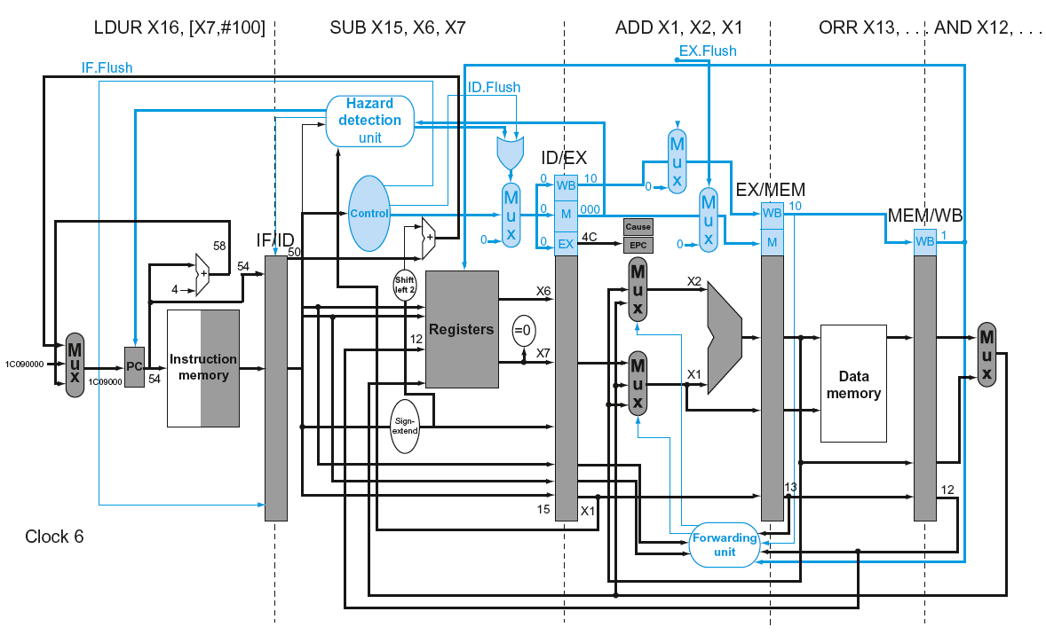
Exception Example

Slide 99
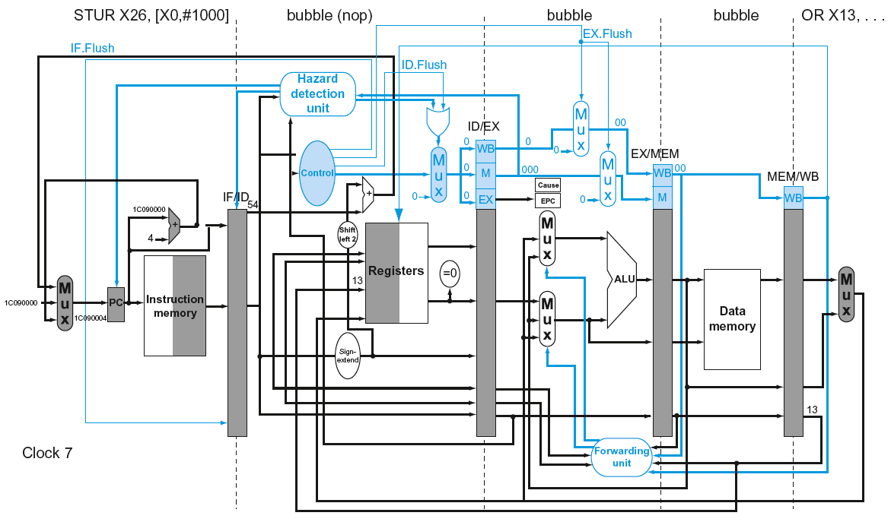
Exception Example

Slide 100
Multiple Exceptions
Pipelining overlaps multiple instructions
Could have multiple exceptions at once
Simple approach: deal with exception from earliest instruction
Flush subsequent instructions
“Precise” exceptions
In complex pipelines
Multiple instructions issued per cycle
Out-of-order completion
Maintaining precise exceptions is difficult!

Slide 101
Imprecise Exceptions
Just stop pipeline and save state
Including exception cause(s)
Let the handler work out
Which instruction(s) had exceptions
Which to complete or flush
May require “manual” completion
Simplifies hardware, but more complex handler software
Not feasible for complex multiple-issue out-of-order pipelines

Slide 102
Instruction-Level Parallelism (ILP)
Pipelining: executing multiple instructions in parallel
To increase ILP
Deeper pipeline
Less work per stage ⇒ shorter clock cycle
Multiple issue
Replicate pipeline stages ⇒ multiple pipelines
Start multiple instructions per clock cycle
CPI < 1, so use Instructions Per Cycle (IPC)
E.g., 4GHz 4-way multiple-issue
16 BIPS, peak CPI = 0.25, peak IPC = 4
But dependencies reduce this in practice
§4.10 Parallelism via Instructions

Slide 103
Multiple Issue
Static multiple issue
Compiler groups instructions to be issued together
Packages them into “issue slots”
Compiler detects and avoids hazards
Dynamic multiple issue
CPU examines instruction stream and chooses instructions to issue each cycle
Compiler can help by reordering instructions
CPU resolves hazards using advanced techniques at runtime

Slide 104
Speculation
“Guess” what to do with an instruction
Start operation as soon as possible
Check whether guess was right
If so, complete the operation
If not, roll-back and do the right thing
Common to static and dynamic multiple issue
Examples
Speculate on branch outcome
Roll back if path taken is different
Speculate on load
Roll back if location is updated

Slide 105
Compiler/Hardware Speculation
Compiler can reorder instructions
e.g., move load before branch
Can include “fix-up” instructions to recover from incorrect guess
Hardware can look ahead for instructions to execute
Buffer results until it determines they are actually needed
Flush buffers on incorrect speculation

Slide 106
Speculation and Exceptions
What if exception occurs on a speculatively executed instruction?
e.g., speculative load before null-pointer check
Static speculation
Can add ISA support for deferring exceptions
Dynamic speculation
Can buffer exceptions until instruction completion (which may not occur)

Slide 107
Static Multiple Issue
Compiler groups instructions into “issue packets”
Group of instructions that can be issued on a single cycle
Determined by pipeline resources required
Think of an issue packet as a very long instruction
Specifies multiple concurrent operations
⇒ Very Long Instruction Word (VLIW)

Slide 108
Scheduling Static Multiple Issue
Compiler must remove some/all hazards
Reorder instructions into issue packets
No dependencies with a packet
Possibly some dependencies between packets
Varies between ISAs; compiler must know!
Pad with nop if necessary

Slide 109
ARMv6-M with Static Dual Issue
Two-issue packets
One ALU/branch instruction
One load/store instruction
64-bit aligned
ALU/branch, then load/store
Pad an unused instruction with nop
Address | Instruction type | Pipeline Stages
n | ALU/branch | IF | ID | EX | MEM | WB
n + 4 | Load/store | IF | ID | EX | MEM | WB
n + 8 | ALU/branch |  | IF | ID | EX | MEM | WB
n + 12 | Load/store |  | IF | ID | EX | MEM | WB
n + 16 | ALU/branch |  |  | IF | ID | EX | MEM | WB
n + 20 | Load/store |  |  | IF | ID | EX | MEM | WB

Slide 110
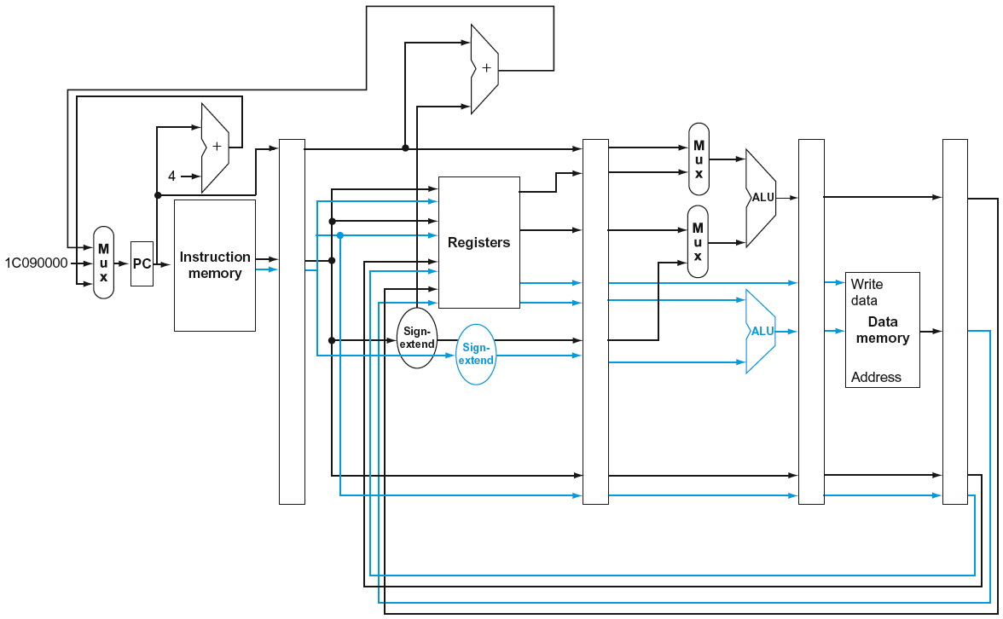
ARMv6-M with Static Dual Issue

Slide 111
Hazards in the Dual-Issue ARMv6-M
More instructions executing in parallel
EX data hazard
Forwarding avoided stalls with single-issue
Now can’t use ALU result in load/store in same packet
ADD X0, X0, X1 LDUR X2, [X0,#0]
Split into two packets, effectively a stall
Load-use hazard
Still one cycle use latency, but now two instructions
More aggressive scheduling required

Slide 112
Scheduling Example
Schedule this for dual-issue ARMv6-M
Loop: LDUR X0, [X20,#0] // X0=array element ADD X0, X0,X21 // add scalar in X21 STUR X0, [X20,#0] // store result SUBI X20, X20,#4 // decrement pointer CMP X20, X22 // branch $s1!=0
BGT Loop
 | ALU/branch | Load/store | cycle
Loop: | nop | LDUR X0, [X20,#0] | 1
 | SUBI X20, X20,#4 | nop | 2
 | ADD X0, X0,X21 | nop | 3
 | CMP X20, X22 | sw $t0, 4($s1) | 4
 | BGT Loop | STUR X0, [X20,#0] | 5
IPC = 7/6 = 1.17 (c.f. peak IPC = 2)

Slide 113
Loop Unrolling
Replicate loop body to expose more parallelism
Reduces loop-control overhead
Use different registers per replication
Called “register renaming”
Avoid loop-carried “anti-dependencies”
Store followed by a load of the same register
Aka “name dependence”
Reuse of a register name

Slide 114
Loop Unrolling Example
 | ALU/branch | Load/store | cycle
Loop: | SUBI X20, X20,#32 | LDUR X0, [X20,#0] | 1
 | nop | LDUR X1, [X20,#24] | 2
 | ADD X0, X0, X21 | LDUR X2, [X20,#16] | 3
 | ADD X1, X1, X21 | LDUR X3, [X20,#8] | 4
 | ADD X2, X2, X21 | STUR X0, [X20,#32] | 5
 | ADD X3, X3, X21 | sw X1, [X20,#24] | 6
 | CMP X20,X22 | sw X2, [X20,#16] | 7
 | BGT Loop | sw X3, [X20,#8] | 8
IPC = 15/8 = 1.875
Closer to 2, but at cost of registers and code size

Slide 115
Dynamic Multiple Issue
“Superscalar” processors
CPU decides whether to issue 0, 1, 2, … each cycle
Avoiding structural and data hazards
Avoids the need for compiler scheduling
Though it may still help
Code semantics ensured by the CPU

Slide 116
Dynamic Pipeline Scheduling
Allow the CPU to execute instructions out of order to avoid stalls
But commit result to registers in order
Example
LDUR X0, [X21,#20] ADD X1, X0, X2 SUB X23,X23,X3 ANDI X5, X23,#20
Can start sub while ADD is waiting for LDUI

Slide 117
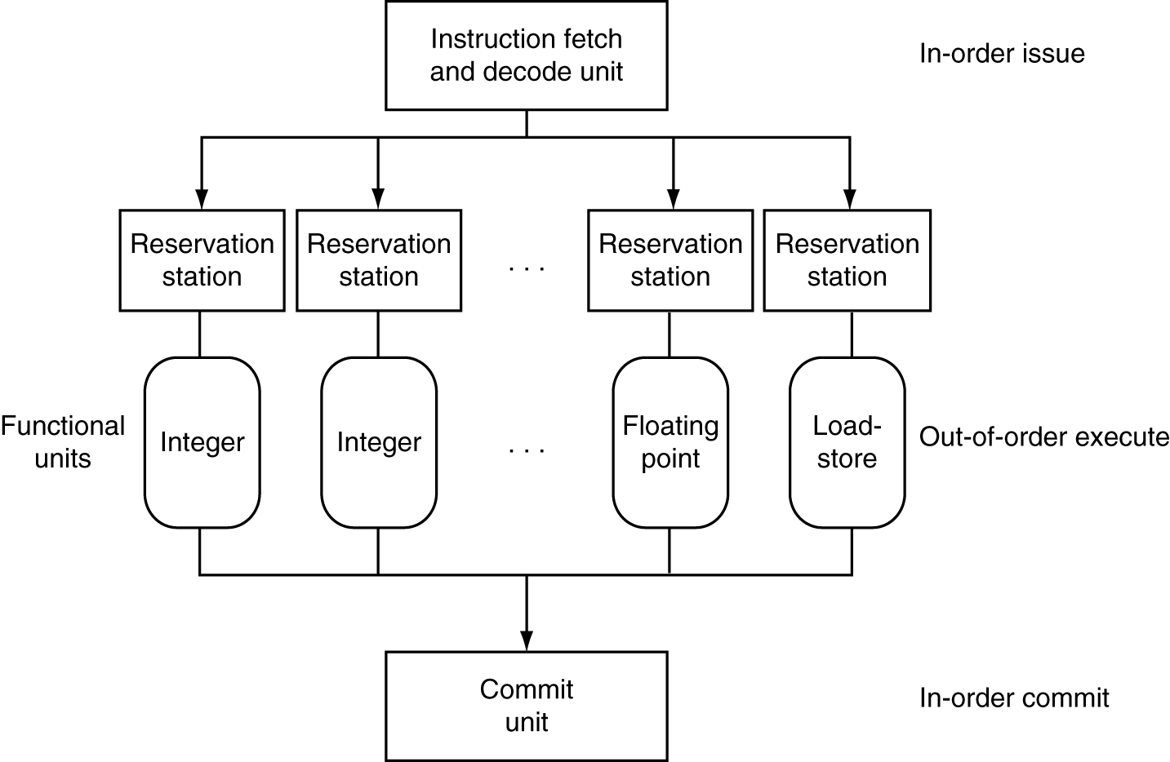
Dynamically Scheduled CPU
Preserves dependencies
Hold pending operands
Results also sent to any waiting reservation stations
Reorders buffer for register writes
Can supply operands for issued instructions

Slide 118
Register Renaming
Reservation stations and reorder buffer effectively provide register renaming
On instruction issue to reservation station
If operand is available in register file or reorder buffer
Copied to reservation station
No longer required in the register; can be overwritten
If operand is not yet available
It will be provided to the reservation station by a function unit
Register update may not be required

Slide 119
Speculation
Predict branch and continue issuing
Don’t commit until branch outcome determined
Load speculation
Avoid load and cache miss delay
Predict the effective address
Predict loaded value
Load before completing outstanding stores
Bypass stored values to load unit
Don’t commit load until speculation cleared

Slide 120
Why Do Dynamic Scheduling?
Why not just let the compiler schedule code?
Not all stalls are predicable
e.g., cache misses
Can’t always schedule around branches
Branch outcome is dynamically determined
Different implementations of an ISA have different latencies and hazards

Slide 121
Does Multiple Issue Work?
The BIG Picture
Yes, but not as much as we’d like
Programs have real dependencies that limit ILP
Some dependencies are hard to eliminate
e.g., pointer aliasing
Some parallelism is hard to expose
Limited window size during instruction issue
Memory delays and limited bandwidth
Hard to keep pipelines full
Speculation can help if done well

Slide 122
Power Efficiency
Complexity of dynamic scheduling and speculations requires power
Multiple simpler cores may be better
Microprocessor | Year | Clock Rate | Pipeline Stages | Issue width | Out-of-order/ Speculation | Cores | Power
i486 | 1989 | 25MHz | 5 | 1 | No | 1 | 5W
Pentium | 1993 | 66MHz | 5 | 2 | No | 1 | 10W
Pentium Pro | 1997 | 200MHz | 10 | 3 | Yes | 1 | 29W
P4 Willamette | 2001 | 2000MHz | 22 | 3 | Yes | 1 | 75W
P4 Prescott | 2004 | 3600MHz | 31 | 3 | Yes | 1 | 103W
Core | 2006 | 2930MHz | 14 | 4 | Yes | 2 | 75W
UltraSparc III | 2003 | 1950MHz | 14 | 4 | No | 1 | 90W
UltraSparc T1 | 2005 | 1200MHz | 6 | 1 | No | 8 | 70W

Slide 123
Cortex A53 and Intel i7
Processor | ARM A53 | Intel Core i7 920
Market | Personal Mobile Device | Server, cloud
Thermal design power | 100 milliWatts (1 core @ 1 GHz) | 130 Watts
Clock rate | 1.5 GHz | 2.66 GHz
Cores/Chip | 4 (configurable) | 4
Floating point? | Yes | Yes
Multiple issue? | Dynamic | Dynamic
Peak instructions/clock cycle | 2 | 4
Pipeline stages | 8 | 14
Pipeline schedule | Static in-order | Dynamic out-of-order with speculation
Branch prediction | Hybrid | 2-level
1st level caches/core | 16-64 KiB I, 16-64 KiB D | 32 KiB I, 32 KiB D
2nd level caches/core | 128-2048 KiB | 256 KiB (per core)
3rd level caches (shared) | (platform dependent) | 2-8 MB
§4.11 Real Stuff: The ARM Cortex-A8 and Intel Core i7 Pipelines

Slide 124
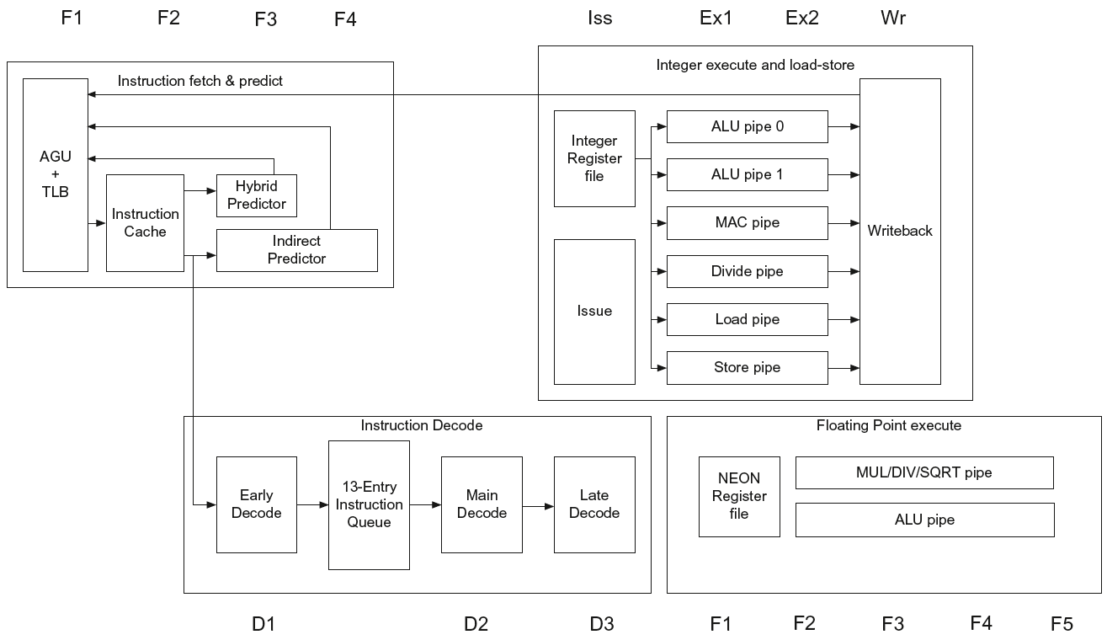
ARM Cortex-A53 Pipeline

Slide 125

ARM Cortex-A53 Performance

Slide 126

Core i7 Pipeline

Slide 127


Core i7 Performance

Slide 128
Matrix Multiply
Unrolled C code
1 #include <x86intrin.h>
2 #define UNROLL (4)
3
4 void dgemm (int n, double* A, double* B, double* C)
5 {
6 for ( int i = 0; i < n; i+=UNROLL*4 )
7 for ( int j = 0; j < n; j++ ) {
8 __m256d c[4];
9 for ( int x = 0; x < UNROLL; x++ )
10 c[x] = _mm256_load_pd(C+i+x*4+j*n);
11
12 for( int k = 0; k < n; k++ )
13 {
14 __m256d b = _mm256_broadcast_sd(B+k+j*n);
15 for (int x = 0; x < UNROLL; x++)
16 c[x] = _mm256_add_pd(c[x],
17 _mm256_mul_pd(_mm256_load_pd(A+n*k+x*4+i), b));
18 }
19
20 for ( int x = 0; x < UNROLL; x++ )
21 _mm256_store_pd(C+i+x*4+j*n, c[x]);
22 }
23 }
§4.12 Instruction-Level Parallelism and Matrix Multiply

Slide 129
Matrix Multiply
Assembly code:
1 vmovapd (%r11),%ymm4 # Load 4 elements of C into %ymm4
2 mov %rbx,%rax # register %rax = %rbx
3 xor %ecx,%ecx # register %ecx = 0
4 vmovapd 0x20(%r11),%ymm3 # Load 4 elements of C into %ymm3
5 vmovapd 0x40(%r11),%ymm2 # Load 4 elements of C into %ymm2
6 vmovapd 0x60(%r11),%ymm1 # Load 4 elements of C into %ymm1
7 vbroadcastsd (%rcx,%r9,1),%ymm0 # Make 4 copies of B element
8 add $0x8,%rcx # register %rcx = %rcx + 8
9 vmulpd (%rax),%ymm0,%ymm5 # Parallel mul %ymm1,4 A elements
10 vaddpd %ymm5,%ymm4,%ymm4 # Parallel add %ymm5, %ymm4
11 vmulpd 0x20(%rax),%ymm0,%ymm5 # Parallel mul %ymm1,4 A elements
12 vaddpd %ymm5,%ymm3,%ymm3 # Parallel add %ymm5, %ymm3
13 vmulpd 0x40(%rax),%ymm0,%ymm5 # Parallel mul %ymm1,4 A elements
14 vmulpd 0x60(%rax),%ymm0,%ymm0 # Parallel mul %ymm1,4 A elements
15 add %r8,%rax # register %rax = %rax + %r8
16 cmp %r10,%rcx # compare %r8 to %rax
17 vaddpd %ymm5,%ymm2,%ymm2 # Parallel add %ymm5, %ymm2
18 vaddpd %ymm0,%ymm1,%ymm1 # Parallel add %ymm0, %ymm1
19 jne 68 <dgemm+0x68> # jump if not %r8 != %rax
20 add $0x1,%esi # register % esi = % esi + 1
21 vmovapd %ymm4,(%r11) # Store %ymm4 into 4 C elements
22 vmovapd %ymm3,0x20(%r11) # Store %ymm3 into 4 C elements
23 vmovapd %ymm2,0x40(%r11) # Store %ymm2 into 4 C elements
24 vmovapd %ymm1,0x60(%r11) # Store %ymm1 into 4 C elements
§4.12 Instruction-Level Parallelism and Matrix Multiply

Slide 130

Performance Impact

Slide 131
Fallacies
Pipelining is easy (!)
The basic idea is easy
The devil is in the details
e.g., detecting data hazards
Pipelining is independent of technology
So why haven’t we always done pipelining?
More transistors make more advanced techniques feasible
Pipeline-related ISA design needs to take account of technology trends
e.g., predicated instructions
§4.14 Fallacies and Pitfalls

Slide 132
Pitfalls
Poor ISA design can make pipelining harder
e.g., complex instruction sets (VAX, IA-32)
Significant overhead to make pipelining work
IA-32 micro-op approach
e.g., complex addressing modes
Register update side effects, memory indirection
e.g., delayed branches
Advanced pipelines have long delay slots

Slide 133
Concluding Remarks
ISA influences design of datapath and control
Datapath and control influence design of ISA
Pipelining improves instruction throughput using parallelism
More instructions completed per second
Latency for each instruction not reduced
Hazards: structural, data, control
Multiple issue and dynamic scheduling (ILP)
Dependencies limit achievable parallelism
Complexity leads to the power wall
§4.14 Concluding Remarks

