Slide 1
TE2003B SoC Design: Computer organisation & architecture Introduction to Cortex-M0+ assembly language

Slide 2
References
The following material has been adopted and adapted from
Patterson, D. A., Hennessy, J. L., Computer Organization and design: The hardware/software interface – ARM edition, Morgan Kaufmann, 2017.
S. L. Harris and D. M. Harris, Digital design and computer architecture - ARM edition, Morgan Kaufmann, 2016.
J. Yiu, The definitive guide to ARM Cortex-M0 and Cortex-M0+ processors, Second edition, Elsevier, 2015.

Slide 3
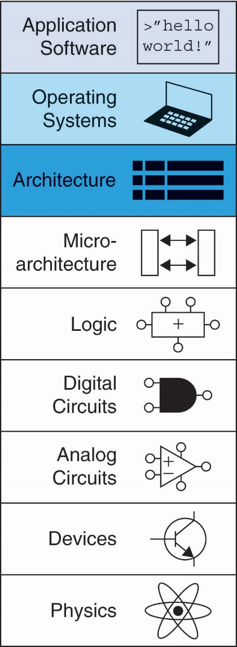
Recalling abstraction
Jumping up a few levels of abstraction
Architecture: programmer’s view of computer
Defined by instructions & operand locations
Microarchitecture: how to implement an architecture in hardware.

Slide 4
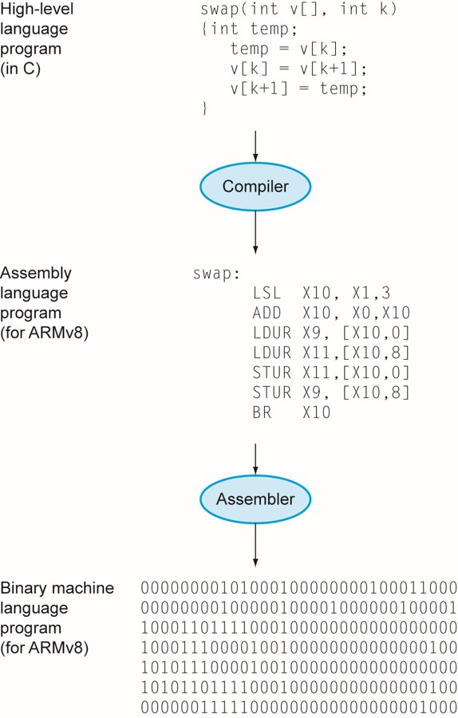
From human-language to machine language
Commands in a computer’s language
Assembly language: human-readable format of instructions
Machine language: computer-readable format (1’s and 0’s)

Slide 5
Why assembler language?
High-level languages provide flexibility to the programmer.
Close to human language.
A C program might be ported between different systems with minor modifications.
Assembly language is specific to each Instruction Set Architecture (ISA).
We can’t simply take ARM assembly code and easily convert it to Intel assembly.

Slide 6
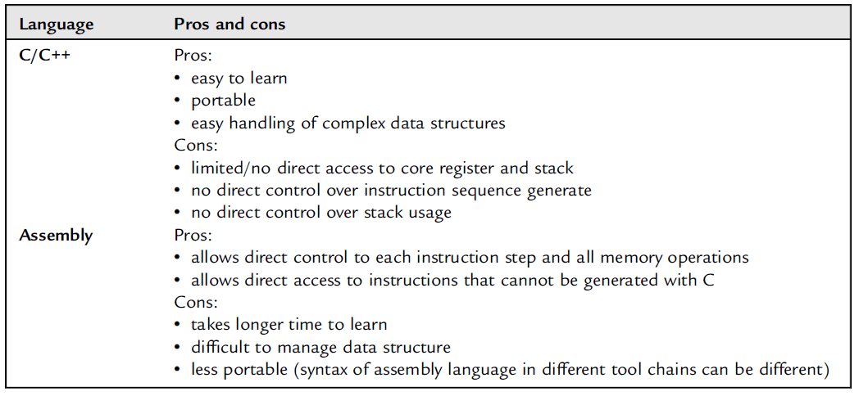
Why assembly language?

Slide 7
Assembly advantages
Time efficient.
Fast compile times.
Yields fast program execution.
Memory efficient.
Program stored efficiently in system’s memory.
Efficient use of resources.
Programmers have direct access to resources such as registers, memory, Input/Output (IO) ports, peripherals, etc.

Slide 8
ARM’s background
Developed in the 1980’s by Advanced RISC Machines – now called ARM Holdings.
ARM does not fabricate Integrated Circuits (ICs).
ARM licenses (sells) μP cores in the form of Intellectual Property (IP).
ARM architecture has several variants, which are identified as ARMvX.
For example: Freescale’s KL25Z μC (Microcontroller) is based on ARM’s Cortex-M0+ (read as M zero plus), which is based on ARMv6-M ISA.

Slide 9
ARM’s background
Nearly 10 billion ARM processors sold/year
Almost all cell phones and tablets have multiple ARM processors
Over 75% of humans use products with an ARM processor
Used in servers, cameras, robots, cars, pinball machines,, etc.
Once you’ve learned one architecture, it’s easier to learn others

Slide 10
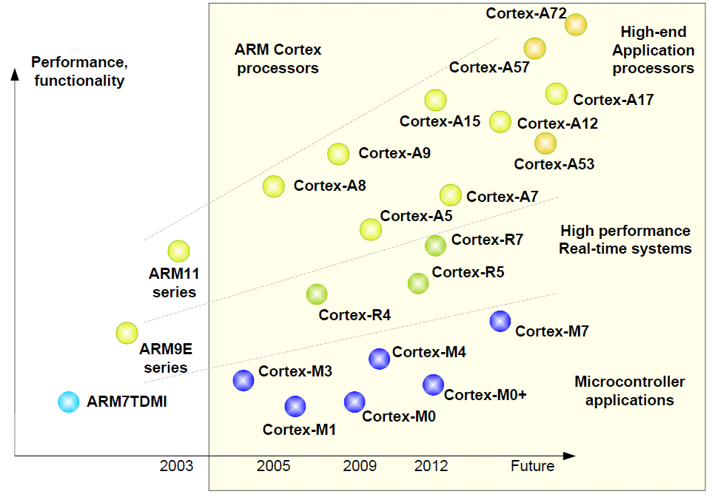
ARM core families
Based on ARMv6-M ISA

Slide 11
Cortex-M0+ instructions
Cortex-M0+ processors are not designed for heavy duty number crunching.
No Floating-Point Unit (FPU).
Multiplication (MUL) available, however, no division instruction available.
Designed for handling general data, IO control tasks in ultra low power and low-cost systems.
Upwards compatibility.
Program developed for Cortex-M0+ might run without (major) changes in Cortex-M7 processors.

Slide 12
Cortex-M0+ main characteristics
32-bit RISC processor
16 32-bit registers
Some of these registers have a special purpose
56 instructions
50 16-bit instructions
6 32-bit instructions
Stack Pointer (SP)
Designed for low-power applications

Slide 13
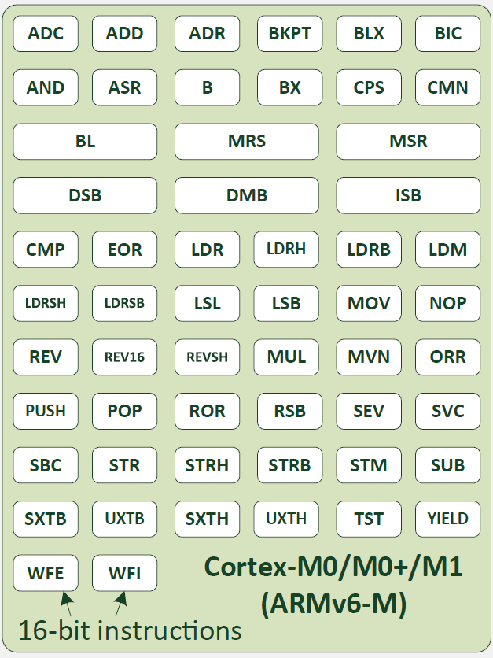
Cortex-M0+ instructions
ARM Cortex-M processors support the instruction set called Thumb.
Cortex-M0+ support only a subset (56) instructions.
50/56 instructions encoded in 16 bits.
6/56 instructions encoded in 32 bits.

Slide 14
Cortex-M0+ instructions
Data processing instructions.
Arithmetic and logic operations.
Memory access instructions.
Read/write from/to memory.
Program flow control.
Branches, function calls.
Exception and Operative System (OS) support.
Special registers.
Sleep operations.
Memory barriers.

Slide 15
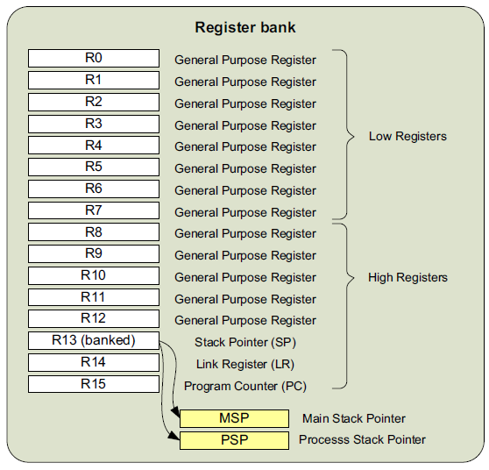
Cortex-M0+ registers
Many Thumb instructions can only access R0-R7.
Assembly code syntax allows using both upper- and lower-case letters.
R0 == r0
R13 == r13 == SP
R14 == r14 == LR
R15 == r15 == PC
Figure 8: Cortex-M0+ registers

Slide 16
Cortex-M0+ memory map
16 registers are not enough for storing all the required data.
Code (instructions, program)
Data (user data such as variables and constants)
Cortex-M0+ provides a total of 4 GB of memory space, divided into several regions.

Slide 17
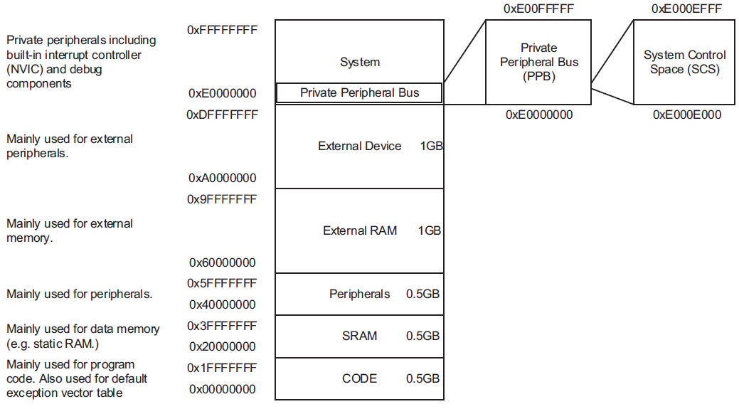
Cortex-M0+ memory map
Figure 7: Cortex-M0+ memory map
Notes:
Von Neumann model

Slide 18
Assembly basics

Slide 19
Assembly general considerations
Generally speaking, every assembly language code might be structured as follows
label
mnemonic operand1, operand2, …, ; comments
“label” is any word used as a reference for address location.
Optional for some instructions.
Used by branch instructions.
“mnemonic” is the name of the instruction.
“operands” for data processing instructions in ARMv6-M, first word after mnemonic is the destination of the operation. Following operands determine the source of the operation.
Comments are defined after “;” character.

Slide 20
Assembly general considerations
Number of operands depend on the type of the instruction.
# symbol is used for specifying a constant (immediate) value.
adds, r0, r1, #0xA ; r0 = r1 + 10 in hexadecimal
adds, r0, r1, r2 ; r0 = r1 + r2
; Same mnemonic, different operands
Types of operands for each instruction are defined by the ARMv6-M reference manual.
Not all instructions accept different types of operands.
Why are constants called immediate?

Slide 21
Assembly general considerations
Constants
Declared in compiler directives
MY_CONSTANT EQU 0x1234
BIT_MASK EQU 0x000C0000
These constants might be later used in the code
adds, r0, r1, #MY_CONSTANT ; r0 = r1 + 0x1234

Slide 22
C and its assembly equivalent
Instructions with Registers
Revisit ADDS instruction
C Code
a = b + c
ARM Assembly Code
; R0 = a, R1 = b, R2 = c
ADDS R0, R1, R2

Slide 23
C and its assembly equivalent
Instructions with Registers
C Code
a = a + 4;
b = a – 12;
ARM Assembly Code
; R0 = a, R1 = b
ADDS R0, R0, #4
SUBS R1, R0, #12

Slide 24
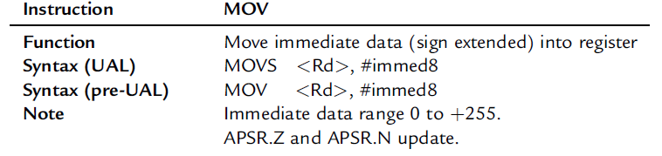
C and its assembly equivalent
Instructions with Registers
MOV instruction might be used for generating a small constant
C Code
//int: 32-bit signed word
int a = 23;
int b = 0x45;
ARM Assembly Code
; R0 = a, R1 = b
MOV R0, #23
MOV R1, #0x45

Slide 25
C and its assembly equivalent
Instructions with Registers
What about immediate values larger than 8 bits?
We will solve that (later) with LDR pseudo-instruction
C Code
//int: 32-bit signed word
int a = 23;
int b = 0x45;
ARM Assembly Code
; R0 = a, R1 = b
MOV R0, #23
MOV R1, #0x45

Slide 26
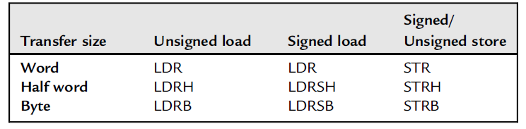
Cortex-M0+ memory access instructions
Cortex-M0+ allows access to byte, half-word and word data sizes.
Data must be aligned.
Unaligned access result in an exception.

Slide 27
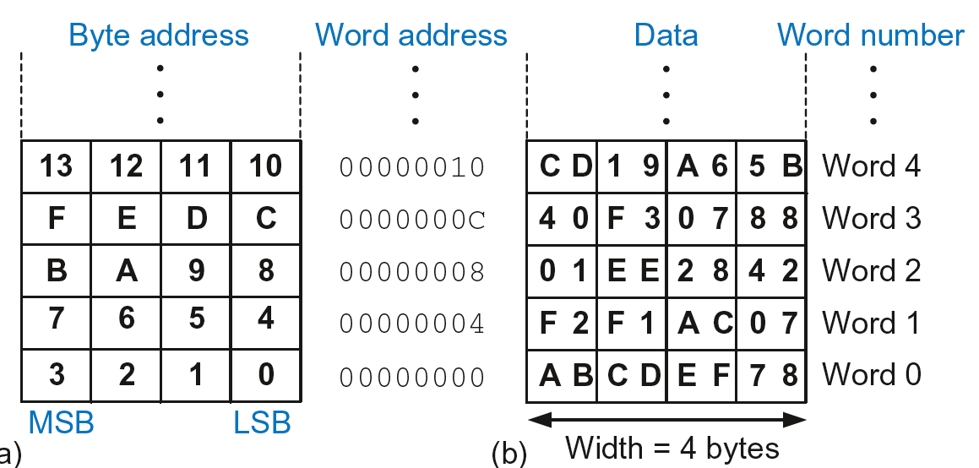
Cortex-M0+ addressable memory
Each data byte has a unique address.
Word address = 32 bits or 4 bytes.
Addresses increment by 4.

Slide 28
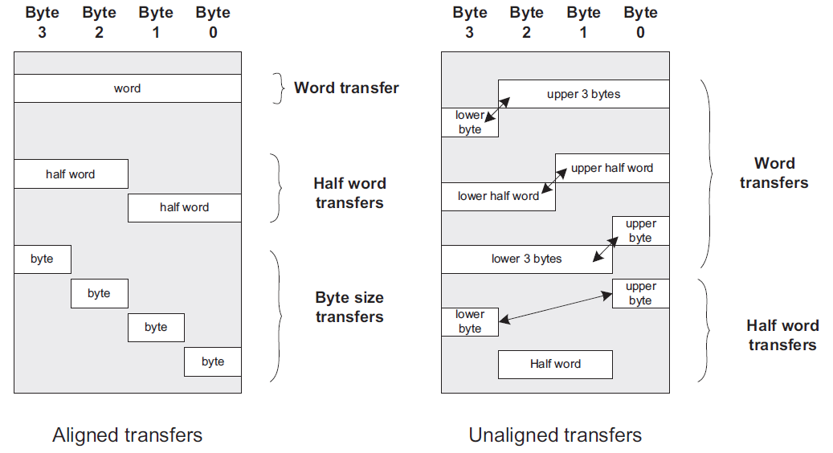
Cortex-M0+ memory alignment
Notes:
Only aligned transfers are allowed
Addresses must be a multiple of the transfer size
Word tranfers can access 0x0, 0x4, 0x8, 0xC, etc
Half-word transfers can access 0x0, 0x2, 0x4, etc
Byte transfers can access 0x0, 0x1, 0x2, 0x3, etc
Unaligned transfers generate an exception

Slide 29
Memory access instructions

Slide 30
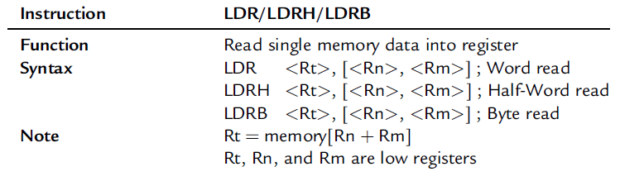
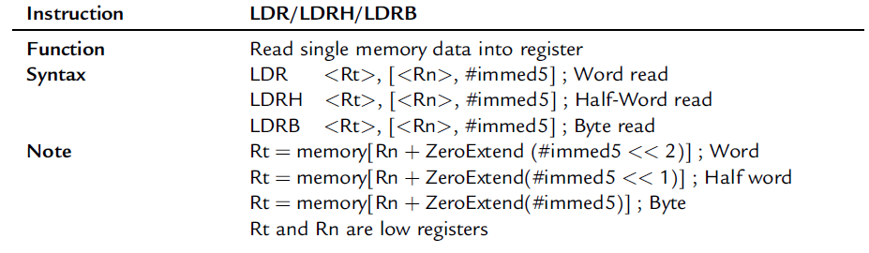
Cortex-M0+ memory access instructions
Reading from memory

Slide 31
Memory access instructions - example
Memory read called load
Mnemonic: load register (LDR)
Format:
LDR R0, [R1, #12]
Address calculation:
add base address (R1) to the offset (12)
address = (R1 + 12)
Result:
R0 holds the data at memory address (R1 + 12)
Cortex-M0+ might only use low registers

Slide 32
Cortex-M0+ memory access
Reading Memory
Example: Read a word of data at memory address 8 into R3
LDR address is given by the addition of a register and an immediate
We might use a dummy register for this purpose
Address = (R2 + 8) = 8
R3 = 0x01EE2842 after load
ARM Assembly Code
MOV R2, #0
LDR R3, [R2, #8]

Slide 33
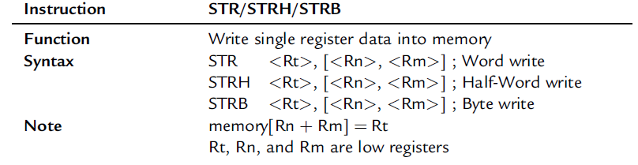
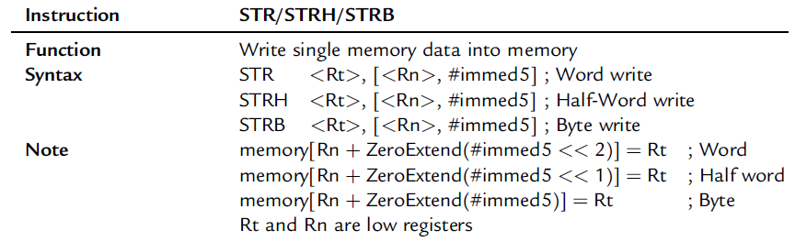
Cortex-M0+ memory access
Writing Memory
Memory write are called stores
Mnemonic: store register (STR)

Slide 34
Cortex-M0+ memory access
Writing Memory
Example: Store the value held in R7 into memory word 21.
We want to access word 21, which address should access?
Memory address = 4 x 21 = 84 = 0x54
ARM assembly code
MOV R5, #0
STR R7, [R5, #0x54]

Slide 35
Cortex-M0+ memory access
Recap: Accessing Memory
Address of a memory word must be multiplied by 4
Examples:
Address of memory word 2 = 2 × 4 = 8
Address of memory word 10 = 10 × 4 = 40

Slide 36
Data processing instructions

Slide 37
Cortex-M0+ data processing instructions
Data-processing Instructions
Arithmetic operations
Logical operations
Shifts/rotate
Multiplication

Slide 38
Cortex-M0+ examples of logical operations
Logical Instructions
AND
ORR
EOR (XOR)
BIC (Bit Clear)
MVN (MoVe and NOT)

Slide 39
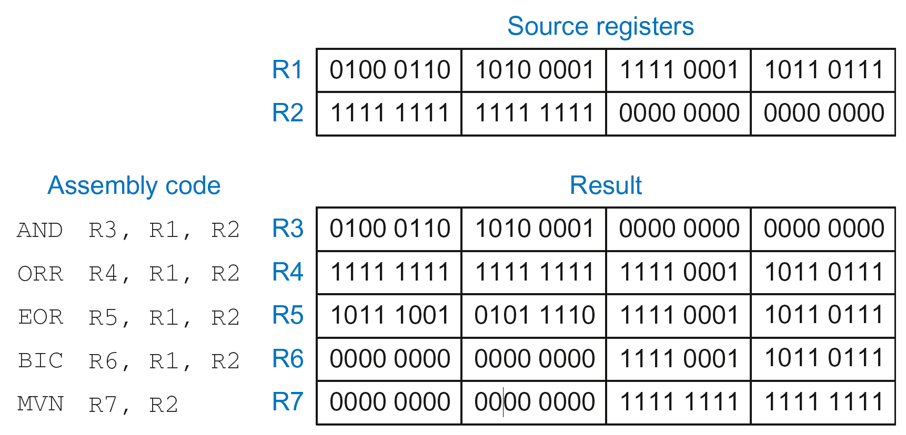
Cortex-M0+ examples of logical operations
Logical Instructions: Examples

Slide 40
Cortex-M0+ examples of logical operations
Logical Instructions: Uses
AND or BIC: useful for masking bits
Example: Masking all but the least significant byte of a value
0xF234012F AND 0x000000FF = 0x0000002F
0xF234012F BIC 0xFFFFFF00 = 0x0000002F
Useful for clearing individual configuration bits
ORR: useful for combining bit fields
Example: Combine 0xF2340000 with 0x000012BC:
0xF2340000 ORR 0x000012BC = 0xF23412BC
Useful for setting specific bits

Slide 41
Cortex-M0+ examples of logical operations
Shift Instructions
LSL: logical shift left
Example: LSL R0, R7, #5 ; R0 = R7 << 5
LSR: logical shift right
Example: LSR R3, R2, #31 ; R3 = R2 >> 31
ASR: arithmetic shift right
Example: ASR R9, R11, R4 ; R9 = R11 >>> R4_{7:0}
ROR: rotate right
Example: ROR R8, R1, #3 ; R8 = R1 ROR 3

Slide 42


Cortex-M0+ examples of logical operations
Arithmetic shifts
Sign bit must be considered in arithmetic shifts
Rotate instructions

Slide 43
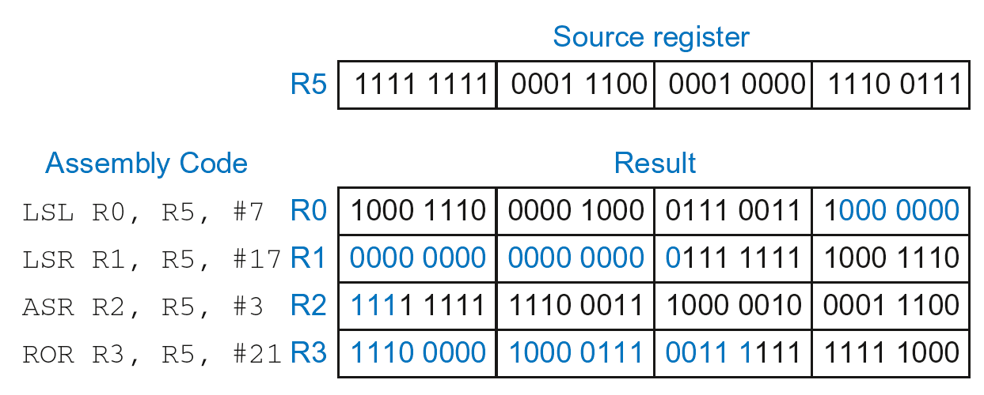
Cortex-M0+ examples of logical operations
Shift Instructions: Example 1
Immediate shift amount (5-bit immediate)
Shift amount: 0-31

Slide 44
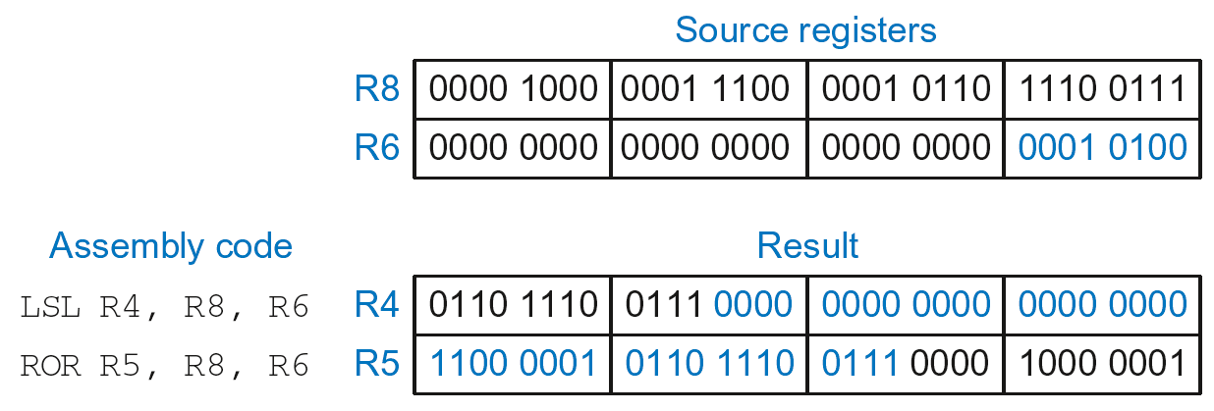
Cortex-M0+ examples of logical operations
Shift Instructions: Example 2
Register shift amount (uses low 8 bits of register)
Shift amount: 0-255

Slide 45
Cortex-M0+ example of multiplication
Multiplication
MUL: 32 × 32 multiplication, 32-bit result
MUL R1, R2, R3
Result: R1 = (R2 x R3)_{31:0}

Slide 46
Programming Building Blocks
Data-processing Instructions
Conditional Execution
Branches
High-level Constructs:
if/else statements
for loops
while loops
arrays
function calls

Slide 47
Conditional Execution
Don’t always want to execute code sequentially
For example:
if/else statements, while loops, etc.: only want to execute code if a condition is true
branching: jump to another portion of code if a condition is true

Slide 48
Conditional Execution
Don’t always want to execute code sequentially
For example:
if/else statements, while loops, etc.: only want to execute code if a condition is true
branching: jump to another portion of code if a condition is true
ARM includes condition flags that can be:
set by an instruction
used to conditionally execute an instruction

Slide 49
ARM Condition Flags
Flag | Name | Description
N | Negative | Instruction result is negative
Z | Zero | Instruction results in zero
C | Carry | Instruction causes an unsigned carry out
V | oVerflow | Instruction causes an overflow

Slide 50
ARM Condition Flags
Flag | Name | Description
N | Negative | Instruction result is negative
Z | Zero | Instruction results in zero
C | Carry | Instruction causes an unsigned carry out
V | oVerflow | Instruction causes an overflow
Set by ALU (recall from Chapter 5)
Held in Current Program Status Register (CPSR)

Slide 51
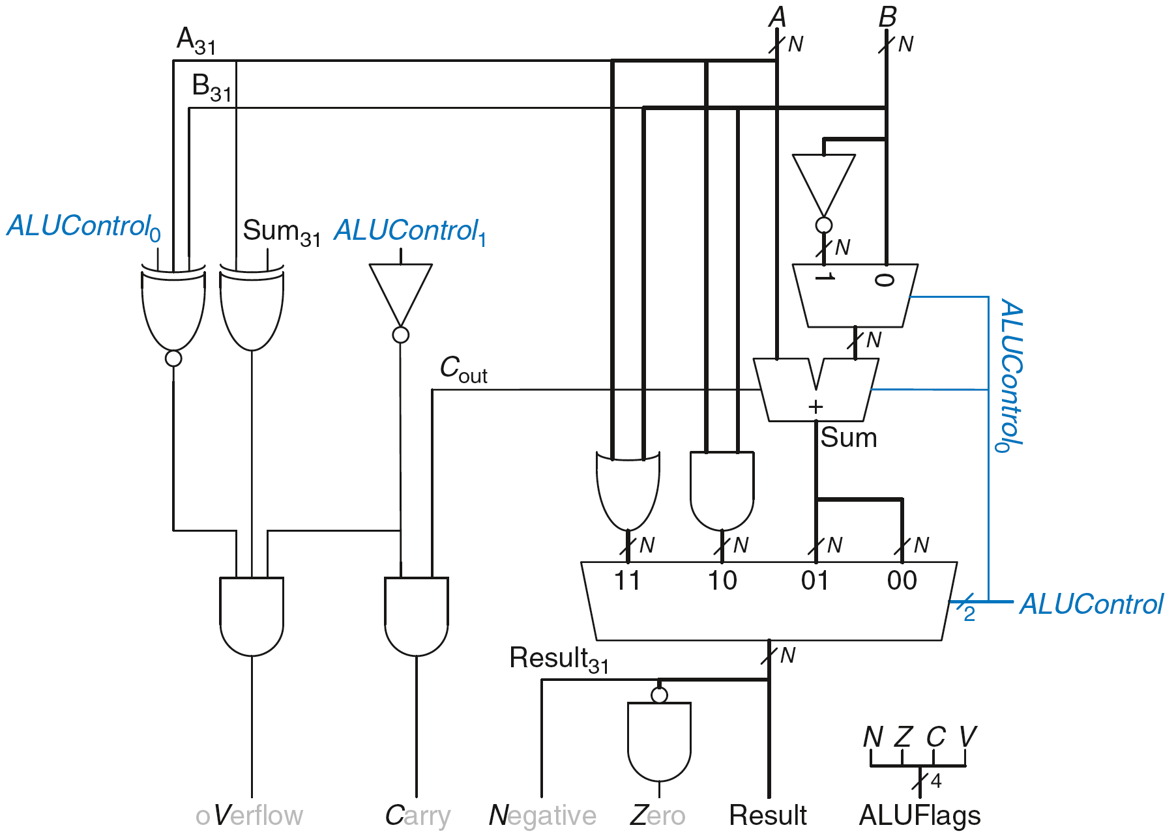
Review: ARM ALU

Slide 52
Setting the Condition Flags: NZCV
Method 1: Compare instruction: CMP
Example: CMP R5, R6
Performs: R5-R6
Does not save result
Sets flags

Slide 53
Setting the Condition Flags: NZCV
Method 1: Compare instruction: CMP
Example: CMP R5, R6
Performs: R5-R6
Does not save result
Sets flags. If result:
Is 0, Z=1
Is negative, N=1
Causes a carry out, C=1
Causes a signed overflow, V=1

Slide 54
Setting the Condition Flags: NZCV
Method 1: Compare instruction: CMP
Example: CMP R5, R6
Performs: R5-R6
Sets flags: If result is 0 (Z=1), negative (N=1), etc.
Does not save result
Method 2: Append instruction mnemonic with S

Slide 55
Setting the Condition Flags: NZCV
Method 1: Compare instruction: CMP
Example: CMP R5, R6
Performs: R5-R6
Sets flags: If result is 0 (Z=1), negative (N=1), etc.
Does not save result
Method 2: Append instruction mnemonic with S
Example: ADDS R1, R2, R3
Performs: R2 + R3
Sets flags: If result is 0 (Z=1), negative (N=1), etc.
Saves result in R1

Slide 56
Condition Mnemonics
Instruction may be conditionally executed based on the condition flags
Condition of execution is encoded as a condition mnemonic appended to the instruction mnemonic
Example: CMP R1, R2
SUBNE R3, R5, R8
NE: condition mnemonic
SUB will only execute if R1 ≠ R2
(i.e., Z = 0)

Slide 57
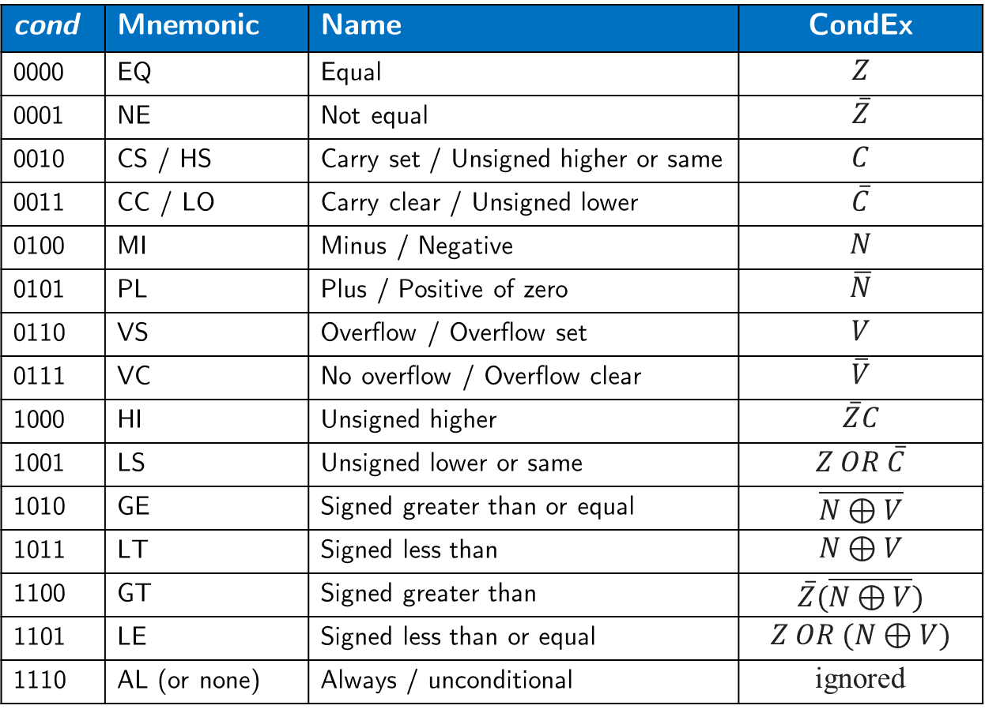
Condition Mnemonics
cond | Mnemonic | Name | CondEx
0000 | EQ | Equal | $$Z$$
0001 | NE | Not equal | $$\overline{Z}$$
0010 | CS / HS | Carry set / Unsigned higher or same | $$C$$
0011 | CC / LO | Carry clear / Unsigned lower | $$\overline{C}$$
0100 | MI | Minus / Negative | $$N$$
0101 | PL | Plus / Positive of zero | $$\overline{N}$$
0110 | VS | Overflow / Overflow set | $$V$$
0111 | VC | No overflow / Overflow clear | $$\overline{V}$$
1000 | HI | Unsigned higher | $$\overline{Z}C$$
1001 | LS | Unsigned lower or same | $$Z OR \overline{C}$$
1010 | GE | Signed greater than or equal | $$\overline{N⊕V}$$
1011 | LT | Signed less than | $$N⊕V$$
1100 | GT | Signed greater than | $$\overline{Z}(\overline{N⊕V})$$
1101 | LE | Signed less than or equal | $$Z OR (N⊕V)$$
1110 | AL (or none) | Always / unconditional | ignored

Slide 58
Conditional Execution
Example:
CMP R5, R9 ; performs R5-R9
; sets condition flags
SUBEQ R1, R2, R3 ; executes if R5==R9 (Z=1)
ORRMI R4, R0, R9 ; executes if R5-R9 is
; negative (N=1)

Slide 59
Conditional Execution
Example:
CMP R5, R9 ; performs R5-R9
; sets condition flags
SUBEQ R1, R2, R3 ; executes if R5==R9 (Z=1)
ORRMI R4, R0, R9 ; executes if R5-R9 is
; negative (N=1)
Suppose R5 = 17, R9 = 23:
CMP performs: 17 – 23 = -6 (Sets flags: N=1, Z=0, C=0, V=0)
SUBEQ doesn’t execute (they aren’t equal: Z=0)
ORRMI executes because the result was negative (N=1)

Slide 60
Programming Building Blocks
Data-processing Instructions
Conditional Execution
Branches
High-level Constructs:
if/else statements
for loops
while loops
arrays
function calls

Slide 61
Branching
Branches enable out of sequence instruction execution
Types of branches:
Branch (B)
branches to another instruction
Branch and link (BL)
discussed later
Both can be conditional or unconditional

Slide 62
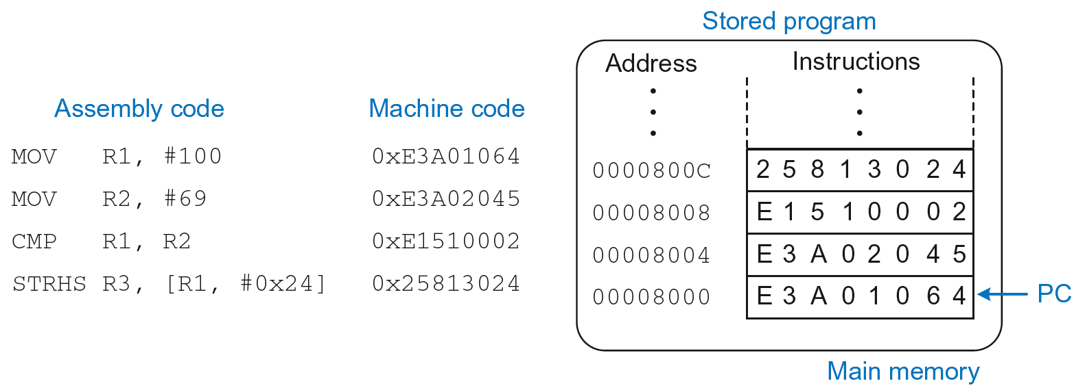
The Stored Program

Slide 63
Unconditional Branching (B)
ARM assembly
MOV R2, #17 ; R2 = 17
B TARGET ; branch to target
ORR R1, R1, #0x4 ; not executed
TARGET
SUB R1, R1, #78 ; R1 = R1 + 78

Slide 64
Unconditional Branching (B)
ARM assembly
MOV R2, #17 ; R2 = 17
B TARGET ; branch to target
ORR R1, R1, #0x4 ; not executed
TARGET
SUB R1, R1, #78 ; R1 = R1 + 78
Labels (like TARGET) indicate instruction location. Labels can’t be reserved words (like ADD, ORR, etc.)

Slide 65
The Branch Not Taken
ARM Assembly
MOV R0, #4 ; R0 = 4
ADD R1, R0, R0 ; R1 = R0+R0 = 8
CMP R0, R1 ; sets flags with R0-R1
BEQ THERE ; branch not taken (Z=0)
ORR R1, R1, #1 ; R1 = R1 OR R1 = 9
THERE
ADD R1, R1, 78 ; R1 = R1 + 78 = 87

Slide 66
Programming Building Blocks
Data-processing Instructions
Conditional Execution
Branches
High-level Constructs:
if/else statements
for loops
while loops
arrays
function calls

Slide 67
if Statement
C Code
if (i == j)
f = g + h;
f = f – i;

Slide 68
if Statement
C Code
if (i == j)
f = g + h;
f = f – i;
ARM Assembly Code
;R0=f, R1=g, R2=h, R3=i, R4=j
CMP R3, R4 ; set flags with R3-R4
BNE L1 ; if i!=j, skip if block
ADD R0, R1, R2 ; f = g + h
L1
SUB R0, R0, R2 ; f = f - i

Slide 69
if Statement
C Code
if (i == j)
f = g + h;
f = f – i;
ARM Assembly Code
;R0=f, R1=g, R2=h, R3=i, R4=j
CMP R3, R4 ; set flags with R3-R4
BNE L1 ; if i!=j, skip if block
ADD R0, R1, R2 ; f = g + h
L1
SUB R0, R0, R2 ; f = f - i
Assembly tests opposite case (i != j) of high-level code (i == j)

Slide 70
if Statement: Alternate Code
C Code
if (i == j)
f = g + h;
f = f – i;
ARM Assembly Code
;R0=f, R1=g, R2=h, R3=i, R4=j
CMP R3, R4 ; set flags with R3-R4
ADDEQ R0, R1, R2 ; if (i==j) f = g + h
SUB R0, R0, R2 ; f = f - i

Slide 71
if Statement: Alternate Code
Alternate Assembly Code
;R0=f, R1=g, R2=h, R3=i, R4=j
CMP R3, R4 ; set flags with R3-R4
ADDEQ R0, R1, R2 ; if (i==j) f = g + h
SUB R0, R0, R2 ; f = f - i
Original
CMP R3, R4
BNE L1
ADD R0, R1, R2
L1
SUB R0, R0, R2

Slide 72
if Statement: Alternate Code
Alternate Assembly Code
;R0=f, R1=g, R2=h, R3=i, R4=j
CMP R3, R4 ; set flags with R3-R4
ADDEQ R0, R1, R2 ; if (i==j) f = g + h
SUB R0, R0, R2 ; f = f - i
Original
CMP R3, R4
BNE L1
ADD R0, R1, R2
L1
SUB R0, R0, R2
Useful for short conditional blocks of code

Slide 73
if/else Statement
C Code
if (i == j)
f = g + h;
else
f = f – i;
ARM Assembly Code

Slide 74
if/else Statement
C Code
if (i == j)
f = g + h;
else
f = f – i;
ARM Assembly Code
;R0=f, R1=g, R2=h, R3=i, R4=j
CMP R3, R4 ; set flags with R3-R4
BNE L1 ; if i!=j, skip if block
ADD R0, R1, R2 ; f = g + h
B L2 ; branch past else block
L1
SUB R0, R0, R2 ; f = f – i
L2

Slide 75
if/else Statement: Alternate Code
C Code
if (i == j)
f = g + h;
else
f = f – i;
ARM Assembly Code
;R0=f, R1=g, R2=h, R3=i, R4=j
CMP R3, R4 ; set flags with R3-R4
ADDEQ R0, R1, R2 ; if (i==j) f = g + h
SUBNE R0, R0, R2 ; else f = f - i

Slide 76
if/else Statement: Alternate Code
Original
CMP R3, R4
BNE L1
ADD R0, R1, R2
B L2
L1
SUB R0, R0, R2
L2
Alternate Assembly Code
;R0=f, R1=g, R2=h, R3=i, R4=j
CMP R3, R4 ; set flags with R3-R4
ADDEQ R0, R1, R2 ; if (i==j) f = g + h
SUBNE R0, R0, R2 ; else f = f - i

Slide 77
while Loops
C Code
// determines the power
// of x such that 2^{x} = 128
int pow = 1;
int x = 0;
while (pow != 128) {
pow = pow * 2;
x = x + 1;
}
ARM Assembly Code

Slide 78
while Loops
C Code
// determines the power
// of x such that 2^{x} = 128
int pow = 1;
int x = 0;
while (pow != 128) {
pow = pow * 2;
x = x + 1;
}
ARM Assembly Code
; R0 = pow, R1 = x
MOV R0, #1 ; pow = 1
MOV R1, #0 ; x = 0
WHILE
CMP R0, #128 ; R0-128
BEQ DONE ; if (pow==128) ; exit loop
LSL R0, R0, #1 ; pow=pow*2
ADD R1, R1, #1 ; x=x+1
B WHILE ; repeat loop
DONE

Slide 79
while Loops
C Code
// determines the power
// of x such that 2^{x} = 128
int pow = 1;
int x = 0;
while (pow != 128) {
pow = pow * 2;
x = x + 1;
}
ARM Assembly Code
; R0 = pow, R1 = x
MOV R0, #1 ; pow = 1
MOV R1, #0 ; x = 0
WHILE
CMP R0, #128 ; R0-128
BEQ DONE ; if (pow==128) ; exit loop
LSL R0, R0, #1 ; pow=pow*2
ADD R1, R1, #1 ; x=x+1
B WHILE ; repeat loop
DONE
Assembly tests for the opposite case (pow == 128) of the C code (pow != 128).

Slide 80
for Loops
for (initialization; condition; loop operation)
statement
initialization: executes before the loop begins
condition: is tested at the beginning of each iteration
loop operation: executes at the end of each iteration
statement: executes each time the condition is met

Slide 81
for Loops
C Code
// adds numbers from 1-9
int sum = 0
for (i=1; i!=10; i=i+1)
sum = sum + i;
ARM Assembly Code

Slide 82
for Loops
C Code
// adds numbers from 1-9
int sum = 0
for (i=1; i!=10; i=i+1)
sum = sum + i;
ARM Assembly Code
; R0 = i, R1 = sum
MOV R0, #1 ; i = 1
MOV R1, #0 ; sum = 0
FOR
CMP R0, #10 ; R0-10
BEQ DONE ; if (i==10) ; exit loop
ADD R1, R1, R0 ; sum=sum + i
ADD R0, R0, #1 ; i = i + 1
B FOR ; repeat loop
DONE

Slide 83
for Loops: Decremented Loops
In ARM, decremented loop variables are more efficient

Slide 84
for Loops: Decremented Loops
In ARM, decremented loop variables are more efficient
C Code
// adds numbers from 1-9
int sum = 0
for (i=9; i!=0; i=i-1)
sum = sum + i;
ARM Assembly Code
; R0 = i, R1 = sum
MOV R0, #9 ; i = 9
MOV R1, #0 ; sum = 0
FOR
ADD R1, R1, R0 ; sum=sum + i
SUBS R0, R0, #1 ; i = i – 1
; and set flags
BNE FOR ; if (i!=0) ; repeat loop

Slide 85
for Loops: Decremented Loops
In ARM, decremented loop variables are more efficient
C Code
// adds numbers from 1-9
int sum = 0
for (i=9; i!=0; i=i-1)
sum = sum + i;
ARM Assembly Code
; R0 = i, R1 = sum
MOV R0, #9 ; i = 9
MOV R1, #0 ; sum = 0
FOR
ADD R1, R1, R0 ; sum=sum + i
SUBS R0, R0, #1 ; i = i – 1
; and set flags
BNE FOR ; if (i!=0) ; repeat loop
Saves 2 instructions per iteration:
Decrement loop variable & compare: SUBS R0, R0, #1
Only 1 branch – instead of 2

Slide 86
Programming Building Blocks
Data-processing Instructions
Conditional Execution
Branches
High-level Constructs:
if/else statements
for loops
while loops
arrays
function calls

Slide 87
Arrays
Access large amounts of similar data
Index: access to each element
Size: number of elements

Slide 88
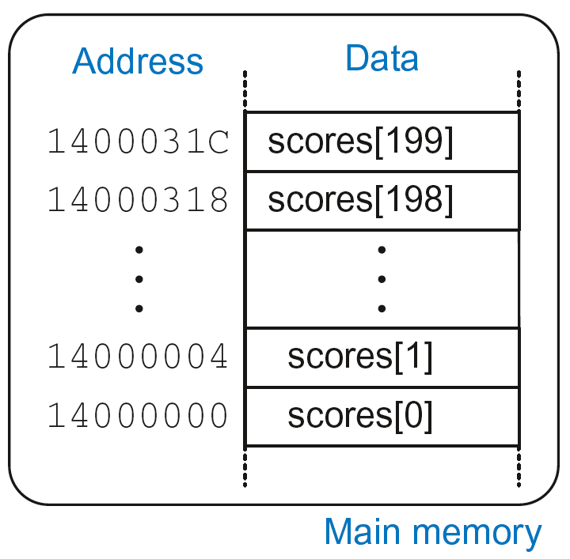
Arrays
5-element array
Base address = 0x14000000 (address of first element, scores[0])
Array elements accessed relative to base address

Slide 89
Accessing Arrays
C Code
int array[5];
array[0] = array[0] * 8;
array[1] = array[1] * 8;
ARM Assembly Code
; R0 = array base address

Slide 90
Accessing Arrays
C Code
int array[5];
array[0] = array[0] * 8;
array[1] = array[1] * 8;
ARM Assembly Code
; R0 = array base address
MOV R0, #0x60000000 ; R0 = 0x60000000
LDR R1, [R0] ; R1 = array[0]
LSL R1, R1, 3 ; R1 = R1 << 3 = R1*8
STR R1, [R0] ; array[0] = R1
LDR R1, [R0, #4] ; R1 = array[1]
LSL R1, R1, 3 ; R1 = R1 << 3 = R1*8
STR R1, [R0, #4] ; array[1] = R1

Slide 91
Arrays using for Loops
C Code
int array[200];
int i;
for (i=199; i >= 0; i = i - 1)
array[i] = array[i] * 8;
ARM Assembly Code
; R0 = array base address, R1 = i

Slide 92
Arrays using for Loops
C Code
int array[200];
int i;
for (i=199; i >= 0; i = i - 1)
array[i] = array[i] * 8;
ARM Assembly Code
; R0 = array base address, R1 = i
MOV R0, 0x60000000
MOV R1, #199
FOR
LDR R2, [R0, R1, LSL #2] ; R2 = array(i)
LSL R2, R2, #3 ; R2 = R2<<3 = R3*8
STR R2, [R0, R1, LSL #2] ; array(i) = R2
SUBS R0, R0, #1 ; i = i – 1
; and set flags
BPL FOR ; if (i>=0) repeat loop

Slide 93
ASCII Code
American Standard Code for Information Interchange
Each text character has unique byte value
For example, S = 0x53, a = 0x61, A = 0x41
Lower-case and upper-case differ by 0x20 (32)

Slide 94
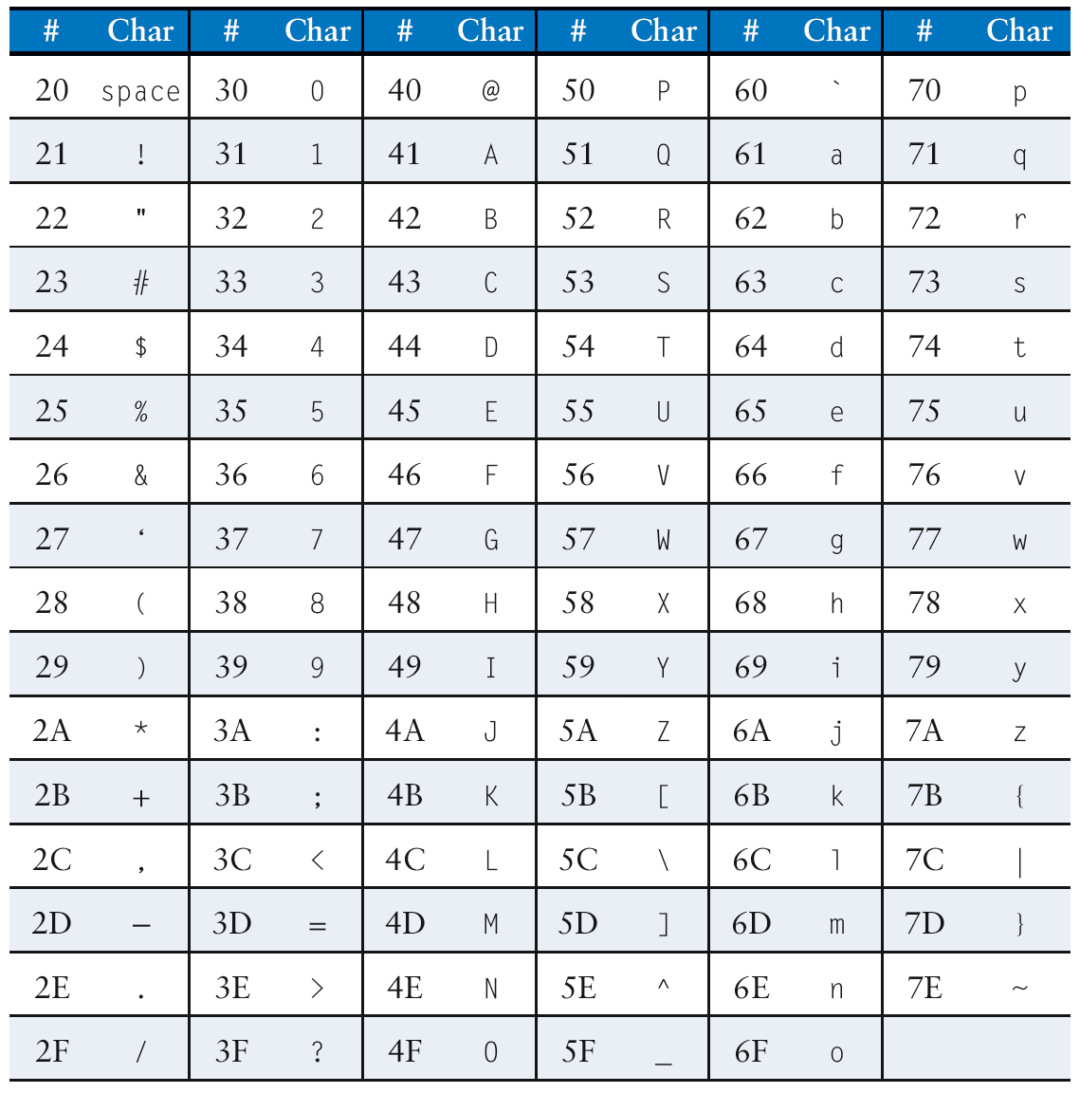
Cast of Characters

Slide 95
Programming Building Blocks
Data-processing Instructions
Conditional Execution
Branches
High-level Constructs:
if/else statements
for loops
while loops
arrays
function calls

Slide 96
Function Calls
Caller: calling function (in this case, main)
Callee: called function (in this case, sum)
C Code
void main()
{
int y;
y = sum(42, 7);
...
}
int sum(int a, int b)
{
return (a + b);
}

Slide 97
Function Conventions
Caller:
passes arguments to callee
jumps to callee

Slide 98
Function Conventions
Caller:
passes arguments to callee
jumps to callee
Callee:
performs the function
returns result to caller
returns to point of call
must not overwrite registers or memory needed by caller

Slide 99
ARM Function Conventions
Call Function: branch and link
BL
Return from function: move the link register to PC: MOV PC, LR
Arguments: R0-R3
Return value: R0

Slide 100
Function Calls
C Code
int main() {
simple();
a = b + c;
}
void simple() {
return;
}
ARM Assembly Code
0x00000200 MAIN BL SIMPLE
0x00000204 ADD R4, R5, R6
...
0x00401020 SIMPLE MOV PC, LR

Slide 101
Function Calls
C Code
int main() {
simple();
a = b + c;
}
void simple() {
return;
}
ARM Assembly Code
0x00000200 MAIN BL SIMPLE
0x00000204 ADD R4, R5, R6
...
0x00401020 SIMPLE MOV PC, LR
void means that simple doesn’t return a value

Slide 102
Function Calls
C Code
int main() {
simple();
a = b + c;
}
void simple() {
return;
}
ARM Assembly Code
0x00000200 MAIN BL SIMPLE
0x00000204 ADD R4, R5, R6
...
0x00401020 SIMPLE MOV PC, LR
BL branches to SIMPLE
LR = PC + 4 = 0x00000204
MOV PC, LR makes PC = LR
(the next instruction executed is at 0x00000200)

Slide 103
Input Arguments and Return Value
ARM conventions:
Argument values: R0 - R3
Return value: R0

Slide 104
Input Arguments and Return Value
C Code
int main()
{
int y;
...
y = diffofsums(2, 3, 4, 5); // 4 arguments
...
}
int diffofsums(int f, int g, int h, int i)
{
int result;
result = (f + g) - (h + i);
return result; // return value
}

Slide 105
Input Arguments and Return Value
ARM Assembly Code
; R4 = y
MAIN
...
MOV R0, #2 ; argument 0 = 2
MOV R1, #3 ; argument 1 = 3
MOV R2, #4 ; argument 2 = 4
MOV R3, #5 ; argument 3 = 5
BL DIFFOFSUMS ; call function
MOV R4, R0 ; y = returned value
...
; R4 = result
DIFFOFSUMS
ADD R8, R0, R1 ; R8 = f + g
ADD R9, R2, R3 ; R9 = h + i
SUB R4, R8, R9 ; result = (f + g) - (h + i)
MOV R0, R4 ; put return value in R0
MOV PC, LR ; return to caller

Slide 106
Input Arguments and Return Value
ARM Assembly Code
; R4 = result
DIFFOFSUMS
ADD R8, R0, R1 ; R8 = f + g
ADD R9, R2, R3 ; R9 = h + i
SUB R4, R8, R9 ; result = (f + g) - (h + i)
MOV R0, R4 ; put return value in R0
MOV PC, LR ; return to caller
diffofsums overwrote 3 registers: R4, R8, R9
diffofsums can use stack to temporarily store registers

Slide 107

The Stack
Memory used to temporarily save variables
Like stack of dishes, last-in-first-out (LIFO) queue
Expands: uses more memory when more space needed
Contracts: uses less memory when the space no longer needed

Slide 108
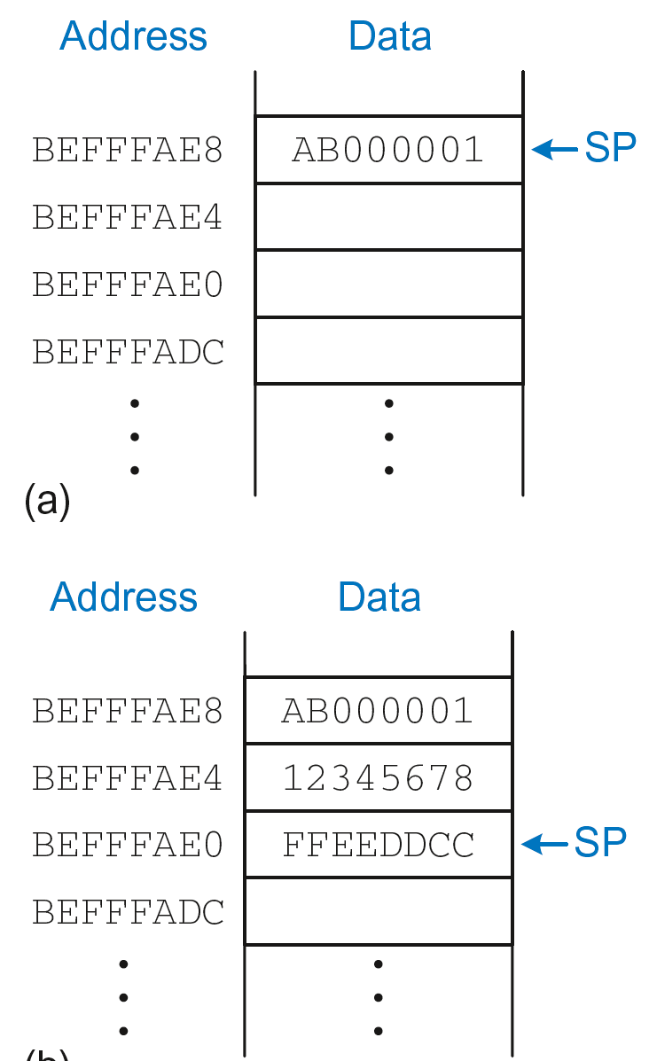
The Stack
Grows down (from higher to lower memory addresses)
Stack pointer: SP points to top of the stack
Stack expands by 2 words

Slide 109
How Functions use the Stack
Called functions must have no unintended side effects
But diffofsums overwrites 3 registers: R4, R8, R9
ARM Assembly Code
; R4 = result
DIFFOFSUMS
ADD R8, R0, R1 ; R8 = f + g
ADD R9, R2, R3 ; R9 = h + i
SUB R4, R8, R9 ; result = (f + g) - (h + i)
MOV R0, R4 ; put return value in R0
MOV PC, LR ; return to caller

Slide 110
Storing Register Values on the Stack
ARM Assembly Code
; R2 = result
DIFFOFSUMS
SUB SP, SP, #12 ; make space on stack for 3 registers
STR R4, [SP, #-8] ; save R4 on stack
STR R8, [SP, #-4] ; save R8 on stack
STR R9, [SP] ; save R9 on stack
ADD R8, R0, R1 ; R8 = f + g
ADD R9, R2, R3 ; R9 = h + i
SUB R4, R8, R9 ; result = (f + g) - (h + i)
MOV R0, R4 ; put return value in R0
LDR R9, [SP] ; restore R9 from stack
LDR R8, [SP, #-4] ; restore R8 from stack
LDR R4, [SP, #-8] ; restore R4 from stack
ADD SP, SP, #12 ; deallocate stack space
MOV PC, LR ; return to caller

Slide 111
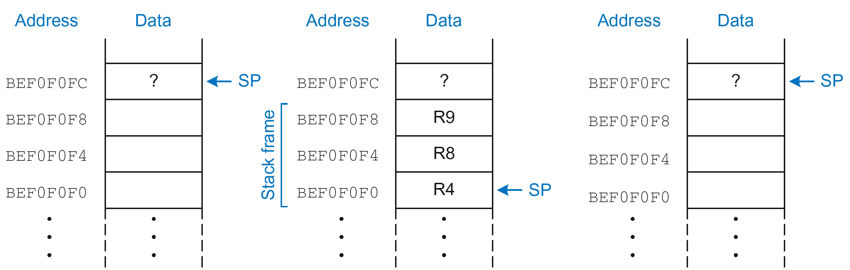
The Stack during diffofsums Call
Before call
During call
After call

Slide 112
Registers
Preserved Callee-Saved | Nonpreserved Caller-Saved
R4-R11 | R12
R14 (LR) | R0-R3
R13 (SP) | CPSR
stack above SP | stack below SP

Slide 113
Storing Saved Registers only on Stack
ARM Assembly Code
; R2 = result
DIFFOFSUMS
STR R4, [SP, #-4]! ; save R4 on stack
ADD R8, R0, R1 ; R8 = f + g
ADD R9, R2, R3 ; R9 = h + i
SUB R4, R8, R9 ; result = (f + g) - (h + i)
MOV R0, R4 ; put return value in R0
LDR R4, [SP], #4 ; restore R4 from stack
MOV PC, LR ; return to caller

Slide 114
Storing Saved Registers only on Stack
ARM Assembly Code
; R2 = result
DIFFOFSUMS
STR R4, [SP, #-4]! ; save R4 on stack
ADD R8, R0, R1 ; R8 = f + g
ADD R9, R2, R3 ; R9 = h + i
SUB R4, R8, R9 ; result = (f + g) - (h + i)
MOV R0, R4 ; put return value in R0
LDR R4, [SP], #4 ; restore R4 from stack
MOV PC, LR ; return to caller
Notice code optimization for expanding/contracting stack

Slide 115
Nonleaf Function
ARM Assembly Code
STR LR, [SP, #-4]! ; store LR on stack
BL PROC2 ; call another function
...
LDR LR, [SP], #4 ; restore LR from stack
jr $ra ; return to caller

Slide 116
Nonleaf Function Example
C Code
int f1(int a, int b) {
int i, x;
x = (a + b)*(a − b);
for (i=0; i<a; i++)
x = x + f2(b+i);
return x;
}
int f2(int p) {
int r;
r = p + 5;
return r + p;
}

Slide 117
Nonleaf Function Example
C Code
int f1(int a, int b) {
int i, x;
x = (a + b)*(a − b);
for (i=0; i<a; i++)
x = x + f2(b+i);
return x;
}
int f2(int p) {
int r;
r = p + 5;
return r + p;
}
ARM Assembly Code
; R0=a, R1=b, R4=i, R5=x
F1
PUSH {R4, R5, LR}
ADD R5, R0, R1
SUB R12, R0, R1
MUL R5, R5, R12
MOV R4, #0
FOR
CMP R4, R0
BGE RETURN
PUSH {R0, R1}
ADD R0, R1, R4
BL F2
ADD R5, R5, R0
POP {R0, R1}
ADD R4, R4, #1
B FOR
RETURN
MOV R0, R5
POP {R4, R5, LR}
MOV PC, LR
; R0=p, R4=r
F2
PUSH {R4}
ADD R4, R0, 5
ADD R0, R4, R0
POP {R4}
MOV PC, LR

Slide 118
Nonleaf Function Example
ARM Assembly Code
; R0=a, R1=b, R4=i, R5=x
F1
PUSH {R4, R5, LR} ; save regs
ADD R5, R0, R1 ; x = (a+b)
SUB R12, R0, R1 ; temp = (a-b)
MUL R5, R5, R12 ; x = x*temp
MOV R4, #0 ; i = 0
FOR
CMP R4, R0 ; i < a?
BGE RETURN ; no: exit loop
PUSH {R0, R1} ; save regs
ADD R0, R1, R4 ; arg is b+i
BL F2 ; call f2(b+i)
ADD R5, R5, R0 ; x = x+f2(b+i)
POP {R0, R1} ; restore regs
ADD R4, R4, #1 ; i++
B FOR ; repeat loop
RETURN
MOV R0, R5 ; return x
POP {R4, R5, LR} ; restore regs
MOV PC, LR ; return
; R0=p, R4=r
F2
PUSH {R4} ; save regs
ADD R4, R0, 5 ; r = p+5
ADD R0, R4, R0 ; return r+p
POP {R4} ; restore regs
MOV PC, LR ; return

Slide 119
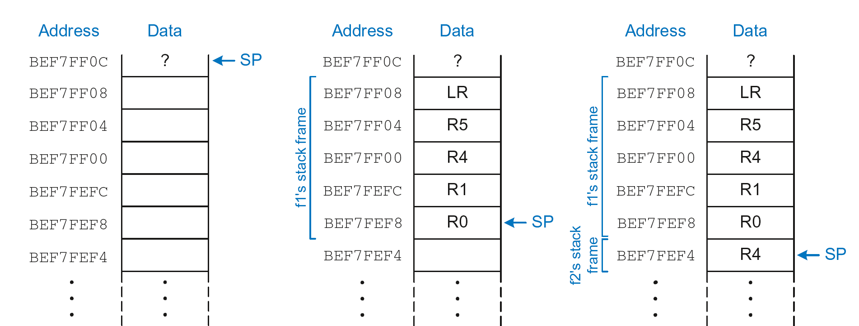
Stack during Nonleaf Function
At beginning of f1
Just before calling f2
After calling f2

Slide 120
Recursive Function Call
C Code
int factorial(int n) {
if (n <= 1)
return 1;
else
return (n * factorial(n-1));
}

Slide 121
Recursive Function Call
ARM Assembly Code
0x94 FACTORIAL STR R0, [SP, #-4]! ;store R0 on stack
0x98 STR LR, [SP, #-4]! ;store LR on stack
0x9C CMP R0, #2 ;set flags with R0-2
0xA0 BHS ELSE ;if (r0>=2) branch to else
0xA4 MOV R0, #1 ; otherwise return 1
0xA8 ADD SP, SP, #8 ; restore SP 1
0xAC MOV PC, LR ; return
0xB0 ELSE SUB R0, R0, #1 ; n = n - 1
0xB4 BL FACTORIAL ; recursive call
0xB8 LDR LR, [SP], #4 ; restore LR
0xBC LDR R1, [SP], #4 ; restore R0 (n) into R1
0xC0 MUL R0, R1, R0 ; R0 = n*factorial(n-1)
0xC4 MOV PC, LR ; return

Slide 122
Recursive Function Call
C Code
int factorial(int n) {
if (n <= 1)
return 1;
else
return (n * factorial(n-1));
}
ARM Assembly Code
0x94 FACTORIAL STR R0, [SP, #-4]!
0x98 STR LR, [SP, #-4]!
0x9C CMP R0, #2
0xA0 BHS ELSE
0xA4 MOV R0, #1
0xA8 ADD SP, SP, #8
0xAC MOV PC, LR
0xB0 ELSE SUB R0, R0, #1
0xB4 BL FACTORIAL
0xB8 LDR LR, [SP], #4
0xBC LDR R1, [SP], #4
0xC0 MUL R0, R1, R0
0xC4 MOV PC, LR

Slide 123
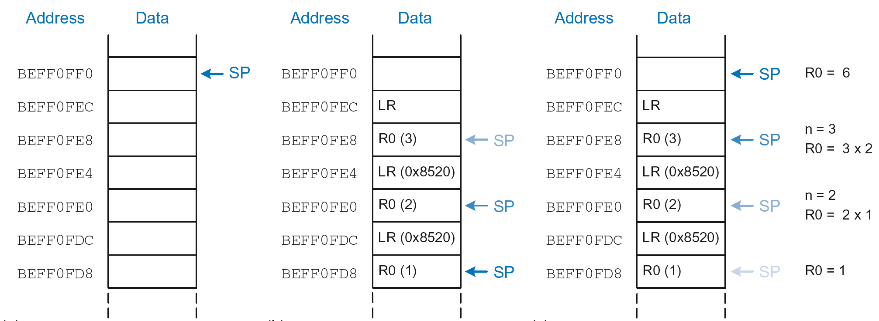
Stack during Recursive Call
Before call
During call
After call

Slide 124
Function Call Summary
Caller
Puts arguments in R0-R3
Saves any needed registers (LR, maybe R0-R3, R8-R12)
Calls function: BL CALLEE
Restores registers
Looks for result in R0
Callee
Saves registers that might be disturbed (R4-R7)
Performs function
Puts result in R0
Restores registers
Returns: MOV PC, LR

