Slide 1
TC2009B: Digital design Multiplication and Division

Slide 2
References
The following material has been adopted and adapted from
Patterson, D. A., Hennessy, J. L., Computer Organization and design: The hardware/software interface – ARM edition, Morgan Kaufmann, 2017.
S. L. Harris and D. M. Harris, Digital design and computer architecture - ARM edition, Morgan Kaufmann, 2016.

Slide 3
Arithmetic for Computers
Operations on integers
Addition and subtraction
Multiplication and division
Dealing with overflow
Floating-point real numbers
Representation and operations

Slide 4
Integer operations

Slide 5
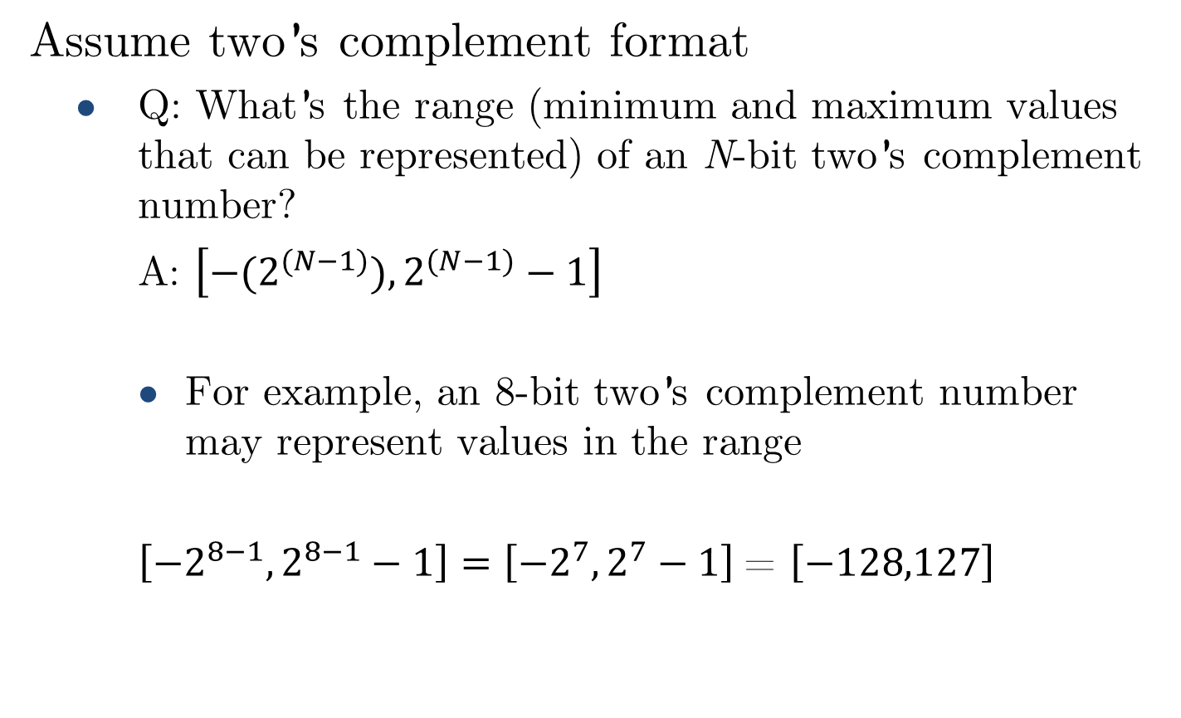
Two’s complement review
Assume two’s complement format
Q: What’s the range (minimum and maximum values that can be represented) of an N-bit two’s complement number?
A: $\left[{−(2}^{(N−1)}),2^{(N−1)}−1\right]$
For example, an 8-bit two’s complement number may represent values in the range
$\left[{−2}^{8−1},2^{8−1}−1\right]=\left[{−2}^{7},2^{7}−1\right]$= $\left[−128,127\right]$

Slide 6
Overflow & underflow
Q: What is overflow?
A: A condition when the result of a calculation exceeds the maximum value that can be represented in a numeric format.
Q: What is underflow?
A: A condition when the result of a calculation is smaller than the minimum value that can be represented in a numeric format.
Sometimes, the term overflow is used for describing both conditions.

Slide 7
Addition

Slide 8
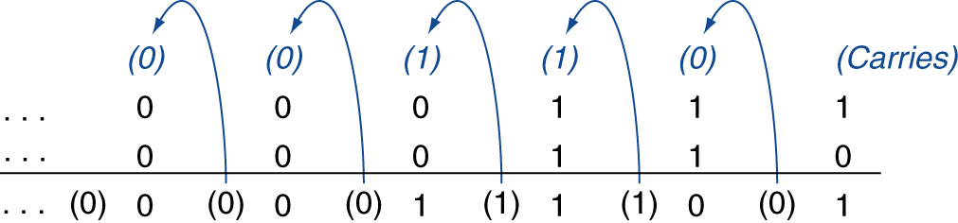
Integer addition
Example: 7 + 6
(+7)
(+6)
(+13)
Overflow if result out of range
Adding +ve and –ve operands, no overflow
Adding two +ve operands
Overflow if result sign is 1
Adding two –ve operands
Overflow if result sign is 0

Slide 9
Integer addition
Example: Adding two 4-bit two’s complement numbers
5 + 1
+5: 0101 +1: 0001 +6: 0110
3 + 6
+3: 0011 +6: 0110 -7: 1001
–2 + 5
-2: 1110 +5: 0101 +3: 0011
–7 +(–1)
-7: 1001 -1: 1111 -8: 1000
–3 +(–6)
-3: 1101 -6: 1010 +7: 0111
Overflow:+9 and -9
can not be represented in 4-bit
two’s complement.

Slide 10
Subtraction

Slide 11
Integer subtraction
Addition with negation of second operand
Example: 7 – 6 = 7 + (–6)
+7: 0000 0000 … 0000 0111 –6: 1111 1111 … 1111 1010 +1: 0000 0000 … 0000 0001
Overflow if result out of range
Subtracting two +ve or two –ve operands, no overflow
Subtracting +ve from –ve operand
Overflow if result sign is 0
Subtracting –ve from +ve operand
Overflow if result sign is 1

Slide 12
Integer subtraction
Example: Subtracting two 4-bit two’s complement numbers
5 – (+1)
+5: 0101 -1: 1111 +4: 0100
–3 – (+6)
-3: 1101 -6: 1010 +7: 0111
–2 – (–5)
-2: 1110 +5: 0101 +3: 0011
7 –(–1)
+7: 0111 +1: 0001 -8: 1000
Overflow: -9 and +8 can not be represented in 4-bit two’s complement.

Slide 13
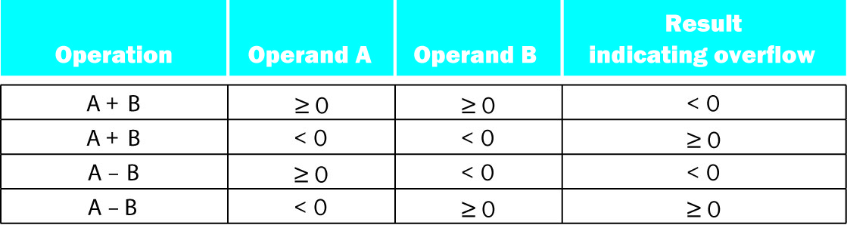
Addition & subtraction overflow summary
Overflow conditions for additions and subtraction in two’s complement.

Slide 14
Multiplication

Slide 15
Multiplier
Partial products formed by multiplying a single digit of the multiplier with multiplicand
Shifted partial products summed to form result

Slide 16
Parallel multiplication

Slide 17
Parallel multiplication

Slide 18
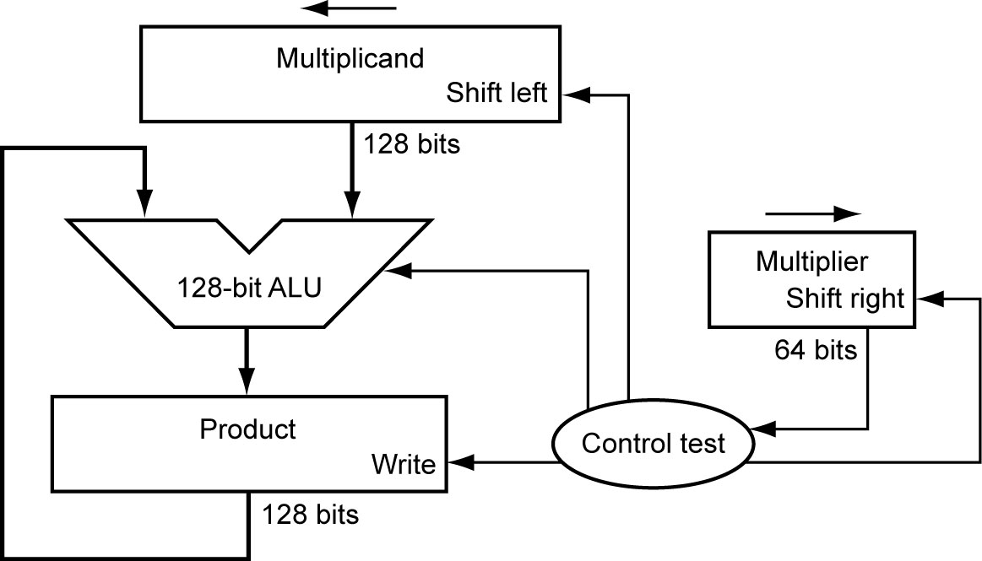

Sequential multiplication
Start with long-multiplication approach
Assume we want to multiply two 64-bit numbers
multiplicand
1000
× 1001
1000
0000
0000
1000
01001000
multiplier
product
Length of product is the sum of operand lengths.
What can be improved in this architecture?
$$A_{M−bits}×B_{N−bits}=X_{\left(M+N\right)−bits}$$

Slide 19
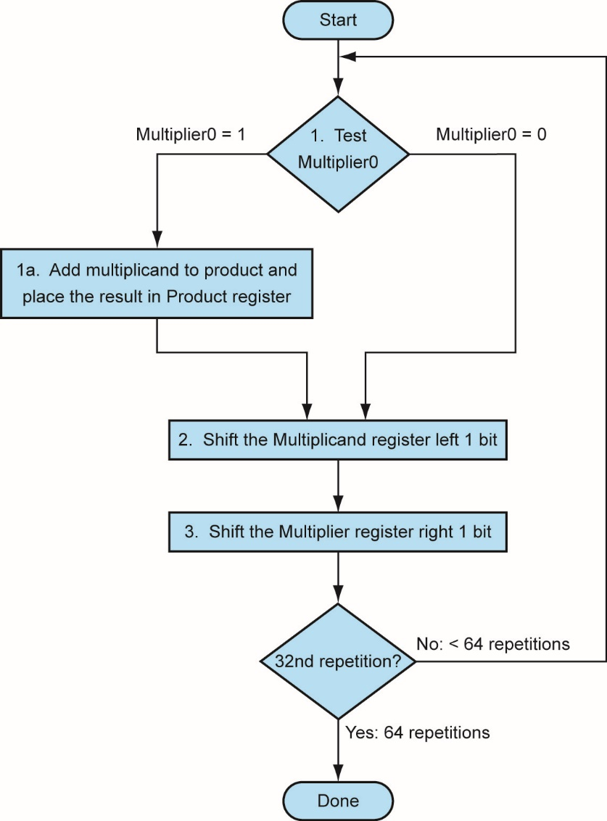
Multiplication hardware
There’s one error in the flow chart. Can you spot it?
What can be improved in this architecture?
LSB
64th repetition?
Initially 0

Slide 20
Multiplication hardware
This architecture has a major flaw.
Can you spot it?
LSB
For multiplying two N-bit number, it requires:
Two 2N-bit registers
One N-bit register
A 2N-bit ALU
This is a waste of resources!

Slide 21
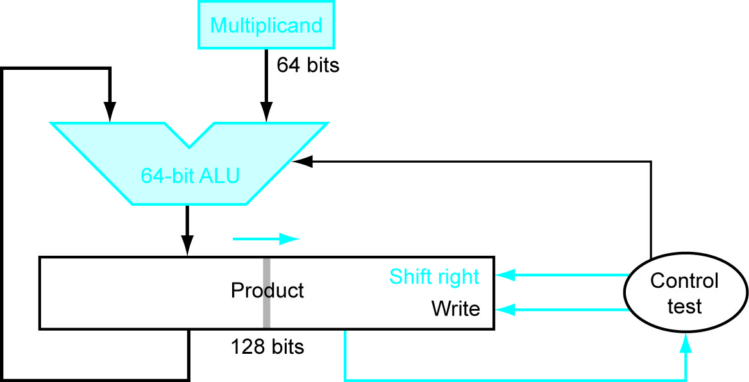
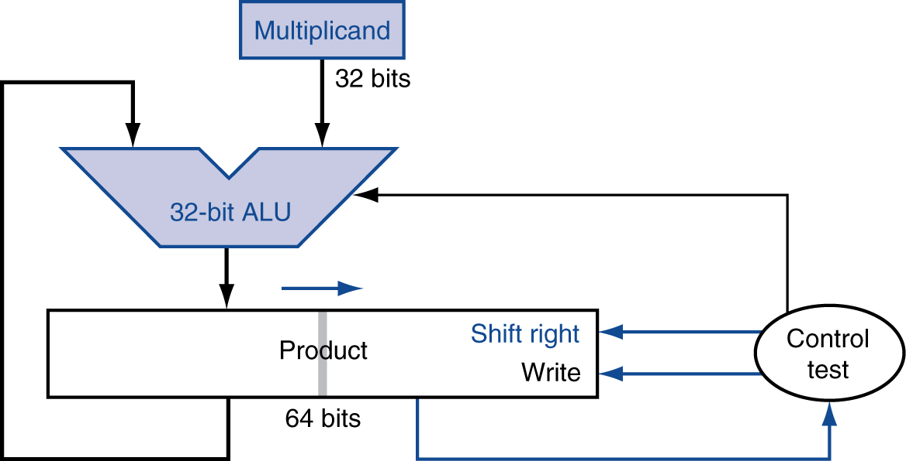
Optimised multiplier
Perform steps in parallel: add/shift
For multiplying two N-bit number, it requires:
One N-bit register
One 2N-bit register
An N-bit ALU
One cycle per partial-product addition
That’s ok, if frequency of multiplications is low

Slide 22
Optimised multiplier
Start
Load lower half of Product with Multiplier
YES
P[0] == 1?
NO
Add multiplicand to upper half of product
Shift product right
NO
N^{th} repetition?
YES
End

Slide 23

Optimised multiplier - example
Multiplicand = ${15}_{10}$: 1111
Multiplier = ${13}_{10}:$1101
STEP 0: Initialize registers
Multiplier loaded into lower half of product
1111
4-bit ALU
0000 1101

Slide 24

Optimised multiplier - example
Multiplicand = ${15}_{10}$: 1111
Multiplier = ${13}_{10}:$1101
STEP 1:
Product LSB == 1 : Add
Right shift product
0000
1111
4-bit ALU
0 1111
01111 1101

Slide 25
Optimised multiplier - example
Multiplicand = ${15}_{10}$: 1111
Multiplier = ${13}_{10}:$1101
STEP 1:
Product LSB == 1 : Add
Right shift product
1111
4-bit ALU
0111 1110

Slide 26
Optimised multiplier - example
Multiplicand = ${15}_{10}$: 1111
Multiplier = ${13}_{10}:$1101
STEP 2:
Product LSB == 0 : No Add
Right shift product
1111
4-bit ALU
0111 1110

Slide 27
Optimised multiplier - example
Multiplicand = ${15}_{10}$: 1111
Multiplier = ${13}_{10}:$1101
STEP 2:
Product LSB == 0 : No Add
Right shift product
1111
4-bit ALU
0011 1111

Slide 28
Optimised multiplier - example
Multiplicand = ${15}_{10}$: 1111
Multiplier = ${13}_{10}:$1101
STEP 3:
Product LSB == 1 : Add
Right shift product
0011
1111
4-bit ALU
1 0010
1 0010 1111

Slide 29
Optimised multiplier - example
Multiplicand = ${15}_{10}$: 1111
Multiplier = ${13}_{10}:$1101
STEP 3:
Product LSB == 1 : Add
Right shift product
1111
4-bit ALU
1001 0111

Slide 30
Optimised multiplier - example
Multiplicand = ${15}_{10}$: 1111
Multiplier = ${13}_{10}:$1101
STEP 4:
Product LSB == 1 : Add
Right shift product
1001
1111
4-bit ALU
1 1000
1 1000 0111

Slide 31
Optimised multiplier - example
Multiplicand = ${15}_{10}$: 1111
Multiplier = ${13}_{10}:$1101
STEP 4:
Product LSB == 1 : Add
Right shift product
1111
4-bit ALU
1100 0011

Slide 32
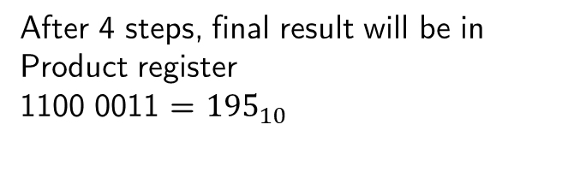
Optimised multiplier - example
Multiplicand = ${15}_{10}$: 1111
Multiplier = ${13}_{10}:$1101
After 4 steps, final result will be in Product register
1100 0011 = ${195}_{10}$
4-bit ALU
1100 0011

Slide 33
Signed multiplication
So far, we’ve only dealt with unsinged operands.
What happens in signed multiplication?
For adding two signed N-bit numbers:
Convert both multiplicand and multiplier to positive numbers and keep track of their respective sign.
Apply multiplication algorithm N-1 times.
Negate product if signs are not the same.
Alternatively, previous algorithm works for signed numbers if shifts are performed using sign extension.

Slide 34
Division

Slide 35
Division
Check for 0 divisor
Long division approach
If divisor ≤ dividend bits
1 bit in quotient, subtract
Otherwise
0 bit in quotient, bring down next dividend bit
Restoring division
Do the subtract, and if remainder goes < 0, add divisor back
Signed division
Divide using absolute values
Adjust sign of quotient and remainder as required
quotient
dividend
1001
1000 1001010
-1000
10
101
1010
-1000
10
divisor
remainder
n-bit operands yield n-bit quotient and remainder

Slide 36
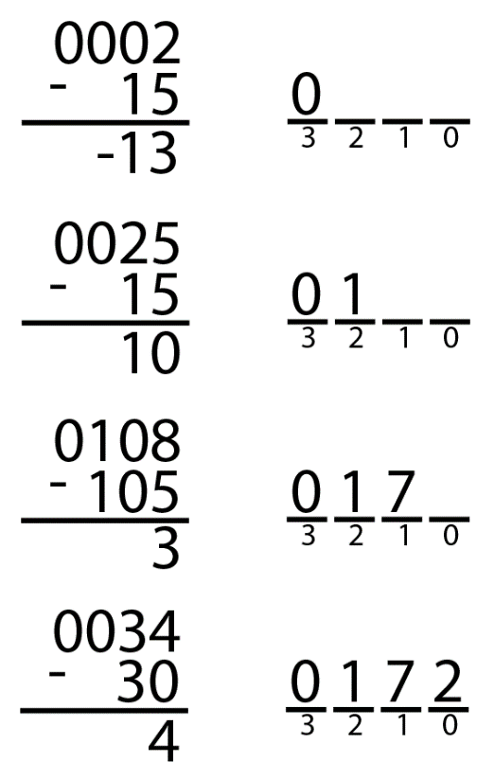
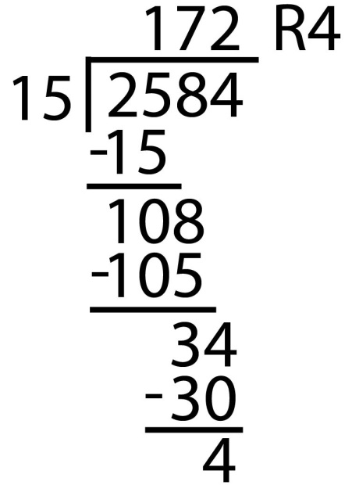
Divider
A/B = Q + R
Decimal Example: 2584/15 = 172 R4
Long-Hand:

Slide 37

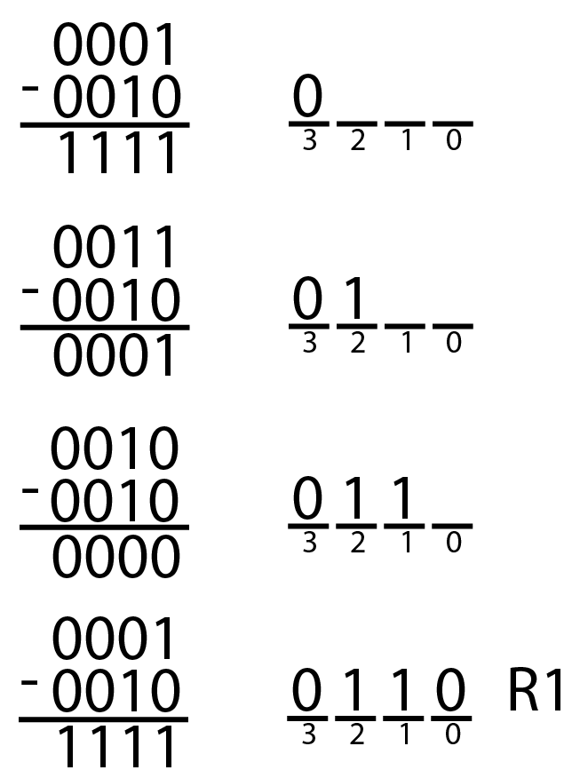
Divider
A/B = Q + R
Decimal:
2584/15 = 172 R4
Binary:
1101/10 = 0110 R1

Slide 38
Divider
A/B = Q + R/B
R’ = 0
for i = N-1 to 0
R = {R’ << 1, A_{i}}
D = R - B
if D < 0, Q_{i}= 0; R’= R
else Q_{i}= 1; R’= D
R’=R
Binary: 1101/10 = 0110 R1

Slide 39
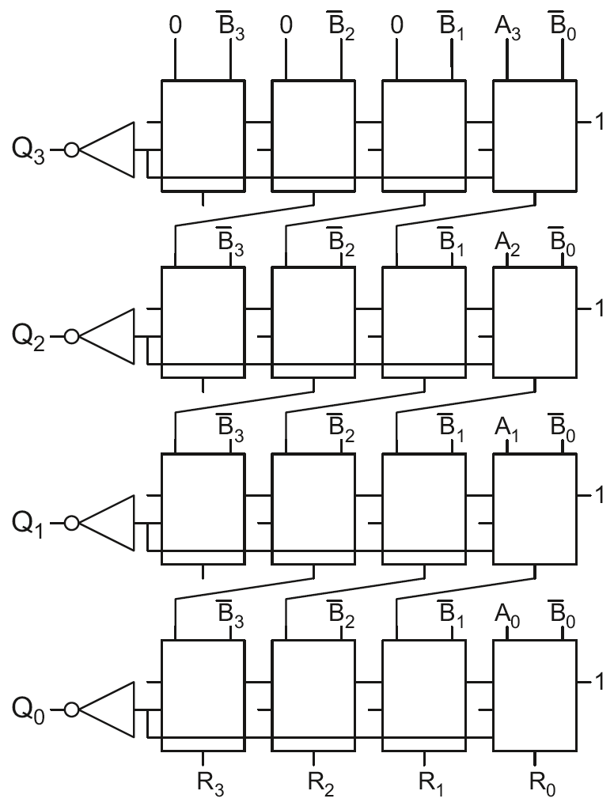
4x4 Divider
Division: A/B = Q + R/B
R’ = 0
for i = N-1 to 0
R = {R’ << 1, A_{i}}
D = R - B
if D < 0, Q_{i}=0, R’=R
else Q_{i}=1, R’=D
R’=R
Each row computes one iteration of the division algorithm.

Slide 40
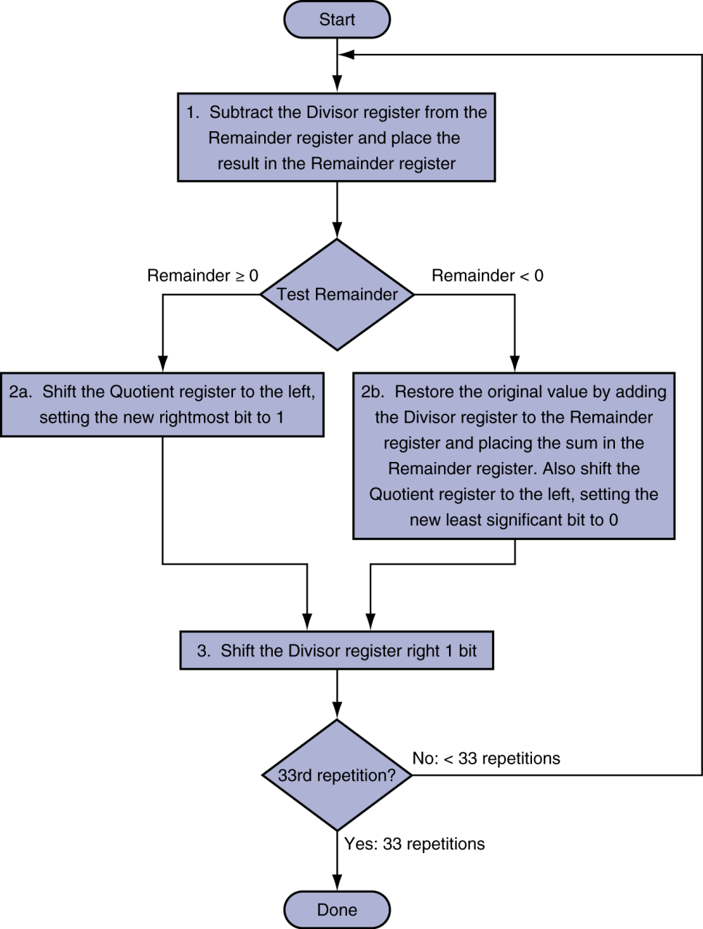
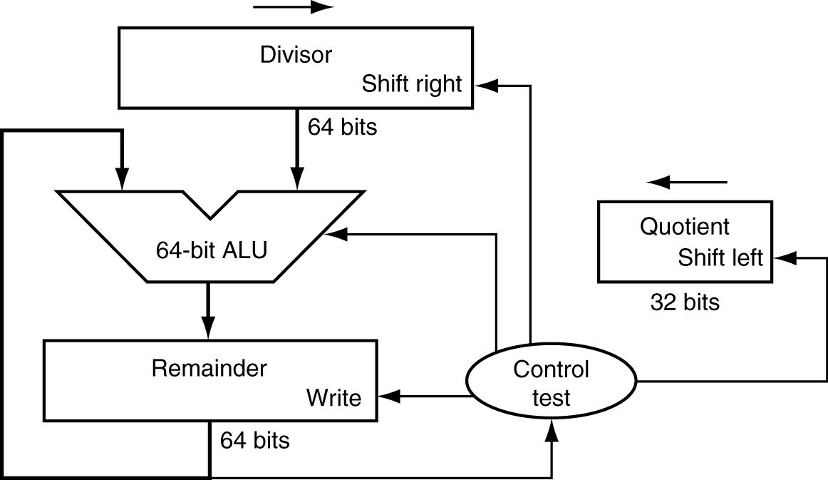
Sequential division
Initially divisor in left half
Initially dividend

Slide 41
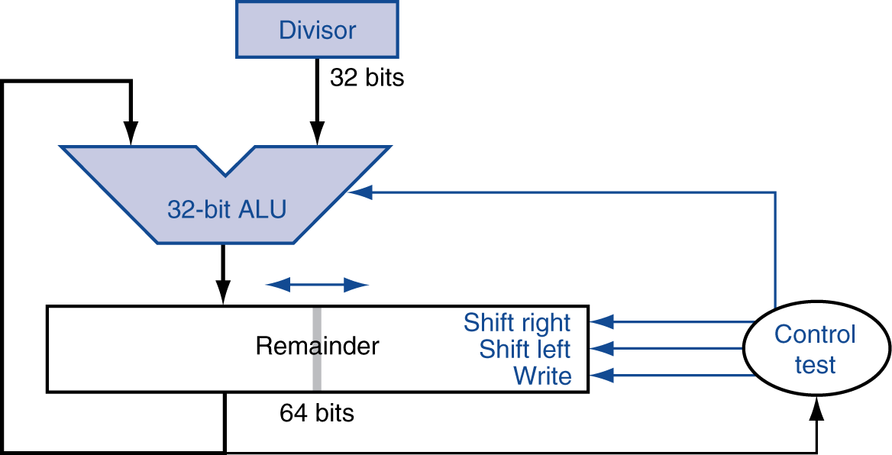
Optimized divider
One cycle per partial-remainder subtraction
Looks a lot like a multiplier!
Same hardware can be used for both

Slide 42
Faster Division
Can’t use parallel hardware as in multiplier
Subtraction is conditional on sign of remainder
Faster dividers generate multiple quotient bits per step
Still require multiple steps

