Slide 1
TC2009B: Digital Design Fixed-point and floating-point numbers

Slide 2
References
The following material has been adopted and adapted from
Patterson, D. A., Hennessy, J. L., Computer Organization and design: The hardware/software interface – ARM edition, Morgan Kaufmann, 2017.
S. L. Harris and D. M. Harris, Digital design and computer architecture - ARM edition, Morgan Kaufmann, 2016.

Slide 3
Numbers is digital systems
How is information represented in digital systems?
How do computers represent information?

Slide 4
Numbers is computer systems
Fixed-point representation
Integers – limited precision
Non-integers – limited precision
Floating-point representation
Real-world numbers
Extremely large or extremely small numbers

Slide 5
Fixed-point representation

Slide 6
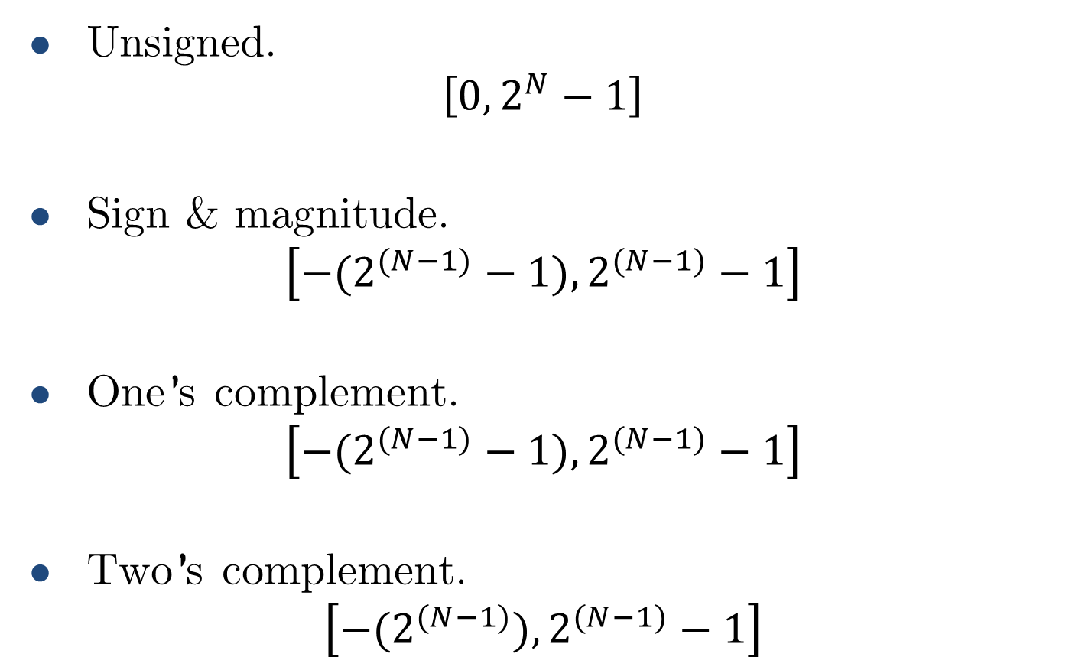
Fixed-point integer representation
Unsigned.
$$\left[0,2^{N}−1\right]$$
Sign & magnitude.
$$\left[{−(2}^{(N−1)}−1),2^{(N−1)}−1\right]$$
One’s complement.
$$\left[{−(2}^{(N−1)}−1),2^{(N−1)}−1\right]$$
Two’s complement.
$$\left[{−(2}^{(N−1)}),2^{(N−1)}−1\right]$$

Slide 7
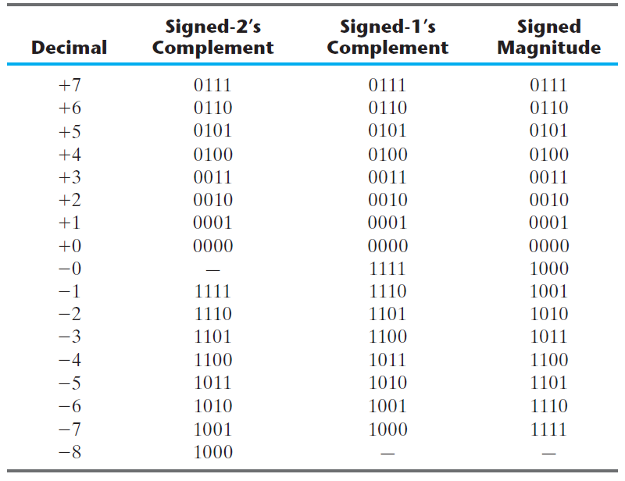
Signed integer representation

Slide 8
Fixed-point integer representation
Unsigned.
Sign & magnitude.
One’s complement.
Two’s complement.
From all these binary integer representations, which one is most used in computer systems?

Slide 9
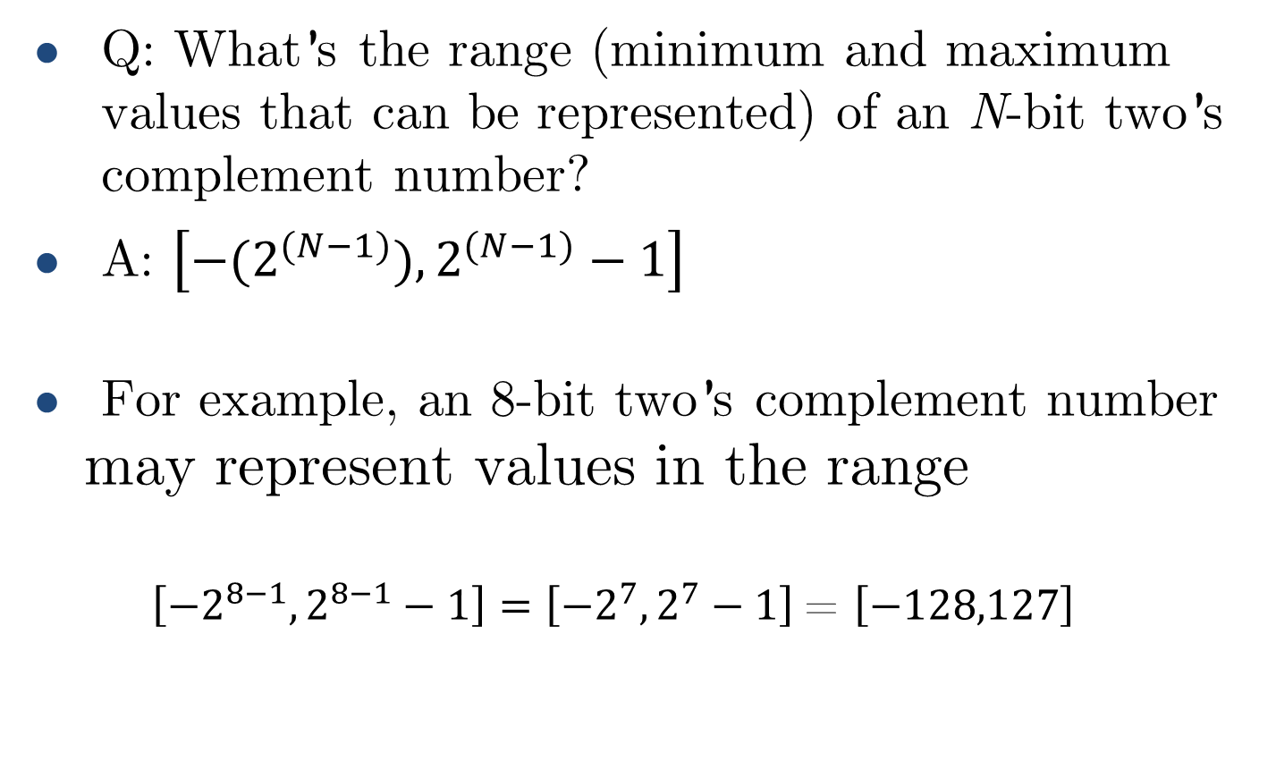
Two’s complement integer range
Q: What’s the range (minimum and maximum values that can be represented) of an N-bit two’s complement number?
A: $\left[{−(2}^{(N−1)}),2^{(N−1)}−1\right]$
For example, an 8-bit two’s complement number may represent values in the range
$\left[{−2}^{8−1},2^{8−1}−1\right]=\left[{−2}^{7},2^{7}−1\right]$= $\left[−128,127\right]$

Slide 10
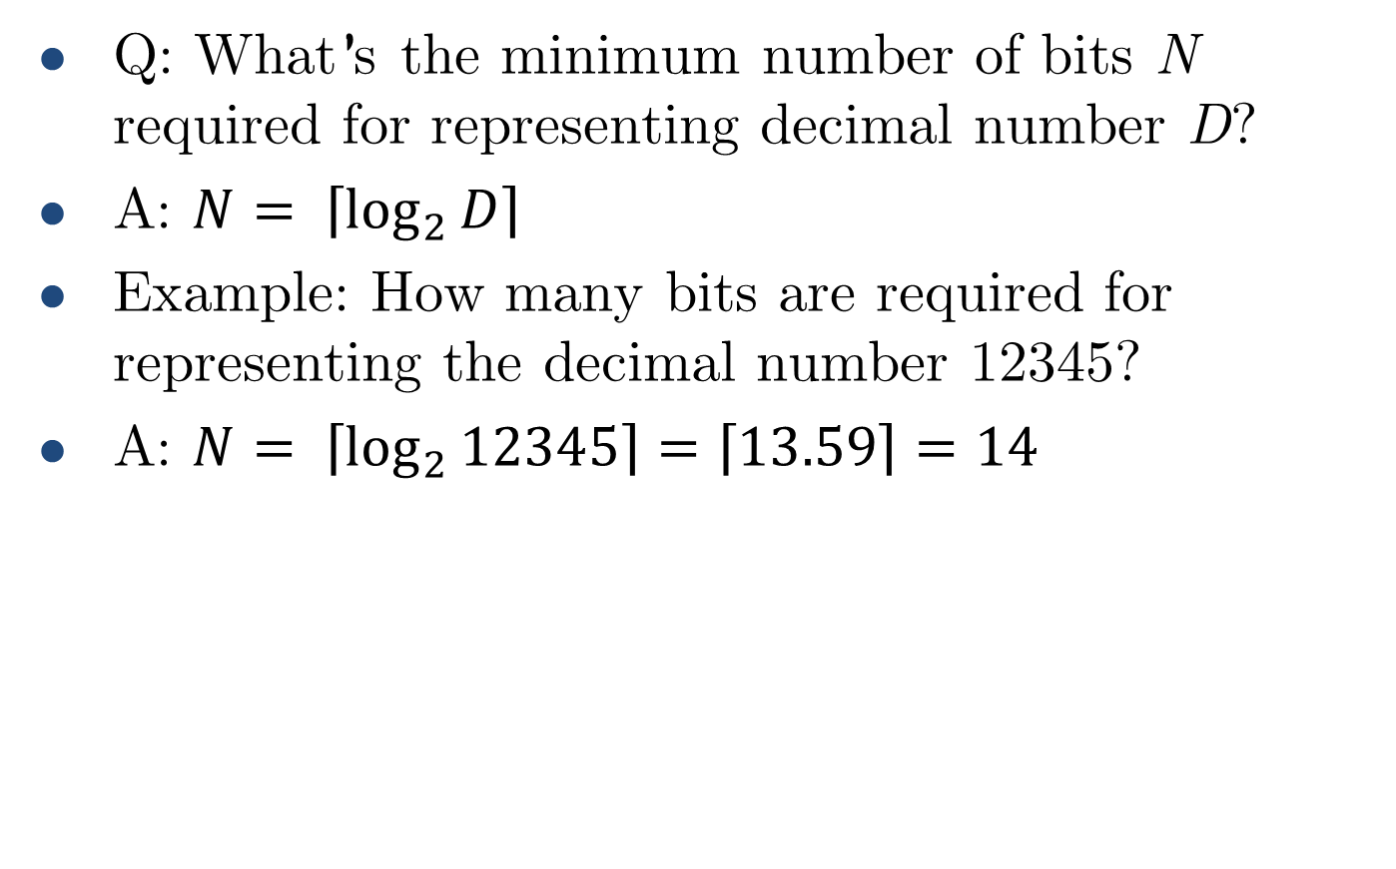
Bits required for representing decimals
Q: What’s the minimum number of bits N required for representing decimal number D?
A: $N= \left\lceil \log_{2}{D}\right\rceil$
Example: How many bits are required for representing the decimal number 12345?
A: $N= \left\lceil \log_{2}{12345}\right\rceil =\left\lceil 13.59\right\rceil =14$

Slide 11
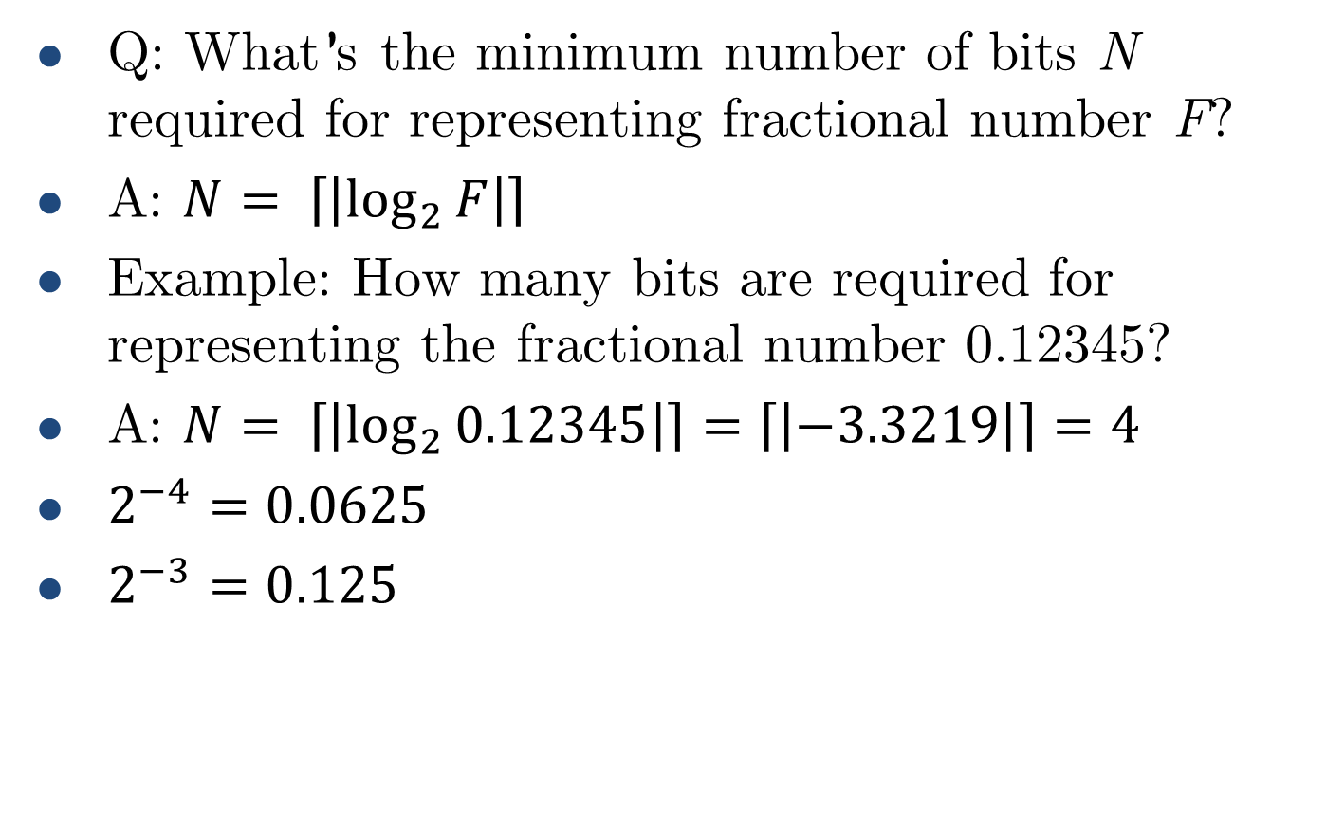
Bits required for representing decimals
Q: What’s the minimum number of bits N required for representing fractional number F?
A: $N= \left\lceil \left|\log_{2}{F}\right|\right\rceil$
Example: How many bits are required for representing the fractional number 0.12345?
A: $N= \left\lceil \left|\log_{2}{0.12345}\right|\right\rceil =\left\lceil \left|−3.3219\right|\right\rceil =4$
$2^{−4}=0.0625$
$2^{−3}=0.125$

Slide 12
Fixed-point numbers
What about real numbers?

Slide 13
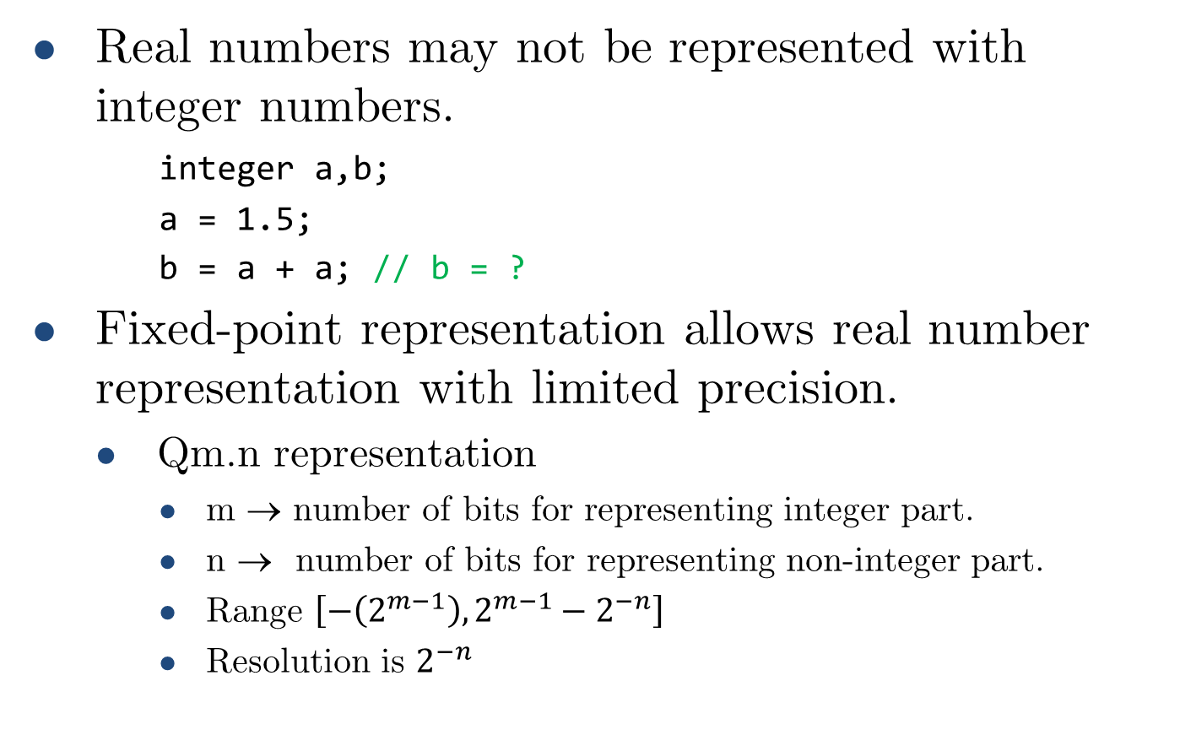
Fixed-point real numbers
Real numbers may not be represented with integer numbers.
integer a,b;
a = 1.5;
b = a + a; // b = ?
Fixed-point representation allows real number representation with limited precision.
Qm.n representation
m → number of bits for representing integer part.
n → number of bits for representing non-integer part.
Range $\left[−\left(2^{m−1}\right),2^{m−1}−2^{−n}\right]$
Resolution is $2^{−n}$

Slide 14
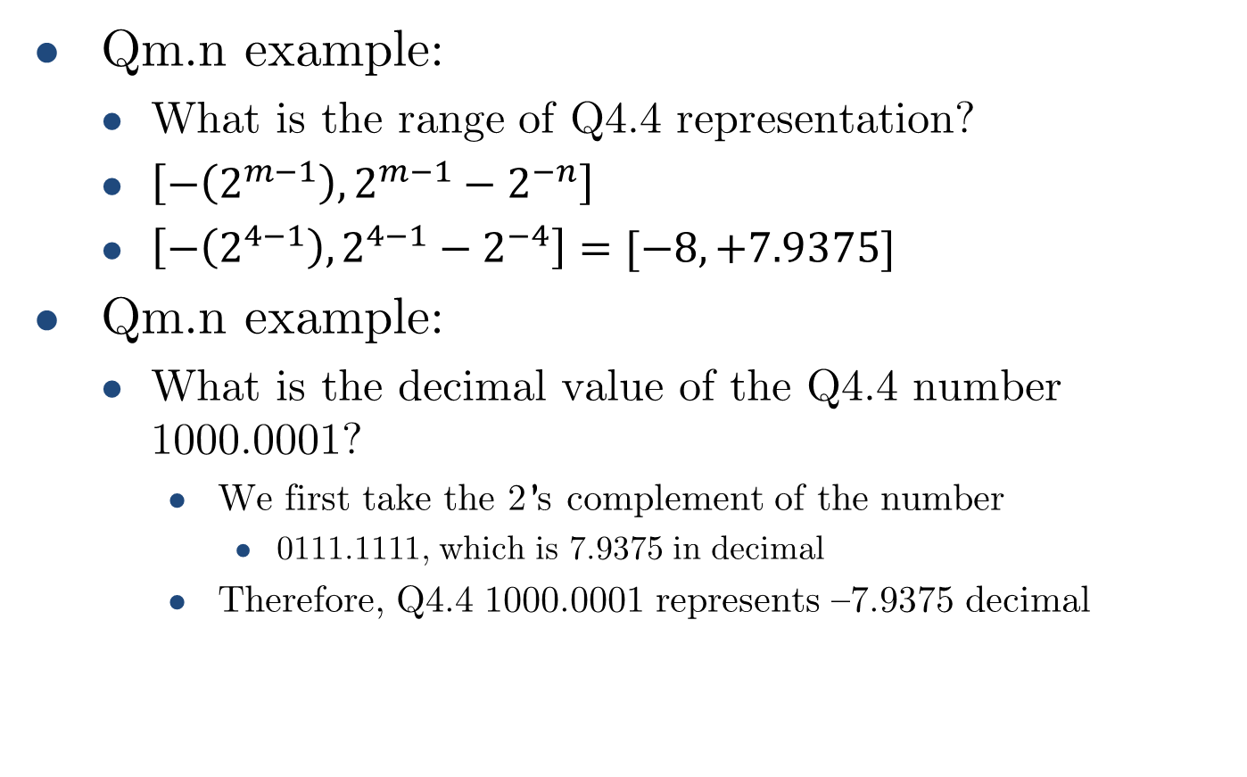
Fixed-point real numbers
Qm.n example:
What is the range of Q4.4 representation?
$\left[−\left(2^{m−1}\right),2^{m−1}−2^{−n}\right]$
$\left[−\left(2^{4−1}\right),2^{4−1}−2^{−4}\right]=[−8, +7.9375]$
Qm.n example:
What is the decimal value of the Q4.4 number 1000.0001?
We first take the 2’s complement of the number
0111.1111, which is 7.9375 in decimal
Therefore, Q4.4 1000.0001 represents –7.9375 decimal

Slide 15
Fixed-point in real-world applications
Fixed-point representation is suitable for embedded applications requiring limited degree of fractional precision.
DOOM (1993 videogame) originally used a Q16.16 format for all non-integer operations https://doomwiki.org/wiki/Fixed_point
What about high-precision applications?

Slide 16
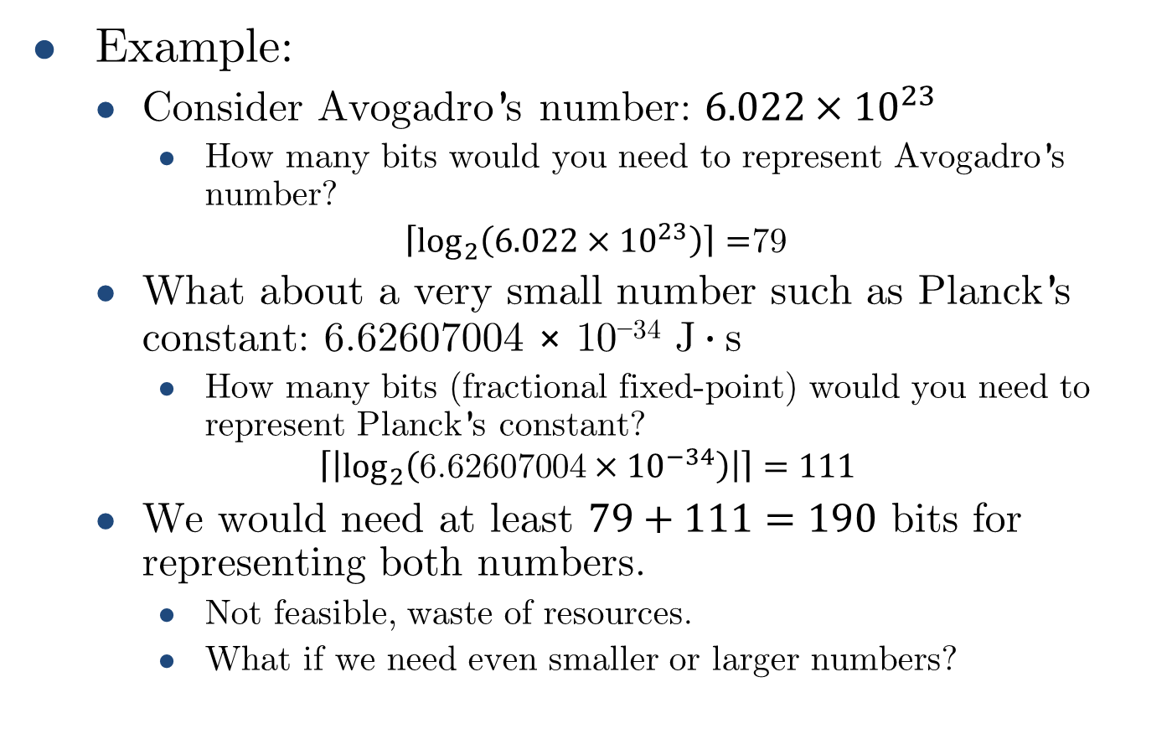
Fixed-point limitations
Example:
Consider Avogadro’s number: ${6.022×10}^{23}$
How many bits would you need to represent Avogadro’s number?
$\left\lceil \log_{2}\left({6.022×10}^{23}\right)\right\rceil =$79
What about a very small number such as Planck’s constant: $\text{6.62607004 × 10}\text{−34} \text{J}∙\text{s}$
How many bits (fractional fixed-point) would you need to represent Planck’s constant?
$$\left\lceil \left|\log_{2}\left({\text{6.62607004}×10}^{−34}\right)\right|\right\rceil =111$$
We would need at least $79+111=190$ bits for representing both numbers.
Not feasible, waste of resources.
What if we need even smaller or larger numbers?

Slide 17
Floating-point representation

Slide 18
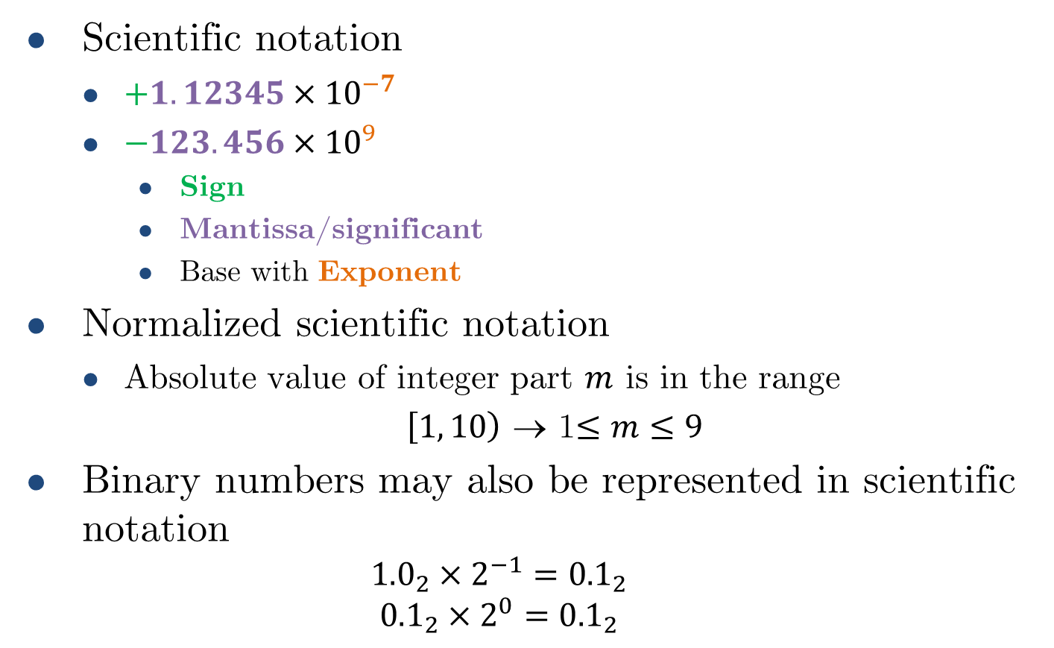

Floating-point
Scientific notation
$+1.12345{×10}^{−7}$
$−123.456{×10}^{9}$
Sign
Mantissa/significant
Base with Exponent
Normalized scientific notation
Absolute value of integer part $m$ is in the range
$\left[1,\left.10\right)\right.$ → 1$≤m≤9$
Binary numbers may also be represented in scientific notation
$${1.0}_{2}×2^{−1}={0.1}_{2}$$
$${0.1}_{2}×2^{0}={0.1}_{2}$$
normalized
not normalized
$${0.5}_{10}$$
normalized
not normalized

Slide 19
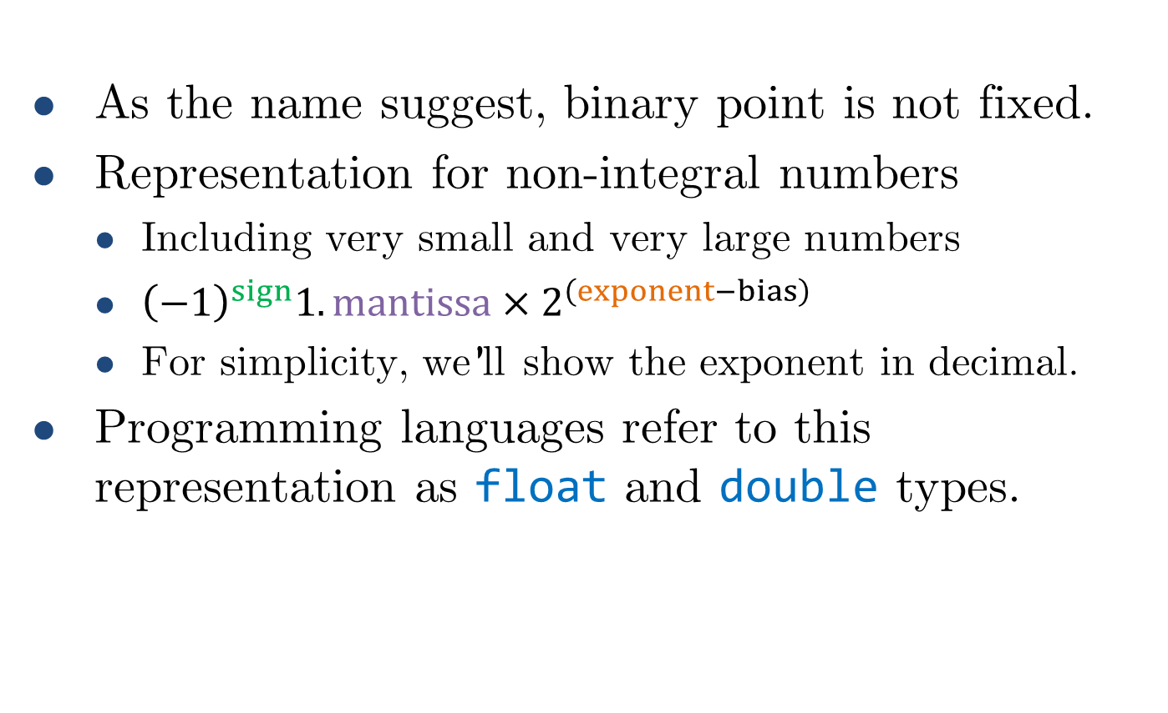
Floating-point
As the name suggest, binary point is not fixed.
Representation for non-integral numbers
Including very small and very large numbers
${\left(−1\right)}^{sign}1.mantissa×2^{\left(exponent−bias\right)}$
For simplicity, we’ll show the exponent in decimal.
Programming languages refer to this representation as float and double types.

Slide 20
Floating-point standard
Defined by IEEE Std 754-1985
Developed in response to divergence of representations
Portability issues for scientific code
Now almost universally adopted
Two representations
Single precision (32-bit)
Double precision (64-bit)
Simplifies exchange of data, arithmetic and increases accuracy.

Slide 21
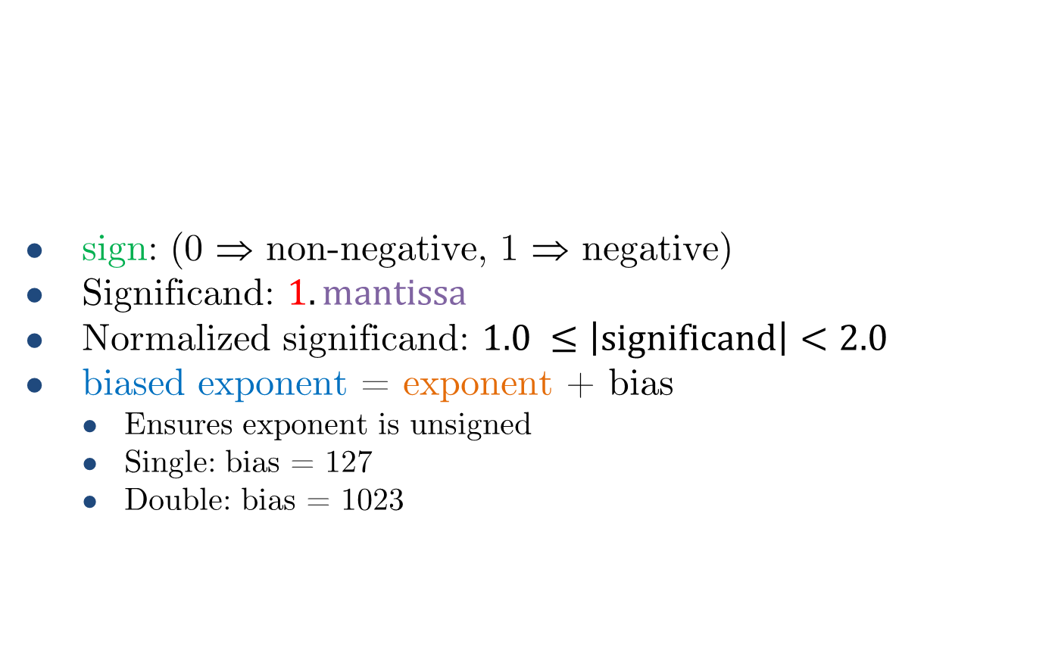
IEEE Floating-point format
single: 8 bits double: 11 bits
single: 23 bits double: 52 bits
sign: (0 ⇒ non-negative, 1 ⇒ negative)
Significand: $1.mantissa$
Normalized significand: $1.0 ≤\left|significand\right|<2.0$
biased exponent = exponent + bias
Ensures exponent is unsigned
Single: bias = 127
Double: bias = 1023
1 bit
sign
biased exponent
mantissa
Implicit 1
$${x= \left(−1\right)}^{sign}1.mantissa×2^{\left(exponent\right)}$$

Slide 22
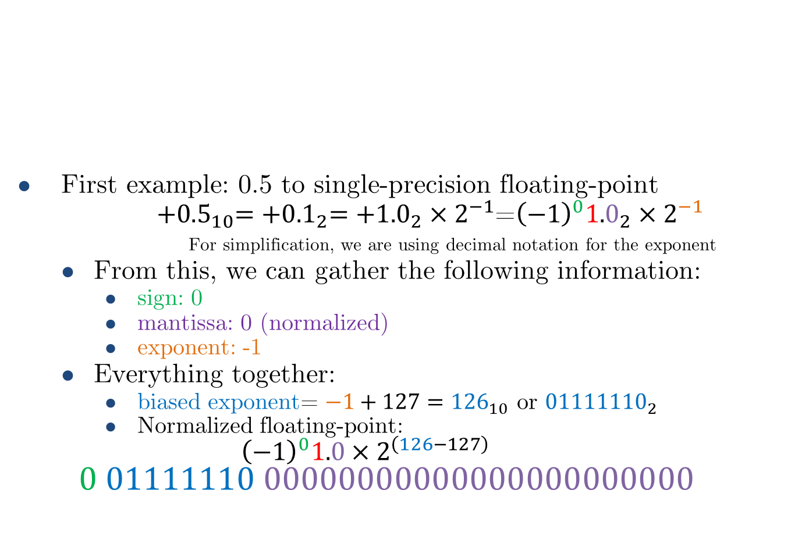

IEEE Floating-point format
single: 8 bits double: 11 bits
single: 23 bits double: 52 bits
First example: 0.5 to single-precision floating-point
${+0.5}_{10}={+0.1}_{2}={+1.0}_{2}×2^{−1}$=${\left(−1\right)}^{0}{1.0}_{2}×2^{−1}$
For simplification, we are using decimal notation for the exponent
From this, we can gather the following information:
sign: 0
mantissa: 0 (normalized)
exponent: -1
Everything together:
biased exponent= $−1+127={126}_{10}$ or ${01111110}_{2}$
Normalized floating-point:
$${\left(−1\right)}^{0}1.0×2^{\left(126−127\right)}$$
$$0 01111110 00000000000000000000000$$
1 bit
sign
biased exponent
mantissa
$${x= \left(−1\right)}^{sign}1.mantissa×2^{\left(exponent\right)}$$

Slide 23
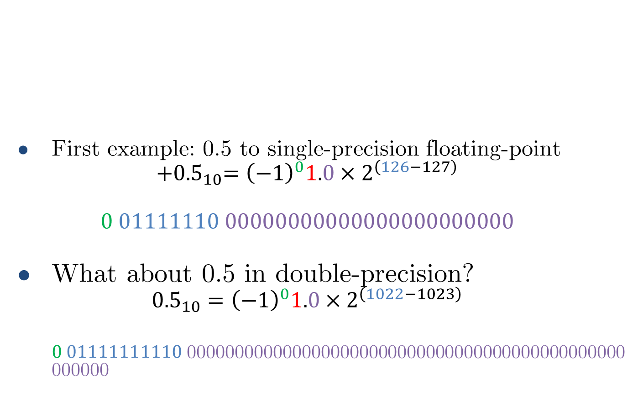
IEEE Floating-point format
single: 8 bits double: 11 bits
single: 23 bits double: 52 bits
First example: 0.5 to single-precision floating-point
$${+0.5}_{10}={\left(−1\right)}^{0}1.0×2^{\left(126−127\right)}$$
$$0 01111110 00000000000000000000000$$
What about 0.5 in double-precision?
$${0.5}_{10}={\left(−1\right)}^{0}1.0×2^{\left(1022−1023\right)}$$
$0 01111111110$0000000000000000000000000000000000000000000000000000
1 bit
sign
biased exponent
mantissa
$${x= \left(−1\right)}^{sign}1.mantissa×2^{\left(exponent\right)}$$
This 1 is not actually required here

Slide 24
Floating-point example
Represent –0.75
–0.75 = (–1)¹ × 1.1₂ × 2^{–1}
sign = 1
mantissa = 1000…00₂
biased exponent = –1 + bias
Single: –1 + 127 = 126 = 01111110₂
Double: –1 + 1023 = 1022 = 01111111110₂
Single: 1011111101000…00
Double: 1011111111101000…00

Slide 25
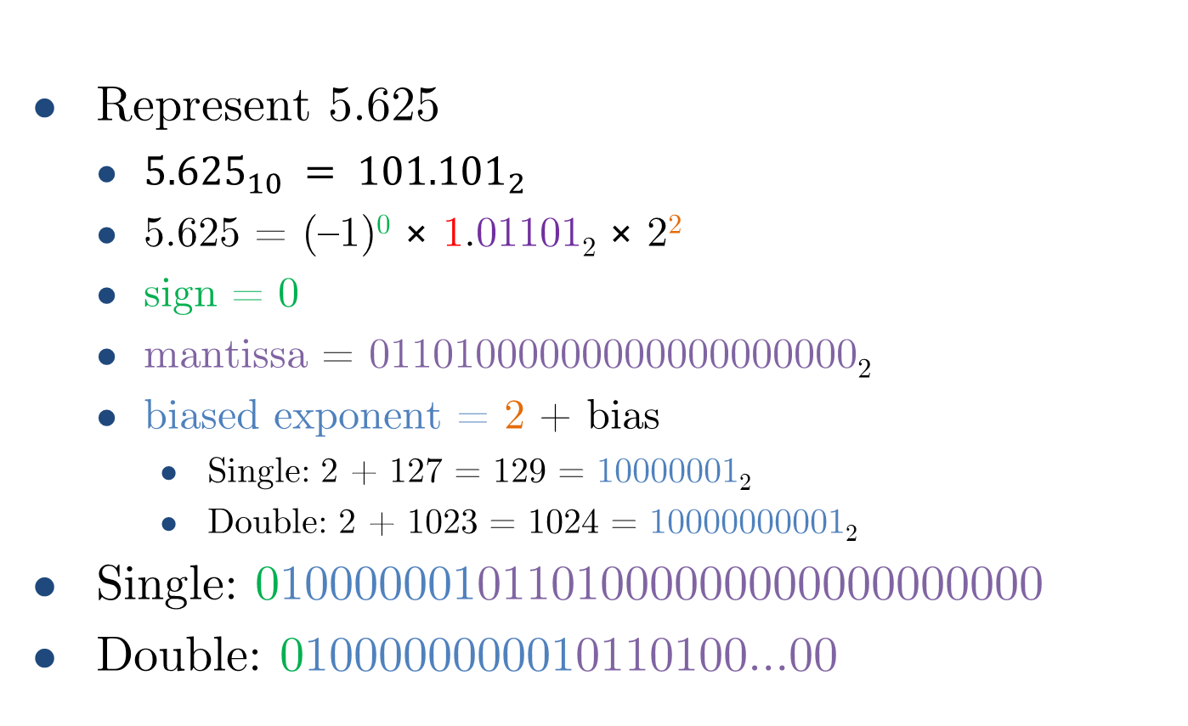
Floating-point example
Represent 5.625
${5.625}_{10} = {101.101}_{2}$
5.625 = (–1)⁰ × 1.01101₂ × 2²
sign = 0
mantissa = 01101000000000000000000₂
biased exponent = 2 + bias
Single: 2 + 127 = 129 = 10000001₂
Double: 2 + 1023 = 1024 = 10000000001₂
Single: 01000000101101000000000000000000
Double: 0100000000010110100…00

Slide 26
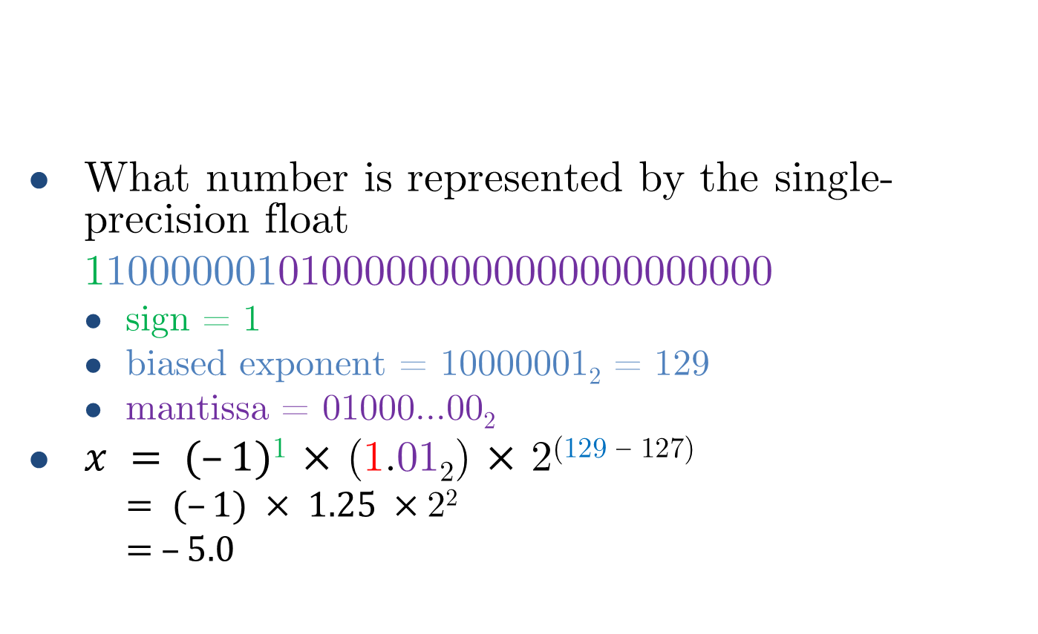
Floating-point example
single: 8 bits double: 11 bits
single: 23 bits double: 52 bits
What number is represented by the single-precision float
11000000101000000000000000000000
sign = 1
biased exponent = 10000001₂ = 129
mantissa = 01000…00₂
$x = (–1)$¹ $×$ (1.01₂) $×$ 2^{(129 – 127)}
$= (–1) × 1.25 ×$2²
$= –5.0$
1 bit
sign
exponent
mantissa
Remember that this 1 is always implied!

Slide 27
Floating-point exercises
Convert the following real numbers to floating-point representation.
1234.5625
31.875
-219.125

Slide 28
Floating-point exercises
Convert the following real numbers to floating-point representation.
1234.5625 => 0x449a5200
31.875 => 0x41ff0000
-219.125 => 0xc35b2000

Slide 29
Floating-point exercises
Convert the following floating-point numbers to real numbers
0xc3db2000
0x40808000
0x41200000

Slide 30
Floating-point exercises
Convert the following floating-point numbers to real numbers
0xc3db2000 => -438.25
0x40808000 => 4.015625
0x41200000 => 10.0

Slide 31
Single precision range
Exponents 00000000 and 11111111 reserved
Smallest value
exponent: 00000001 ⇒ actual exponent = 1 – 127 = –126
Fraction: 000…00 ⇒ significand = 1.0
±1.0 × 2^{–126} ≈ ±1.2 × 10^{–38}
Largest value
exponent: 11111110 ⇒ actual exponent = 254 – 127 = +127
Fraction: 111…11 ⇒ significand ≈ 2.0
±2.0 × 2⁺¹²⁷ ≈ ±3.4 × 10⁺³⁸

Slide 32
Double precision range
Exponents 00000000000 and 11111111111 reserved
Smallest value
Exponent: 00000000001 ⇒ actual exponent = 1 – 1023 = –1022
Fraction: 000…00 ⇒ significand = 1.0
±1.0 × 2^{–1022} ≈ ±2.2 × 10^{–308}
Largest value
exponent: 11111111110 ⇒ actual exponent = 2046 – 1023 = +1023
Fraction: 111…11 ⇒ significand ≈ 2.0
±2.0 × 2⁺¹⁰²³ ≈ ±1.8 × 10⁺³⁰⁸

Slide 33

Floating-point precision
Relative precision
Single: approx. $2^{−23}→≈7$ decimal digits
Double: approx. $2^{−52}→≈16$ decimal digits

Slide 34
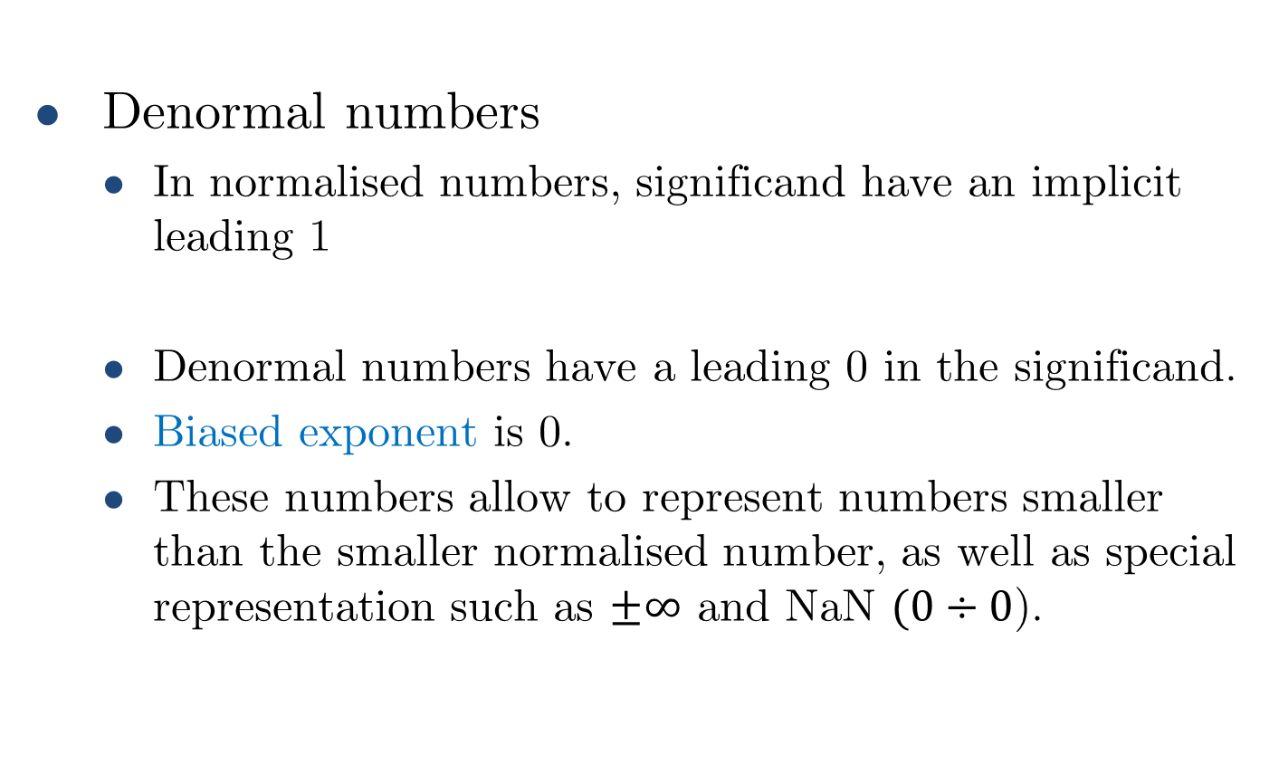

Floating-point special representation
Denormal numbers
In normalised numbers, significand have an implicit leading 1
Denormal numbers have a leading 0 in the significand.
Biased exponent is 0.
These numbers allow to represent numbers smaller than the smaller normalised number, as well as special representation such as $±∞$ and NaN $(0÷0$).
$${x= \left(−1\right)}^{sign}1.mantissa×2^{\left(exponent\right)}$$

Slide 35

Denormal numbers
$$x=(−1)^{sign}×(0.mantissa)×2^{0−bias}$$
Smaller than normal numbers.
Zero
sign = 0,1
biased exponent = 0
mantissa = 0
$$x=(−1)^{sign}×(0+0)×2^{−bias}=±0.0$$
Two representations of 0.0!

Slide 36
Denormalized numbers
Smallest denormalized value
Single precision: ${±2^{−23}×2^{−126}≈1.4×10}^{−45}$
Single precision: 〖±2^(−23)×2^(−126)≈1.4×10〗^(−45)
Largest denormalized value
Single precision: ${±\left(1−2^{−23}\right)×2^{−126}≈±1.17×10}^{−38}$
Single precision: 〖±(1−2^(−23) )×2^(−126)≈±1.17×10〗^(−38)
Double precision: ${±2^{−52}×2^{−1022}≈4.9×10}^{−324}$
Double precision: 〖±2^(−52)×2^(−1022)≈4.9×10〗^(−324)
Double precision: ${±\left(1−2^{−52}\right)×2^{−1022}≈±2.22×10}^{−308}$
Double precision: 〖±(1−2^(−52) )×2^(−1022)≈±2.22×10〗^(−308)

Slide 37
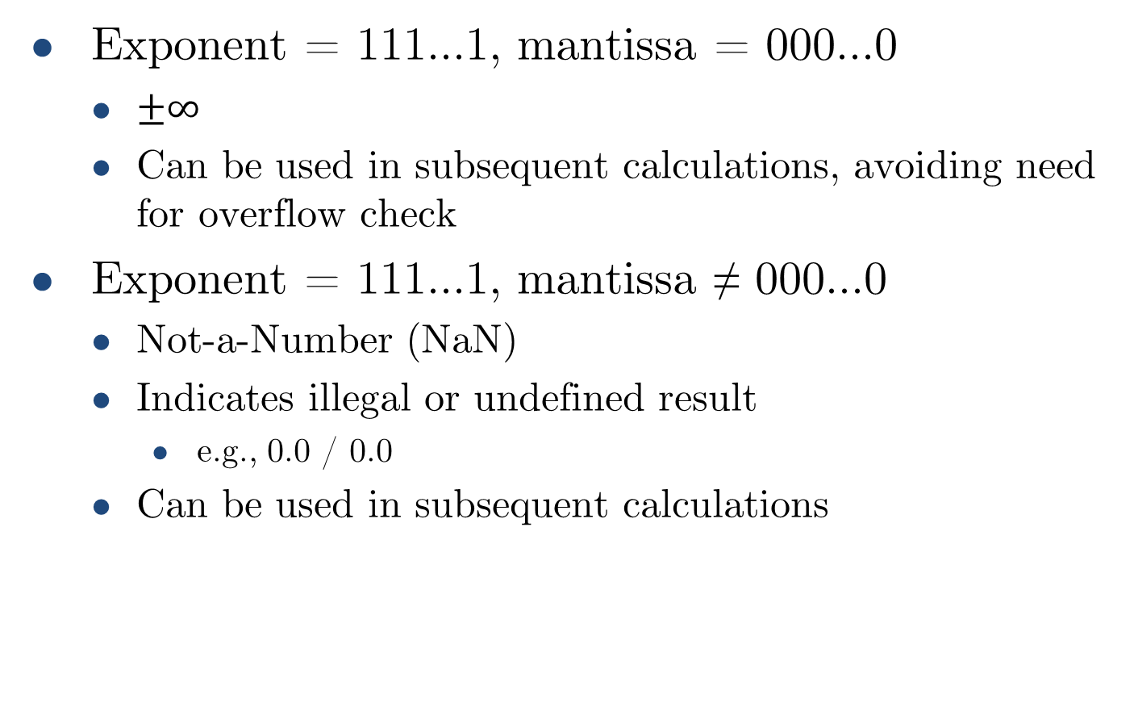
Infinities and NaNs
Exponent = 111...1, mantissa = 000...0
$±∞$
Can be used in subsequent calculations, avoiding need for overflow check
Exponent = 111...1, mantissa ≠ 000...0
Not-a-Number (NaN)
Indicates illegal or undefined result
e.g., 0.0 / 0.0
Can be used in subsequent calculations

Slide 38
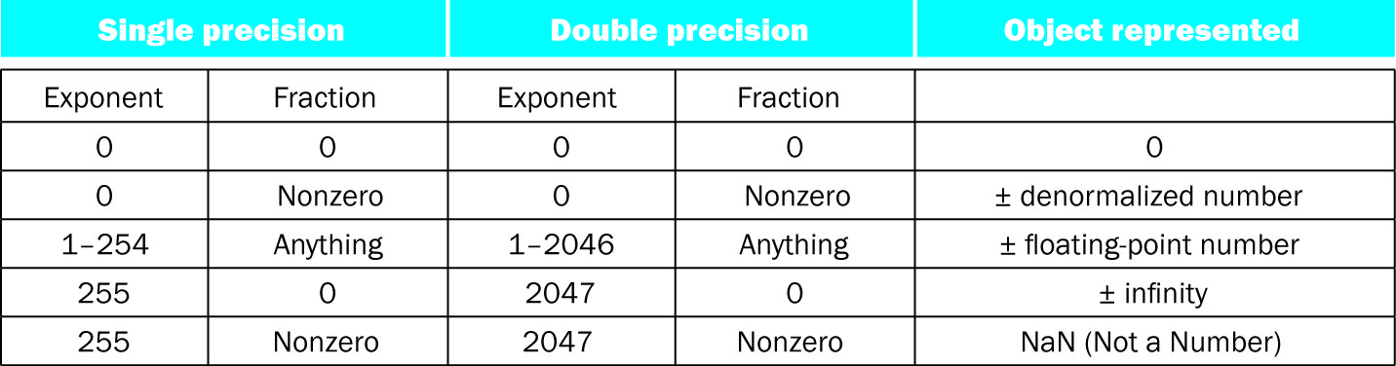
Floating-point special formats summary

Slide 39
Floating-point rounding

Slide 40
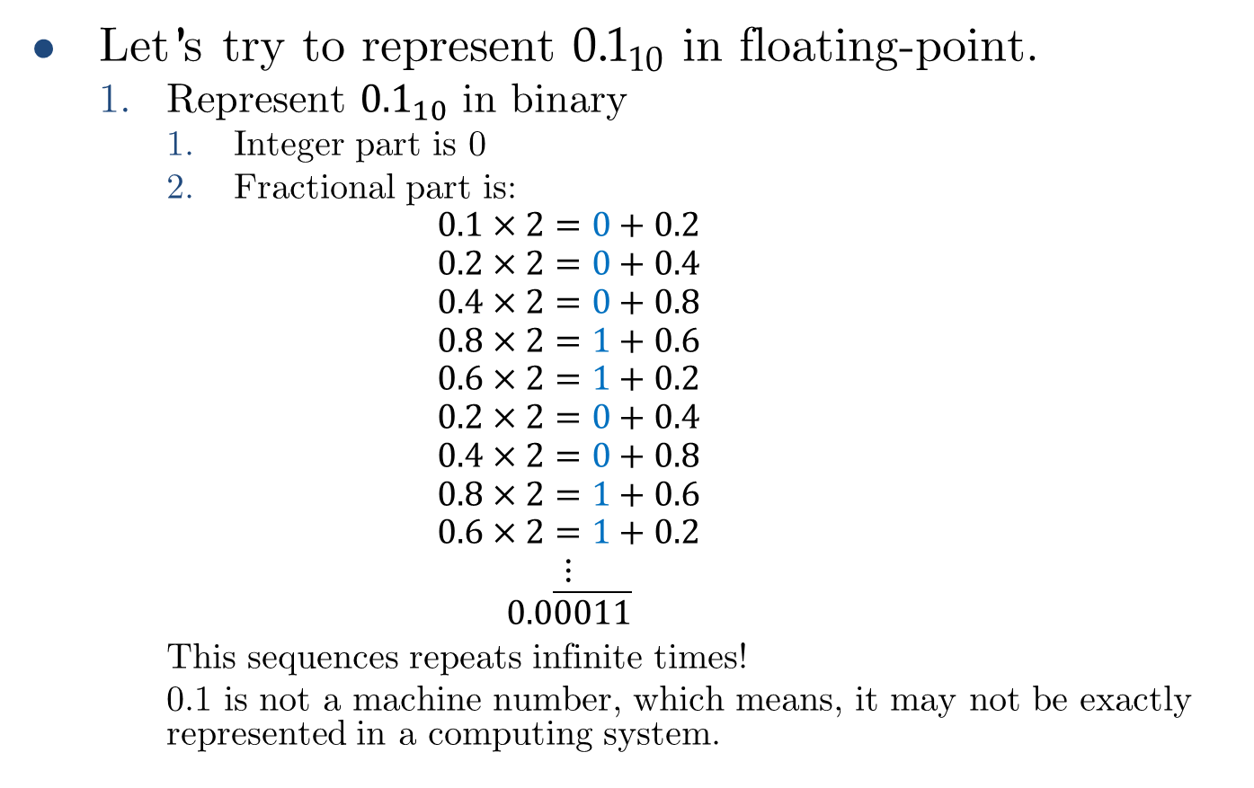
Floating-point rounding
Let’s try to represent ${0.1}_{10}$ in floating-point.
Represent ${0.1}_{10}$ in binary
Integer part is 0
Fractional part is:
$$0.1×2=0+0.2$$
$$0.2×2=0+0.4$$
$$0.4×2=0+0.8$$
$$0.8×2=1+0.6$$
$$0.6×2=1+0.2$$
$$0.2×2=0+0.4$$
$$0.4×2=0+0.8$$
$$0.8×2=1+0.6$$
$$0.6×2=1+0.2$$
$$⋮$$
$$0.0\overline{0011}$$
This sequences repeats infinite times!
0.1 is not a machine number, which means, it may not be exactly represented in a computing system.

Slide 41
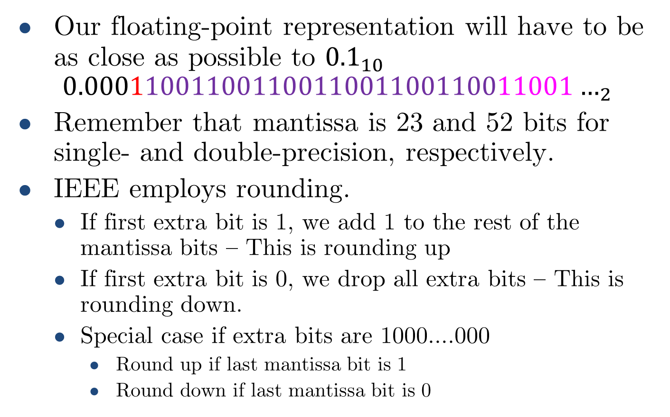
Floating-point rounding
Our floating-point representation will have to be as close as possible to ${0.1}_{10}$
$${0.00011001100110011001100110011001…}_{2}$$
Remember that mantissa is 23 and 52 bits for single- and double-precision, respectively.
IEEE employs rounding.
If first extra bit is 1, we add 1 to the rest of the mantissa bits – This is rounding up
If first extra bit is 0, we drop all extra bits – This is rounding down.
Special case if extra bits are 1000….000
Round up if last mantissa bit is 1
Round down if last mantissa bit is 0

Slide 42
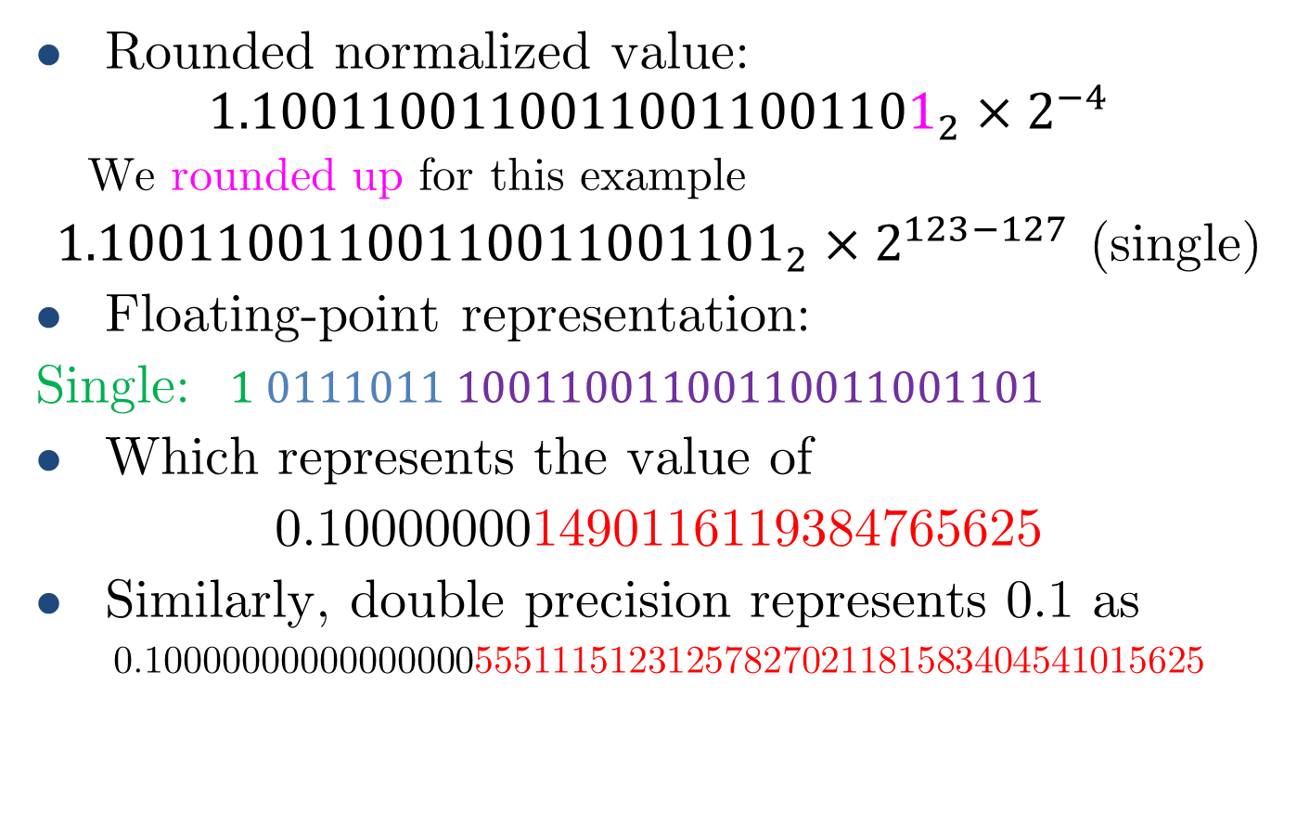
Floating-point rounding
Rounded normalized value:
$${1.10011001100110011001101}_{2}×2^{−4}$$
We rounded up for this example
${1.10011001100110011001101}_{2}×2^{123−127}$ (single)
Floating-point representation:
Single: $1 0111011 10011001100110011001101$
Which represents the value of
0.100000001490116119384765625
Similarly, double precision represents 0.1 as
0.1000000000000000055511151231257827021181583404541015625

Slide 43
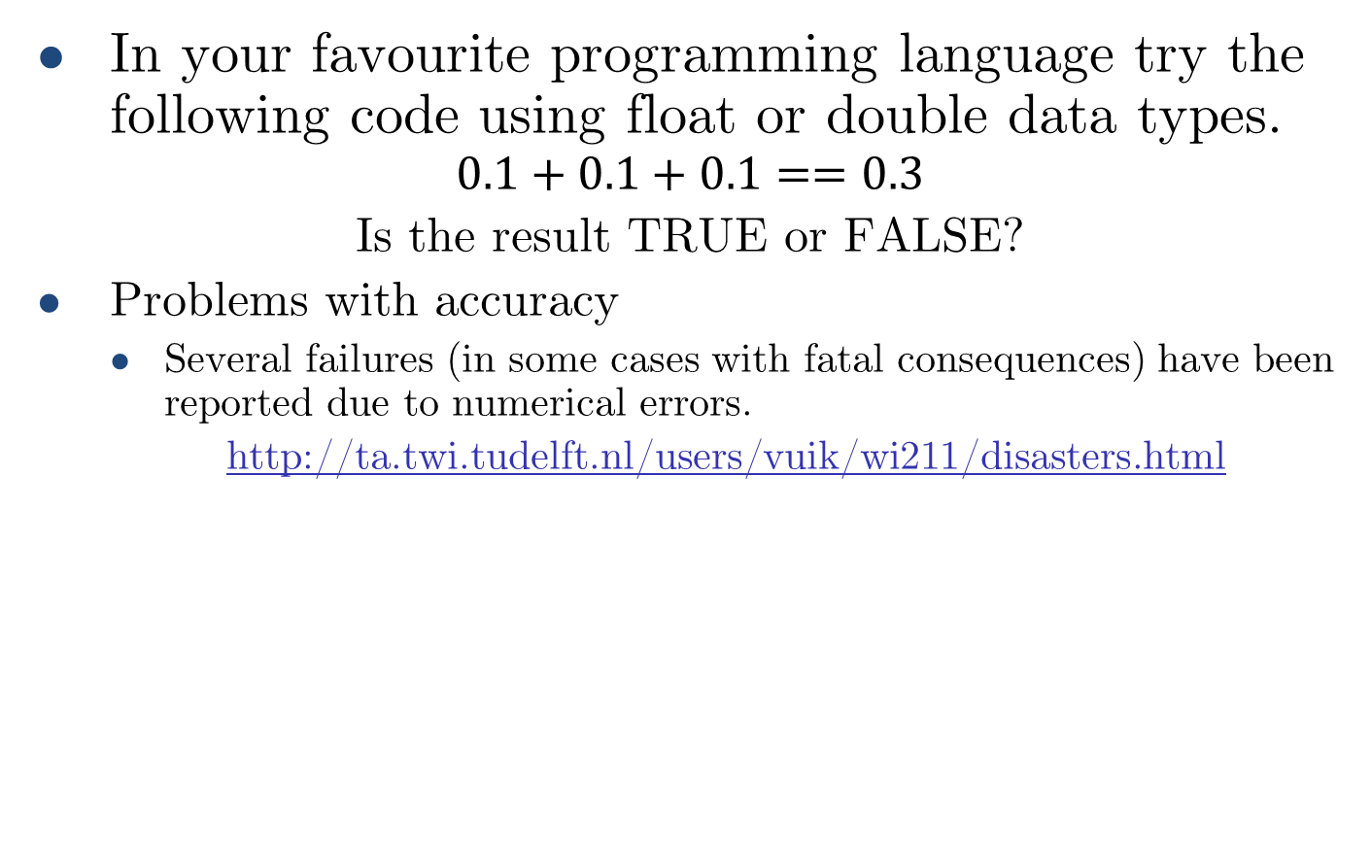
Floating-point rounding
In your favourite programming language try the following code using float or double data types.
$$0.1+0.1+0.1==0.3$$
Is the result TRUE or FALSE?
Problems with accuracy
Several failures (in some cases with fatal consequences) have been reported due to numerical errors.
http://ta.twi.tudelft.nl/users/vuik/wi211/disasters.html

Slide 44
Concluding remarks
Bits have no inherent meaning
Interpretation depends on the application.
Computer representations of numbers
Finite range and precision, even in double-precision floating-point representation.
Need to account for this in programs.

Slide 45
Floating-point addition

Slide 46
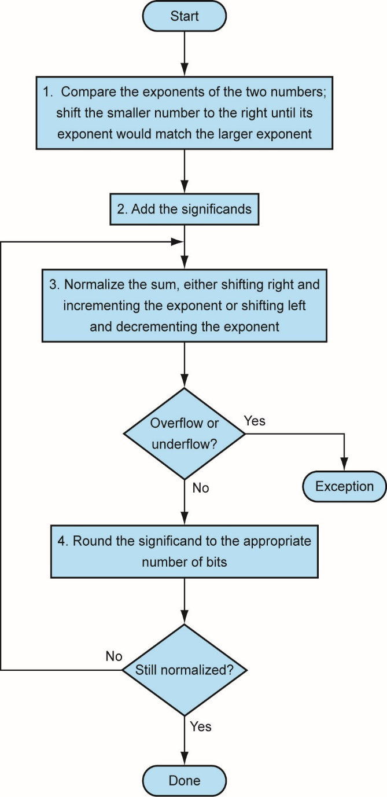
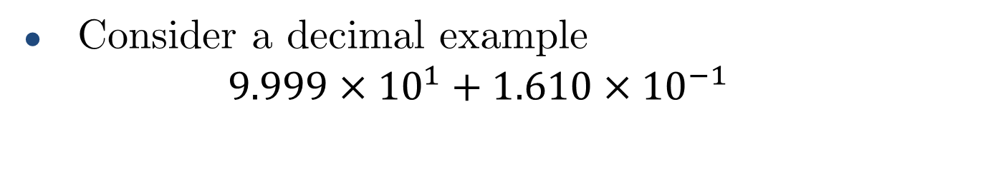
Floating-point addition
Consider a decimal example
$$9.999×{10}^{1}+1.610×{10}^{−1}$$
1. Align decimal points
Shift number with smaller exponent
9.999 × 10¹ + 0.016 × 10¹
9.999 × 10¹ + 0.016 × 10¹ = 10.015 × 10¹
3. Normalize result & check for over/underflow
1.0015 × 10²
4. Round and renormalize if necessary
1.002 × 10²
2. Add significands
Rounding up to 3 decimal places

Slide 47
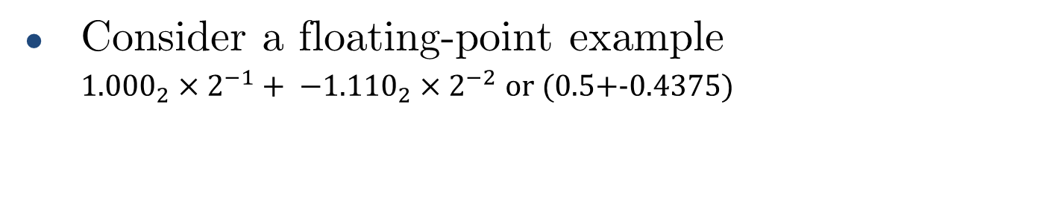
Floating-point addition
Consider a floating-point example
${1.000}_{2}×2^{−1}+ −{{1.110}_{2}×2}^{−2}$ or (0.5+-0.4375)
1. Align decimal points
Shift number with smaller exponent
$${1.000}_{2}×2^{−1}+ −{0.1110}_{2}×2^{−1}$$
〖1.000〗_2×2^(−1)+ −〖0.1110〗_2×2^(−1)
$$1.0002 × 2^{−1} + –0.1112 × 2^{−1} = 0.0012 × 2^{−1}$$
1.000₂ × 2^(−1) + –0.111₂ × 2^(−1) = 0.001₂ × 2^(−1)
3. Normalize result & check for over/underflow
$${1.0}_{2}×2^{−4}$$
〖1.0〗_2×2^(−4)
4. Round and renormalize if necessary
$${1.0}_{2}×2^{−4}=0.0625$$
〖1.0〗_2×2^(−4)=0.0625
2. Add significands

Slide 48
Floating-point adder hardware
Much more complex than integer adder.
Doing it in one clock cycle would take too long.
Much longer than integer operations.
Slower clock would penalize all instructions.
Floating-point adder usually takes several cycles
Can be pipelined

Slide 49
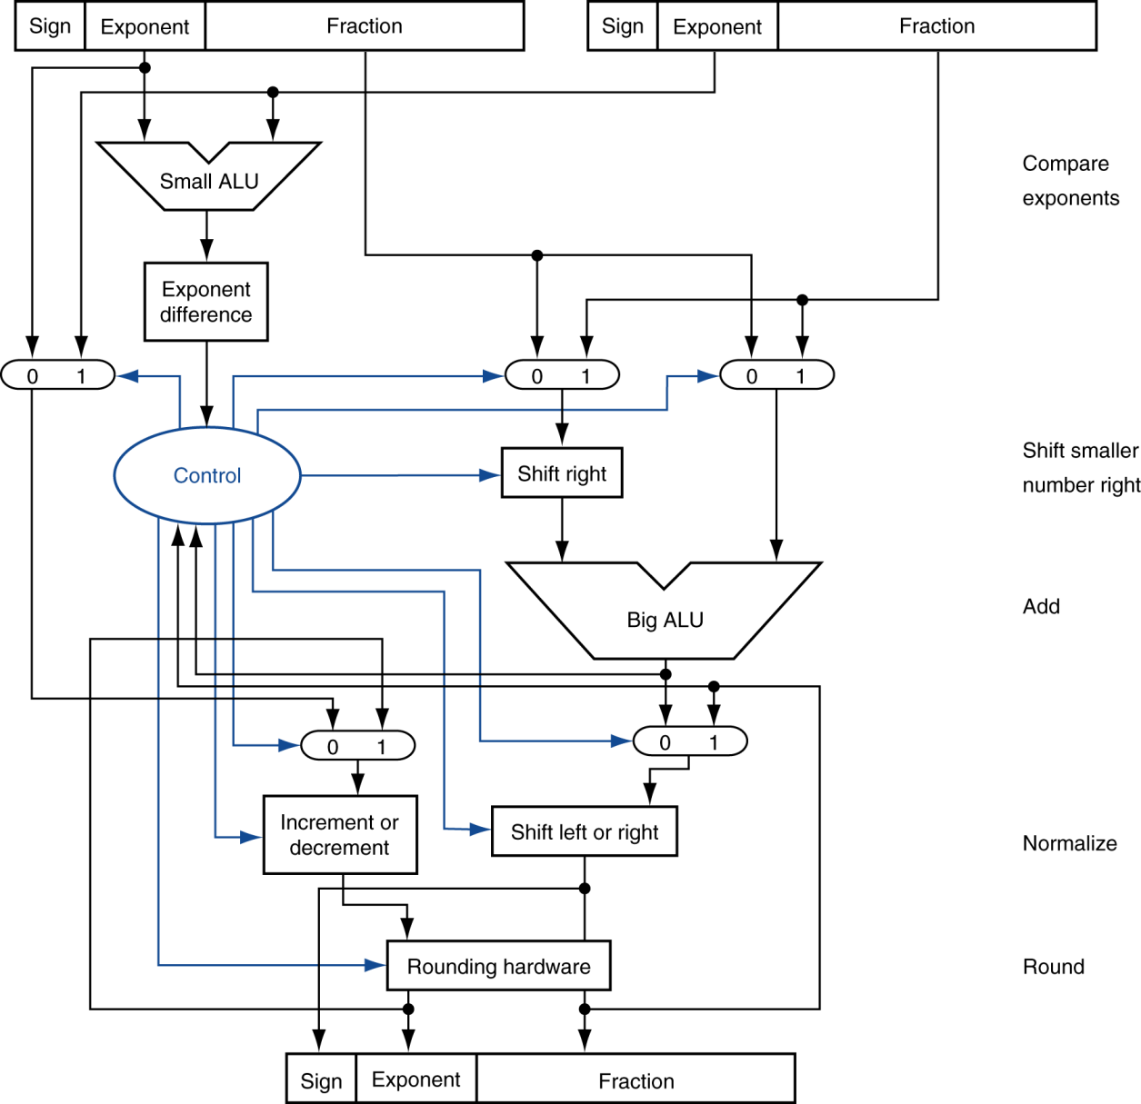

Floating-point adder hardware
Step 1
Step 2
Step 3
Step 4

Slide 50
Floating-point adder hardware
Step 1
Step 2
Step 3
Step 4

Slide 51
Floating-point adder hardware
Step 1
Step 2
Step 3
Step 4

Slide 52
Floating-point adder hardware
Step 1
Step 2
Step 3
Step 4

Slide 53
Floating-point adder hardware
Step 1
Step 2
Step 3
Step 4

Slide 54
Floating-point adder hardware
Step 1
Step 2
Step 3
Step 4

Slide 55
Floating-point adder hardware
Step 1
Step 2
Step 3
Step 4

Slide 56
Floating-point multiplication

Slide 57
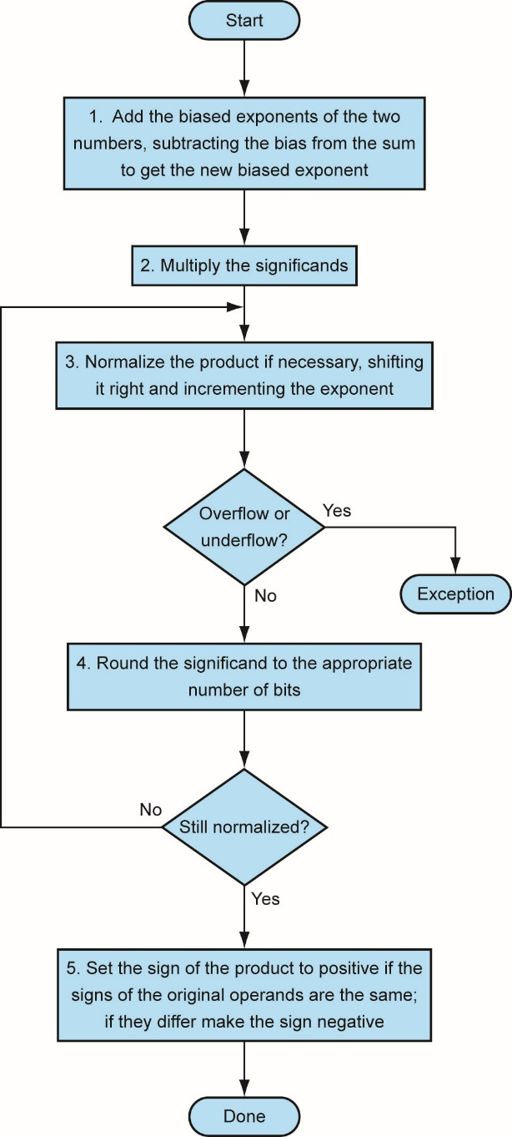
Floating-point multiplication
Consider a decimal example
$$1.110 × 1010 × 9.200 × {10}^{−5}$$
1.110 × 10¹⁰ × 9.200 × 10^(−5)
1. Add exponents
For biased exponents, subtract bias from sum
New exponent = 10 + –5 = 5
2. Multiply significands
$$1.110 × 9.200 = 10.212  10.212 × 105$$
1.110 × 9.200 = 10.212 ⇒ 10.212 × 10⁵
3. Normalize result & check for over/underflow
$$1.0212 × 106$$
1.0212 × 10⁶
4. Round and renormalize if necessary
$$1.021 × 106$$
1.021 × 10⁶
5. Determine sign of result from signs of operands
$$+1.021 × 106$$
+1.021 × 10⁶

Slide 58
Floating-point multiplication
Consider a floating-point example
$−14.25 ×3.125$ in decimal, or
−14.25 ×3.125 in decimal, or
1. Add exponents
Unbiased: 3 + 1 = 4
Biased: (3 + 127) + (1 + 127)$−127$
Biased: (3 + 127) + (1 + 127)−127
2. Multiply significands
$$−1.110012×1.10012$$
−1.11001₂×1.1001₂
3. Normalize result & check for over/underflow
$1.01100100012×2^{5}$ with no over/underflow
1.0110010001₂×2^5 with no over/underflow
4. Round and renormalize if necessary
$1.01100100012×2^{5}$(no change)
1.0110010001₂×2^5(no change)
5. Determine sign of result from signs of operands
$$–1.01100100012×2^{5}= –44.53125$$
–1.0110010001₂×2^5= –44.53125
$$= {10.110010001}_{2}$$
= 〖10.110010001〗_2
$$−1.110012×2^{3}×1.10012×2^{1}$$
−1.11001₂×2^3×1.1001₂×2^1
$$= 4 + 254 – 127 = 4 + 127$$
= 4 + 254 – 127 = 4 + 127
$$ 10.1100100012×2^{4}$$
⇒ 10.110010001₂×2^4

Slide 59
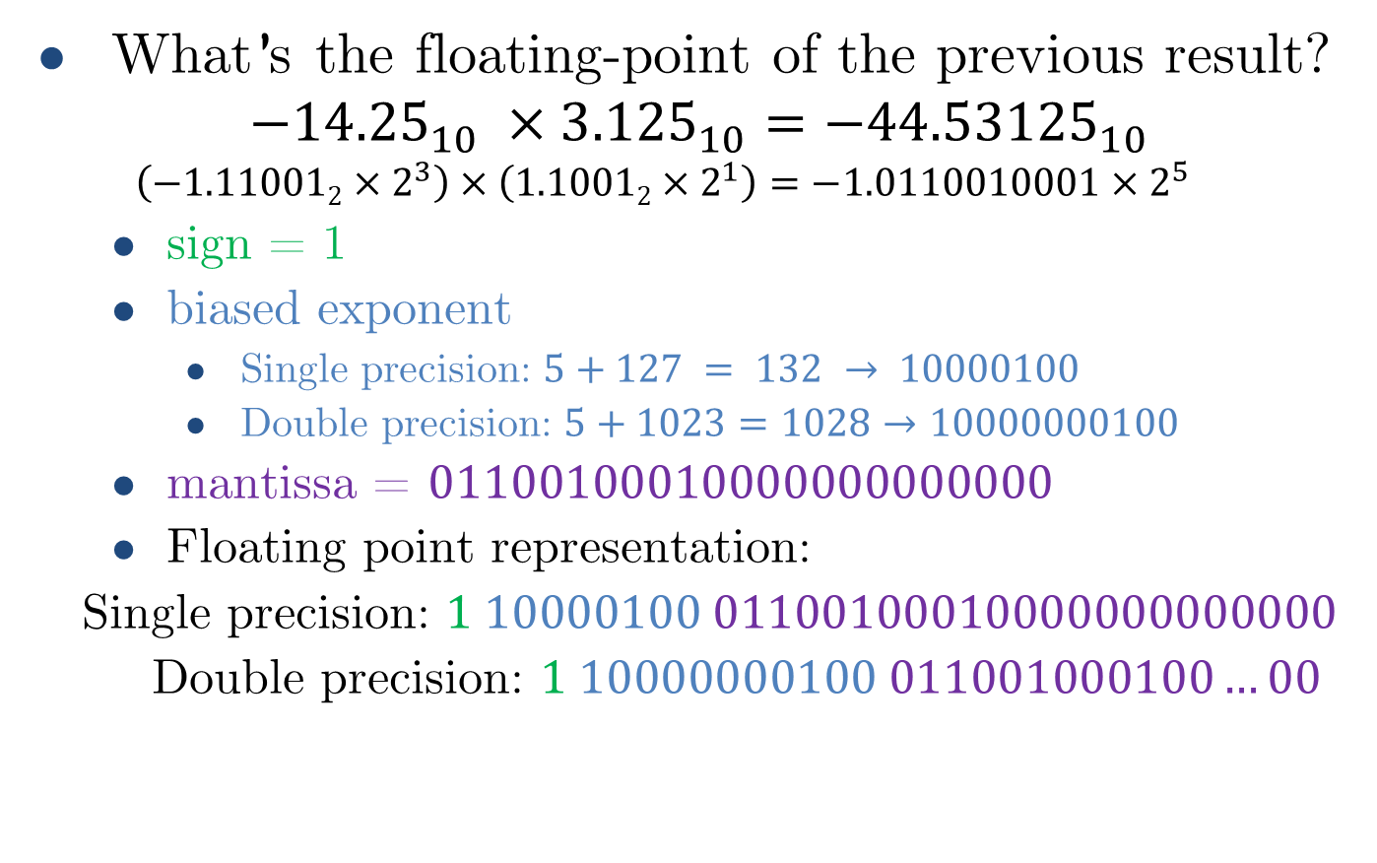
Floating-point multiplication
What’s the floating-point of the previous result?
$${−14.25}_{10} ×{3.125}_{10}={−44.53125}_{10}$$
$$\left(−1.110012×2^{3}\right)×\left(1.10012×2^{1}\right)=−1.0110010001×2^{5}$$
sign = 1
biased exponent
Single precision: $5+127 = 132 → 10000100$
Double precision: $5+1023=1028→10000000100$
mantissa = $01100100010000000000000$
Floating point representation:
Single precision: $1 10000100 01100100010000000000000$
Double precision: $1 10000000100 011001000100…00$

Slide 60
Floating-point arithmetic hardware
Floating-point multiplier is of similar complexity to floating-point adder.
But uses a multiplier for significands instead of an adder.
Floating-point arithmetic hardware usually does
Addition, subtraction, multiplication, division, reciprocal, square-root.
Floating-point ↔ integer conversion
Operations usually takes several cycles
Can be pipelined

