Slide 1
TC2009B: Digital design Addition & Subtraction

Slide 2
References
The following material has been adopted and adapted from
Patterson, D. A., Hennessy, J. L., Computer Organization and design: The hardware/software interface – ARM edition, Morgan Kaufmann, 2017.
S. L. Harris and D. M. Harris, Digital design and computer architecture - ARM edition, Morgan Kaufmann, 2016.

Slide 3
Adder

Slide 4
1-bit adders

Slide 5
1-bit adders

Slide 6
1-bit adders

Slide 7
Multibit adders
Types of carry propagate adders (CPAs):
Ripple-carry (slow)
Carry-lookahead (fast)
Prefix (faster)
Carry-lookahead and prefix adders faster for large adders but require more hardware

Slide 8

Ripple-Carry adder
Chain 1-bit adders together
Carry ripples through entire chain
Disadvantage: slow
$t_{ripple}=Nt_{FA}$
$t_{FA}$ is the delay of a 1-bit full adder

Slide 9
Carry-lookahead adder
Compute C_{out} for k-bit blocks using generate and propagate signals
Some definitions:
Column i produces a carry out by either generating a carry out or propagating a carry in to the carry out
Generate (G_{i}) and propagate (P_{i}) signals for each column:
Generate: Column i will generate a carry out if A_{i} and B_{i} are both 1.
G_{i} = A_{i} B_{i}
Propagate: Column i will propagate a carry in into the carry out if A_{i} or B_{i} is 1.
P_{i} = A_{i} + B_{i}
Carry out: The carry out of column i (C_{i}) is:
C_{i} = A_{i} B_{i} + (A_{i} + B_{i} )C_{i-1} = G_{i} + P_{i} C_{i-1}

Slide 10
Carry-lookahead adder
Now use column propagate and generate signals to compute block propagate and block generate signals for k-bit blocks, i.e.:
Compute if a k-bit group will propagate a carry in (to the block) to the carry out (of the block)
Compute if a k-bit group will generate a carry out (of the block)

Slide 11
Carry-lookahead adder
Example: Block propagate and generate signals for 4-bit blocks (P_{3:0} and G_{3:0}):
P_{3:0} = P₃P₂ P₁P₀
G_{3:0} = G₃ + P₃ (G₂ + P₂ (G₁ + P₁G₀ ))
Generally,
P_{i:j} = P_{i}P_{i-1} P_{i-2}…P_{j}
G_{i:j} = G_{i} + P_{i} (G_{i-1} + P_{i-1} (G_{i-2} + P_{i-2}(G_{i-3} +P_{i-3}(… G_{j+1} + P_{j+1}G_{j}))
C_{i} = G_{i:j} + P_{i:j} C_{i-1}

Slide 12
32-bit Carry-lookahead with 4 blocks

Slide 13
Carry-lookahead addition
Step 1: Compute G_{i} and P_{i} for all columns
Step 2: Compute G and P for k-bit blocks
Step 3: C_{in} propagates through each k-bit propagate/generate logic (meanwhile computing sums)
Step 4: Compute sum for most significant k-bit block

Slide 14
Carry-lookahead adder delay
For N-bit CLA with k-bit blocks:
t_{CLA} = t_{pg} + t_{pg_block} + (N/k – 1)t_{AND_OR} + kt_{FA}
where:
t_{pg}: delay to generate all P_{i} and G_{i}
t_{pg_block} : delay to generate all P_{i:j} and G_{i:j}
t_{AND_OR} : delay from C_{in} to C_{out} of final AND/OR gate in k-bit CLA block
An N-bit carry-lookahead adder is generally much faster than a ripple-carry adder for N > 16

Slide 15
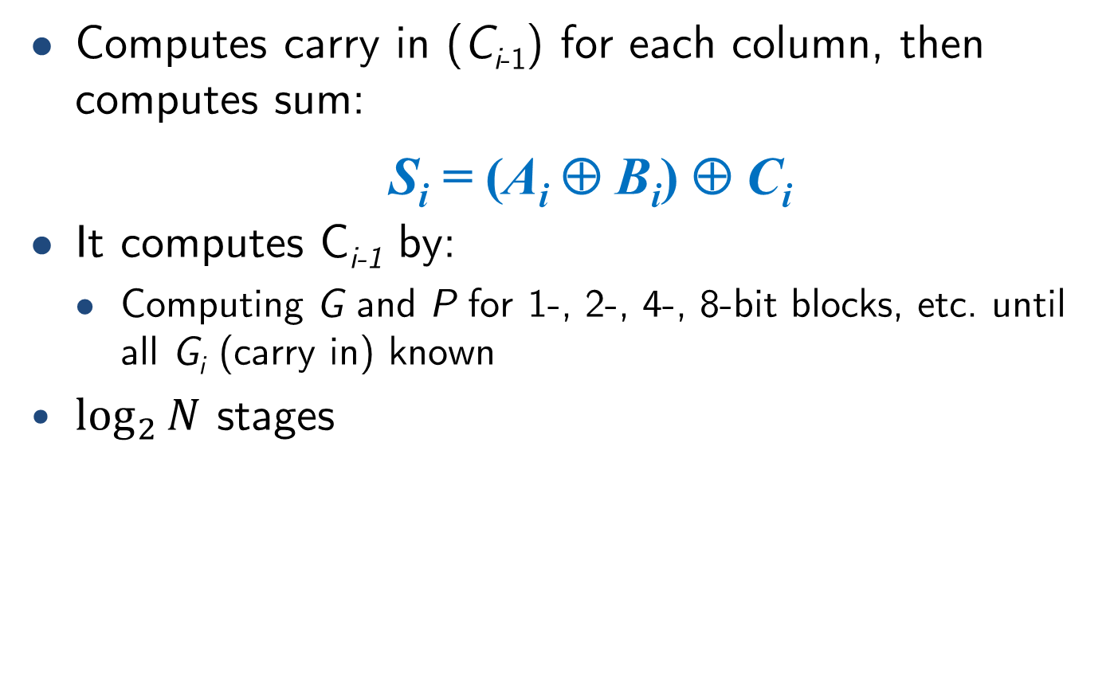
Prefix adder
Computes carry in (C_{i-1}) for each column, then computes sum:
S_{i} = (A_{i} ⊕ B_{i}) ⊕ C_{i}
It computes C_{i-1} by:
Computing G and P for 1-, 2-, 4-, 8-bit blocks, etc. until all G_{i} (carry in) known
$\log_{2}{N}$ stages

Slide 16
Prefix adder
Carry is either generated in a column or propagated from a previous column.
Column -1 holds C_{in}, so
G₋₁ = C_{in}
P₋₁ = 0
Carry in into column i = carry out of column i-1:
C_{i-1} = G_{i-1:-1}
G_{i-1:-1}: generate signal spanning columns i-1 to -1
Sum equation:
S_{i} = (A_{i} ⊕ B_{i}) ⊕ G_{i-1:-1}
Goal: Quickly compute G_{0:-1}, G_{1:-1}, G_{2:-1}, G_{3:-1}, G_{4:-1}, G_{5:-1}, … (called prefixes) (C₀, C₁, C₂, C₃, C₄, C₅,)

Slide 17
Prefix adder
Generate and propagate signals for a block spanning bits i:j
G_{i:j} = G_{i:k} + P_{i:k} G_{k-1:j}
P_{i:j} = P_{i:k}P_{k-1:j}
In words:
Generate: block i:j will generate a carry if:
upper part (i:k) generates a carry or
upper part (i:k) propagates a carry generated in lower part (k-1:j)
Propagate: block i:j will propagate a carry if both the upper and lower parts propagate the carry

Slide 18
16-bit prefix adder

Slide 19
Prefix adder delay
t_{PA} = t_{pg} + log₂N(t_{pg_prefix} ) + t_{XOR}
t_{pg}: delay to produce P_{i}, G_{i} (AND or OR gate)
t_{pg_prefix}: delay of black prefix cell (AND-OR gate)

Slide 20
Adder delay comparison
Compare delay of 32-bit adder structures: ripple-carry, carry-lookahead, and prefix adders
Carry-lookahead has 4-bit blocks
2-input gate delay = 100 ps;
full adder delay = 300 ps
t_{ripple} = Nt_{FA} = 32(300 ps)
= 9.6 ns
t_{CLA} = t_{pg} + t_{pg_block} + (N/k – 1)t_{AND_OR} + kt_{FA}
= [100 + 600 + (7)200 + 4(300)] ps
= 3.3 ns
t_{PA} = t_{pg} + log₂N(t_{pg_prefix} ) + t_{XOR}
= [100 + log₂32(200) + 100] ps
= 1.2 ns

Slide 21
Misc arithmetic circuits

Slide 22
Subtractor

Slide 23
Comparator

Slide 24
Adder/subtractor circuit
How can we implement an adder/subtractor circuit reutilizing adder’s HW?

