Slide 1
Attrition Analysis
Isiah Perine

Slide 2


Overview
MSDS at Southern Methodist University
DDSAnalytics

Slide 3
Understanding The Problem
Concept
Task 1
Task 2
Predicting employee turnover
Identify top three factors that lead to turnover
Identify job role specific trends

Slide 4
Data Set
870 rows & 36 columns
1 row per employee
30+ descriptive variables
JobInvolvement
JobSatisfaction
WorkLifeBalance
Response
Attrition
No missing values

Slide 5
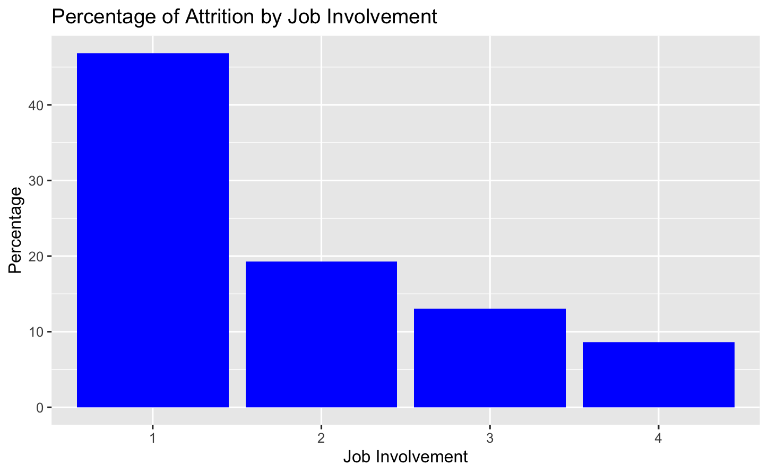
Graphical Exploration
Job Involvement Findings
Low Job Involvement - 46.81%
Medium Job Involvement - 19.30%
High Job Involvement - 13.04%
Very High Job Involvement - 8.64%
46.81%
19.30%
13.04%
35
8.64%
22
15
Job Involvement Levels:
1 = Low 2 = Medium
3 = High 4 = Very High

Slide 6
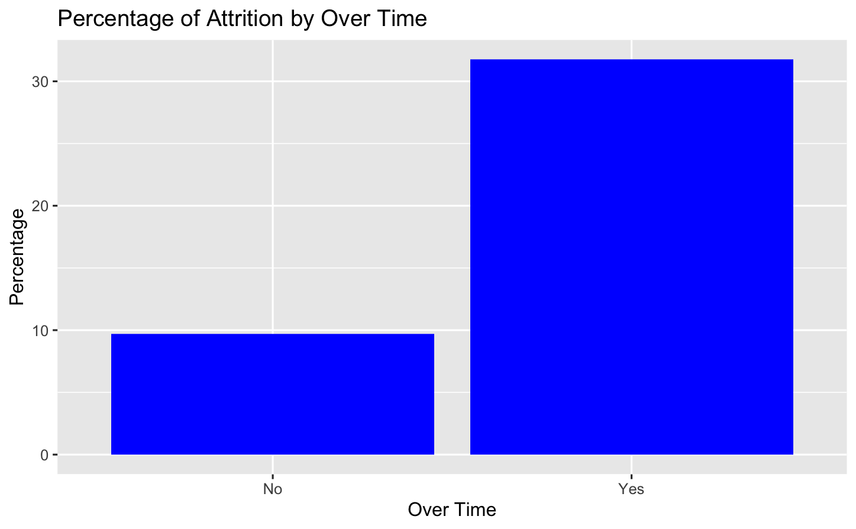
Graphical Exploration
Over Time Findings
No Over Time - 9.71%
Over Time - 31.75%
31.75%
9.71%
35
22
15

Slide 7
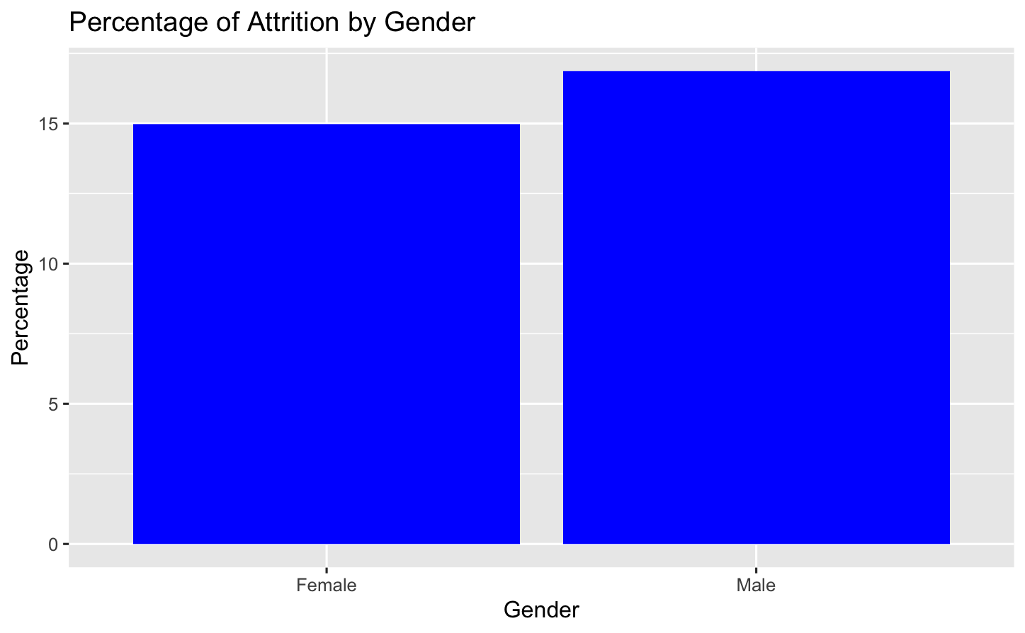
Graphical Exploration
Gender Findings
Female - 14.97%
Male- 16.86%
(may not be allowed to be included)
16.86%
14.97%
35
22
15

Slide 8
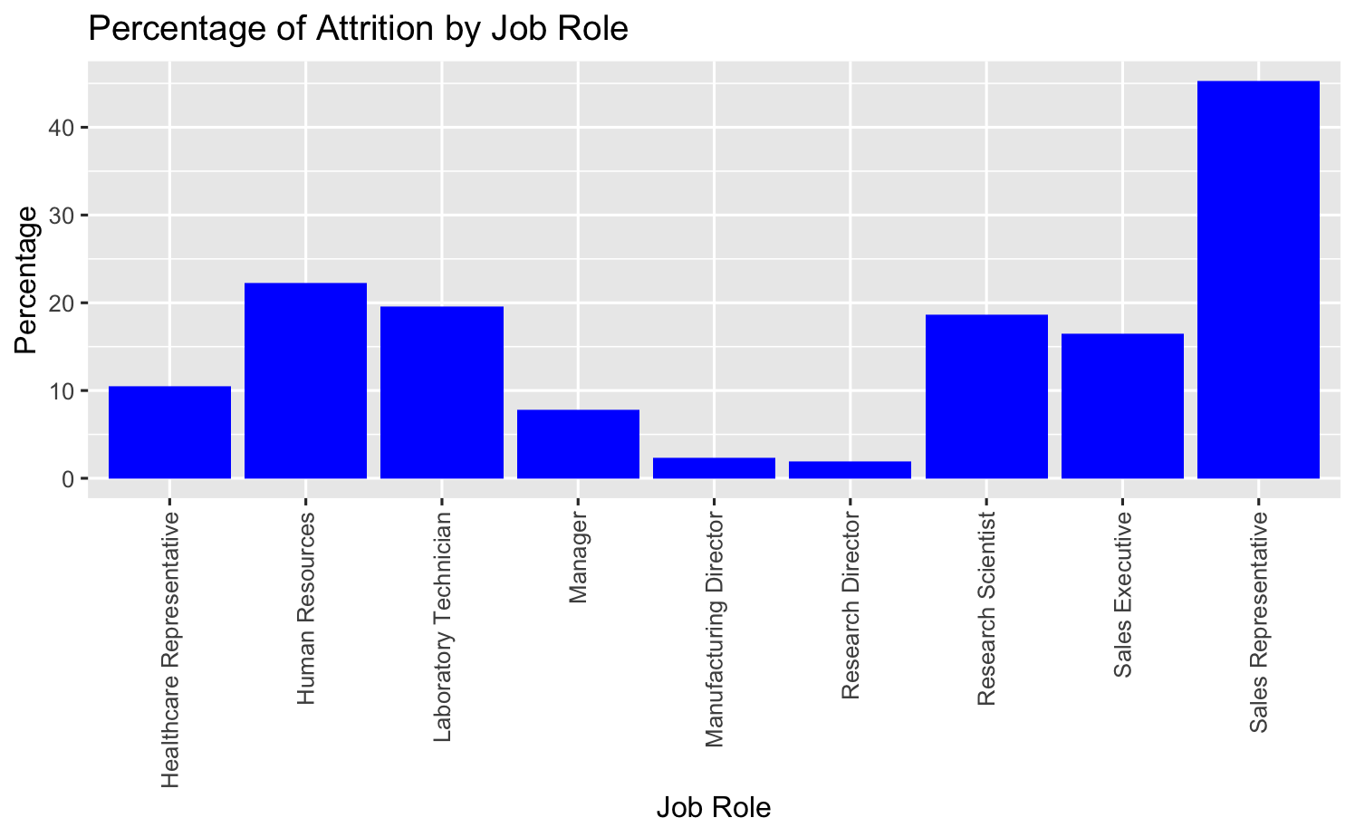
Graphical Exploration
Job Role Findings
Sales Representative - 45.28%!!
OTHER ROLES ALL < 22%
45.28%
35
22
15

Slide 9
Model Building
Most Significant Correlation (by Chi-Squared Test)
JobInvolvement
JobLevel
JobRole
MaritalStatus
OverTime
StockOptionLevel
YearsAtCompany
3
1
35
2
15
35 possible models

Slide 10
Models
Naive Bayes Model 1:
MaritalStatus
OverTime
StockOptionLevel
Naive Bayes Model 2:
JobLevel
OverTime
StockOptionLevel

Slide 11
Models
Naive Bayes Model 1:
Naive Bayes Model 2:
ACTUAL
ACTUAL
 | No | Yes
No | 207 | 26
Yes | 13 | 15
 | No | Yes
No | 214 | 31
Yes | 6 | 10
PREDICTED
PREDICTED
Accuracy = 85.06%
Sensitivity = 84.09%
Specificity = 36.59%
F1 = 91.39%
Accuracy = 85.82%
Sensitivity = 97.27%
Specificity = 24.39%
F1 = 92.04%

Slide 12
Model Selection
Choose Naive Bayes Model 2:
JobLevel, OverTime, and StockOptionLevel
Mean Accuracy = 86.30%
Mean Sensitivity = 97.33%
Mean Specificity = 28.93%
35
15

Slide 13
Answering The Problem
Top 3 Factors Leading to Turnover:
Job Level
Over Time
Stock Option Level
35
15

Slide 14
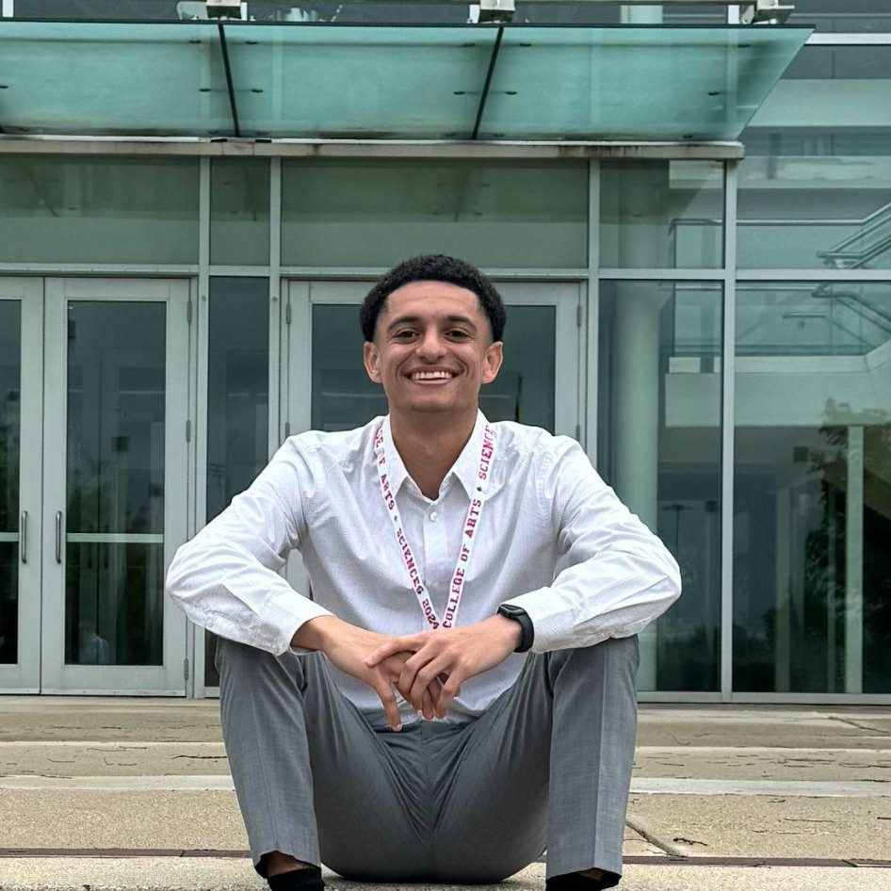
Thank You!
Isiah Perine
iperine@smu.edu

