Slide 1

SOPRA User Manual
SAE On-Premise Risk Assessment – Quick Reference for ISSOs

Slide 2
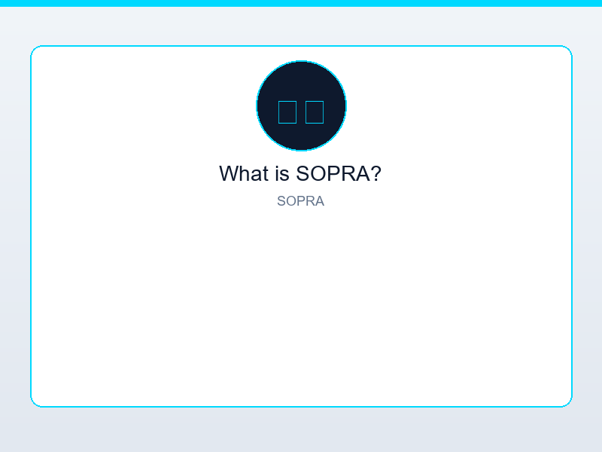
What is SOPRA?
• SOPRA (SAE On-Premise Risk Assessment) is an on-premise security assessment tool for enterprise infrastructure.
• It focuses on operational controls across 20 categories (e.g., Identity, Network, Endpoint, Physical Security).
• Uses CSV-based data upload – no cloud connection required for assessments.

Slide 3
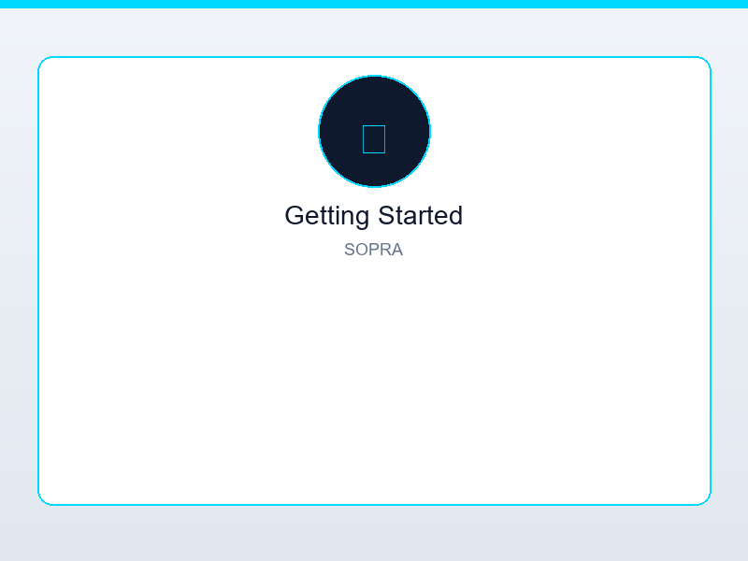
Getting Started
• 1. Open SOPRA and use the sidebar to navigate.
• 2. Go to Assessment → Download Templates to get CSV templates for each control category.
• 3. Populate the CSVs with your environment data (or use Demo Data for exploration).
• 4. Upload completed CSVs in the Assessment tab to run the assessment.

Slide 4
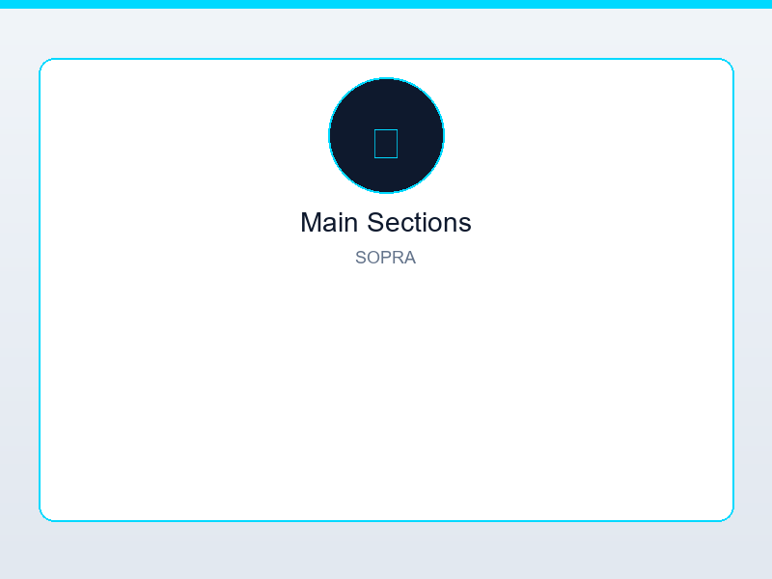
Main Sections
• Dashboard – Overview of assessment results, risk score, and category status.
• Assessment – Upload CSVs, run assessments, view control-level results.
• Reports – Export assessment reports and findings.
• Vulnerability Management – AI-assisted remediation for identified gaps.
• SSP Generator – Generate System Security Plan content from assessment data.
• AI Assistant – Chat for guidance on controls and remediation.

Slide 5
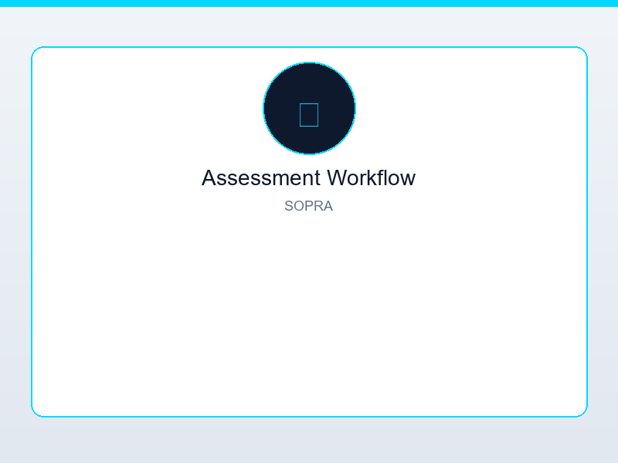
Assessment Workflow
• Download Templates (Assessment tab) – Get CSV templates with required columns for each category.
• Fill in your data – Status, evidence, notes per control.
• Upload CSVs – One or more files; SOPRA aggregates and scores.
• Review Dashboard – Risk score, category breakdown, and findings.

Slide 6

Dashboard Metrics
• Categories Assessed – Number of control families evaluated.
• Controls Assessed – Total controls with FIPS 199 level if applicable.
• Risk Score – Aggregate risk percentage based on findings.
• Status – Pending or Complete.
• Click metric tiles to drill into details.

Slide 7
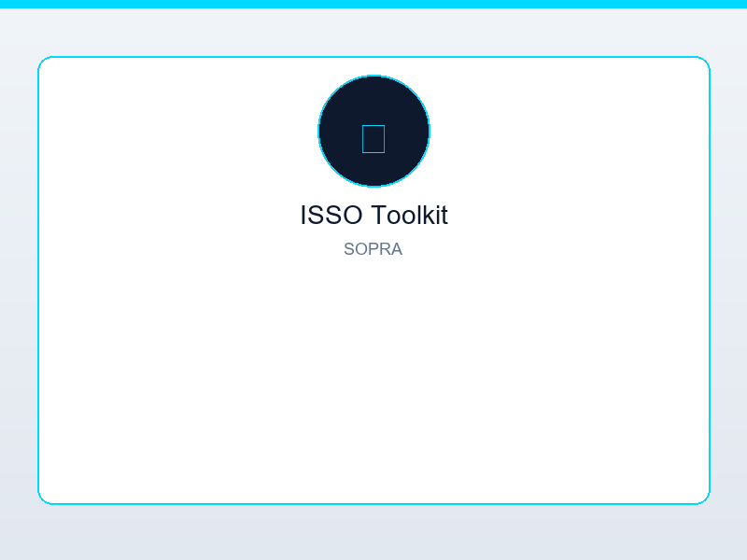
ISSO Toolkit
• Access via the ISSO Toolkit link in the sidebar.
• Central hub for POA&M, Risk Acceptance, STIG Import, Evidence, Incidents, Approvals.
• Supports continuous monitoring workflows and compliance documentation.

Slide 8
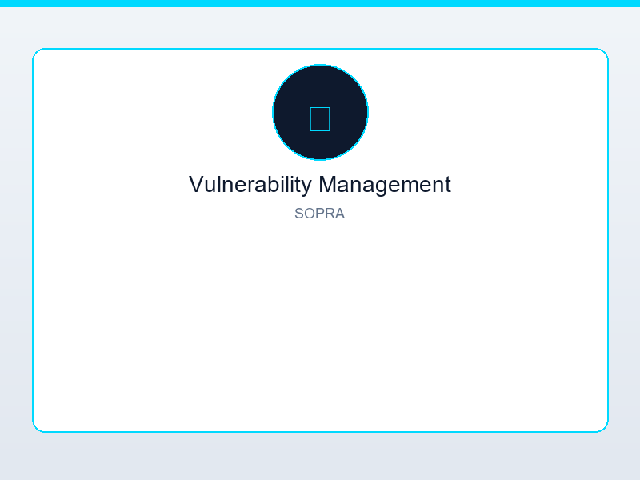
Vulnerability Management & Remediation
• Vulnerability Management tab – AI-assisted remediation dashboard.
• Review findings, get suggested fixes, track remediation status.
• Integration with CISA KEV and security best practices.

Slide 9
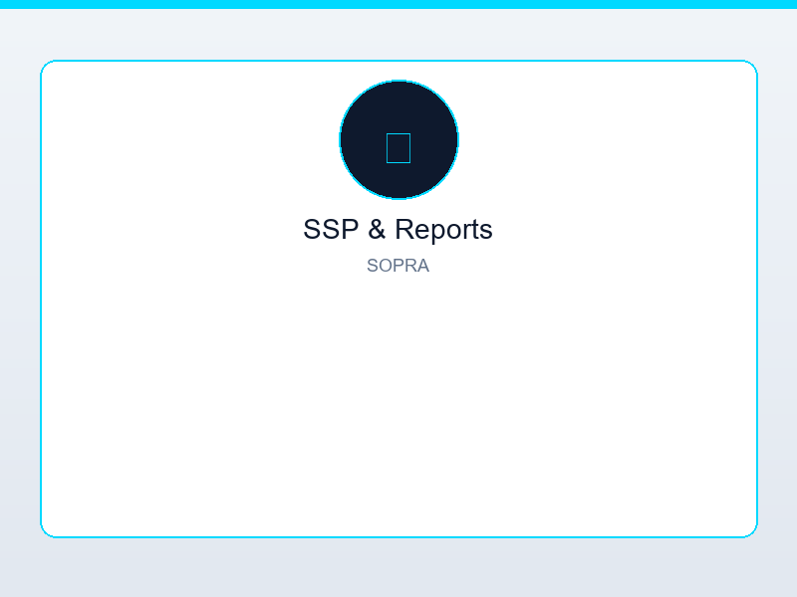
SSP Generator & Reports
• Generate SSP sections from your assessment results.
• Reports tab – Export findings in formats suitable for ATO packages.
• Link evidence and control status to documentation.

Slide 10
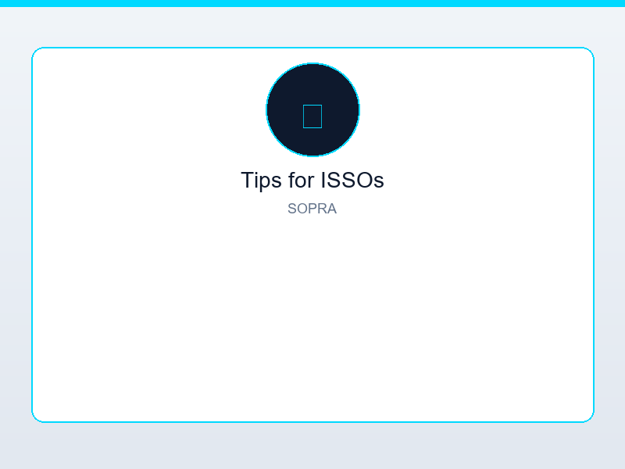
Tips for ISSOs
• Use Demo Data first to explore the tool without real data.
• Start with a few categories (e.g., Identity, Network) before full assessment.
• ISSO Toolkit centralizes POA&M, risk acceptance, and evidence – use it for ConMon.
• AI Assistant helps interpret controls and draft remediation language.

Slide 11

Need Help?
• Contact your system administrator for access and deployment.
• SOPRA can run locally or on a shared server – check your organization’s setup.

